Slide 1

MA57012: Solution of system of Linear Interval Equations for Portfolio Optimization
By: Supervisor:
Shayan Shafquat Dr. Geetanjali Panda 15MA20038 Department of Mathematics shafquat.shayan@gmail.com

Slide 2


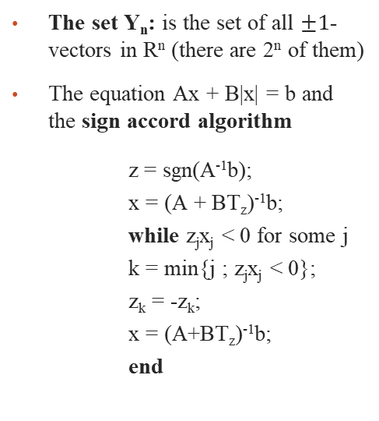
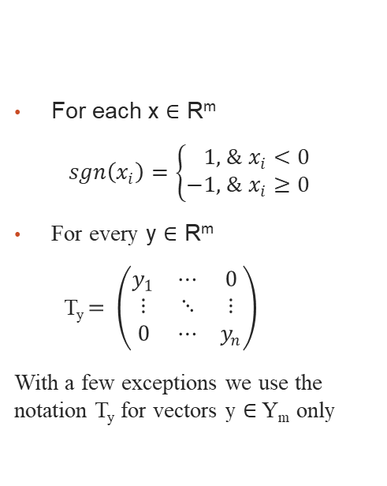
Literature Review
Notations
Auxiliary Results
For each x ∈ R^{m}
$sgn\left(x_{i}\right)=\left\{\begin{aligned}1, &x_{i}<0 \\ −1, &x_{i}≥0\end{aligned}\right.$
For every y ∈ R^{m}
T_{y} $= \left(\begin{matrix}y_{1} & ⋯ & 0 \\ ⋮ & ⋱ & ⋮ \\ 0 & ⋯ & y_{n}\end{matrix}\right)$
With a few exceptions we use the notation T_{y} for vectors y ∈ Y_{m} only
The set Y_{n}: is the set of all $±1$-vectors in R^{n} (there are 2^{n} of them)
The equation Ax + B|x| = b and the sign accord algorithm
z = sgn(A⁻¹b);
x = (A + BT_{z})⁻¹b;
while z_{j}x_{j} < 0 for some j
k = min{j ; z_{j}x_{j} < 0};
z_{k} = -z_{k};
x = (A+BT_{z})⁻¹b;
end
Notes:
Notations: sgn x ∈ Y_{m}

Slide 3

Literature Review
Interval Matrices
Definition. If$\overline{A}$, $\underline{A}$ are two matrices in R_{m×n}, $\overline{A}$ ≤$\underline{A}$, then the set of matrices
A = [$\underline{A}$, $\overline{A}$ ] = {A; $\underline{A}$ ≤ A ≤$\overline{A}$ }
is called an interval matrix, and the matrices $\underline{A}$, $\overline{A}$ are called its bounds.
$A_{c}$= 1/2($\underline{A}$+$\overline{A}$), Δ = 1/2($\underline{A}$ - $\overline{A}$)
$\underline{A}$ = $A_{c}$−Δ,
$\overline{A}$ = $A_{c}$+ Δ
Matrices A_{yz}
Given an m×n interval matrix A = [$A_{c}$−Δ, $A_{c}$+ Δ], we define matrices $A_{yz}$= $A_{c}$ – T_{y}ΔT_{z}
for each y ∈ Y_{m} and z ∈ Y_{n}
Notes:
Δ is always non negative as all the elements of Δ are positive.

Slide 4
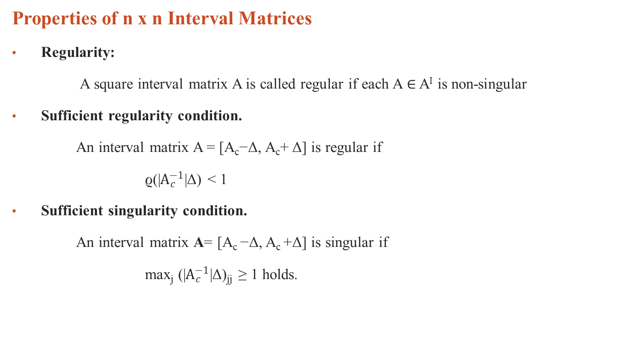
Literature Review
Properties of n x n Interval Matrices
Regularity:
A square interval matrix A is called regular if each A ∈ A^{I} is non-singular
Sufficient regularity condition.
An interval matrix A = [A_{c}−Δ, A_{c}+ Δ] is regular if
ϱ(|$A_{c}^{−1}$|Δ) < 1
Sufficient singularity condition.
An interval matrix A= [A_{c} −Δ, A_{c} +Δ] is singular if
max_{j} (|$A_{c}^{−1}$|Δ)_{jj} ≥ 1 holds.
Notes:
Used this algorithm to first check the regularity of the central interval matrix further in our problem.

Slide 5
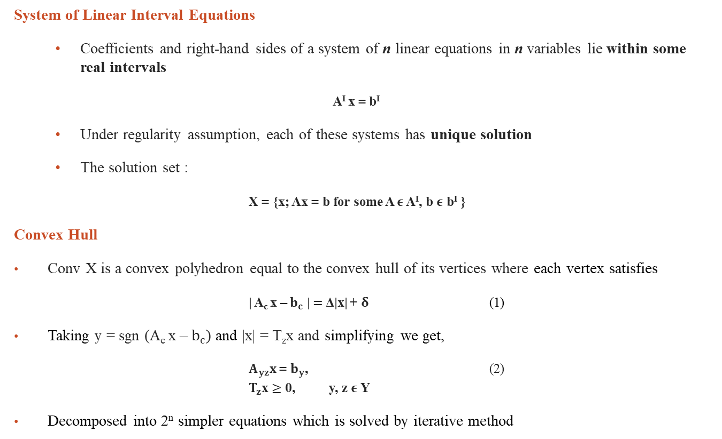
Methodology
System of Linear Interval Equations
Coefficients and right-hand sides of a system of n linear equations in n variables lie within some real intervals
A^{I} x = b^{I}
Under regularity assumption, each of these systems has unique solution
The solution set :
X = {x; Ax = b for some A $ε$ A^{I}, b $ε$ b^{I} }
Convex Hull
Conv X is a convex polyhedron equal to the convex hull of its vertices where each vertex satisfies
| A_{c} x – $b_{c}$ | $=$ Δ|x| + $δ$ (1)
Taking y = sgn (A_{c} x – $b_{c})$and |x| = T_{z}x and simplifying we get,
$A_{yz}x$ = $b_{y}$, (2) $T_{z}$x $≥$ 0, y, z $ε$Y
Decomposed into 2^{n} simpler equations which is solved by iterative method
Notes:
If A is regular, then X is compact and connected.
If A is singular, then each component of X is unbounded.
Y here is the set of all y’s.

Slide 6
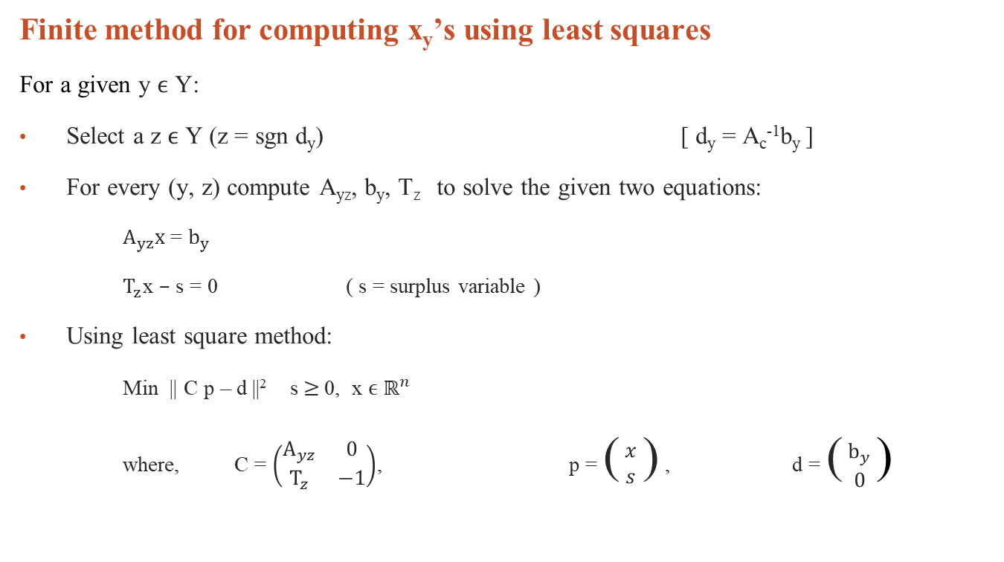
Methodology
Finite method for computing x_{y}’s using least squares
For a given y $ϵ$ Y:
Select a z $ϵ$ Y (z = sgn d_{y}) [ d_{y} = A_{c}⁻¹b_{y} ]
For every (y, z) compute A_{yz}, b_{y}, T_{z} to solve the given two equations:
$A_{yz}x$ = $b_{y}$
$T_{z}$x $–$ s = 0 ( s = surplus variable )
Using least square method:
Min || C p – d ||² s$≥$ 0, x $ϵ$ $ℝ^{n}$
where, C = $\left(\begin{matrix}A_{yz} & 0 \\ T_{z} & −1\end{matrix}\right)$, p = ( $\begin{matrix}x \\ s\end{matrix}$ ) , d = ( $\begin{matrix}b_{y} \\ 0\end{matrix}$ )
Notes:
If A is regular, then X is compact and connected.
If A is singular, then each component of X is unbounded.
Y here is the set of all y’s.

Slide 7
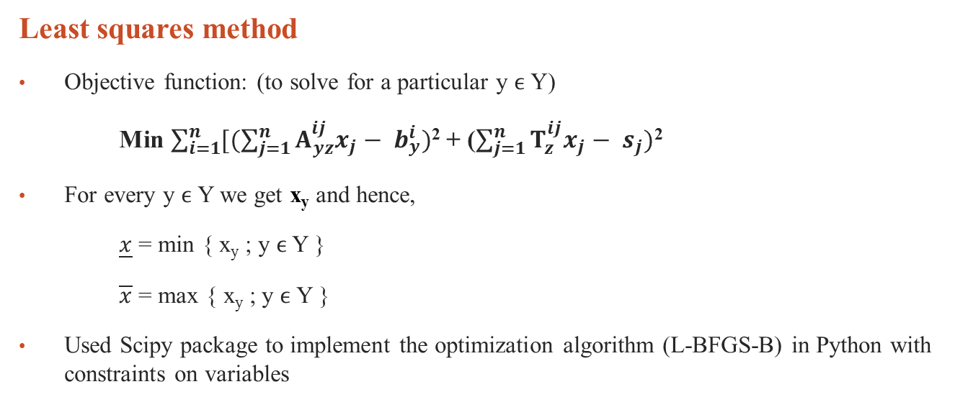
Methodology
Least squares method
Objective function: (to solve for a particular y $ϵ$Y)
Min $\sum_{i=1}^{n}{[(\sum_{j=1}^{n}{A_{yz}^{ij}x_{j}− b_{y}^{i}})}$² + ($\sum_{j=1}^{n}{T_{z}^{ij}x_{j}− s_{j})}$²
For every y $ϵ$Y we get x_{y} and hence,
$\underline{x}$ = min { x_{y} ; y $ϵ$ Y }
$\overline{x}$ = max { x_{y} ; y $ϵ$ Y }
Used Scipy package to implement the optimization algorithm (L-BFGS-B) in Python with constraints on variables
Notes:
Assuming that the central matrix is regular

Slide 8

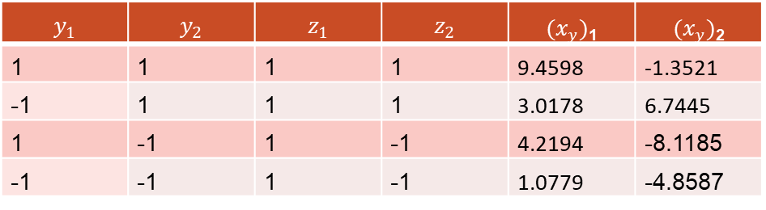
Results
Example of system of linear interval equations
[1, 5]$x_{1}$ + [-3, -1]$x_{2}$ = [7, 12],
[4, 7]$x_{1}$ + [3, 4]$x_{2}$ = [6, 35]
Check that the central matrix which is regular in the case (Assumed)
For each y $ϵ$ Y, starting from z = sgn d_{y}
Interval solution of $x_{1}$ and $x_{2}$ :
$x_{1}$ = [1.0779, 9.4598], $x_{2}$ = [-8.1185, 6.7445]
$$y_{1}$$ | $$y_{2}$$ | $$z_{1}$$ | $$z_{2}$$ | ${(x}_{y})$₁ | ${(x}_{y})$₂
1 | 1 | 1 | 1 | 9.4598 | -1.3521
-1 | 1 | 1 | 1 | 3.0178 | 6.7445
1 | -1 | 1 | -1 | 4.2194 | -8.1185
-1 | -1 | 1 | -1 | 1.0779 | -4.8587
Notes:
Assuming that the central matrix is regular for our solving of Ax=b

Slide 9
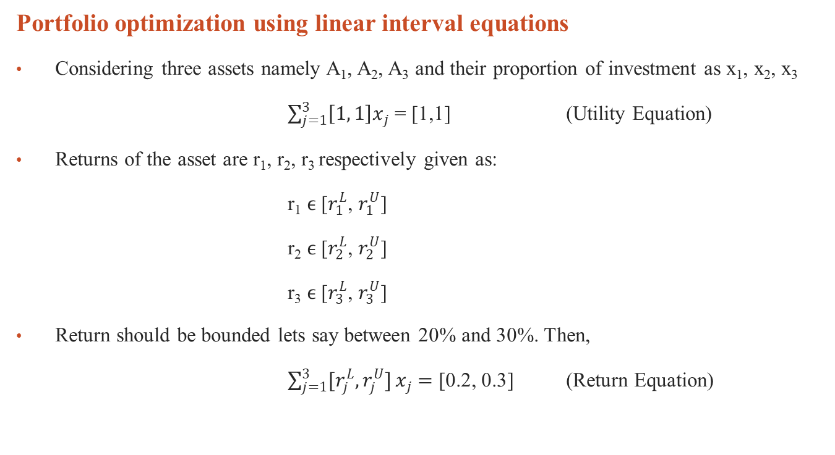
Application
Portfolio optimization using linear interval equations
Considering three assets namely A₁, A₂, A₃ and their proportion of investment as x₁, x₂, x₃
$\sum_{j=1}^{3}{\left[1, 1\right]x_{j}}$ = [1,1] (Utility Equation)
Returns of the asset are r₁, r₂, r₃ respectively given as:
r₁ $ϵ$ [$r_{1}^{L}$, $r_{1}^{U}$]
r₂ $ϵ$ [$r_{2}^{L}$, $r_{2}^{U}$]
r₃ $ϵ$ [$r_{3}^{L}$, $r_{3}^{U}$]
Return should be bounded lets say between 20% and 30%. Then,
$\sum_{j=1}^{3}{[r_{j}^{L}, r_{j}^{U}]}x_{j}$ $=$ [0.2, 0.3] (Return Equation)
Notes:
Remember that all the three equations are linear interval equations which forms the system of Ax=b

Slide 10
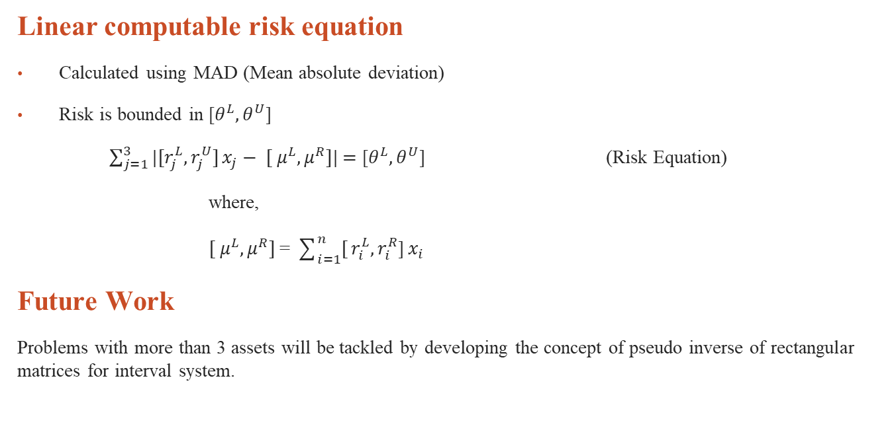
Application
Linear computable risk equation
Calculated using MAD (Mean absolute deviation)
Risk is bounded in [$θ^{L}, θ^{U}$]
$\sum_{j=1}^{3}{|[r_{j}^{L}, r_{j}^{U}]}x_{j}− {[ μ}^{L}, μ^{R}]|$ $=$ [$θ^{L}, θ^{U}$] (Risk Equation)
where,
${[ μ}^{L}, μ^{R}]$ = $\sum_{i=1}^{n}{[}r_{i}^{L},r_{i}^{R}$]$x_{i}$
Future Work
Problems with more than 3 assets will be tackled by developing the concept of pseudo inverse of rectangular matrices for interval system.
Notes:
Introducing t₁, t₂, t₃ to make it linear in a way such that
abs([a, b]x + c)=abs(( bt + (1 - t)a)x + c), where t lies between 0 and 1.
=max{ (bt + (1 - t)a)x + c, - (bt + (1 - t)a)x + c}

Slide 11
Conclusion
Get used to the concepts of interval matrices
Using them to solve system of linear interval equations
Packages like Numpy, Scipy are used for matrix computations and optimization respectively.
Form a problem of portfolio optimization involving a system of linear interval equations of
return,
risk and
utility equations
Assumption involved:
Regular central matrix
Equal number of assets and equations
Notes:
Introducing t₁, t₂, t₃ to make it linear in a way such that
abs([a, b]x + c)=abs(( bt + (1 - t)a)x + c), where t lies between 0 and 1.
=max{ (bt + (1 - t)a)x + c, - (bt + (1 - t)a)x + c}

Slide 12
References
J. Rohn, Systems of linear interval equations, Linear Algebra and Its Applications, 126 (1989), pp.39–78. http://www.cs.cas.cz/̃rohn/publist/47.doc
Jana, Panda, G. Solution of nonlinear interval vector optimization problem
Jana, Kumar, P., Panda, G. Efficient Portfolio for Interval Sharpe Ratio Model
Rohn, J. A sufficent condition for an interval matrix to have a full column rank
Orgyczak, W., Speranza, M., Mansini, R. Linear models for portfolio optimization
M. Baumann, A regularity criterion for interval matrices
Notes:
Introducing t₁, t₂, t₃ to make it linear in a way such that
abs([a, b]x + c)=abs(( bt + (1 - t)a)x + c), where t lies between 0 and 1.
=max{ (bt + (1 - t)a)x + c, - (bt + (1 - t)a)x + c}

Slide 13
Thank You!

