Slide 1
Company Logo
Company Name
Username :
Password :

Slide 2
Company Logo
Company Name
My Company
Accounts
Companies
Leads
Product Registration
Alerts
Pro Services
Company Sponsor
Invoices

Slide 3
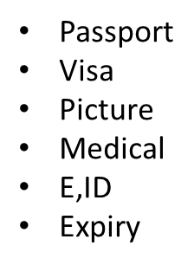
My Company
Preview Documents
PRINT
Company documents
Owner Documents
Company Employs
Company license
Company E-Sign Card
Company MOA
Company Labor card
Names of owner
Name of each employ
Passport
Visa
Picture
Medical
E,ID
Expiry
Salary
Labor contracts

Slide 4
Companies
Preview Documents
PRINT
X
Y
Z
Company documents
Owner Documents
Company Employs
Company license
Company E-Sign Card
Company MOA
Company Labor card
OWNER NAMESS
Name of each employ
Passport
Visa
Picture
Medical
E,ID
Expiry
Salary
Labor contracts

Slide 5
Pro Services

