Slide 1
Accelerating value creation through AI
Blue Currency & Client funding request
June 3, 2026

Slide 2
Context & Objectives
Context
Objectives of this document
We recently completed a 7-week diagnostic & design effort¹ at Varsity Brands (KKR’s portco) focused on redesigning and automating core sales support workflows (e.g., order intake & tracking). The effort mapped E2E processes, identified pain points, prioritized critical workflows, defined improvement initiatives, and detailed the requirements for agent-based solutions to streamline / automate work.
Our assessment surfaced material opportunity to “agentify” these types of processes, with ~60%+ productivity upside at scale. However, our current / typical op model to run diagnostic and design work is highly manual and time/resource-intensive, making it difficult to scale. We believe we can use AI to compress and productize our approach into a faster, repeatable 3-week sprint – we would love to test this out with another KKR portco before scaling more broadly.
If successful, this effort creates a repeatable, lower-cost way to identify and capture agentic opportunities in PE, positioning us to secure KKR commitment to expand to their additional portcos (and ultimately, scale this beyond KKR to other PE firms).
1
Delineating our plan to productize the approach and why this is important
2
Summarizing our approach and deliverables – how we are going to re-define how we run the engagement
3
Confirming what we need to get started
1. Plus 4 weeks of invested pre-work ahead of Kick-off

Slide 3
1. The plan to productize our methodology, replicate with KKR, and scale to other PE funds
2 phases of investment to re-wire our way of working and to scale AI impact in PE
Details to follow
Deployment with PE funds (e.g., KKR)
This investment request is informed by our learnings from the successful AI-driven value creation effort with KKR’s portfolio company Varsity Brands
Running a Blue Currency study will ensure all new tools, capabilities, and ways of working are in place to successfully re-wire our way of working and deliver the next phase of work on AI with KKR
2
Internal build (Blue Currency)
1
Timing
3 weeks – Jun 8-26
3 week – Jul 13-31
Description
Re-running the previous value creation effort with Varsity Brands in ~3 week (vs previous 7-10 weeks) by leveraging AI
Run new diagnostic and design effort for another KKR portfolio company in ~3 weeks by leveraging the playbook and tools developed through the Blue Currency
Objectives
Building agentic capabilities and tooling needed
Demonstrate feasibility of achieving results comparable to traditional methodology
Adjust way of working to include Cursor-embedded workflows
Synthesize AI-driven value creation approach into a scalable product / playbook
Enable broad scalability of AI-driven value creation playbook across PortCos of KKR (and later other PE funds)
Drive efficiency in the Diagnostic & Design process to rapidly launch the Build phase
Build credibility behind McKinsey stance as state-of-the-art consultancy on using AI to deliver new ways of working
Budget needed
$925k
Across BC and client (KKR) efforts

Slide 4
1. What we are trying to achieve with the BC
Why is this important?
1
FROM: 7–10-week traditional study
Two phases of work (Diagnostic to identify issues with current workflows and Design to define initiatives to addresses these issues) by leveraging traditional ENS, client interviews, McKinsey expert PS, PPT, Excel, etc.
Potential to replicate this value creation effort with most of KKR’s 50+ portfolio companies in Americas
Also, the Playbook can be expanded to other PE funds
Manual / traditional approach
2
TO: 3-week AI-enabled study
Leveraging latest AI tools (e.g., Cursor, Cleansheet AI, IndexAI, etc.) to replicate Diagnostic and Design phases in a very compressed timeframe – allowing scaling of study deployment across multiple PortCos as well as across multiple PE funds
AI/Agentic-led approach
We aim at synthesizing the AI-driven value creation approach into a Playbook to efficiently and effectively scale effort across PE funds and their portfolio companies

Slide 5
1. Our hypothesis on new capabilities we will build / further develop
High-level overview of AI Agents and human team member responsibilities across Diagnostic and Design phases
Directional
Diagnostic
Designing
Current-state workflow & pain points
Improvement levers identification
Value estimation and initiative prioritization
Business Requirements definition
What Agents do
1
GenAI-powered interview guides creation
4
GenAI-driven brainstorming of potential improvement levers / initiatives
6
Agentic value estimation to size opportunity and create model outputs
8
GenAI-enabled future state workflow redesign with high level build plans
2
ProcessAI-powered conversion of interview notes to workflows (handoffs, pain points, opportunities)
5
Agentic mapping of improvement levers to key pain points
7
Agent-led prioritization and roadmap drafting
3
Interview agent automating initial SME interviews – allowing to conduct more interviews and faster
What team members do
1
Human-led client follow-up interviews, workshops, and shadowing to ensure we still capture all the crucial details that are needed – in addition to review of interview agent’s outputs
3
Problem-solving and interviews to reflect inflight-initiatives and refine value estimates
4
Human-led SMEs interviews to design business requirements
2
Human-led validation, refinement, and pressure-testing of results – incl. running internal expert interviews to enhance the emerging answer and syndicate answer
5
Business rules and edge cases definition and incorporation into BRD

Slide 6
2. Our workplan for the Blue Currency
1 AP/P role-playing clients / SMEs, 1 AP playing ED, and EM+2 team set-up
1 week
2 weeks
1 weeks
Prep (invested)
Diagnostic: pain points & improvement levers
Design: lever prioritization & detailing
A
B
Key activities
Launch data requests (e.g., current process documentation)
Identify PortCo SMEs (role play) per workflow
Schedule SME working sessions, interviews, and shadowing for each workflow
Schedule leadership working sessions
Identify all processes and workflows in-scope within sales support functions (e.g., customer care, Fin. Serv., etc.)
Prioritize sub-set of workflows based on impact and feasibility metrics
Map the current E2E processes and their pain points
Identify and pressure test improvement initiatives (across different time horizons) for prioritized workflows (incl. dependency risks) – split by process and AI levers
Evaluate the current sales tech stack and infrastructure for AI readiness
Assess status of ongoing efforts and gap to full potential
Set future aspiration with recommended priority workflows and improvement initiatives for potential Phase 2 design and execution effort
Build business cases for improvement initiatives / levers
Confirm 10-15 priority initiatives (mostly Horizon 1) for further detailing
Build and populate the Business Requirement Document (BRD) including:
Executive Summary and expected ROI by process
Horizon 1 process maps – showing improvement vs current-state maps
Feature list (key building blocks / steps) for each lever
Bus. Requirements, rules, and edge cases
System requirements & KPIs
Path forward towards deployment
How are we going to run this BC effort?
1 AP/P role-playing clients / SMEs
1 AP playing ED
EM+2 team set-up
The subsequent client deployment (other KKR PortCo) will follow the same workplan and deliverables tested during the Blue Currency
1
2
Main deliverables
Mutually-agreed calendar, objectives, and approach for the study
ProcessAI-powered current state process maps (AI conversion of interview notes to workflows), including view of roles, what works well, pain points, and hand-offs
GenAI-generated improvement initiatives (across 3 horizons and incl. long-term Bold Vision) to address challenges, classified into either 1) process redesign, or 2) AI / automation levers
AI agent mapping improvement levers to pain points
AI-Agent conducting opportunity sizing (efficiency benefit) and prioritization across 3 horizons (short, medium, and long-term); broken-down pod and by initiative
Tech dependency for any AI / automation / system improvements needed
GenAI-driven codification of initiatives underway
8
Gen-AI enabled comprehensive Business Requirements Document (BRD) for each process and lever prioritized for Horizon 1 (i.e., next ~3 months)
3
4
5
6
7

Slide 7
3. Joint Private Capital and GM&S support – Co-investing in the BC for the benefit of both Practices
Ensure broader syndication and radiation - Joseba Eceiza <joseba_eceiza@mckinsey.com>; Alfonso Pulido alfonso_pulido@mckinsey.com
+ Steve Reise + Kim
SteerCo format with them as stakeholders.
Broder client activation plan for. What’s our client acti plan. Put page together on this.
1-2 pager cases study to bring to different forums.
Private Capital
GM&S
Opportunity to synthesize the approach, capabilities, and tools developed into a transferable Playbook for AI-driven value creation – aim at replicating the success of our efforts at Varsity Brands (KKR portco) with other portfolio companies and PE funds
Opportunity to re-run our study at Varsity Brands focused on Sales (incl. sales support) that helps build a repeatable approach that could help significantly expedite Sales diagnostics to identify AI value levers
Private Capital Practice
GM&S Practice

Slide 8
3. What do we need to get started
1
$900K total investment to staff the BC team for 3 weeks ($325K) and subsequently the KKR team for another 3 weeks ($600K)
2
Access to all key AI tools (e.g., Cursor) and other firm offerings (e.g., Process AI) to integrate all offerings into a single solution
3
Ad-hoc support from Leadership to pressure-test results

Slide 9
Backup

Slide 10
We will leverage the learning from Procurement / Pricing efforts, but recognize the differences
Private Capital Practice: Value creation for sales support functions
Re-running the KKR (Varsity Brands) study in ~3 weeks vs original ~10 weeks
Leveraging key learnings from Procurement and Pricing BC efforts on AI “re-wiring”
Recognizing that our work at Varsity Brands is materially different to procurement or pricing – driving functional org efficiency / effectiveness includes elements that may require more time and/or human intervention (e.g., need for higher number of interviews, more detailed workshops, more frequent validations with clients, etc.)
Our plan is to scale across the KKR portfolio
Pricing “AI re-wiring” BC study
Sales Support functions “AI re-wiring” BC study
Not completing
What the role of the human is vs agents
What could be different here
Procurement “AI re-wiring” BC study
Re-runs of previous studies are already happening – NA Leadership involved (i.e., Eric Kutcher Kevin Laczkowski Steve Reis Dan Tinkoff)

Slide 11
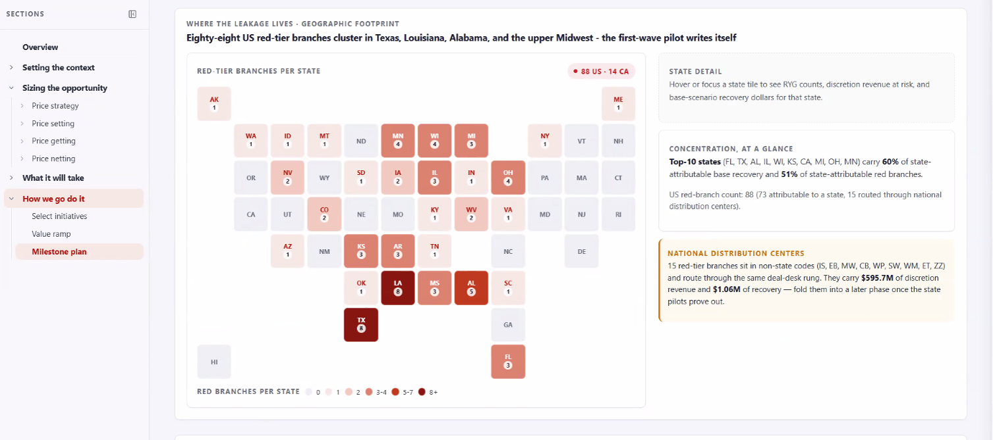
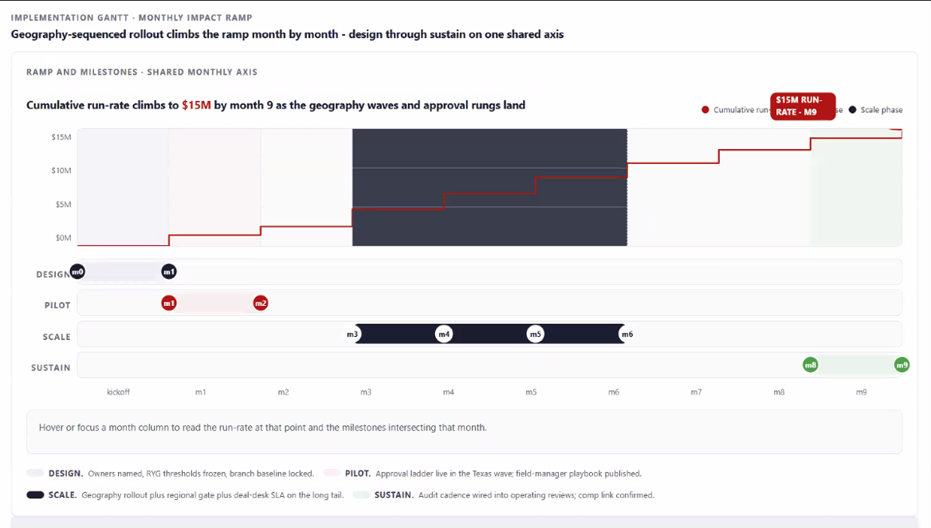
Example screenshots from Cursor-based dashboard created for a similar Blue Currency currently running for another client

