Slide 1
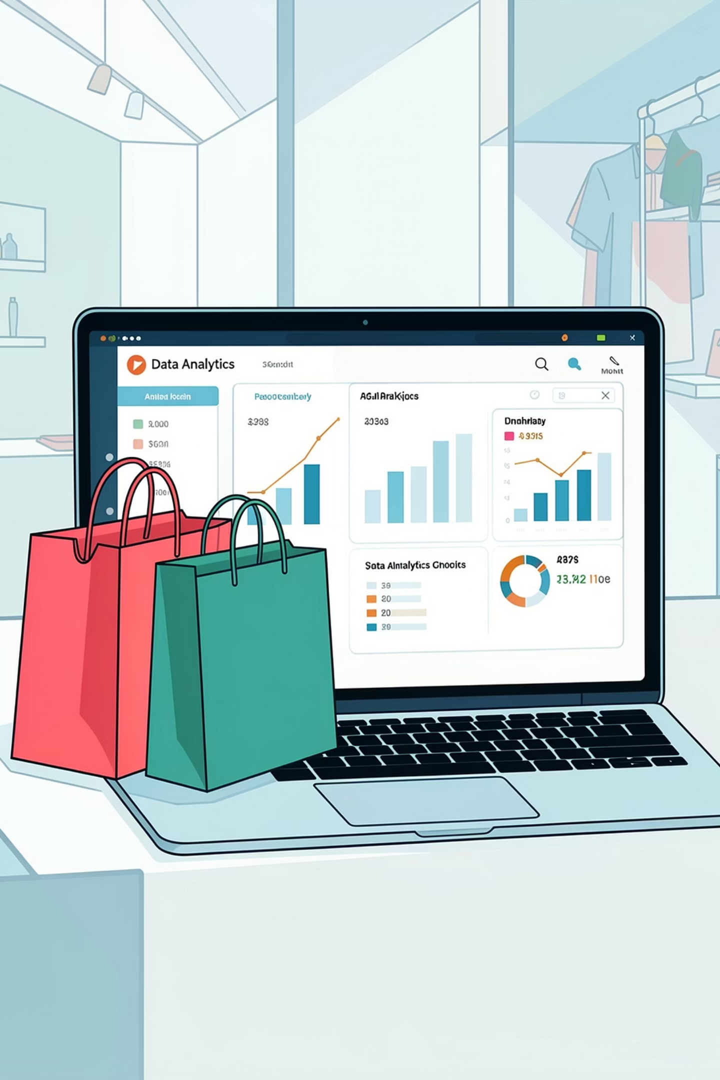
Customer Shopping Behavior Analysis
Uncovering insights from 3,900 transactions across product categories — spending patterns, customer segments, and subscription behavior to guide strategic decisions.

Slide 2
Dataset at a Glance
3,900
18
Transactions
Columns
Across all product categories
Demographics, purchases & behavior
37
$59.76
Missing Values
Avg Purchase
In Review Rating column only
Mean transaction value
Key features include customer demographics (Age, Gender, Location, Subscription Status), purchase details (Item, Category, Amount, Season, Size, Color), and shopping behavior (Discount Applied, Previous Purchases, Frequency, Review Rating, Shipping Type).

Slide 3
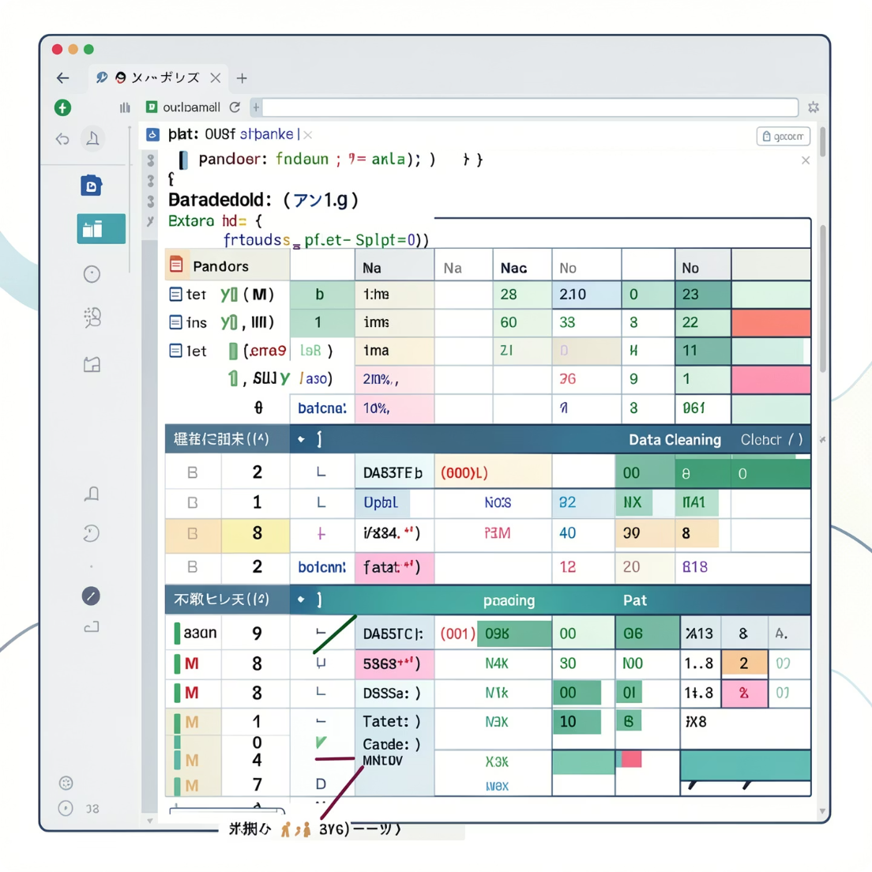

Data Preparation in Python
Clean & Standardize
Feature Engineering
Loaded via pandas, checked structure with df.info() and .describe(), renamed columns to snake_case, imputed missing Review Ratings using median by category
Created age_group bins and purchase_frequency_days; dropped redundant promo_code_used
Database Integration
Loaded cleaned DataFrame into PostgreSQL for SQL analysis

Slide 4
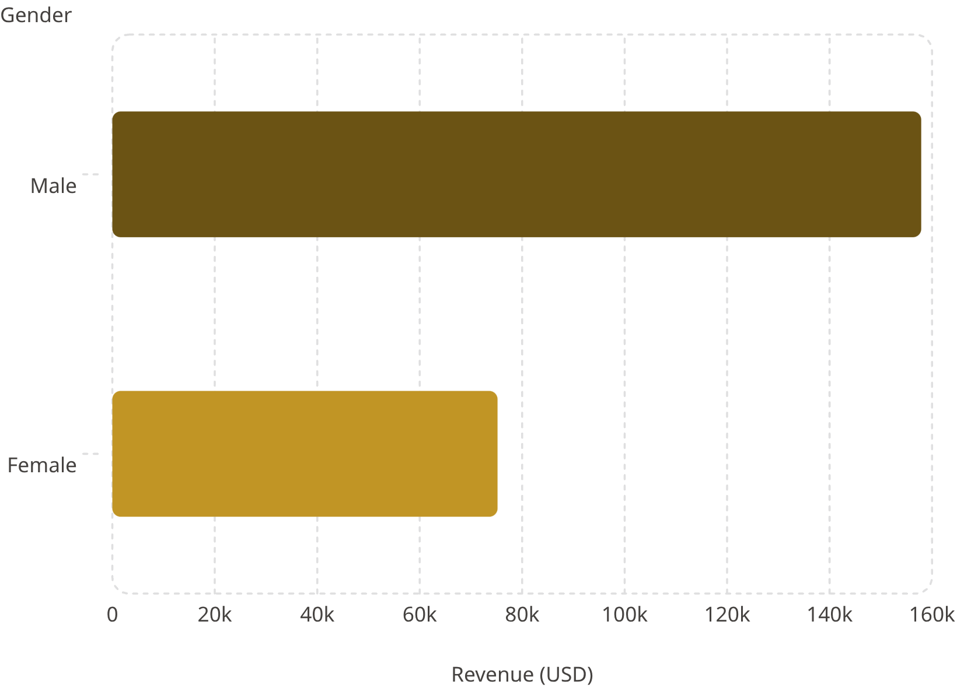
Revenue by Gender
Key Finding
Male customers generated more than double the revenue of female customers — $157,890 vs $75,191. This disparity should inform targeting and product strategy.

Slide 5
Top Products & Discount Insights
Top 5 Products by Rating
Most Discount-Dependent Products
Product
Avg Rating
Product
Discount Rate
Gloves
3.86
Hat
50.00%
Sandals
3.84
Sneakers
49.66%
Boots
3.82
Coat
49.07%
Hat
3.80
Sweater
48.17%
Skirt
3.78
Pants
47.37%
839 high-spending customers used discounts yet exceeded average purchase amounts. Hats lead discount dependency at 50% — review policy to balance sales lift with margin control.

Slide 6
Subscription & Shipping Analysis
Subscribers (27%)
Non-Subscribers (73%)
1,053 customers · Avg spend $59.49 · Revenue $62,645
2,847 customers · Avg spend $59.87 · Revenue $170,436
Express Shipping
Repeat Buyers
Avg purchase $60.48 vs Standard $58.46 — slight premium
958 subscribers vs 2,518 non-subscribers among customers with >5 purchases

Slide 7
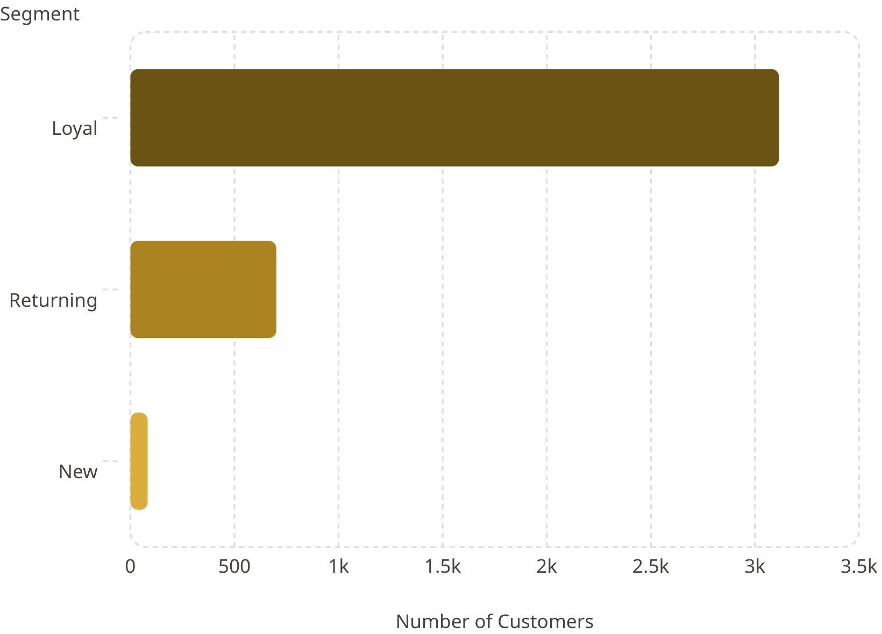
Customer Segmentation
Segment Breakdown
Customers classified as New, Returning, and Loyal based on purchase history.
Loyal — 3,116 customers: The dominant segment, representing the vast majority of the customer base
Returning — 701 customers: A mid-tier segment with growth potential
New — 83 customers: The smallest segment, representing an opportunity for acquisition

Slide 8
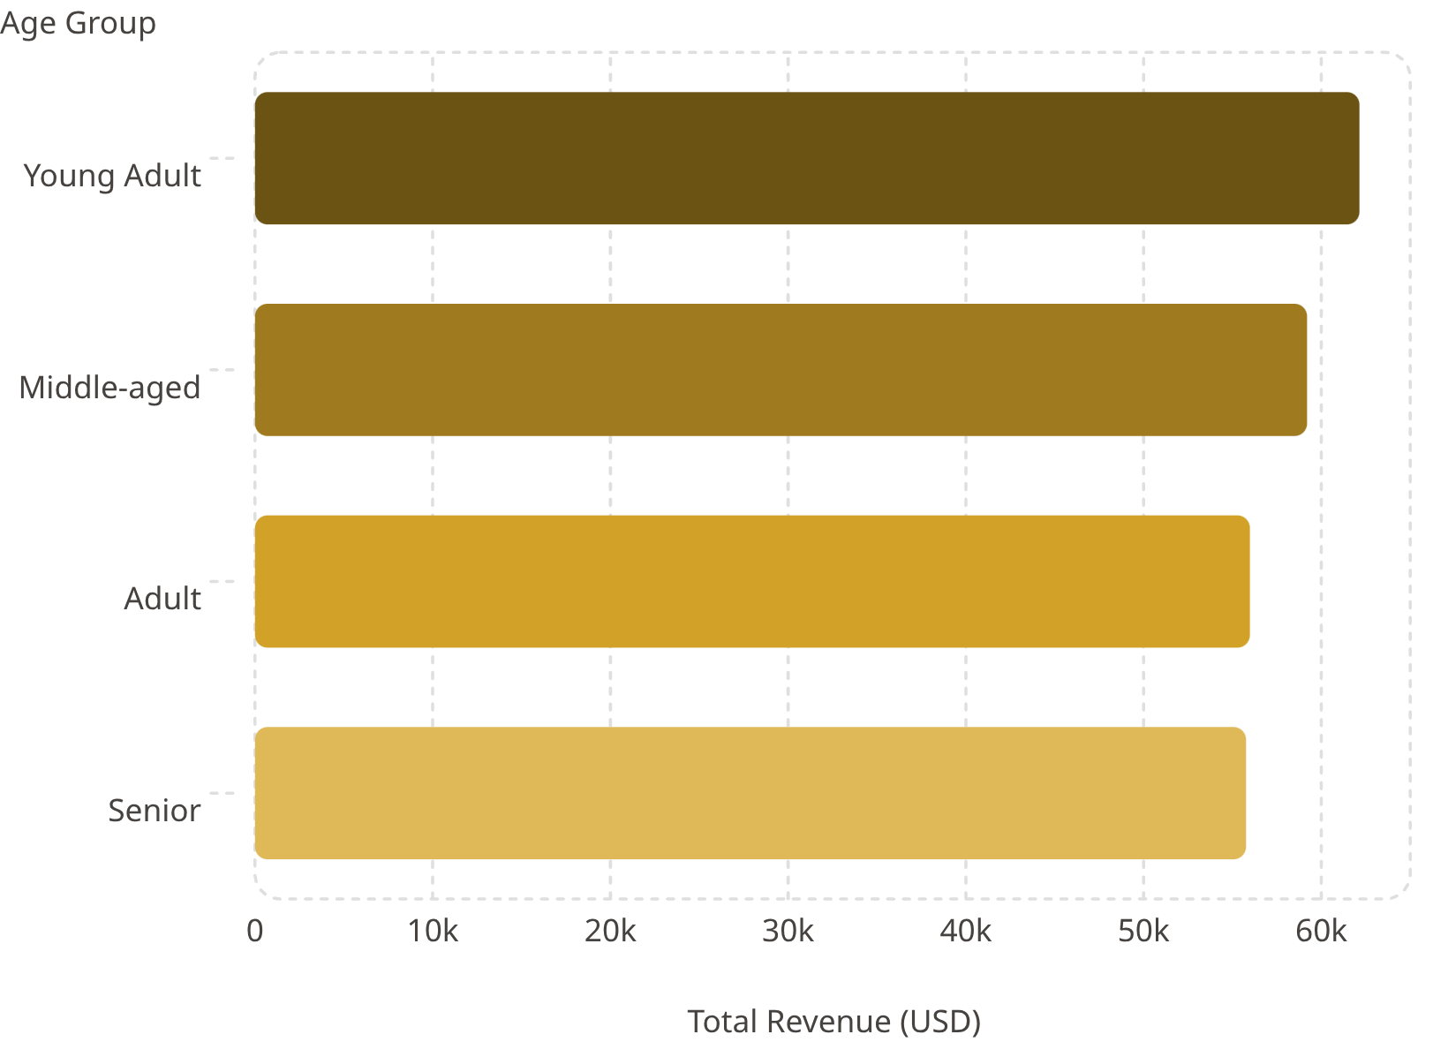
Revenue by Age Group & Top Products
Top Products by Category
Accessories: Jewelry (171), Sunglasses (161), Belt (161)
Clothing: Blouse (171), Pants (171), Shirt (169)
Footwear: Sandals (160), Shoes (150), Sneakers (145)
Outerwear: Jacket (163), Coat (161)
Young Adults lead revenue at $62,143. Revenue is relatively evenly distributed across age groups, with a gradual decline from Young Adult to Senior.

Slide 9
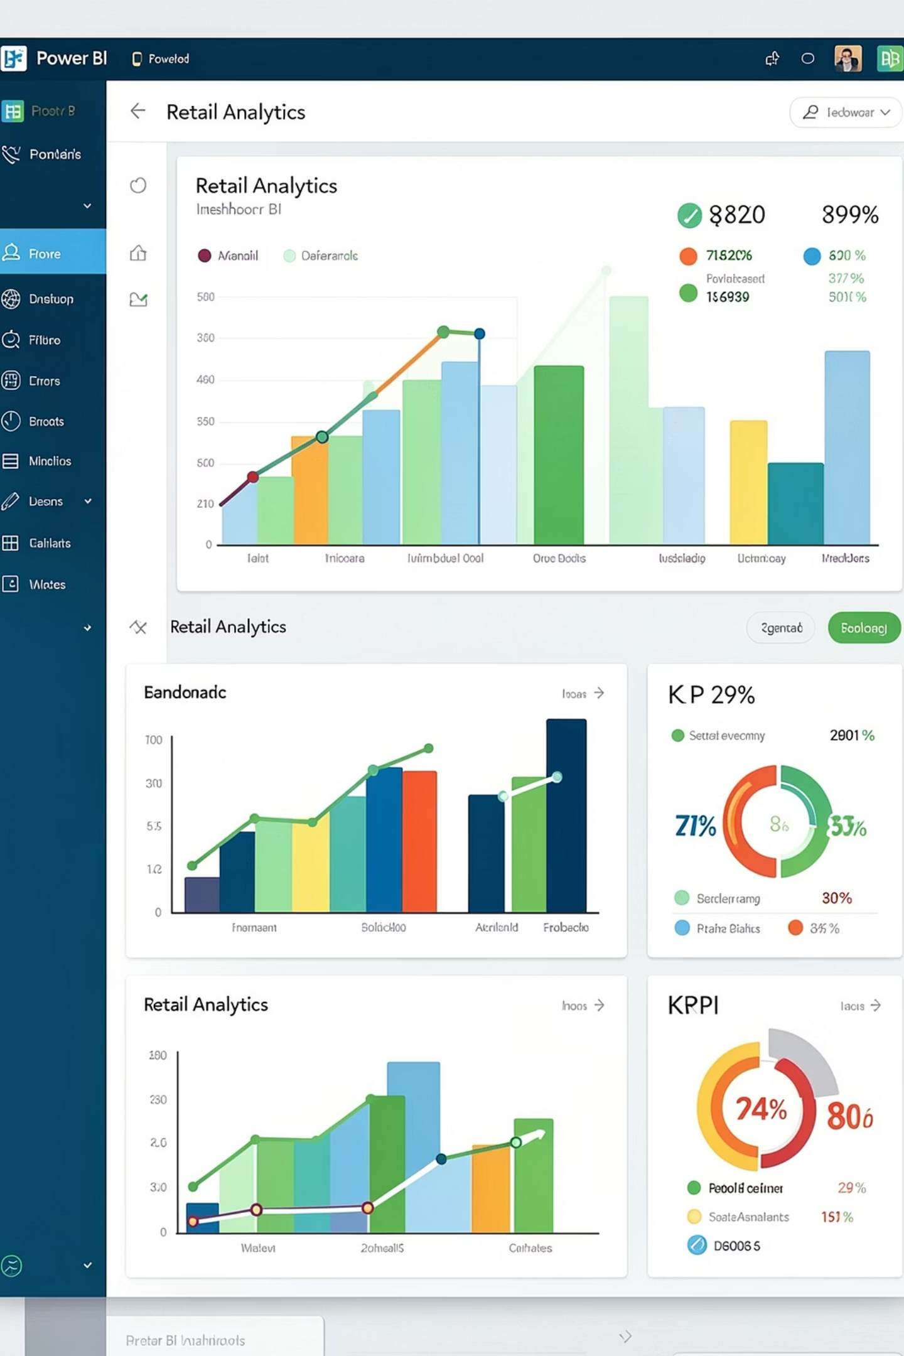
Power BI Dashboard
Key Metrics
3.9K customers · $59.76 avg purchase · 3.75 avg rating
Subscription Split
Donut chart: 27% subscribers vs 73% non-subscribers
Category Revenue
Bar charts for Clothing, Accessories, Footwear & Outerwear
Age Group Views
Horizontal bars showing revenue & sales by age segment

Slide 10
Business Recommendations
Boost Subscriptions
Loyalty Programs
Review Discount Policy
Promote exclusive benefits to convert non-subscribers
Reward repeat buyers to grow the Loyal segment
Balance sales boosts with margin control on discount-heavy products
Targeted Marketing
Product Positioning
Focus on high-revenue age groups and express-shipping users
Highlight top-rated and best-selling products in campaigns

