Slide 1
Assignment #4
Shay Ben-Sasson
061203410

Slide 2
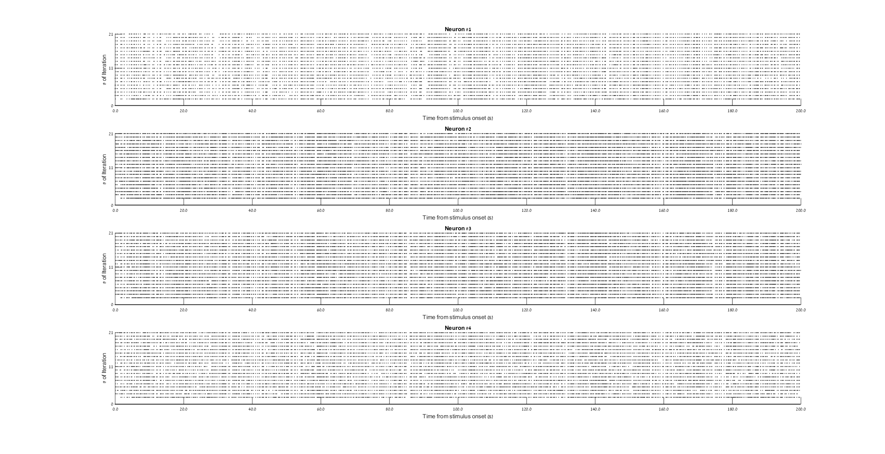
Q #1 – Raster -rep

Slide 3
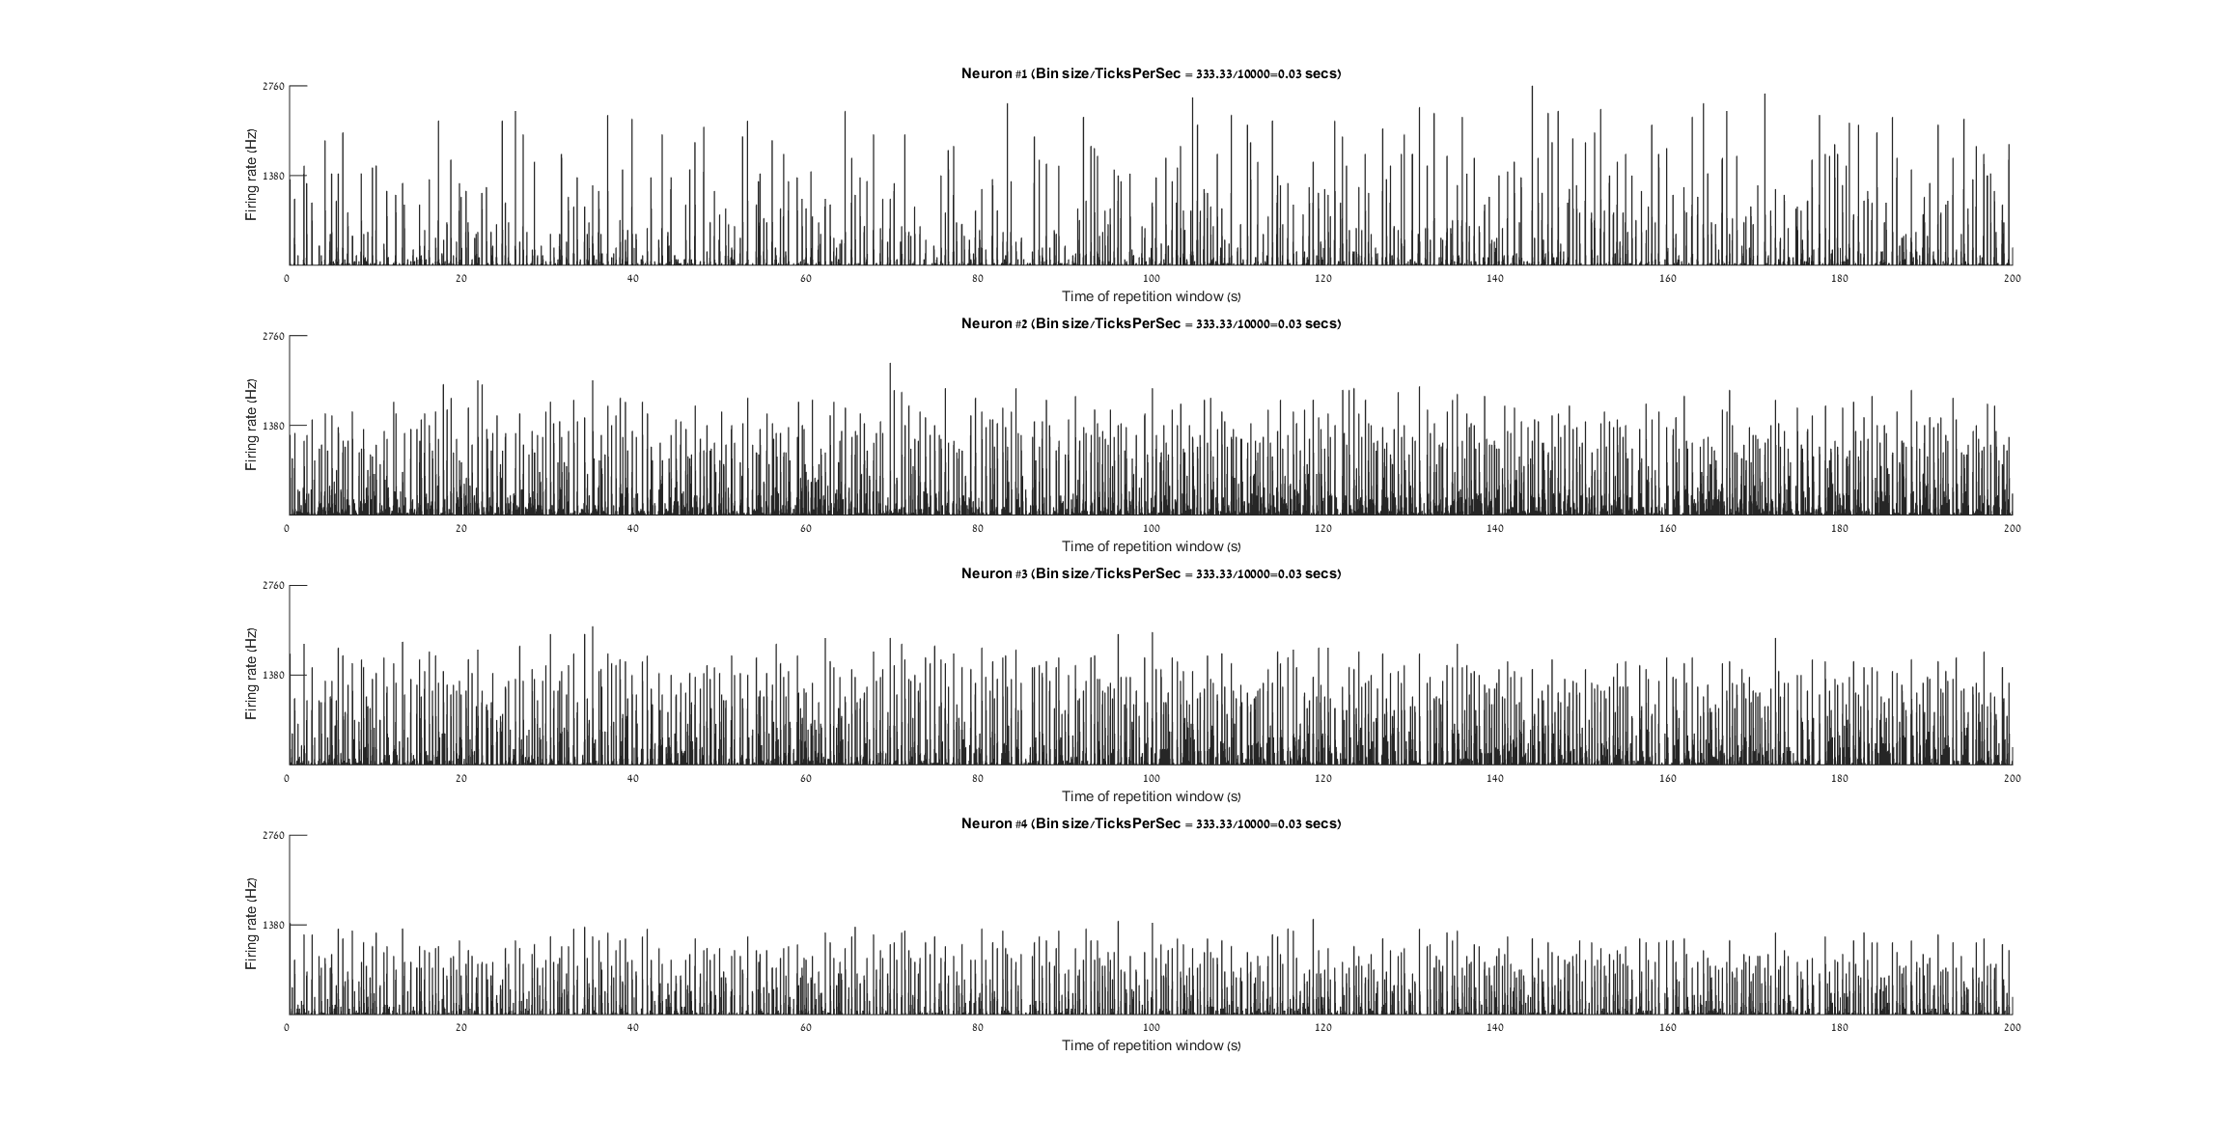
Q #1 – PSTH -rep

Slide 4
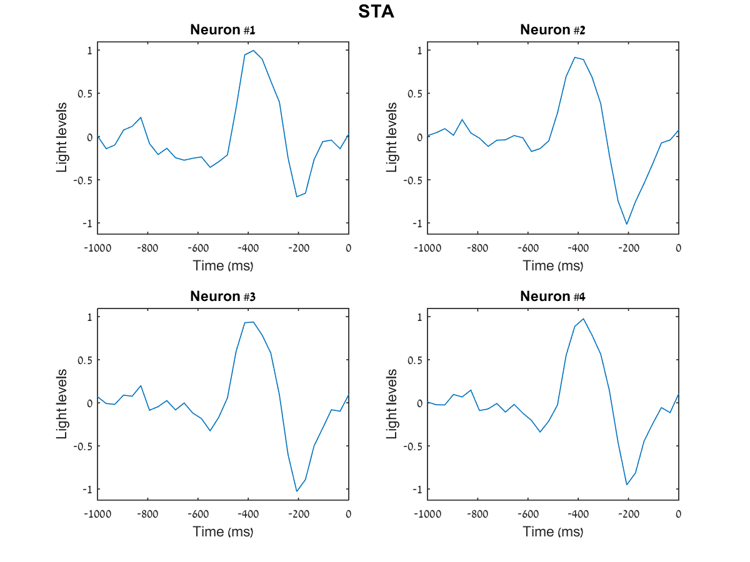
Q #2 – STA-rep

Slide 5
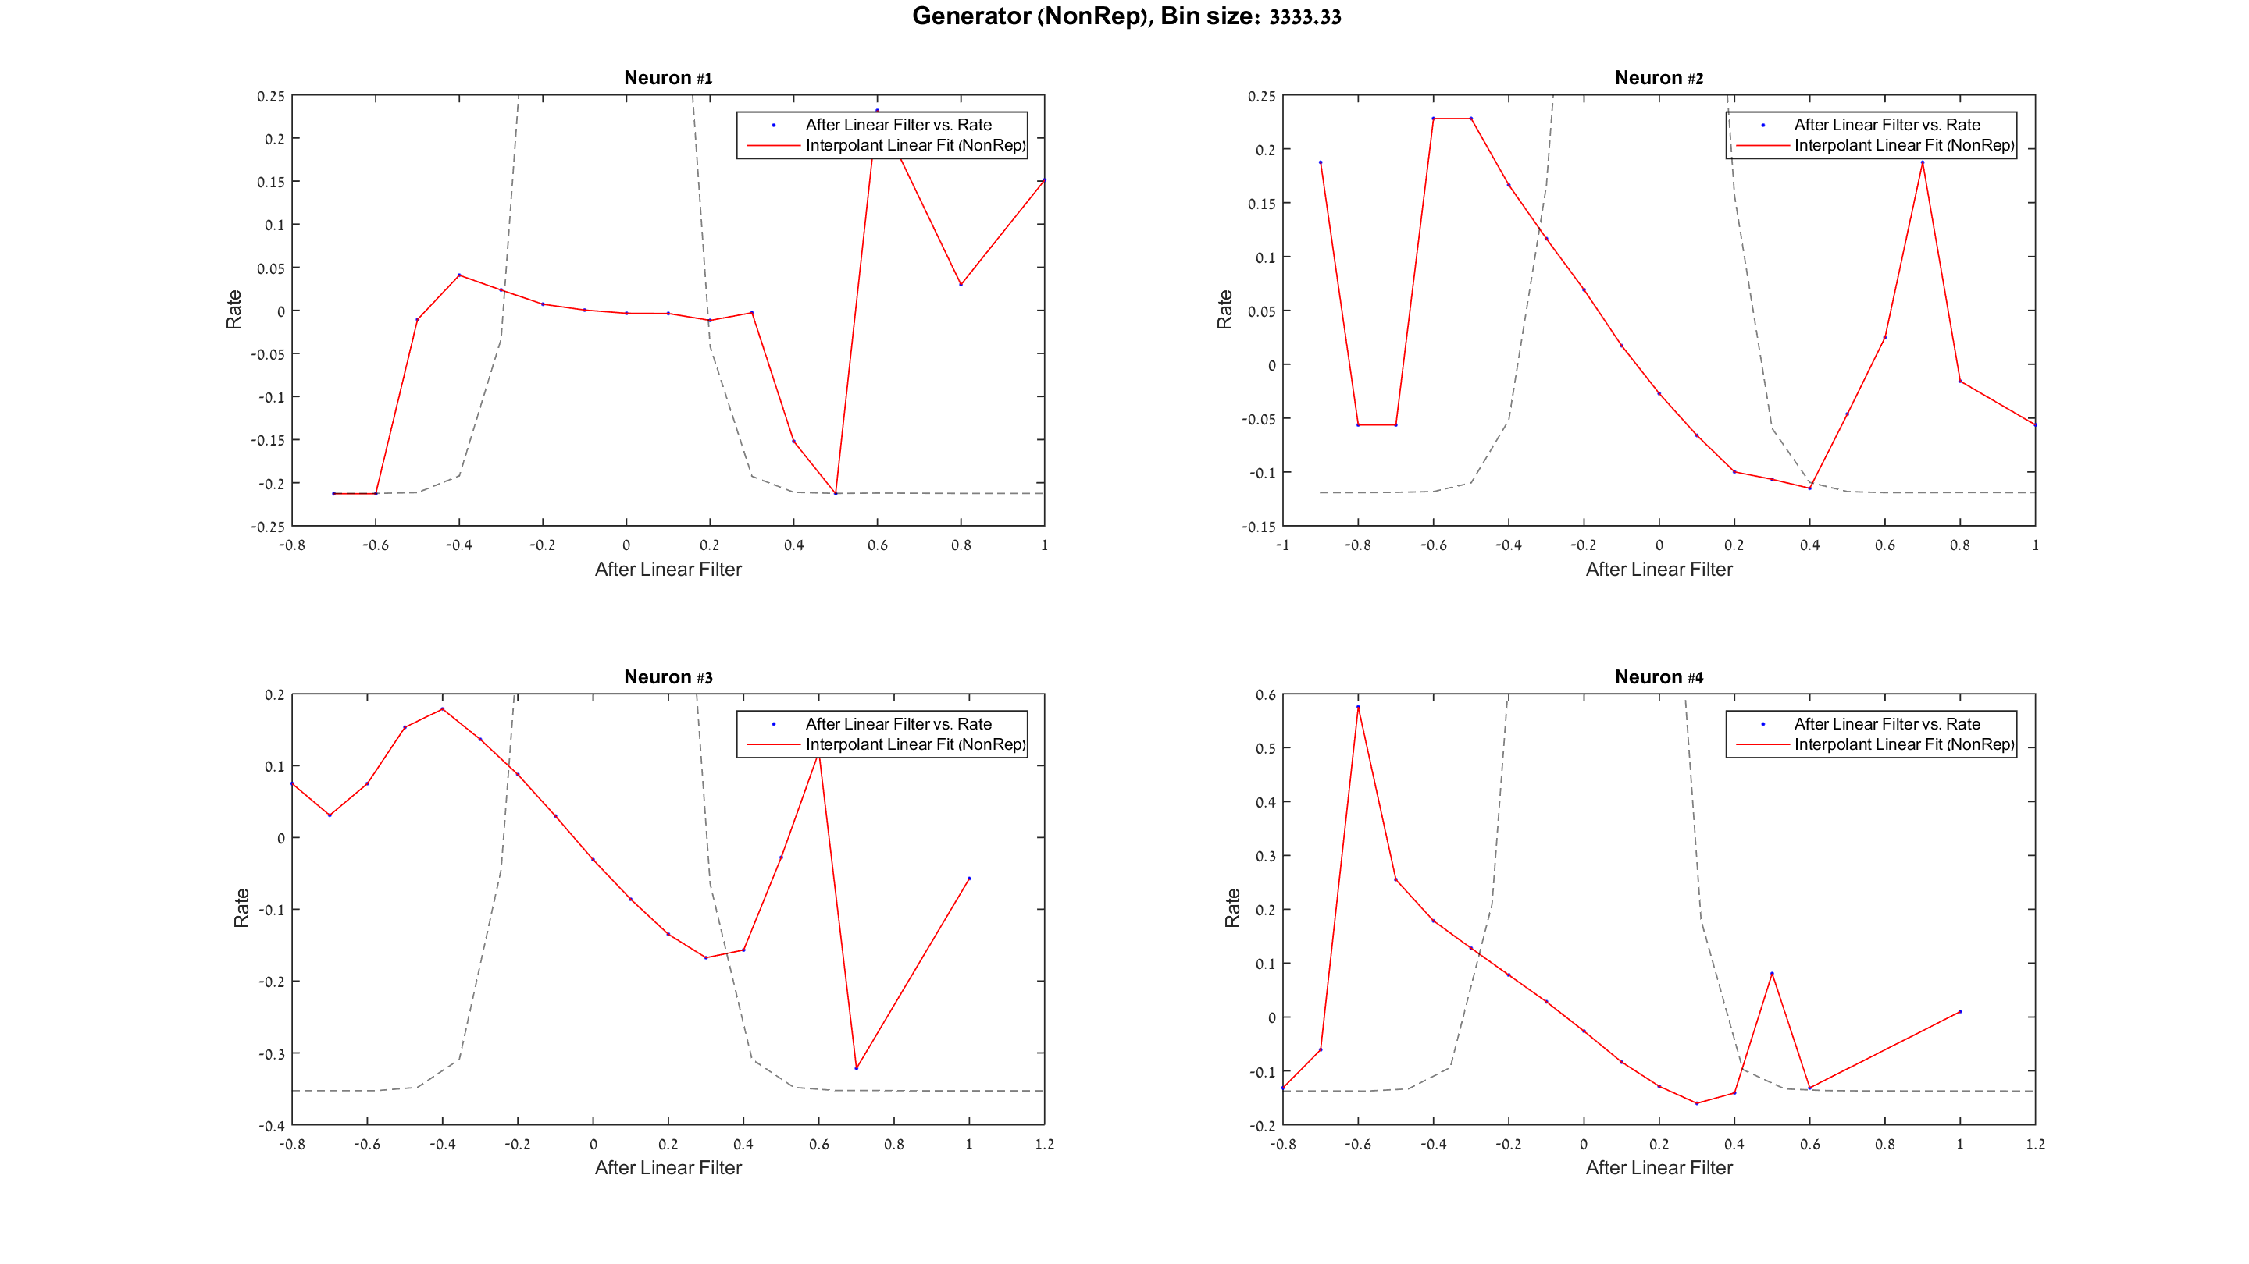
Q #3 – LN model – learning non rep - generator

Slide 6
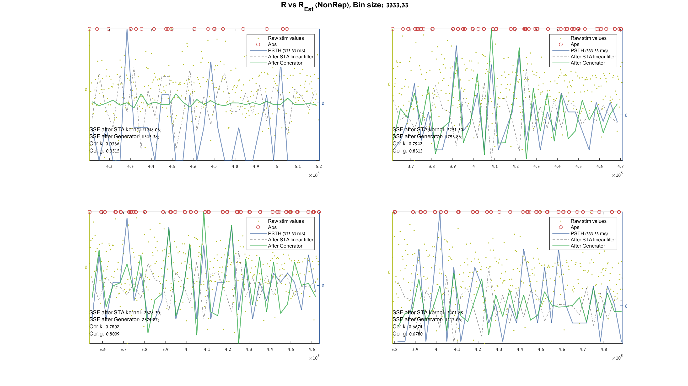
Q #3 – LN model – learning non rep - RvsRest

Slide 7
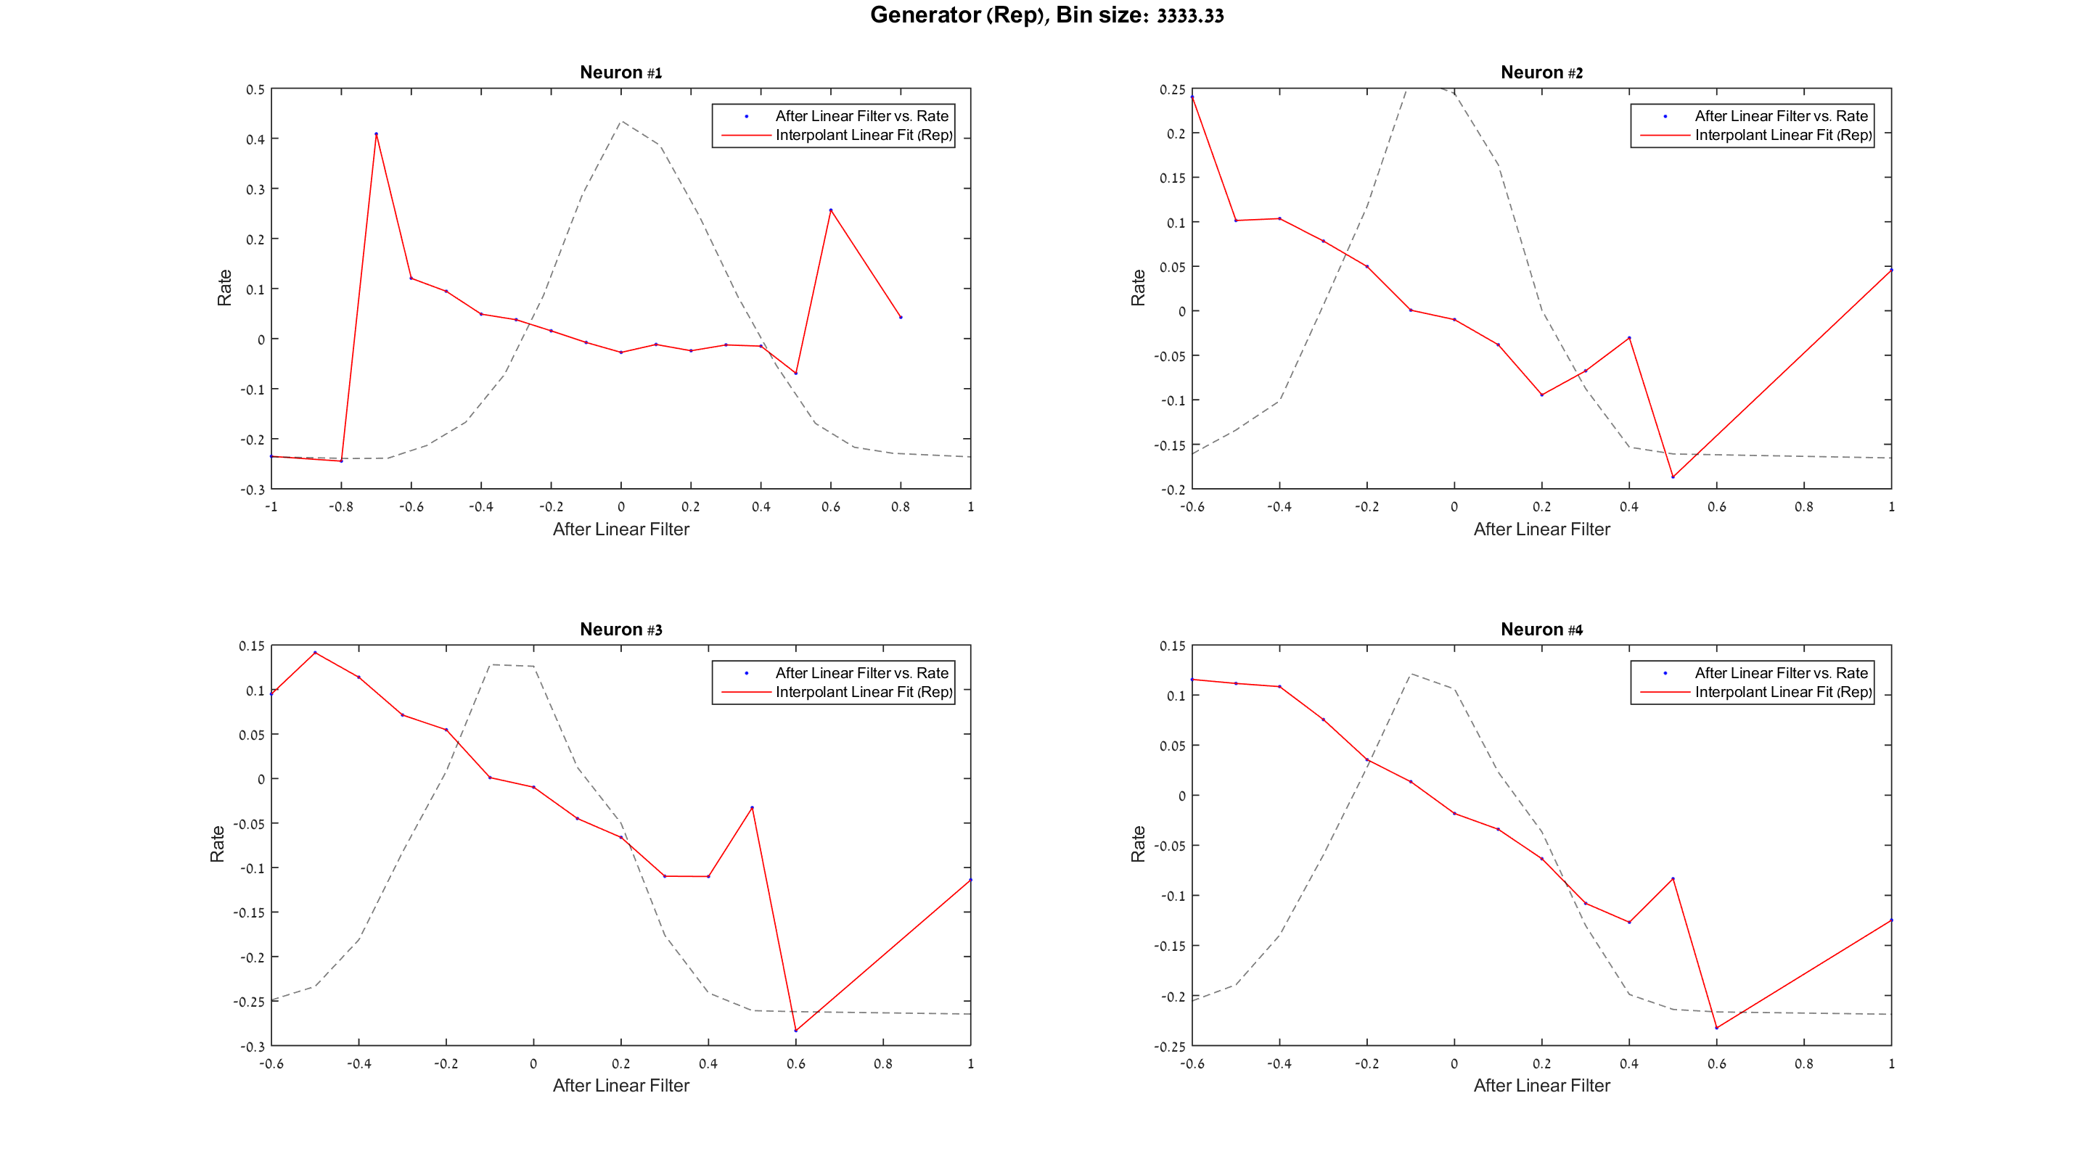
Q #3 – LN model – testing rep - generator

Slide 8
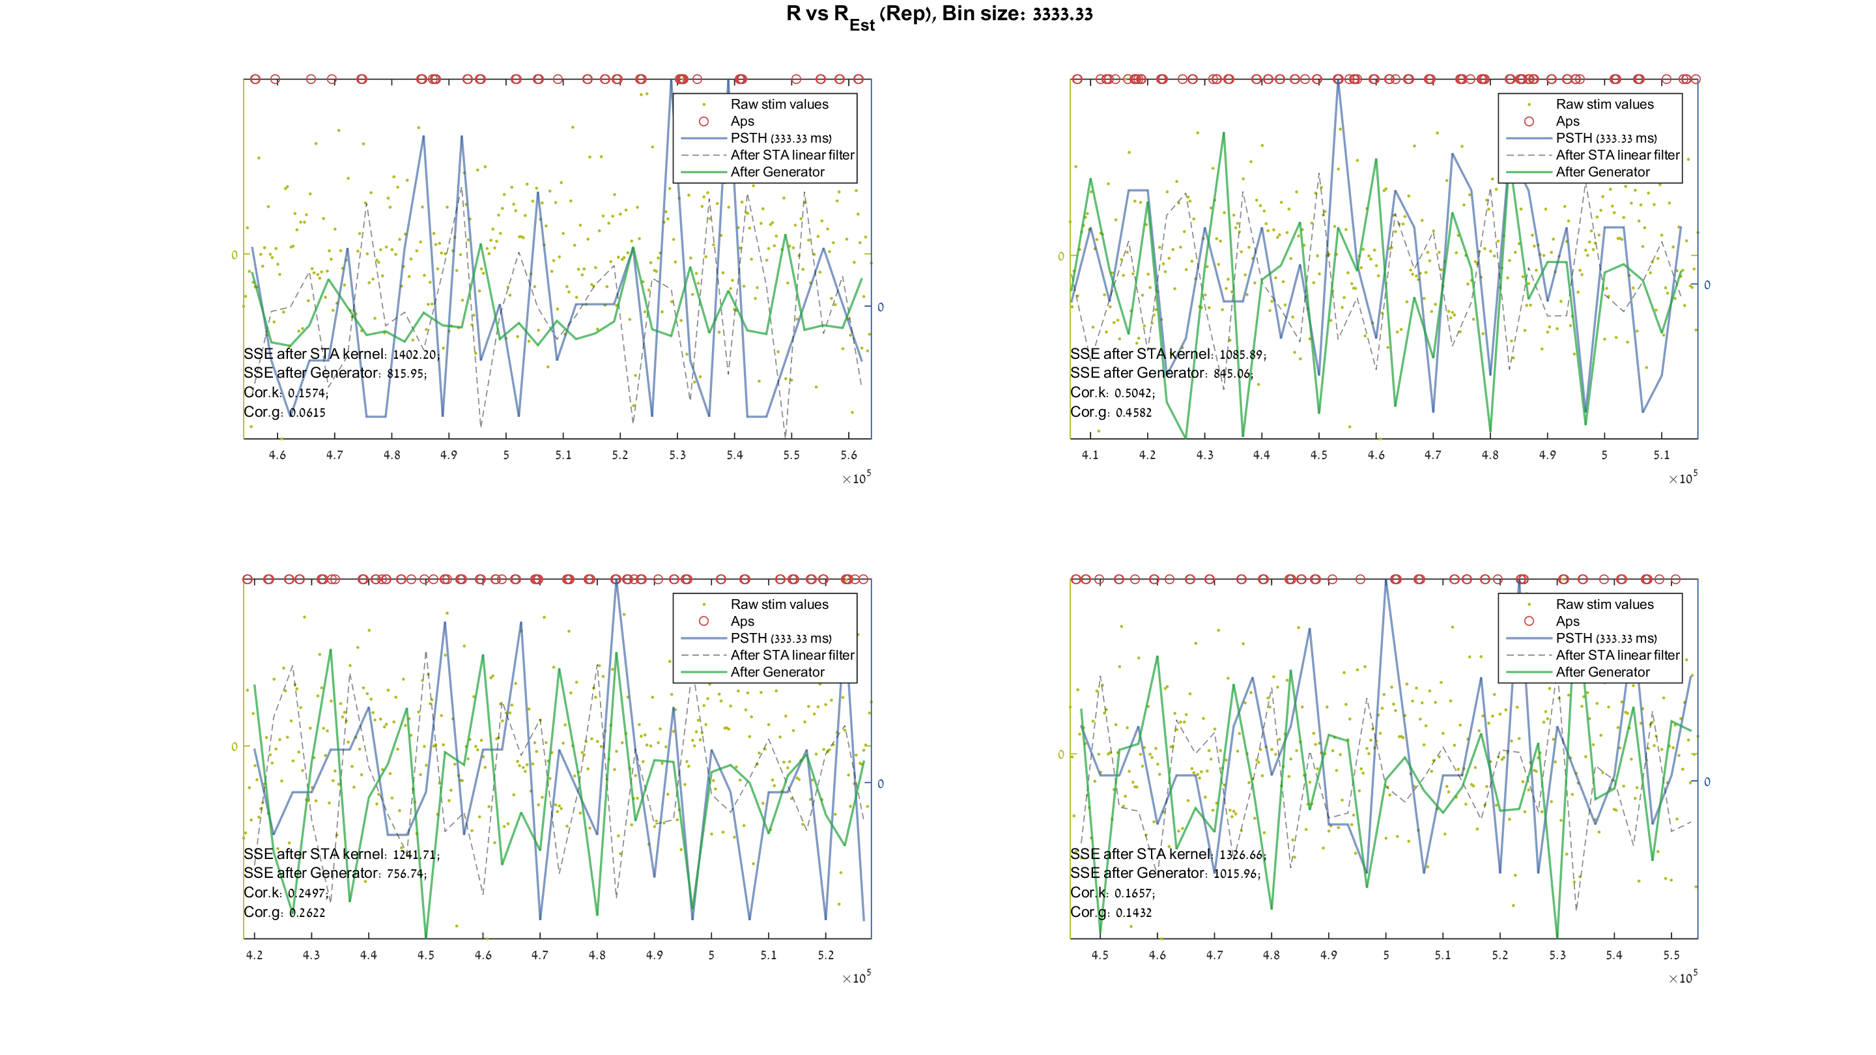
Q #3 – LN model – testing rep - RvsRest

Slide 9
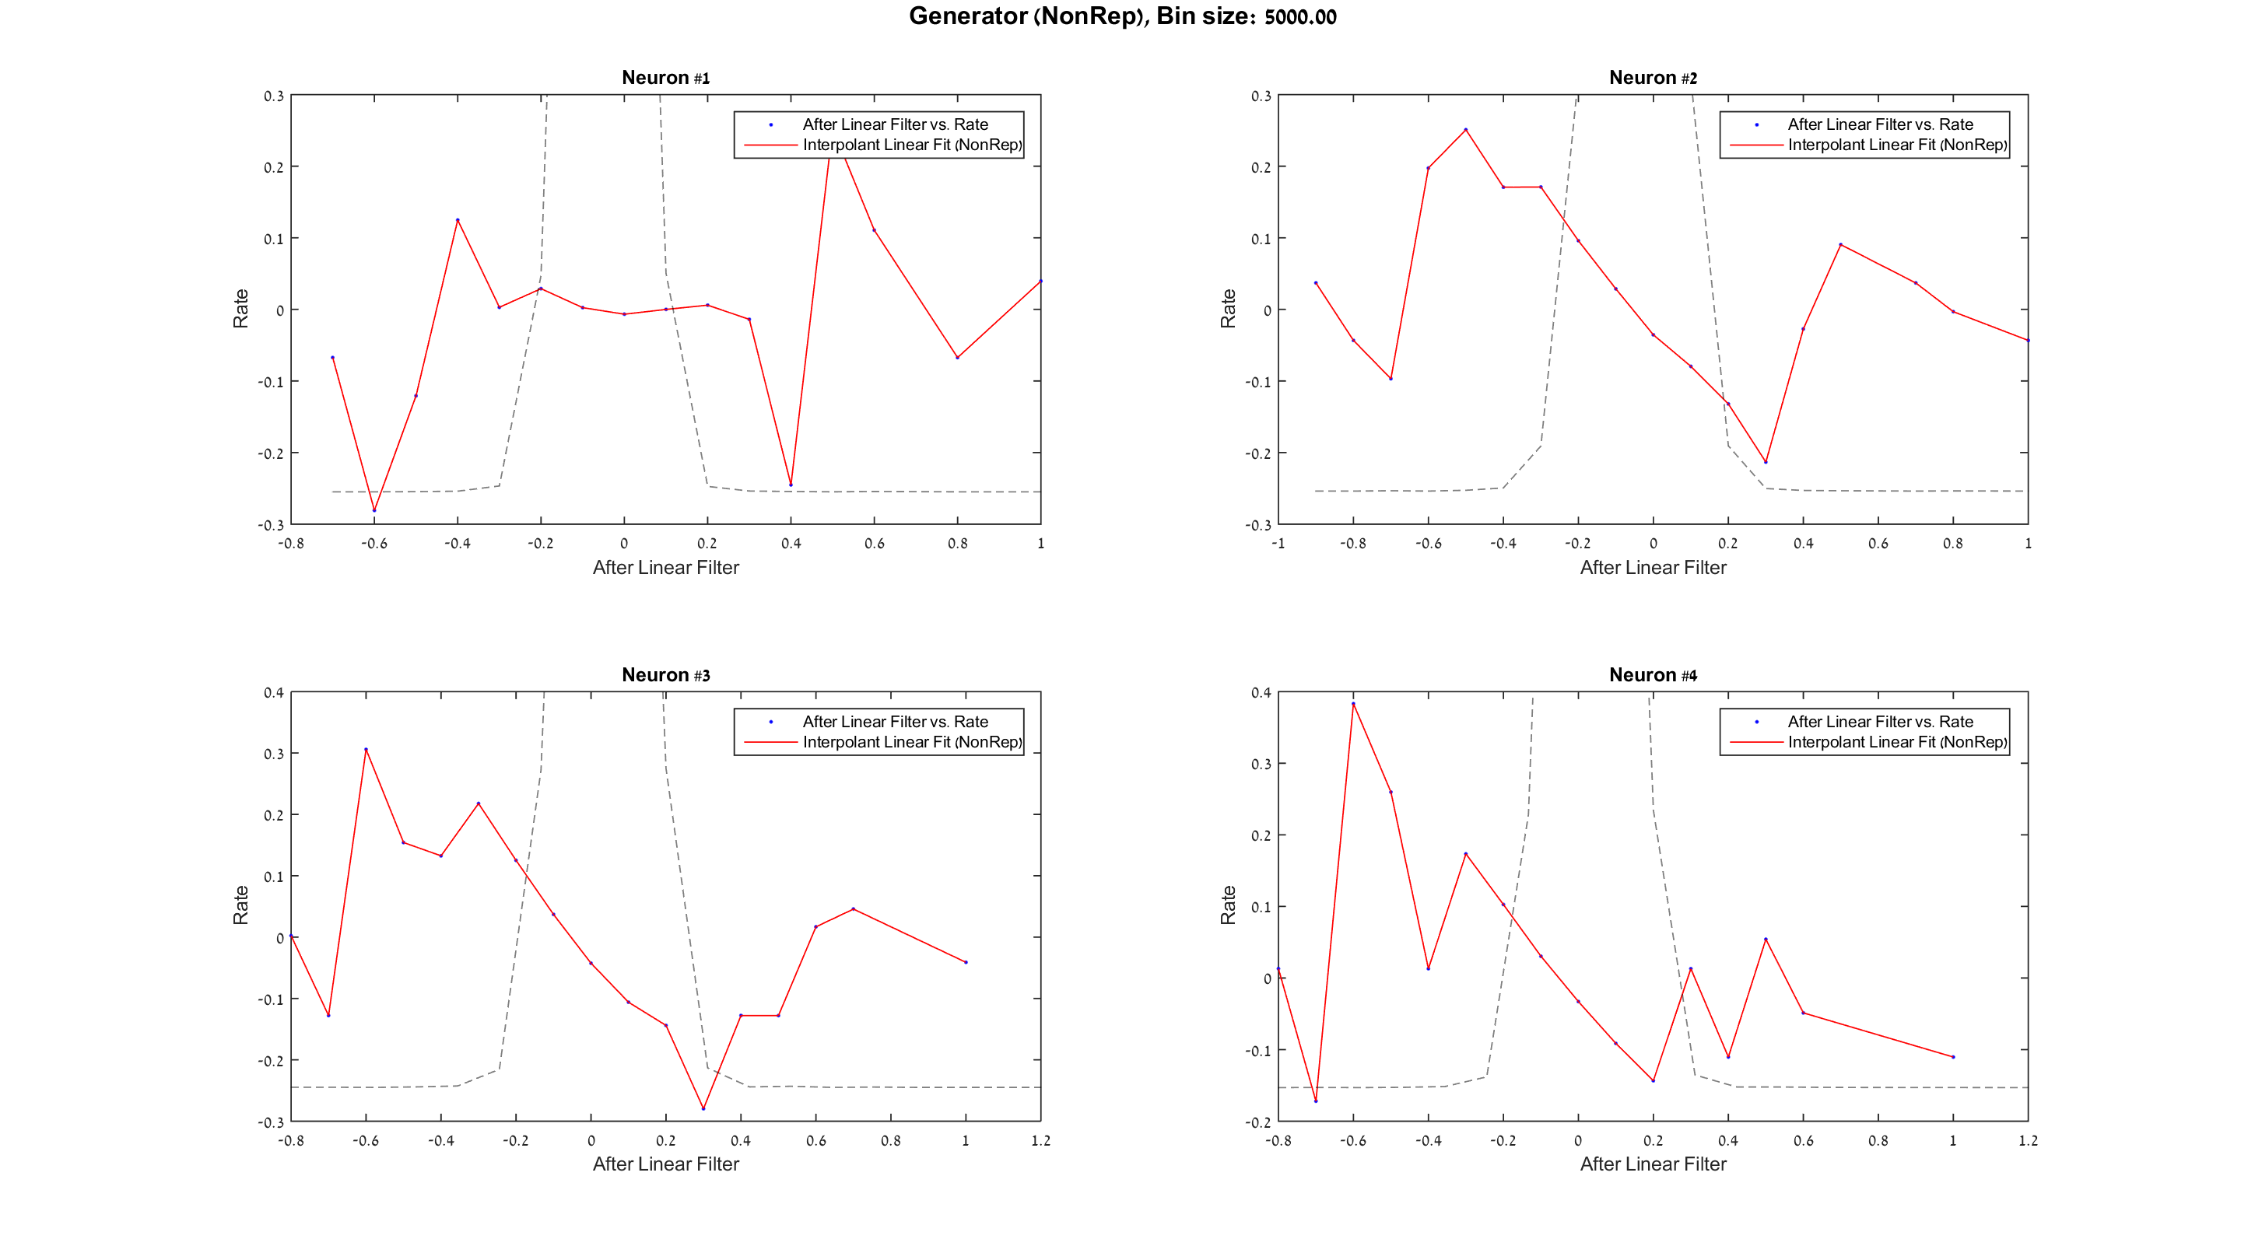
Q #3 – LN model – learning non rep - generator

Slide 10
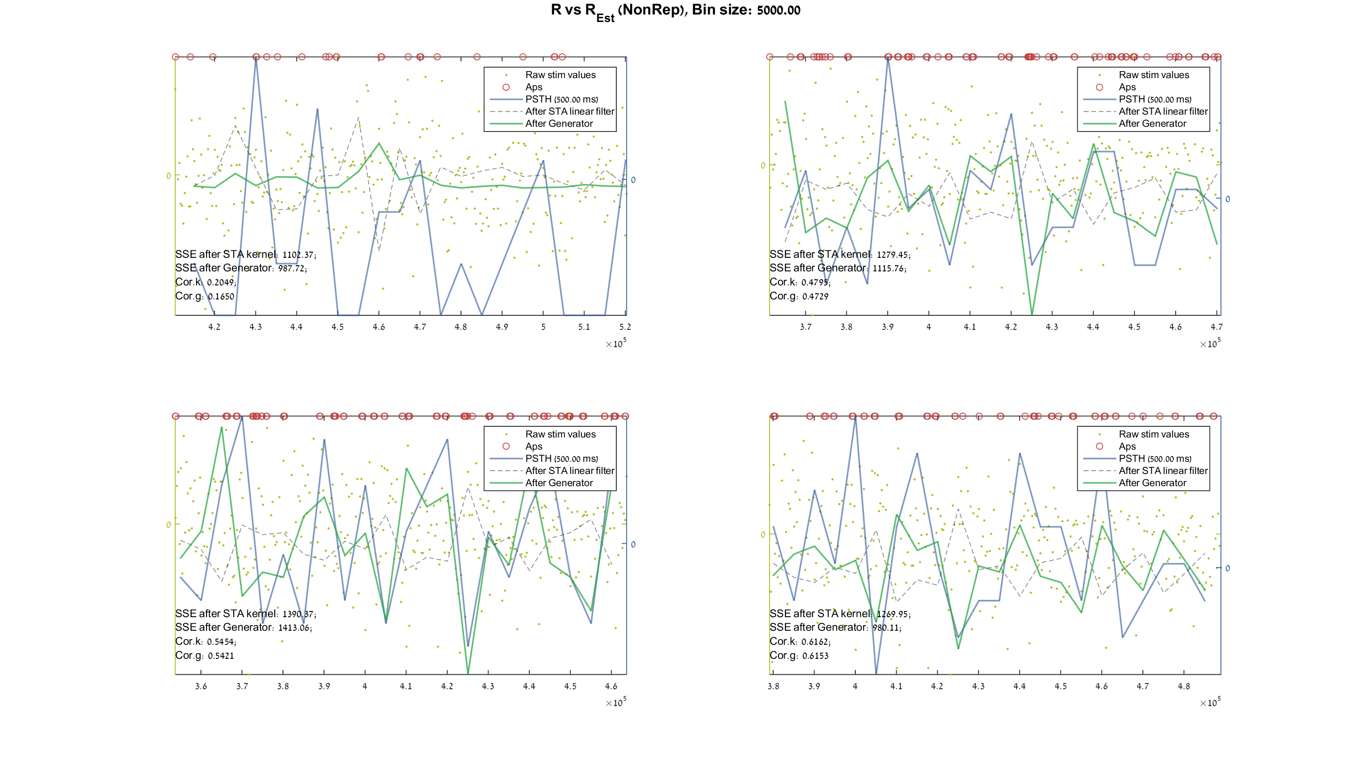
Q #3 – LN model – learning non rep - RvsRest

Slide 11
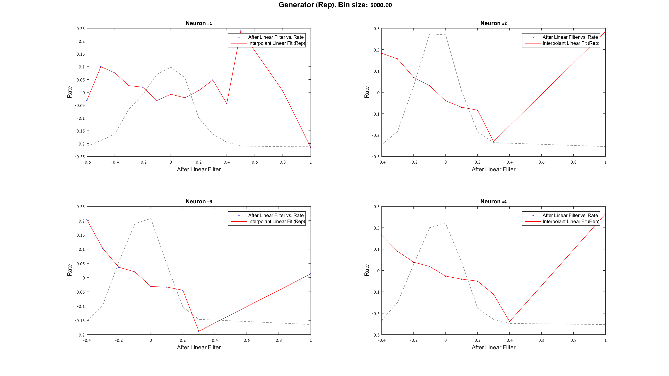
Q #3 – LN model – testing rep - generator

Slide 12
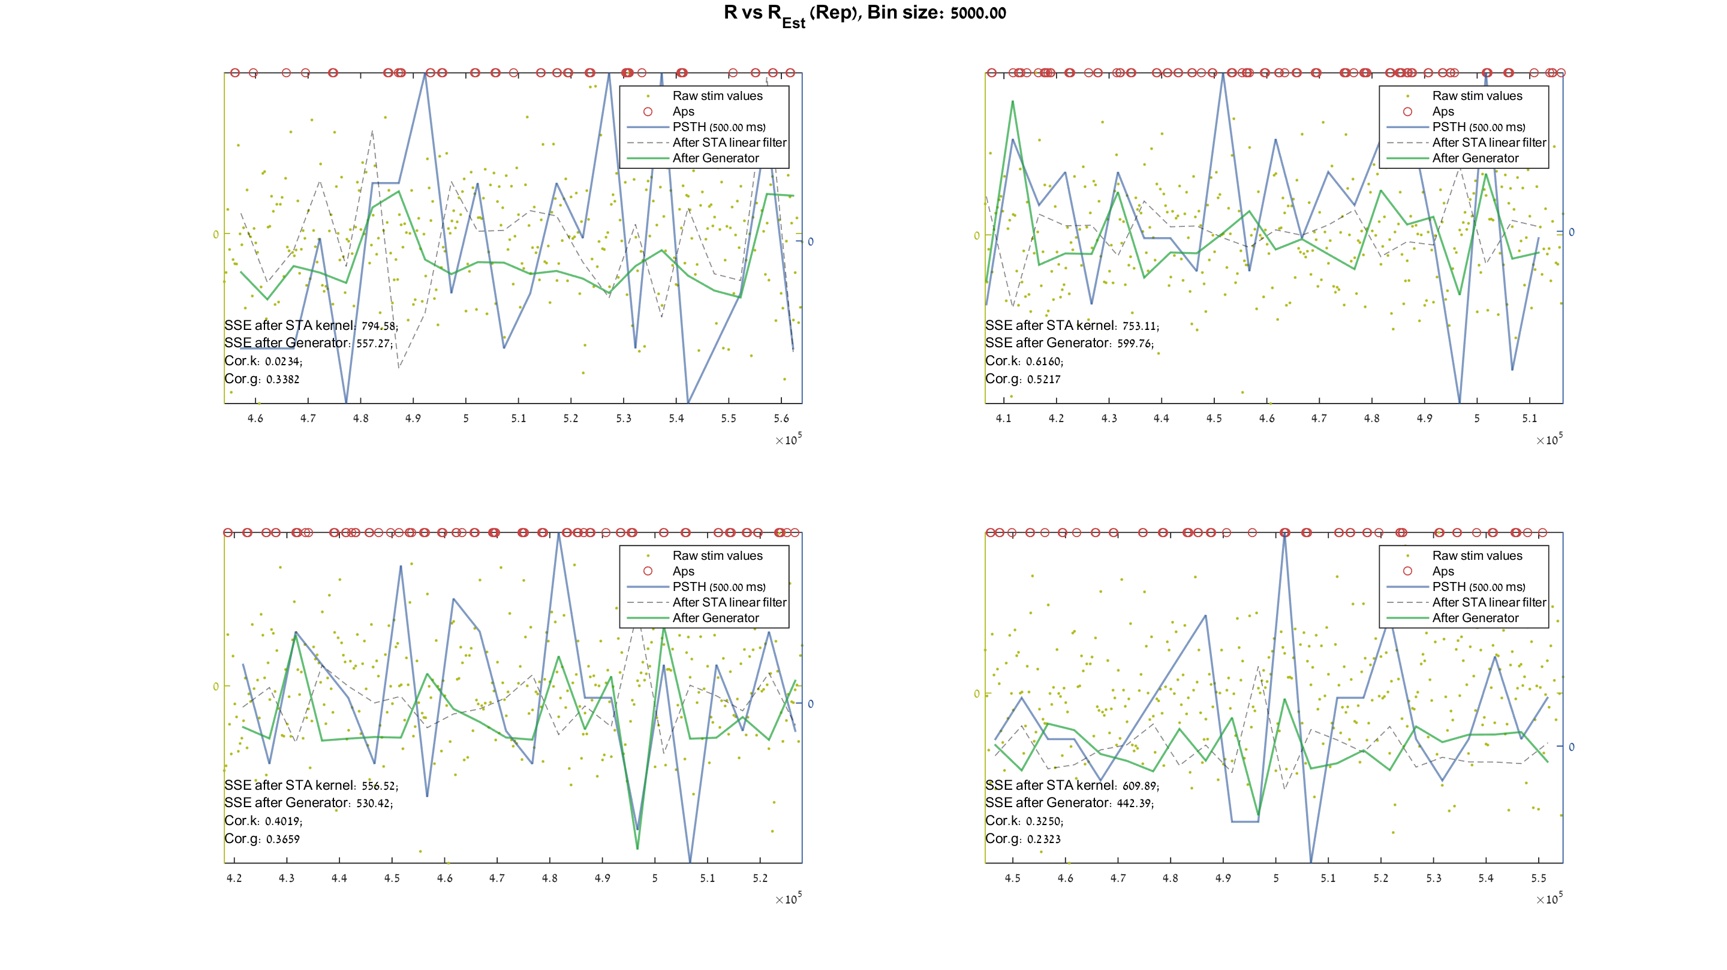
Q #3 – LN model – testing rep - RvsRest

Slide 13
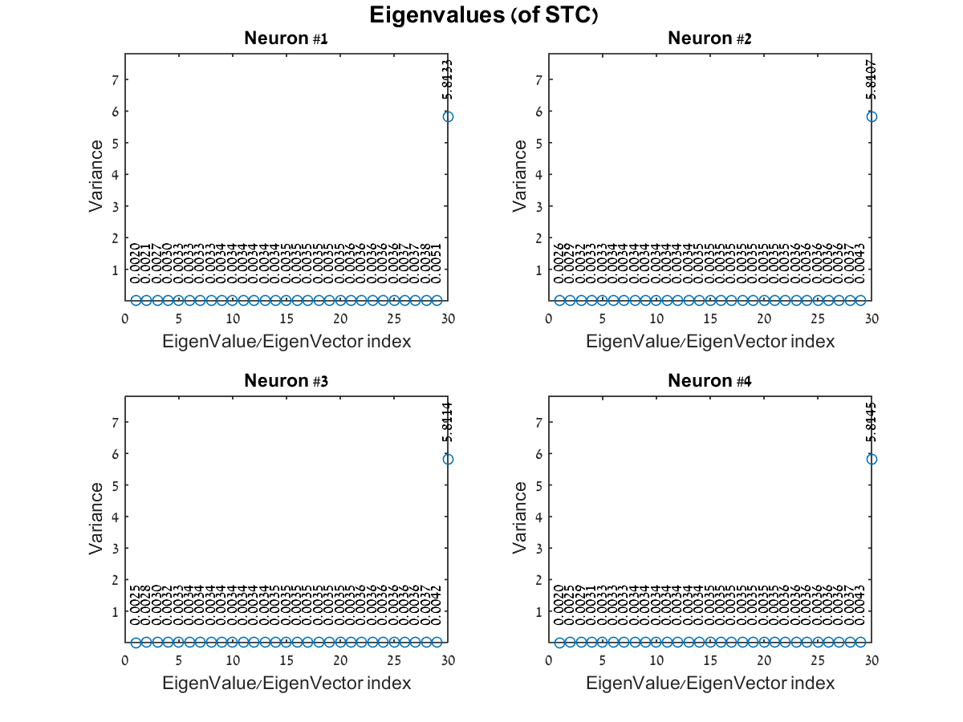
Q #4 – STC eigenvalues –non-rep

Slide 14
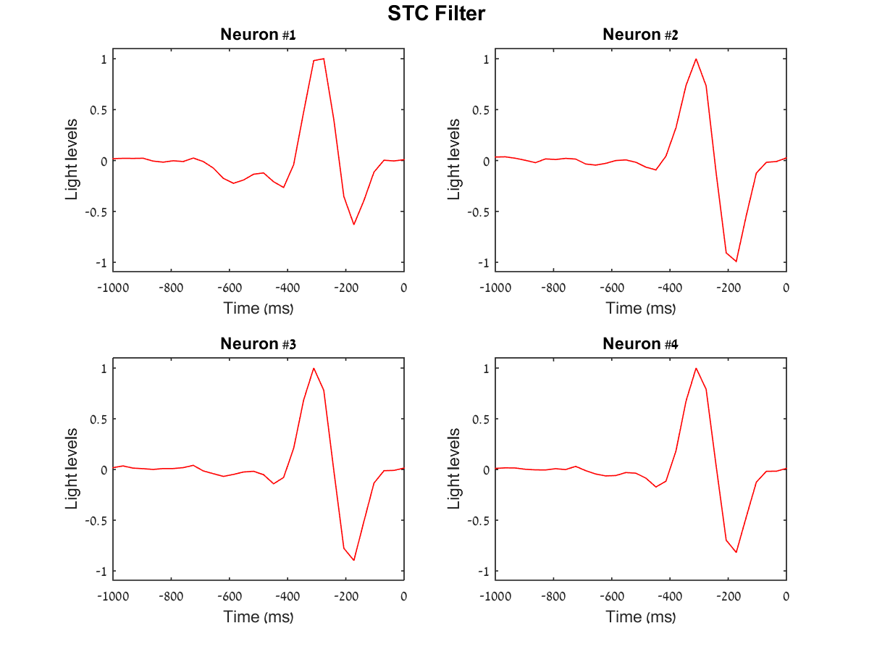
Q #4 – STC filter non-rep

Slide 15

Q #4 – LN model using STC – testing rep - generator

Slide 16
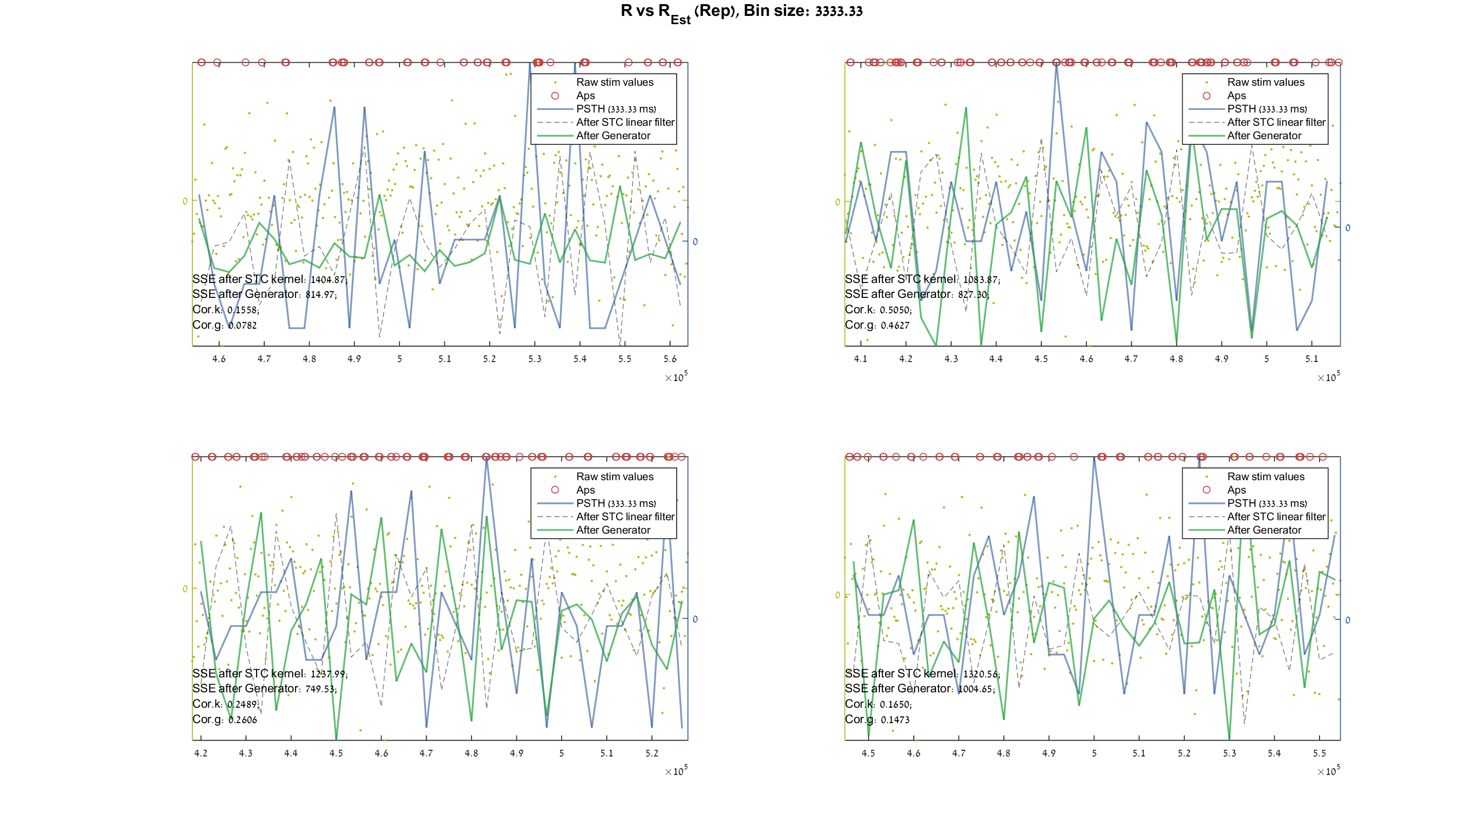
Q #4 – LN model using STC – testing rep - RvsRest

Slide 17
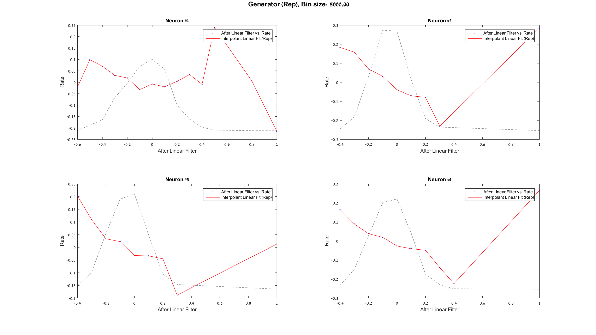
Q #4 – LN model using STC – testing rep - generator

Slide 18

Q #4 – LN model using STC – testing rep - RvsRest

