Slide 1
Assignment #4
Shay Ben-Sasson
061203410

Slide 2
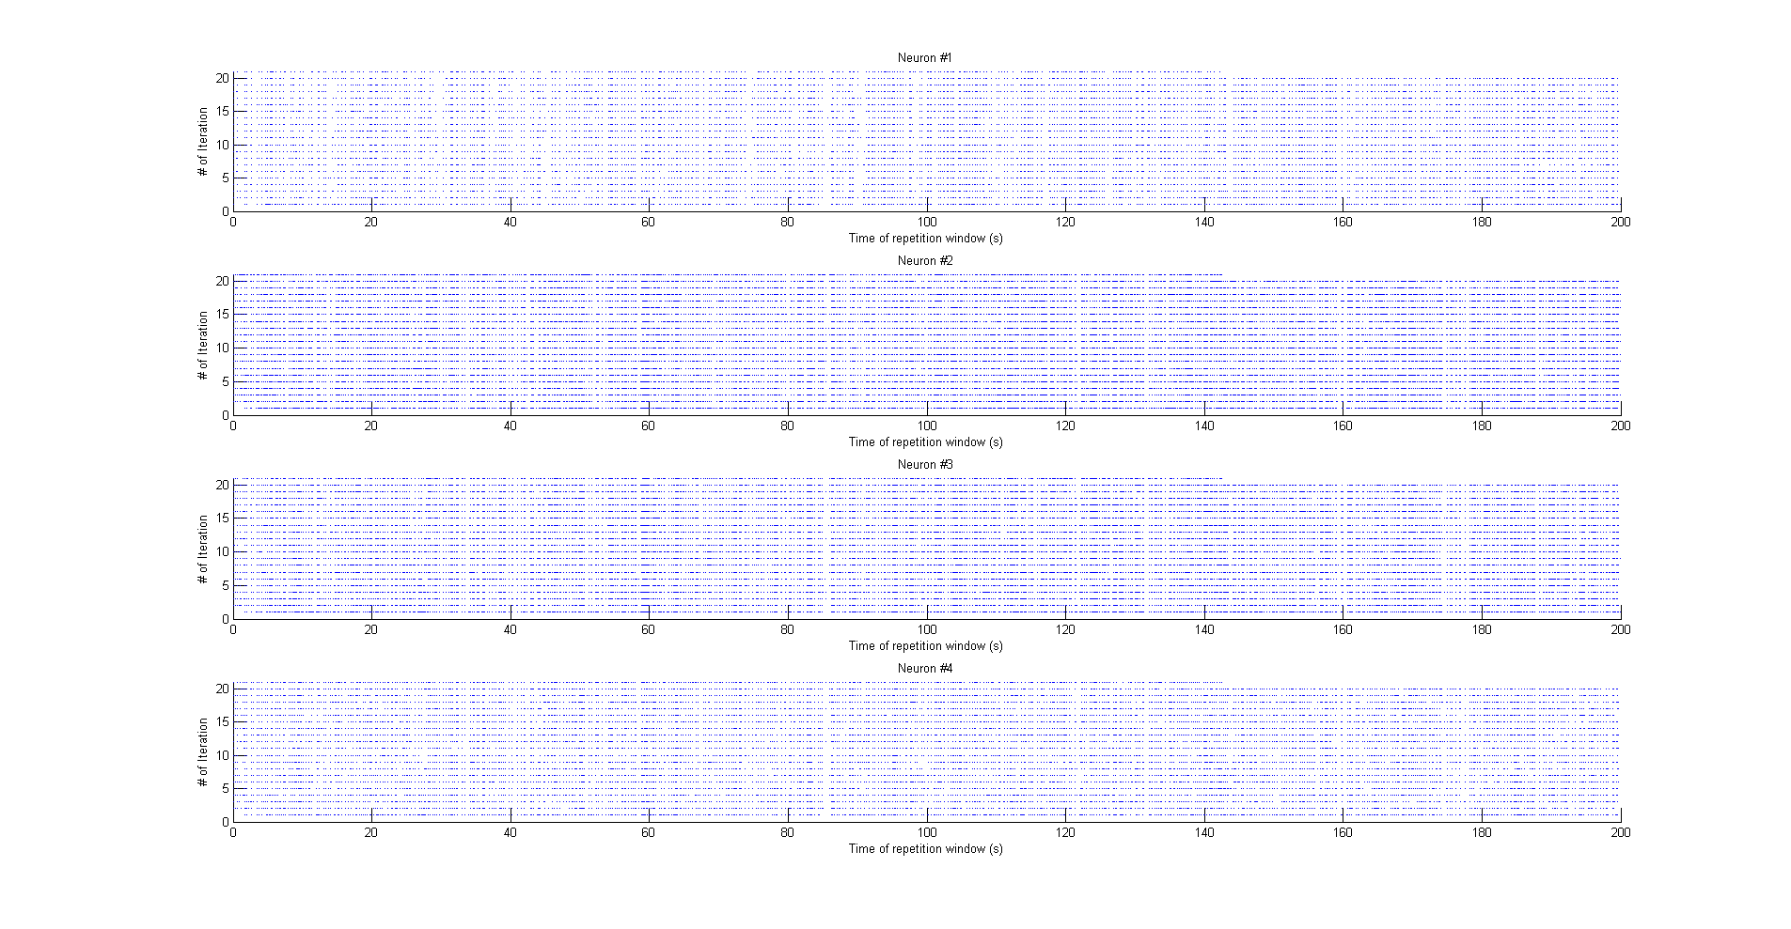

Slide 3
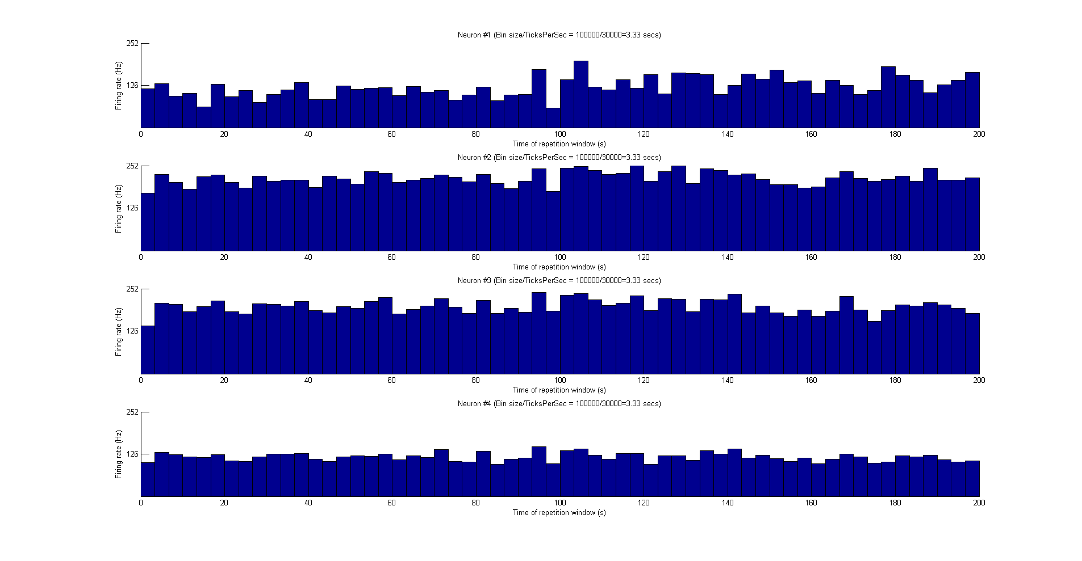

Slide 4
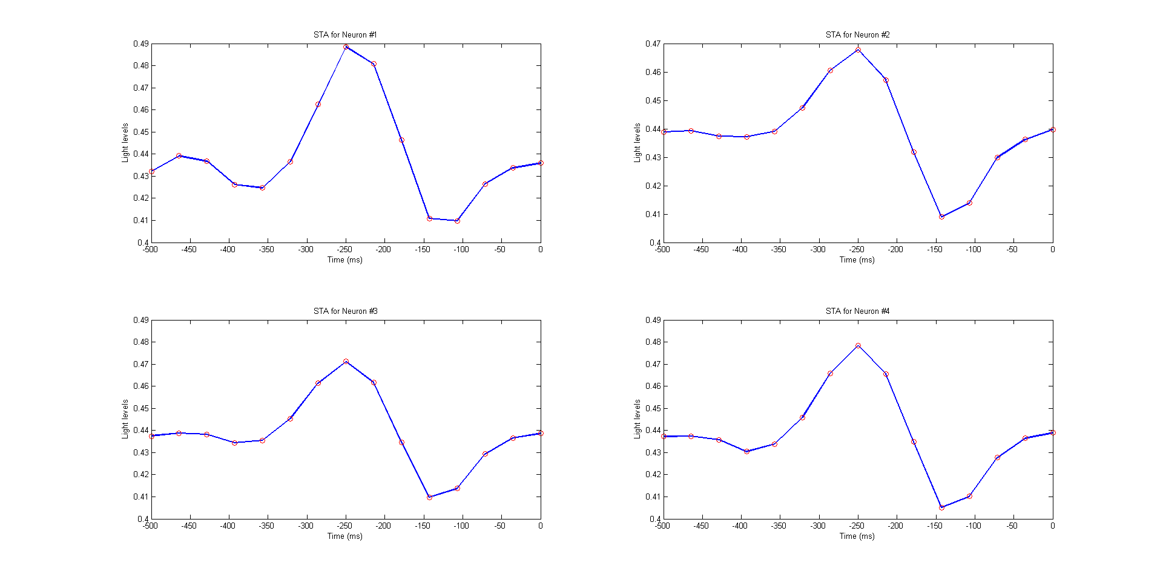
REP, 500ms STA

Slide 5
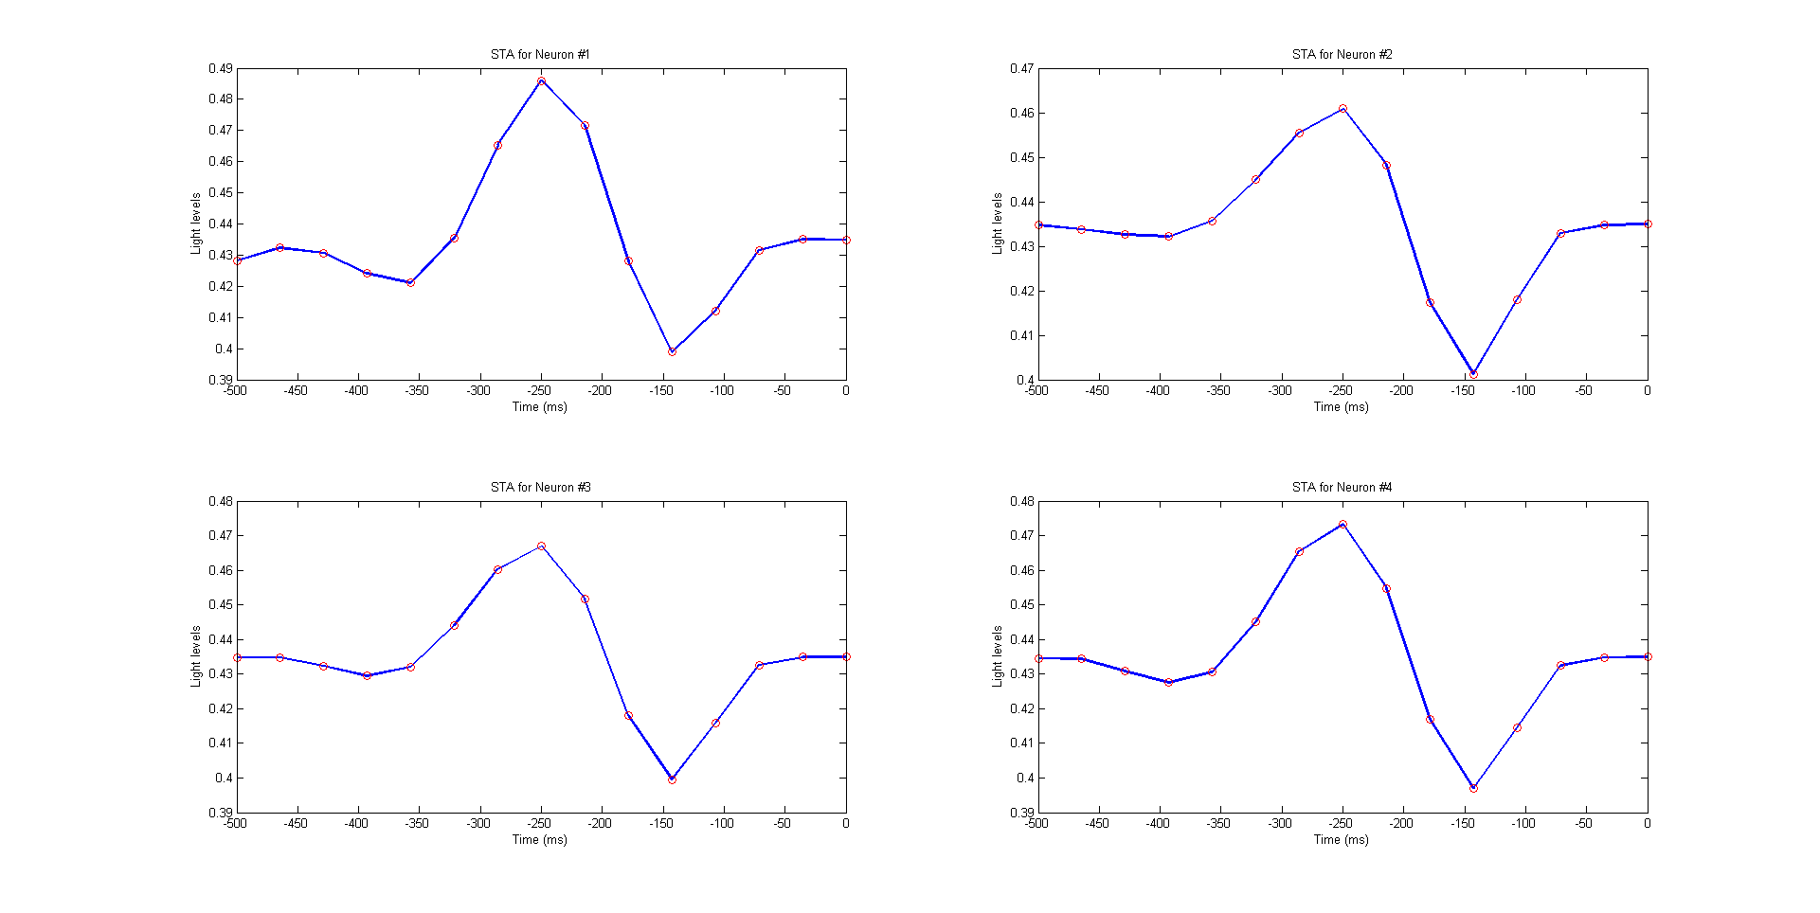
Non-REP, 500ms STA

