Slide 1
Assignment #2
Shay Ben-Sasson
061203410

Slide 2
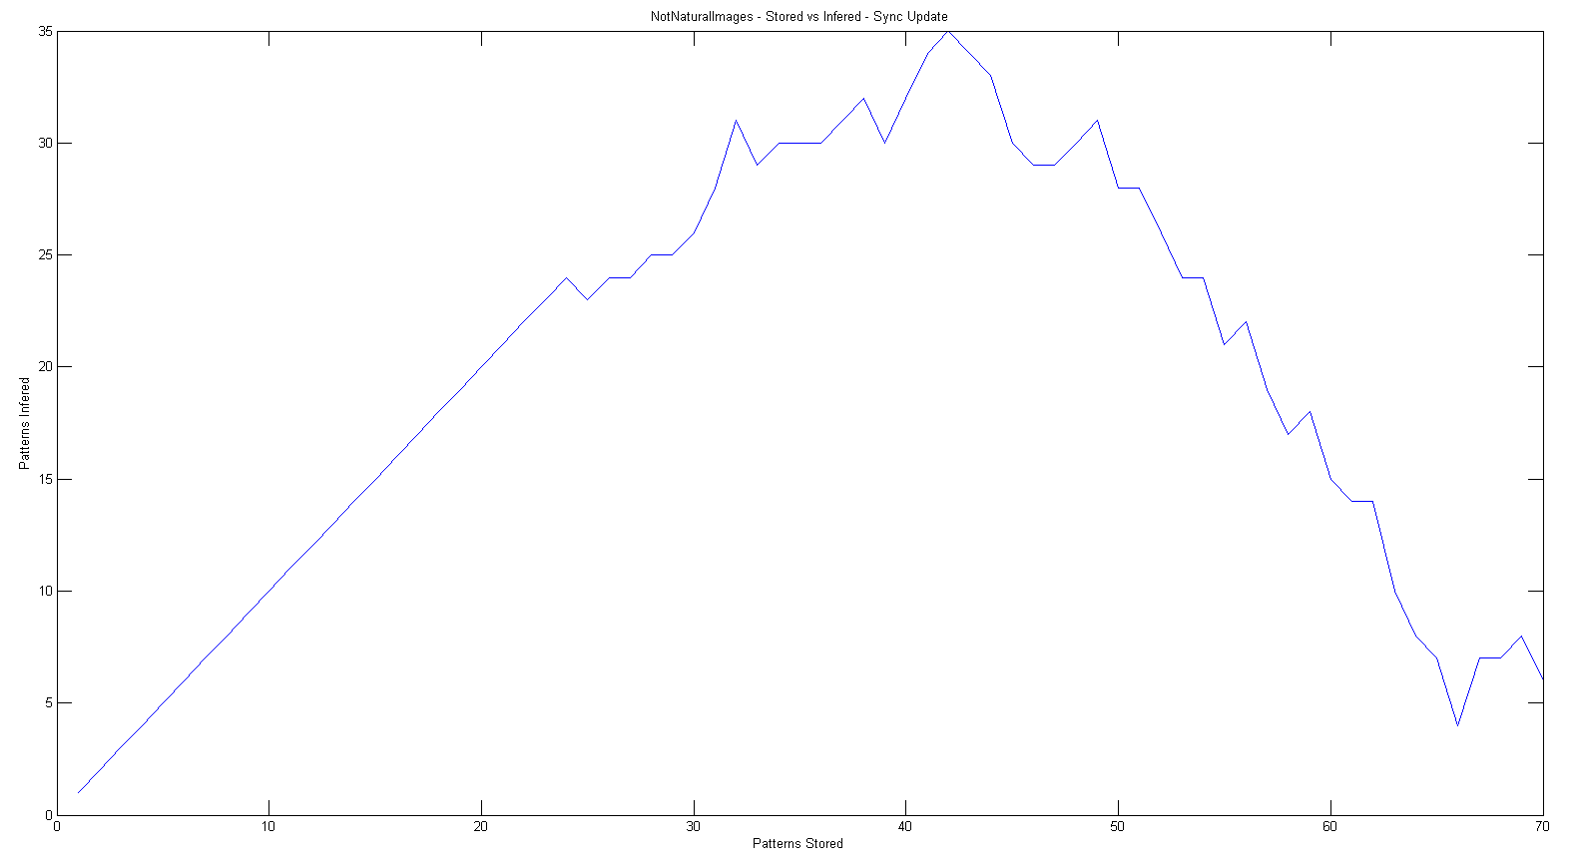
Q #1
Non natural Images | 400 cells
Stored vs Inferred | 70 Patterns
Sync update

Slide 3
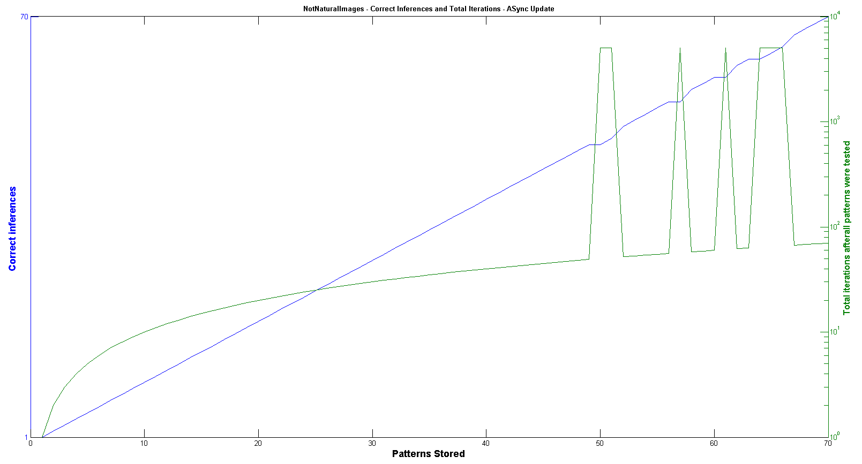
Q #1
Non natural Images | 400 cells
Stored vs Inferred | 70 Patterns
ASync update

Slide 4
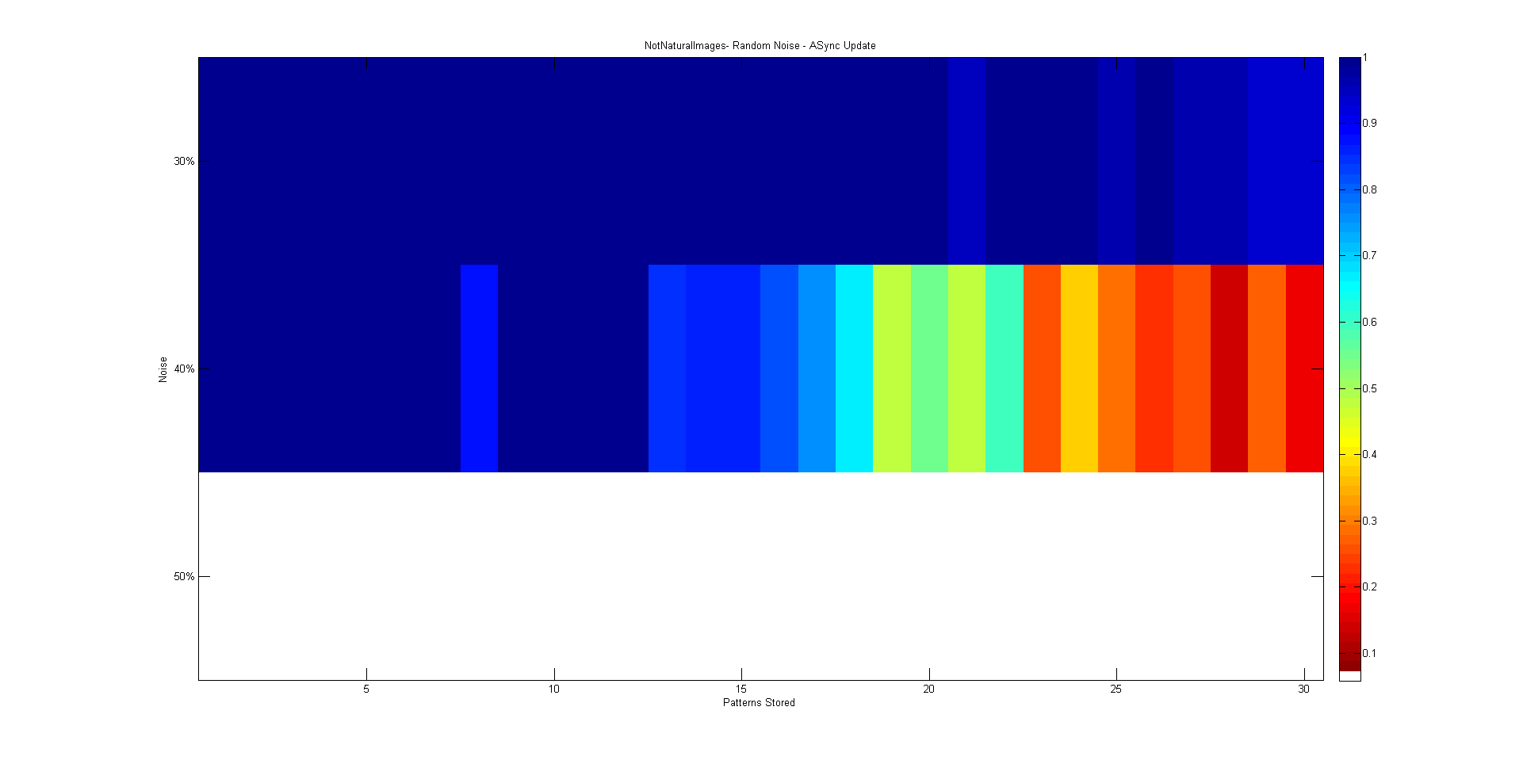
Q #1
Non natural Images | 400 cells
Random Noise effect on stored patterns | 30 Patterns
ASync update

Slide 5
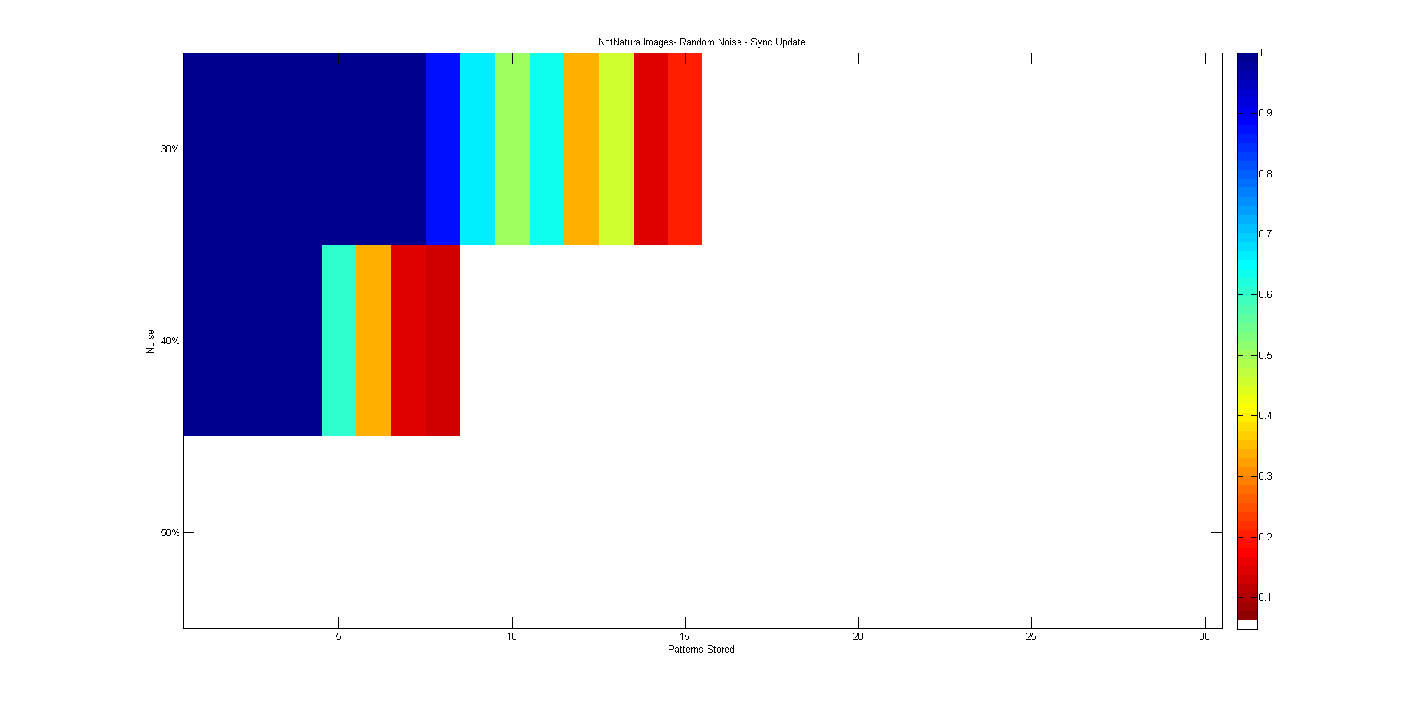
Q #1
Non natural Images | 400 cells
Random Noise effect on stored patterns | 30 Patterns
Sync update

Slide 6
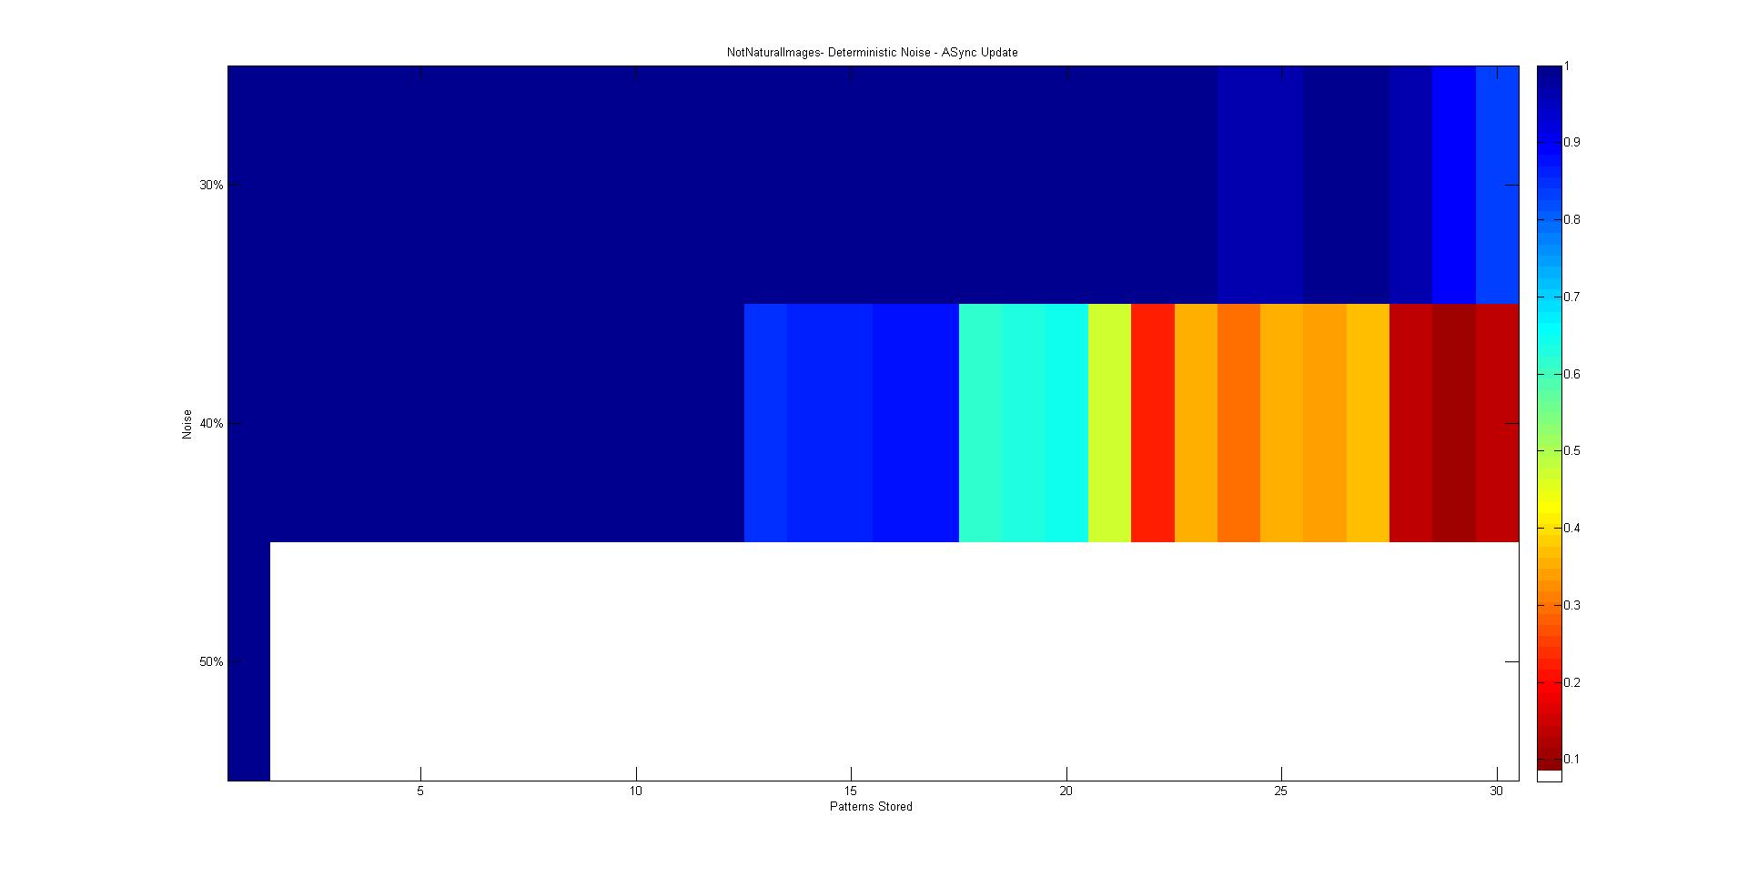
Q #1
Non natural Images | 400 cells
Deterministic Noise effect on stored patterns | 30 Patterns
ASync update

Slide 7
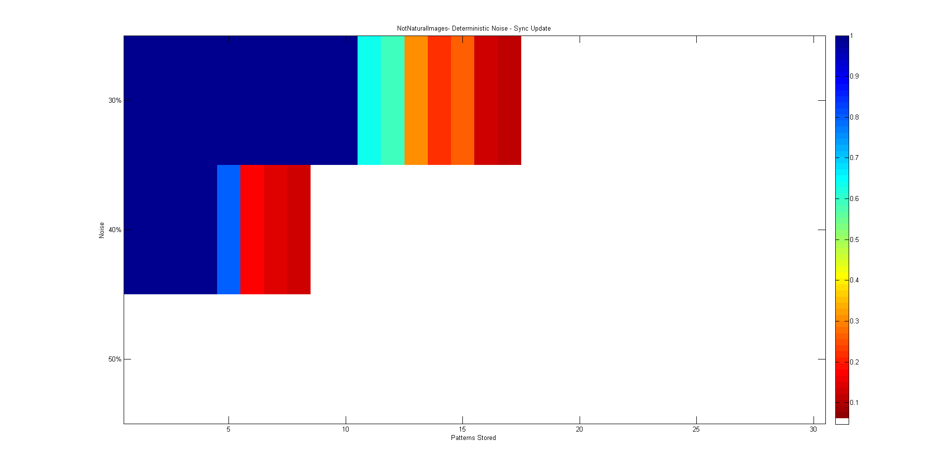
Q #1
Non natural Images | 400 cells
Deterministic Noise effect on stored patterns | 30 Patterns
Sync update

Slide 8
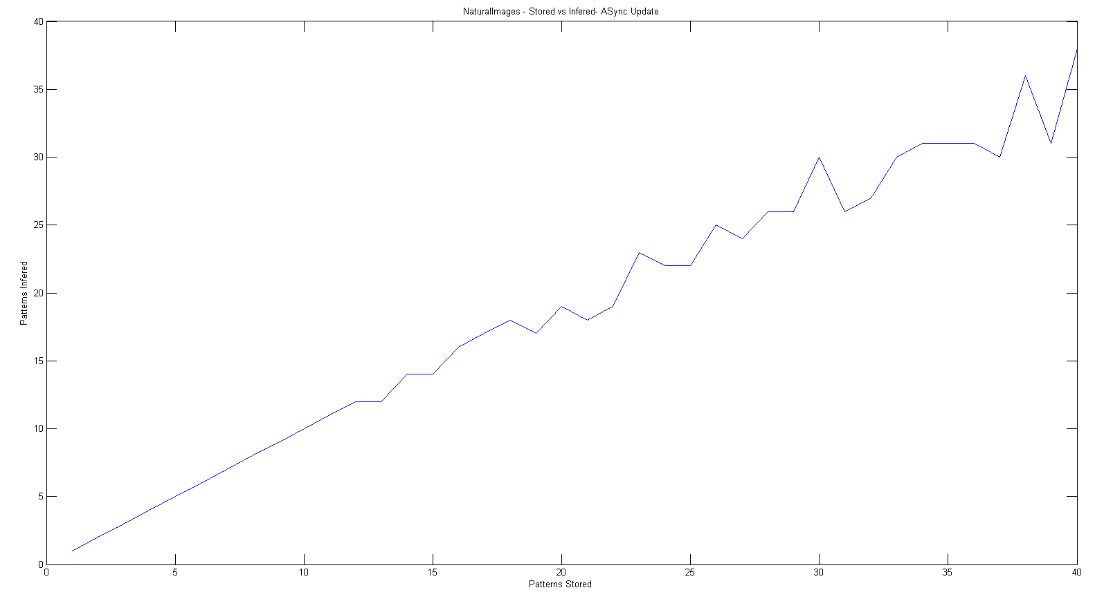
Q #2
Natural Images | 1600 cells
Stored vs Inferred | 40 Patterns
ASync update

Slide 9
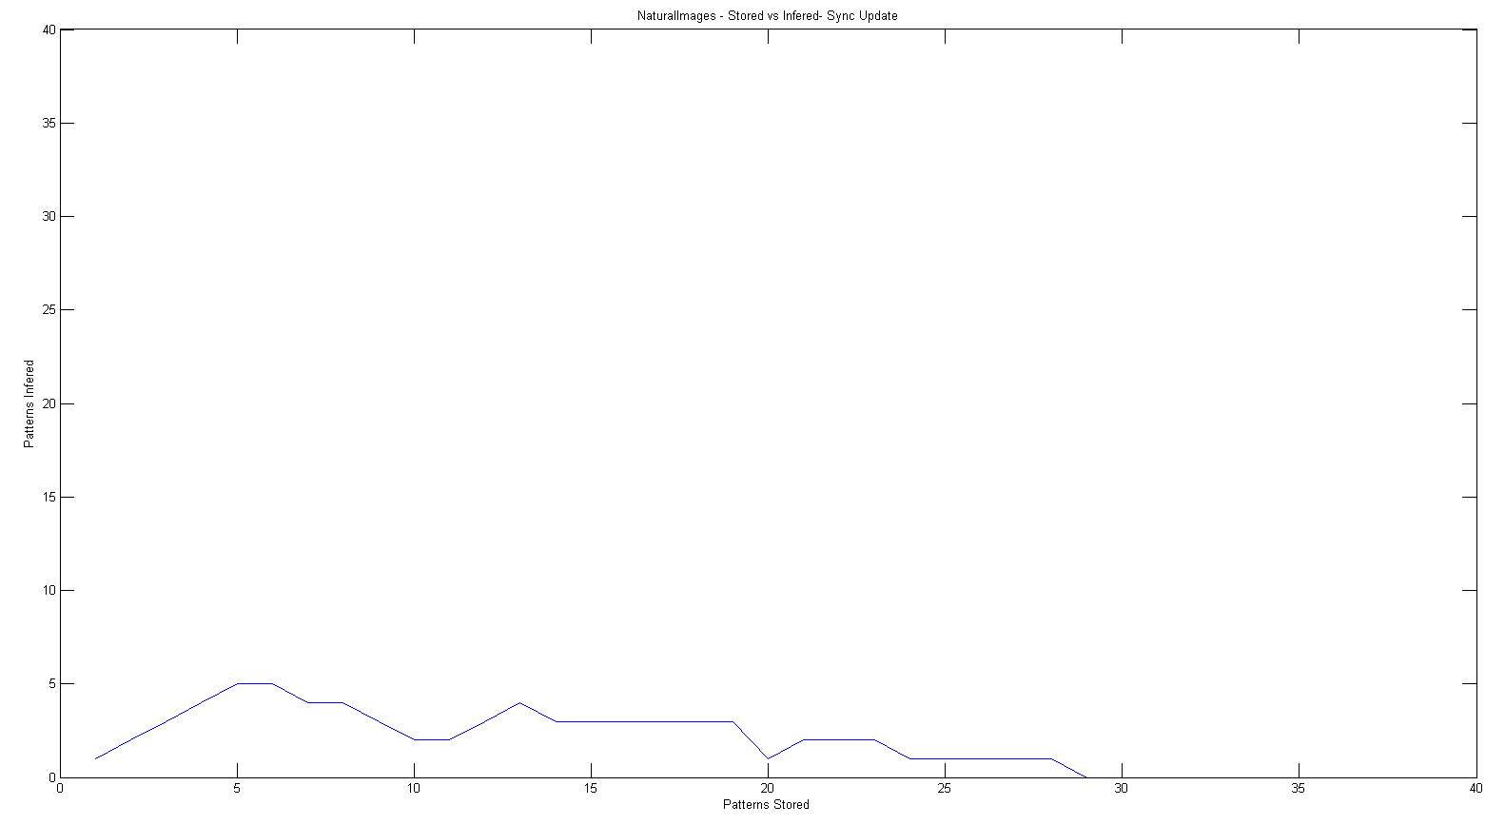
Q #2
Natural Images | 1600 cells
Stored vs Inferred | 40 Patterns
Sync update

Slide 10
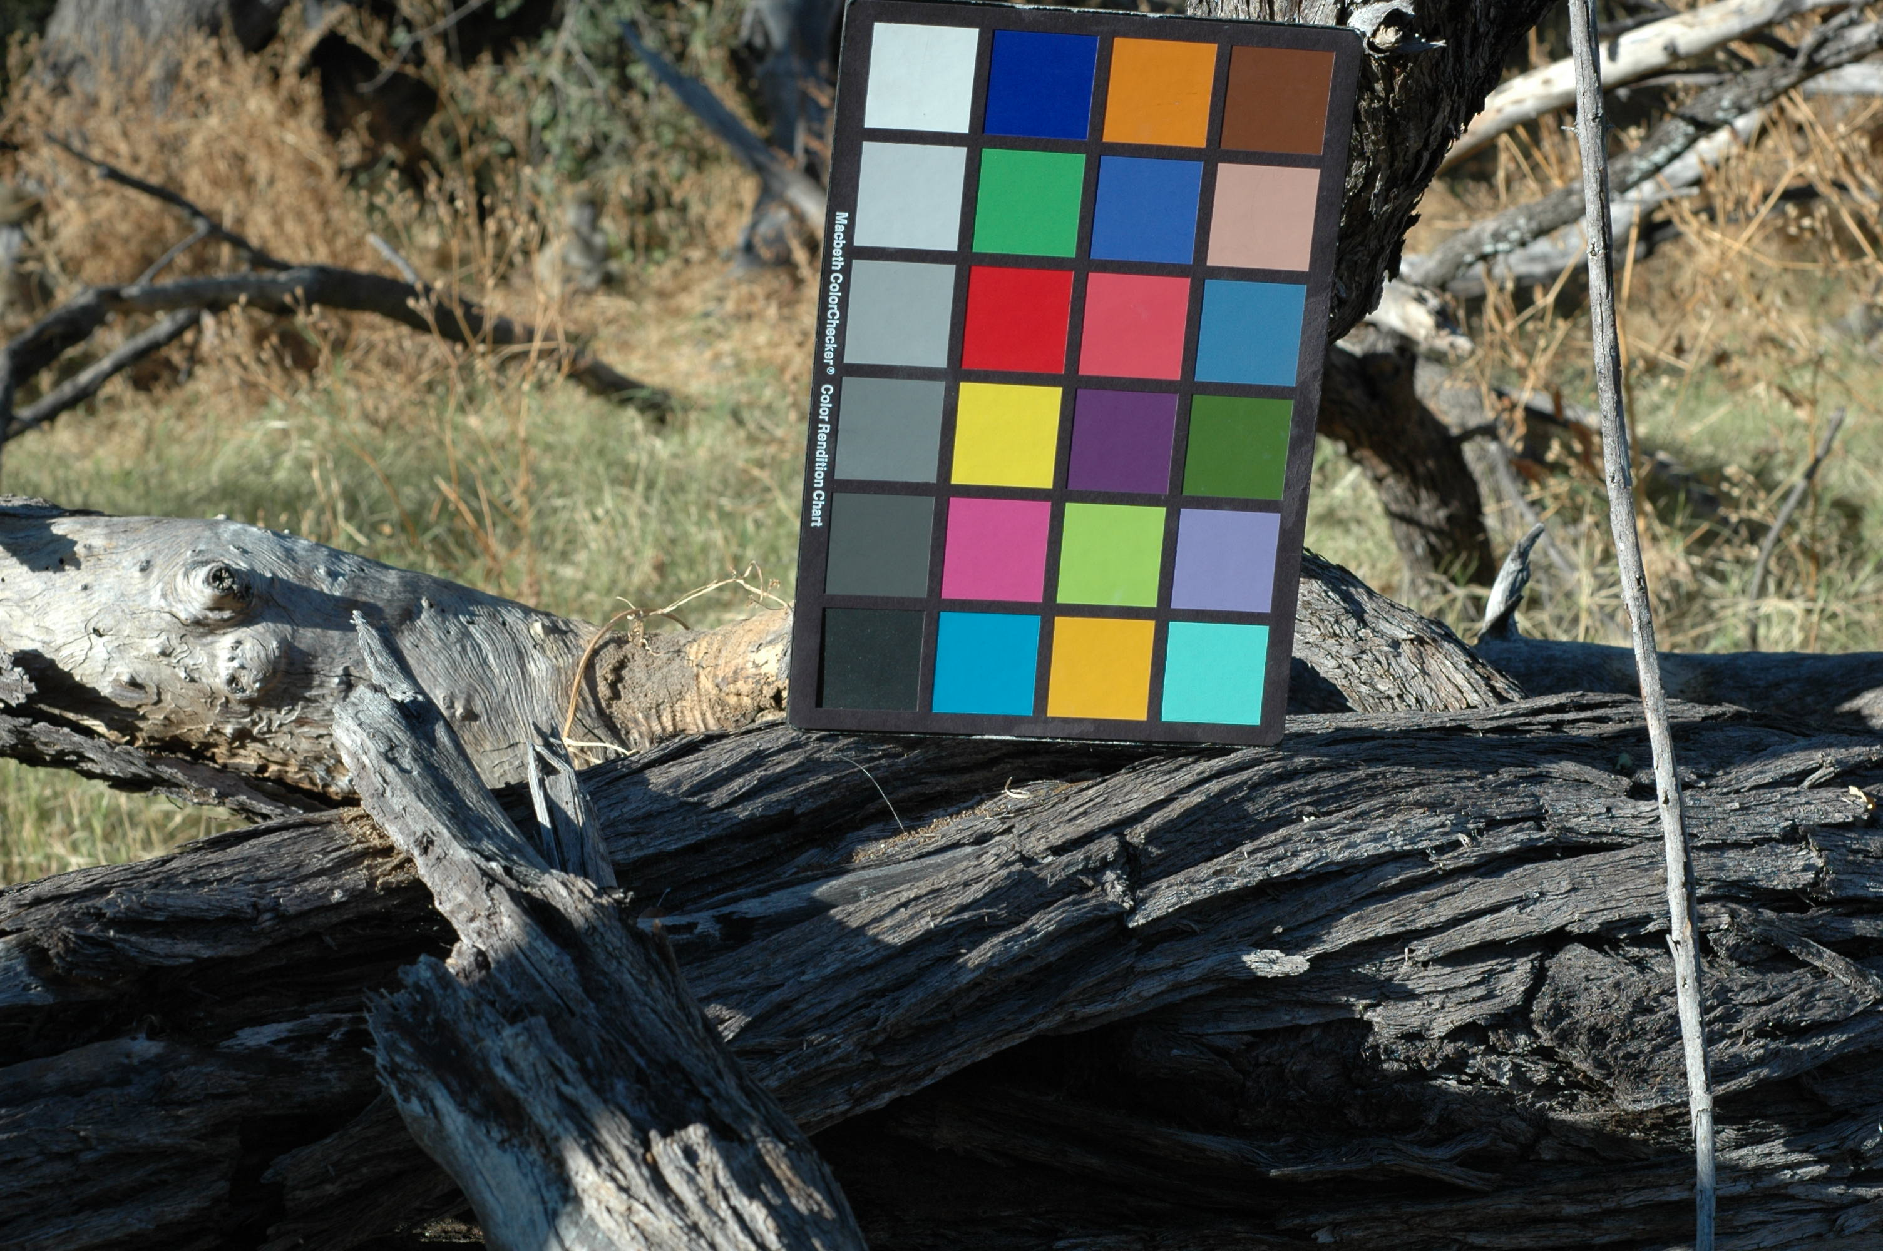
Q #2 – using natural images
An example of a stored pattern (referred to as pattern #1 on next slides)
10,000 cells
20 Patterns

Slide 11
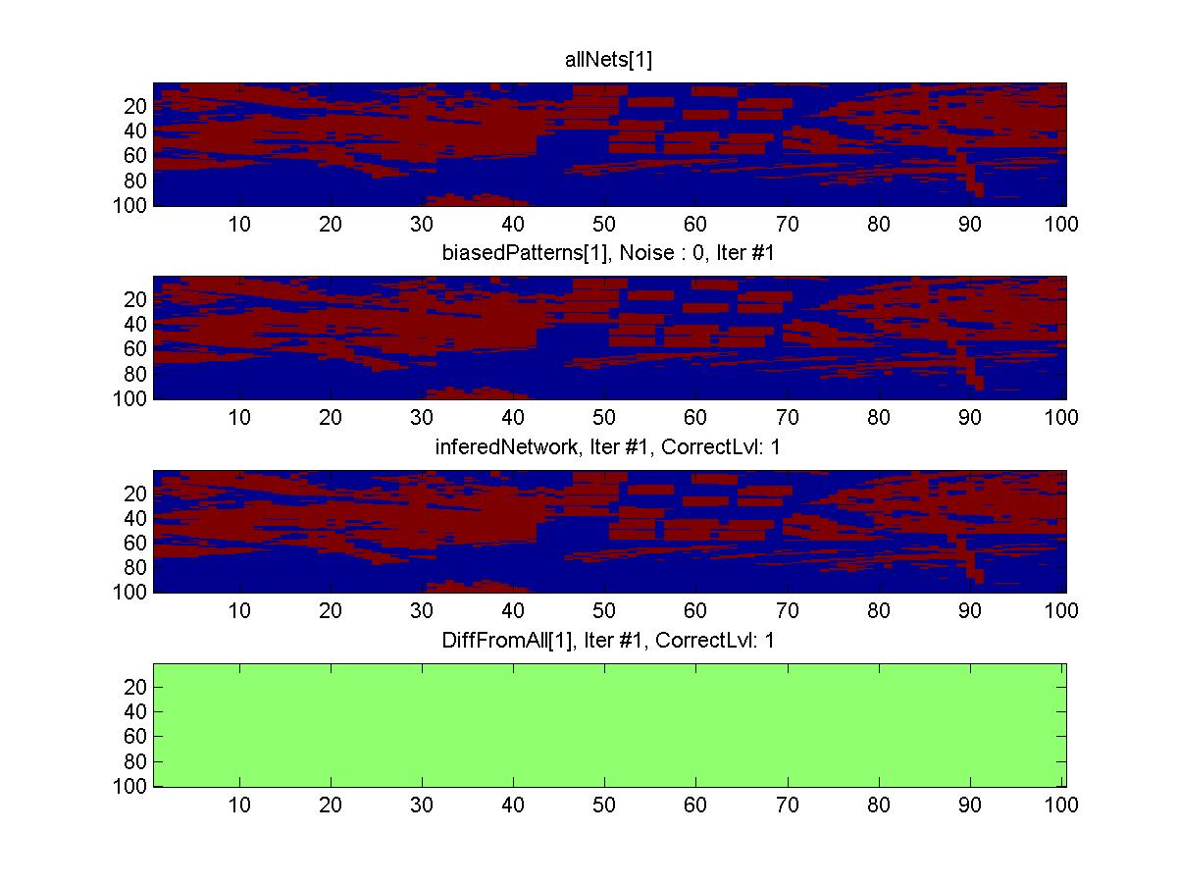
Q #2
Natural Images | 10,000 cells
Stored vs Inferred | 20 Patterns
ASync update

Slide 12
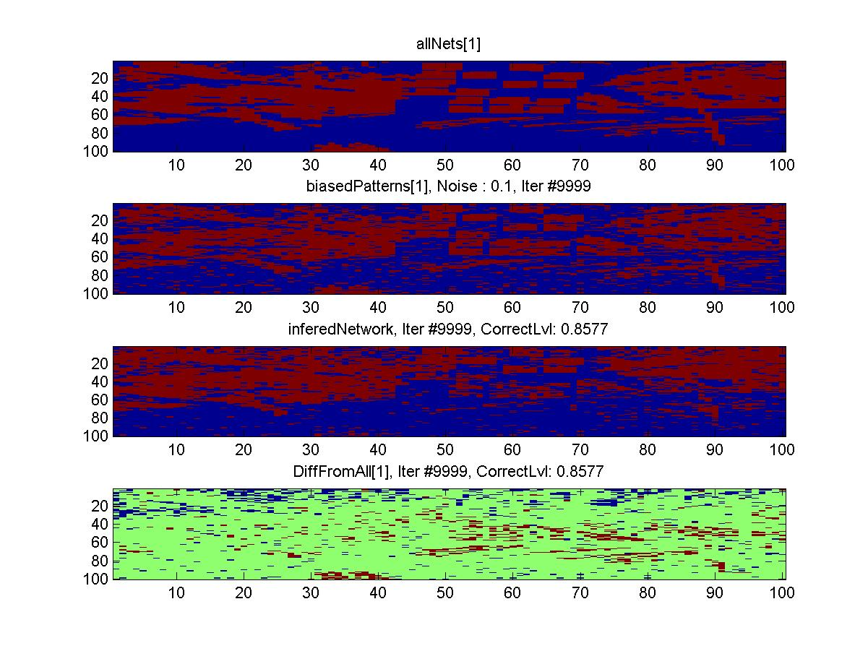
Q #2
Natural Images | 10,000 cells
Stored vs Inferred | 20 Patterns
ASync update | Noisy 10%

Slide 13
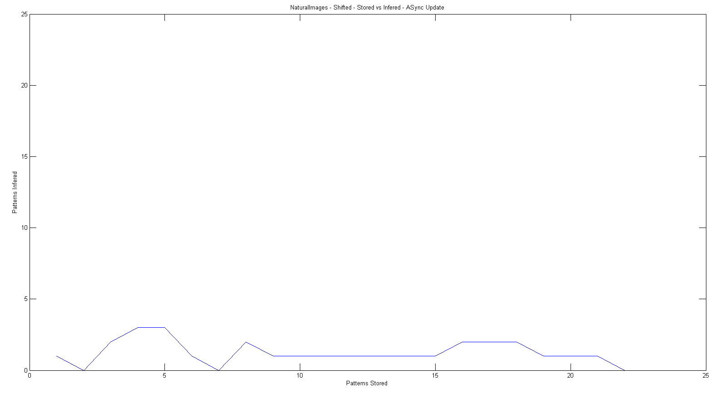
Q #3
Natural Images | 1600 cells
Stored vs Inferred | <40 Patterns
ASync update | Shifted: 1 “pixel” horizontally

Slide 14
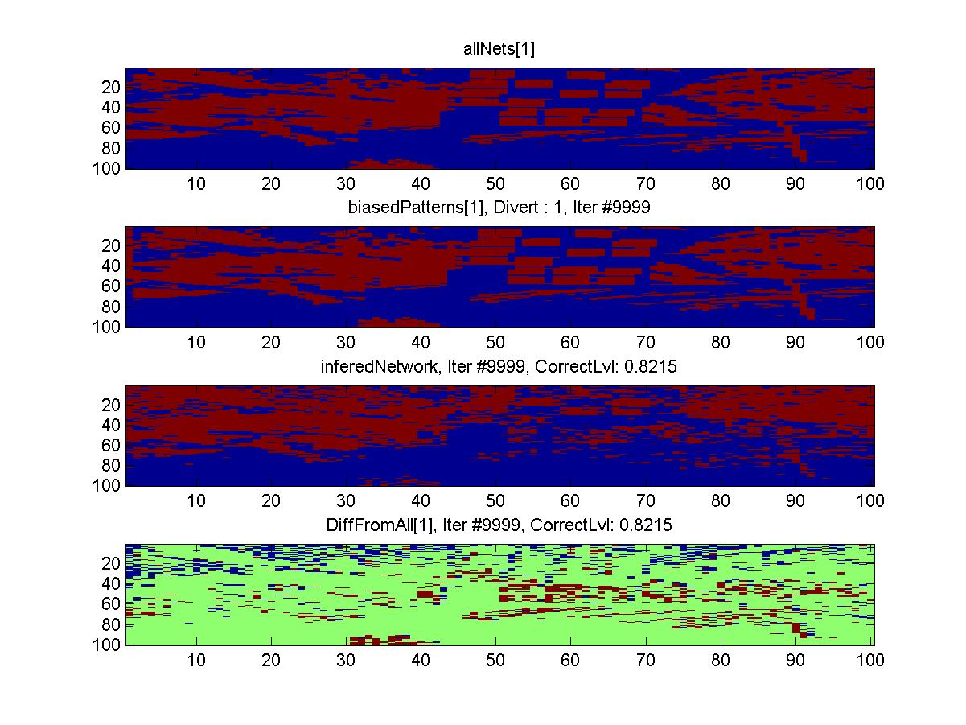
Q #3
Natural Images | 10,000 cells
Stored vs Inferred | 20 Patterns
ASync update | Shifted: 1 “pixel” horizontally

Slide 15
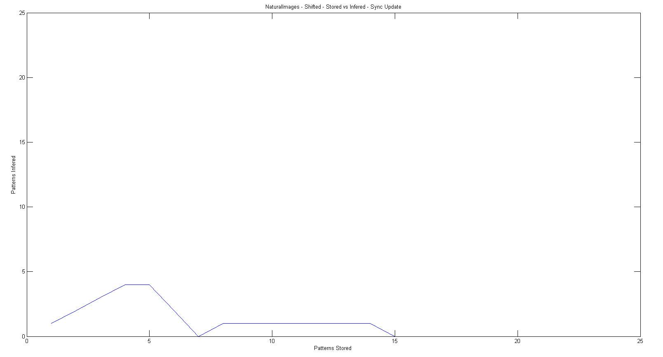
Q #3
Natural Images | 1600 cells
Stored vs Inferred | <40 Patterns
Sync update | Shifted: 1 “pixel” horizontally

Slide 16
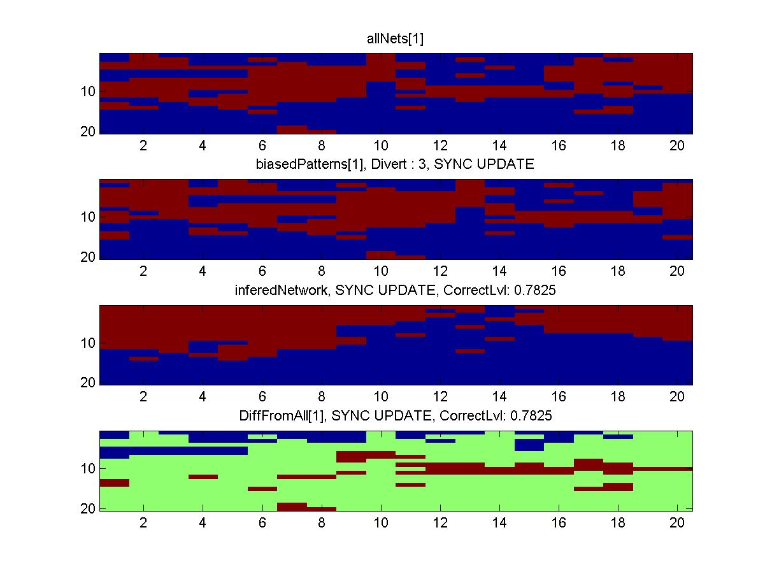
Q #3
Natural Images | 10,000 cells
Stored vs Inferred | 20 Patterns
ASync update | Noisy 10%

