Slide 1
Predicting Infant Mortality Using Logistic Regression
Capstone Project 1 (Springboard Data Science Career Track)
Shishay Bisrat
Jan. 2018

Slide 2
Introduction
Huge amount of data about millions of individual pregnancies and child birth is collected in the US.
The National Center for Health Statistics compiles and provides natality and infant mortality data on yearly basis.
The objective of this project is to use machine learning methods to predict infant mortality (infant mortality is defined as death of children who have lived less than one year)

Slide 3
Data and data wrangling
2008 birth cohort data: infant deaths that occurred in 2008 or 2009 and linked to birth in 2008.
The data consists of the “actual data” file and accompanying file that describes the name of the attributes, possible values for each attribute, and the position of each attribute in the “actual data” file.
The guide document was incorporated with the data document in two steps:
Convert pdf to tsv using Tabula (service software) and reformat using python.
Extract attribute name and position and incorporate with the data file.

Slide 4
Data and Data Wrangling (Continued)
Columns which did not have any values (such as state and county of birth) were removed. Records (rows) with missing values were removed.
The final cleaned dataset consisted of 1,569,762 records and 102 attributes.

Slide 5
Data Exploration
The attributes contain information such as
Infant information
Mother/Father information
Pregnancy information
Delivery methods
Risk factors (previous and related to current pregnancy)
Obstetric procedures
Characteristics/complications of labor and delivery
Abnormal and congenital anomalies of newborn

Slide 6
Data Exploration
Investigate relationship between APGAR score and infant mortality:

Slide 7
Data Exploration (Continued)
The APGAR score for mortality (left) shows a bimodal distribution.
Why is there high number of infant death at high APGAR score rate (09)?
Sudden infant death syndrome, suffocation, and unclassified infant death anomalies are the main causes of death for infants with high APGAR score

Slide 8
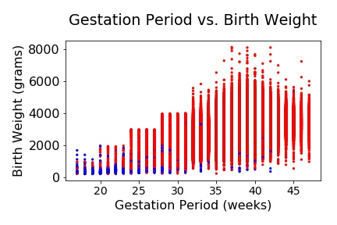
Data Exploration (Continued)
Investigate relationship between gestation period and birth weight.

Slide 9
Data Exploration (Continued)
The birth weight is significantly influenced by the gestation period.
The shorter the gestation period, the lower the birth weight is.
The figure shows infant mortality is generally related to lower birth weight and shorter gestation period (blue circles).

Slide 10
Machine Learning
Logistic Regression (LR) used to predict infant mortality/non-mortality
Challenge – data imbalance

Slide 11
Machine Learning (Continued)
One way to counteract the issue of data imbalance in classification problems is to balance the data.
There are two major methods of balancing data: under-sampling and over-sampling.
Used under-sampling algorithms:
Random Under-Sampling (RUS
RUS + TomekLinks
Edited Nearest Neighbor (ENN)
Used over-sampling algorithms:
Synthetic Minority Oversampling Technique (SMOTE)

Slide 12
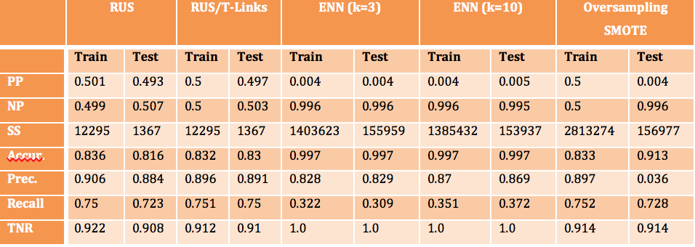
Machine Learning (Continued)
The table above shows data balanced by RUS or RUS/TomekLinks yield
results

Slide 13
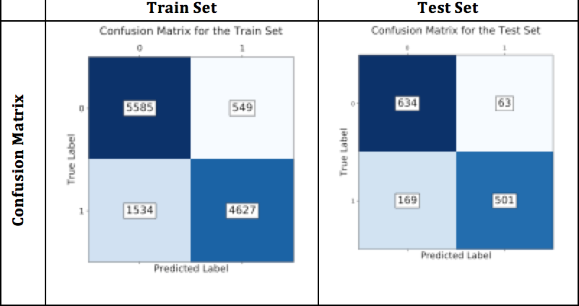
Machine Learning (Confusion matrix for data balanced by RUS + TomekLinks)

Slide 14
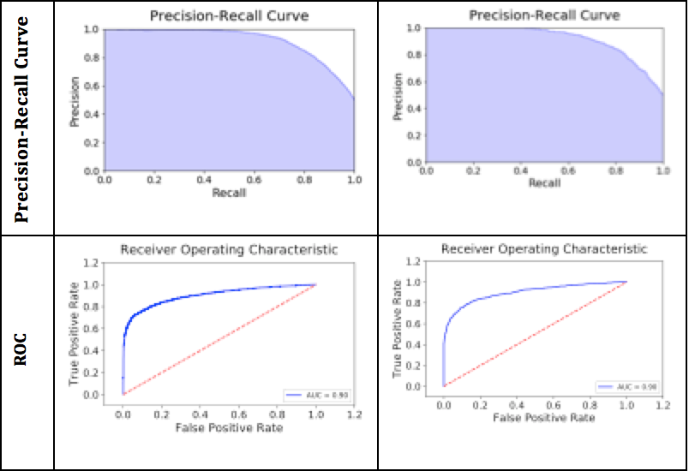
Machine Learning (Precision-Recall Curve and ROC for data balanced by RUS + TomekLinks)
Training Set
Test Set

Slide 15
Conclusion
Performance metrics indicate that pre-processing the data by removing TomekLinks followed by random under-sampling gave the best results.
Oversampling of the data (SMOTE) gives good results in accuracy, recall, and TNR, but the precision is very low.
The SMOTE based model can be used if the main objective of a project is to correctly identify most infants that die without worrying about many more infants that will incorrectly be classified to the mortality class.

Slide 16
Recommendation
The major causes of deaths for infants with high APGAR score are sudden infant death syndrome, anomalous causes of death and sudden suffocation. An intensive education is recommended to new parents of the dangers of suffocation and how to avoid it.
The effectiveness of machine learning methods depends on the availability and accuracy of data. Parents, policy makers and personnel involved in collecting data should be diligent in collecting data and constantly analyze its significance to help understand and mitigate infant death.

Slide 17
Recommendation (Continued)
The precision, recall, and accuracy for the best model in this project are 89%, 75%, and 83%. Responsible medical personnel can use the model or an improvement of the model to predict infant death.

