Slide 1
Predicting Criminal Recidivism Using Machine Learning
Capstone Project 2
(Springboard Data Science Career Track)
Shishay Bisrat
March 2018

Slide 2
Introduction
Criminal recidivism refers to the act of a person repeating a criminal offense after being released from prison for a similar offense.
The Bureau of Justice Statistics reported 67% and 76.6% of state prisoners released in 2005 were re-arrested within three and five years of release, respectively (Durose et al, 2014).
The justice system in the US predicts an individual’s recidivism potential when making key decisions such as parole, probation, and sentencing.

Slide 3
Introduction (Continued)
The court systems rely on a software called Correctional Offender Management Profiling for Alternative Sanctions (COMPAS) to predict the likelihood of recidivism.
The recidivism prediction individuals could be biased depending on one’s life experiences and perspectives.
Prediction made by software could also be biased due to fixed pre-determined weightage for variables.
Machine Learning can address some of the bias.

Slide 4
Data and data wrangling
The original data set consisted of 21,646 rows and 17 features.
Rows that do not have any value for all the features were removed from the dataset.
Any categorical entries with “NaN” values were assigned to an “unknown” group for each attribute.
The dataset is reasonably clean and the number of records in the “unknown group” is few.

Slide 5
Data and data wrangling
The cleaned dataset consists of 21,611 rows and 17 columns.
Each row represents a prisoner released from prison in the five-year period between 2010 and 2014.
One of the columns, whether an individual returned to prison within 3 years of release, is used as the label (a.k.a. target feature).

Slide 6
Data Exploration
The attributes contain information such as
Year released and year of recidivism
Race/ Ethnicity
Convicting offense classification, type, and subtype
Main supervising district
Release type
Recidivism type
New convicting offense classification, type, and subtype

Slide 7
Data Exploration
The ratio of recidivism to non-recidivism is 1:2

Slide 8
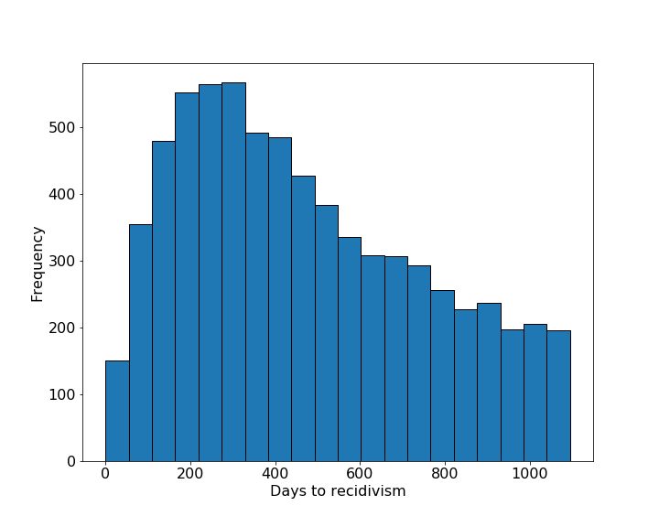
Data Exploration (Continued)
The distribution of “days to recidivism” shows most recidivism occurs between 150 to 400 days.
Most recidivism studies focus in the first 3 years after prisoner release since most prisoners, if they are ever to recidivate, they recidivate within three years.

Slide 9
Data Exploration (Continued)
The ratio of recidivism to non-recidivism is highest for the year 2014.
The average recidivism for the 5-year period is 32.5%.

Slide 10
Data Exploration (Continued)
The recidivism rate for whites (non-Hispanic), blacks, whites (Hispanic), and American Indians/Alaska natives is 33.4, 32.8, 20.9, and 39.4% respectively .

Slide 11
Data Exploration (Continued)
The recidivism rate for the age groups under 25, 25-34, 35-44, 45-54, and over 55 is 37.1%, 34.6%, 31.8%, 28.0%, and 19.1% respectively
Recidivism is highest for the age group under 25 and the lowest for age group over 55 years.

Slide 12
Data Exploration (Continued)
Although female prisoners make up only 12.6% of the total number of prisoners, the recidivism rate is 27.7%

Slide 13
Machine Learning
The positive to negative class ratio is ~1:2
The class imbalance is not as extreme as in problems in areas such as fraud detection and infant mortality
I have used under-sampling, over-sampling and combined (under-sampling followed by over-sampling) to balance the data.
The resampling step can be applied before or after splitting the dataset into train and test datasets.
I have applied resampling both before and after splitting getting contrasting results.

Slide 14
Machine Learning: Resampling
Under-sampling methods
Random Under-Sampling (RUS)
RUS/TomekLinks
Edited Nearest Neighbor (ENN)
Over-sampling methods
Synthetic Minority Oversampling Technique (SMOTE)
Adaptive Synthetic Sampling Approach (ADAYSN)
Combined methods
SMOTEENN

Slide 15
ML: Logistic Regression
Logistic regression is popular machine-learning tool for classification problems.
For binary classification, logistic regression computes the probability of an outcome by computing fitted probabilities of linear combination of predictors.
Sigmoid function is used to constrain the result of the linear combination to be between 0 and 1.

Slide 16
ML: Logistic Regression
The logistic regression function in sklearn has three options for the norms used in penalization.
I used the default, norm L2 regularization, in this study.
Performance evaluation using
values (accuracy, precision, recall, TNR, area under the curve—AUC)
tables (confusion matrix table)
curves (precision-recall curve, receiver operating characteristic—ROC—curve)

Slide 17
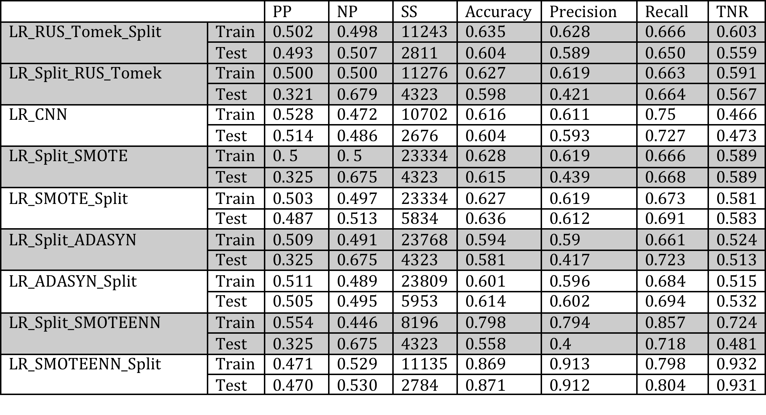
ML: Logistic Regression Result
The performance indicators show the best model is the model built by using SMOTEENN resampling technique, followed by splitting the dataset into train and test sets.

Slide 18
ML: Logistic Regression Result
Confusion Matrix

Slide 19
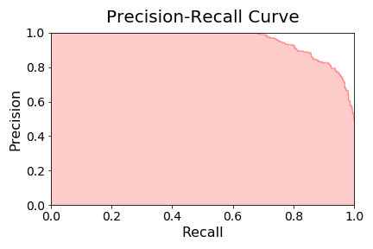

ML: Logistic Regression Result
Test Set
Train Set

Slide 20
ML: Random Forest
Decision trees are generated from the binary splitting of variables at nodes with similar cases grouped in the same branches.
Random Forest grows many classification trees with each tree giving a classification.
The random forest chooses the classification by choosing the most votes over all the trees in the forest or averaging the trees’ probabilistic prediction.
Random Forests are used widely for classification problems due to their high accuracy and efficiency when dealing with large databases.
I use the RandomForestClassifier method from the sklearn.ensemble module

Slide 21
ML: Random Forest
The two main parameters when using Random Forest Classifier are the number of trees in the forest and the size of the subset of features randomly selected at each split.
I OOB—score to choose the best number of trees and subset of features. OOB score is a measure of accuracy of a model when it is fed samples not included when training the model.
The average OOB score versus number of estimators’ plot shows that there is not significant difference in performance whether the number of estimators used is log2 or square root of number of features.

Slide 22
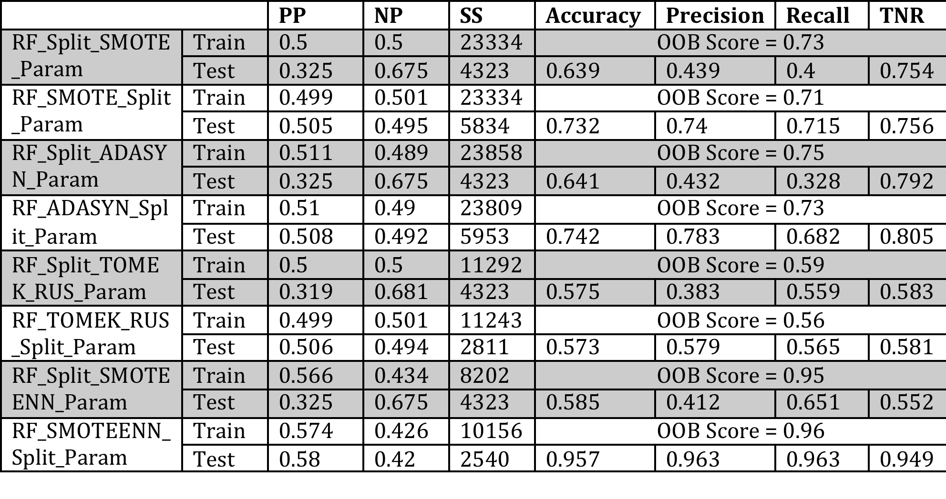
ML: Random Forest Result
The performance indicators show the best model is the model built by using SMOTEENN resampling technique, followed by splitting the dataset into train and test sets.

Slide 23
ML: Random Forest Result
Confusion Matrix

Slide 24
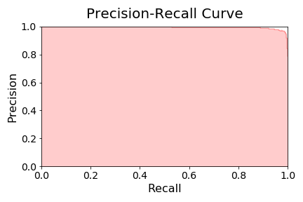
ML: Random Forest Result
Test Set

Slide 25
Conclusion
Prediction of recidivism also plays a great role in decisions related to parole, probation and sentencing. In this study, I explored the predictive capability of two common machine learning classification algorithms namely logistic regression and random forests.
The logistic regression model has good accuracy comparable to accuracy values in the literature. The model has similar performance on both the train and test data sets showing no indication of over-fitting.
The prediction results show that random forests outperformed logistic regression. This could be explained by the fact that random forest algorithm is appropriate for capturing non-linear relationships in datasets which potentially involve complex higher-order interactions.

Slide 26
Recommendation
The justice system uses recidivism prediction to make decisions on probation, parole, and sentencing. The predictions based on software or individuals can be biased. Some states such as Pennsylvania have started using machine learning to predict recidivism.
Understandably, there is some concern by many people, who want to know what goes “under the hood” before embracing machine learning based predictions. The excellent performance of machine learning algorithms in predicting recidivism should convince more states to take advantage of such advances.
In this study, random forest model trained on SMOTEENN resampled data is the best model. Random forest models are intuitive and can easily be explained to relevant personnel.
The best model is generally expected to have high performance metrics such as accuracy, precision, recall, and AUC. Some models can be better at certain metrics but worse at other metrics.

Slide 27
Recommendation
The purpose of the model dictates the choice of the best model. For example, for violent offenders, the justice system may want to err on safety side, preferring low False Negative Rate at the cost of incorrectly identifying non-recidivists as recidivists (i.e. higher False Positive Rate).
It is recommended to start with the objective (e.g., is the interest violent recidivism or general recidivism? Is it preferred to identify as many potential recidivists at the cost of classifying non-recidivists as recidivists?) and then select the best model.

