Slide 1
Reconstructing Peripheral Inputs from Captured USB Traffic
ECEN 522R
Sebastian Hayes & Jordan Williams

Slide 2
Human Interface Devices (HID) Data
HIDs include keyboards, mice, game controllers, and more.
HID data represents the interaction between these devices and computers.
Standardized protocols ensure seamless communication and usability.
Focus on the movement of input data from devices to the operating system.

Slide 3
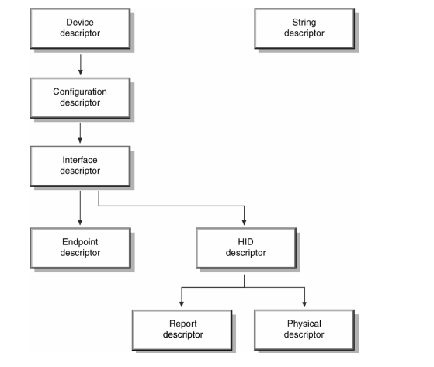
HID Descriptors

Slide 4
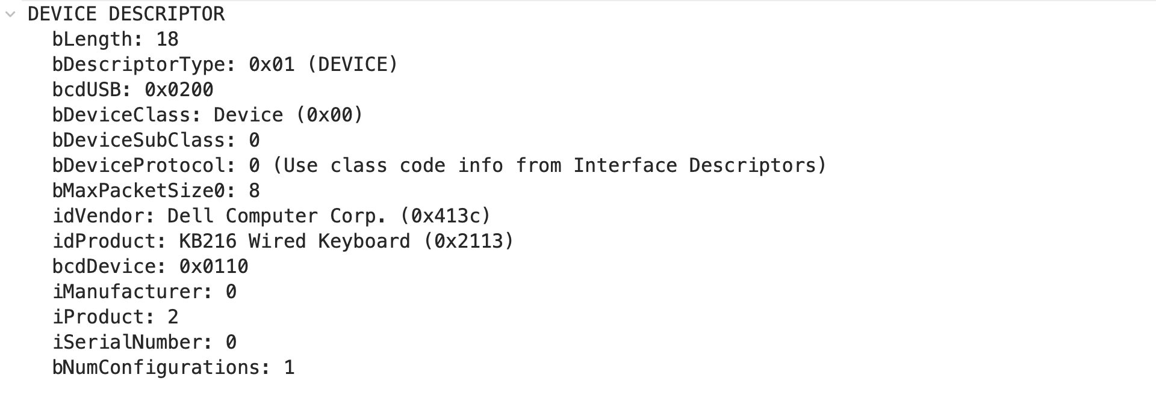
HID Device Descriptor

Slide 5
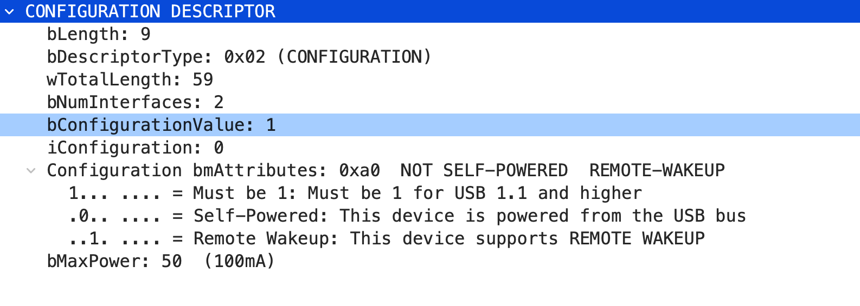
HID Formatting

Slide 6
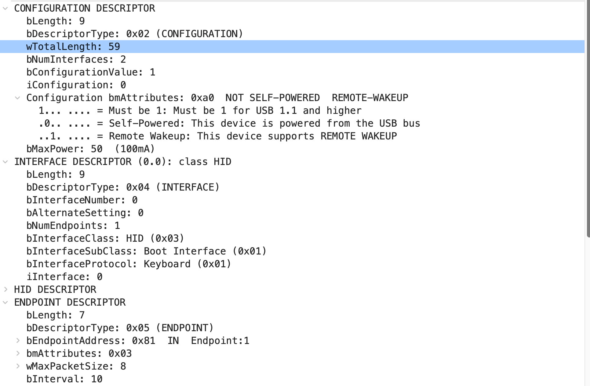
HID Formatting

Slide 7
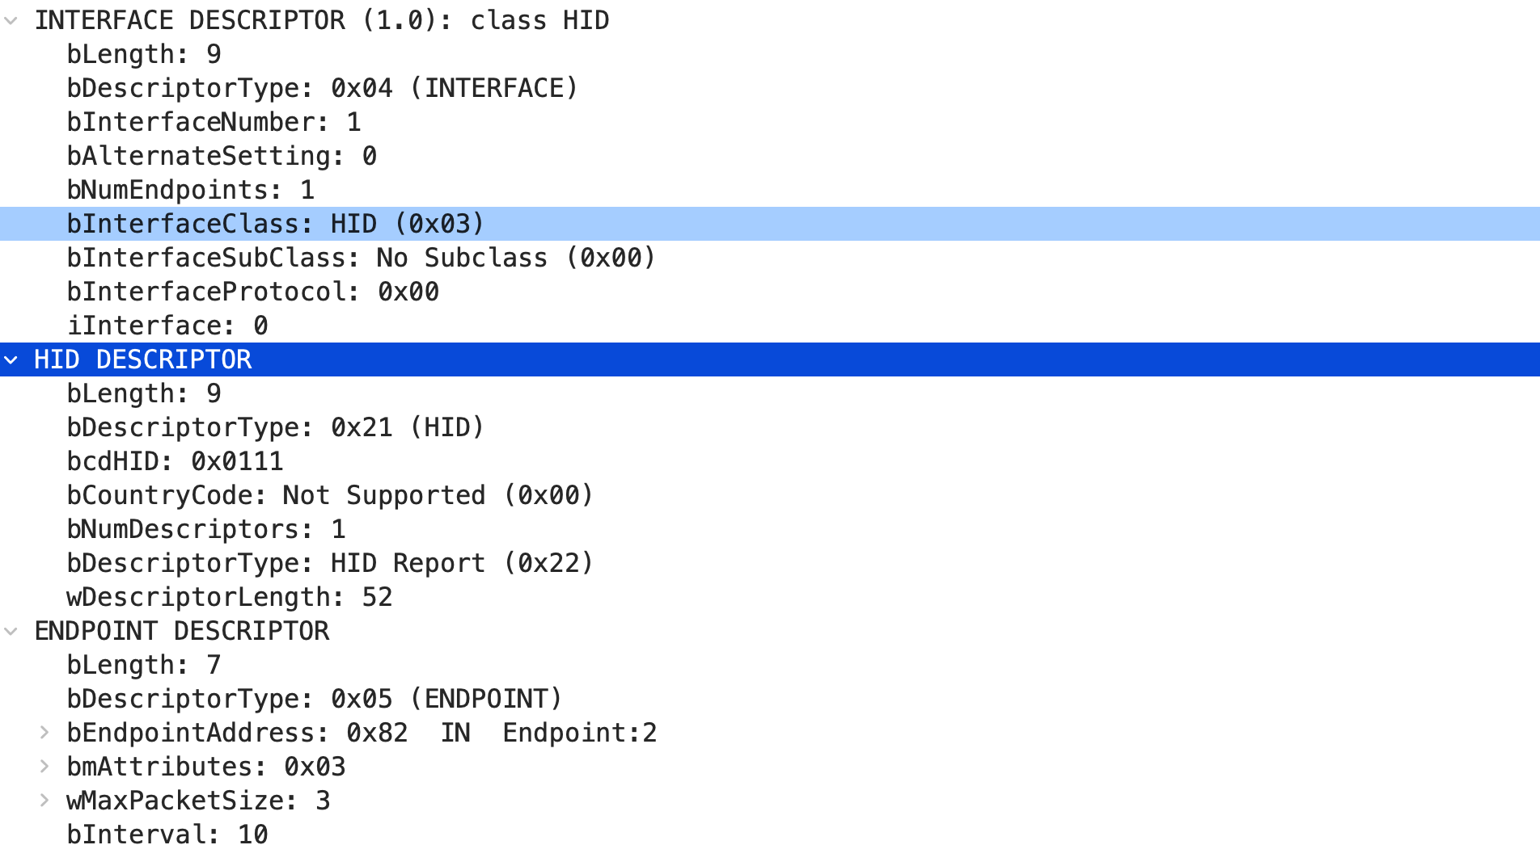
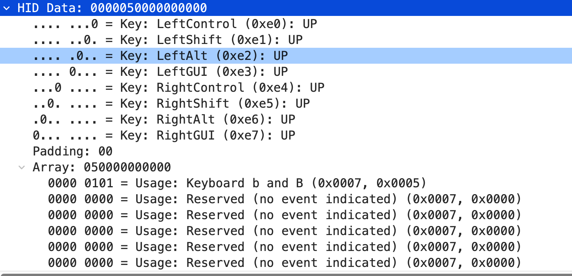
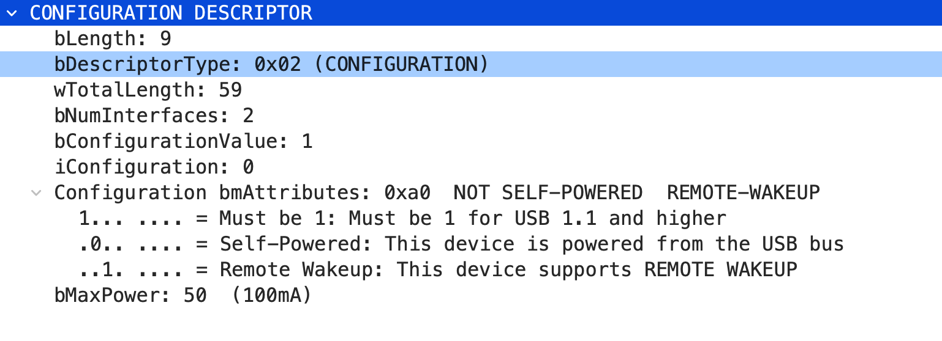
HID Formatting

Slide 8
HID Data

Slide 9

Capturing Traffic
Monitor USB device communication for debugging, security audits, or reverse engineering.
Hak5 Key Croc:
A covert keystroke logger for capturing USB keyboard traffic.
Operates transparently, logging data without disrupting functionality.
Ideal for quick, hardware-based USB traffic analysis.
Wireshark:
A powerful network protocol analyzer for capturing USB packets on supported systems.
Provides detailed insights into USB protocol layers and data transactions.
Requires proper setup for USB interface monitoring.

Slide 10
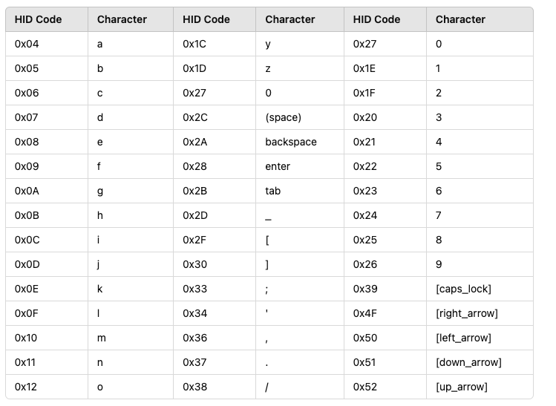
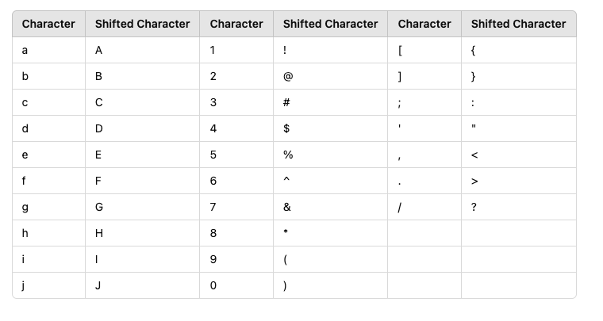
Hex Conversions

Slide 11
Dell Keyboard
0000050000000000
00001c0000000000
0000180000000000
0000060000000000
0000170000000000
0000090000000000
02002f0000000000
0000180000000000
0000160000000000
0000050000000000
02002d0000000000
0000070000000000
0000210000000000
0000170000000000
0000210000000000
02002d0000000000
00001e0000000000
0000160000000000
02002d0000000000
0000160000000000
0000270000000000
02002d0000000000
0000060000000000
0000270000000000
0000270000000000
00000f0000000000
0200300000000000
Byte[0] – Special Keys
Byte[2] – Keyboard Value

Slide 12
Mac Keyboard
0000050000000000
00001c0000000000
0000180000000000
00001d0000000000
00002a0000000000
0000060000000000
0000170000000000
0000090000000000
02002f0000000000
0200070000000000
0000210000000000
02002d0000000000
00001e0000000000
0000160000000000
02002d0000000000
0000160000000000
0000270000000000
02002d0000000000
0000060000000000
0000270000000000
0000270000000000
00000f0000000000
0200300000000000
Byte[0] – Special Keys
Byte[2] – Keyboard Value

Slide 13
Razor Keyboard
01001c00000000000000000000000000
01001800000000000000000000000000
01000600000000000000000000000000
01001700000000000000000000000000
01000900000000000000000000000000
01022f00000000000000000000000000
01020000000000000000000000000000
01021a00000000000000000000000000
Byte[0] – Keyboard
Byte[1] – Special Keys
Byte[2] – Keyboard Value

Slide 14
Dell Mouse
01000100
01000100
01000100
01000200
01000100
01000100
00ff0100
Byte[0] – Mouse click
Byte[1] – X
Byte[2] - Y

Slide 15
Razor Mouse
00000000fbfffdff
00000000f3fff7ff
00000000f0fff4ff
00000000eefff2ff
00000000edfff3ff
00000000eefff6ff
00000000f0fff9ff
00000000effffbff
00000000f2fffeff
00000000f0ffffff
00000000f6ff0000
Byte[5] –
Byte[6] –
Byte[7] –
Byte[8] -

Slide 16

Questions

