Slide 1
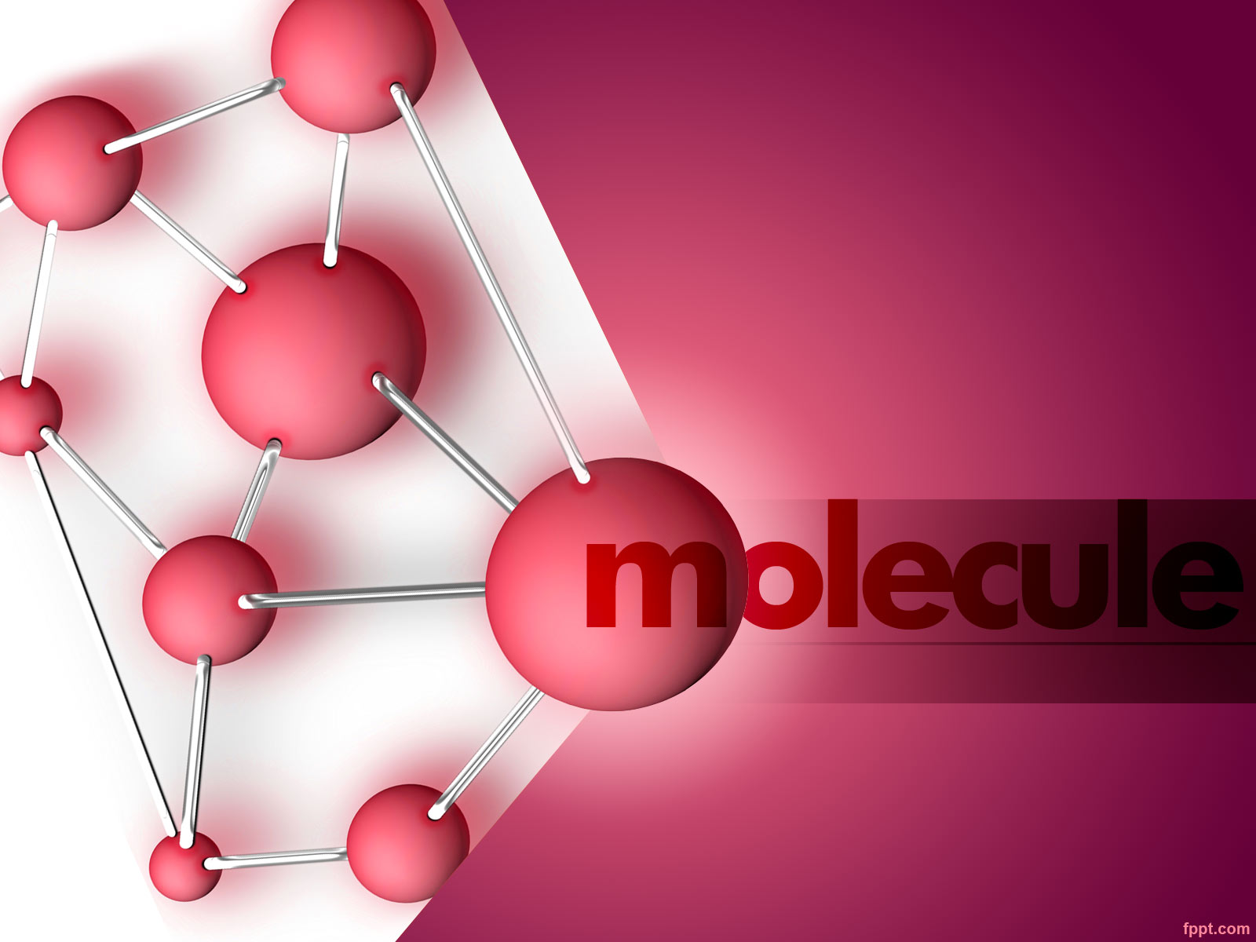
Effective Graph Classification Based on Topological and Label Attributes
By : Hamid Shayesteh-manesh

Slide 2
What is our problem ?
Related Work
Graph Attribute For Classification
Datasets
Feature Importance Study
Augmented Topological Features
References
Questions!

Slide 3
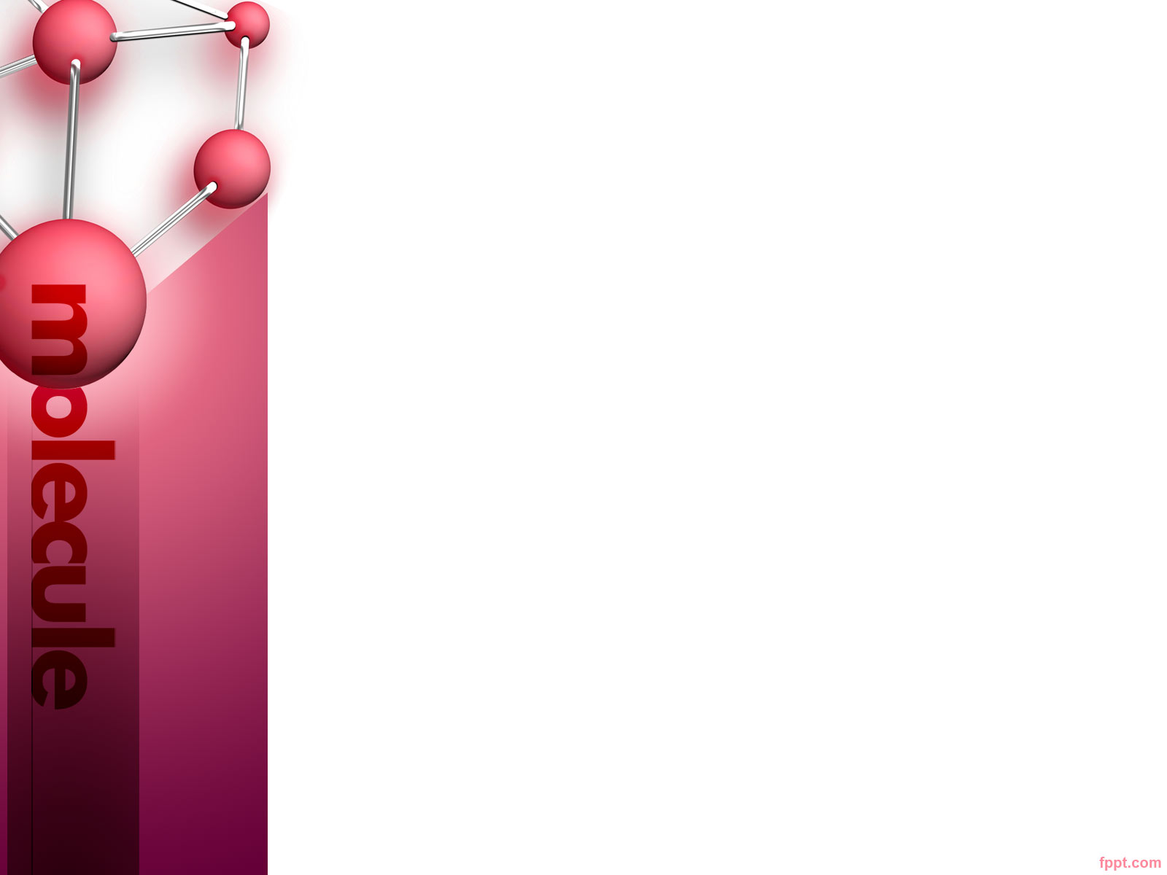
What is Our Problem ? Graph Classification
Graph classification is an important data mining task, and various graph kernel methods have been proposed
Your Samples are Graph.
Such as Enzymes

Slide 4
Related Work
Graph kernels compute the similarity between pairs of graphs, based on the common patterns they share, such as
Random Walk Kernels
Shortest Path Kernels
Cyclic Pattern Kernels
Graphlet and Subgraph Kernels

Slide 5
Random Walk Kernels
The similarity of two graphs can be quantified by counting labeled walks that are common to both of them.
One of first Ideas
Complexity O(n^3) – BEST!!!
One potential problem with these kernels is that artificially high kernel values may be obtained by repeatedly visiting same nodes and edges multiple times

Slide 6
Graph Attribute
Many sophisticated graph kernels have been proposed, efficiency and scalability remain as challenges
Our basic idea is to compute several topological and label attributes for each graph
And we use the SVM as classifier of choice
And 10 times 10 fold

Slide 7
Graph Attributes
Average Degree
Average Clustering coefficient
Average Effective Eccentricity
Max Effective Eccentricity
Min Effective Eccentricity
Average Path Length (Closeness Centrality )
Percentage of Central Points
Giant Connected Ratio
Percentage of Isolated Points
Percentage of End Points
Number of Nodes
Number of Edges

Slide 8
Graph Attribute For Classification
Spectral Radius
Second Largest eigenvalue
Trace
Energy
Number of Eigenvalues
Label Entropy
Neighborhood Impurity
Link Impurity

Slide 9
Graph Attributes Complexity
Number of Nodes and Number of Edges are O(1)
Degree Based Attributes such as percentage of isolated or end points and average degree can be computed in linear time.
Also the Giant Ratio is linear

Slide 10
Graph Attributes Complexity
The Clustering Coefficient , O(nd^2) where d is max degree
Eccentricity-based features and the average path length can be easily computed from the all-pairs SP matrix, which can be computed in O(n^2 + nm) and features can be computed from SP matrix in O(n^2)

Slide 11
Graph Attributes Complexity
For eigenvalue-based features , as much as Graphs in real world are sparse so all the eigenvalues can be computed is O(n^2).
Finally, label entropy can be computed in O(n) , neighborhood impurity can be computed in O(nd) where d is max deg
And link impurity can be computed in O(n+m)

Slide 12
Datasets
PTC ( 4 datasets )
Mutag
NCI1
NCI109
Enzymes

Slide 13
Datasets -Results
Datasets | Size | Classes | No-Normal | Range-Normal | Z-Normal
MUTAG | 188 | 2 | 90 +- 7 | 83.5 +- 9.4 | 86.1 +- 8.1
NCI1 | 4110 | 2 | 52 +- 2.3 | 52 +- 2.5 | 55 +- 2.3
NCI109 | 4127 | 2 | 51.9 +- 1.6 | 52 +- 2.7 | 55 +- 1.8
PTC(MM) | 395 | 2 | 57.4 +- 3 | 53.1 +- 5.8 | 53.9 +- 3.9
PTC(FM) | 407 | 2 | 55.2 +- 5.9 | 48.4 +- 8.2 | 48.8 +- 5.7
PTC(MR) | 399 | 2 | 50.8 +- 6 | 51.8 +- 6.6 | 55.9 +- 7
PTC(FR) | 407 | 2 | 60.2 +- 8 | 55.2 +- 6.9 | 55.8 +- 4.3
Enzymes | 600 | 2 | 79.9 +- 4.8 | 25.8 +- 5.4 | 16.7 +- 4.7

Slide 14
Datasets
The Only dataset which is same with the paper is MUTAG
PTC dataset has change too much, how ?

Slide 15
Datasets -Results
Datasets | Train Size | Test Size | Classes | No-Normal – Test, Train | Range-Normal – Test, Train | Z-Normal – Test, Train
PTC(MM) | 192 | 203 | 2 | 80.7 – 78.1 | 83.2 – 64.05 | 83.2 – 98.4
PTC(FM) | 204 | 203 | 2 | 74.8 – 77.9 | 78.3 – 60.8 | 78.3 - 99
PTC(MR) | 196 | 203 | 2 | 61.5 – 80.1 | 73.8 – 64.2 | 73.8 – 98.4
PTC(FR) | 204 | 203 | 2 | 71.9 – 80.3 | 81.2 – 69.1 | 81.2 – 99.5

Slide 16
Feature Importance Study
Datasets
Mutag | Average Clustring Coefficient | Min Effective Eccentricity | Trace | Average Deg | Number of Edges
NCI1 | Number of Edges | Spectral Radius | Average Clustring Coefficient | Min Effective Eccentricity | Neighborhood Impurity
NCI109 | Number of Edges | Spectral Radius | Average Clustring Coefficient | Min Effective Eccentricity | Neighborhood Impurity
Enzymes | Average Clustring Coefficient | Min Effective Eccentricity | Trace | Average Deg | Number of Nodes

Slide 17
Augmented Topological Features
Eigen-exponent
Hop-Plot exponent
Averaged current-flow closeness centrality
Degree assortativity coefficient
Number of Cliques
Average neighbor degree
Transitivity
Periphery
Cycle basis
Square clustering coefficient

Slide 18
Datasets -Results
Datasets | Size | Classes | No-Normal | Range-Normal | Z-Normal
MUTAG | 188 | 2 | 89.8 +- 6.4 | 83.7 +- 8.4 | 86.3 +- 10.1
NCI1 | 4110 | 2 | 52.1 +- 2.2 | 52.6 +- 2.1 | 55 +- 2.1
NCI109 | 4127 | 2 | 52 +- 2.7 | 52.1 +- 1.9 | 55 +- 2.6
PTC(MM) | 395 | 2 | 63.9 +- 8.5 | 54.9 +- 4 | 55.1 +- 5
PTC(FM) | 407 | 2 | 63.2 +- 6 | 54.4 +- 6.6 | 54.8 +- 4.6
PTC(MR) | 399 | 2 | 61.2 +- 5.1 | 55.3 +- 4.3 | 55.7 +- 5.7
PTC(FR) | 407 | 2 | 62.5 +- 5.5 | 55.2 +- 5.6 | 55.4 +- 4.4
Enzymes | 600 | 2 | 88.5 +- 3.6 | 26.3 +- 5.4 | 16.7 +- 4.3

Slide 19
References
Effective Graph Classification Based on Topological and Label Attributes – Geng Li, Murat Semerci, Bulent Yener and Mohammed Zaki

Slide 20
Questions ?

