Slide 1
Group 1
Progress Update
19/08/14

Slide 2


No Rest for Group 1!
Gtest
Subclassing
Project Deliverables

Slide 3

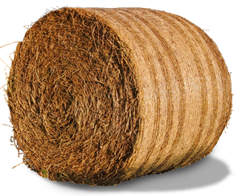
Current Tasks
Algorithm
Synthesis
Finalise
Extra
Feature
Group
Reflection
Notes:
Current tasks: Breaking down each robot into an algorithm we can implement

Slide 4
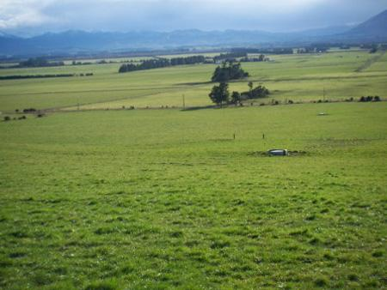

Future Tasks

Slide 5

Current Difficulties
Rostest
Time constraints with upcoming test and assignments due

