Slide 1
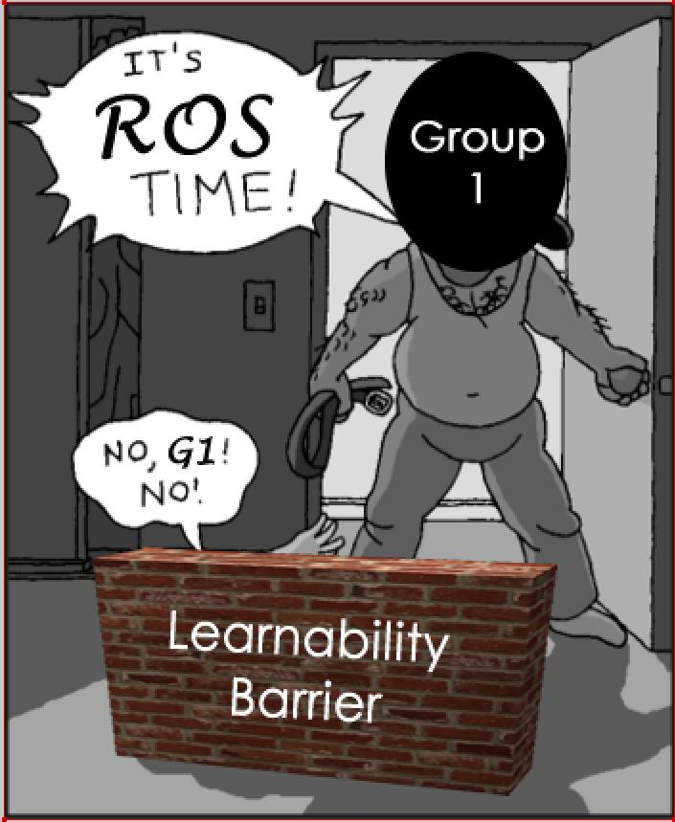
Group 1
Progress Update 14/08/14

Slide 2

A Violent Thunderstorm of Innovation
Probabilistic Modelling
Photorealistic House
Reactive
Navigation
Communication Realism
Advanced Scheduling
http://dc443.4shared.com/img/Viq0cJe_/s7/13c9ac13d88/Thunderstorm.jpg
Notes:
Michael: Run through how we branched out to create features and prototypes. Briefly walk through each feature but be as ambiguous as possible so groups don’t mimic us exactly.

Slide 3


Current Task
Integration of prototyped features into alpha
“In the midst of chaos, there is also opportunity”
Sun Tzu, The Art of War
http://us.123rf.com/450wm/cappan/cappan1306/cappan130600049/20308766-fantasy-blue-lightning.jpg
Notes:
Michael: Talk about how we are integrating the previous slide’s features into tomorrow’ alpha.

Slide 4

Future Tasks
Number of Innovations
Requirements
Analysis
Design
Coding
Test & Acceptance
Time and Quality
http://i.kinja-img.com/gawker-media/image/upload/s--j0e8yWw6--/18kzki3ibdwyujpg.jpg
Notes:
Bert: Talk about funnelling ideas as discussed at the meeting. Talk briefly about some future ideas we are going to implement, but not in too much detail.

Slide 5

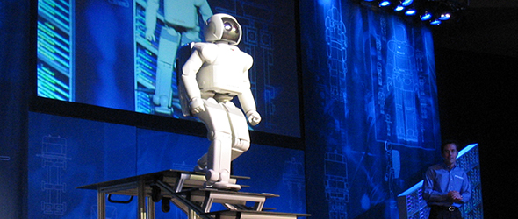
Difficulties Experienced
Effective navigation/path-finding algorithm
Managing workload with other courses
http://www.pcog.org/wp-content/uploads/2010/04/AsimoStairs.jpg
http://fc04.deviantart.net/fs71/f/2011/106/4/7/alien_navigation_by_prelkia-d3e3ojw.png
Notes:
Tommy: Talk about these 2 points. Pretty straight-forward.

