Slide 1

Group 1 “Striving for Excellence in Healthcare Simulation Software”
Notes:
Shay: Introduce self

Slide 2
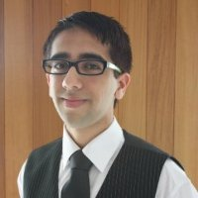
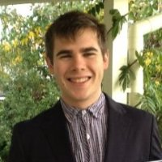
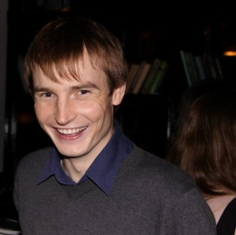
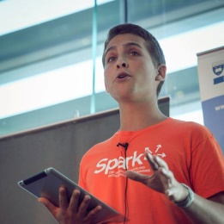
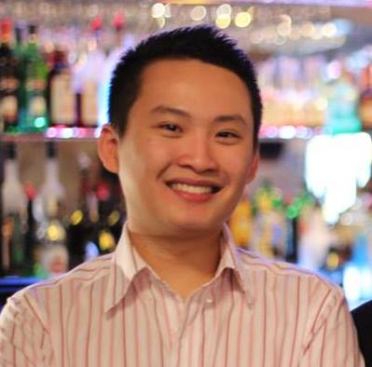
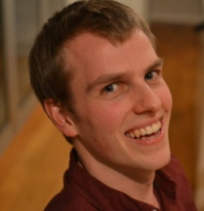
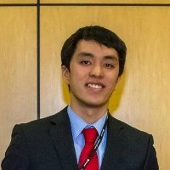
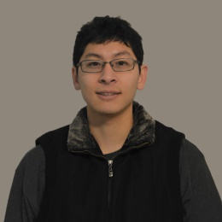
Akshay Kalyan
Project Manager
James Butler
Planning,
Stage
Nicholas W.
Navigation
Hugo Bateman
Planning,
Stage
Tommy Ngo
Navigation
Michael Shafer
Roslaunch and
Build Scripts
Matthew Chiam
Events, Marketing
Bert Huang
Client Architect

Slide 3


Project Goals
Settle for less?
Just another boring university project?
Innovative and revolutionary healthcare simulation using swarm robotics.

Slide 4
Alpha Goals
Bare minimum.
Plain functionality.
Group 1 exceeding expectations for the client.

Slide 5

lpha Demo

Slide 6
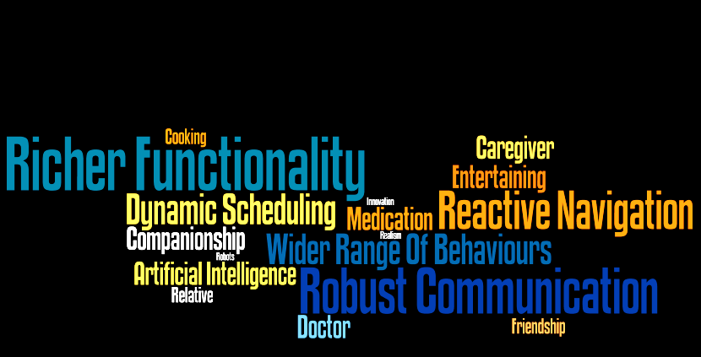
Post-Alpha Goals

Slide 7


Slide 8

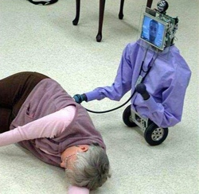
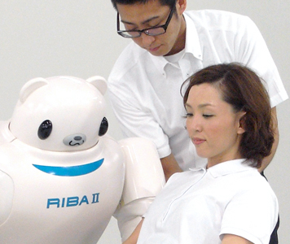


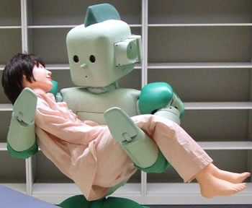
Group 1
http://www.mynursingdegree.com/images/Ri-Man-robot.jpg
http://www.akihabaranews.com/wp-content/uploads//images/6/76/103576/1.jpg
http://www.blogcdn.com/www.engadget.com/media/2009/11/irobot-healthcare-11-05-09.jpg

Slide 9

Thank you for listening.
http://www.globalroboticsinstitute.com/sites/default/files/image_selects/img-asset_about_institute.png

Slide 10
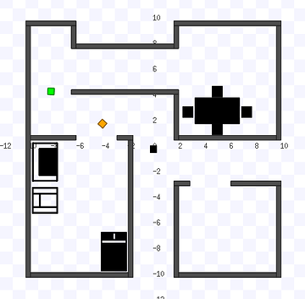

Slide 11
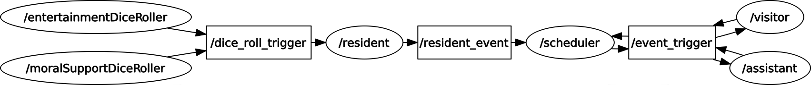

Slide 12
