Slide 1
Group 1
Progress Update
29/07/14
Notes:
Akshay – Briefly introduce self and role with regards to team [30 seconds]

Slide 2
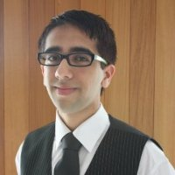
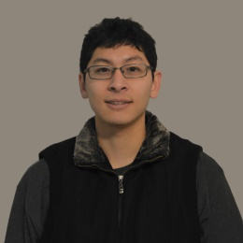
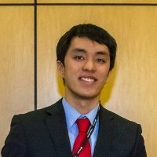
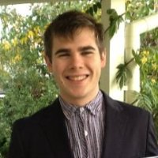
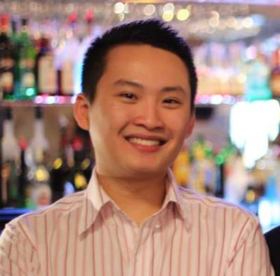
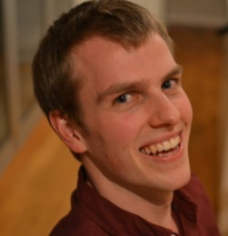
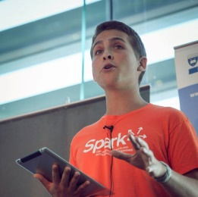
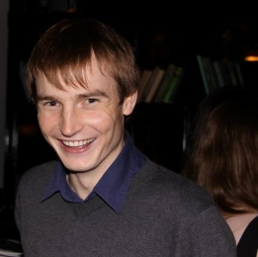
Organisational Structure
Akshay Kalyan
Project Manager
Bert Huang
Stage
Matthew Chiam
Services
James Butler
Planning
Tommy Ngo
Navigation
Michael Shafer
Roslaunch and
Build Tools
Hugo Bateman
Planning
Nicholas W.
Navigation
Notes:
Akshay – Talk about the roles of each person, introduce each team member [1 minute]

Slide 3
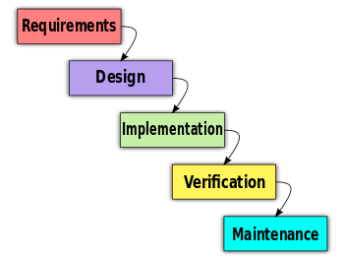
Initial Performed Tasks
Training to ensure group is familiar with ROS
Found suitable test framework
Git setup
http://rossgkinney.com/wp-content/uploads/2013/07/Waterfall_model_1.svg_.png
Notes:
Hugo – Talk about the bullet points. No need to mention where we are in the waterfall model as everyone and Bruce will already know. [1 minute]

Slide 4
Task Roadmap
Requirements Analysis
Create Project Plan
Alpha Release
Notes:
Hugo – Broad explanation of our plan ahead. Requirements analysis to be explained more detail. [1 minute]

Slide 5
Difficulties Experienced
Effectiveness
Usefulness
ROS Familiarisation
Learnability Barrier
Notes:
Nick – Talk about current struggles with getting everyone accustomed to ROS, and how we are trying to overcome that by splitting up the learning [1 minute]

