Slide 1
Group 1
Progress Update
07/08/14
Notes:
James: nothing much to say here

Slide 2
Learning ROS:
Effectiveness
Usefulness
Concept Breakdown
Specialised Learning
Learnability Barrier: BROKEN!
Notes:
James: talk about how we’re tackling the learnability barrier by getting each group member to specialise in certain aspects of ROS [1 minute]

Slide 3
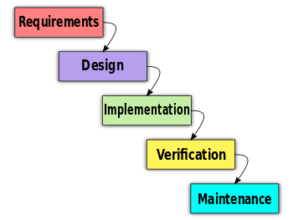
Current Tasks:
Finalising project plan
Allocating of tasks
http://rossgkinney.com/wp-content/uploads/2013/07/Waterfall_model_1.svg_.png
Notes:
Matthew: [1 minute]

Slide 4
Future Tasks:
Drafting ROS project structure
Designing communication between components
http://rossgkinney.com/wp-content/uploads/2013/07/Waterfall_model_1.svg_.png
Notes:
Tommy: Talk about what we intend for future tasks after our project plan is approved (pretend we haven’t started yet as it doesn’t make sense for us to start designing before approval) – (1) deciding on overall structure of solution (2) discussing how nodes communicate using services/topics [1.5 minutes]

Slide 5

Difficulties Experienced:
Allocating tasks evenly across group members can be challenging!
Time to complete task often underestimated due to bug-fixing.
http://www.vizioshop.com/en/T-shirt-Confused-Robot-91574-1.png
Notes:
Bert: Talk about how difficult it is to allocate tasks, primarily because it’s hard to estimate how long a particular implementation might take – most of it is debugging! (We know what we want to do -> tough to implement!) [1 minute]

