Slide 1
Group 1 “Striving for Excellence in Healthcare Simulation”
Notes:
Shay: Introduce self

Slide 2

Progress Update
1.0
Basic Functionality
Random Events
Richer Functionality
Probabilistic Modelling
Dynamic Path-finding
Displacement Handling
Event Concurrency
Event Dependencies
Event Priorities
Event Injections
State Visualisation
Model Improvements

Slide 3
1.0

Slide 4
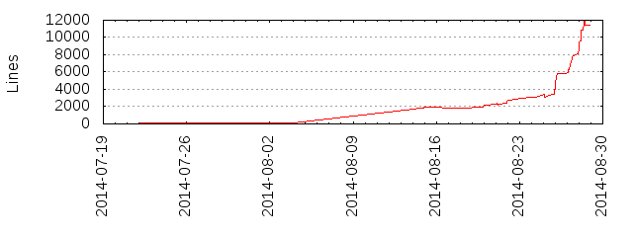
Hugo | James | Akshay | Matthew
38 commits 3001 line additions 1496 line deletions | 44 commits 3599 line additions 592 line deletions | 99 commits 1597 line additions 1278 line deletions | 62 commits 3225 line additions 1008 line deletions
Bert | Tommy | Michael | Nicholas
54 commits 3439 line additions 1661 line deletions | 39 commits 1711 line additions 912 line deletions | 56 commits 1946 line additions 1091 line deletions | 99 commits 4288 line additions 3190 line deletions

Slide 5

Thank you for listening.
http://www.globalroboticsinstitute.com/sites/default/files/image_selects/img-asset_about_institute.png

Slide 6


Slide 7
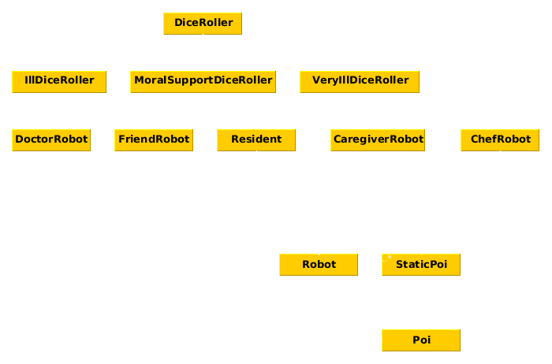

Slide 8
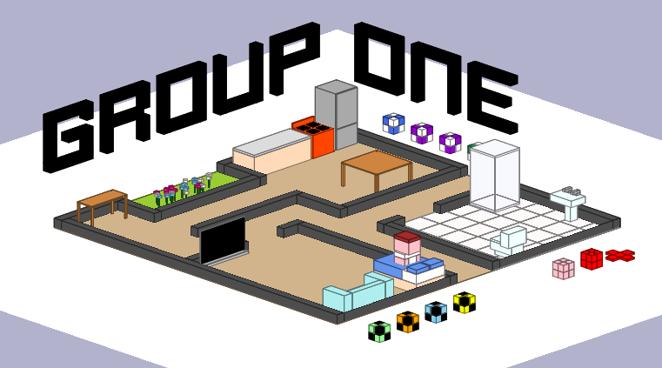

Slide 9
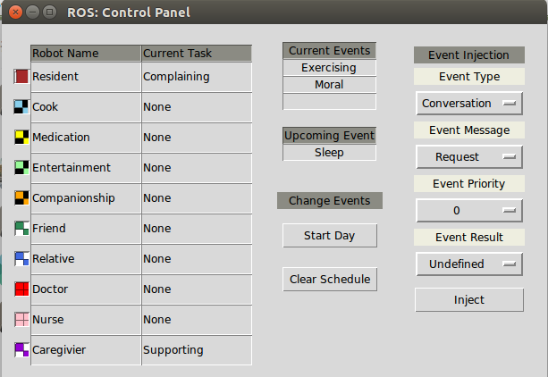
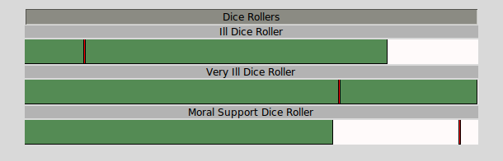

Slide 10
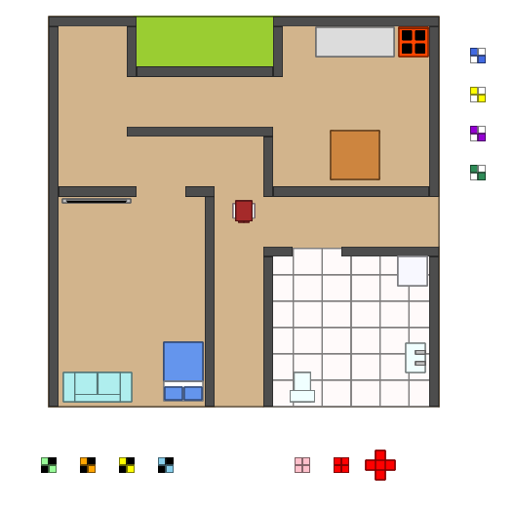
1.0

Slide 11
