Slide 1
Pretty good sum

Slide 2
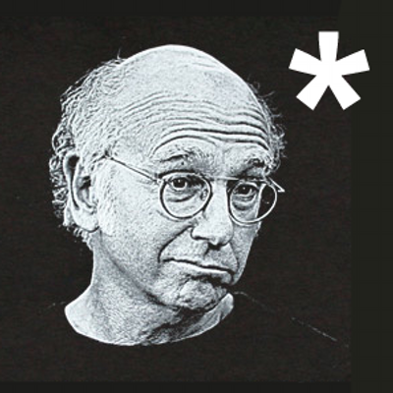

Slide 3
Algebraic data types

Slide 4
Theory
Algebraic data types are a kind of composite type
That is, a type formed by combining types
There are two common classes of algebraic type
Products
Sums
The terms product and sum (co-product) come from category theory

Slide 5
Practice
Examples of products in C++:
Structure types e.g. struct type_name { member_type1 member_name1; member_type2 member_name2; ... };
Tuple types e.g. std::tuple<int, double, std::string>
Indeed, one can view structures as tuples where the fields are named for the corresponding projection function

Slide 6
Practice
Examples of sum types in C++:
Enumerated types e.g. enum colors={red, blue, green}; // … switch (c) { case red: // … case blue: // … // … }

Slide 7
Practice
Discriminated union types e.g. struct poly_var { int type; union { int w; double num; char* str } val; };
boost::variant<int, double, char*>
bdetu_Variant<int, double, char*>

Slide 8
practice
Inheritance e.g.
struct airplane_seat { /* … */ };
struct economy_seat : airplane_seat { /*… */ };
struct first_class_seat : airplane_seat { /* ... */ };
void book (airplane_seat* seat) {
if (first_class_seat* s =
dynamic_cast<first_class_seat*> (seat)){
// ...
}
else {
// ...
}
}

Slide 9
practice
Side notes:
Support for sum types in C++ has been limited
Situation somewhat improved in C++11 with unrestricted unions and variadic templates
std::variant<> coming soon to a standard near you

Slide 10
Sums with constructors

Slide 11
Sums with constructors
OCaml syntax: type expr = Num of int | Add of expr * expr
expr is a (recursive) sum type of two cases
The symbols Num and Add are termed “constructors”
An example value of type expr (1 + (2 + 3)): let e : expr = Add (Num 1, Add (Num 2, Num 3))

Slide 12
Sum deconstruction (match)
Sums are good where programming naturally proceeds via “case” let evaluate (e : expr) : int = match e with | Num i -> i | Add (u, v) -> (evaluate u) + (evaluate v)
Lots of data structures are naturally expressible as sums

Slide 13
Pretty good sum type
The “Pretty Good Sum” library brings sums with constructors to C++ struct Num; struct Add; using expr = pgs::sum_type< Num, recursive_wrapper<Add> >; struct Num {int i; //…}; struct Add {expr l; expr r; //…};

Slide 14
Constructing sums
An example value of type expr (1 + (2 + 3)): expr e{
constructor<Add>{},
expr{constructor<Num>{}, 1},
expr{constructor<Add>{},
expr{constructor<Num>{}, 2},
expr{constructor<Num>{}, 3}}
}; Verbose. We can do better…

Slide 15
Reduce syntactic verbosity
An example value of type expr (1 + (2 + 3)): //Factory functions
expr num (int i) {
return expr{constructor<Num>{}, i};
}
expr add (expr const& u, expr const& v) {
return expr{constructor<Add>{}, u, v};
}
expr e = add (num (1), add (num (2), num (3))); Much better.

Slide 16
Pattern matching
Deconstructing expressions int evaluate (expr const& e) { return e.match<int> -> int ( [](Num const& n) {
return n.i
}, [](Add const& op) {
return evaluate (op.l) + evaluate (op.r);
} ); }

Slide 17
Pattern matching
In some contexts, the full generality of match<> is more than needed e.g.
if (e.is<Num> ()) {
E_num const& n = pgs::get<Num> (e);
// ... do something with n
}

Slide 18
examples

Slide 19
Example : optional
Consider a pointer : either it is nullptr or, it can be dereferenced
Types boost::optional<T> and bdet_NullableValue<T> have similar semantics : either a given instance is a valid T or is “missing”
Such types are sums with two cases type ‘a option = Some of ‘a | None

Slide 20
Example : optional
In C++ using pretty good sums we can implement α option like this template <class T>
struct Some { T data; //ctor };
struct None {};
template<class T>
using option = sum_type<Some<T>, None>;

Slide 21
Example : functional lists
Lists are empty or non empty sequences of elements type α list = Nil | Cons of α * α list

Slide 22
Example : functional lists
In C++ template <class T> struct cons_t; // Case 1
struct nil_t {}; // Case 2
template <class T> using list =
sum_type <recursive_wrapper<cons_t<T>>, nil_t>; template <class T>
struct cons_t {
T hd;
list<T> tl;
// ctors… };

Slide 23
Example : Binary search trees
In OCaml, type (α, β) tree =
Empty
| Node of (α * β) * (α * β) tree * (α * β) tree
In C++,
struct empty_t {}; template <class T, class V> struct node_t;
template <class K, class V>
using tree = sum_type <empty_t, recursive_wrapper<node_t<K, V>>>;

Slide 24
Example : Binary search trees
template <class K, class V>
struct node_t {
using tree_type = tree<K, V>;
using value_type = std::pair<K, V>;
value_type data;
tree_type left_child; tree_type right_child;
//ctors... };

Slide 25
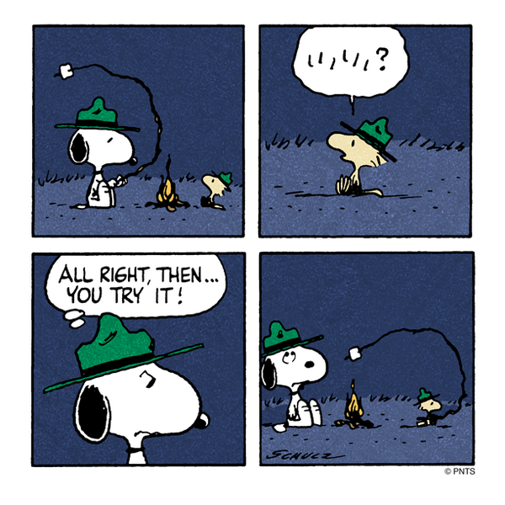
Notes:
Wouldn’t be a QDLA presentation without Snoopy!

