Slide 1
Pretty good sum

Slide 2
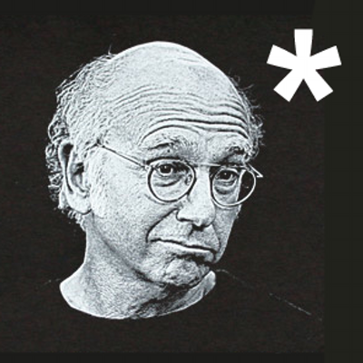

Slide 3
Algebraic data types (‘n all that)

Slide 4
Why sums?
Algebraic data types are a kind of composite type
That is, a type formed by combining types
There are two common classes of algebraic type
Products
Sums
To understand this better we need to (lightly) look at a little (category) theory…

Slide 5
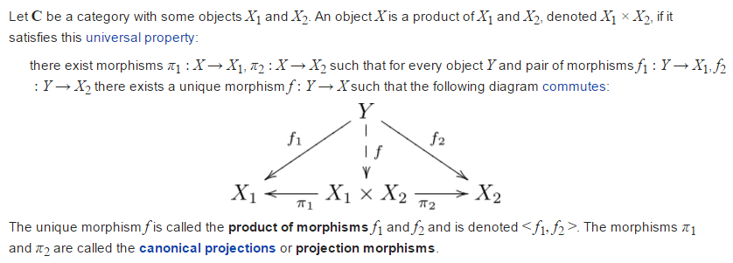
Theory : Products

Slide 6
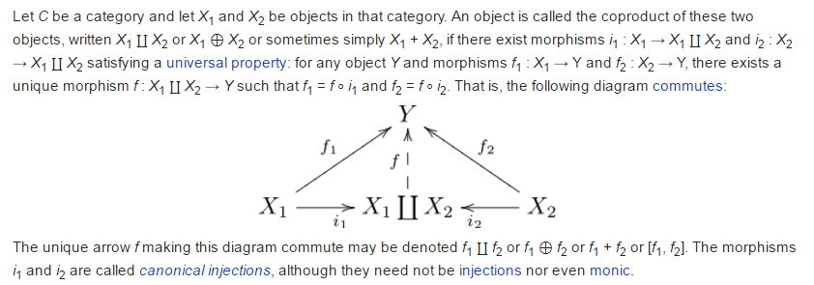
Theory : Sums (coproducts)

Slide 7
Practice
Examples of products in C++:
Structure types e.g. struct type_name { member_type1 member_name1; member_type2 member_name2; ... };
Tuple types e.g. std::tuple<int, double, std::string>
Indeed, one can view structures as tuples where the fields are named for the corresponding projection function

Slide 8
Practice
Examples of sum types in C++:
Enumerated types e.g. enum colors={red, blue, green}; // … switch (c) { case red: // … case blue: // … // … }

Slide 9
Practice
Discriminated union types e.g. struct poly_var { int type; union { int w; double num; char* str } val; };
boost::variant<int, double, char*>
bdetu_Variant<int, double, char*>

Slide 10
practice
Side notes:
Support for sum types in C++ has been limited
Situation somewhat improved in C++11 with unrestricted unions and variadic templates
std::variant<> coming soon to a standard near you

Slide 11
sums

Slide 12
Sums with constructors
OCaml syntax: type expr = Num of int | Add of expr * expr
expr is a (recursive) sum type of two cases
The symbols Num and Add are termed “constructors”
An example value of type expr (1 + (2 + 3)): let e : expr = Add (Num 1, Add (Num 1, Num 3))

Slide 13
Sum deconstruction (match)
So what are sums good for? They are good in contexts where programming proceeds via “case” let evaluate (e:expr) : int = match e with | Num i -> i | Add (u, v) -> (evaluate u) + (evaluate v)
Lots of data structures are naturally expressible as sums
Trees
Lists
Expressions
…

Slide 14
Pretty good sum type
In a nutshell, the “Pretty Good Sum” library is an emulation of OCaml‘s sums with constructors struct num; struct add; using expr = pgs::sum_type< num, recursive_wrapper<add> >; struct num {int i; //…}; struct add {expr l; expr r; //…};

Slide 15
Constructing sums
An example value of type expr (1 + (2 + 3)): expr e{
constructor<Add>{},
expr{constructor<Num>{}, 1},
expr{constructor<Add>{},
expr{constructor<Num>{}, 2},
expr{constructor<Num>{}, 3}}
}; Verbose. We can do better…

Slide 16
Reduce syntactic verbosity
An example value of type expr (1 + (2 + 3)): //Factory functions
expr num (int i) {
return expr{constructor<num>{}, i};
}
expr add (expr const& u, expr const& v) {
return expr{constructor<add>{}, u, v};
}
expr e = add (num (1), add (num (2), num (3))); Much better.

Slide 17
Pattern matching
Deconstructing expressions int evaluate (expr const& e) { return e.match<int>( [](Num const& n) {
return n.i
}, [](Add const& op) {
return evaluate (op.l) + evaluate (op.r);
} ); }

