Slide 1
Pretty good sum

Slide 2
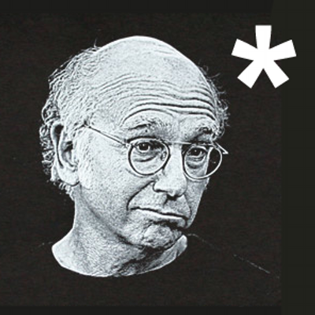

Slide 3
Algebraic data types

Slide 4
Theory
Algebraic data types are a kind of composite type
That is, a type formed by combining types
There are two common classes of algebraic type
Products
Sums
The terms product and sum (co-product) come from category theory

Slide 5
Practice
Examples of products in C++:
Structure types e.g. struct type_name { member_type1 member_name1; member_type2 member_name2; ... };
Tuple types e.g. std::tuple<int, double, std::string>
Indeed, one can view structures as tuples where the fields are named for the corresponding projection function

Slide 6
Practice
Examples of sum types in C++:
Enumerated types e.g. enum colors={red, blue, green}; // … switch (c) { case red: // … case blue: // … // … }

Slide 7
Practice
Discriminated union types e.g. struct poly_var { int type; union { int w; double num; char* str } val; };
boost::variant<int, double, char*>
bdetu_Variant<int, double, char*>

Slide 8
practice
Inheritance e.g.
struct airplane_seat { /* … */ };
struct economy_seat : airplane_seat { /*… */ };
struct first_class_seat : airplane_seat { /* ... */ };
void book (airplane_seat* seat) {
if (first_class_seat* s =
dynamic_cast<first_class_seat*> (seat)){
// ...
}
else {
// ...
}
}

Slide 9
practice
Side notes:
Support for sum types in C++ has been limited
Situation somewhat improved in C++11 with unrestricted unions and variadic templates
std::variant<> coming soon to a standard near you

Slide 10
Sums with constructors

Slide 11
Sums with constructors
OCaml syntax: type expr = Num of int | Add of expr * expr
expr is a (recursive) sum type of two cases
The symbols Num and Add are termed “constructors”
An example value of type expr (1 + (2 + 3)): let e : expr = Add (Num 1, Add (Num 2, Num 3))

Slide 12
Sum deconstruction (match)
Sums are good where programming naturally proceeds via “case” let rec evaluate (e : expr) : int = match e with | Num i -> i | Add (u, v) -> (evaluate u) + (evaluate v)
Lots of data structures are naturally expressible as sums

Slide 13
Pretty good sum type
The “Pretty Good Sum” library brings sums with constructors to C++ struct Num; struct Add; using expr = pgs::sum_type< Num, recursive_wrapper<Add> >; struct Num {int i; //…}; struct Add {expr l; expr r; //…};

Slide 14
Constructing sums
An example value of type expr (1 + (2 + 3)): expr e{
constructor<Add>{},
expr{constructor<Num>{}, 1},
expr{constructor<Add>{},
expr{constructor<Num>{}, 2},
expr{constructor<Num>{}, 3}}
}; Verbose. We can do better…

Slide 15
Reduce syntactic verbosity
An example value of type expr (1 + (2 + 3)): //Factory functions
expr num (int i) {
return expr{constructor<Num>{}, i};
}
expr add (expr const& u, expr const& v) {
return expr{constructor<Add>{}, u, v};
}
expr e = add (num (1), add (num (2), num (3))); Much better.

Slide 16
Reduce syntactic verbosity
Side note : PGS sums are move aware. In production code, you would probably prefer to write something like template <class U, class V> expr add (U&& u, V&& v) {
return expr{
constructor<Add>{}
, std::forward<U>(u)
, std::forward<V>(v)};
} in order to get the benefit of move semantics where you can

Slide 17
Pattern matching
Deconstructing expressions int evaluate (expr const& e) { return e.match<int> -> int ( [](Num const& n) {
return n.i
}, [](Add const& op) {
return evaluate (op.l) + evaluate (op.r);
} ); }

Slide 18
Pattern matching
In some contexts, the full generality of match<> is more than needed e.g.
if (e.is<Num> ()) {
E_num const& n = pgs::get<Num> (e);
// ... do something with n
}

Slide 19
examples

Slide 20
Example : optional
Consider a pointer : either it is nullptr or, it can be dereferenced
Types boost::optional<T> and bdet_NullableValue<T> have similar semantics : either a given instance is a valid T or is “missing”
Such types are sums with two cases type ‘a option = Some of ‘a | None

Slide 21
Example : optional
In C++ using pretty good sums we can implement α option like this template <class T>
struct Some { T data; //ctor };
struct None {};
template<class T>
using option = sum_type<Some<T>, None>;

Slide 22
Example : functional lists
Lists are empty or non empty sequences of elements type α list = Nil | Cons of α * α list

Slide 23
Example : functional lists
In C++ template <class T> struct cons_t; // Case 1
struct nil_t {}; // Case 2
template <class T> using list =
sum_type <recursive_wrapper<cons_t<T>>, nil_t>; template <class T>
struct cons_t {
T hd;
list<T> tl;
// ctors… };

Slide 24
Example : Binary search trees
In OCaml, type (α, β) tree =
Empty
| Node of (α * β) * (α * β) tree * (α * β) tree
In C++,
struct empty_t {}; template <class T, class V> struct node_t;
template <class K, class V>
using tree = sum_type <empty_t, recursive_wrapper<node_t<K, V>>>;

Slide 25
Example : Binary search trees
template <class K, class V>
struct node_t {
using tree_type = tree<K, V>;
using value_type = std::pair<K, V>;
value_type data;
tree_type left_child; tree_type right_child;
//ctors... };

Slide 26
implementation

Slide 27
implementation
template <class...>
struct recursive_union {};
template <class T, class Ts...>
struct recursive_union<T, Ts...> {
union {
T v;
recursive_union<Ts...> r; };
};
template<> struct recursive_union<> {};

Slide 28
Gotchas

Slide 29
common “gotchas”
There are a common mistakes made in client code that lead to highly inscrutable error messages
Before you issue a bug report, check for these (and remember “Always assume it’s your fault” – Jonathan Wakely)

Slide 30
common “gotchas”
Failure to mark single argument constructors explicit in the context of perfect forwarding
template <class T>
struct some_t {
T data;
template <class U>
explicit some_t (U&& data) :
data { std::forward<U> (data) }
{}
};
Of course, unless you actually want to encourage implicit behavior (bad), always mark your single argument constructors explicit!

Slide 31
common “gotchas”
Getting your type-math wrong in the presence of perfect forwarding
//Wrong!
template <class T>
option<T> some (T&& val) {
return option<T>{
constructor<some_t<T>>{},
std::forward<T> (val)};
}
Why is this wrong?

Slide 32
common “gotchas”
//Correct template <class T>
option<typename std::decay<T>::type>
some (T&& val) {
using t = typename std::decay<T>::type;
return option<t>{
constructor<some_t<t>>{},
std::forward<T> (val)};
}

Slide 33
common “GOTCHAS”
Who can tell me what’s wrong with this?
//Wrong! template <class T>
T const& get (option<T> const & u) {
return u.match<T const&> (
[](some_t<T> const& o) -> T const& {
return o.data;
},
[](none_t const&) -> T const& {
throw std::runtime_error {"get"};
}
);
}

Slide 34
common “GOTCHAS”
//Correct template <class T>
T const& get (option<T> const & u) {
return u.template match<T const&> (
[](some_t<T> const& o) -> T const& {
return o.data;
},
[](none_t const&) -> T const& {
throw std::runtime_error {"get"};
}
);
}

Slide 35
postcript

Slide 36
Resources
Code
https://bbgithub.dev.bloomberg.com/QDLA-infrastructure/pretty-good-sum
Will soon be present in our Windows installer and DPKG
Online documentation
http://nydeviisquant01/pretty-good-sum/index.html

Slide 37
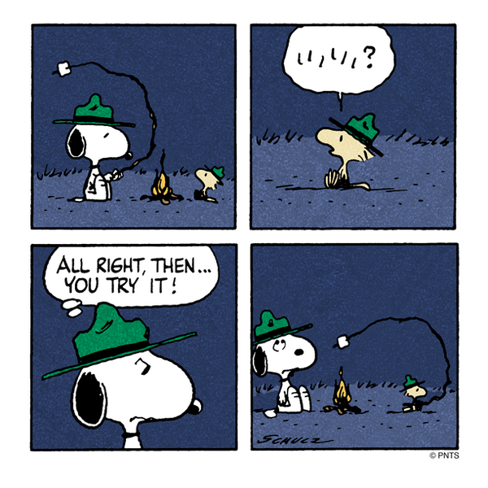
Notes:
Wouldn’t be a QDLA presentation without Snoopy!

