Slide 1
Surrounded by defender stones?
Surrounded by defender stones?
>3
Real
Connected spaces
False
Eyes
False
Unknown
Unknown
Input:
List of
unoccupied spots

Slide 2
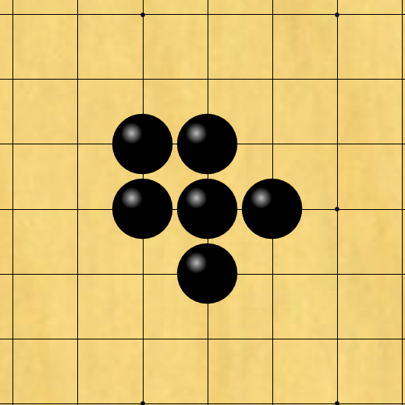
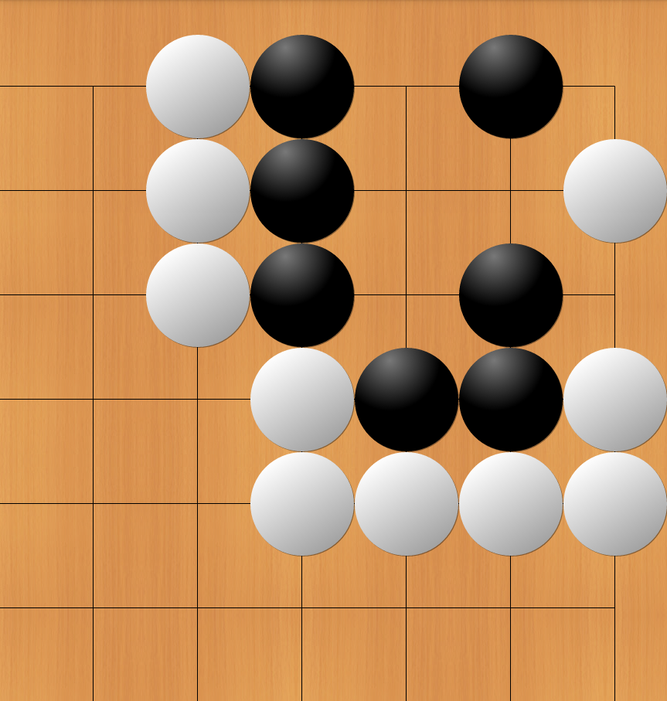
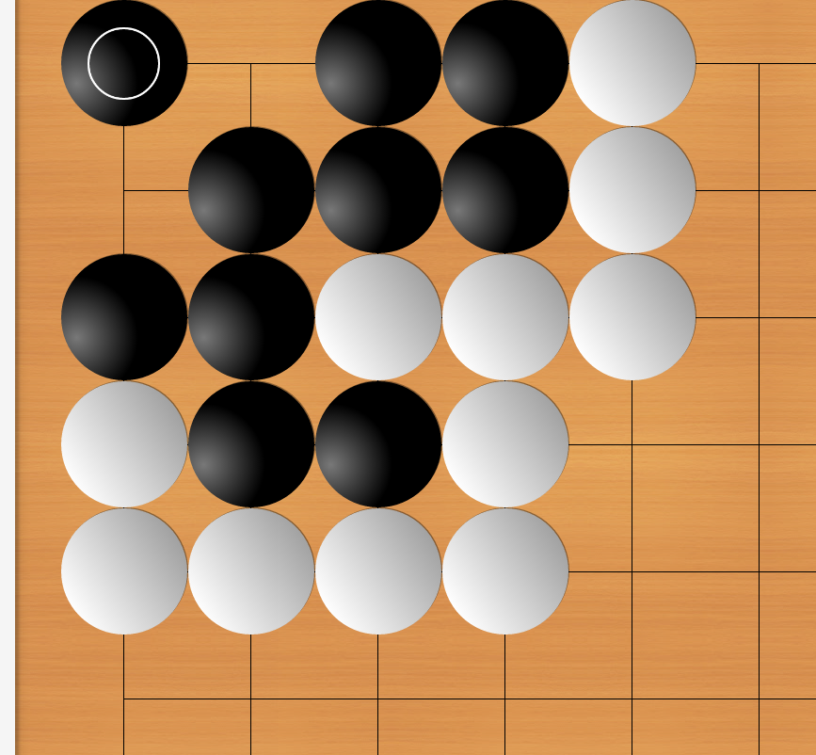
5
1
3
2
4

