Slide 1
Modifier: activator emax increase 1ge1 by 2 fold or 10 fold???km (EC50) and vmax (Emax)
Velocity (constant) of combination, when enzyme is very low=vel
C2LD in Jan 24 (Dan Rycroft)
Y
2comp PK endo tissue,tissue is in quilibrium : assump
Distribution coeff= DisCoeff_plasma
BP
Y
PAPPA2
PAPPA2
IGF1-BP
SM: C2LO in March 24 (John Barrett)
Days ?
Ternary complex has t1/2 of 16 h
+
SLC7A3
Luteal Phase
+
Estrogen
IGF1
+
???
-
(sigmoid…rep ass
Time scale??)
More or less eq
+
+
Rp propotional to IGF1
Validate with data
T1/2 <10 mins
10-30 min
Progesterone
Pain
-
Tissue
(sensitive)
Tissue
(insensitive)
???
Gareth Young
+
Kpain(TS)
Pain
Nox,pip3
PTGR3 (EP3)
SM: C2LD in Mach 24
Available chemical matter
correlation
PGE2
Outcome
Infertility
Cox

Slide 2



Y
Y
ksynPAPPA2: 9.1495e-06
PAPPA2
Tissue Ectopic
(sensitive)
Ectopic/Eutopic = alpha;
Alpha*tissue endometrium = pain
ksynIGFBPc: 5.5321
IGFBPc
PAPPA2
-
kdegPAPPA: 0.0069
kdegPAPPA2: 0.0069
kdegIGFBPc: 0.0433
+
ksynIGF1: 34.8031
+
IGF1
Pain
PGE2
ksynIGFBP: 33.4447
EP3
+
kdegPAPPA: 0.0069
IGFBP
Drug
ksynPAPPA: 0.0014
PAPPA
kdegIGF1
: 4.1506
kdegIGFBP: 0.0433
kdegPAPPA: 0.0069
+
+
rp
Nox
+
+
$$k_{deg⁡_Nox}$$
Tissue
Endo
+
$$k_{in}$$
???
Arginine
Extracellular space
+
SLC7A3
P4
E2
Drug
P4 resistance
Intracellular space
-
ra
$$k_{deg⁡_Arg}$$

Slide 3
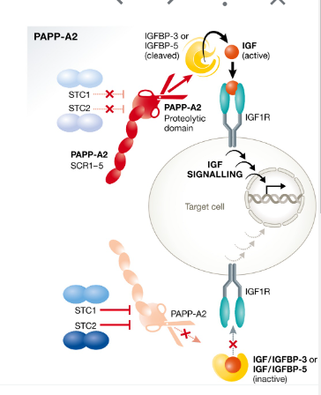
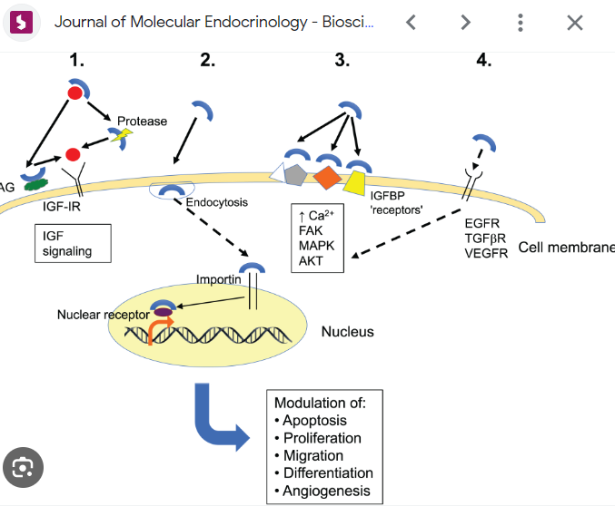

Slide 4
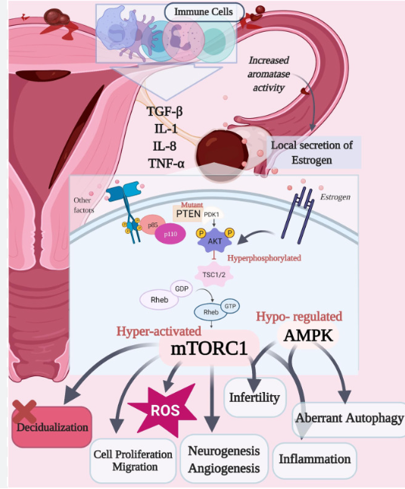
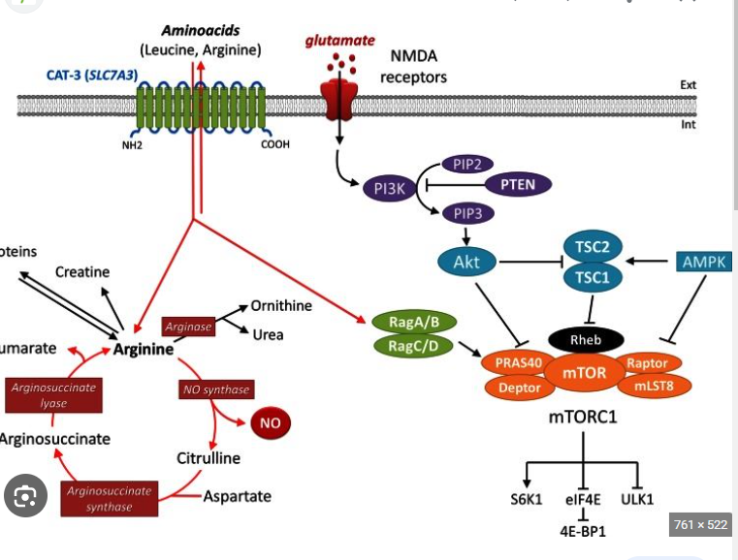

Slide 5
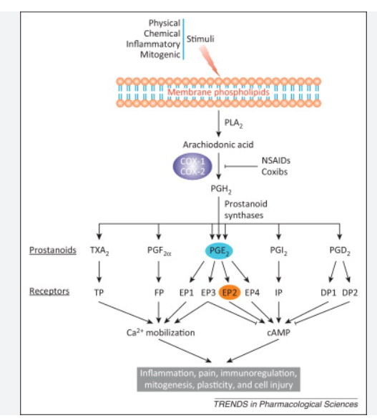
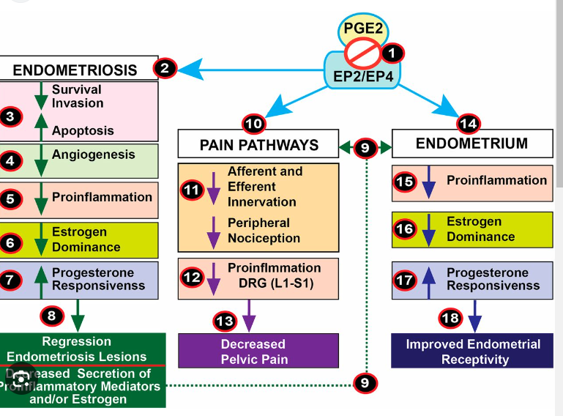

Slide 6
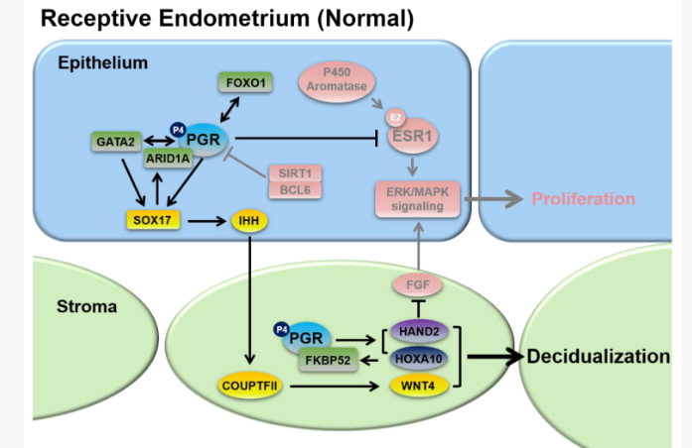
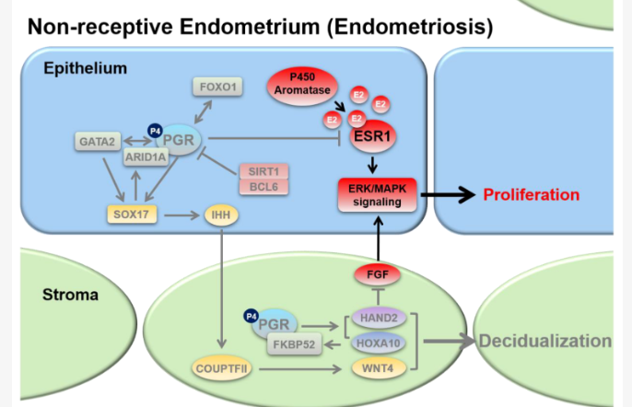
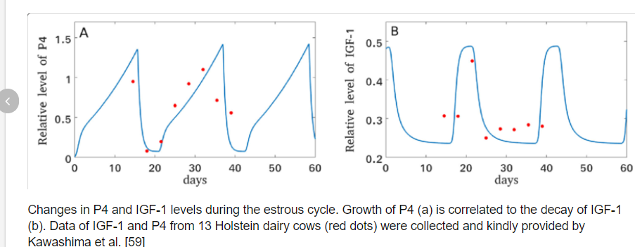
In endometriosis, when endometrial tissue grows outside the uterine cavity, progesterone and estrogen signaling are disrupted, commonly resulting in progesterone (P4) resistance and estrogen(E2) dominance.s
E2 induces epithelial proliferation to build endometrial thickness during the proliferative phase of the menstrual cycle, then P4 inhibits E2-induced proliferation and allows stromal cells to begin decidualization during the secretory phase. When the tightly regulated balance of epithelial-stromal P4 and E2 signaling is lost, P4 resistance and E2 dominance are prone to ensue, potentially leading to uterine diseases such as endometriosis

Slide 7
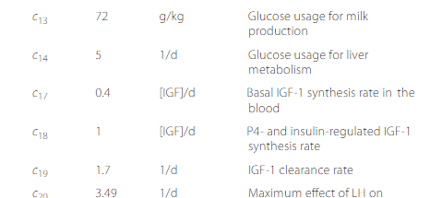
https://www.researchgate.net/publication/338615338_Model-based_exploration_of_the_impact_of_glucose_metabolism_on_the_estrous_cycle_dynamics_in_dairy_cows#pf8

Slide 8
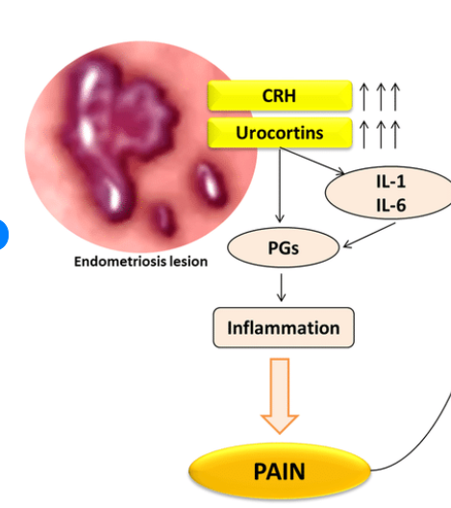
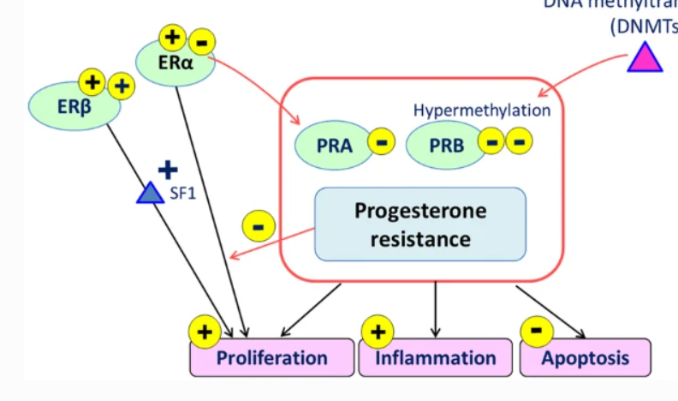
SECRETORY/LUTEAL phase when P4 is high and E2 low
igf1
IGFBP-1
igf1
E2
IGFR
-
-
ER-a
P4
Resistance
-
+
+
-
PGR-A
proliferation
lesion
IL1

Slide 9
BP
Y
Y
PAPPA2
PAPPA2
IGF1-BP
Days ?
-
SLC7A3
+
Estrogen
IGF1
+
-
+
+
10-30 min
Progesterone
Pain
-
Tissue
(sensitive)
Tissue
(insensitive)
Nox
Outcome
Infertility

Slide 10
BP
IGF1-BP
Days ?
-
Estrogen
IGF1
+
-
+
+
10-30 min
Progesterone
Pain
-
Tissue
(sensitive)
Tissue
(insensitive)
Outcome
Infertility

Slide 11
Y
Y
PAPPA2
PAPPA2
IGF1-BP
-
Estrogen
IGF1
+
-
+
+
Progesterone
Pain
Tissue
(lesions)
-
lesions
Outcome
Infertility

Slide 12
Y
Y
PAPPA2
PAPPA2
IGF1-BP
-
Estrogen
IGF1
+
-
+
+
Progesterone
Pain
Tissue
-
Fibrotic
Tissue
Outcome

Slide 13
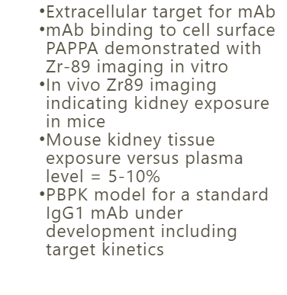
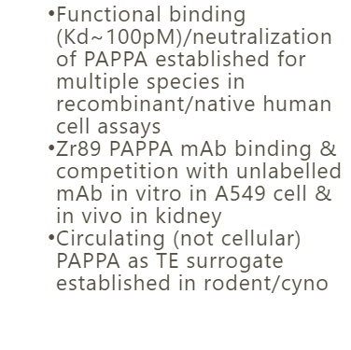
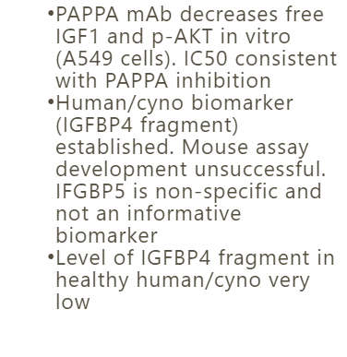
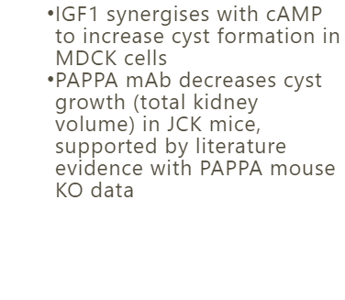
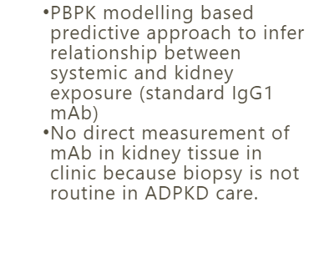
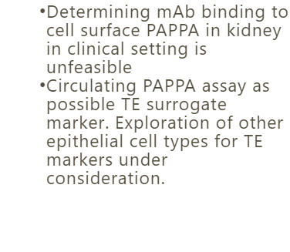
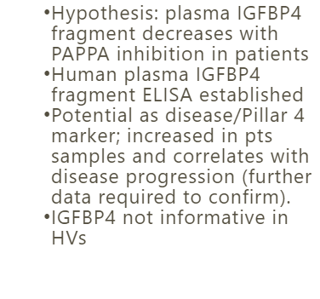
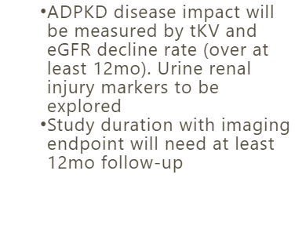
Model Informed Translational Strategy
PoPS (%)
Green
Pillar 1: Drug Exposure at Site of Action​
Pillar 2: Target Binding
Pillar 3: Functional Pharmacology​
Pillar 4: Disease Relevant Endpoints
Non-Clinical​
Green
Green
Amber
Green
Clinical​
Green
Red
Amber
Amber
Pillar 5: Precision Medicine
Amber

