Slide 1

Leap-List

Slide 2
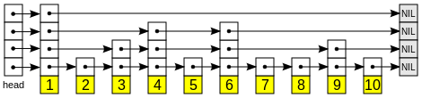
What is a Leap-List
It’s basically a skip list which has a set of key-value pairs in each node.
What’s a skip list?
Our data structure is base on a set of n Leap-Lists.
Notes:
רשימת דילוגים בנויה משכבות. השכבה התחתונה ביותר היא רשימה מקושרת רגילה, בה מופיעים כל האיברים במבנה הנתונים הנתון. האיברים מסודרים מהחוליה הקטנה ביותר לחוליה הגדולה ביותר. כל שכבה מוכלת על ידי השכבה מתחתיה. ההסתברות שחוליה כלשהי, השייכת לרשימה בשכבה , תימצא גם ברשימה בשכבה היא 0.5. ככלל, סיכויו של איבר כלשהו להימצא בשכבה הוא , כשהשכבה התחתונה ביותר (אשר מכילה את כל האיברים) מיוצגת על ידי .

Slide 3
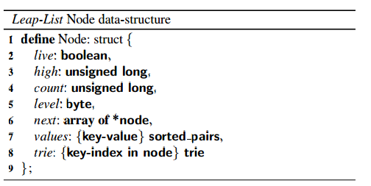
Leap-Node

Slide 4
API
Lookup
Gets a list, and a key.
Returns the value associated with the key.
Range Query
Gets a list, low key and a high key.
Returns an array of the values associated with the existing keys within the given range.
Update
Gets a set of lists, key-value pairs.
Updates/Inserts any key-value pair to their associated list.
Remove
Gets a set of lists, key-value pairs.
Removes the key-value pairs associated with the given list.

Slide 5
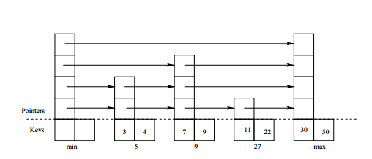
SearchPredecessor(key,pa[],na[])
Returns the node containing the desired key.
Changes the given predecessor and successor arrays.

Slide 6
pa[i].next[i] -> n (for all indexes up to n.level)
na[i] = pa[i].next[i].
na[0] = n

Slide 7
Differences between global lock and fine grained lock
In the grained locking mechanism the locks move from the API functions to the individual nodes themselves.
Only the nodes that needs to be replaced (by the update or remove functions) are actually locked.
The lookup functions checks the “live” fields instead of using locks.

Slide 8
Transactional Memory implementation
In this implementation two more atomic utility functions are added to the update and remove actions: updateLT and removeLT.
These functions check if “our” nodes are marked as going through changes by another thread. If these nodes are marked the function fails and tries again, if not it marks them itself.

Slide 9
Our improvment
In the transactional code we received, if the atomic action fails than the update/remove actions starts allover again for the Leap-Lists in the array.
In our implementation the action is retried only for the problematic list itself.
In the “c” module the transactional code didn’t work before improvement.

Slide 10
Diffrences between “C” and “Java”

Slide 11


