Slide 1

Leap-List

Slide 2
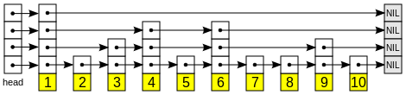
What is a Leap-List
It’s basically a skip list which has a set of key-value pairs in each node.
What’s a skip list?
Our data structure is base on a set of n Leap-Lists.
Notes:
רשימת דילוגים בנויה משכבות. השכבה התחתונה ביותר היא רשימה מקושרת רגילה, בה מופיעים כל האיברים במבנה הנתונים הנתון. האיברים מסודרים מהחוליה הקטנה ביותר לחוליה הגדולה ביותר. כל שכבה מוכלת על ידי השכבה מתחתיה. ההסתברות שחוליה כלשהי, השייכת לרשימה בשכבה , תימצא גם ברשימה בשכבה היא 0.5. ככלל, סיכויו של איבר כלשהו להימצא בשכבה הוא , כשהשכבה התחתונה ביותר (אשר מכילה את כל האיברים) מיוצגת על ידי .

Slide 3
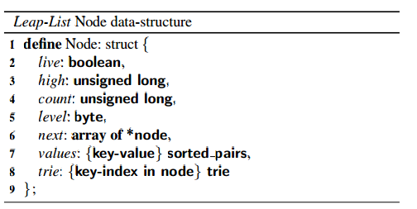
Leap-Node

Slide 4
API
Lookup
Gets a list, and a key.
Returns the value associated with the key.
Range Query
Gets a list, low key and a high key.
Returns an array of the values associated with the existing keys within the given range.
Update
Gets a set of lists, key-value pairs.
Updates/Inserts any key-value pair to their associated list.
Remove
Gets a set of lists, key-value pairs.
Removes the key-value pairs associated with the given list.

Slide 5
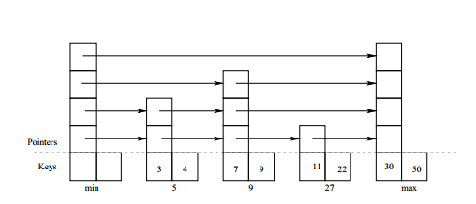
SearchPredecessor(key,pa[],na[])
Returns the node containing the desired key.
Changes the given predecessor and successor arrays.

Slide 6
pa[i].next[i] -> n (for all indexes up to n.level)
na[i] = pa[i].next[i].
n = na[0]

Slide 7
Differences between global lock and fine grained lock
The fine grained implementation is base on the “lazy skip list” algorithem.
In the grained locking mechanism the locks move from the API functions to the individual nodes themselves.
Only the nodes that are changed (by the update or remove functions) and their predecessors are actually locked.
The lookup functions checks the “live” fields instead of using locks.

Slide 8
Transactional Memory implementation
In this implementation two more atomic utility functions are added to the update and remove actions: updateLT and removeLT.
These functions check if “our” nodes are marked as going through changes by another thread. If these nodes are marked the function fails and tries again, if not it marks them itself.

Slide 9
Our improvement
In the transactional code we received, if the atomic action fails than the update/remove actions starts allover again for the Leap-Lists in the array.
In our implementation the action is retried only for the problematic list itself.
In the “c” module the hardware transactional code didn’t work before improvement.

Slide 10
Pitfalls - 1
The given code wasn’t entirely compatible with the article. So it took a while to understand the changes between the given implementations to the article.
False Sharing. Slowed down the application and probably cause inconsistencies. We solved it by padding small variables (byte) to long.
Cache coherence. We witnessed some old data being used by threads, causing dead locks and live locks. We’ve changed the next array of each node to be a list of AtomicRefernce objects.

Slide 11
Pitfalls - 2
Data races. We had a scenario where we validated data and assumed it was correct a few code lines later. Incorrect data caused the application to get stuck and function incorrectly, we fixed by using tryLock instead of lock. (checking that the lock is initialized)
Split/Merge Threshold . Parallel updates & removes on the same node , while it’s at the threshold caused unexpected behavior. We fixed it by changing the split threshold to be a bit smaller.

Slide 12
Efficiency VS. Coding Difficulties - Java
The transaction memory implementations had an overhead of creating the updateLT/removeLT functions. It had good results when the modify part in the application was small. When the modify part was much bigger, transaction had worse results than the global lock.
Global lock was the easiest to implement.
Grained lock was the hardest to implement and seems to have the best results ( or similar to transaction when modification part is small).

Slide 13
Differences between “C” and “Java”
Memory handling.
No try,catch & finally in C.
STM vs HTM. STM is more robust and flexible to big transactions. HTM is much more efficient.
Thread debugging.

Slide 14
Efficiency VS. Coding Difficulties - C
The transaction memory implementations were given in STM form.
Changing it to HTM was fairly simple. But, the given implementation didn’t work because its transaction part was too big for an hardware transaction to handle.
Grained lock was the hardest to implement, and it seems to be running better than global lock and worse that the transactions implementations.

Slide 15


