Slide 1
Global Terrorism Database
By Shalin Singh

Slide 2
About the data set
Global terrorism database (GTD)
Terrorist attacks that have happened since 1970-2017
Data sources PGIS and Hewitt Project
Making data collection consistent across all platforms.
Data set can be found on Kaggle (Search GTD)

Slide 3
Algorithms
Decision Tree (Suicide Classification)
K Means Clustering (Severity Grouping)
KNN (Terrorist Group Determination)
Named Entity Recognition
Knowledge Graph

Slide 4
Decision Tree
Create a tree that shows attributes that lead to suicide.
Data Processing Involved
Issues/Troubleshooting
Final Result

Slide 5
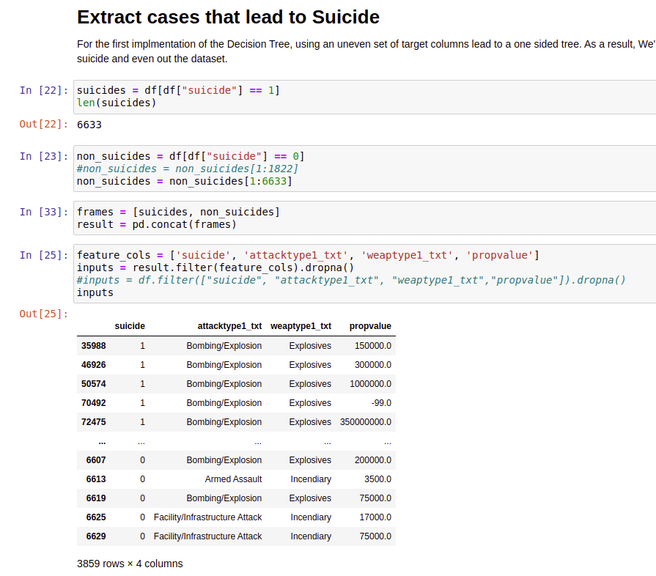
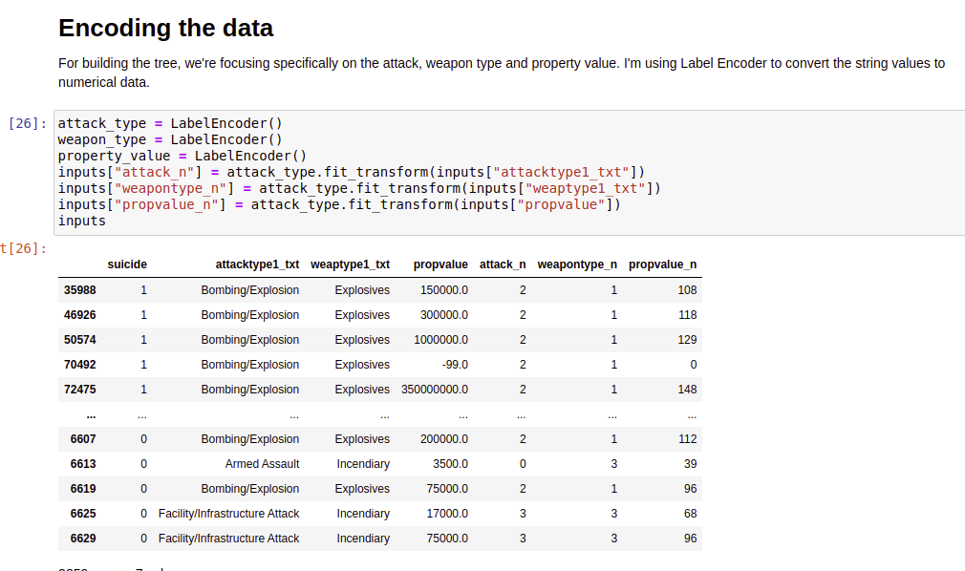
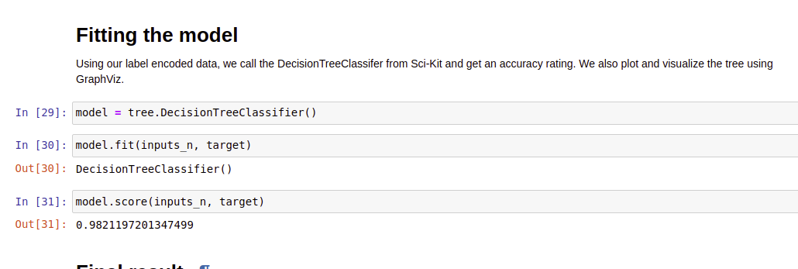
Processing

Slide 6
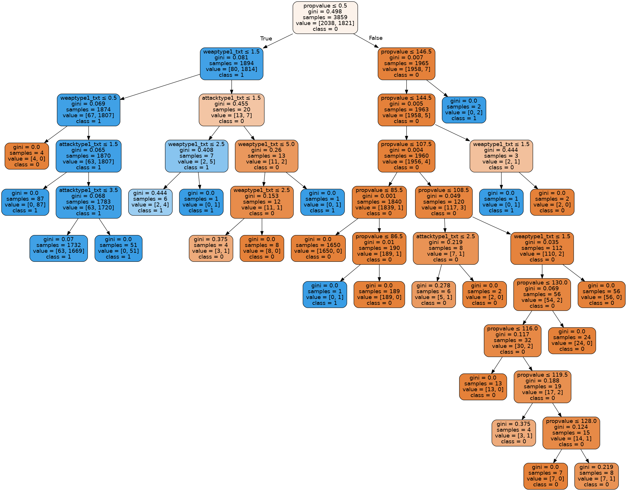
Result

Slide 7
K Means Clustering
Group attacks based on severity
Use property value and wounded/harmed as column attributes.
Data Processing Involved
Issues Faced/ How I failed
Final Result

Slide 8
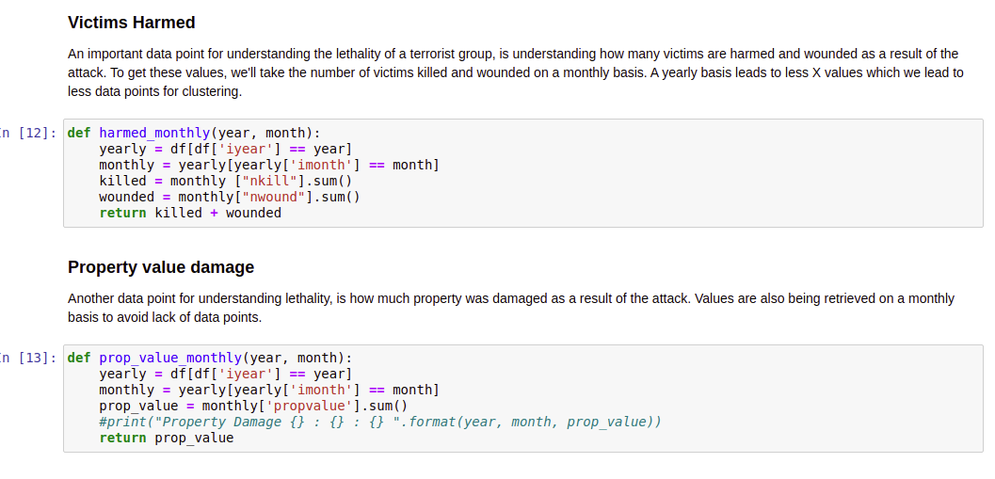
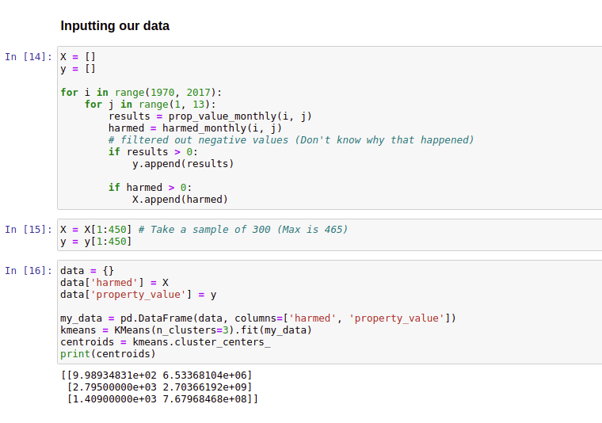
Processing

Slide 9
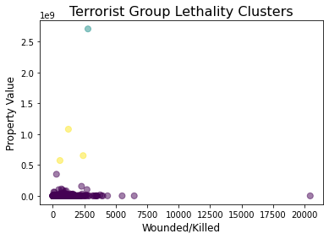
Result

Slide 10
KNN
Classify terrorist group based on Harmed/Killed
Choose optimal K value
Feed in different subsets of sliced column
Data Processing Involved
Issues Faced

Slide 11
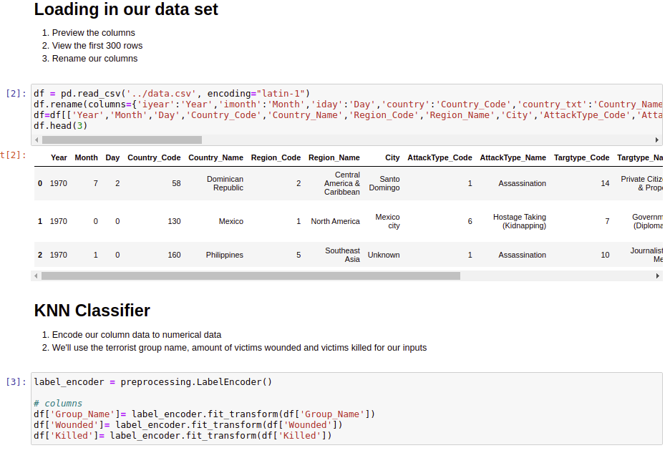
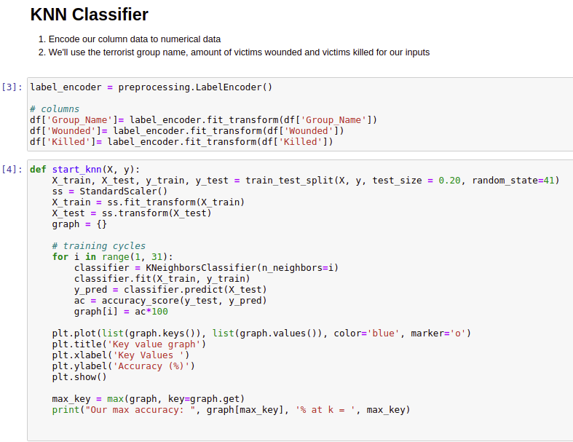
Processing

Slide 12
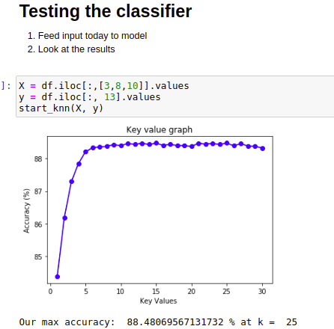
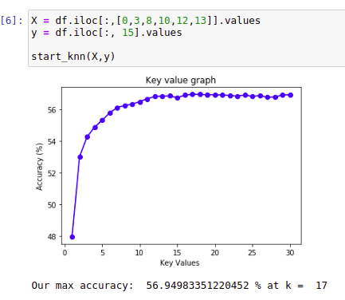
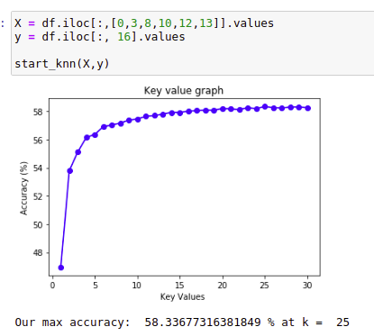
Results

Slide 13
Named Entity Recognition
Data processing Involved
Extracting overlooked data
Novelties
How this can be used in future GT event databases

Slide 14
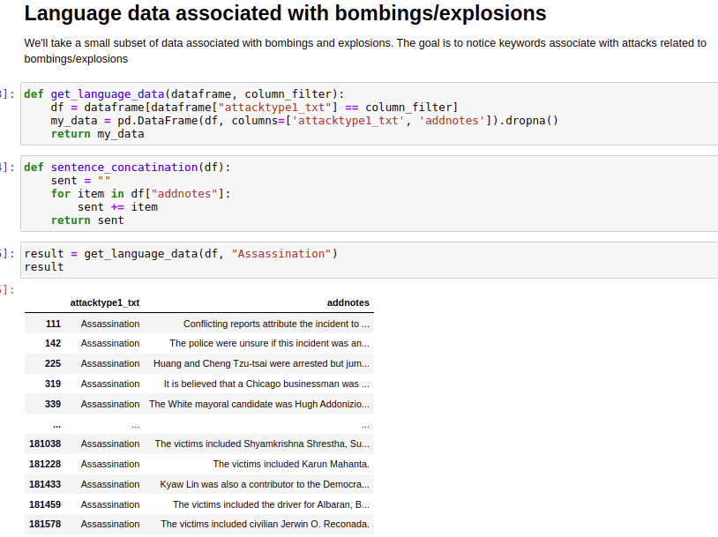
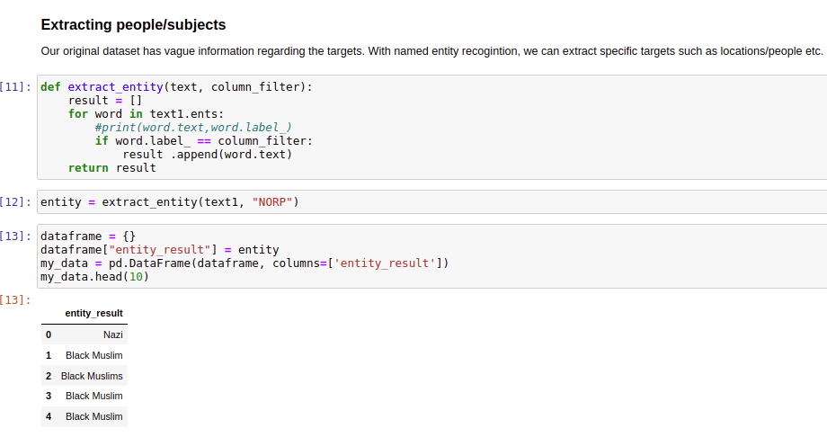
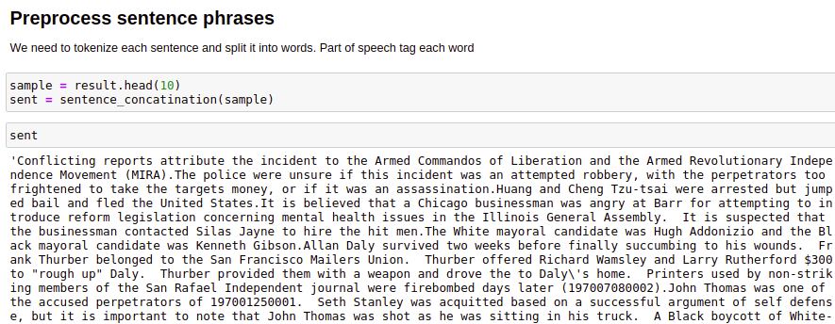
Processing

Slide 15
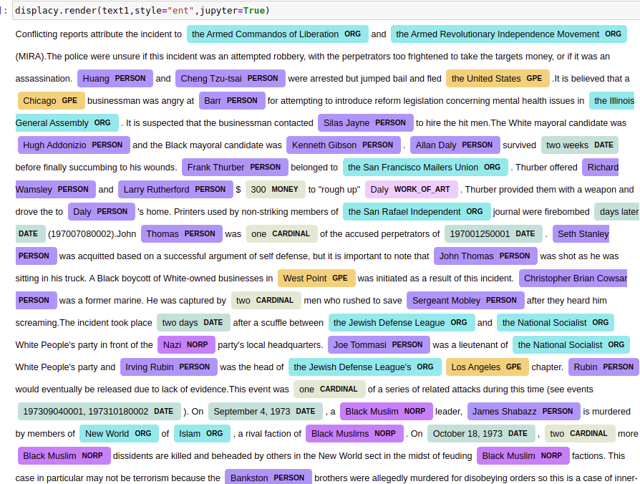
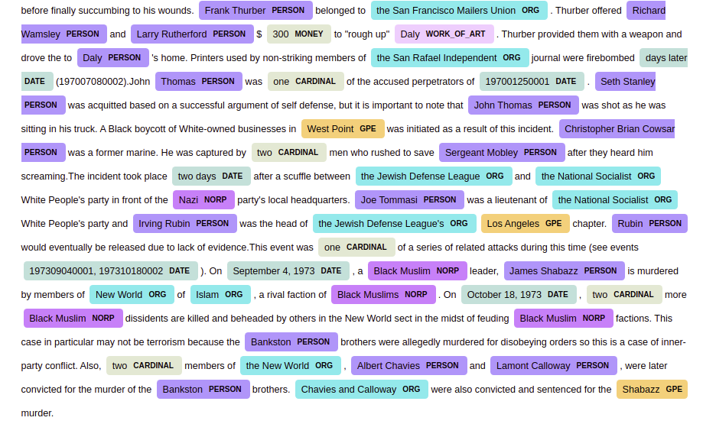
Results

Slide 16
Knowledge Graph
Visualize common relationships between words
Extract entities from sentences
Use knowledge graphs to model specific patterns in terrorist attack notes summary.
Data processing Involved
Issues/Failures

Slide 17
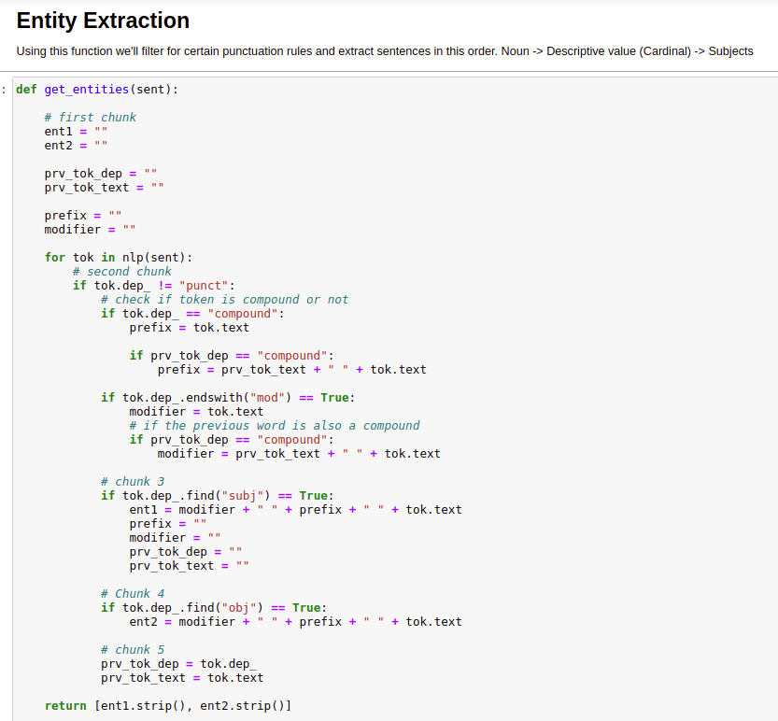
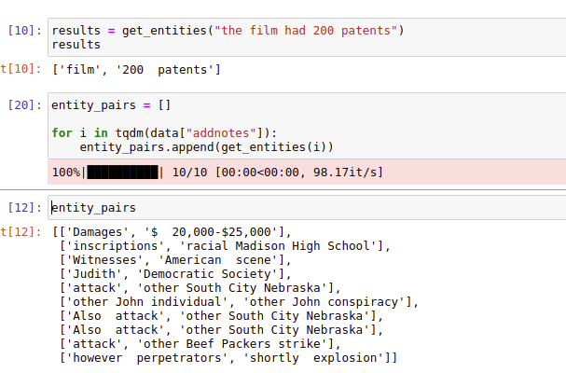
Processing

Slide 18
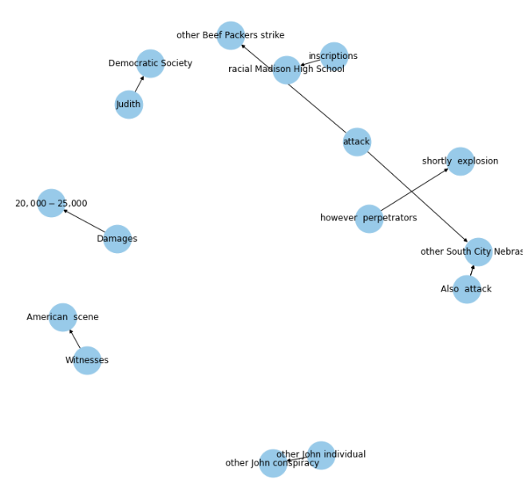
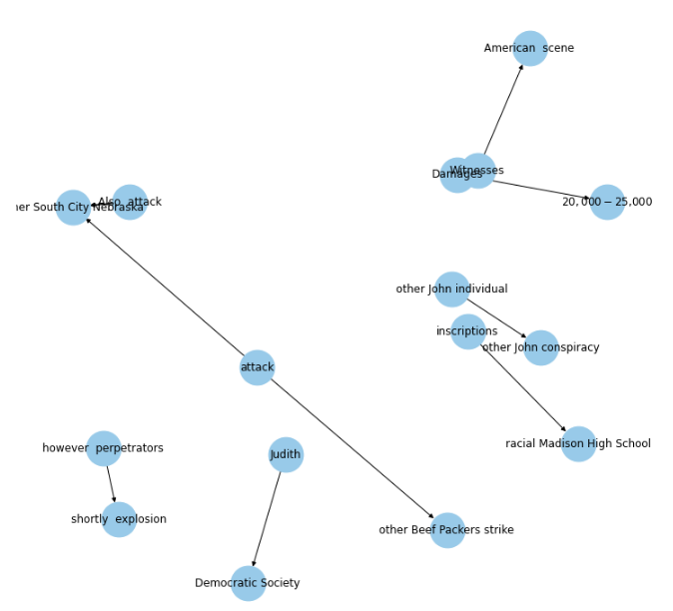
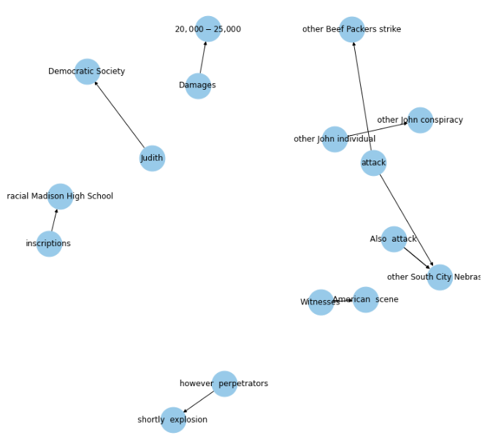
Results

Slide 19
Conclusion
Further Investigate language data
Extend Decision Tree to Random Forests
Used named entity recognition for identifying political motivation
Find a continuous data set to test the accuracy of the classifiers provided.

Slide 20
THANK YOU

