Slide 1
Claude Code
Dr. Paul Avrahami

Slide 2
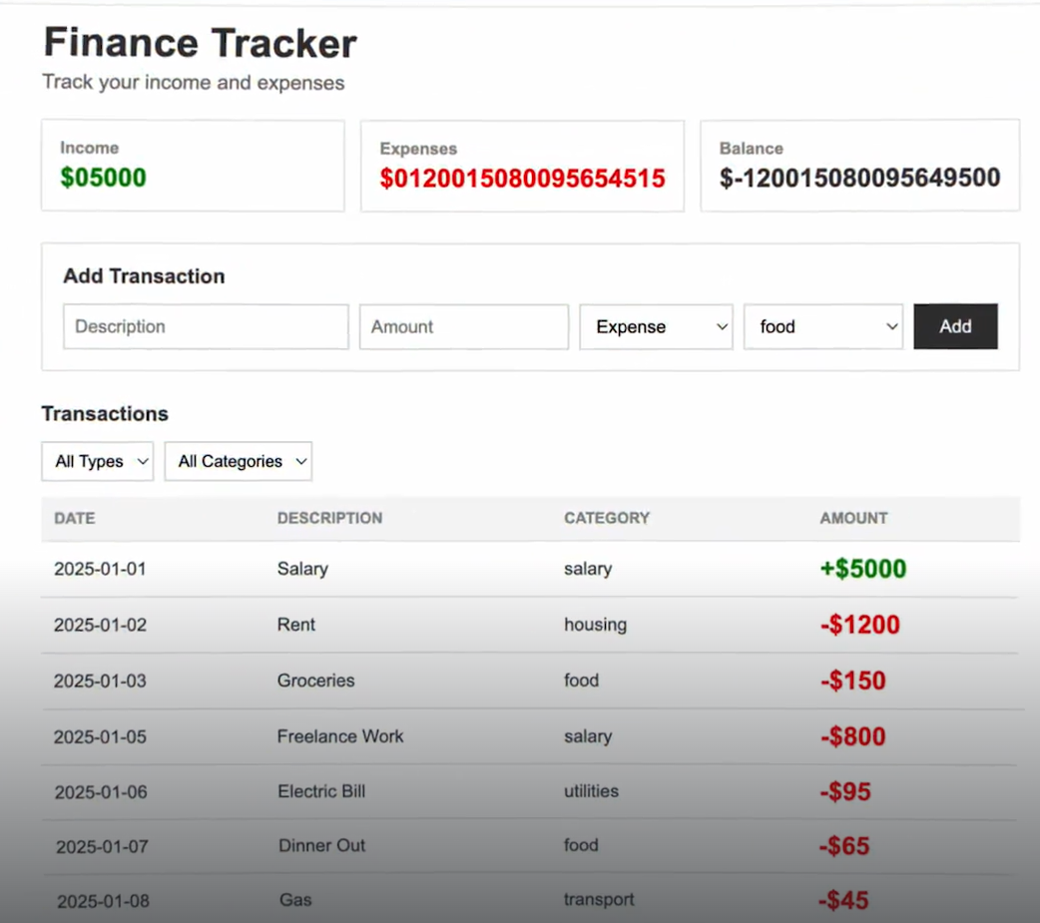
Introduction
You’ll learn
What is Claude code ?
Setting up Claude code
Writing good prompts
Using the planning mode
Managing context window
Adding tools via MCP
Adding skills
Using Checkpoints
Using Subagents
To demonstrate we will use a simple expanse tracker build with react

Slide 3
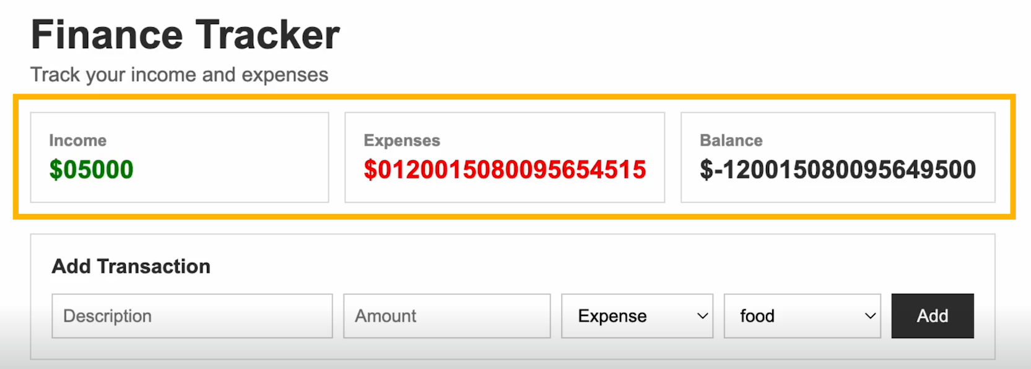
What we will fix
There is a bug , the total expenses are not calculated correctly , the code is messy and the UA needs some uplifting

Slide 4
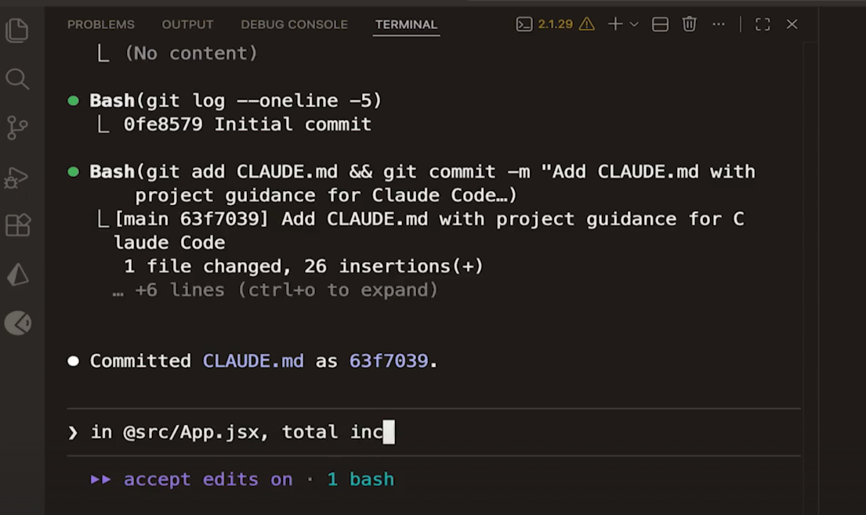
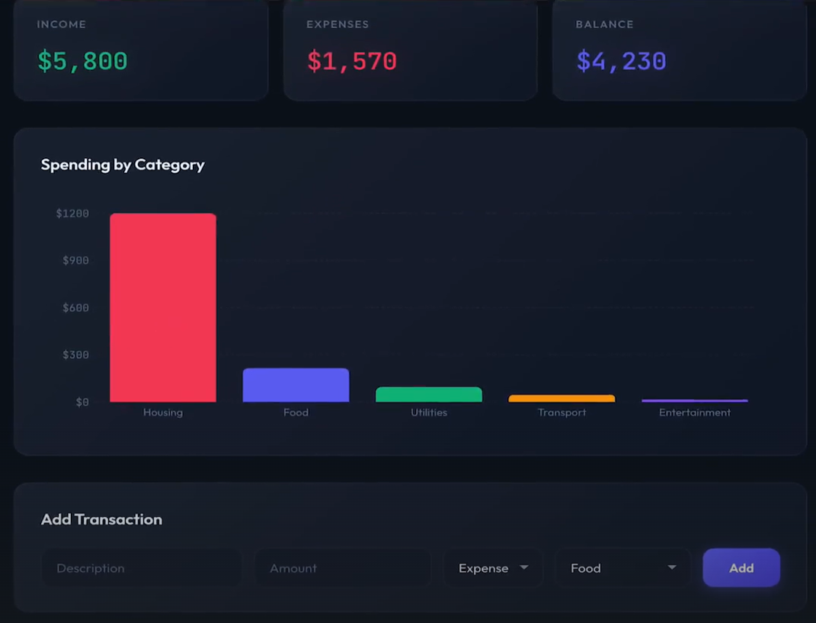
The tools and outcome
In this section we will use Claude code to fix the bug , refactor the code add new feature and give it a new look and feel.

Slide 5
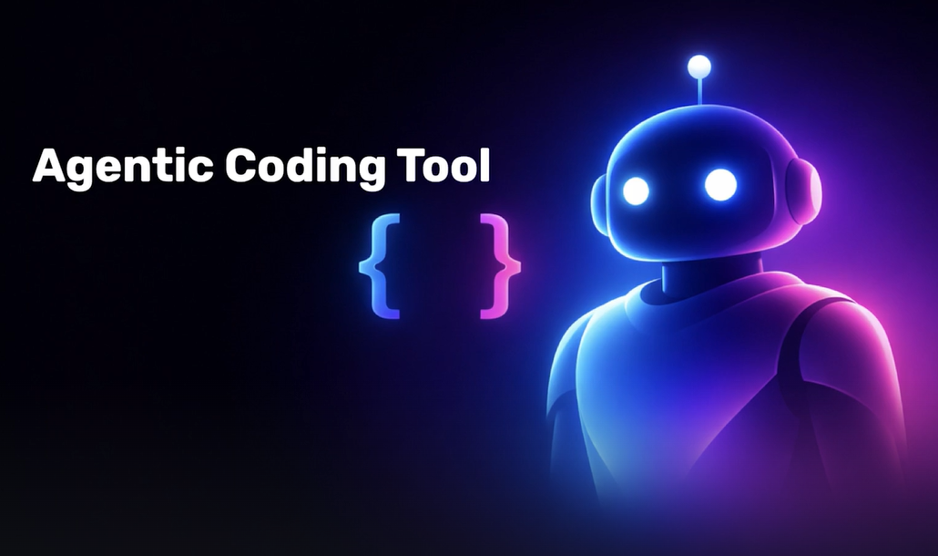
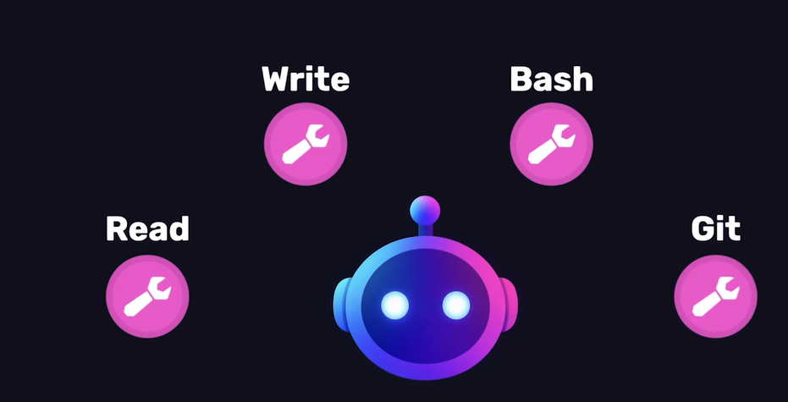
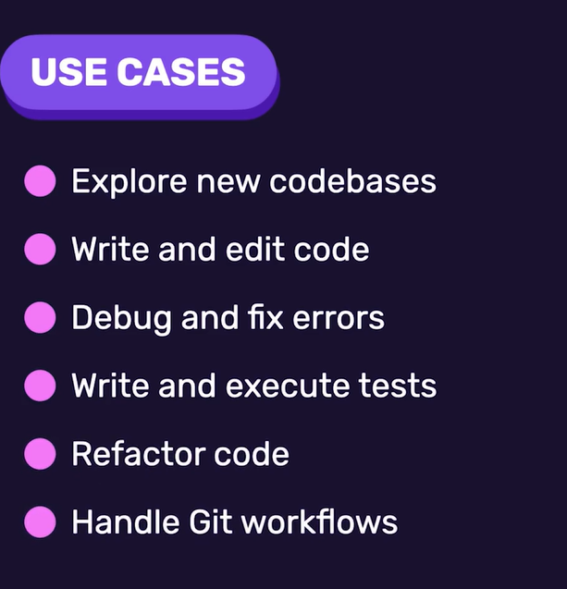
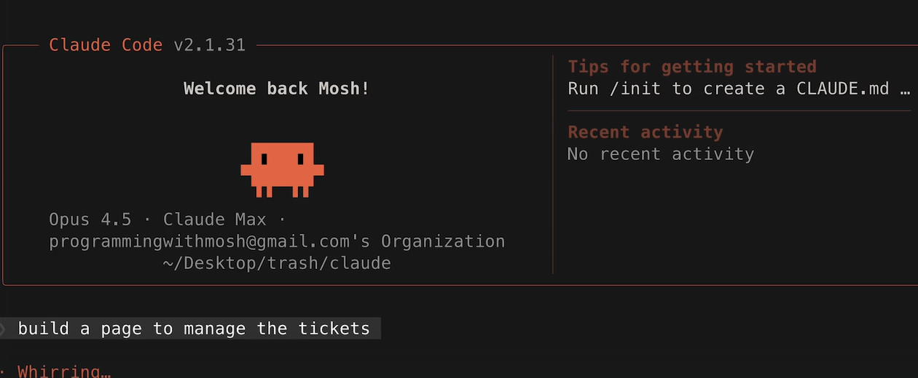

What is Claude code ?
Access to tools that can preform actions
Is it only for Vibe coding ?
You describe what you want and the Claude does it

Slide 6
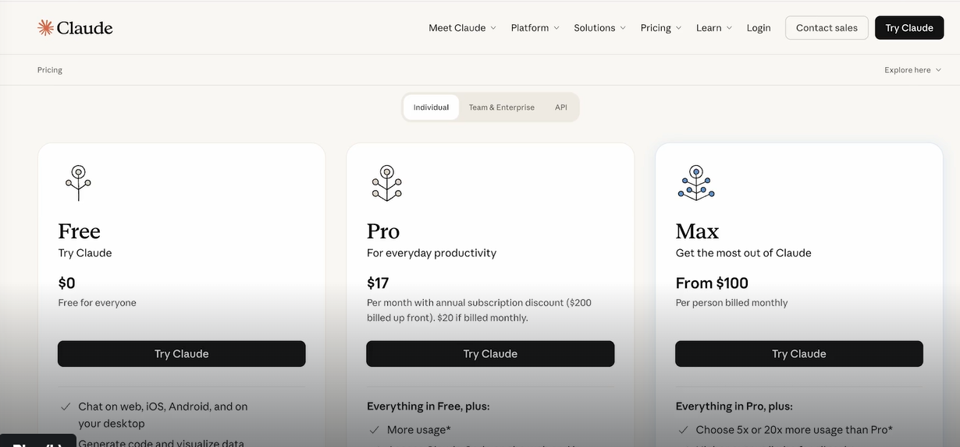
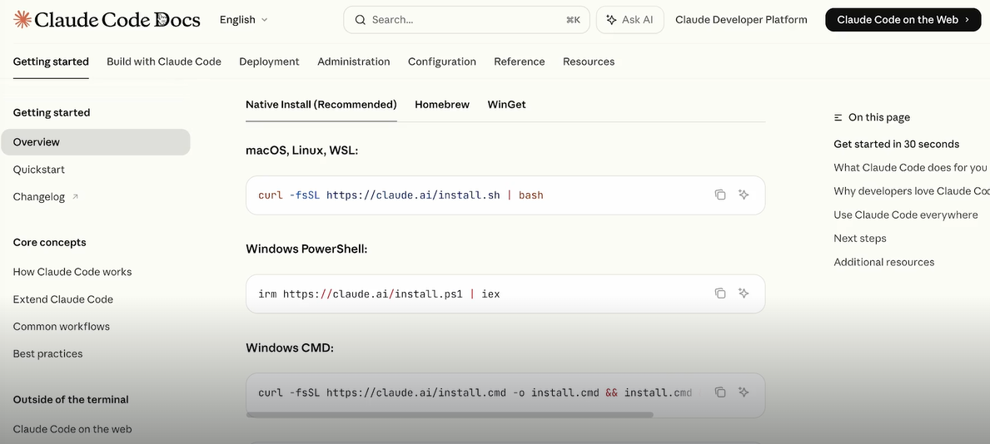
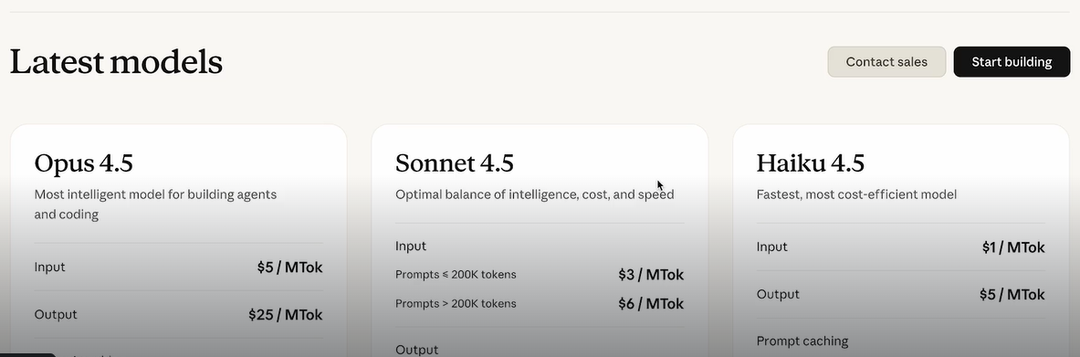
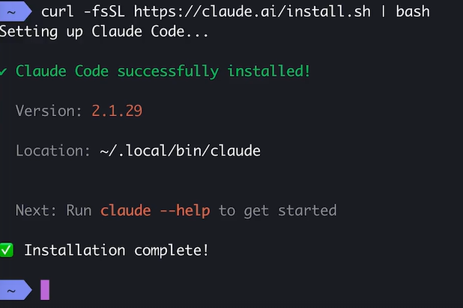
Installing Claude code
Subscription – Best Pro
Installation instruction
Pay as you go by using an API
If there is a warring to add Claude to your PATH , press the suggested command

Slide 7
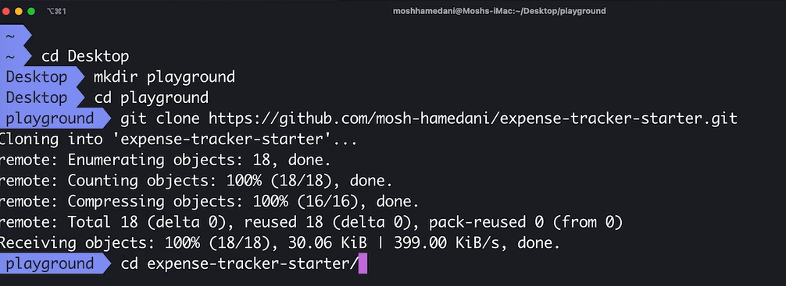
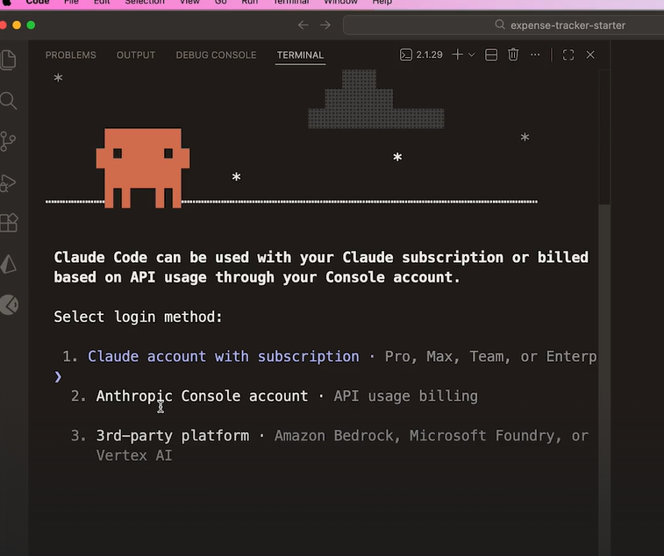
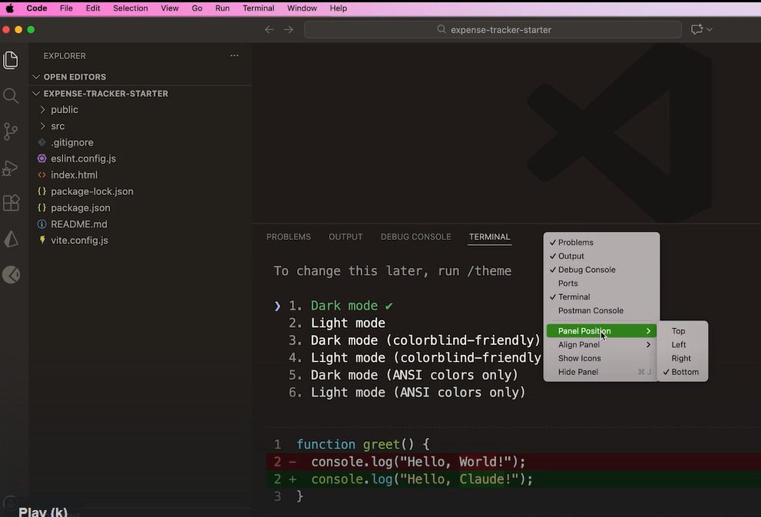
Using Claude Code
Login with your subscription :
Put the Claude code on the left

Slide 8
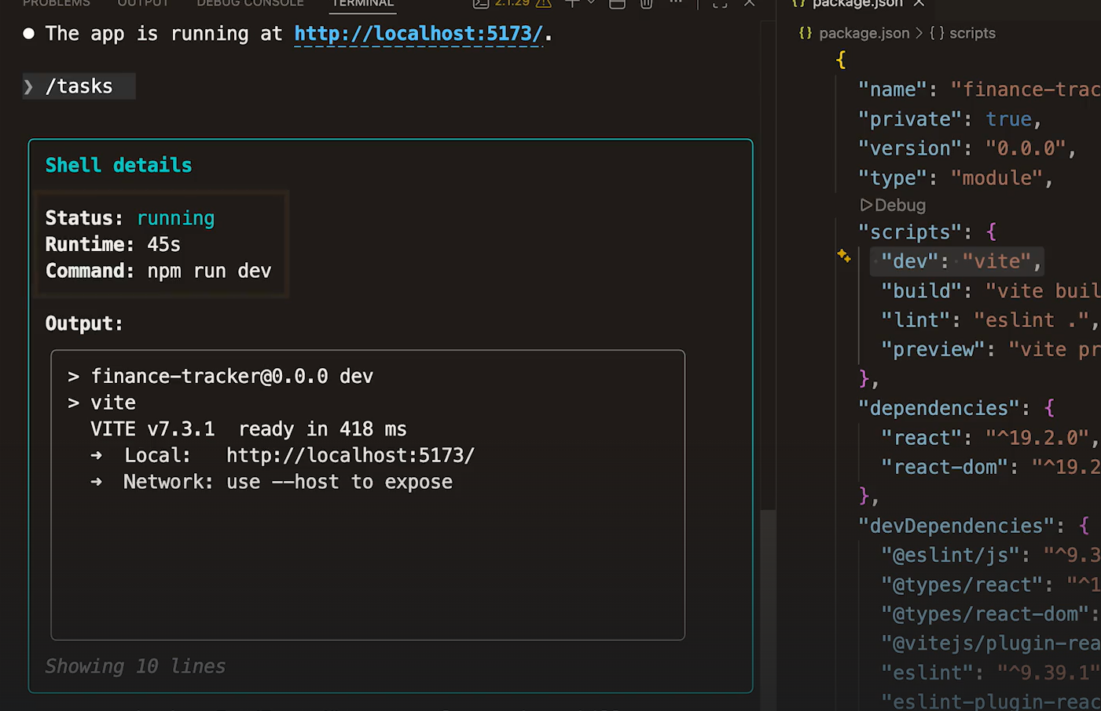
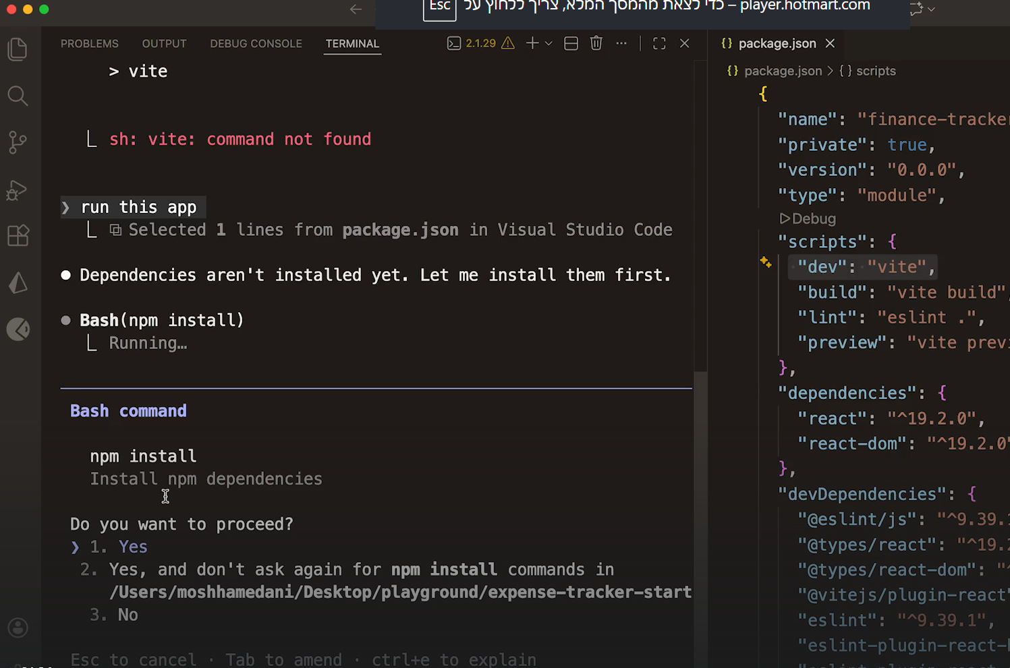
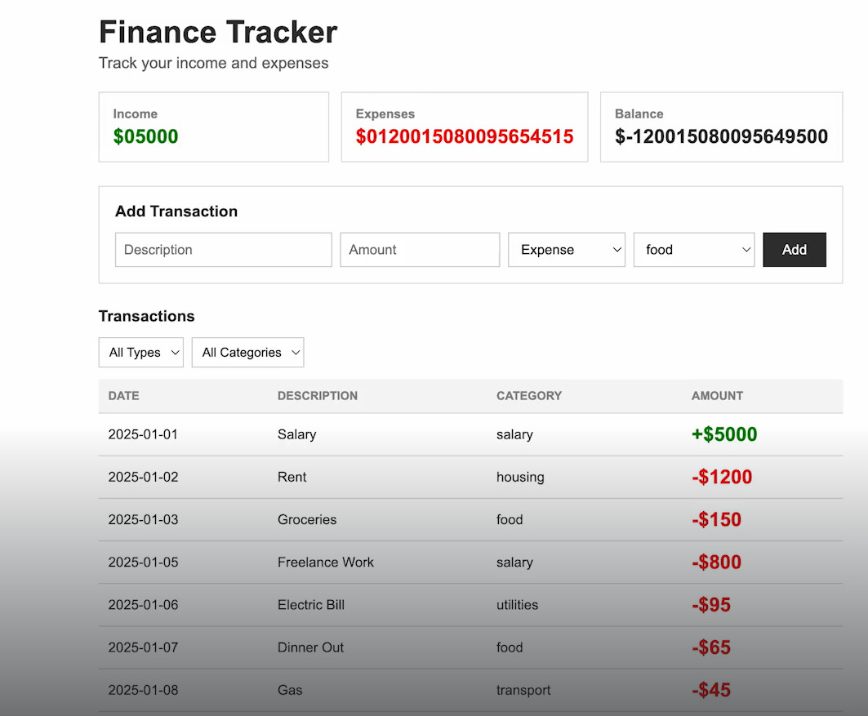
Useful commands
See the background tasks
/model – selects the LLM model
/terminal-setup – Install Shift Enter for multi line prompts
(CTL + l clears the prompt)
Write “Run this app” to run the application
The first time Claude runs a tool it need out permission
The application is running and we have a lot to fix

Slide 9
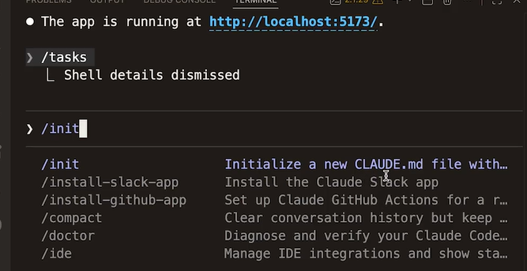
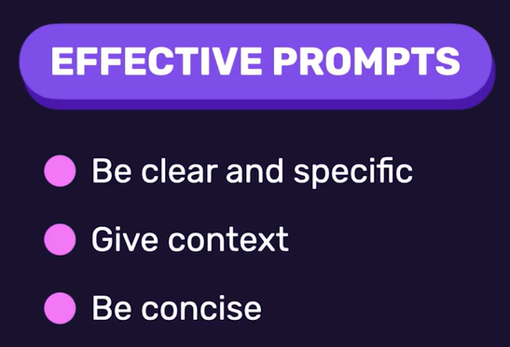
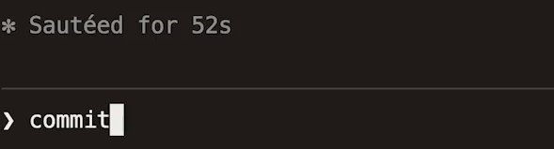
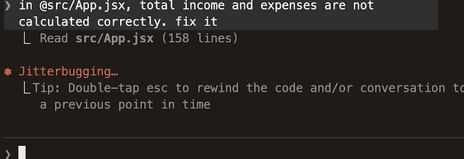
Creating our project Memory
Creates a project specific MD file
Writing comment on the change
Correction the bug we have in Summarization

Slide 10
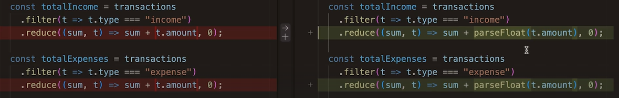
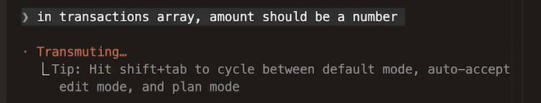
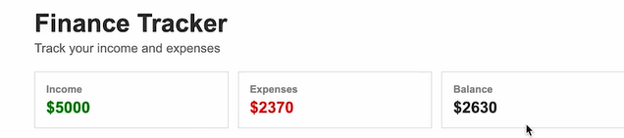
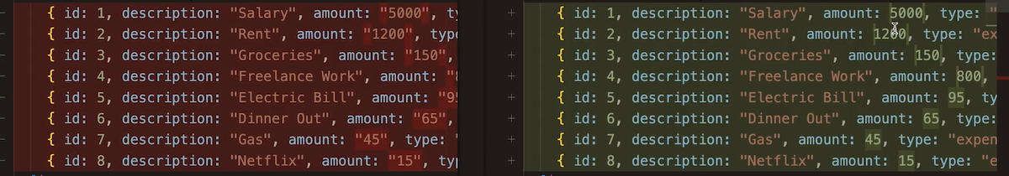
The “right” prompt
Claude had fixed the problem, but it took a wrong path
The issue that numbers are represented as strings
Give Claude a more accurate prompt
The bug was fixed
Now Claude made the right correction
Don’t forget to write a commit

Slide 11

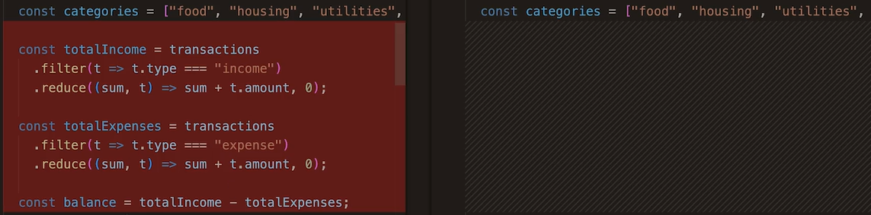

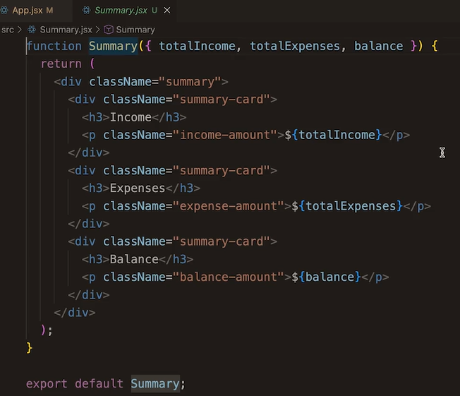

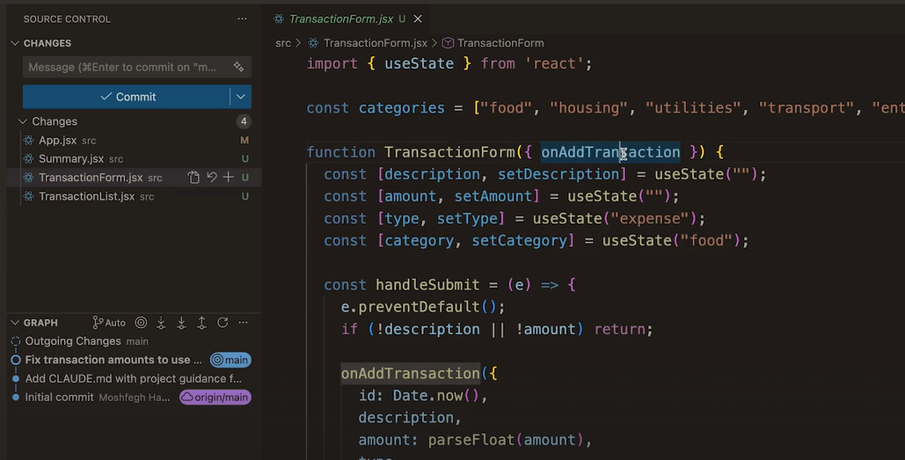
A follow-up prompt
Let’s arrange the code
New file was created for the summary
The code moved to the appropriate file
Now we want to create

Slide 12
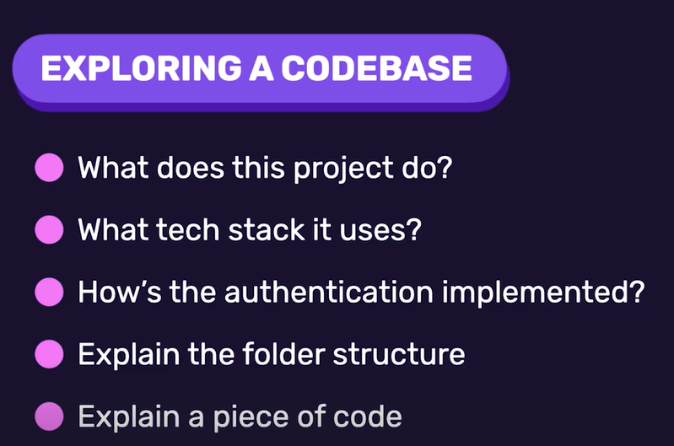
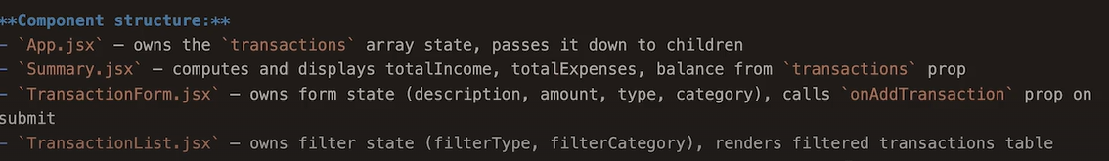
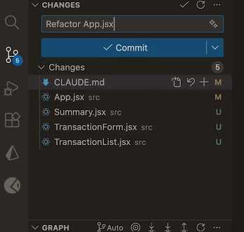
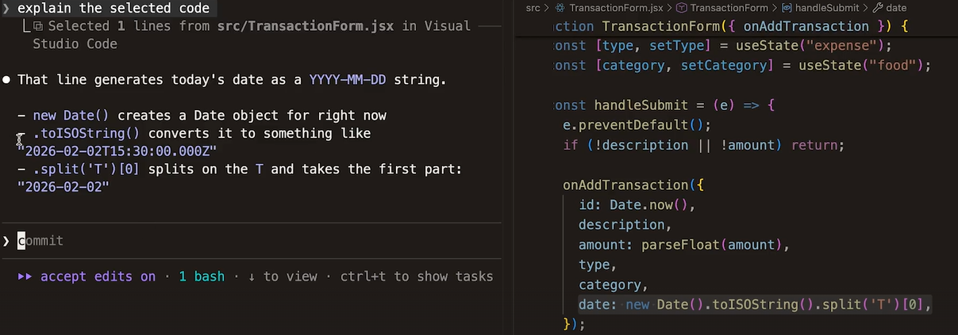
Exploring the code base
Update the documentation of architecture
Another option to commit
Highlight any piece of code and ask Claude to explain it

Slide 13

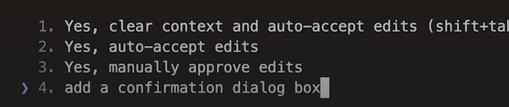
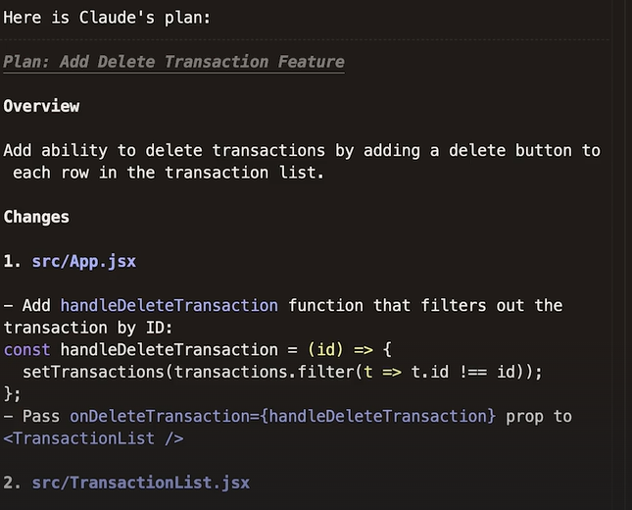
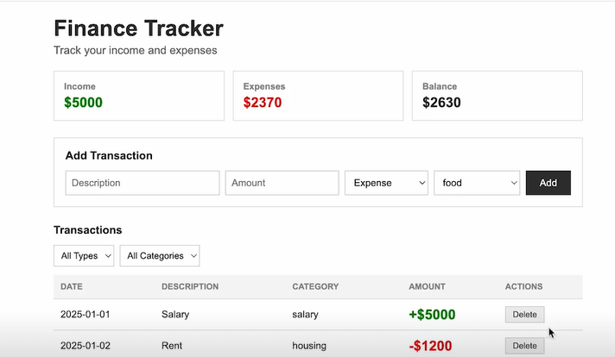
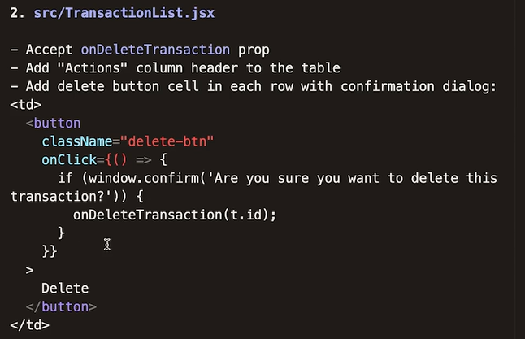
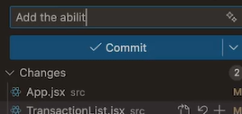
Using the Plan mode
We want to add a conformation dialog box
Shift+Tab : change to plan mode
The plan :
The result
Changes were made
Don’t forget the commit

Slide 14
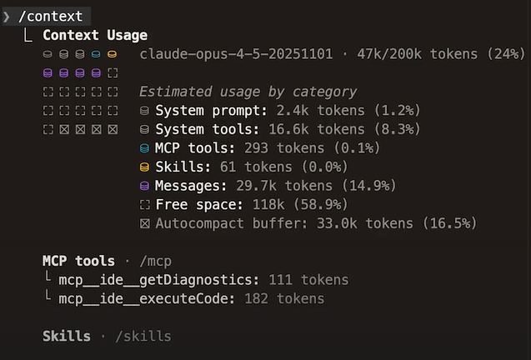
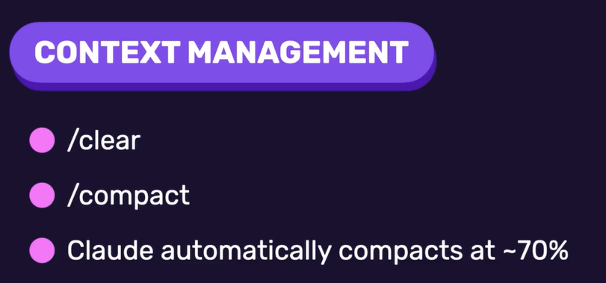
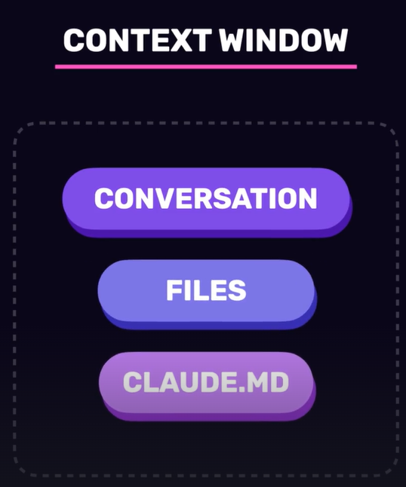


Managing the Context
Claude Working Memory

Slide 15

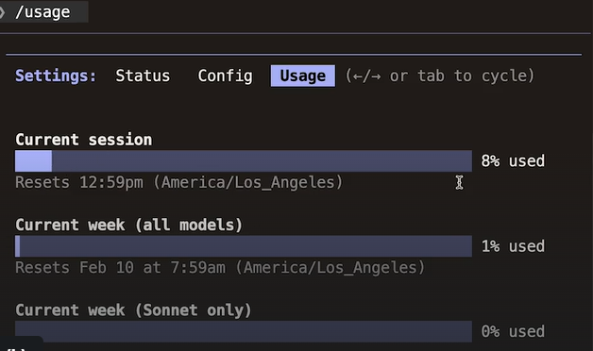
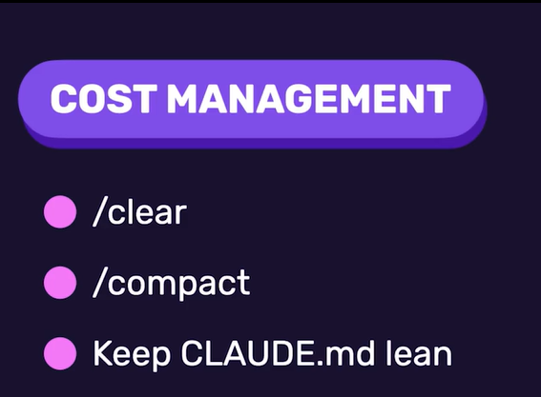
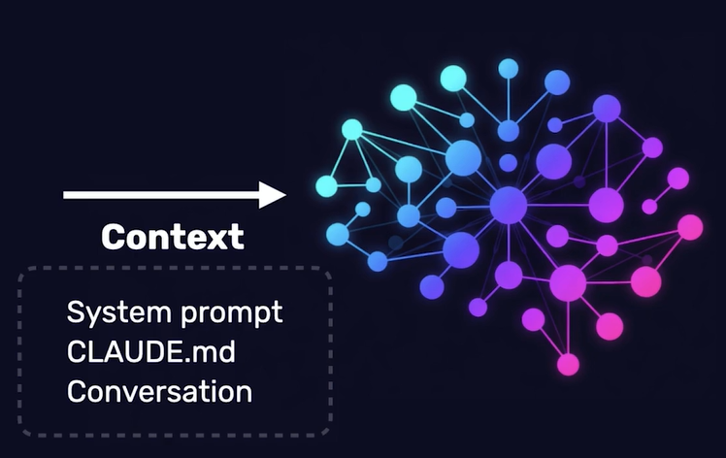
Tracking Usage and Cost
For API related

Slide 16
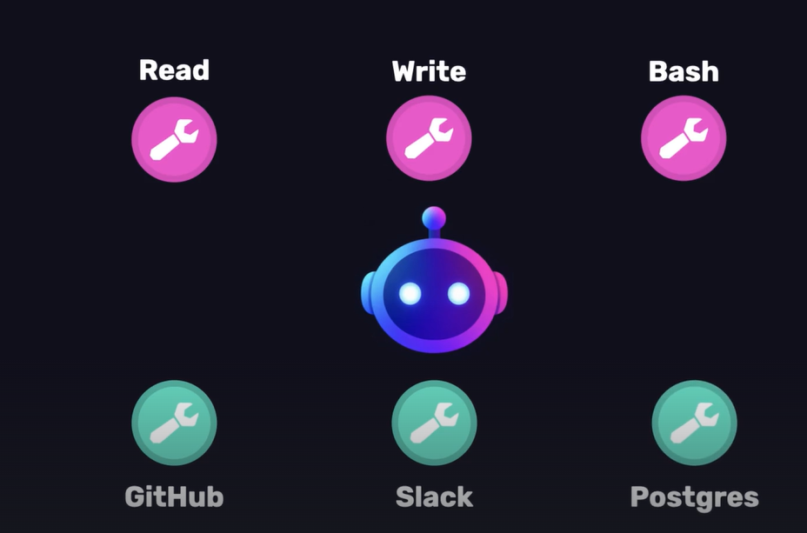
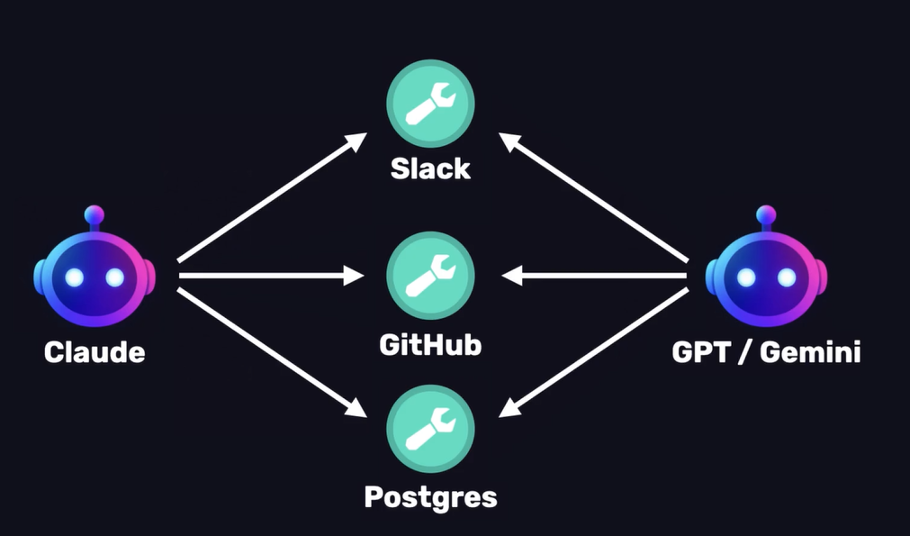
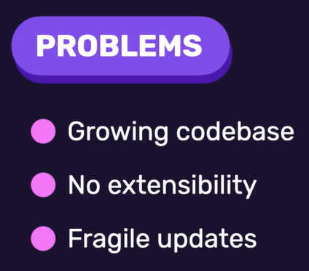
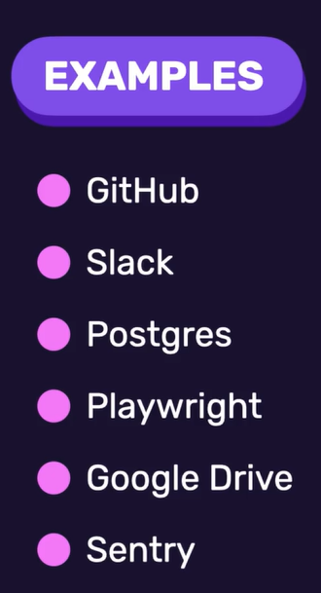
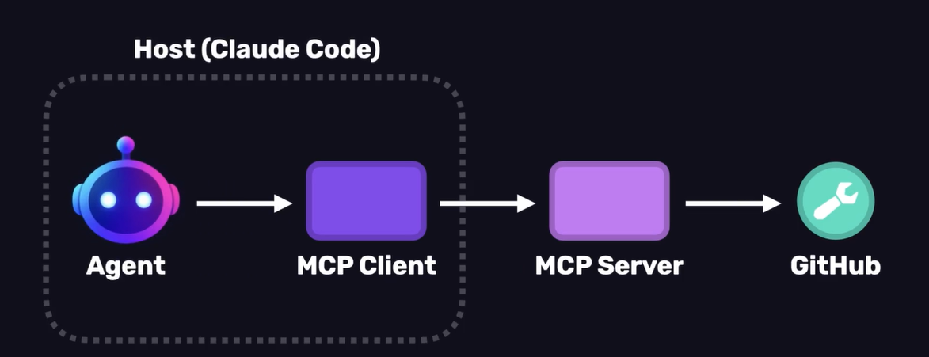
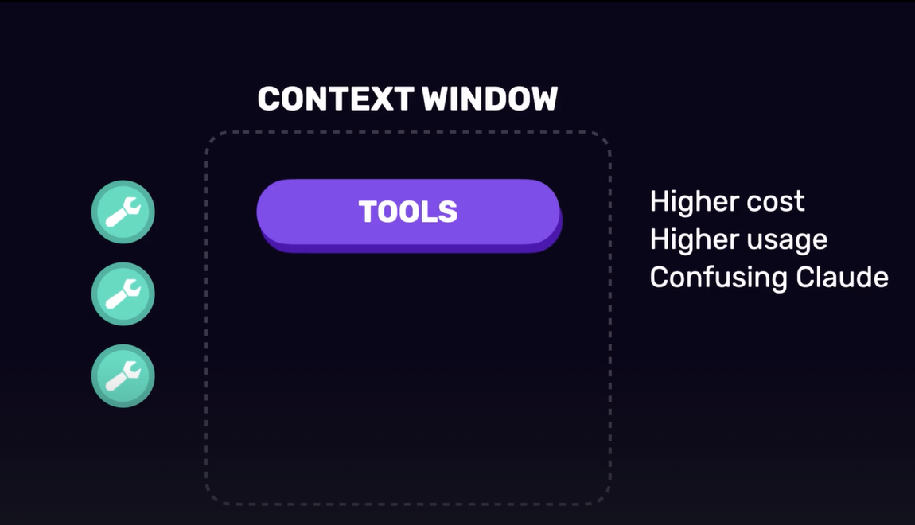
Model Context Protocol )MCP(
Without MCP – Custom code

Slide 17







Adding tools

Slide 18







Adding tools

Slide 19










Creating skills

Slide 20






Adding skills

Slide 21








Checkpointing

Slide 22




Checkpointing

Slide 23





Creating Subagents

Slide 24








Code Review

Slide 25








The future of engineering

