Slide 1
The Renewable Grid,
Hour by Hour
A six-view interactive story using 2025 EIA-930 data
Shazab Ali · 13-minute explanation and live demo
Shazab Ali · Renewable Grid Story 1
Notes:
0:00–1:00 — Slide 1: Opening
“My project is *The Renewable Grid, Hour by Hour*, a six-view interactive story built from 2025 EIA-930 operating data.”
State the central question: how can a reader understand changes across a day, a year, and multiple regions without losing scale, variability, missingness, or methodological limits?
Preview the argument: absolute output and renewable share tell different stories, and combining renewable sources can smooth some signals without always beating the steadiest component.

Slide 2
Question, audience, and design
Question: how do renewable patterns change across hours, seasons, and regions?
Audience: students, instructors, and interested public readers.
Design: context → rhythm → seasons → regions → variability → portfolio.
Guardrail: descriptive evidence, not dispatch causation or forecasting.
Shazab Ali · Renewable Grid Story 2
Notes:
1:00–2:00 — Slide 2: Audience and narrative design
Identify the audience as students, instructors, and interested public readers with basic chart literacy.
Explain the sequence:
1. whole-system context;
2. one renewable day;
3. annual source patterns;
4. regional comparison;
5. numerical variability; and
6. portfolio complementarity.
Emphasize that this is descriptive visualization—not a forecast, causal dispatch explanation, capacity-factor study, or reliability model.

Slide 3
Reproducible data workflow
EIA-930 → verified archives → 35,040 hourly records → six views
1
Verify
MD5 + SHA-256
2
Prepare
adjusted → imputed → raw
3
Aggregate
solar + wind + hydro
4
Validate
11 explicit checks
One-hour average MW sums to MWh; daily charts use available-hour means.
Shazab Ali · Renewable Grid Story 3
Notes:
2:00–3:10 — Slide 3: Preparation-code talking points
Use these concise code-level points:
- The source is a fixed Zenodo record of EIA Form 930, version 97.0.0.
- The download stage verifies published MD5 values and records SHA-256 checksums.
- Preparation filters CISO, ERCO, NYIS, and PJM.
- For each field, adjusted values are preferred, then imputed, then raw.
- Solar combines with- and without-integrated-battery reporting; wind does the same.
- Renewables equal solar + wind + hydropower excluding pumped storage.
- Standalone and pumped storage are excluded from the primary mix.
- One-hour average MW sums to MWh; daily curves are available-hour arithmetic means.
- Missing values remain gaps rather than being filled after preparation.
Mention that the processed result is 35,040 rows: 8,760 per authority.

Slide 4
Validation is transparent—not “all clean”
10 / 11
validation checks passed
31
missing renewable/mix rows
0
aggregation mismatches
20
automated tests
All four authorities have 8,760 rows and continuous hourly UTC timestamps.
25 demand and net-generation values are also missing.
Gaps remain gaps and are disclosed beside each chart.
Shazab Ali · Renewable Grid Story 4
Notes:
3:10–4:00 — Slide 4: Validation
Say clearly: “Validation is not entirely clean.”
- 10 of 11 persisted checks pass.
- Coverage, unique timestamps, hourly continuity, arithmetic, archive integrity, and versioned provenance pass.
- The required-values check fails.
- There are **31 missing renewable and generation-mix rows**, plus 25 missing demand and net-generation rows.
- The app reports missing values beside affected selections.
Mention the 20 automated tests, but distinguish tests from audience evaluation.

Slide 5
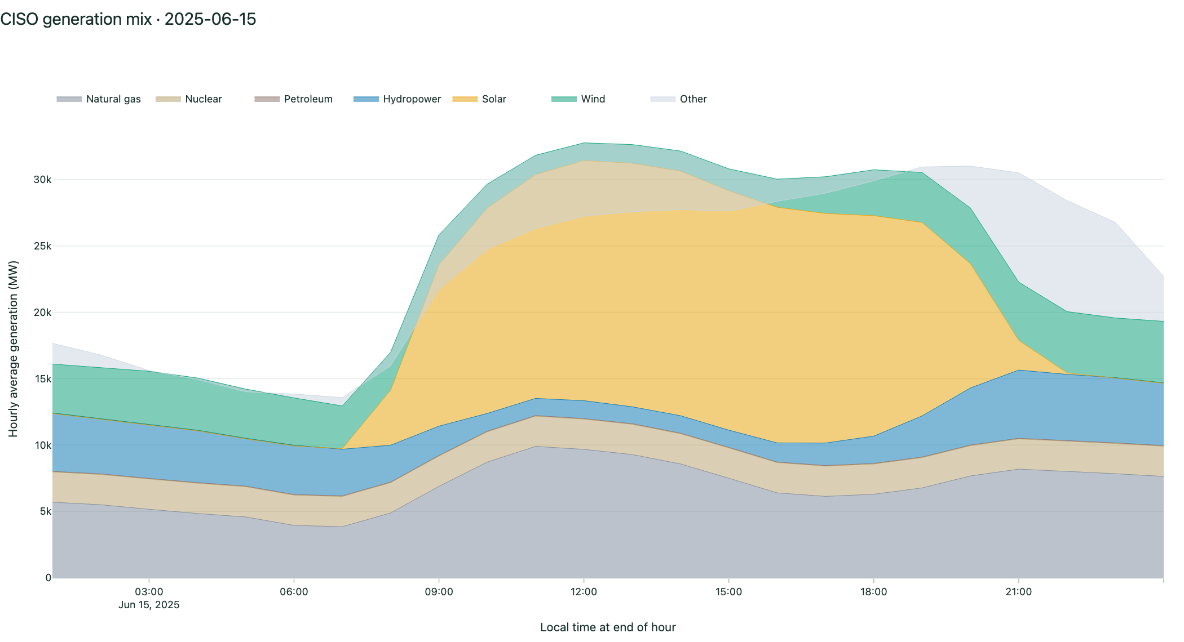
View 1 · Whole-system context
Daily stacked mix
CISO June 15: solar leads at 35.1% of positive reported mix
Shazab Ali · Renewable Grid Story 5
Notes:
4:00–4:50 — Slide 5 + live View 1: Generation mix
Switch to the local application at <http://127.0.0.1:8050/#view-1>.
Demo route:
1. Confirm CISO and June 15, 2025.
2. Hover across the stacked mix.
3. Point to the takeaway and missing-data notice.
4. Briefly switch authority or date, then return to the default.
Finding: solar has the largest summed hourly average on the default CISO day, about 35.1% of the positive reported mix. Explain that “positive reported mix” avoids allowing retained negative reports to distort the denominator.

Slide 6
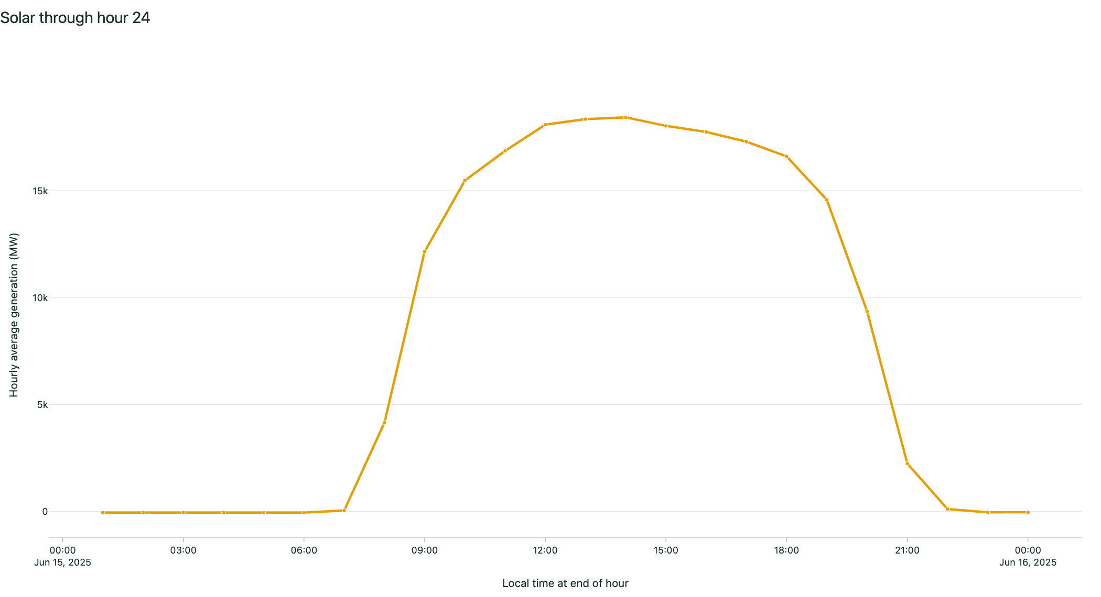
View 2 · Hourly rhythm
Previous / Play / Next / Reset
Dynamic 23-, 24-, or 25-observation boundary
Shazab Ali · Renewable Grid Story 6
Notes:
4:50–5:40 — Slide 6 + live View 2: Hourly playback
Navigate to `#view-2`.
1. Click Reset.
2. Click Next twice.
3. Click Play, let several points appear, then Pause.
4. Drag the slider toward the last observation.
Explain that the maximum is based on the selected day’s actual record count, supporting 23- and 25-observation daylight-saving days. Playback is clamped at both boundaries.

Slide 7
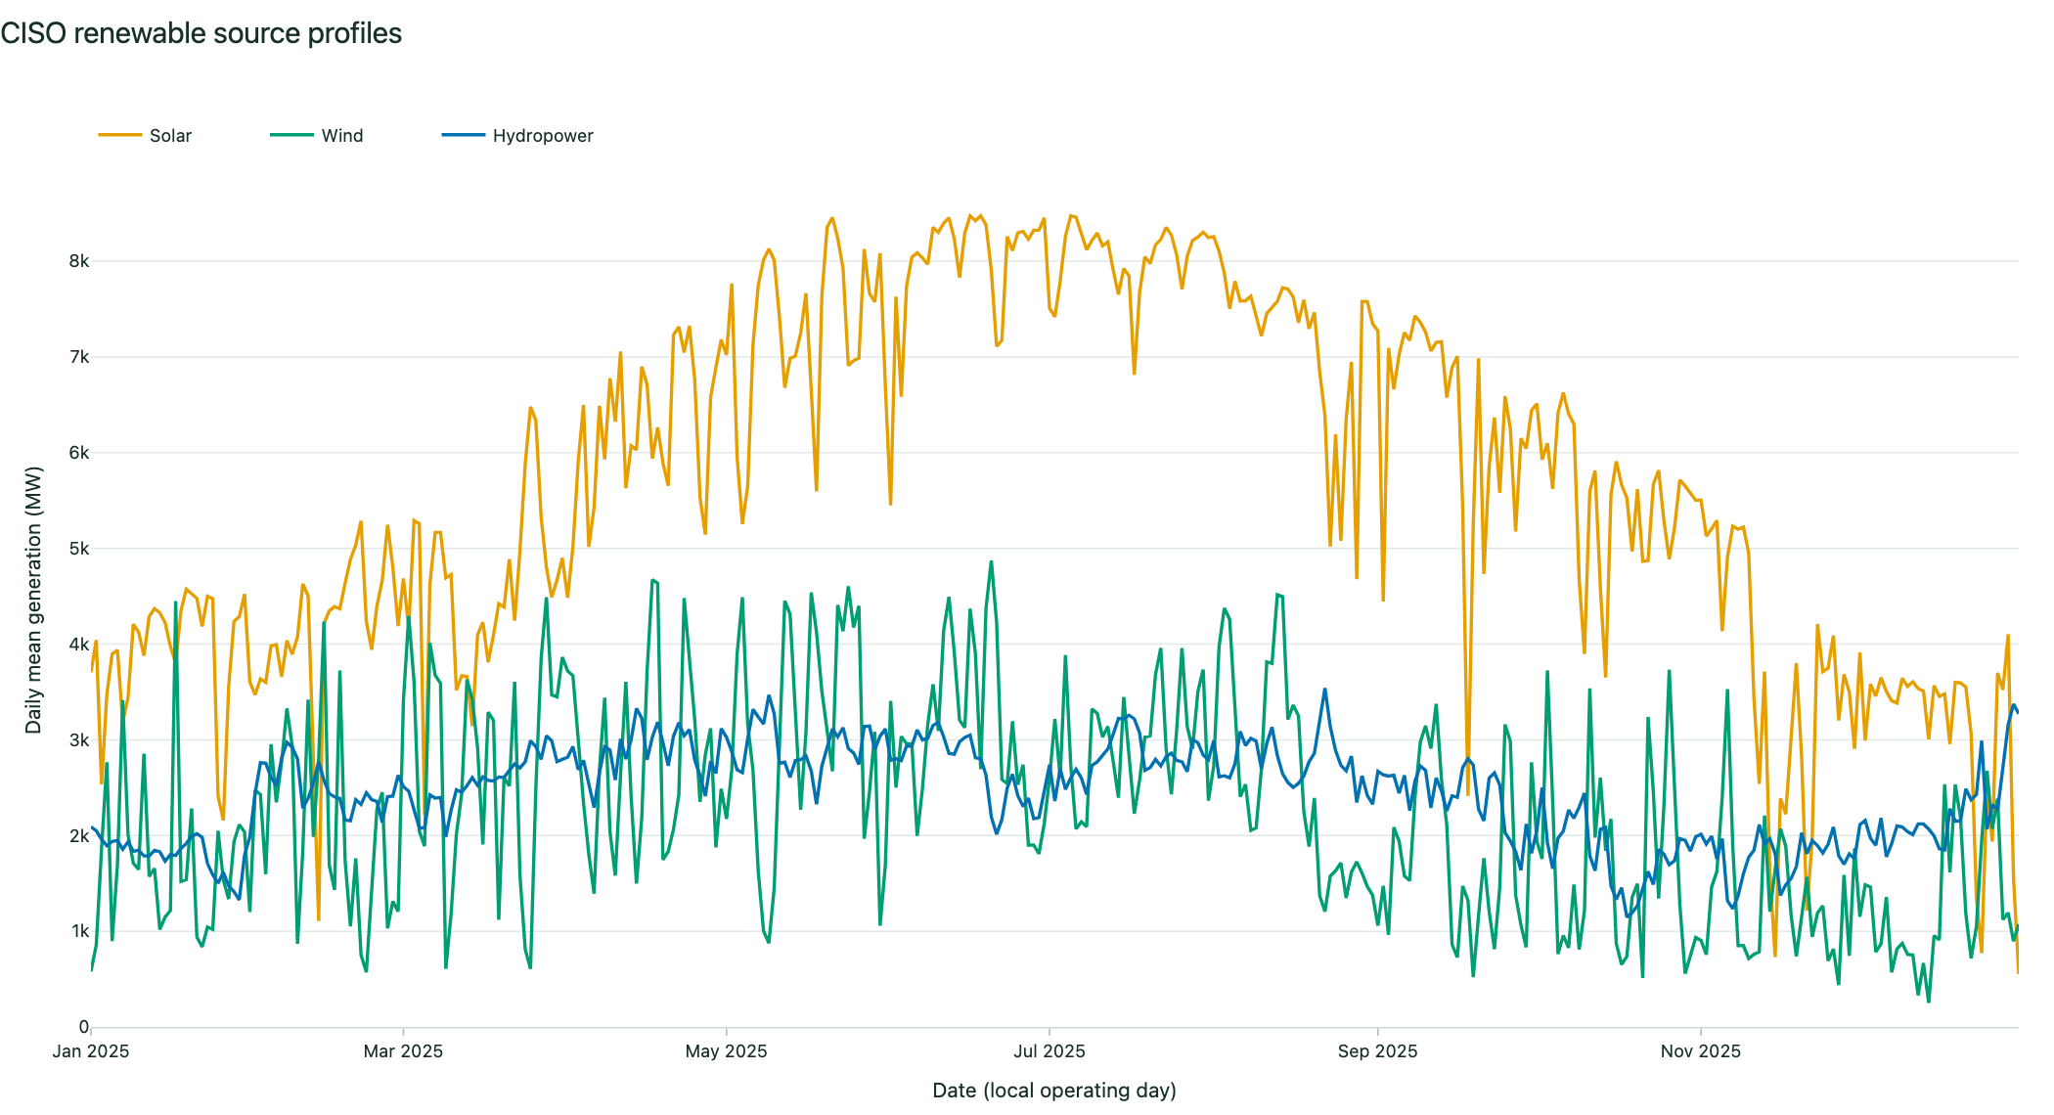
View 3 · Annual pulse
Daily means expose seasonal structure
Normalized = percent of each source’s own peak
Shazab Ali · Renewable Grid Story 7
Notes:
5:40–6:35 — Slide 7 + live View 3: Annual pulse
Navigate to `#view-3`.
1. Show all three sources in absolute mode.
2. Toggle individual source checkboxes.
3. Switch to Normalized.
Say: “Each source is divided by its own annual peak. A value of 100% means that source’s peak, not equal MW and not renewable share.” Use the normalized mode to discuss shape and the absolute mode to discuss magnitude.

Slide 8
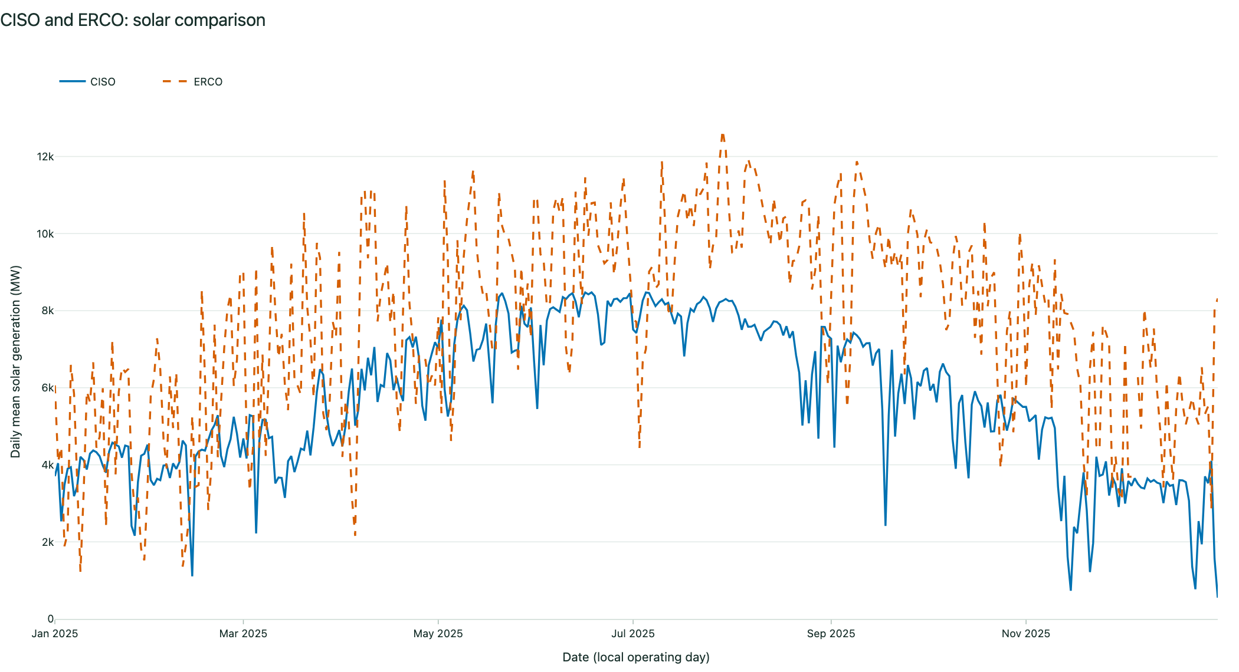
View 4 · Regional context
Matched source and dates
ERCO mean solar ≈ 1.36× CISO in 2025
Shazab Ali · Renewable Grid Story 8
Notes:
6:35–7:30 — Slide 8 + live View 4: Regional comparison
Navigate to `#view-4`.
1. Keep CISO and ERCO.
2. Keep solar and the full 2025 period.
3. Toggle Raw MW to Normalized and back.
4. Point out that both series use exactly the same operating dates.
Finding: ERCO’s 2025 hourly mean solar is about 7,723.9 MW versus CISO’s 5,667.9 MW—about 1.36 times as high. Clarify that map points are schematic references, not balancing-authority boundaries.

Slide 9
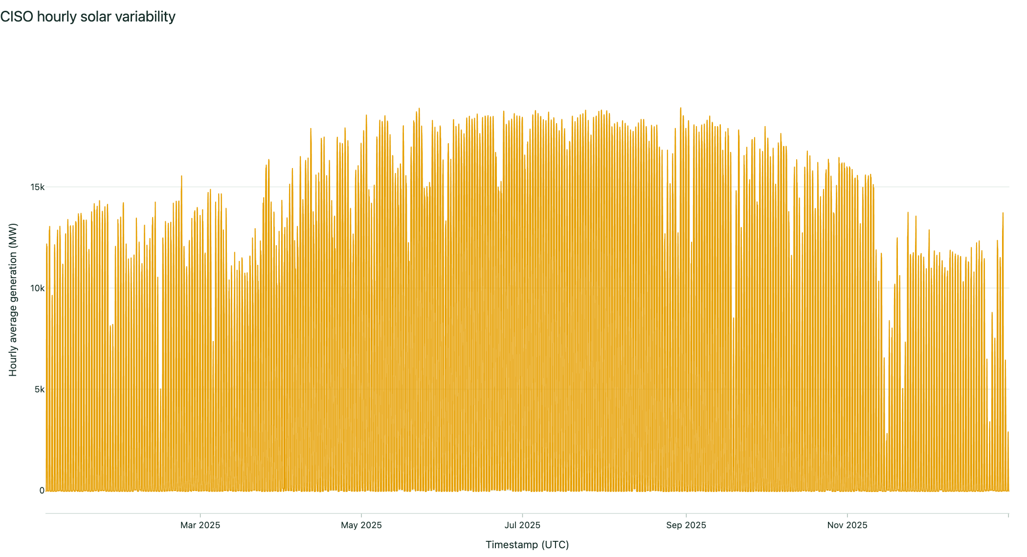
View 5 · Quantified variability
CISO solar mean 5,667.9 MW
CV 1.203; zero mean returns undefined
Shazab Ali · Renewable Grid Story 9
Notes:
7:30–8:30 — Slide 9 + live View 5: Variability
Navigate to `#view-5`.
Read selected CISO solar metrics:
- mean: 5,667.9 MW;
- maximum: 18,912 MW;
- sample standard deviation: 6,818.2 MW; and
- CV: 1.203.
Explain CV as sample standard deviation divided by the absolute mean. It compares relative spread, but it is not predictability, ramping difficulty, forecast error, or reliability. If the mean is zero—as with available NYIS solar values—the implemented result is “undefined.”

Slide 10
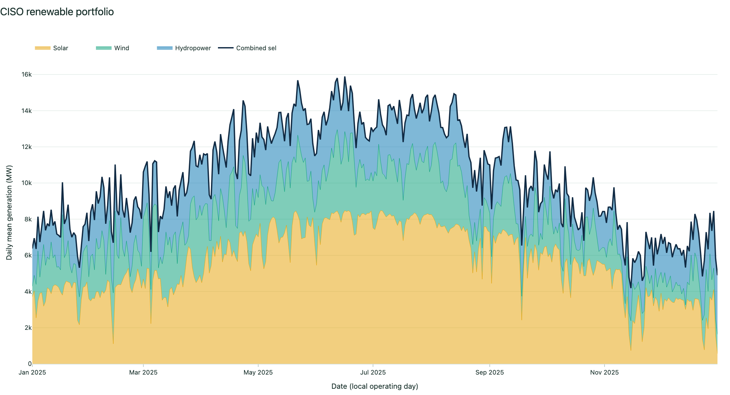
View 6 · Portfolio test
CISO combined CV 0.590
Lower than solar/wind—not lower than hydro (0.463)
Shazab Ali · Renewable Grid Story 10
Notes:
8:30–9:40 — Slide 10 + live View 6: Portfolio
Before revealing the comparison, ask the class:
> If solar, wind, and hydropower are combined, will the portfolio always have the lowest coefficient of variation?
Pause briefly for responses, then navigate to `#view-6`.
1. Show all three selected sources.
2. Point to the combined daily-mean line.
3. Point to the CV comparison chart.
4. Toggle one source off, then use Reset sources.
Finding: CISO 2025 CVs are solar 1.203, wind 0.595, hydropower 0.463, and combined 0.590. The portfolio is lower than solar and wind, but not lower than hydropower. The outcome depends on covariance, source choice, region, and period.

Slide 11
2025: scale and share tell different stories
CISO
90.8M MWh
renewable energy
48.744%
share of net generation
ERCO
182.8M MWh
renewable energy
37.583%
share of net generation
NYIS
31.1M MWh
renewable energy
23.500%
share of net generation
PJM
72.3M MWh
renewable energy
8.255%
share of net generation
ERCO leads absolute renewable output; CISO leads renewable share.
Shazab Ali · Renewable Grid Story 11
Notes:
9:40–10:40 — Slide 11: Main annual findings
Return to slides.
- ERCO: 182.821 million MWh renewables, the largest absolute output; 37.583% share.
- CISO: 90.819 million MWh; the largest share at 48.744%.
- NYIS: 31.137 million MWh; 23.500%.
- PJM: 72.299 million MWh; 8.255%.
Explain why this matters: PJM exceeds NYIS in absolute renewable energy but has a much lower share because its net generation is much larger. A single ranking cannot answer both scale and composition questions.

Slide 12
Evaluation, limitations, and next step
Completed: 20 tests; internal desktop/mobile checks; one visual-feedback revision.
Pending: broader target-audience comprehension testing.
Limits: one year, four authorities, reporting gaps, schematic map, descriptive CV.
Verified Render deployment; local app and screenshots remain presentation backups.
Shazab Ali · Renewable Grid Story 12
Notes:
10:40–11:35 — Slide 12: Evaluation and limitations
Completed evidence:
- 20 automated tests;
- internal desktop and mobile rendering checks;
- playback and normalized-control checks; and
- six reproducible screenshots.
Human evaluation:
- one visual review identified overlapping chart titles and legends;
- the accepted revision separated title/legend zones, improved responsive spacing, and added a colorblind-safe palette; and
- a broader target-audience comprehension session remains pending.
Key limitations: one year, four authorities, 31 renewable/mix gaps, authority-specific reporting, no capacity normalization, schematic map, and descriptive CV.

Slide 13
Class question
Before the final demo result…
If solar, wind, and hydropower are combined,
will the portfolio always have the lowest CV?
CISO 2025 answer: no—the portfolio beats solar and wind, but not hydropower.
Shazab Ali · Renewable Grid Story 13
Notes:
11:35–12:25 — Slide 13: Answer and contribution
Answer the class question: no, a portfolio does not automatically have the lowest CV.
Summarize the project contribution:
- a coherent six-view explanatory sequence;
- reproducible source-to-figure workflow;
- explicit equations and boundary behavior;
- honest disclosure of failed validation and pending human testing.
State that the Render URL has been verified and that the local app remains the presentation backup.
12:25–13:00 — Close and questions
Close with:
“The key lesson is that renewable output has to be read in context: by hour, season, place, scale, and variability. The interface makes those comparisons available while keeping the missing data and analytical limits visible.”
Invite questions.

