Slide 1
BraiNwaves 2019
TEAM AVENGERS

Slide 2
Approach IDEOLOGY
SEMI SUPERVISED LEARNING MODEL
Tools used
PyTorch deep learning library
Infersent by Facebook AI Research
Flair Embeddings – State-of-art natural language processing framework
SpaCy – Industrial-strength natural language processing in Python
Glove 840B Embeddings by Google
Gradient Boost Trees machine learning model

Slide 3
Problem statement
To understand ISDA legal document from scanned files to extract cognitively relevant information to key-in information into software application.
29 of 250 fields available
8 of 40 clauses available
CHALLENGES
Inconsistent OCR XML extractions
Complex text corpus
Scalability & deployment
Incoherent feature set

Slide 4
SUPERVISED LEARNING
Challenges
Limited train data
Duplicate value strings
Scalability due to crowded parameters
Timing constraint for deep learning application
Supervised Learning Recipe
One robust framework for all clauses
Strong cross validation
Light GBM model
TF/IDF, SVD and Word Embedding
Name Entity Recognition for post processing

Slide 5

SUPERVISED LEARNING
Work Flow Diagram
NER
(Date)
Bi-directional Features
Robust LGBM Model
Predictions
Mapping
(Post Processing)
Edge Cases

Slide 6
UNSUPERVISED LEARNING
Why go Unsupervised?
State-of-the art accuracies
Pre-trained models
Scalability
Task independent learning
Unsupervised Learning Recipe
InferSent pre-trained model
Doc2Vec unsupervised model
Glove 800 billion embeddings
High-scalability design
Single model approach

Slide 7
UNSUPERVISED LEARNING
Work Flow Diagram
Root Extraction
Infer Sent
Predicted Sentence
Parse Tree
Doc2Vec
Mapping

Slide 8
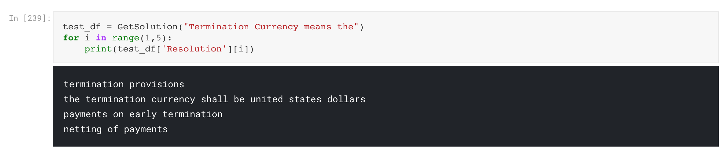
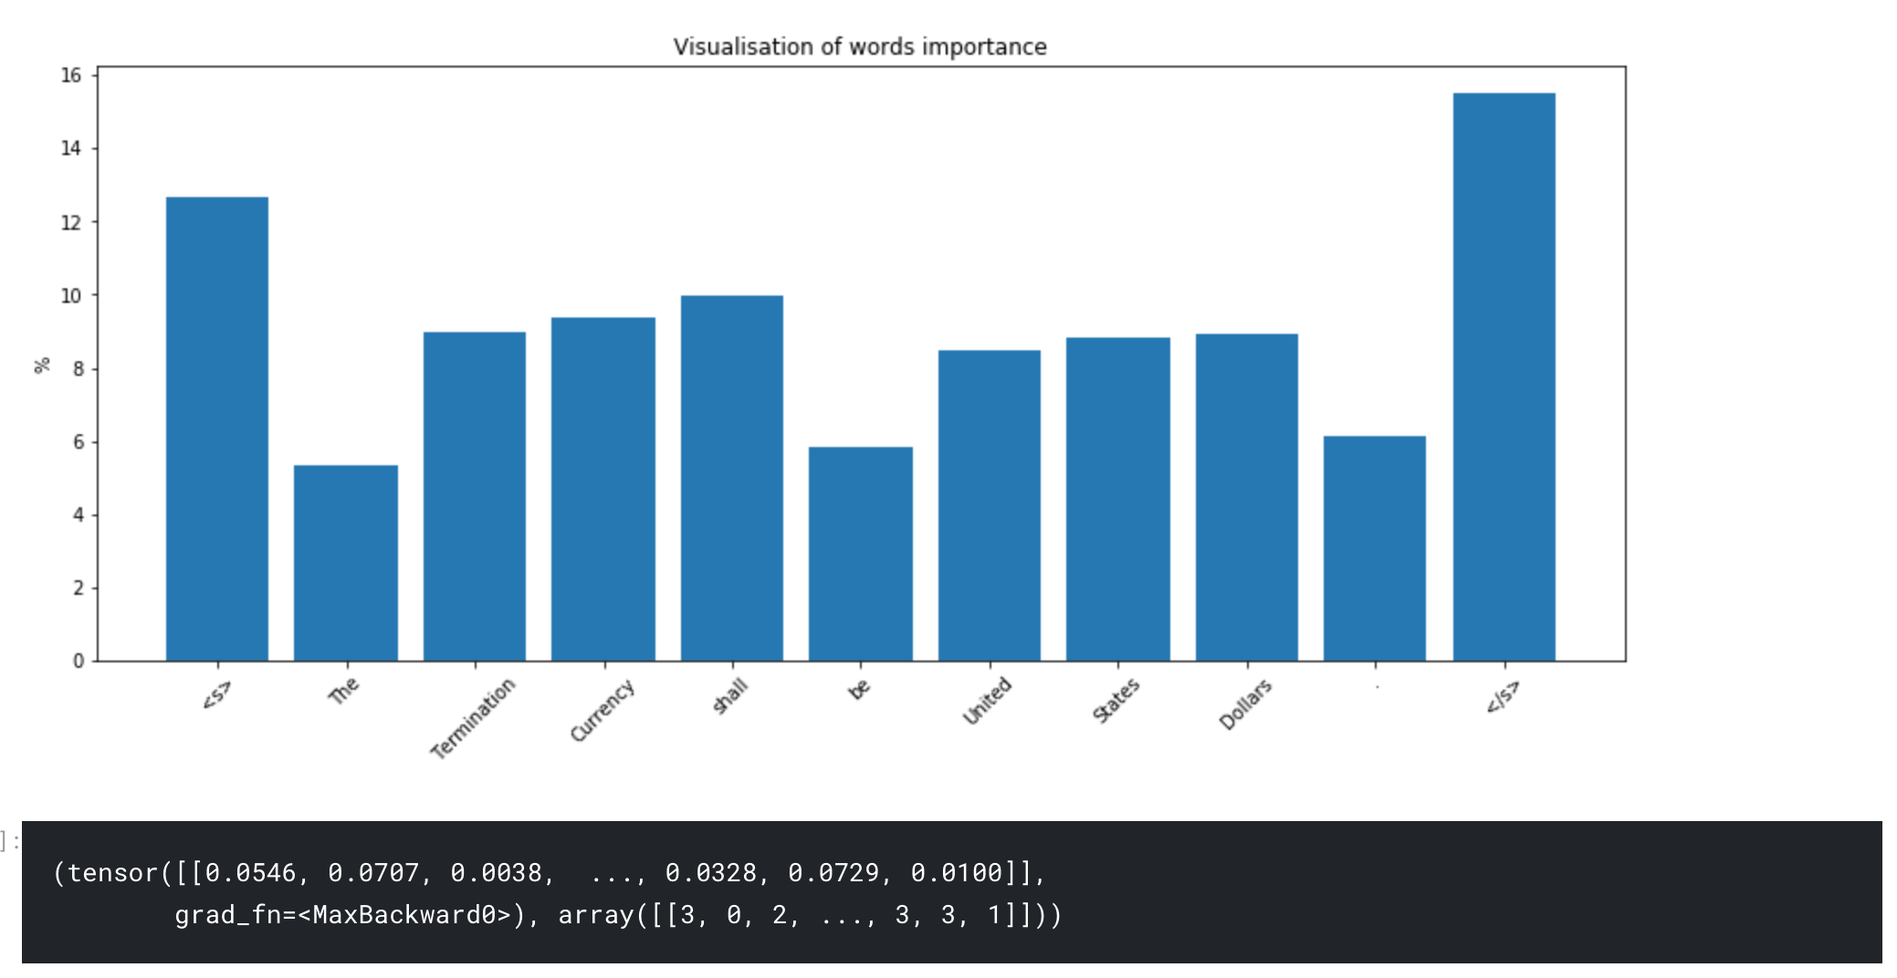

Slide 9
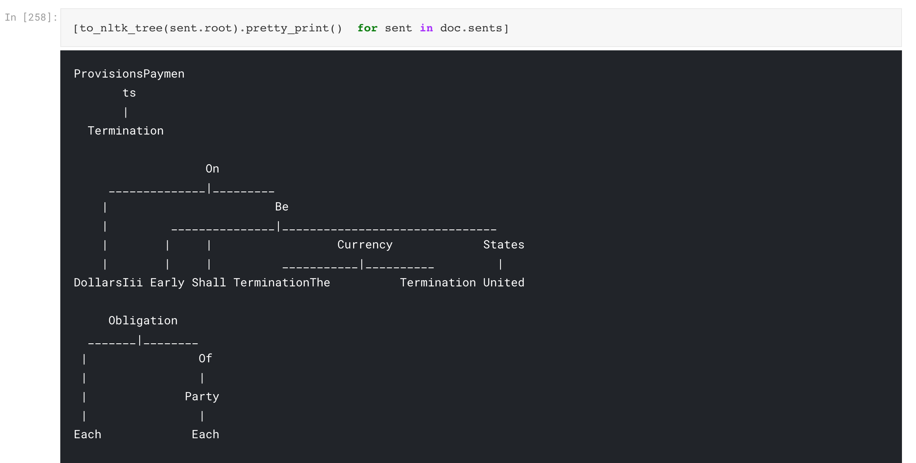

Slide 10
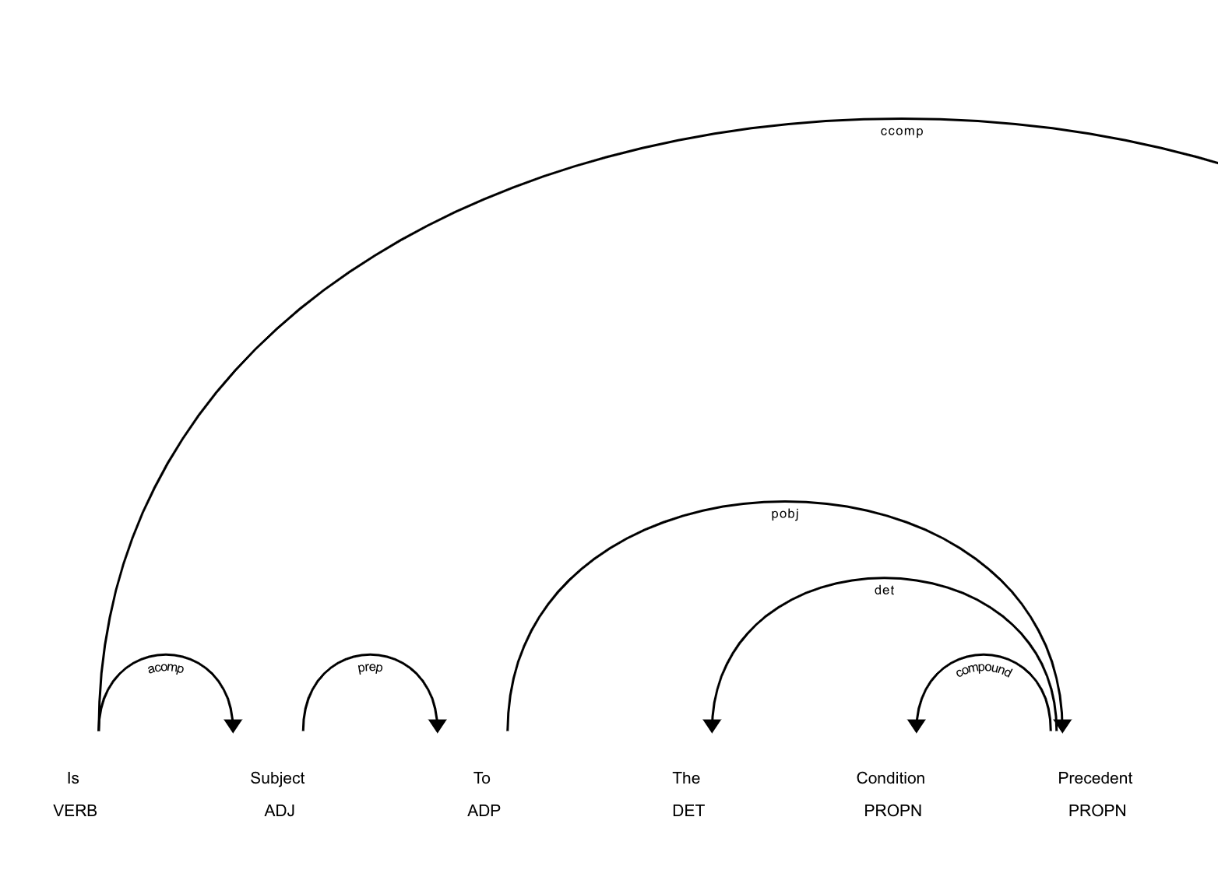
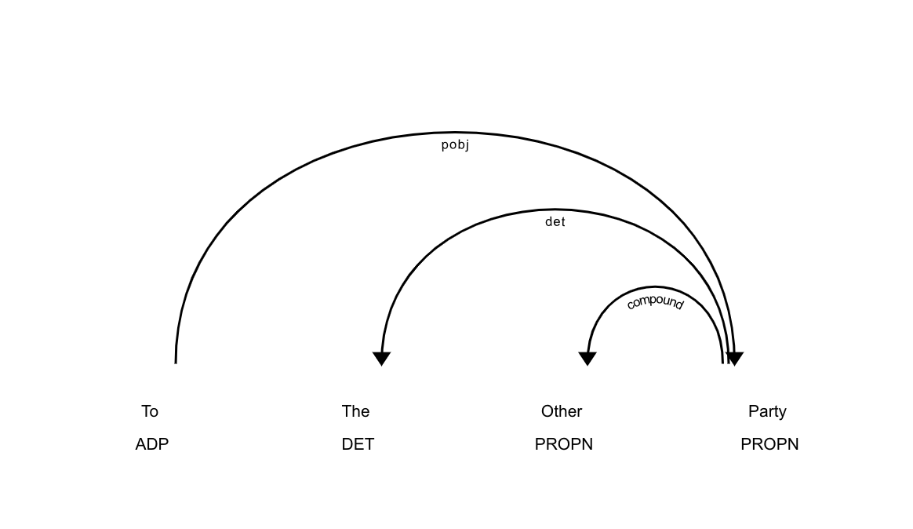

Slide 11
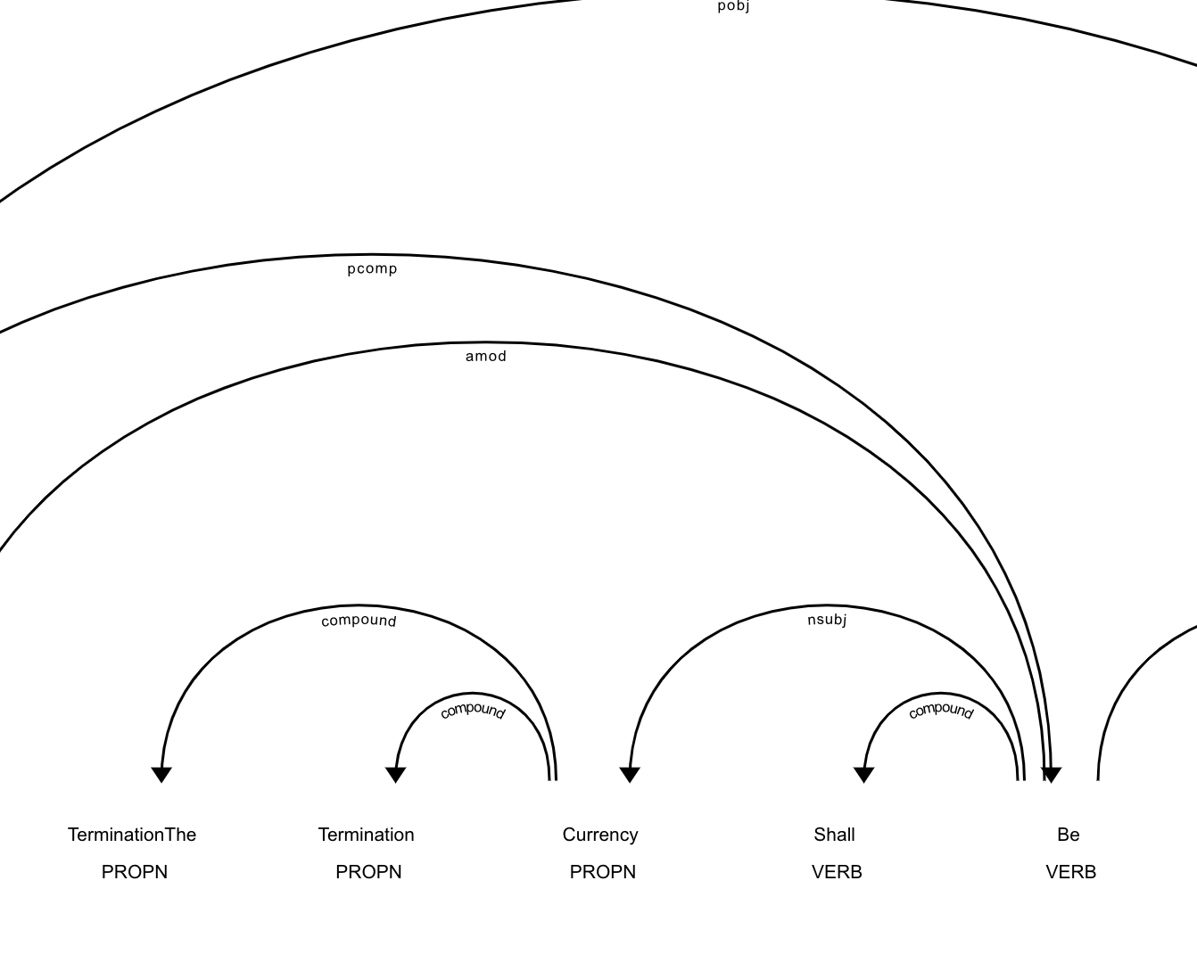
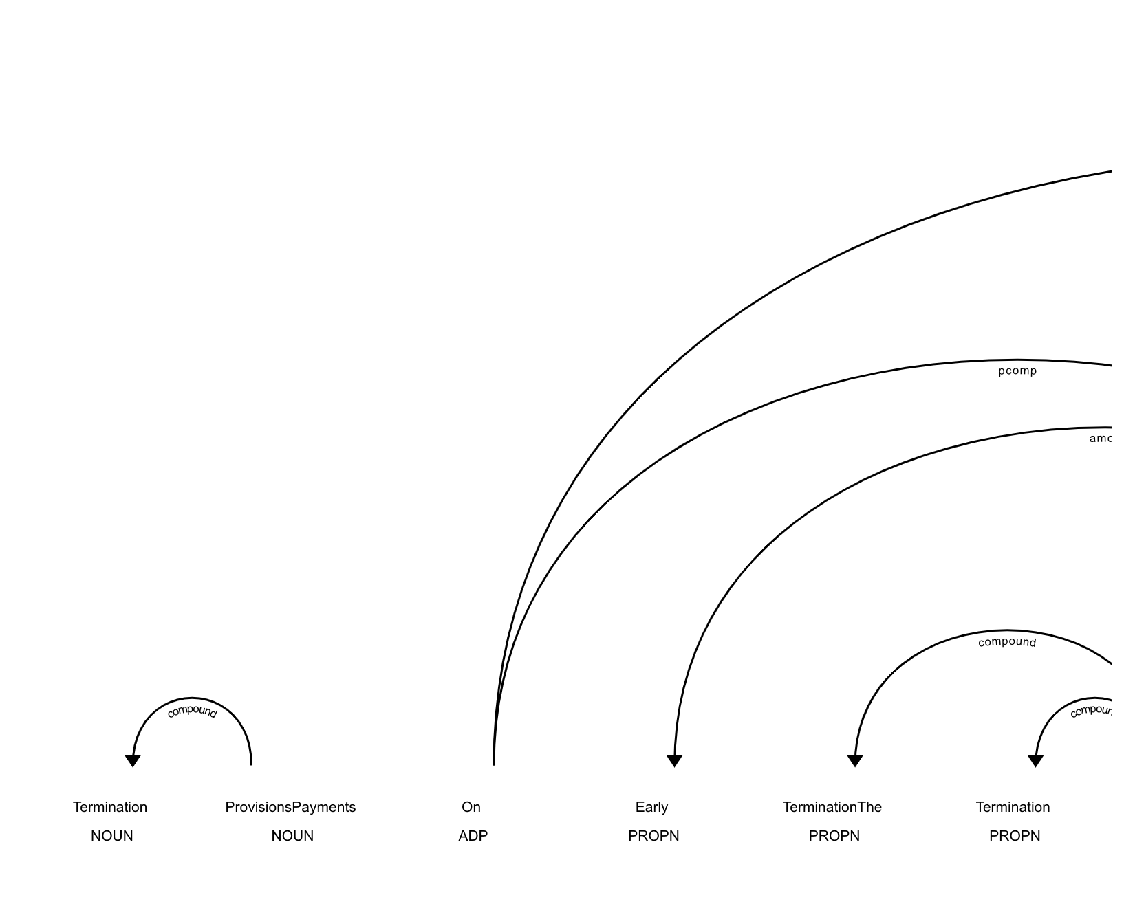

Slide 12
