Slide 1
Innominds
Machine Learning Hackathon
Develop an application that suggests best solution to a question based on past behavior & available solutions.

Slide 2
About You
A few words about you. What do you do, Where do you work, what are your interests..
Currently an undergrad student at
Jawaharlal Nehru Technological University Hyderabad. At the moment I am
Data Science Intern at Analytics Vidhya where I am responsible building in house machine learning products for the company
Here’s list of my achievements:
1st Runner-up and winner of ₹1,00,000 prize at TechGig in Machine Learning Hackathon by CreditSuisse, 2018
Rank 2 with 1636 points at student rankings by Analytics Vidhya with just 27 hackathon participation.
Rank 1 and ₹50,000 grand prize winner at national level data science hackathon by JNTUH and Colaberry - USA, 2018
Rank 1 out of 200 applicants at Analytics Vidhya Hiring Hackathon, 2018
Rank 9 out of 261 participants at “Data Tales – Beyond Infinity” competition on Analytics Vidhya,2017

Slide 3
Core Idea
Explain the given problem statement in your words
As the reach of technology roots to new customers in the Internet era there is increase in customer demands and queries. Current implementation requires L1 technician to go through the manuals and find the apt solution.
This is posing new problems when the requests are scaled at high demand and also the resolution is not correct. Due to this the company is loosing its loyal customers which is not good for a business.

Slide 4
Implementation Overview
Explain the solution submitted in your words
The current project idea presents standard Natural Language Processing Techniques and use Deep learning model to train on the available data to better predict the use cases and resolutions.
The data from the input files is cleaned and processed under data.csv in the root directory of back-end folder. The models are trained on this data to predict the resolution for a passed query.
The data.csv is processed file which contains the resources from given data, FAQs, Tickets and summarized into a single .csv file for training purpose.

Slide 5
Technology/Tool/Components used
Explain the Technologies, Languages used in your solution.
The tools used are:
NLTK
Doc2Vec Model
Flask
PostregSQL
Flask Restful
Cross Origin Extension
Stopwords
Deep Learning (Gensim)

Slide 6
Architecture overview
Explain the Architecture you followed in your solution
The main approach adopted is generating a generalized Doc2Vec model. First the queries and the resolutions are tokenized. The sentences are later converted into TaggedDocuments with the help of gensim library.
Later the tagging is applied from query to resolution. The gensim model is trained for 100 epochs for titles and 600 epochs for the body of document. The models individually are saved. The deep learning model is trained on the data and the models train in about 1 min 58 seconds
Later the query is taken as input from the front-end search / bot interface. At back-end, function GetSolution takes the query string and prepossess into tokenization and later inferred vectors. After the query string is vectorized. The cosine similarity of the query is compared with the existing documents.
The items with highest similarities are then sorted and returned back to front-end

Slide 7
Elaboration of the usage
How does your application work.
The application currently takes keywords/tags or sentences in the search string and outputs relevant resolutions.
The points to be noted are:
The keywords should not be misspelled
Unambiguous search will lead to random results.
The results are often ordered according to similarity scores. Hence, the solutions from the top 5 should be considerable.
If the resolution is not expected. Click the magic button again to sent request again to process the vector. This should give more precise results with more data

Slide 8
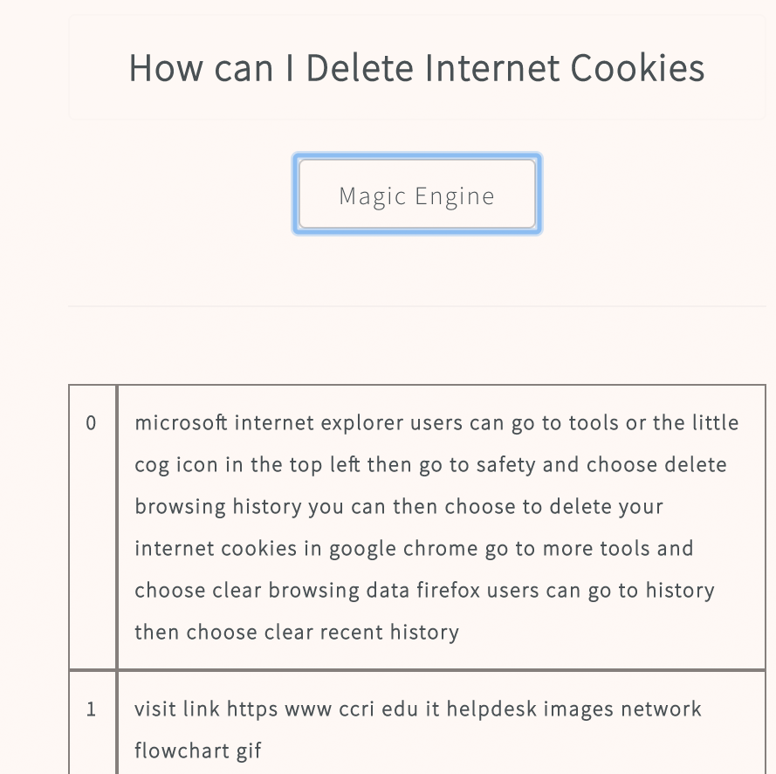
Number of Output Questions
Working
In the output sheet we provided how many questions are showing the correct answers and what are those.
Almost all the question work. The deep learning model currently suffers due to lack of data of past handled tickets. In the challenge we have abundant data for computer queries which work 100% correctly. Due to less data the login and ticket issues require double checks on ”Magic Button” to get correct resolutions. Here are screen shorts of working demo.

Slide 9
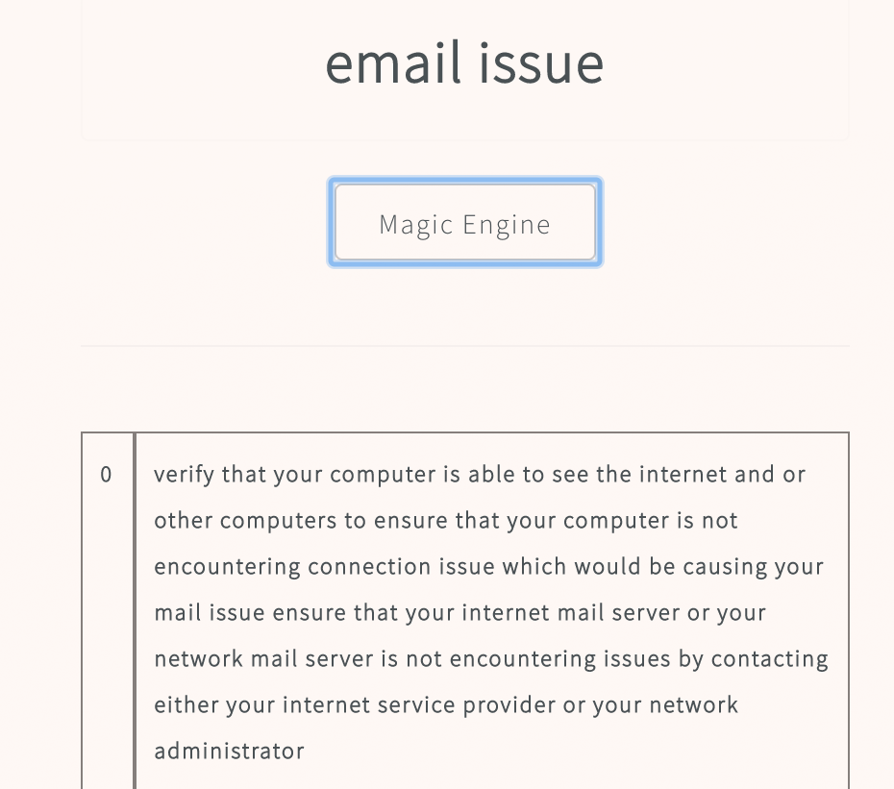
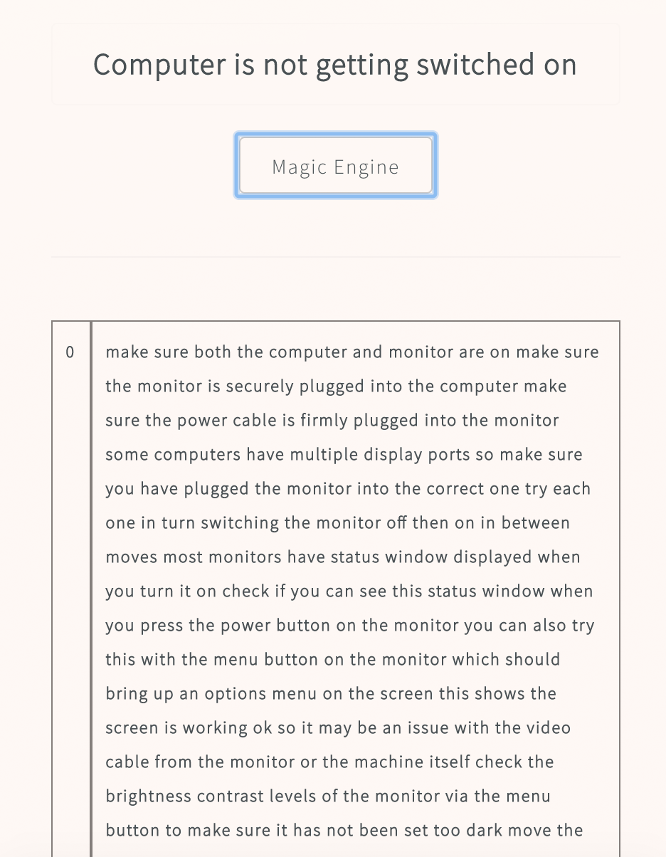

Slide 10
Prototype Demo
Add a video link of the workable solution. Please cover as many output scenario’s as you can show from the output excel provided. (Mandatory)
https://youtu.be/UqJnwbmMfk0

Slide 11
Source Code
GIT Link and Compile Instructions, Solution Hosted URL
https://github.com/shaz13/InnBot
Instructions are written in the README.md of repo

Slide 12
Completeness
Mark the area’s which have been completed and tested. They will be a part of the evaluation parameters.
Area | Description
Performance – How did you measure the performance of this system. | The output was measured with the Sample output provided. If the results appear in predicted first 3 results then the model performs well for that case.
Usability – How usable is your solution | Its completely usable and deployable.
Completeness – What has been completed. | The search backend, deep learning model and front end is done.
Pending – What are the items which are pending | Scalable items that tracks events from front end are left over.

Slide 13
Possible Improvement
Any Improvements you want to add?
Sure, do. I wanted to take this implementation one step further in future as in –
Predicting the follow up question to the asked question
Personalization to user/technician level. And also query specific bots that excel in their domain. IT/Service/Hardware/Software
Question Continuity. Example – My Ctrl key doesn't work. Next time user asks it, It works but seldom. Then the bot should be relating the query to the Ctrl key back
Adding more data. With more data the model will perform with higher accuracies on past tickets.

Slide 14
Thank You InnoMinds!
You really got us innovating our minds again.
~Shaz

