Slide 1
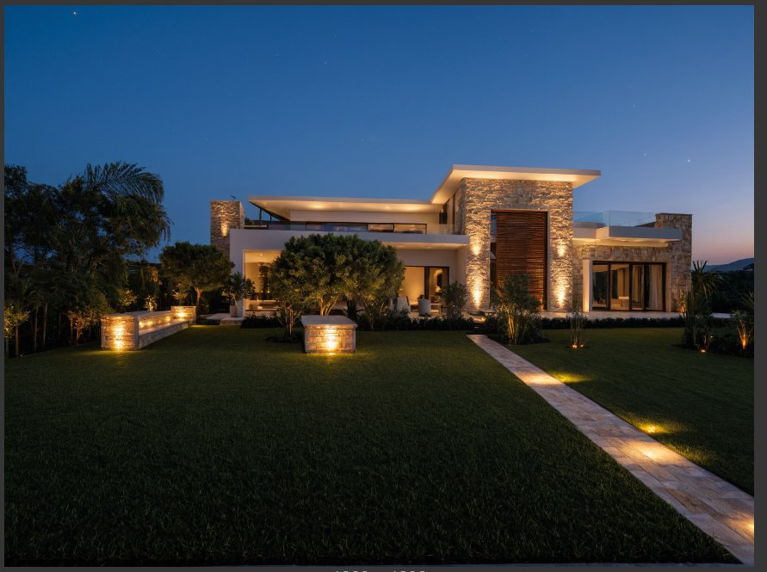
SQ INTERACTIVE
AI-Assisted
Architectural
Visualization
Proof of Concept for Design Line
Locally-hosted · Unlimited Iterations · Zero Recurring Cost
Prepared by Shazaib Qasim · sqinteractive.com

Slide 2



EXECUTIVE SUMMARY
What We Built — And Why It Matters
The Problem
What We Proved
Business Value
Design Line's current AI rendering workflow lacks structural accuracy, session memory, and requires heavy manual prompting — creating friction and revision overhead across every client project.
A fully local AI pipeline using ComfyUI + ControlNet can transform any real-world property photo into a high-quality architectural visualization — with unlimited iterations at zero cloud cost.
Faster concept approvals, reduced rendering dependency, privacy-safe client workflows, and a scalable system that can be embedded directly into Design Line's production pipeline.

Slide 3
THE PROBLEM
Current Visualization Workflows Are Holding Firms Back
01
Slow Iteration Cycles
02
No Session Memory
Each revision requires manual re-rendering or re-prompting, creating multi-hour delays between client feedback and updated concepts.
Every Gemini session starts from scratch. Design intent, style choices, and refinements are lost — forcing repetitive manual prompting.
03
Structural Inaccuracy
04
Cost & Privacy Risk
Cloud AI tools often distort architectural geometry, window proportions, and facade structure — undermining client trust.
Cloud API dependency means ongoing per-render cost and client property images being sent to external servers — a liability risk.

Slide 4
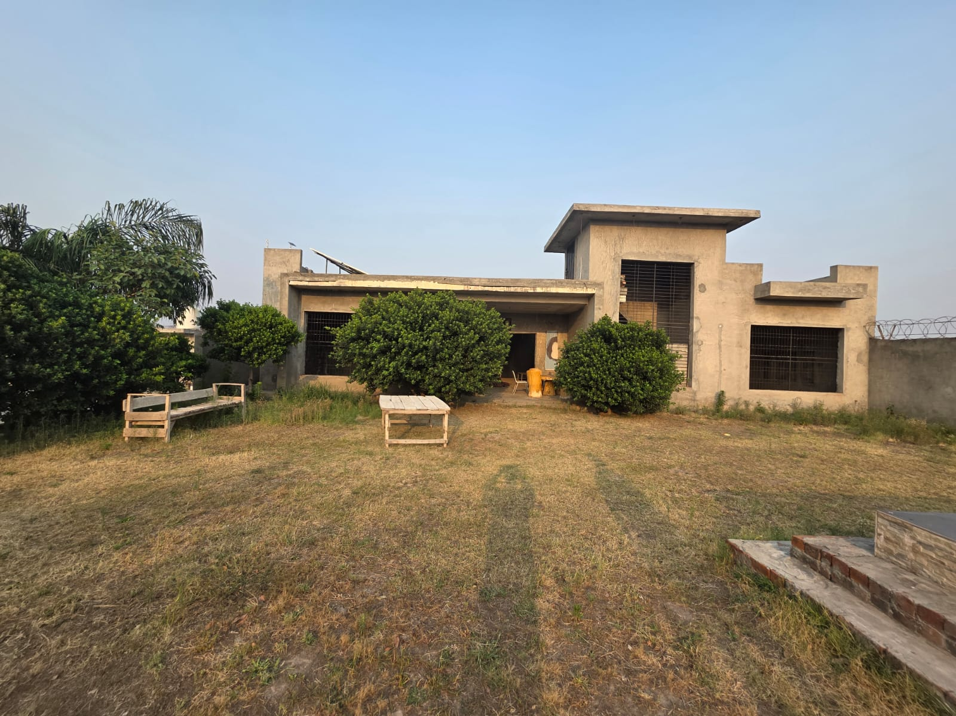

BEFORE & AFTER
Same Property. Same Structural Geometry. Transformed.
BEFORE
AFTER
Client-provided raw photo
AI-generated visualization — fully local pipeline

Slide 5
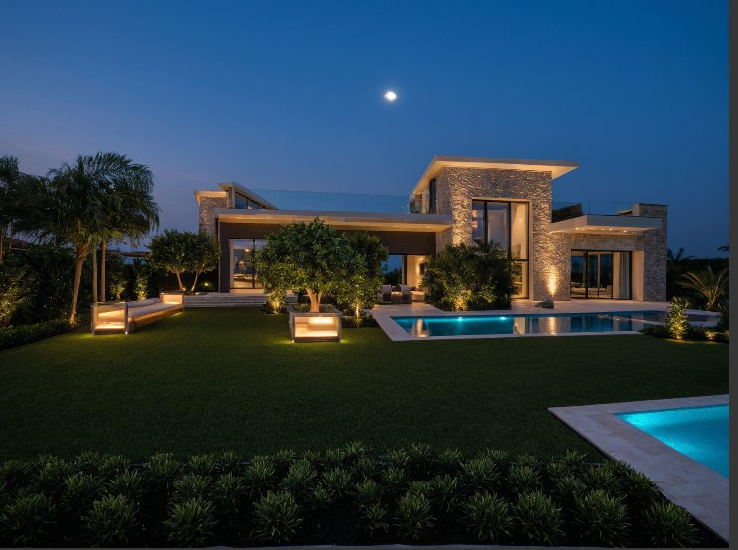
VARIATION SYSTEM
Multiple Concept Directions From a Single Input Image
Variation A — Modern Rustic
Variation B — Contemporary Luxury
Both generated from the same client photo · Same workflow · Zero additional cost

Slide 6
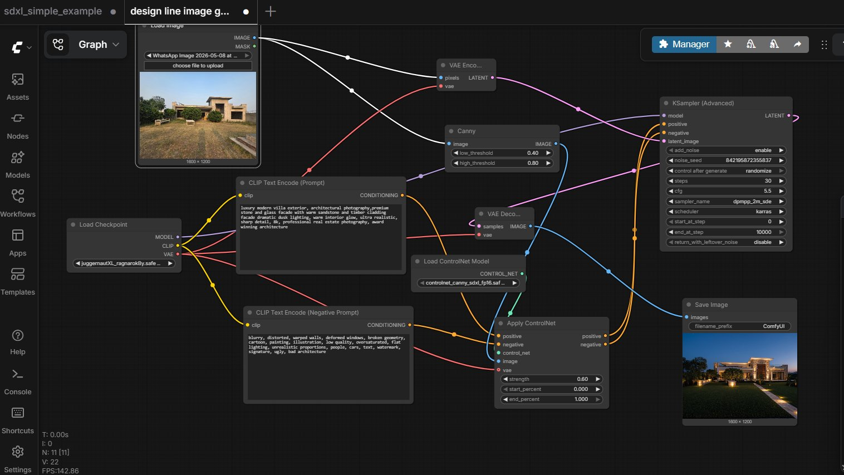
TECHNICAL WORKFLOW
How the Pipeline Works
1
Input
Client property photo uploaded into ComfyUI
2
Canny Edge Detection
ControlNet extracts precise architectural geometry
3
Prompt Engineering
Style, materials, lighting encoded into CLIP text
4
Local Inference
Juggernaut XL generates image via KSampler (30 steps)
5
Variation Output
Randomized seed generates unlimited concept directions
Stack: ComfyUI · Juggernaut XL · ControlNet Canny SDXL · KSampler Advanced · Local GPU

Slide 7


COMMERCIAL POTENTIAL
What This Means for Design Line
Faster Client Approvals
Embedded in Existing Projects
Generate 5–10 concept variations in a single session. Present more options, close approvals faster.
The workflow can run directly on your hardware — no new subscriptions, no data leaving your office.
Scalable Across Firm
Privacy-Safe by Default
Once built, any team member can run the pipeline. No technical expertise needed for day-to-day use.
All client property images stay local. Zero third-party cloud exposure — a selling point for premium clients.

Slide 8
NEXT STEPS
Proposed Path Forward
01
Pilot Phase
Run the pipeline on 3–5 active Design Line projects. Measure iteration time reduction vs. current workflow.
02
Workflow Refinement
Tune prompts, ControlNet strength, and upscaling to match Design Line's specific architectural style standards.
03
Team Onboarding
Train relevant staff on the pipeline interface. No coding required for day-to-day operation.
04
Full Integration
Deploy as a permanent internal tool, optionally packaged into a simple UI for non-technical team members.
Ready to run on your first project whenever you are.

Slide 9
This is not a concept.
It is a working system, built and tested on your firm's imagery.
Shazaib Qasier
XR Developer & AI Systems Consultant · SQ Interactive
sqinteractive.com

