Slide 1
Twitter Streaming application
with
Spark Streaming
Notes:
Twitter Streaming with Spark Structured Streaming

Slide 2
Agenda
Looking into working of Twitter Stream API.
To understand Pyspark based processing to extract media files from Twitter Streams.

Slide 3
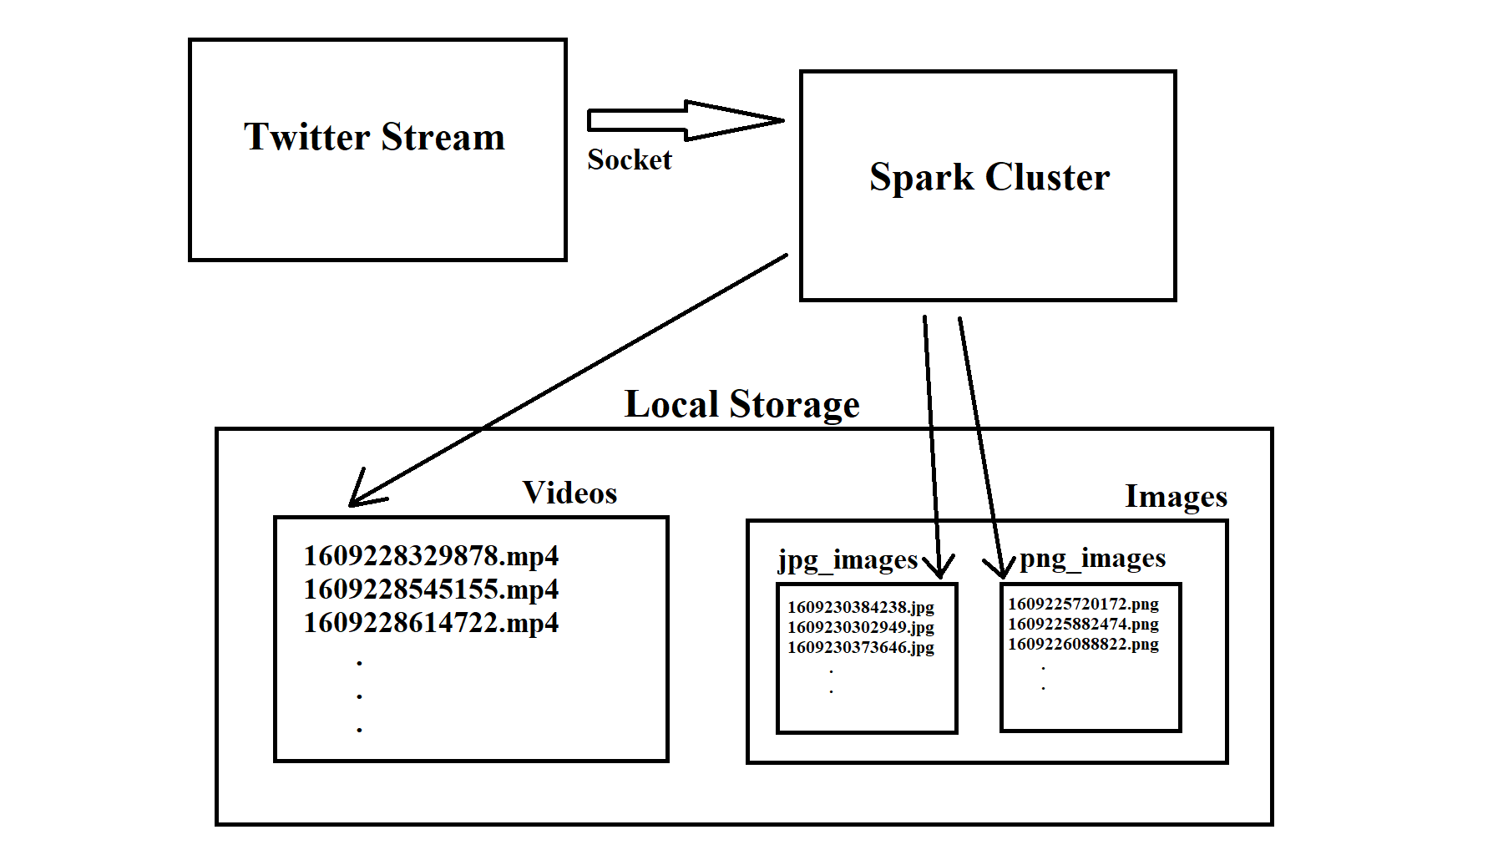
Data Workflow

Slide 4
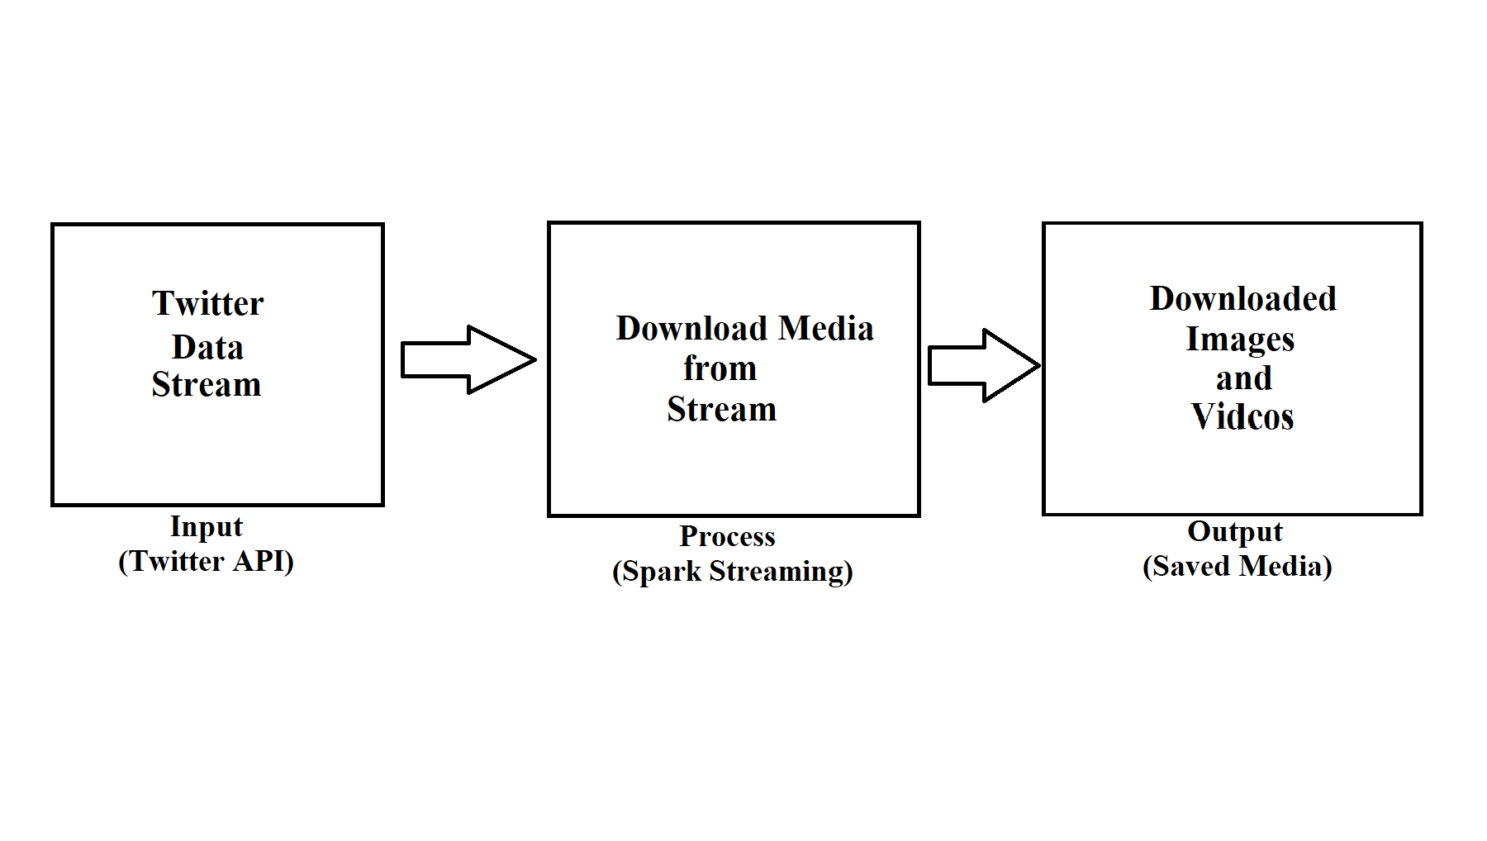
Input – Process - Output

Slide 5
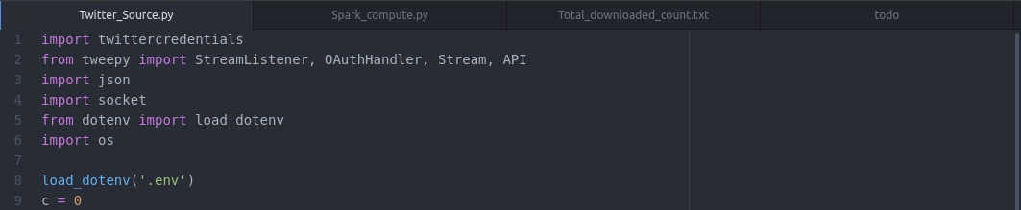
Code Snippets
Input Code (Twitter_Source.py)

Slide 6
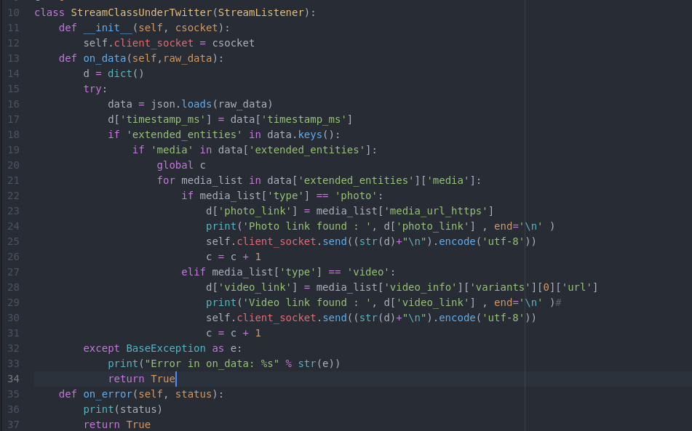
(Continued...)

Slide 7
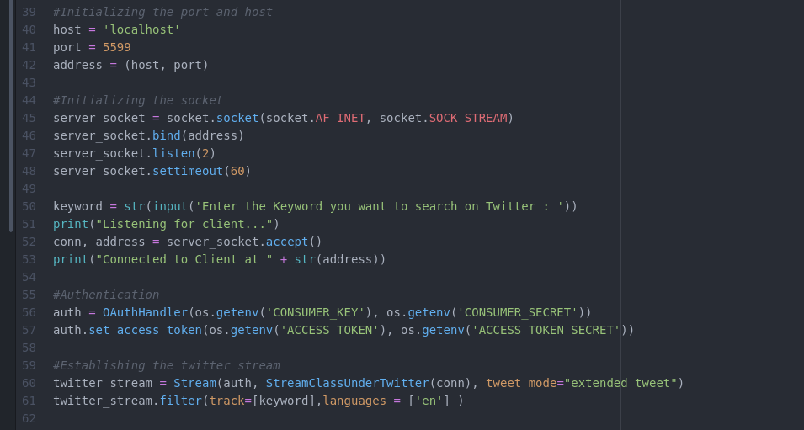
(Continued...)

Slide 8
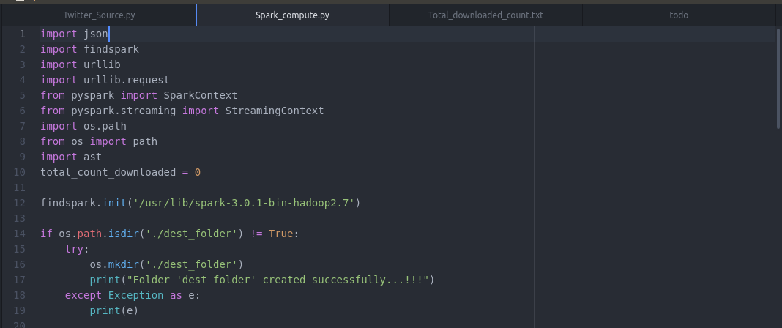
Process code (SparkCompute.py)

Slide 9
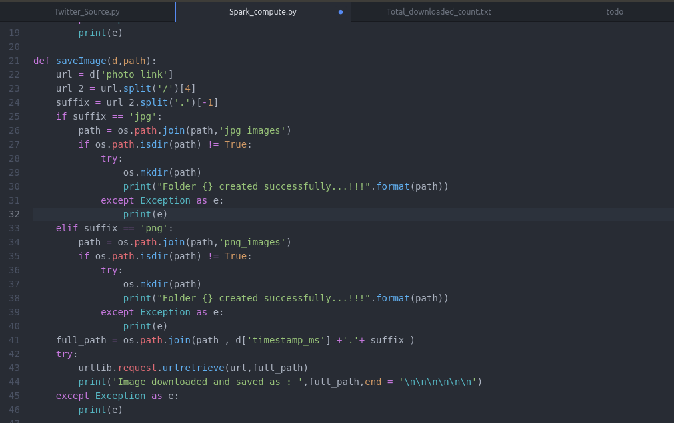
(Continued...)

Slide 10
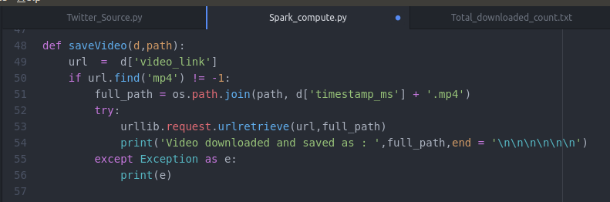
(Continued...)

Slide 11
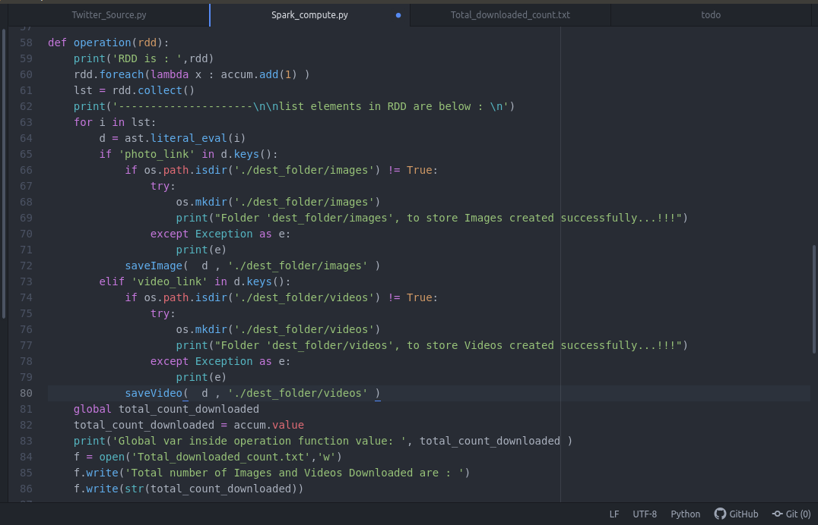
(Continued...)

Slide 12
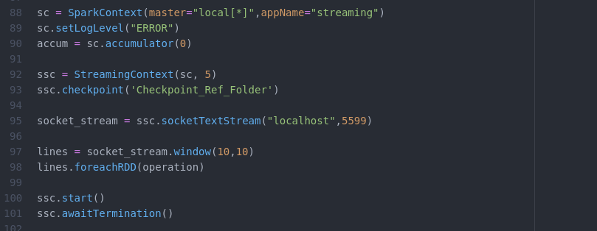
(Continued...)

Slide 13
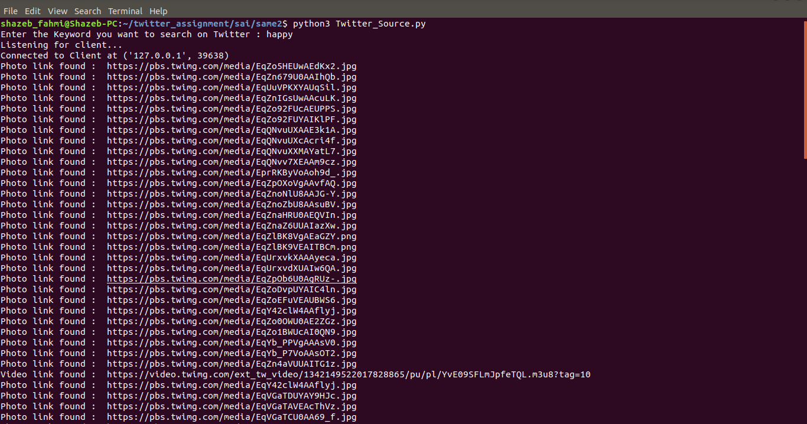
Terminal (Twitter_Source.py)

Slide 14
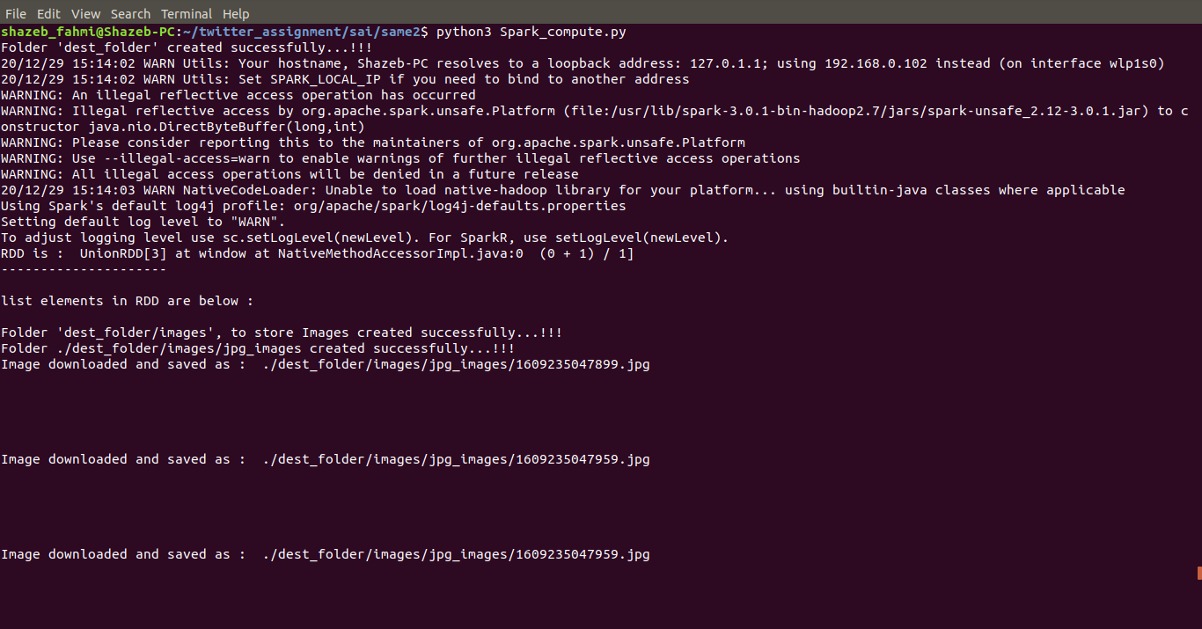
Terminal (Spark_compute.py)

Slide 15
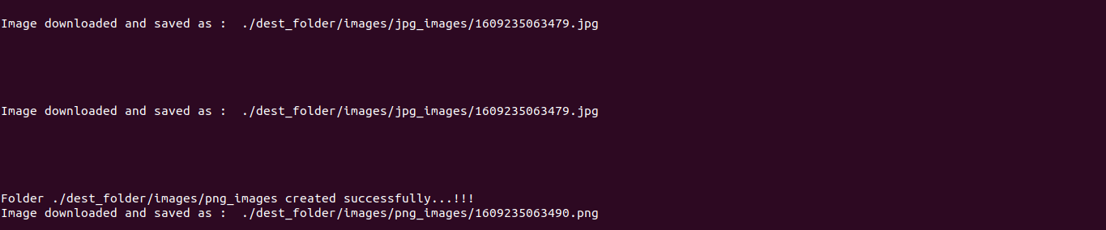
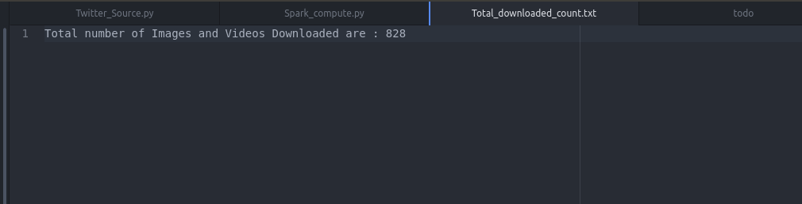
Terminal (Spark_compute.py)

Slide 16
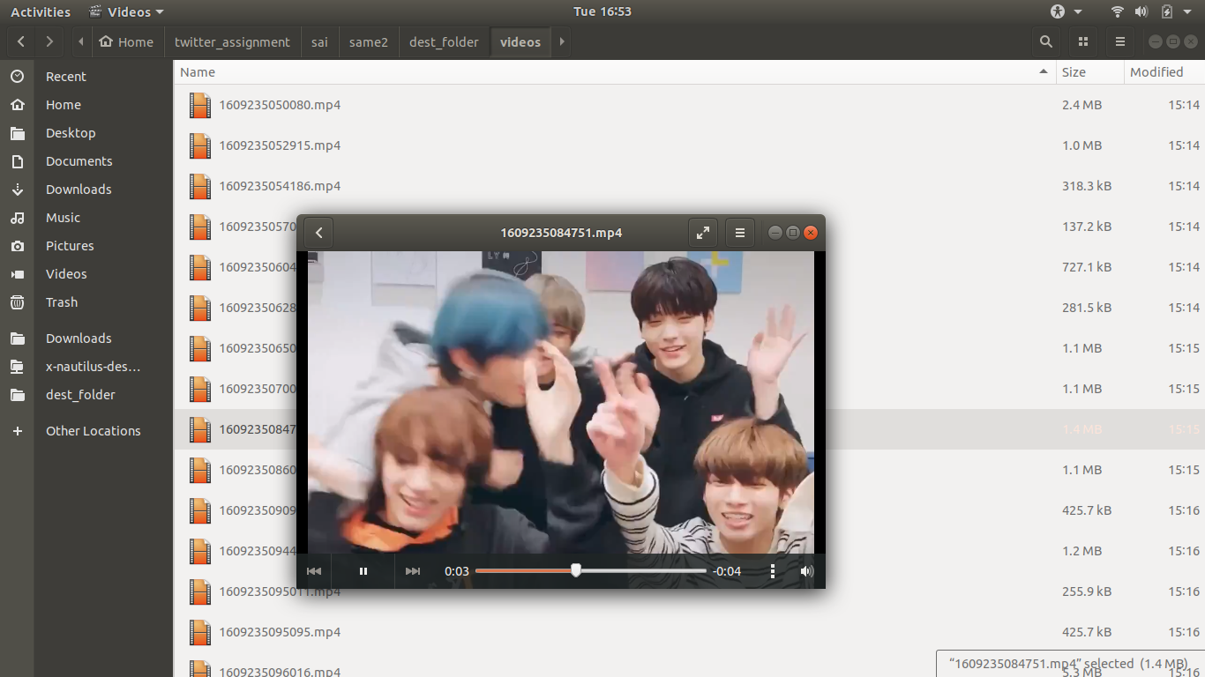
Output Media (mp4 files)

Slide 17
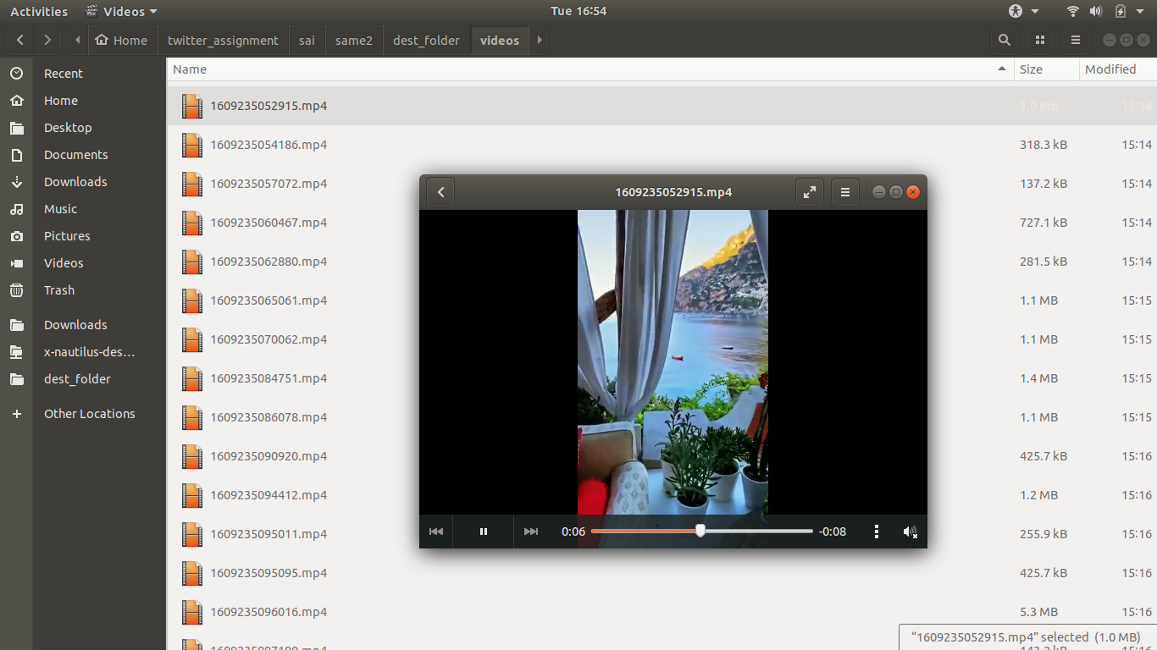
Output Media (mp4 files)

Slide 18
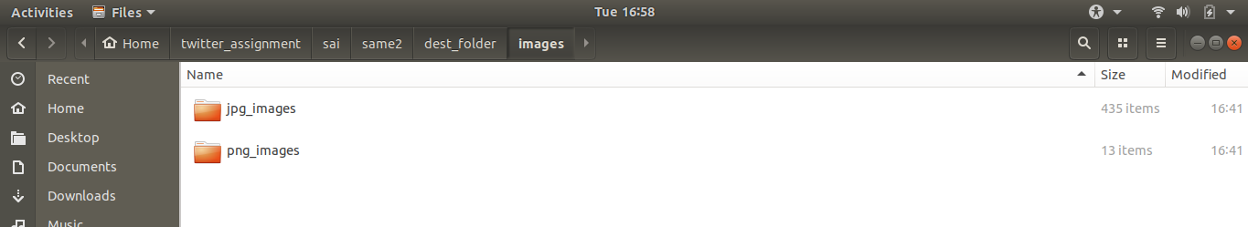
Output (folder structure)

Slide 19
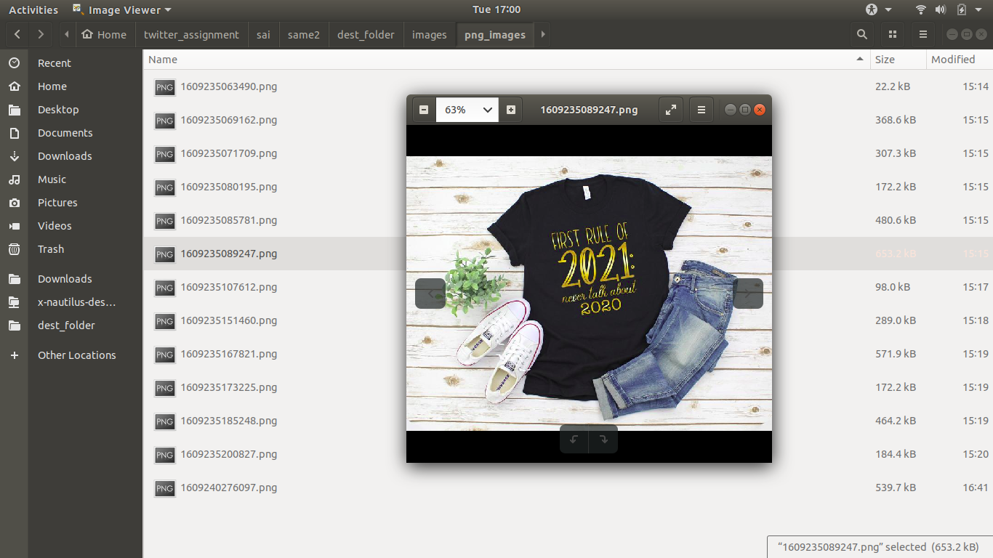
Output Media (image files)

Slide 20
Applications
The images can be aggregated from Twitter for various ML learning algorithms as a data set.
Searcing for images on Twitter becomes easier by entering a keyword.
It can be utilised to perform real time Tweet Analysis with respect to a keyword.

Slide 21
Thank You

