Slide 1
jenkins
introduction

Slide 2
Continuous Integration?
code
build
test
plan
Developers when they work
Code
Build
test
Push
All developers push it in the same way to the central server

Slide 3
Problem? What's the problem
Code gets merged into centralized repository(many times in a day or weeks) and code keeps getting merged.
But after some days when code gets tested and deployed then it leads to serval bugs,issues and conflics.
Reason:
Coz code is getting merged rather than getting integrated.
Solution:
You have to build the code for every commit in version control system.

Slide 4
Building of the code should be automated.
If there are any error then the developer gets notified and he gets in the code modifies and rebuild it.
If we automate this process then its known as Continuous Integrations
And Jenkins is one of the famous tool for continuous integration.

Slide 5
Developer
VCS
Fetch
build
test
notify
Developer

Slide 6
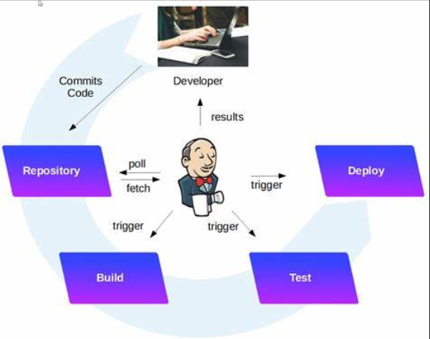
CI with jenkins

Slide 7
Jenkins Features
Easy Configuration
Available Plugins
eg:
VCS plugin,build plugin,cloud plugin.testing plugins …..etc
Extensible
Open source
Easy Installation

Slide 8
Jenkins Installations
Prerequisite
JAVA,JRE,JDK
Any Os
JDK 11 or JDK 17 is required.
Install Java from oracle website

Slide 9
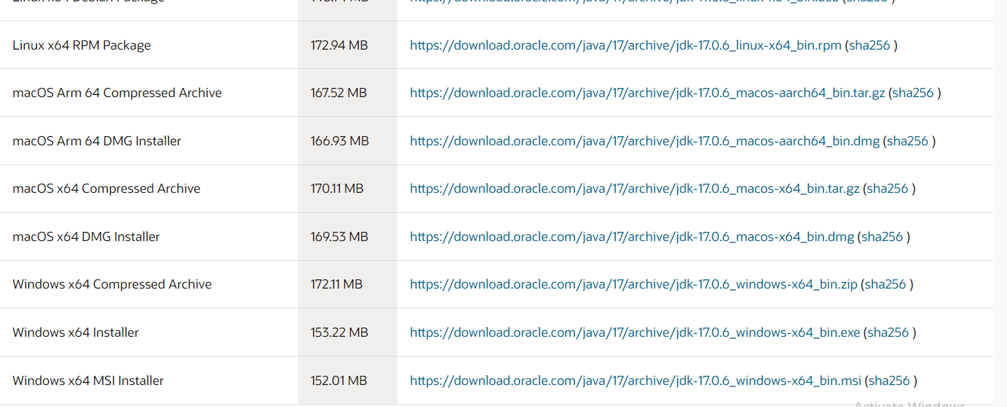

Slide 10


Update the java path
Set environmental variables
Path=
Check the java version

Slide 11
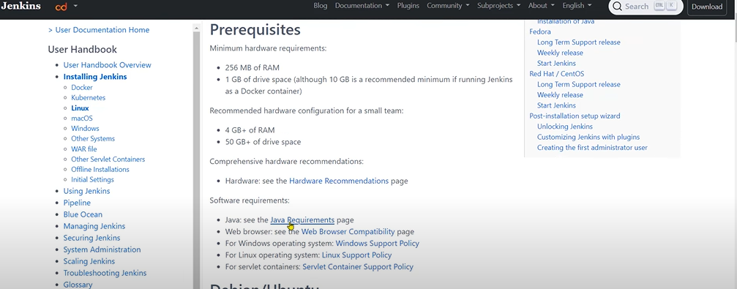
Download jenkins

Slide 12
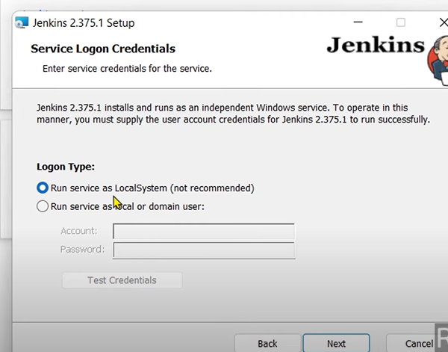
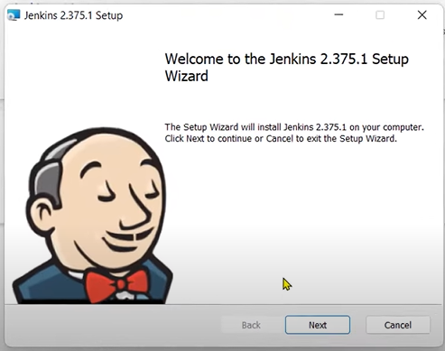

Slide 13
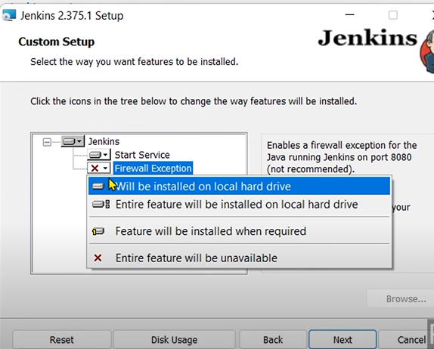

Slide 14
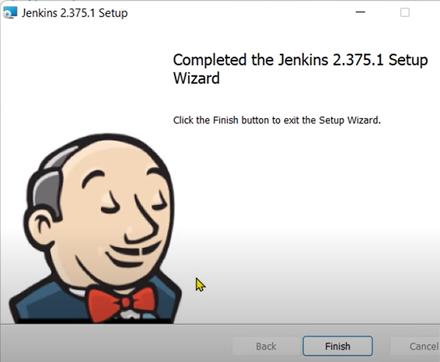

Slide 15
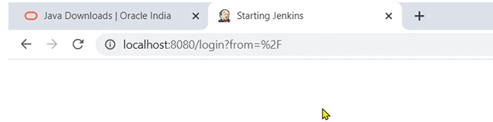
Type
Localhost:8080 in Jenkins and wait for the jenkins to start.
Now copy paste the ipconfig address on the Ethernet Adapter VMWARE

Slide 16
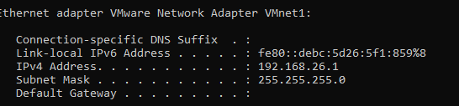
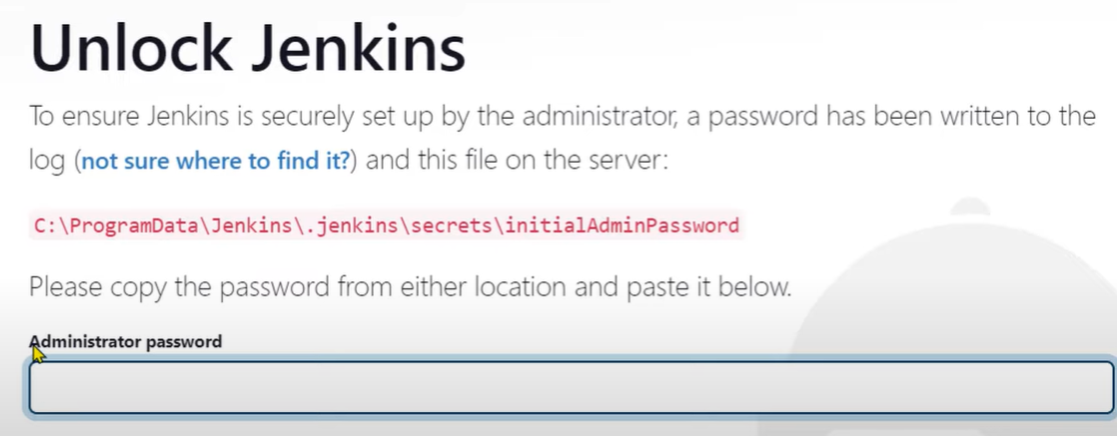

Slide 17
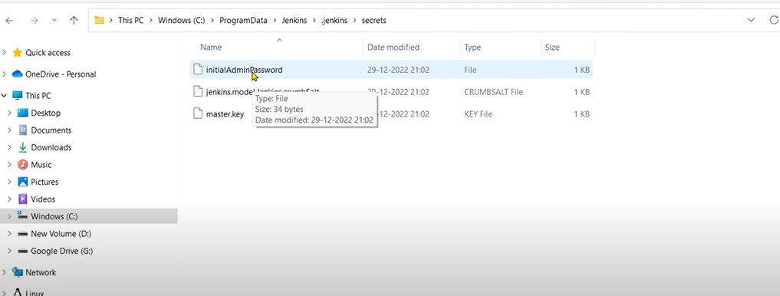
copy the path till secrets in my pc and look for the password.

Slide 18
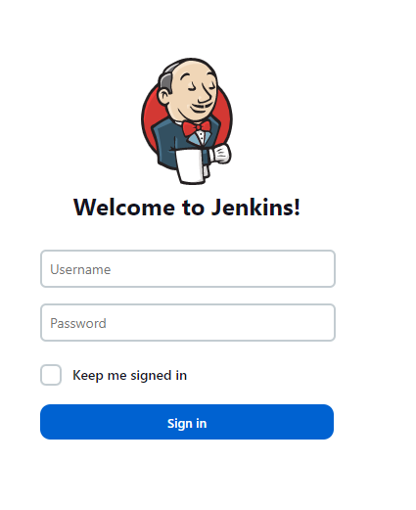
Open with notepad and finally unlock Jenkins and give the username and password.
And login with localhost:8080

Slide 19
Create a first job
Job name:FirstJob
Type:freestyle job
Click ok
Now fill the remaining configuration of the job
Inside builds select windows batch shell
And write java –version
And go back and build

