Slide 1
VibeGuard Cloud
Load-Shift-Aware Industrial Motor Bearing Fault Classification Using 1D Deep Learning and AWS
Final-Year Cloud Computing & Deep Learning Project
Official Verified Run ID: vibeguard-20261102T092858Z-s42
GitHub: github.com/shaziyasultanablr-byte/Cloud-Computing-Final

Slide 2
1. Problem Statement & Industrial Motivation
Why Load-Shift Evaluation and Secure Cloud Deployment Matter
• Rolling-element bearings account for ~40–50% of industrial induction motor failures; unexpected faults cause costly line stoppages.
• Methodological Pitfall #1 (Window Leakage): Many academic studies randomly split overlapping windows from the same recording into train and test sets, memorizing session noise.
• Methodological Pitfall #2 (Operating Load Shift): Motors trained at light load (0–1 HP, 1797–1772 RPM) must be tested at unseen heavier loads (3 HP, 1730 RPM).
• Methodological Pitfall #3 (Overconfident Softmax): Neural networks output uncalibrated softmax scores that require explicit review guardrails.
• Cloud Security Pitfall: Embedding AWS keys in code or opening public buckets/ports exposes student cloud projects to credential compromise and billing shocks.

Slide 3
2. Project Objectives & Research Scope
Clear Boundaries: Four-Class Fault Diagnosis under Unseen Motor Load
• Objective 1 — Provenance & Leakage Control: Validate 16 official CWRU MATLAB (.mat) files with SHA-256 checksums and enforce a strict recording- and load-disjoint split (Train: 0 & 1 HP | Val: 2 HP | Test: 3 HP).
• Objective 2 — 1D Deep Learning vs. Classical Baseline: Compare a 15,572-parameter 1D CNN (TinyFaultCNN) on raw normalized 2,048-sample windows against a 200-tree Random Forest trained on 18 hand-crafted time/frequency features.
• Objective 3 — Manual-Review Heuristic: Trigger a transparent review warning when top uncalibrated score < 0.70 or window-level agreement < 80%.
• Objective 4 — Secure AWS Free Plan Deployment: Host on Ubuntu 24.04 x86_64 EC2 + gp3 EBS + private S3 via IAM Role (VibeGuardEC2Role) and demonstrate via SSH port forwarding (localhost:8501).
• Research Boundary: Diagnoses predefined 0.007-in lab faults; does not claim Remaining Useful Life (RUL) prediction or industrial safety certification.

Slide 4
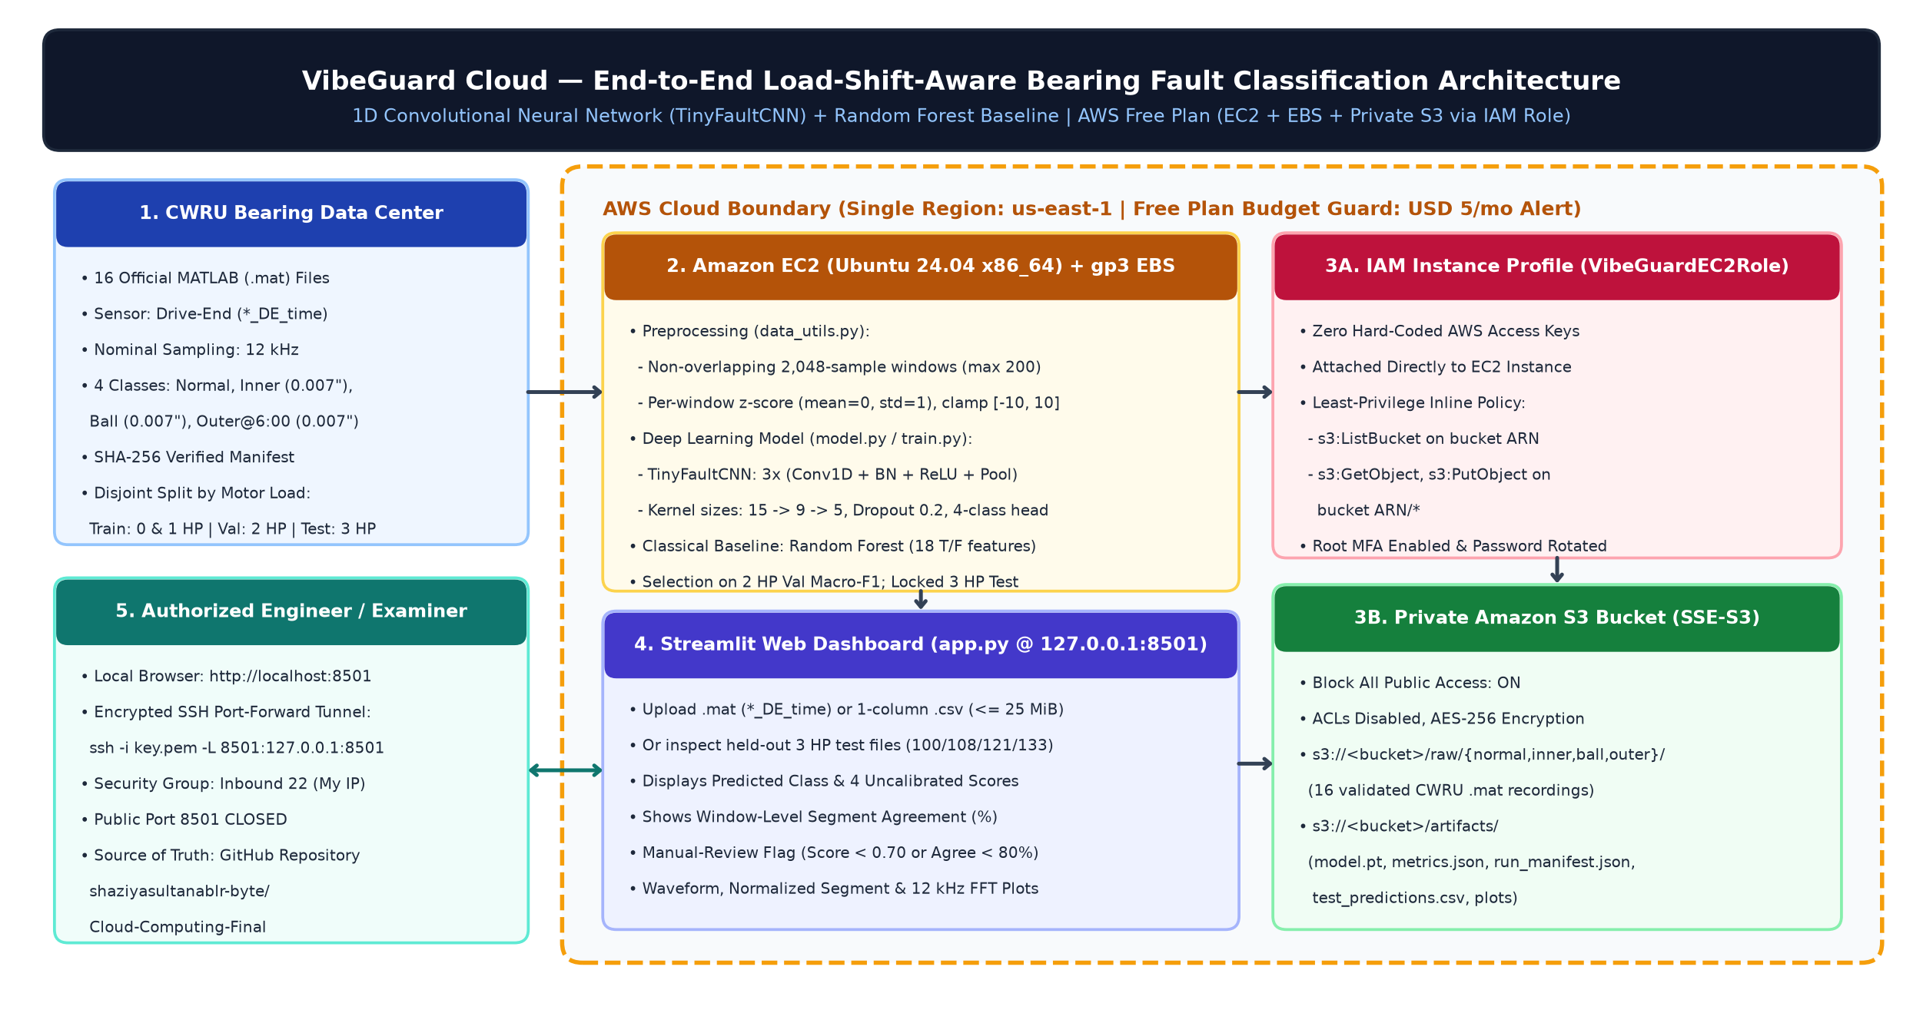
3. End-to-End System & AWS Cloud Architecture
EC2 + EBS + Private S3 + Least-Privilege IAM Role + Encrypted SSH Tunnel

Slide 5
4. CWRU Dataset Provenance & Data Hygiene Discovery
16 Official Drive-End (*_DE_time) Recordings | 1,428 Total Windows
• Source: Case Western Reserve University (CWRU) Bearing Data Center (SKF 6205-2RS drive-end bearing, nominal 12 kHz).
• Four Conditions: Normal Baseline (97–100), Inner Race 0.007" (105–108), Ball 0.007" (118–121), Outer Race @ 6:00 0.007" (130–133).
• Disjoint Split by Load: Train = 0 & 1 HP (8 files, 673 windows) | Val = 2 HP (4 files, 377 windows) | Test = 3 HP (4 files, 378 windows).
• CRITICAL DISCOVERY (99.mat Contamination): Official CWRU 99.mat (2 HP Validation) embeds BOTH X098_DE_time (from 1 HP training 98.mat) and X099_DE_time!
• Remediation: data_utils.py explicitly binds X{file_id:03d}_DE_time and scripts/validate_dataset.py verifies channel identity and SHA-256 digests.

Slide 6
5. Signal Preprocessing & 1D TinyFaultCNN Architecture
Zero Cross-Window Leakage | 15,572 Trainable Parameters
• Window Segmentation: Non-overlapping 2,048-sample windows (stride = 2,048), capped at 200 windows/recording ([0, 409600) samples).
• Per-Window Normalization: Standardized independently to zero mean and unit variance, then clamped to [-10.0, 10.0].
• TinyFaultCNN Architecture: Block 1 Conv1D(1->16, k=15) + BN + ReLU + MaxPool(4) -> Block 2 Conv1D(16->32, k=9) + BN + ReLU + MaxPool(4) -> Block 3 Conv1D(32->64, k=5) + BN + ReLU + AdaptiveAvgPool(1) -> Dropout(0.2) + Linear(64->4).
• Classical Baseline: 200-tree Random Forest trained on 18 standardized time/frequency features (RMS, Kurtosis, Crest, Impulse, Clearance, FFT Centroid, Spread, and 4 Band Ratios).
• Model Selection Protocol: 14 epochs (Adam lr=0.001, batch=64, seed=42); best checkpoint selected strictly on 2 HP validation Macro-F1.

Slide 7
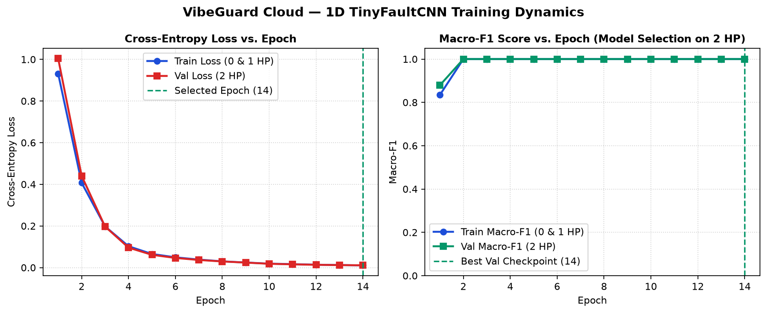
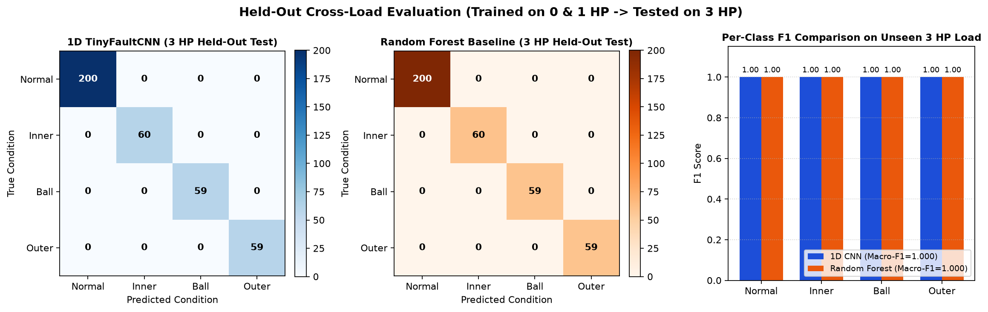
6. Training Convergence & Locked 3 HP Test Evaluation
Run ID: vibeguard-20261102T092858Z-s42 | Selected Checkpoint: Epoch 14

Slide 8
7. Measured Cross-Load Results: 1D CNN vs. Random Forest
100% Window & File Accuracy on 3 HP, but Distinct Score Margin Resilience
Split (Load) | File | True Class | Windows | 1D CNN Pred | 1D CNN Top Score | 1D CNN Margin | RF Pred | RF Top Score | RF Margin
Val (2 HP) | 99.mat | normal | 200 | normal | 0.9879 | 0.9834 | normal | 0.9793 | 0.9600
Val (2 HP) | 107.mat | inner | 59 | inner | 0.9923 | 0.9886 | inner | 0.9877 | 0.9756
Val (2 HP) | 120.mat | ball | 59 | ball | 0.9889 | 0.9824 | ball | 0.9823 | 0.9652
Val (2 HP) | 132.mat | outer | 59 | outer | 0.9908 | 0.9863 | outer | 1.0000 | 1.0000
Test (3 HP) | 100.mat | normal | 200 | normal | 0.9869 | 0.9820 | normal | 0.9785 | 0.9576
Test (3 HP) | 108.mat | inner | 60 | inner | 0.9953 | 0.9932 | inner | 0.7272 | 0.5005
Test (3 HP) | 121.mat | ball | 59 | ball | 0.9890 | 0.9840 | ball | 0.9870 | 0.9794
Test (3 HP) | 133.mat | outer | 59 | outer | 0.9851 | 0.9777 | outer | 0.9981 | 0.9972
• Key Finding on 108.mat (3 HP Inner Race): Random Forest mean score drops to 0.7273 (22.68% trees vote Ball fault, margin 0.5005), near the 0.70 manual-review threshold. 1D TinyFaultCNN maintains 0.9953 mean score (margin 0.9932).

Slide 9
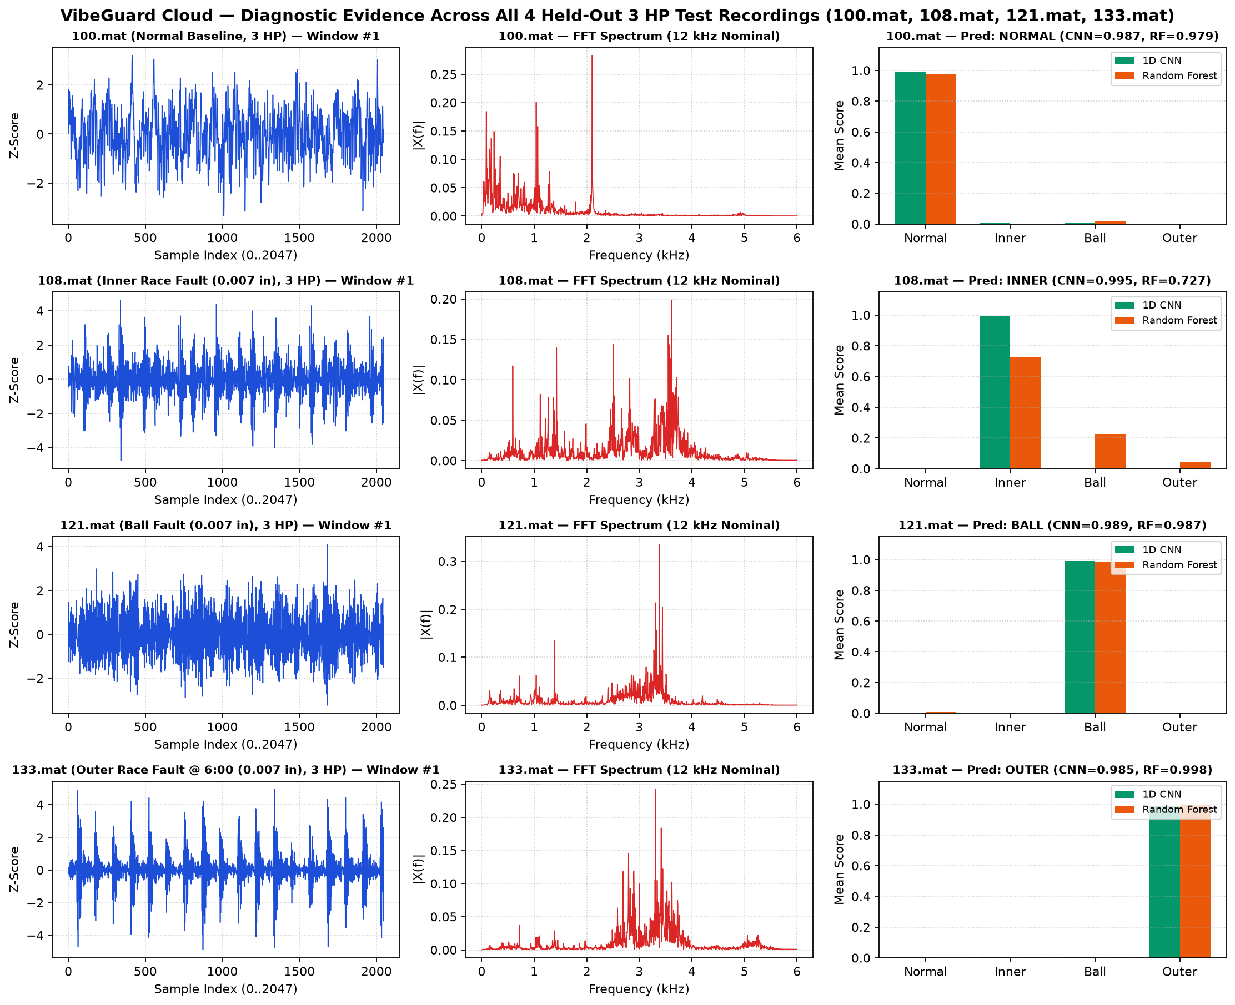
8. Diagnostic Evidence on Held-Out 3 HP Recordings
Waveforms, 12 kHz Nominal FFT Spectra, and 4-Class Uncalibrated Scores

Slide 10
9. Streamlit Cloud Dashboard & Security Architecture
Interactive Upload, Validation Guards, Manual-Review Flag & SSH Tunnel
• Strict Upload Validation: Accepts CWRU .mat (*_DE_time) or 1-column numeric .csv (<= 25 MiB, >= 2,048 samples); rejects HTML error files, NaN/Inf, constant signals, and wrong channels with friendly UI banners.
• Diagnostic Display: Shows predicted bearing condition, 4-class uncalibrated softmax scores, window-level segment agreement (%), raw/normalized waveforms, and FFT spectrum.
• Manual-Review Warning Banner: Automatically flags recordings when top score < 0.70 or window agreement < 80%.
• Credential-Free AWS S3 Integration: Uses IAM Instance Profile (VibeGuardEC2Role) with s3:ListBucket, s3:GetObject, and s3:PutObject on private bucket (Block Public Access ON, SSE-S3).
• Encrypted Demo Access: Streamlit runs on 127.0.0.1:8501 inside tmux on EC2 and is accessed via ssh -i key.pem -L 8501:127.0.0.1:8501.

Slide 11
10. Limitations, Cost Protection & Conclusion
Honest Scientific Boundaries and Reproducible Delivery
• Limitation 1 (Sample Size per Load): 2 HP validation and 3 HP test splits each contain 1 recording per class (4 files/split). High accuracy reflects within-rig consistency across a ~3.7% RPM shift.
• Limitation 2 (Single Rig & Seeded EDM Faults): Trained on 0.007-in EDM faults on one CWRU test stand; does not prove generalization to unseen motor frames or natural progressive spalling.
• Limitation 3 (Uncalibrated Scores): Softmax outputs are uncalibrated confidence scores, not posterior probabilities.
• AWS Cost & Teardown Discipline: Executed strictly within AWS Free Plan ($0.00 cash spend, USD 5 budget alert); EC2/EBS/S3 teardown checklist documented in docs/COST_AND_CLEANUP.md.
• Conclusion: VibeGuard Cloud delivers a fully tested (15/15 pytest passing), reproducible, load-shift-aware bearing fault classification system and cloud deployment package.

