Slide 1
Difference, Performance on MobileNet

Slide 2
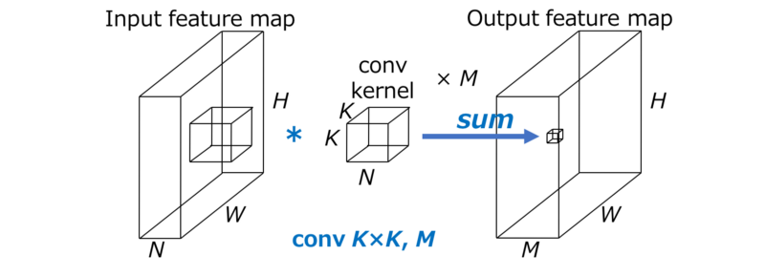
Standard CNN

Slide 3
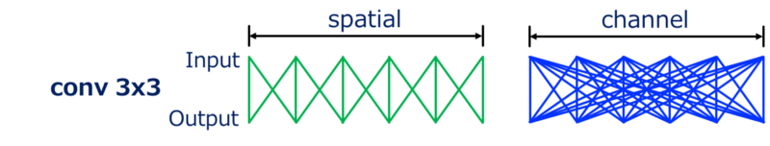
Convolution

Slide 4
Pointwise convolution

Slide 5
Depthwise convolution

Slide 6
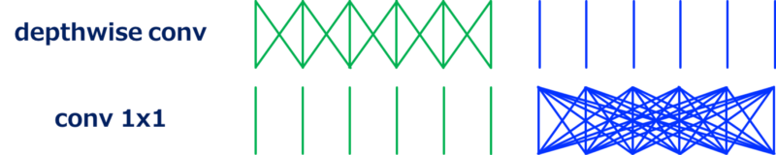
Applied approach
Use pointwise convolution
Use depth wise convolution
Separate point- and depth-wise convolution

Slide 7
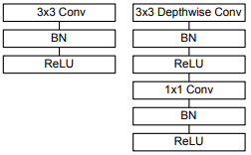
Main block of MobileNet

Slide 8
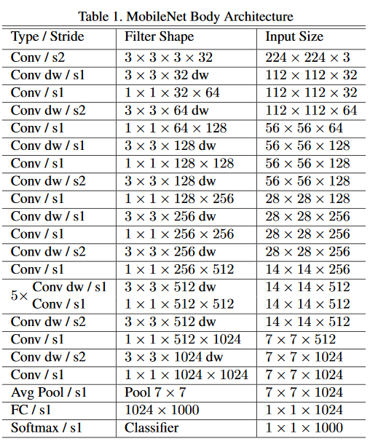
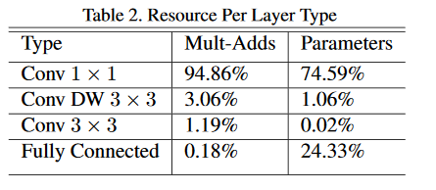

Slide 9
Hyper parameters
A – Width multiplier
A thins a network uniformly at each layer
Any changes of A in N-times change the computational cost in N-time
P – resolution multiplier
Apply on the input size for every layer
Implicitly set the input resolution

Slide 10
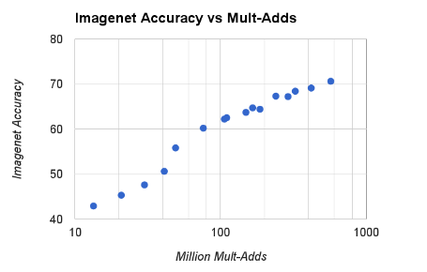
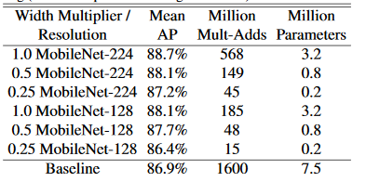
Performance
Changes of A and P may influence on the computation cost and accuracy

Slide 11
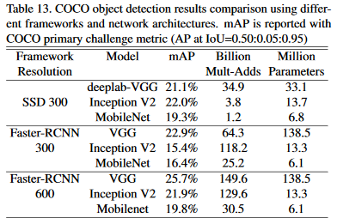
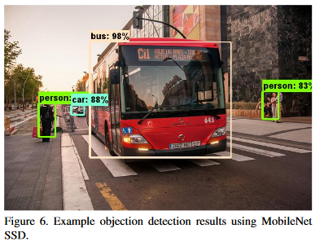

Slide 12
