Slide 1
Theoretical Computer Science
Prof. Shamil Galiev

Slide 2
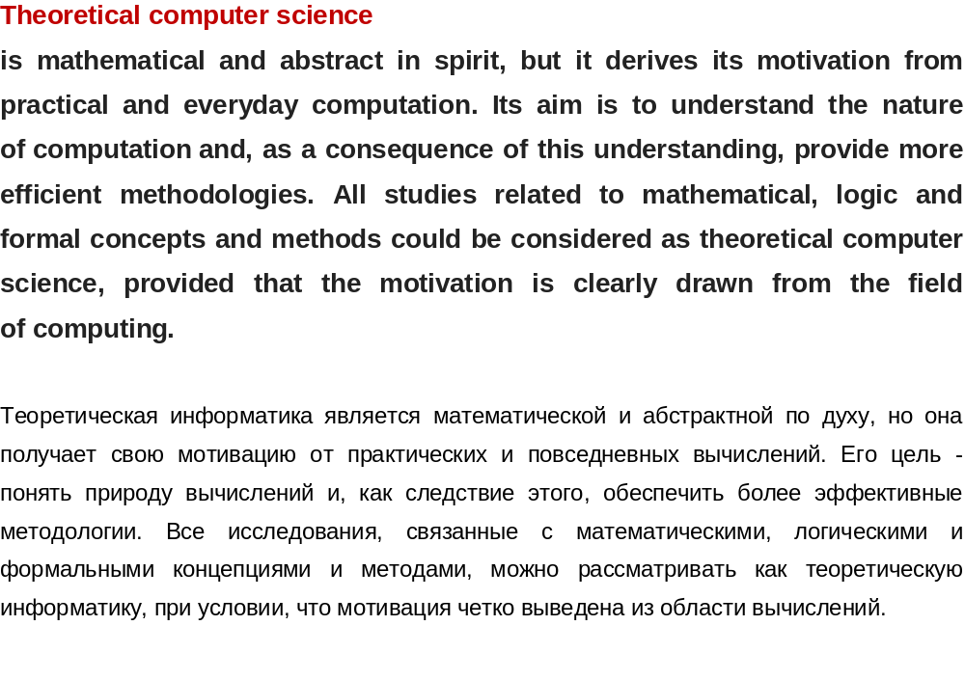

Slide 3
In addition to the development of theoretical computer science there are problems creating:
computers,
software,
satellite systems, etc. etc.

Slide 4
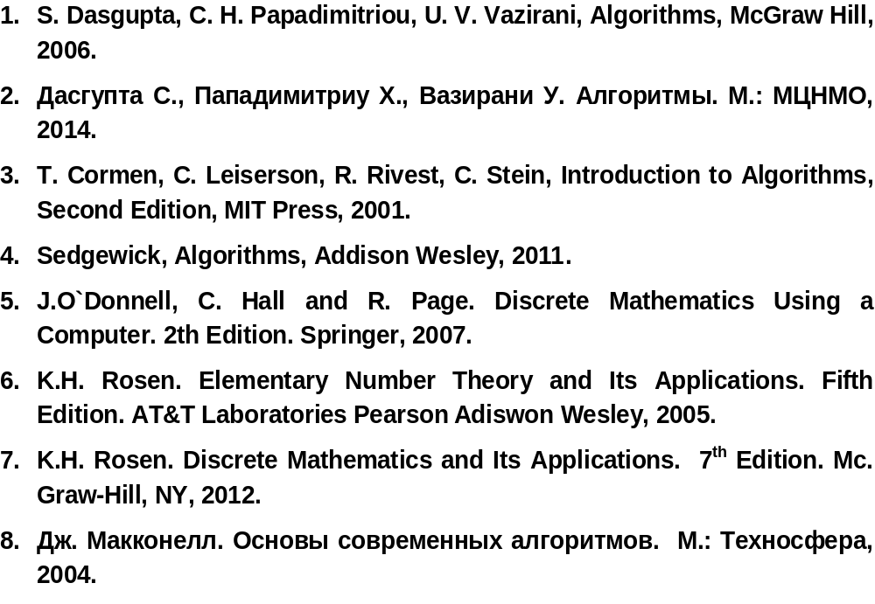

Slide 5
Library, Internet

Slide 6

  Numbers, operators
  Cryptography and RSA system
  Recursive algorithms
  Graphs, some problems on graphs
  Huffman coding
  P, NP, NP-complete problems

Slide 7
1. NUMBERS, OPERATIONS

Slide 8
NUMBERS
The eminent mathematician Kronecer said: “natural numbers were created by God, everything else is the work of men”.
Numbers completely separated from everything else in the universe.
For instance, if you assume that integers exist, then you can define a rational number as the quotient of two integers.

Slide 9
NUMBERS
N = N₀ = { 0, 1, 2, 3,…} or N = { 1, 2, 3,…},
Z = {…,-3, -2, -1, 0, 1, 2, 3,…}
Q = { p/q, q ≠ 0, p, q ∈ Z }
R = ( - ∞, ∞ ), C – set of complex numbers

Slide 10
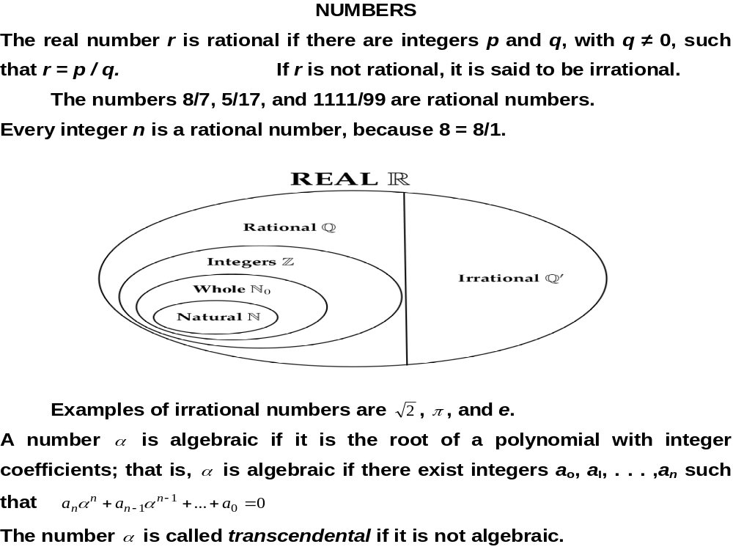

Slide 11
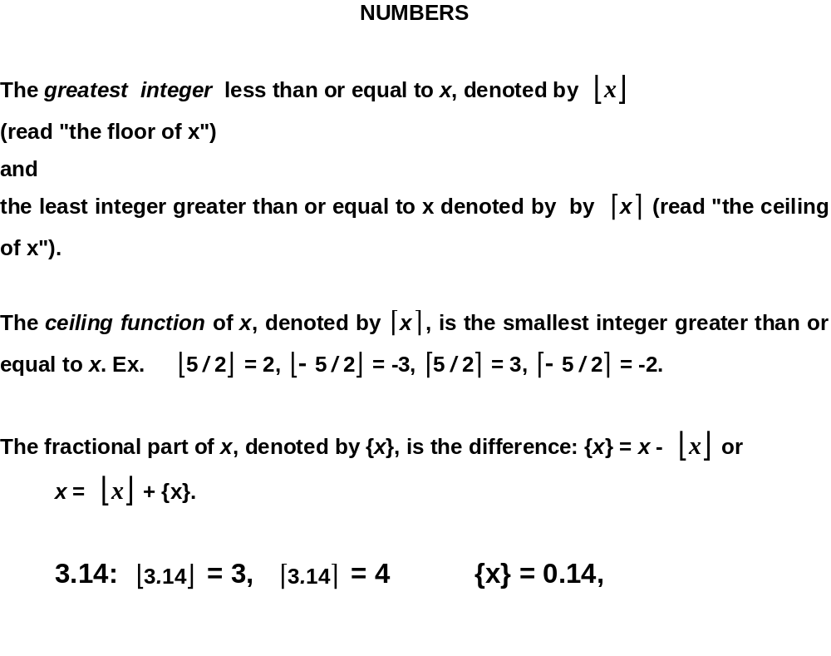

Slide 12
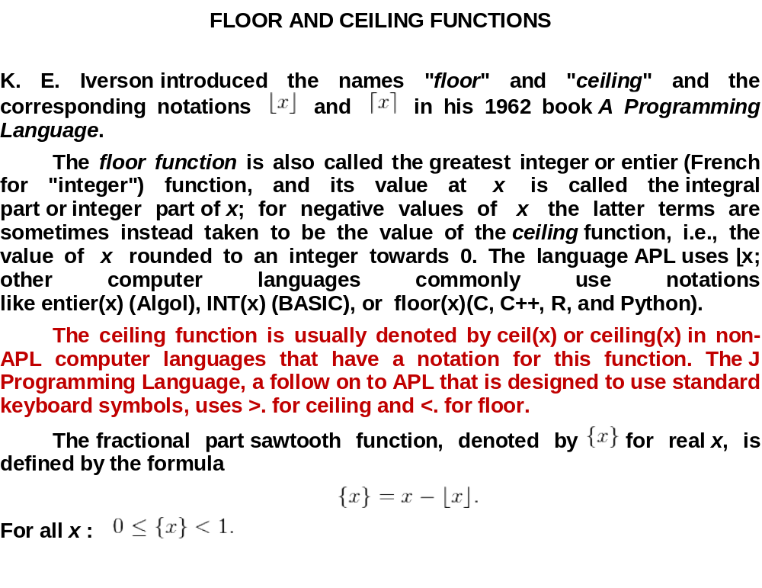

Slide 13
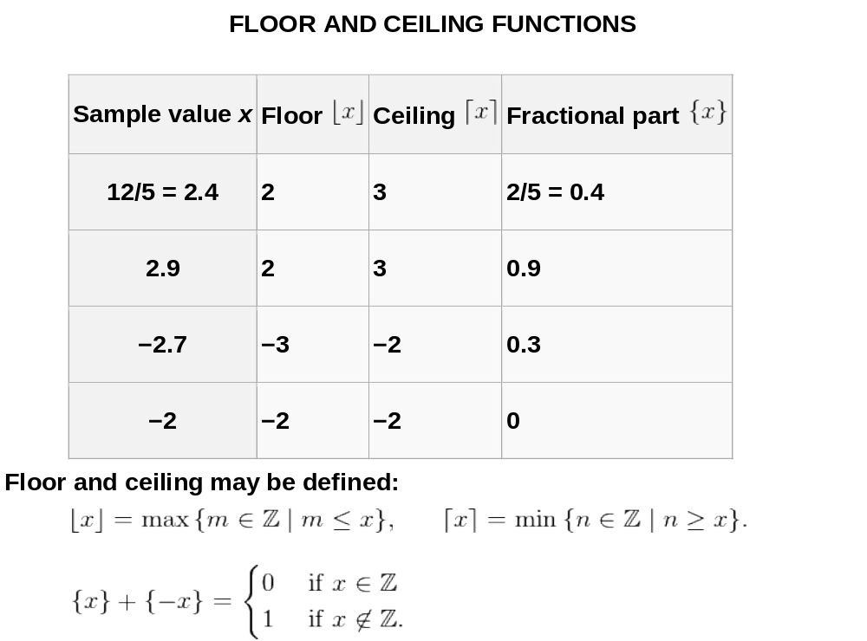

Slide 14
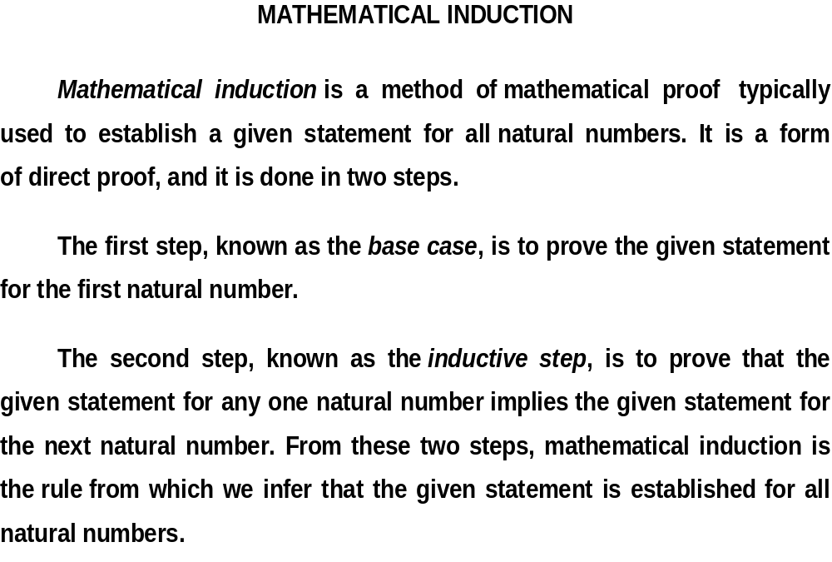

Slide 15
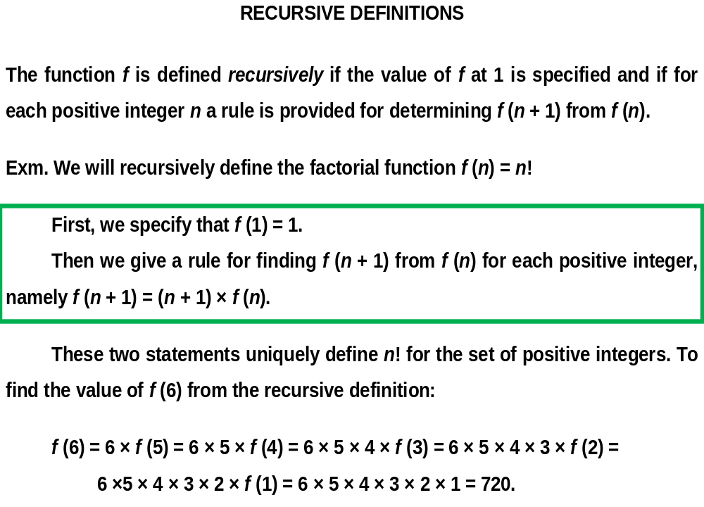

Slide 16
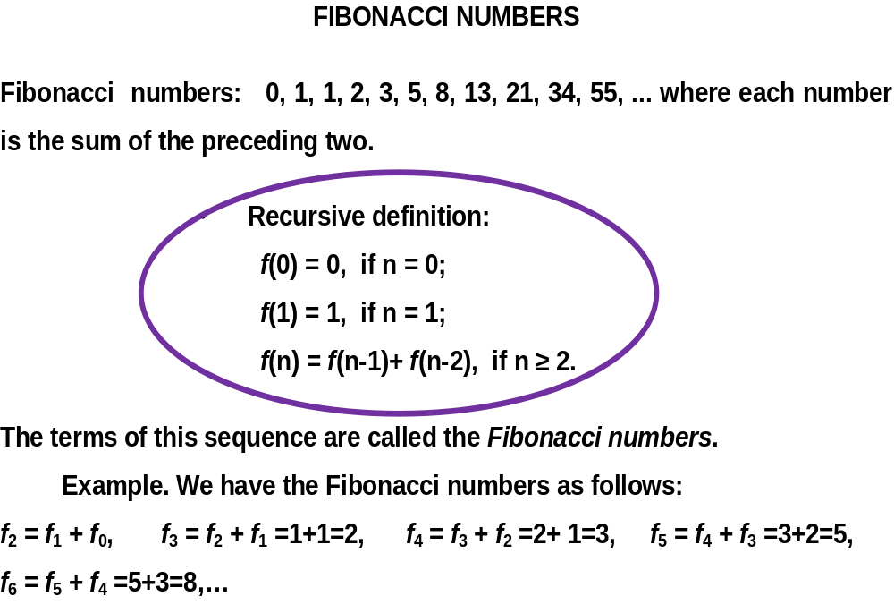

Slide 17
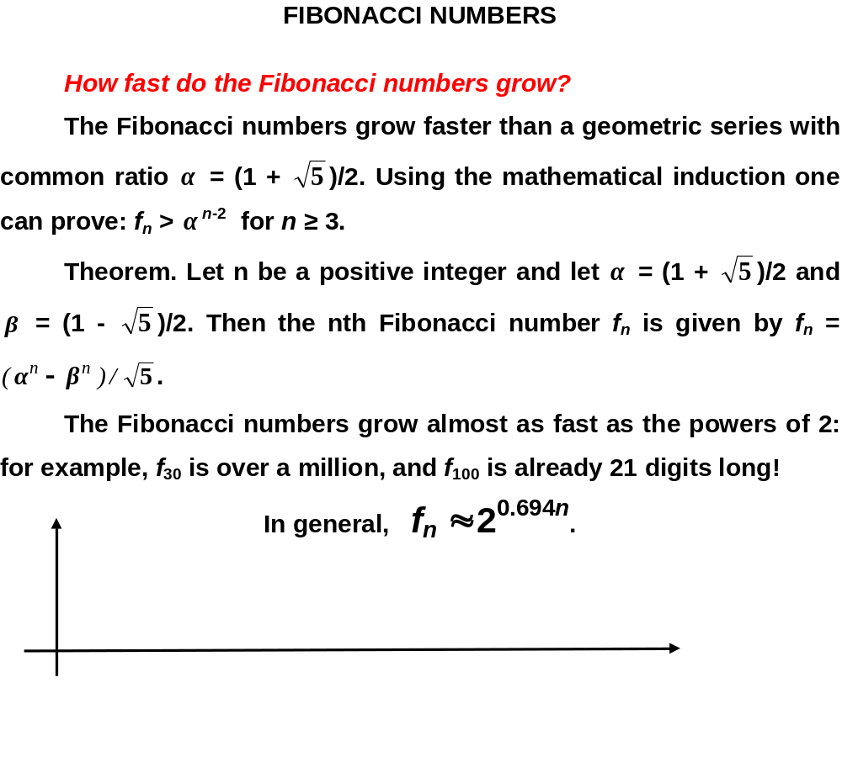

Slide 18
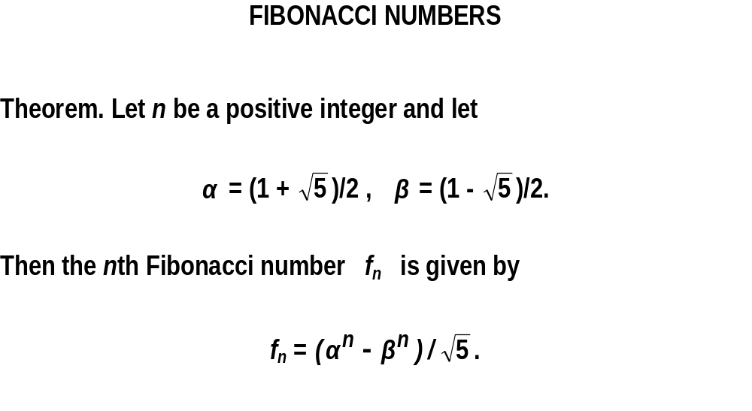

Slide 19
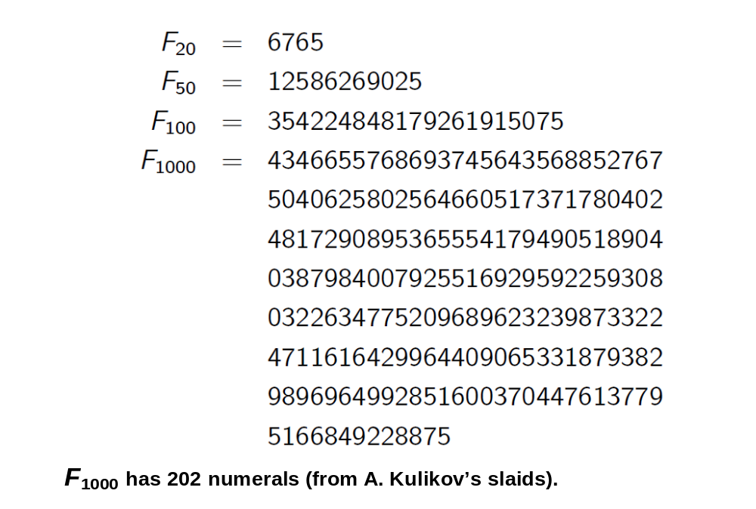

Slide 20
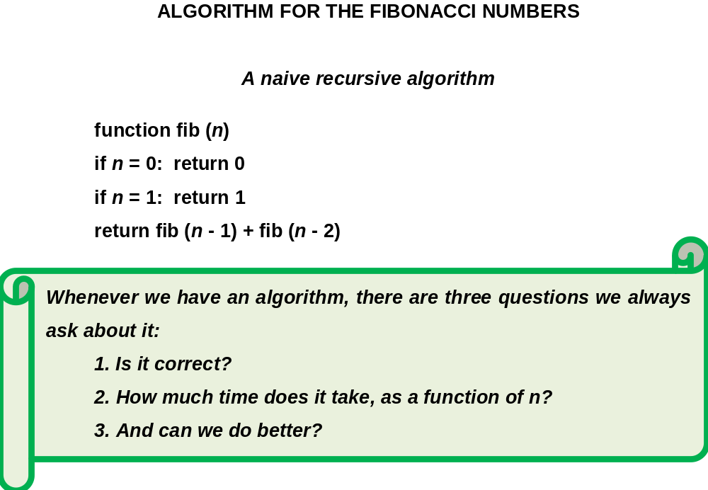

Slide 21
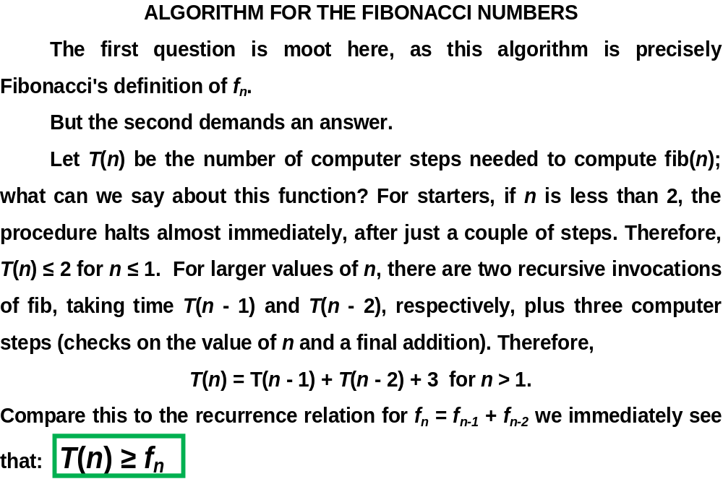

Slide 22
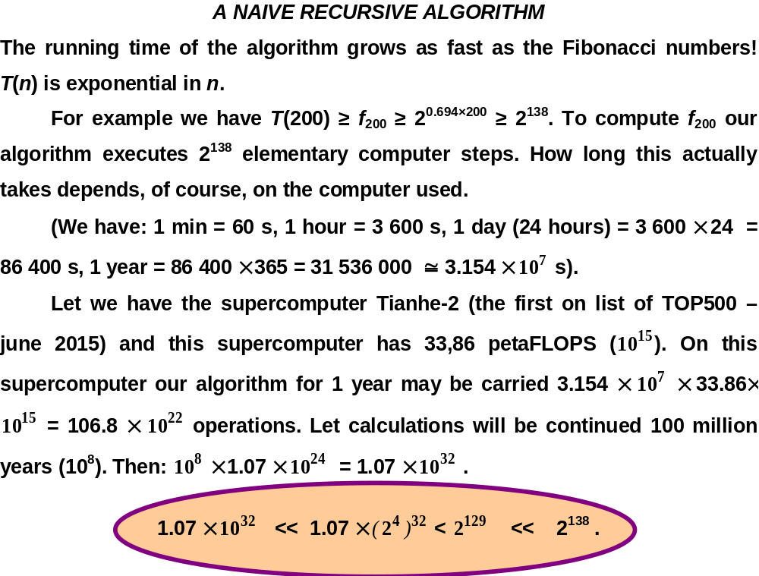

Slide 23
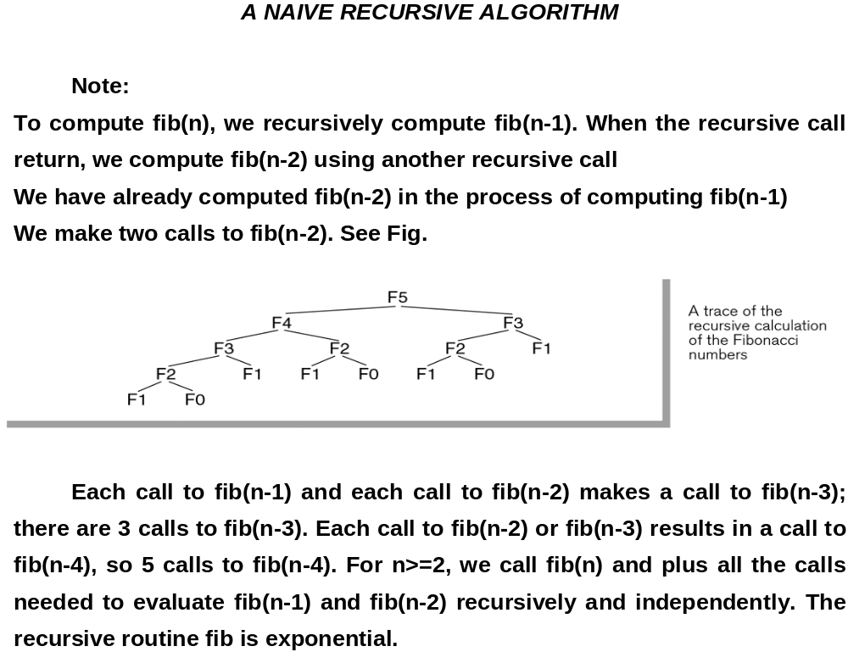

Slide 24
RECURSIVE COMPUTATION
F(n) = F(n-1) + F(n-2) ; F(0) = 0, F(1) = 1
Recursive Solution:
F(6) = 8
F(5)
F(4)
F(4)
F(3)
F(3)
F(2)
F(3)
F(2)
F(2)
F(1)
F(2)
F(1)
F(1)
F(0)
F(2)
F(1)
F(1)
F(0)
F(1)
F(0)
F(1)
F(0)
F(1)
F(0)
Notes:
Implementing it as a recursive procedure is easy but slow!
We keep calculating the same value over and over!

Slide 25
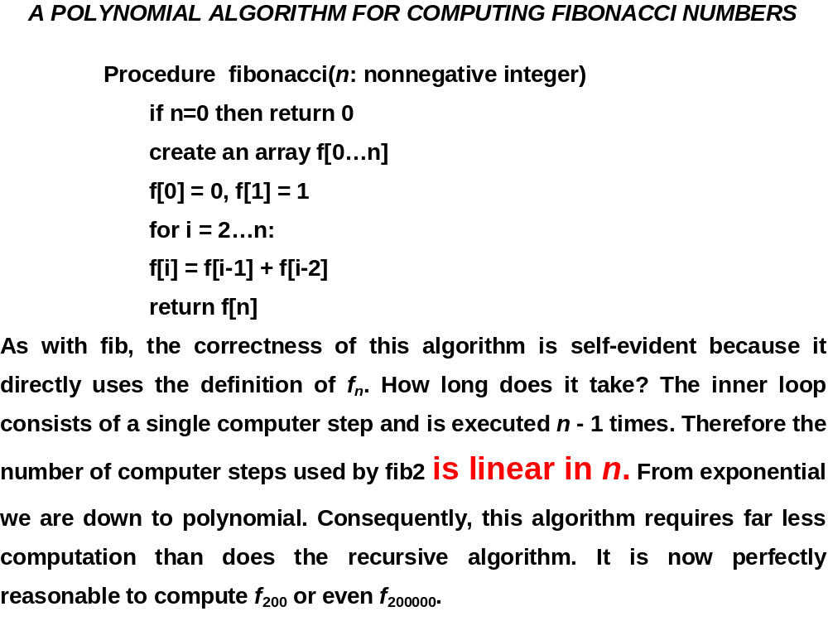

Slide 26
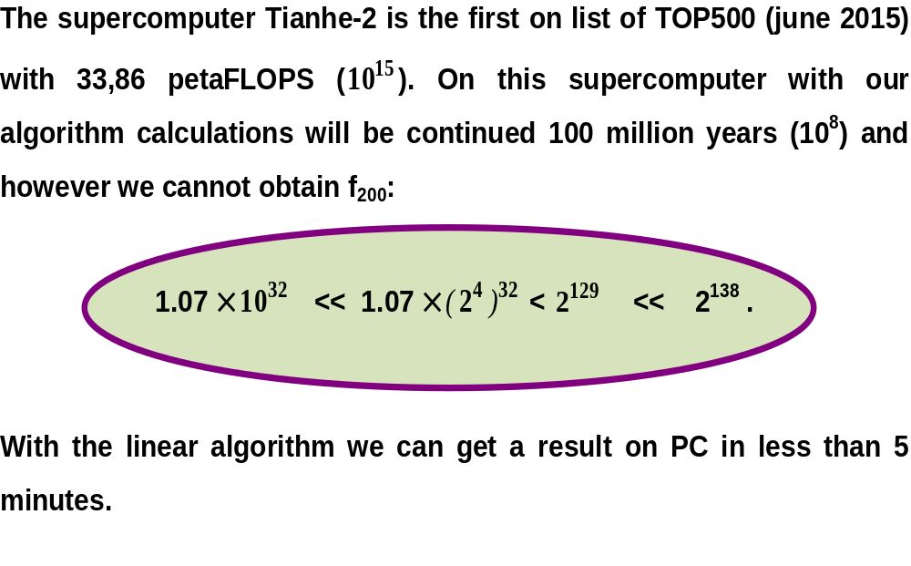

Slide 27
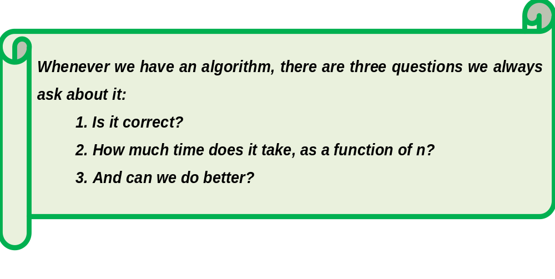

Slide 28
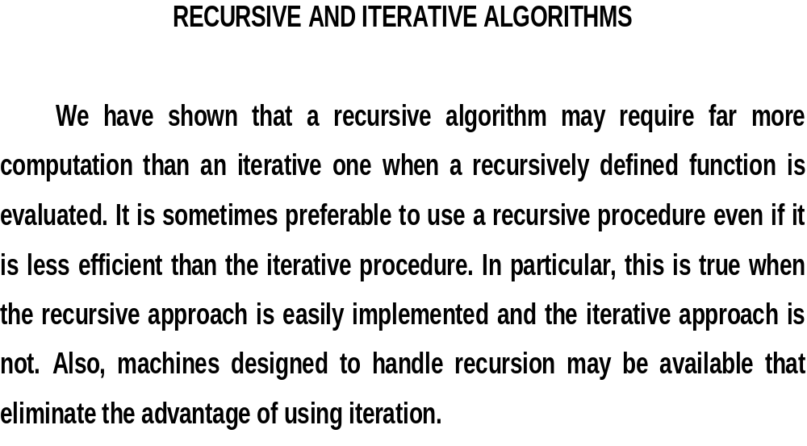

Slide 29
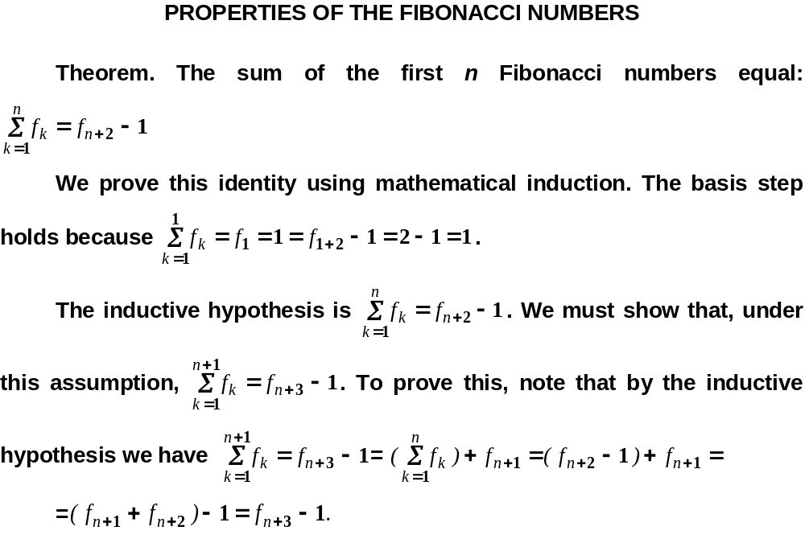

Slide 30
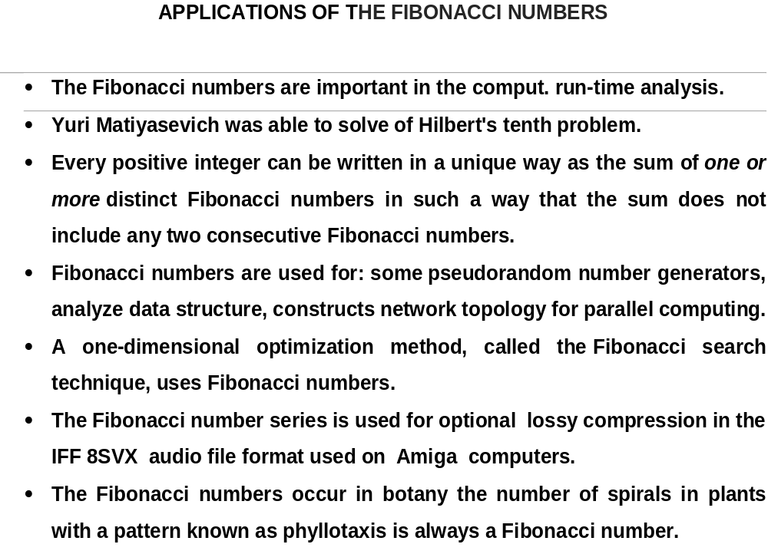

Slide 31
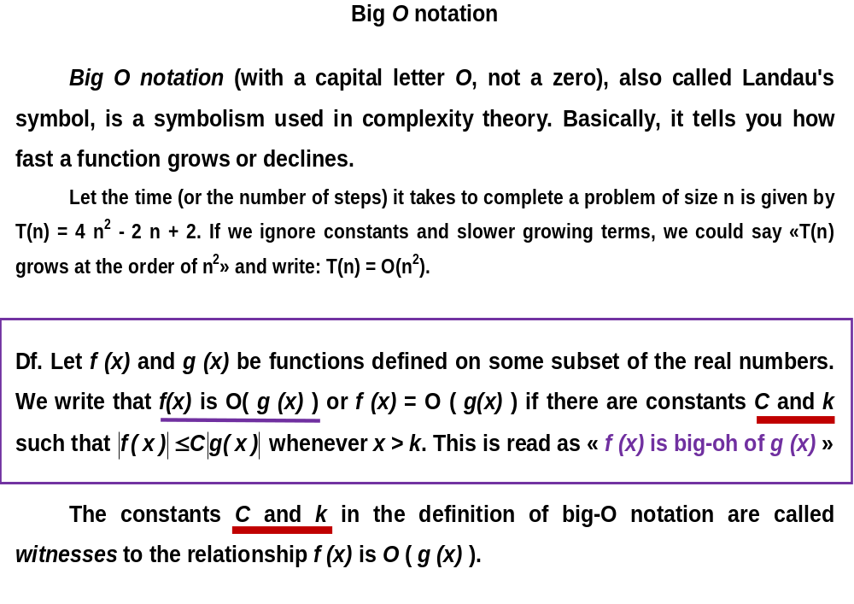

Slide 32
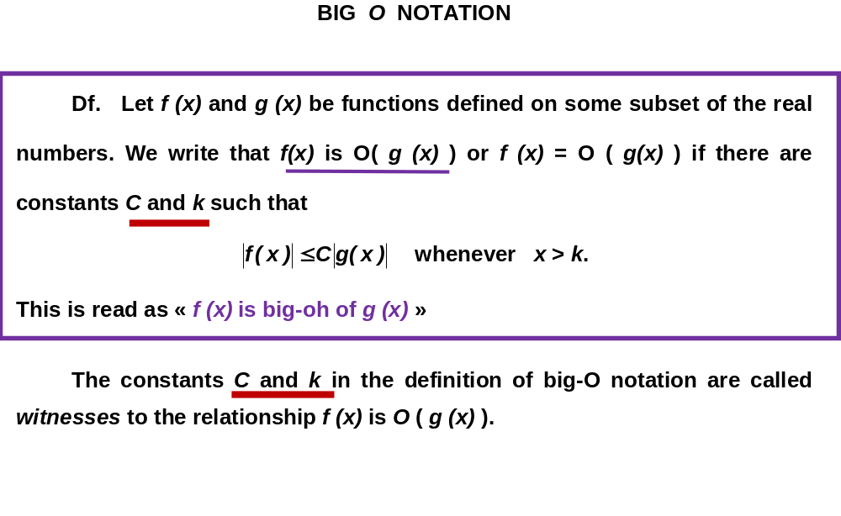

Slide 33
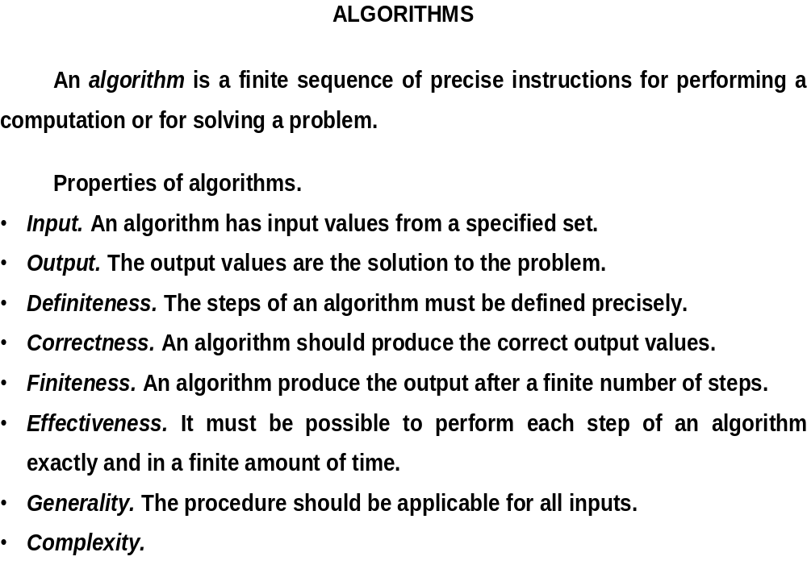

Slide 34
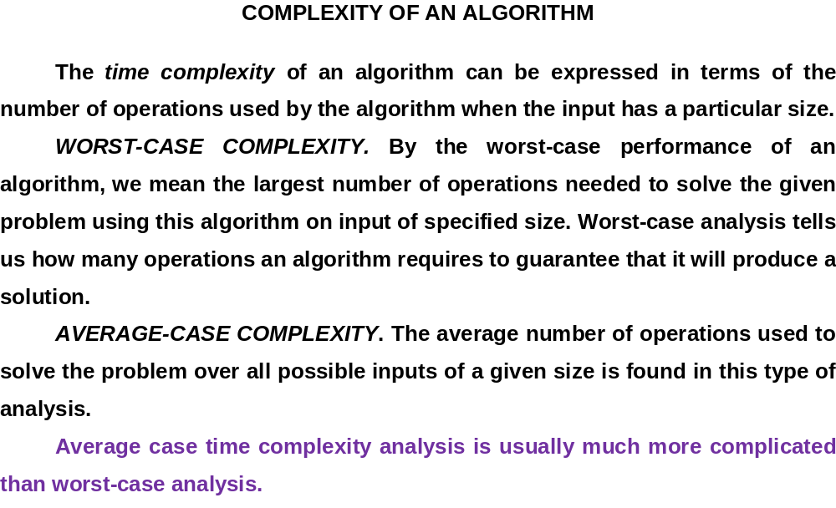

Slide 35
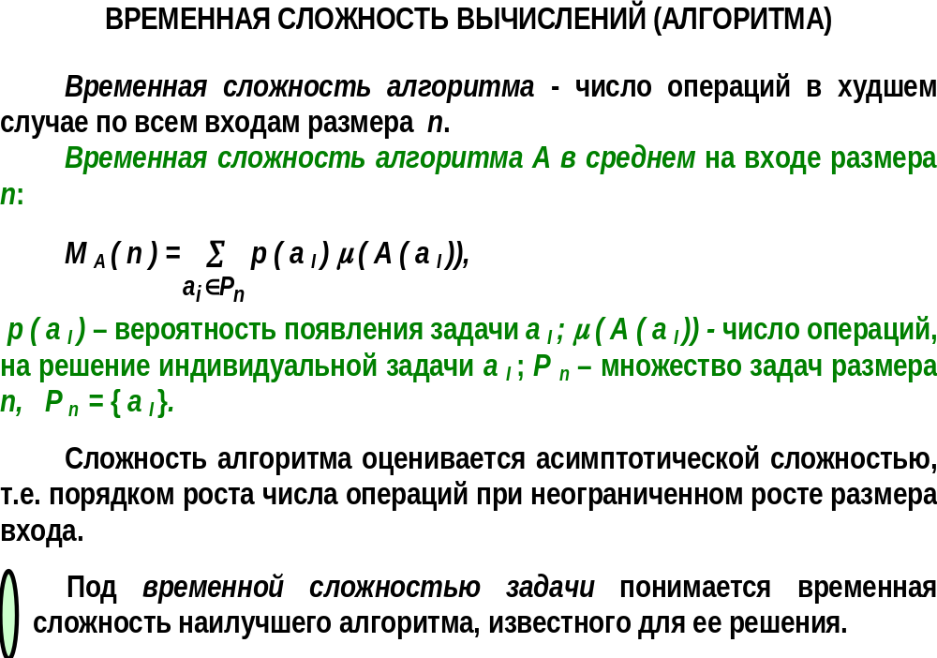

Slide 36
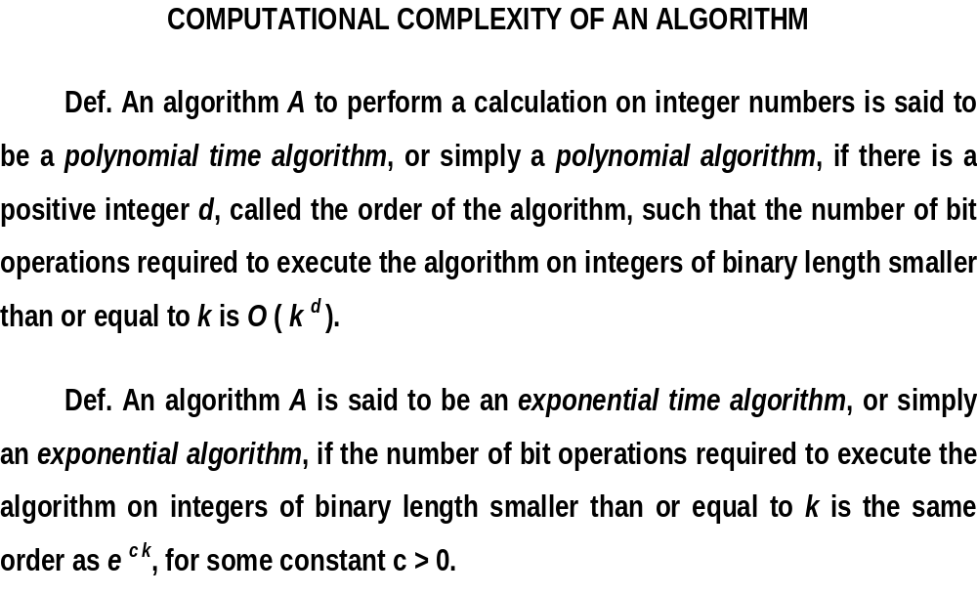

Slide 37
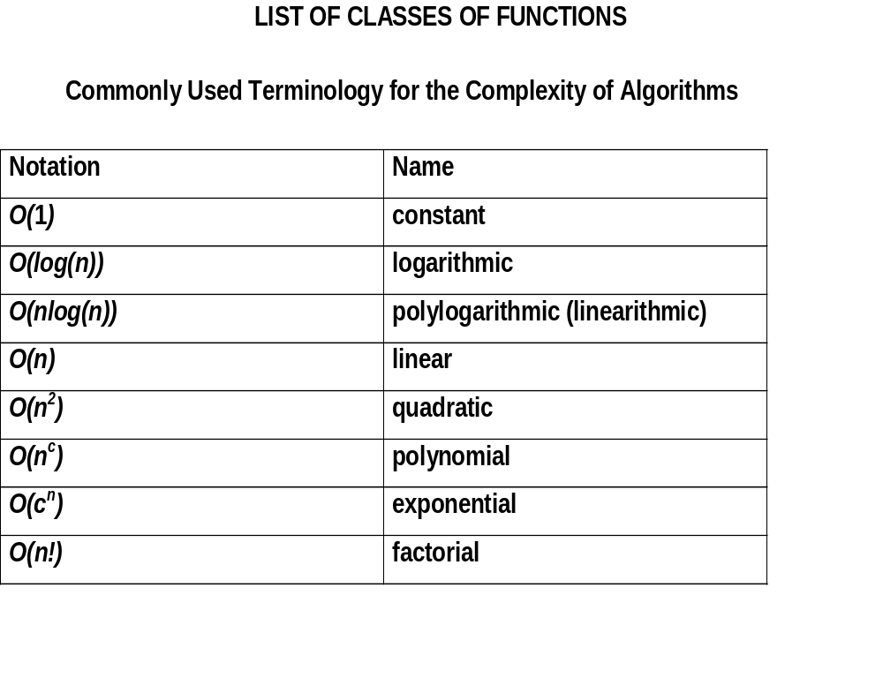

Slide 38
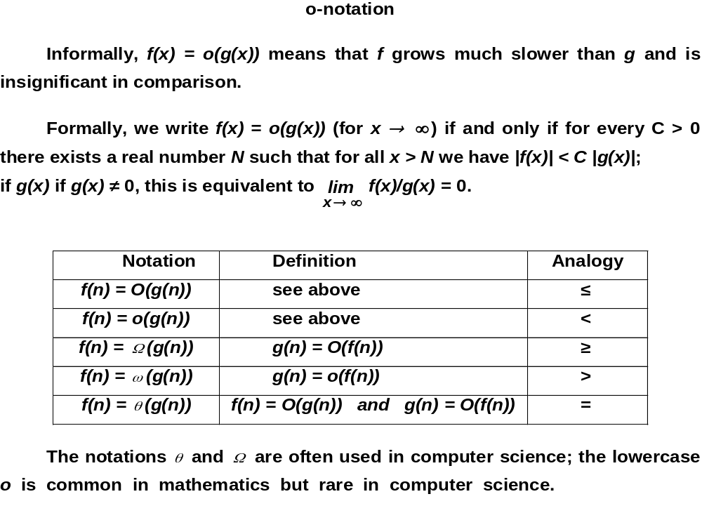

Slide 39
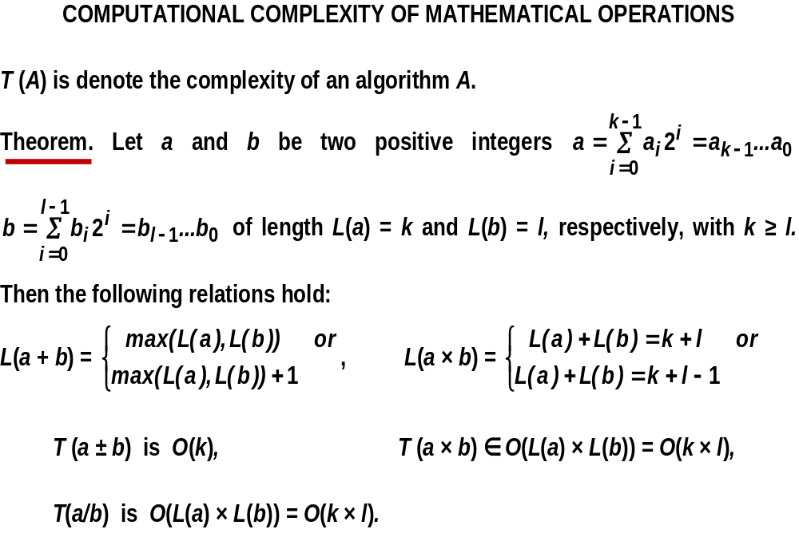

Slide 40
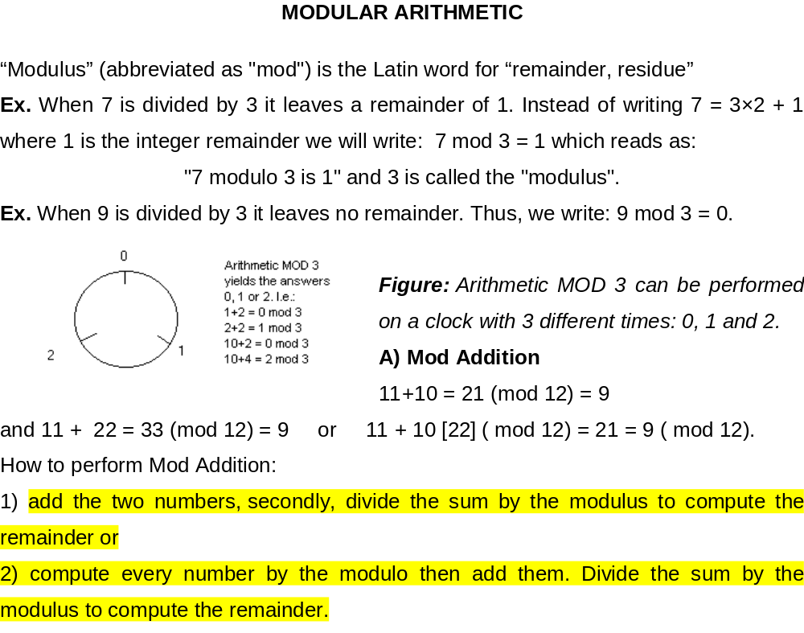

Slide 41
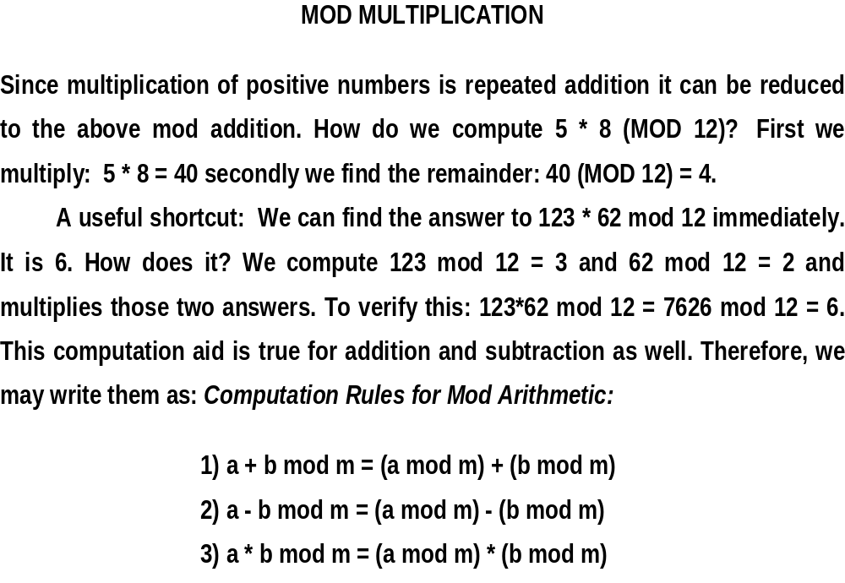

Slide 42
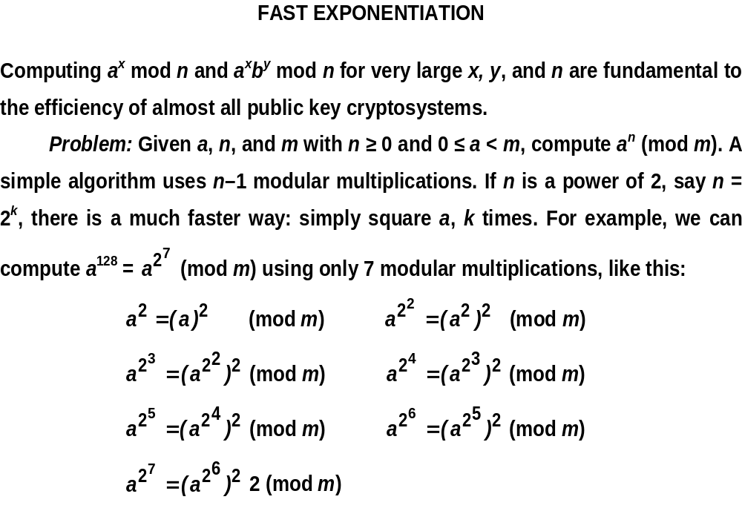

Slide 43
