Slide 1
Neural Networks Semester 1 Practical works for GRIAT RCSE master program Teacher: Makhmutova Alisa Zufarovna AZMakhmutova@kai.ru @DarkAliceSophie

Slide 2
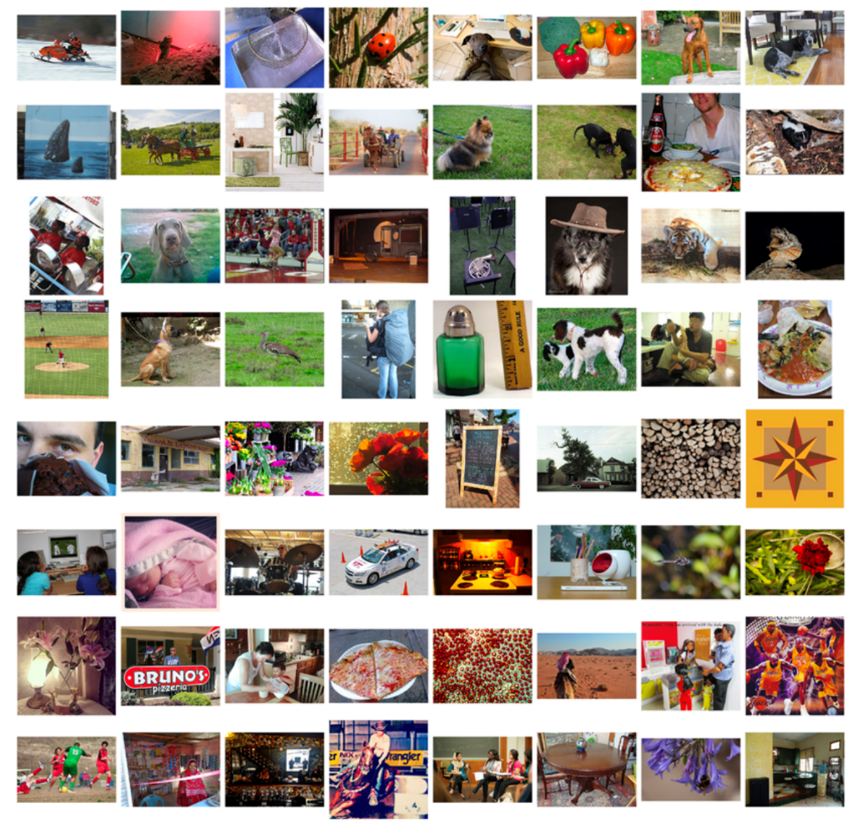
Convolutional Neural Networks
ImageNet is a research project to develop a large database of images with annotations, e.g. images and their descriptions.
The images and their annotations have been the basis for an image classification challenge called the ImageNet Large Scale Visual Recognition Challenge or ILSVRC since 2010. The result is that research organizations battle it out on pre-defined datasets to see who has the best model for classifying the objects in images.
For the classification task, images must be classified into one of 1,000 different categories.
For the last few years very deep convolutional neural network models have been used to win these challenges and results on the tasks have exceeded human performance.
KNRTU-KAI | TU ILMENAU | Neural Networks

Slide 3
Convolutional Neural Networks
Keras Applications are deep learning models that are made available alongside pre-trained weights. These models can be used for prediction, feature extraction, and fine-tuning.
Weights are downloaded automatically when instantiating a model.
https://keras.io/applications/
KNRTU-KAI | TU ILMENAU | Neural Networks

Slide 4
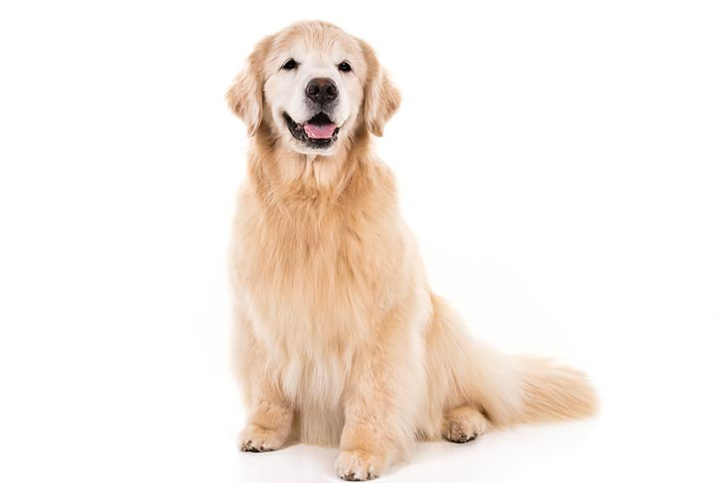
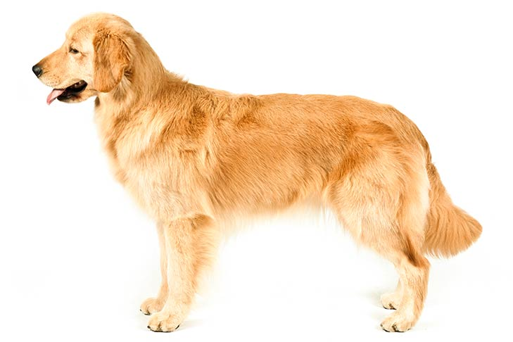
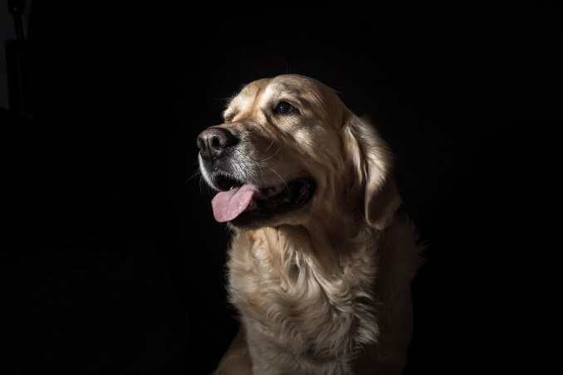
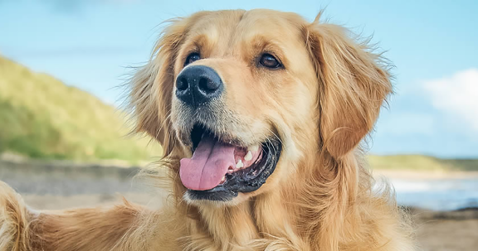
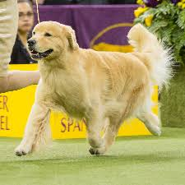
Convolutional Neural Networks
The picture number | Result of prediction ResNet50
1 | ('golden_retriever', 0.99277836), ('otterhound', 0.003416854), ('cocker_spaniel', 0.0016193204)]
2 | 'golden_retriever', 0.9672204 'Afghan_hound', 0.013342308 'Great_Pyrenees', 0.0068841437
3 | 'golden_retriever', 0.4477229, 'Norfolk_terrier', 0.11086729, 'Norwich_terrier', 0.07319994
4 | 'bloodhound', 0.25386468, ''Leonberg', 0.16019459, 'Tibetan_mastiff', 0.15530798, 'golden_retriever', 0.07985571
5 | 'bloodhound', 0.96779644, 'Leonberg', 0.0060789348, 'cocker_spaniel', 0.0034880964
1
2
3
4
5
KNRTU-KAI | TU ILMENAU | Neural Networks

Slide 5
Task
Choose 5 different model for training, train 5 different images of one object (gradually complicating the job of predicting), describe the difference
Compare:
1) Different models between each other – architecture of NN comparison, accuracy of classification (example of table on previous slide)
2) Image quality with different models – one image with noise added, colors inverted etc. 2 different changes from the original image will be enough
3) Time for each model to predict
https://keras.io/applications/
KNRTU-KAI | TU ILMENAU | Neural Networks

Slide 6
Task
from keras.applications.resnet50 import ResNet50 from keras.preprocessing import image from keras.applications.resnet50 import preprocess_input, decode_predictions from PIL import Image import numpy as np model = ResNet50(weights='imagenet') img_path = 'golden-retriever.png' img = image.load_img(img_path, target_size=(224, 224)) x = image.img_to_array(img) x = np.expand_dims(x, axis=0) x = preprocess_input(x) preds = model.predict(x) # decode the results into a list of tuples (class, description, probability) # (one such list for each sample in the batch) print('Predicted:', decode_predictions(preds, top=3)[0])
KNRTU-KAI | TU ILMENAU | Neural Networks

Slide 7
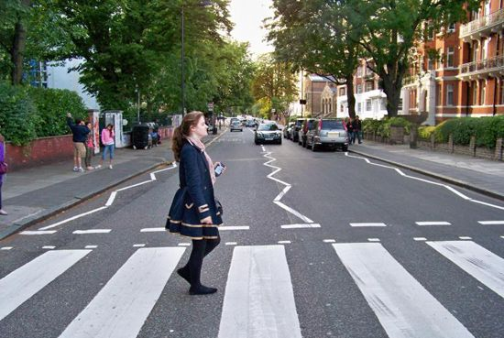
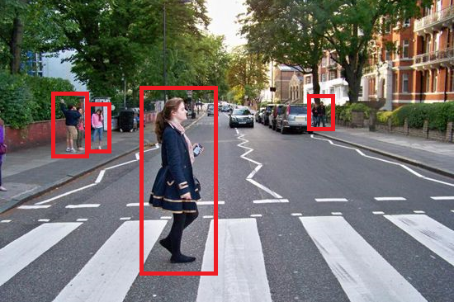
Convolutional Neural Networks – Object detection
To identify what all objects are present in the image and where they’re located
Filter out the object of attention
KNRTU-KAI | TU ILMENAU | Neural Networks

Slide 8
Convolutional Neural Networks – Object detection
Object detection in TensorFlow
1) Run simple example of object detection task in Jupyter* notebook
https://github.com/tensorflow/models/tree/master/research/object_detection
2) Make object detection by using webcam/mobilecam - advanced task
Use OpenCV (Open Source Computer Vision Library) for extracting the video
*PyCharm support Jupyter, but if you want you can use notebook separately
KNRTU-KAI | TU ILMENAU | Neural Networks

Slide 9
Convolutional Neural Networks – Object detection
For next practice (10.12.2018) you need to bring:
1) Results of the pre-trained models in Keras (tables with results)
2) Object Detection result in TensorFlow
3) Information about models for image classification with weights trained on ImageNet. Each of model based on the article. Your task is read the article and make some summary on 5-6 slides about structure of NN, relevance, advantages/disadvantages, how and where to use. Each or pair of students read about only one NN (list on the next slide) and each will present these slides to the group. In addition you can use other resources in the internet.
KNRTU-KAI | TU ILMENAU | Neural Networks

Slide 10
Convolutional Neural Networks – Object detection
Students | NN | Link for article
Aashish Dulal, Khakov Rustam | Xception | https://arxiv.org/abs/1610.02357
Idrisov Azat, Galimov Maxim, | VGG16, VGG19 | https://arxiv.org/abs/1409.1556
Marushkai Nikita, Tuykin Anvar | ResNet50 | https://arxiv.org/abs/1512.03385
Mardanova Aigul, Khairutdinov Samat | InceptionV3 | http://arxiv.org/abs/1512.00567
Khammatov Karim, Khannanova Aigul | InceptionResNetV2 | https://arxiv.org/abs/1602.07261
Kukarcev Kirill, Zaitsev Maksim | MobileNet | https://arxiv.org/pdf/1704.04861.pdf
Leontyev Alexander, Arli Chokoev | DenseNet | https://arxiv.org/abs/1608.06993
Makhmutov Zufar, Ismagilov Aivar | NASNetMobile | https://arxiv.org/abs/1707.07012
KNRTU-KAI | TU ILMENAU | Neural Networks

