Slide 1


Price Track
Group #3 Members and Roles
Name | ID | Role
Shazzad Sakim Sourav | 0446233 | Project Admin, DevOps Specialist & Security Specialist
Sayed Bin Taher | 0456304 | Developer & Data Engineer
Ashif Ahmed | 0438524 | Developer
Faizan Raza | 0446743 | Developer
Amber Mallick | 0441063 | Developer
Revolutionizing Online Shopping through Smart Price Tracking

Slide 2
Introduction
What is the Problem?
Online shoppers struggle with fluctuating prices, missing deals, and lack of historical insights.
Why Does This Matter?
Consumers often overpay due to the lack of tools to track and compare price trends.
Our Solution: An Amazon Product Price Tracking System that monitors prices, analyzes trends, and notifies users of the best deals.
Visuals: Relevant images showcasing e-commerce and price tracking challenges.

Slide 3
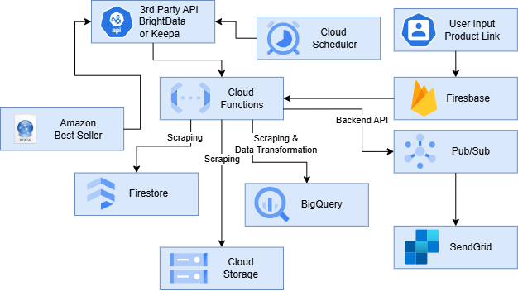
Architecture diagram

Slide 4


Data Storage
and
Management Architecture

Slide 5
Firestore
Collections and Documents:
Products Collection
Stores metadata about the products being tracked.
Document ID: Unique Product ID (e.g., ASIN or generated UUID)
Field | Type | Description
productName | String | Name of the product
category | String | Category of the product
imageUrl | String | URL of the product image
url | String | Product URL
lastUpdated | Timestamp | Last update timestamp
status | String | Status (active, inactive, etc.)
Document ID | Product Name | Category | Image URL | URL | Last Updated | Status
B08N5WRWNW | Sony WH-1000XM4 Wireless Headphones | Electronics | https://example.com/images/sony.jpg | https://www.amazon.com/dp/B08N5WRWNW | 2024-11-25T12:00:00Z | active
B09G3HRPZG | Apple AirPods Pro (2nd Gen) | Electronics | https://example.com/images/airpods.jpg | https://www.amazon.com/dp/B09G3HRPZG | 2024-11-20T10:00:00Z | active
B07FZ8S74R | Instant Pot Duo 7-in-1 | Home & Kitchen | https://example.com/images/instantpot.jpg | https://www.amazon.com/dp/B07FZ8S74R | 2024-11-21T11:00:00Z | active

Slide 6
Users Collection
Stores user information and their subscriptions to price alerts.
Document ID: User ID (UUID or email)
Field | Type | Description
email | String | User's email
preferences | Map | User-specific settings (e.g., notifications)
subscriptions | Array<String> | List of product IDs the user is subscribed to
Document ID | Email | Preferences | Subscriptions
user1 | johndoe@example.com | { "notifications": true } | [ "B08N5WRWNW", "B09G3HRPZG", "B08164VTWH" ]
user2 | janedoe@example.com | { "notifications": false } | [ "B07WC5VNGL", "B082LZ1NXJ", "B08FC5L3RG" ]
user3 | sam@example.com | { "notifications": true } | [ "B097QKT4F2", "B07C1PWSTY", "B08P2DKZ1D" ]

Slide 7
Subscriptions Collection
Links users to product price alerts.
Document ID: Auto-generated
Field | Type | Description
userId | String | ID of the subscribed user
productId | String | ID of the subscribed product
priceThreshold | Float | User-defined price threshold
Document ID | User ID | Product ID | Price Threshold
sub1 | user1 | B08N5WRWNW | 300.00
sub2 | user1 | B09G3HRPZG | 250.00
sub3 | user2 | B07WC5VNGL | 80.00

Slide 8

Cloud Storage Setup
Bucket Name: product-images
Folder Structure
Each product gets its own folder, and all images associated with that product are stored in that folder.
gs://product-images/
├── products/
├── B08N5WRWNW/
├── image1.jpg
├── image2.jpg
├── image3.jpg
├── metadata.json
├── B09G3HRPZG/
├── image1.jpg
├── image2.jpg
├── image3.jpg
├── metadata.json
├── B07FZ8S74R/
├── image1.jpg
├── image2.jpg
├── image3.jpg
├── metadata.json
...

Slide 9
IAM Policy for Collaborative Team Management
Role | Responsibilities | Suggested GCP Role
Project Admin | Oversees the project, resources, billing, IAM. | roles/owner or roles/editor
Developer | Develops/deploys Cloud Functions and APIs. | roles/cloudfunctions.developer
Data Engineer | Manages BigQuery, Firestore, and Cloud Storage. | roles/bigquery.dataEditor, etc.
DevOps Specialist | Manages pipelines, logging, monitoring. | roles/logging.admin, roles/monitoring.editor
Security Specialist | Manages API keys and secrets, ensures resource security. | roles/iam.securityReviewer
Roles and Responsibilities:

Slide 10
Challenges and Solutions
Challenge: Bypassing Amazon's anti-scraping measures.
Solution: Use Keepa or Bright Data for compliant data access.
Challenge: Managing large datasets.
Solution: Leverage BigQuery for scalable storage and querying.
Challenge: Real-time notifications.
Solution: Use Firebase Cloud Messaging and SendGrid for instant alerts.

Slide 11
Cost Analysis
Assuming 10,000 users will use and 100,000 products will be stored:
GCP Costs:
Service | Cost Driver | Estimated Cost
Cloud Functions | Triggers for scrapers, APIs | $150–300/month
Firestore | Metadata for 100K products, frequent queries | $100–200/month
BigQuery | Storage and queries for 100K products | $100–250/month
Cloud Storage | 10GB images, 150K reads | $30–50/month
Pub/Sub | Notifications for 10K users | $5–10/month
Firebase Hosting | Web UI hosting | $10–20/month
SendGrid | Email notifications | $10–50/month

Slide 12
Paid API Costs:
Service | Pricing Model | Estimated Monthly Cost
Bright Data | $25/GB of traffic (10GB usage estimated) | $250–500/month
Keepa API | €0.01/request (100K requests estimated) | €1,000 (~$1,080/month)
Total Estimated Costs:
Phase | Estimated Monthly Cost
Development | ~$500–1,000
Production | ~$1,400–2,300

Slide 13
Future Enhancements
Machine Learning:
Use Vertex AI for predictive analytics (e.g., price trends, best purchase times).
Multi-Platform Expansion:
Extend support to other e-commerce platforms like eBay or Walmart.
Advanced Analytics:
Provide users with comprehensive market insights and recommendations.

Slide 14
Thank You

Slide 15
Appendix

Slide 16
Products Collection Exported (products.json)
[
{
"productId": "B08N5WRWNW",
"productName": "Sony WH-1000XM4 Wireless Headphones",
"category": "Electronics",
"imageUrl": "https://example.com/images/sony.jpg",
"url": "https://www.amazon.com/dp/B08N5WRWNW",
"lastUpdated": "2024-11-25T12:00:00Z",
"status": "active"
},
{
"productId": "B09G3HRPZG",
"productName": "Apple AirPods Pro (2nd Gen)",
"category": "Electronics",
"imageUrl": "https://example.com/images/airpods.jpg",
"url": "https://www.amazon.com/dp/B09G3HRPZG",
"lastUpdated": "2024-11-20T10:00:00Z",
"status": "active"
},
...
]

Slide 17
Users Collection (users.json)
[
{
"userId": "user1",
"email": "johndoe@example.com",
"preferences": { "notifications": true },
"subscriptions": ["B08N5WRWNW", "B09G3HRPZG", "B08164VTWH"]
},
{
"userId": "user2",
"email": "janedoe@example.com",
"preferences": { "notifications": false },
"subscriptions": ["B07WC5VNGL", "B082LZ1NXJ", "B08FC5L3RG"]
},
...
]

Slide 18
Subscriptions Collection (subscriptions.json) [
{
"subscriptionId": "sub1",
"userId": "user1",
"productId": "B08N5WRWNW",
"priceThreshold": 300.00
},
{
"subscriptionId": "sub2",
"userId": "user1",
"productId": "B09G3HRPZG",
"priceThreshold": 250.00
},
...
]

Slide 19
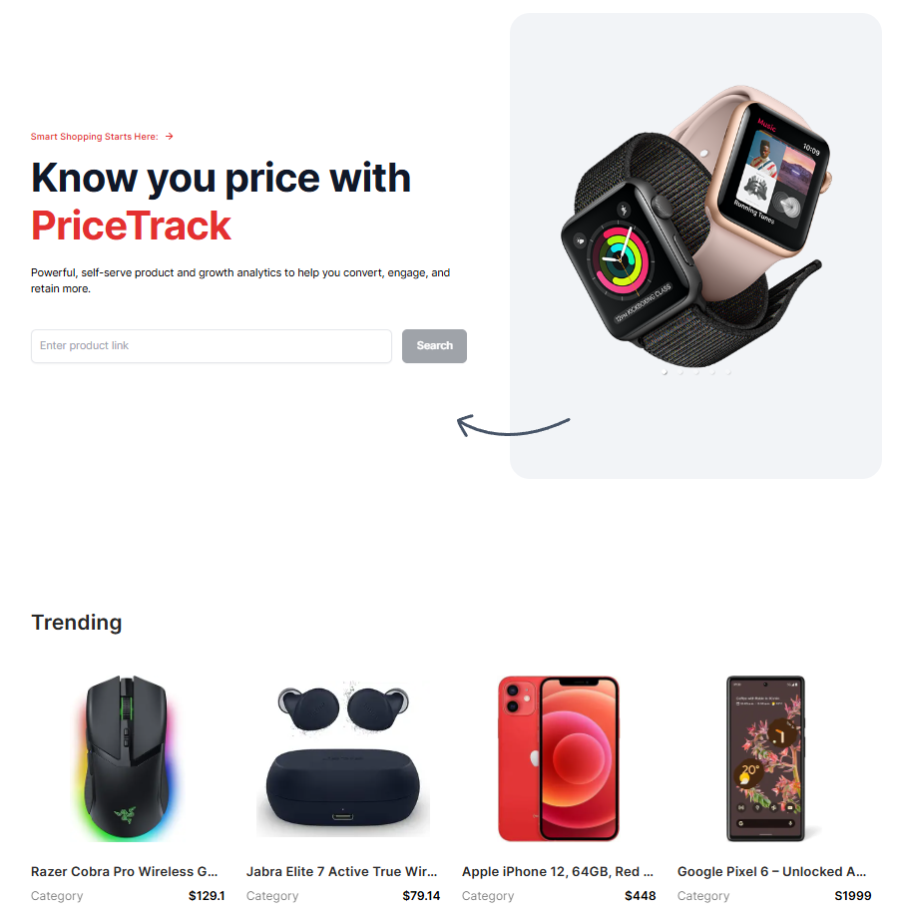
Client side

Slide 20
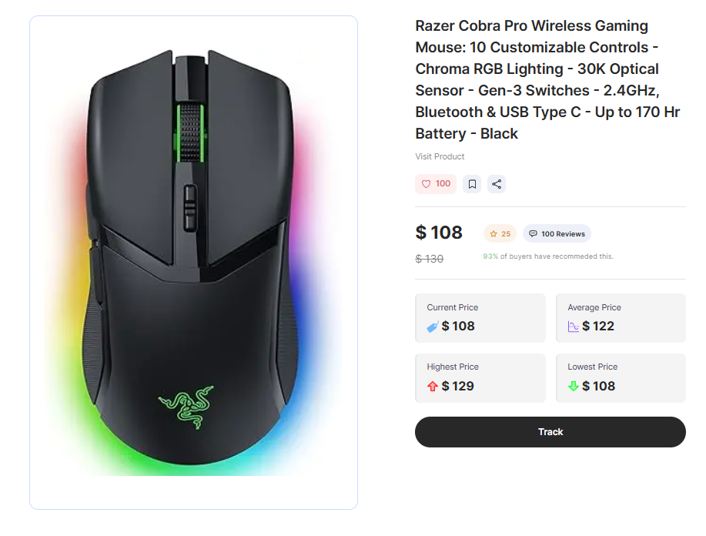
PRODUCT MATRICS

Slide 21
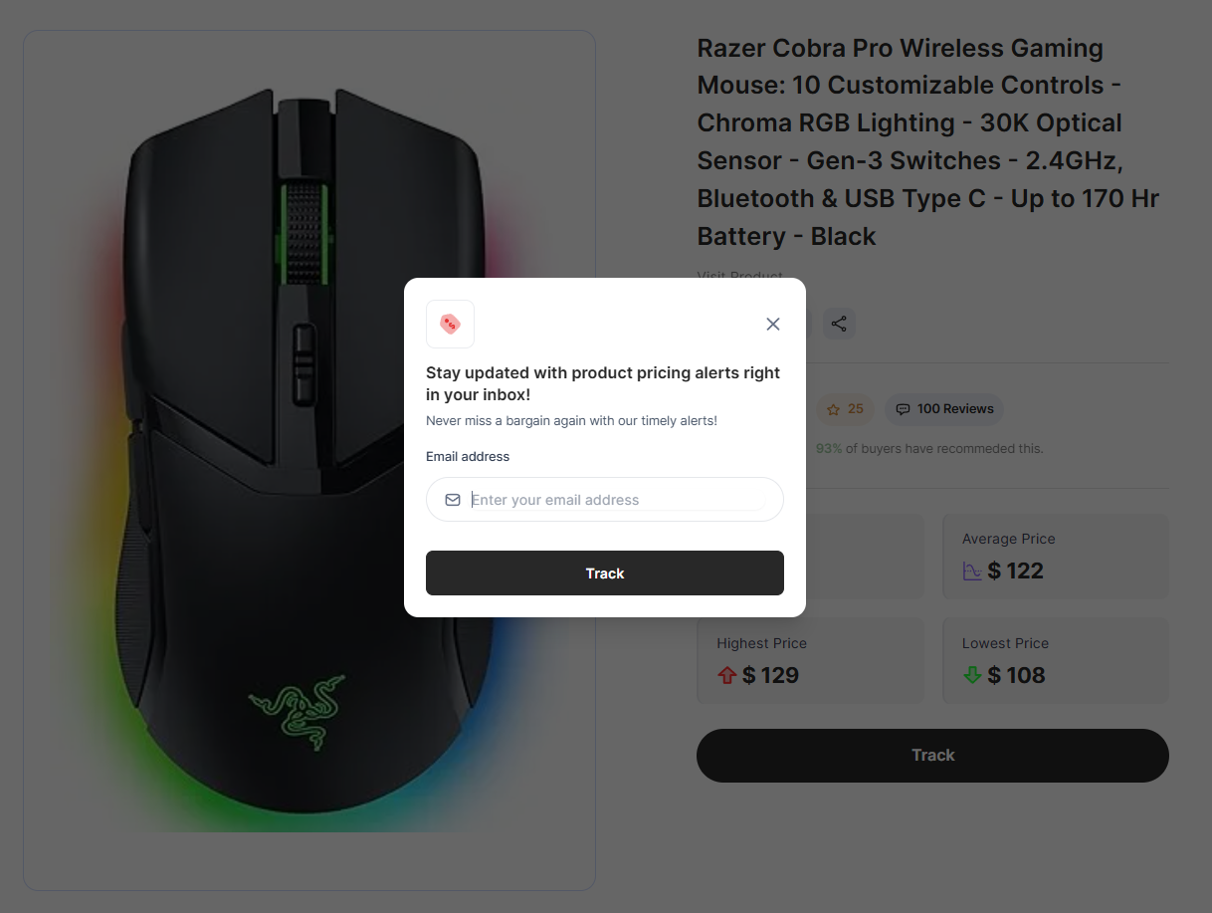
NOTIFICATION ALERT

