Slide 1
Submitted by:
Shazzad Hossain
BSSE Roll: 1203
Exam Roll: 60905
PseudoCoder
UML class diagram to source code generator tool
Supervised by:
Dr. MD. Mahbubul Alam Joarder
Professor
Institute of Information Technology
University of Dhaka

Slide 2
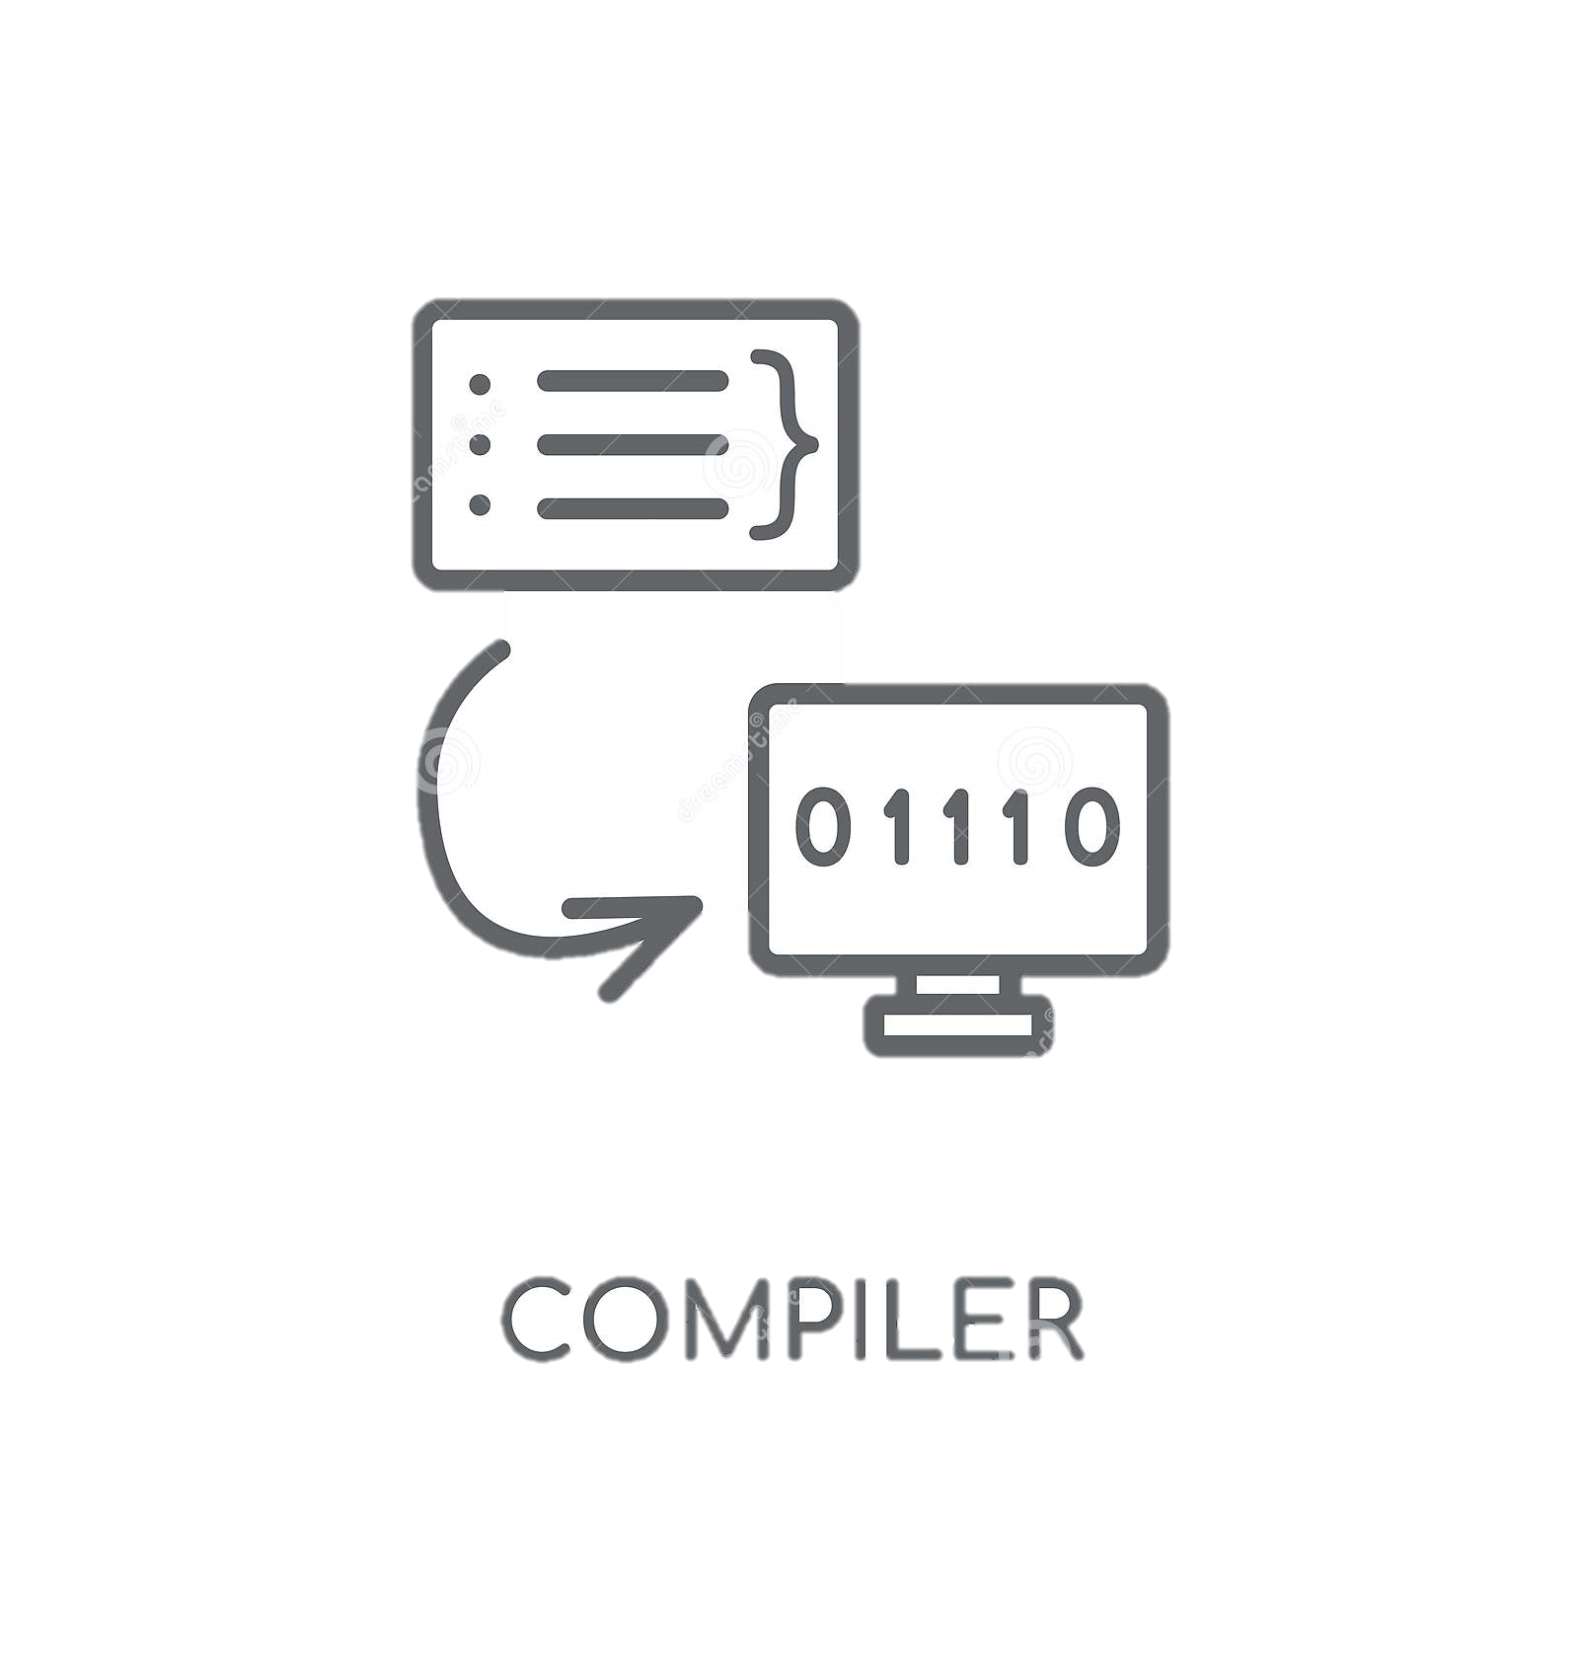
Conceptual Modeling of Application’s Structure
Class Diagram
Pseudo
Coder
Source Code of Application’s Structure (as output)
UML Class Diagram (*.uxf as input)
1

Slide 3
Scanning input
Parsing UML Diagram
Project
Overview
Creates classes with attributes and methods and also handles relations among classes
Tokenizes information for classes and packages
Takes a UML diagram as input
C++ or Java classes are generated
Package and Class Information Analysis
Generate Source Code
4

Slide 4
Encapsulation
Relation
Scope
Inheritance
Multiple Packages
Supports two languages
5

Slide 5
Object Oriented Programming Concepts
OOPs in C++ and Java
Background Study
UML Class Diagram
Lexical Analysis
3

Slide 6
Differences between C++ and Java languages
Challenges faced
UXF language for Class Diagram
5

Slide 7
Learned OOP Based Project Modeling
Achievement
Implementation of OOP concepts in 2 different languages
5

Slide 8
Language: C++
Summary
Project’s GitHub Link: SPL1
7

Slide 9
Project Demonstration

Slide 10
Thank You

