Slide 1
Locality optimizations on ccNUMA architectures
Chapter 8
Introduction to High Performance Computing for Scientists and Engineers
by Georg Hager and Gerhard Wellein
Notes:
Talks about the way data is accessed and utilized in a ccNUMA (Cache-Coherent Non-Uniform Memory Access) architecture.

Slide 2
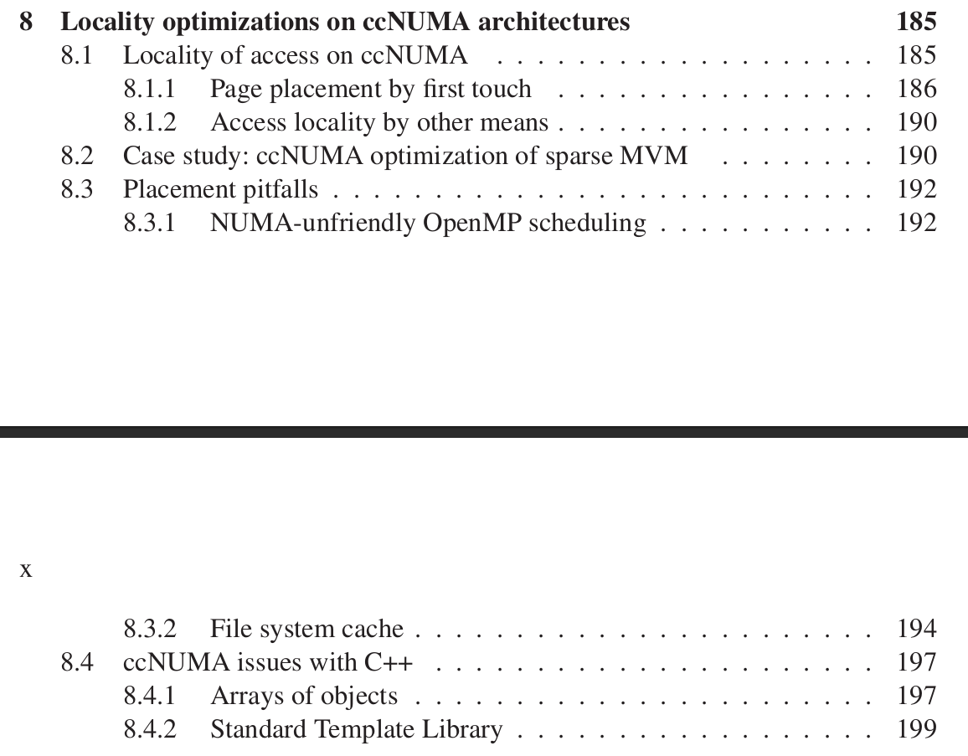
Overview
Mostly system-independent options to correct data placement.

Slide 3
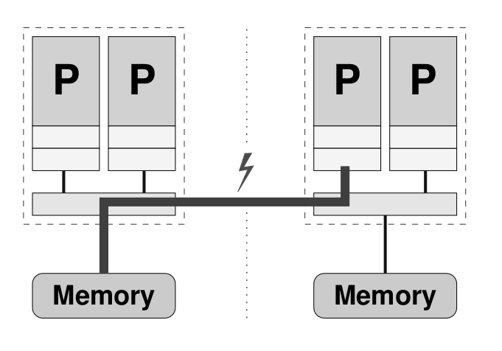
Cache-coherent Nonuniform Memory Access
ccNUMA systems have a physically distributed memory.
This memory is logically shared.
Each processor has its own local memory.
All processors can access the entire global memory address space.
Memory access time depends on which core accesses which parts of memory (“local” vs ”remote”).
Accessing data from the local memory is faster because it has lower latency

Slide 4
ccNUMA
There is a single address space (shared memory).
But there are private caches, or partially shared caches, for the different CPU cores.
Cache coherence protocols ensure consistent data between caches and shared memory.
To optimize performance in a ccNUMA system, it is beneficial to maximize the locality of access.

Slide 5
Locality domains
A set of processor cores together with locally connected memory.
Locality of access refers to the tendency of a processor to access data from its local memory.
Each LD is a UMA building block.
Multiple LDs are connected through a coherent interconnect for cache-coherent memory accesses.
Cache-coherent memory accesses is transparent for the programmer.

Slide 6
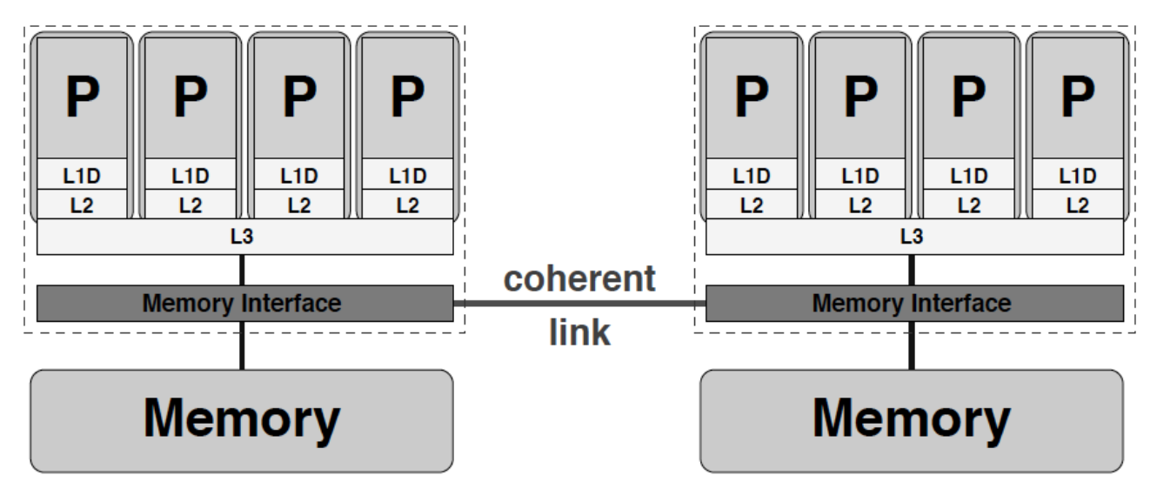
Example of ccNUMA

Slide 7
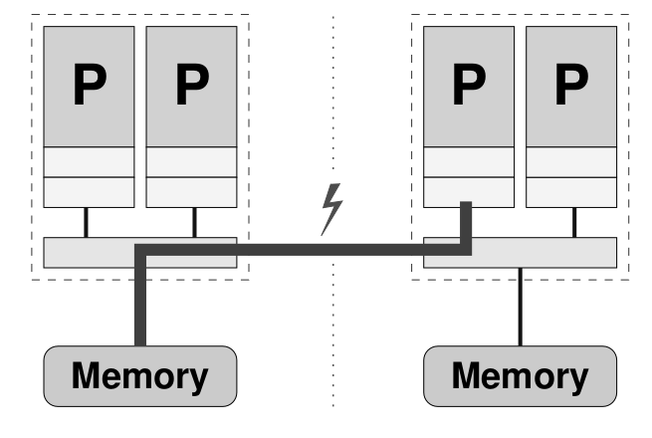
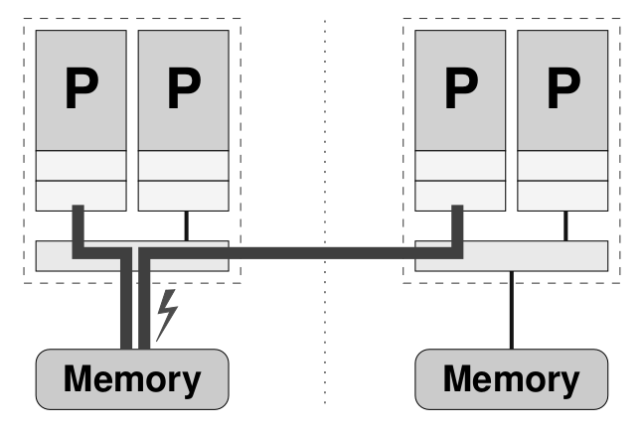
Penalty of non-local transfers
The locality problem:
Non-local memory transfers are more costly than local transfers.
The contention problem:
if two processors from different LDs access memory in the same LD, fighting for memory bandwidth.
Both problems are due to “misplacement” of threads and data.

Slide 8
Solution
Carefully observing the data access patterns of an application
Restricting data access of each processor (mostly) to its own LD
By proper programming

Slide 9
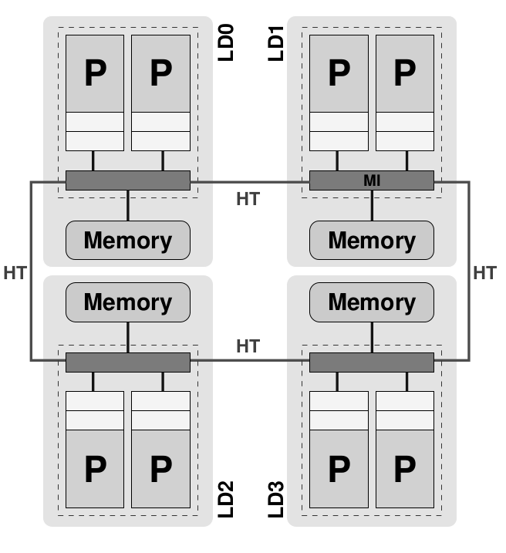
Mapping
When a program is executed on a NUMA system, the operating system needs to decide where to allocate the program's memory.
The mapping process determines the initial placement in the memory hierarchy, which includes both local and remote memory.

Slide 10
HyperTransport (HT)
A high-speed, low-latency interconnect technology.
It provides a high-bandwidth communication channel between the processors.
HT is a point-to-point link technology.
If the HT links are arranged in a loop or ring topology it is called a closed chain configuration.

Slide 11
Placement problem
When a program is executed, the operating system decides where to allocate the program's memory.
"Page placement by first touch" is a policy that determines the initial placement of pages based on the first access or "touch" by a processor.
A page gets mapped into the locality domain of the processor that first writes to it.
By placing frequently accessed pages in the local memory of the processor that touches them first, the system reduces the need for remote memory accesses.

Slide 12
Data initialization
The data initialization part deserves close attention on ccNUMA.
Allocating arrays should use dynamic (heap) memory (malloc).
The calloc function will most probably be counterproductive.

Slide 13
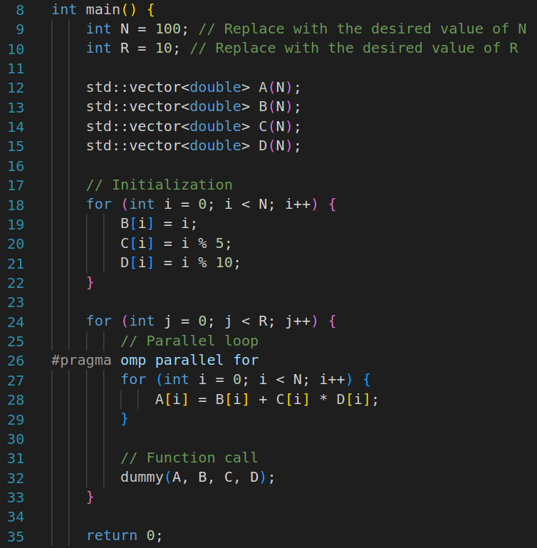
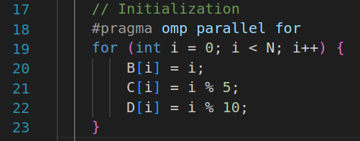
Vector triad performance
This code represents a typical example of OpenMP applications.
If the code is run across several locality domains, it will notscale beyond the maximum performance achievable on a single LD (if the working set does not fit into cache).
This is because the initialization loop is executed by a single thread, writing to B, C, and D for the first time.
Hence, all memory pages belonging to those arrays will be mapped into a single LD.
Problem: many “remote” accesses and severe contention.

Slide 14
First touch by “fake” initialization
Sometimes initializing an array with useful values can only be done by one thread.
Then, a parallelized “fake” (unnecessary) initiation beforehand can secure the desirable first touch.

Slide 15
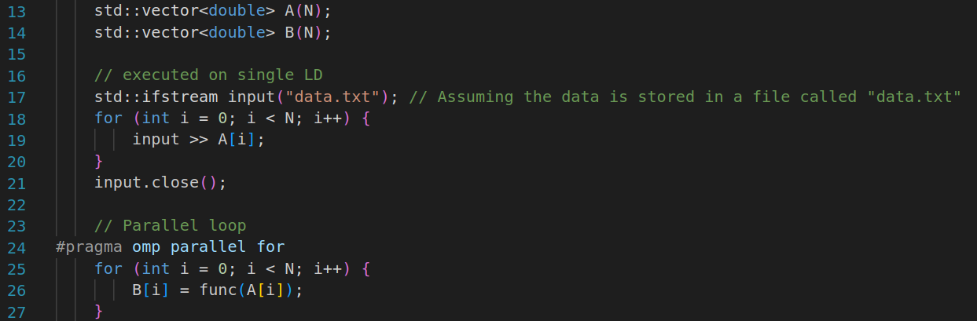
Vector triad performance
In some cases, simply parallelizing array initialization may not be enough.
For example: if there is no loop to parallelize.

Slide 16
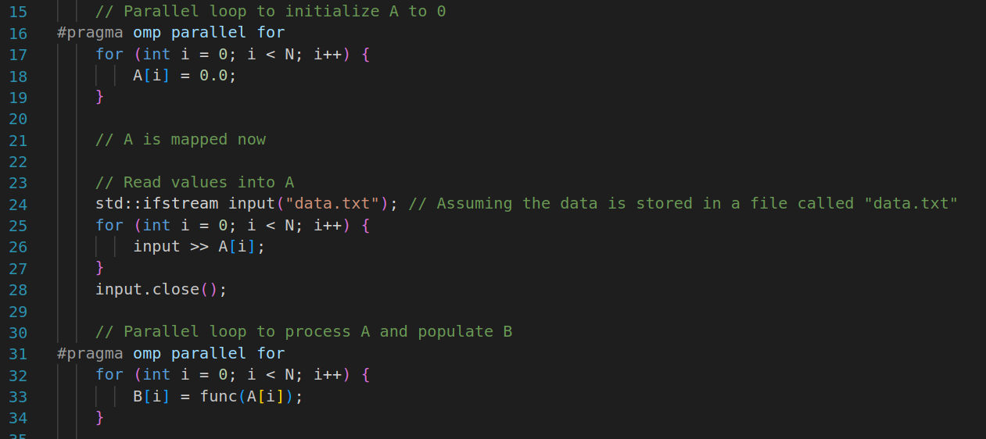

Slide 17
First-touch requirments
The OpenMP loops for initialization and work loops should be identical and reproducible, typically using a STATIC schedule with a constant chunksize, to ensure consistent behavior and avoid load imbalance.
It is recommended to explicitly specify the schedule on all parallel loops, even though most current compilers default to STATIC.
The hardware must be capable of scaling memory bandwidth across locality domains can be affected by factors such as cache coherence traffic, which may lead to contention on the NUMA network.
Notes:
Should use free or delete to make the allocated and initialized pages available later.

Slide 18
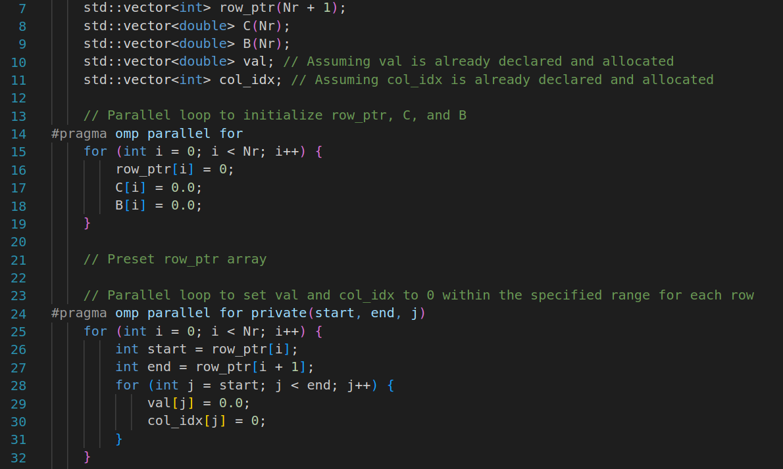
Case study: ccNUMA optimization of sparse MVM
Initialization loops in parallel that exploit first touch mapping policy.
CRS considered.
Arrays C, val, col_idx, row_ptr and B must be initialized in parallel.

Slide 19
Placement pitfalls
Data placement is crucial on ccNUMA architectures for achieving optimal scalability in memory-bound codes.
UMA systems are easier to handle and do not require code optimization for locality of access.
ccNUMA designs are expected to dominate the commodity HPC market due to their price-performance advantages.

Slide 20
NUMA-unfriendly OpenMP scheduling
Dynamic/guided loop scheduling and OpenMP task constructs could be preferable over static work distribution in poorly load-balanced situations.
Assigning tasks to threads dynamically makes it unpredictable and inconsistent, making it difficult to optimize page placement strategies for optimal performance.
To achieve the maximum bandwidth, it is better to distribute memory pages using a round-robin approach across the locality domains..

Slide 21
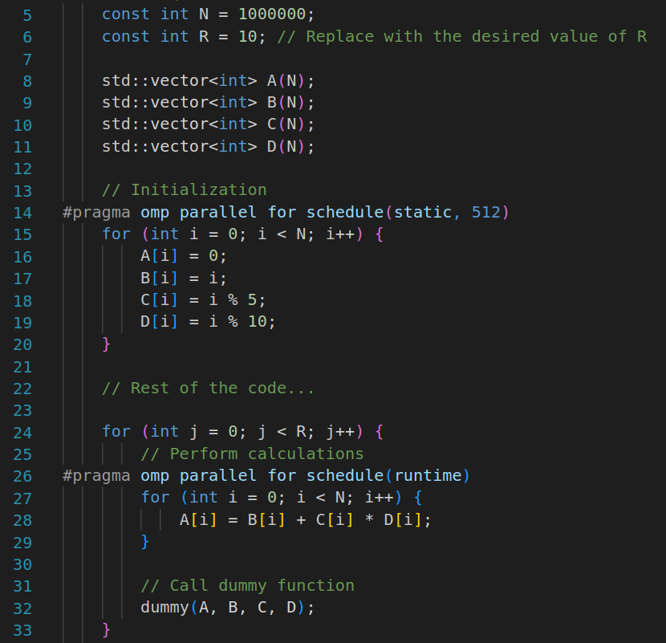
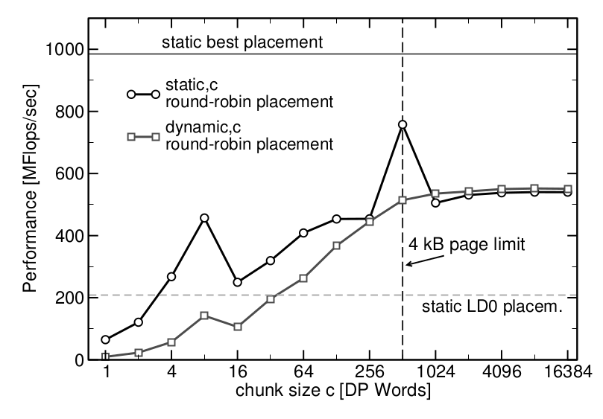
Impact of random page access on vector triad benchmark
Using OMP_SCHEDULE environment variable.
If purely static scheduling (without a chunksize) is ruled out, round robin placement can at least exploit some parallelism.
Prefer static scheduling with an appropriate chunksize for OpenMP worksharing loops to minimize scheduling overhead.

Slide 22
File system cache
Even with correct page placement, OpenMP program scalability and overall system performance can still be below expectations.
Operating systems use buffer caches for efficient disk I/O operations, which store recently read or written file data for efficient re-use.
The size and placement of such caches can be unfortunate with respect to ccNUMA locality.

Slide 23
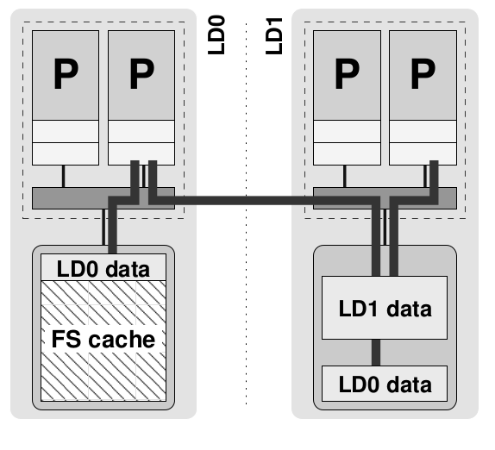
In the example scenario for locality domain 0 (LD0), the file system cache occupies a significant portion of local memory.
As a result, some of the pages allocated and initialized by a core in LD0 are mapped into LD1, which leads to nonlocal access and potential performance issues.

Slide 24
Ideally, in production HPC environments, there should be a way to automatically clear ("toss") the buffer cache after a production job finishes.
This ensures that the system is "clean" and ready for the next user without any lingering cached data.
If there are no user-level tools or system administrators haven't addressed the issue:
Aregular user without special permissions can run a "sweeper" code.
This code allocates and initializes all memory, effectively clearing any lingering cached data.

Slide 25
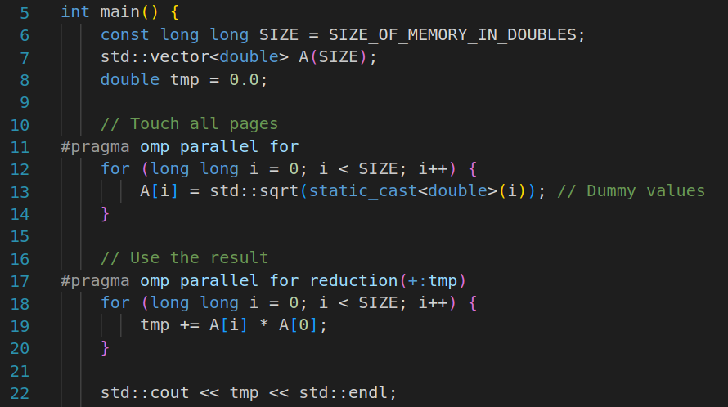
Sweeper

Slide 26
ccNUMA issues with C++
Most relevant pitfalls when using OpenMP-parallel C++ code on ccNUMA systems.

Slide 27
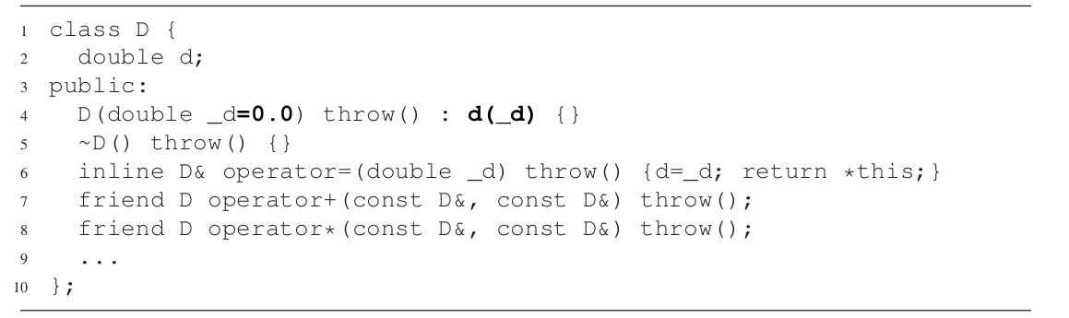
Arrays of objects
Allocating an array of objects using the standard new[] operator.
All the objects are initialized by the thread executing new, leading to all the data ending up in that thread's local memory.

Slide 28
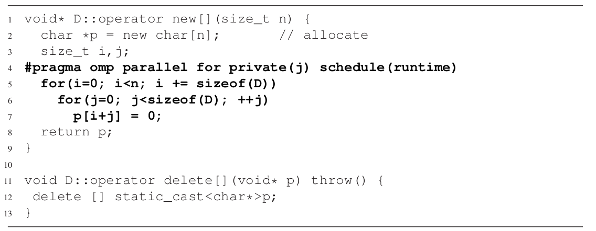
An alternative is to overload the operator new[] for the class
Which handles both memory allocation and parallel initialization of the pages for good NUMA placement.
Overloading operator new[] works well for simple classes.

Slide 29
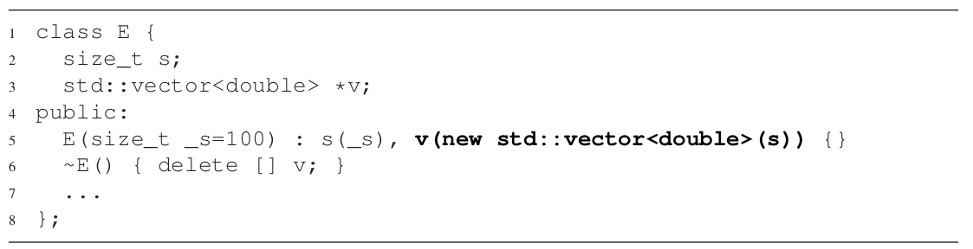
But it becomes challenging for classes with dynamic members that have their own memory allocation.

Slide 30
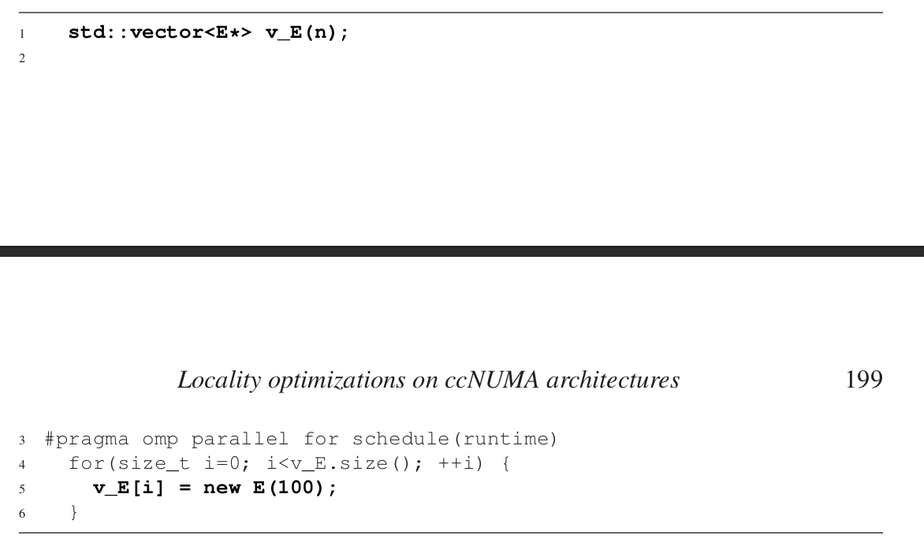
To handle such cases, it is advisable to explicitly call the object constructors in a loop and use a vector to hold pointers to the objects.
This ensures thread-safe construction from different threads.

Slide 31
Standard Template Library
C-style arrays in C++ are discouraged, and std::vector<> is recommended instead.
However, std::vector<> has ccNUMA page placement problems.
Allocators in C++ provide a customizable abstraction layer for managing container memory.
Allocators have methods like allocate() and deallocate() for memory management.
By using allocators, correct ccNUMA placement can be enforced for std::vector<> with minimal code changes.

Slide 32
The allocate() method sets up memory for the container, like operator new[] for arrays.
The deallocate() method frees the allocated memory.
A NUMA-aware allocator can initialize memory in parallel during allocation.
The allocator template must be specified as the second argument when constructing a std::vector<> object.

Slide 33
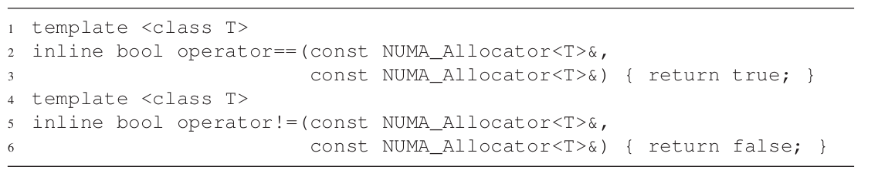
Construction and destruction of container objects involve calling the allocator's construct() and destroy() methods.

Slide 34
The size versus capacity concept in containers can affect NUMA placement during reallocation.
Not all functionality of std::vector<> is suitable for ccNUMA environments.
Using these methods can retrofit existing C++ programs with ccNUMA awareness.
Ideally, new code should be designed with ccNUMA in mind from the start.

