Slide 1
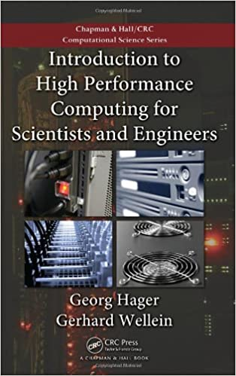
Introduction to High-Performance Computing for Scientists and Engineers
By Georg Hager, Gerhard Wellein

Slide 2

Chapter 1 - Modern Processors

Slide 3
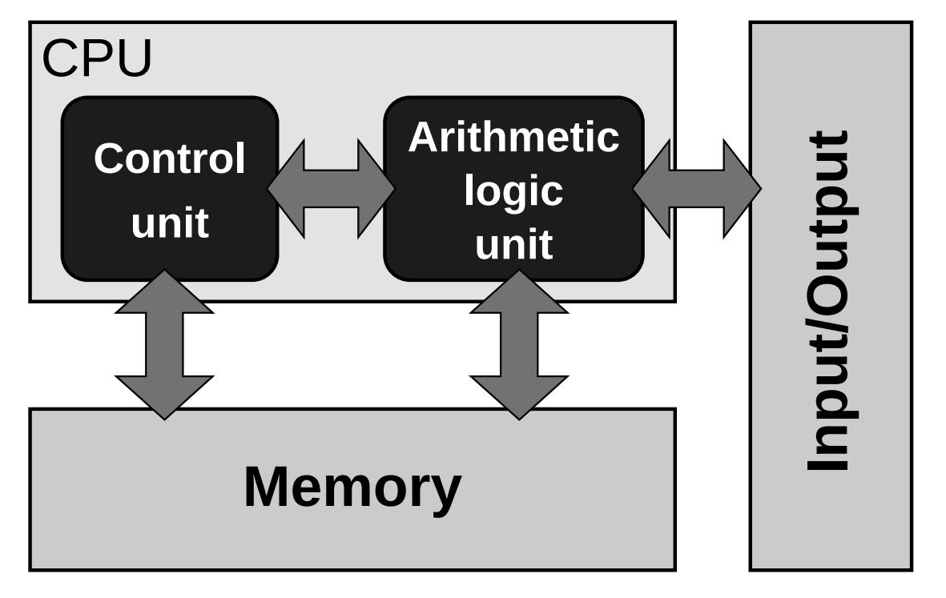
Stored-program computer architecture
Limitations of this architecture:
Feeding data and instructions from memory to CU and ALU.
Speed of memory
The architecture is inherently sequential.
Single Instruction Single Data (SISD)
Notes:
Basis of all computers

Slide 4
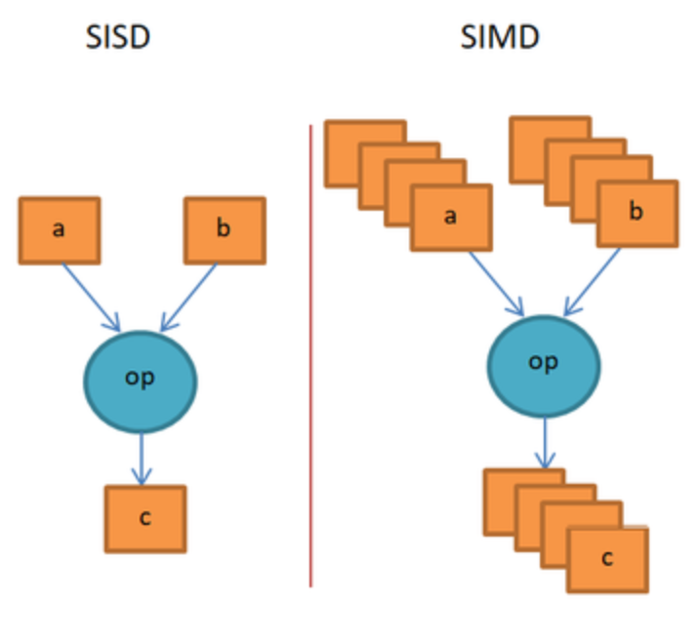
SISD vs SIMD

Slide 5
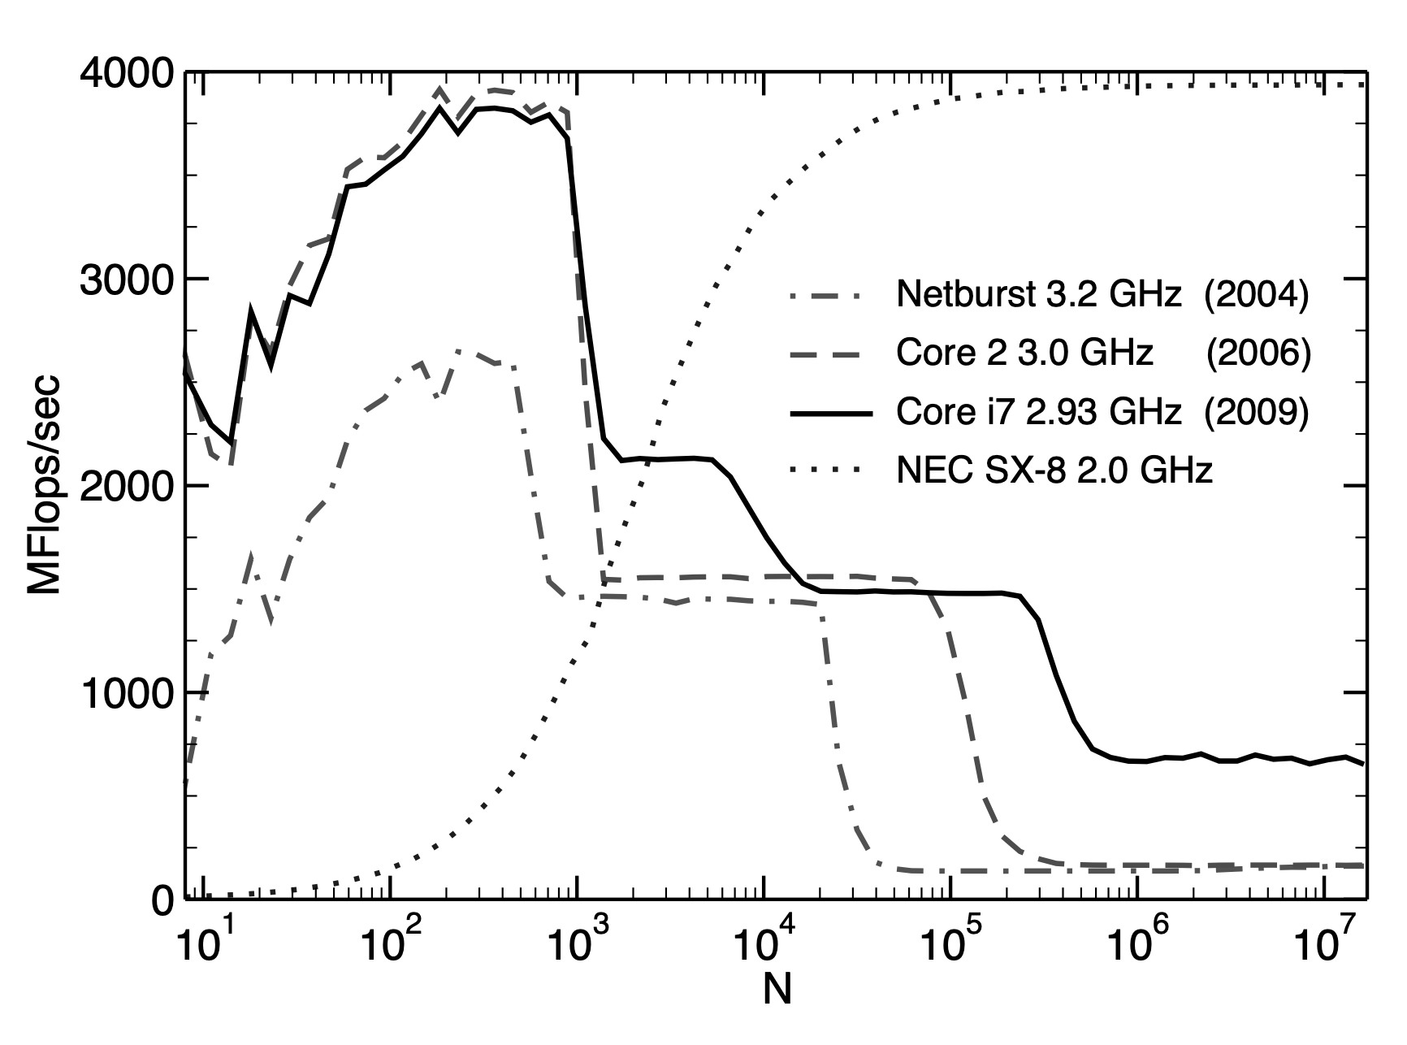
Performance metrics
Peak performance: Flops/second
Memory bandwidth: Bytes/second
Notes:
All the components of a CPU core can operate at some maximum speed called peak performance – but it is not always possible. Because of some limitations and many factors.
To Finding the performance characteristics of a processor or system a low-level benchmarking is used.
Wallclock
Dotted in image is vector processors.
Low level benchmark
Vector tripad
Vector processors vs cache based processors

Slide 6
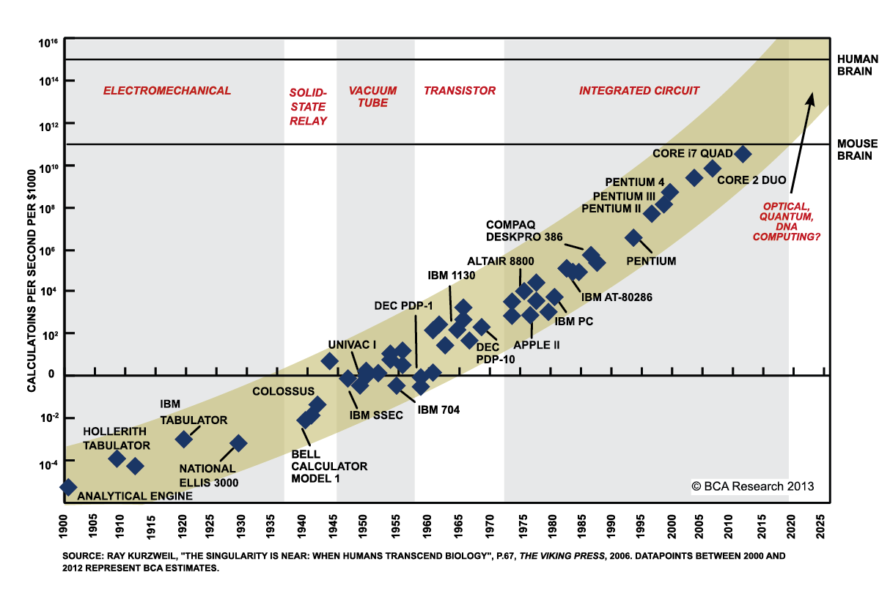
Moore’s Law
https://www.extremetech.com/extreme/210872-extremetech-explains-what-is-moores-law

Slide 7

Enabled Techniques by Increasing Transistor Counts and Clock Speeds
Pipelined functional units.
Notes:
Pipelining is a technique used to increase instruction throughput by breaking down complex operations into simple components that can be executed using different functional units on the CPU. By doing this, it is possible to increase the number of instructions executed per clock cycle, which is known as instruction-level parallelism (ILP).
Pipelining breaks down complex instructions into smaller steps that can be executed in parallel, while superscalar uses multiple functional units to execute multiple instructions simultaneously.
If arguments to instructions are not available in registers “on time,” out-of-order execution can avoid idle times (also called stalls) . using a reorder buffer that stores instructions until they become eligible for execution.
When there is a big cache we have more fast access data. But there is a trade off of a big cache and being too slow.

Slide 8
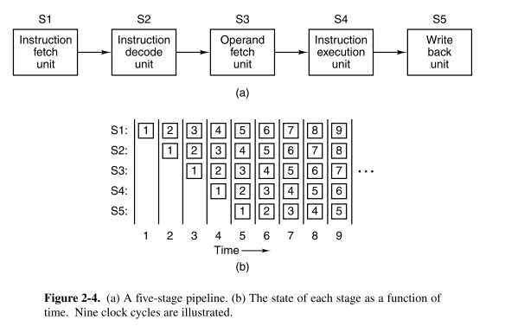
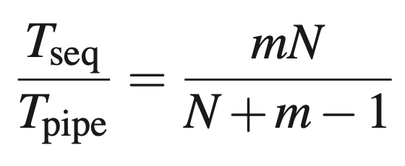
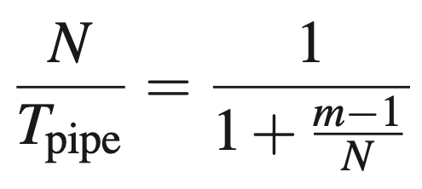
Pipelining
Throughout
Speedup
https://i.stack.imgur.com/V0f2L.png
Notes:
Pipelining is a technique used to increase instruction throughput by breaking down complex operations into simple components that can be executed using different functional units on the CPU. By doing this, it is possible to increase the number of instructions executed per clock cycle, which is known as instruction-level parallelism (ILP).
ratio of the time required to perform a particular computation

Slide 9
Enabled Techniques by Increasing Transistor Counts and Clock Speeds
Pipelined functional units.
Superscalar architecture.
Data parallelism through SIMD instructions.
Out-of-order execution.
Larger caches.
Simplified instruction set.
Notes:
Pipelining breaks down complex instructions into smaller steps that can be executed in parallel, while superscalar uses multiple functional units to execute multiple instructions simultaneously. producing more than one “result” per cycle
If arguments to instructions are not available in registers “on time,” out-of-order execution can avoid idle times (also called stalls) . using a reorder buffer that stores instructions until they become eligible for execution.
When there is a big cache we have more fast access data. But there is a trade off of a big cache and being too slow.

Slide 10
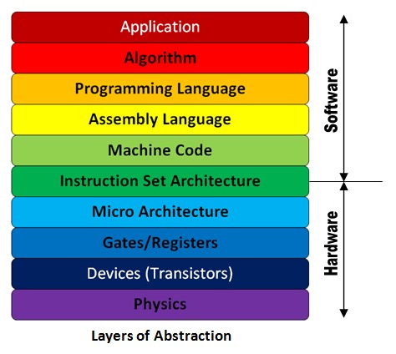
Instruction Set Architecture (ISA)
CISC
RISC
https://i.stack.imgur.com/AvG0R.jpg
Notes:
the set of instructions that a processor can understand and execute. Even the number and size of registers. Different processor architectures have different ISAs, which may limit the compatibility of software programs between processors.
CISC processors have a larger and more complex instruction set, which allows them to execute complex instructions in a single cycle. They also have a larger number of addressing modes and can handle complex memory access patterns. CISC processors are commonly used in general-purpose computing applications such as desktop and laptop computers.
RISC processors have a smaller and simpler instruction set, which allows them to execute instructions more quickly and efficiently. They use pipelining, caching, and other techniques to improve performance. RISC processors are commonly used in high-performance computing applications such as scientific simulations, 3D rendering, and server applications.

Slide 11
Memory Hierarchy
Register
Cache
Main Memory
Disk
Notes:
The need for caches arises because data transfer rates to main memory are much slower than CPU arithmetic performance. storing frequently used data items close to the CPU, reducing latency and increasing bandwidth. There are usually at least two levels of cache, called L1 and L2. with L1 being split into two parts for instructions (L1I) and data (L1D) When the CPU requests to load data, the first-level cache checks if the data item is already resides in cache, and if so, it can satisfy the request immediately with low latency. In the case of a cache miss, data must be fetched from outer cache levels or main memory, and if all cache entries are occupied, old items are evicted to make room for new data.
It has effect on performance just if the data is on cache is going to be used before deleting from cache,. Locality of reference. Temporal locality
Cache read data Cache miss hit
write data – write hit and miss: When data is written to memory, if the data already exists in the cache, a write hit occurs, and the cache line is modified in the cache and written to memory when it is evicted. However, if there is a write miss, the cache line must be transferred from memory to cache before the entry can be modified, and this is called write allocate. Write allocate requires the bus to be used twice, once for cache line allocation and once for evicting modified lines When a computer writes data to memory, it usually stores it in a cache first.
Another technique is called "cache line zero," which marks a whole section of the cache as modified, even if only part of it is actually changed. . When a cache line is marked as modified, any writes to that cache line are written directly to memory

Slide 12
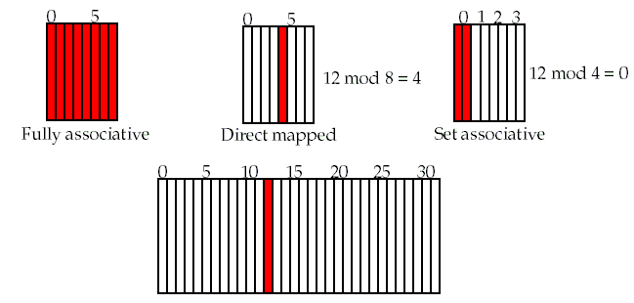
Cache mapping
Fully associative cache
Direct-mapped cache
Set-associative cache
Notes:
This means that any memory location can be stored in any cache line. the decision of which cache line to replace next if the cache is full is made by some algorithm implemented in hardware. Often there is a least recently used (LRU) strategy that makes sure only the "oldest" items are evicted, but alternatives like NRU (not recently used) or random replacement are possible.
Simplified fully associated is direct. A direct-mapped cache is a type of computer memory cache where each block of main memory maps to only one specific cache line or location. In a direct-mapped cache, when a memory address is accessed, the cache location is determined by dividing the memory address by the cache size and taking the remainder. This mapping scheme can be simpler and faster to implement than a fully associative cache, but it has conflict misses, where different memory addresses map to the same cache line.
To reduce the danger of conflict misses and cache thrashing, a set-associative cache is used. A set-associative cache is divided into m direct-mapped caches of equal size, called ways. The number of ways m is the number of different cache lines a memory address can be mapped to.
In set-associative caches, the cache is divided into a number of sets, with each set containing a fixed number of cache lines or blocks. The number of cache lines in each set is typically a power of 2, a
Innermost (L1) caches tend to be less set-associative than outer cache levels, and the tradeoff between low latency and prevention of thrashing must be considered by processor designers for each cache level. Additionally, prefetching is used to improve cache efficiency by predicting and fetching data that is likely to be needed in the near future.

Slide 13

Multicore Processors

Slide 14
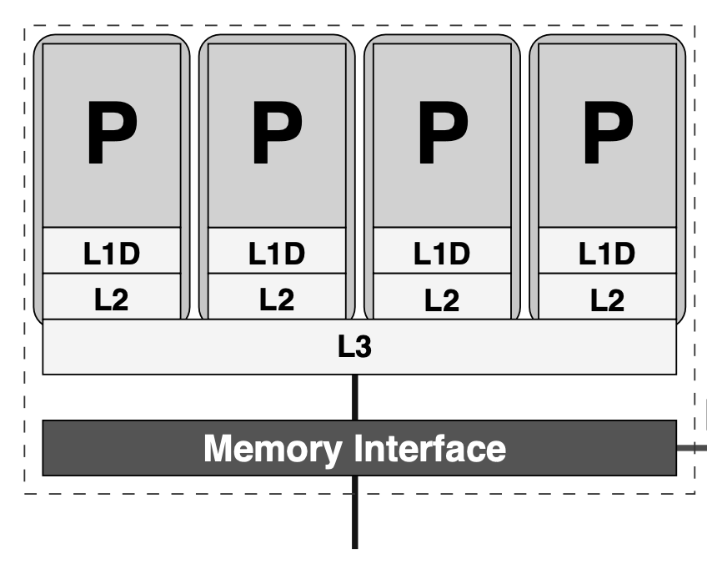
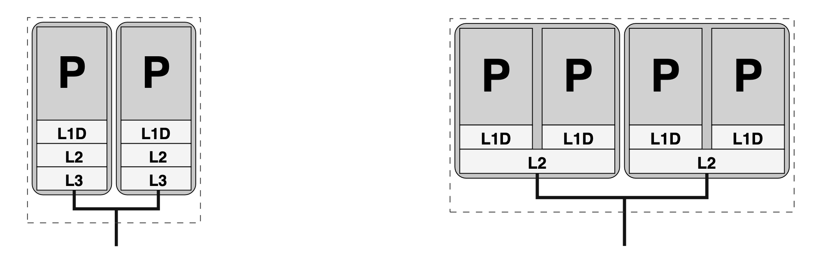
Multicore Processors
Parallelism
Dual Core
Quad Core
Notes:
which refers to the ability of a computer to perform multiple tasks simultaneously. The author then discusses how multicore processors are designed to take advantage of parallel processing by incorporating multiple processing cores on a single chip.
A “socket” is the physical package in which multiple cores (sometimes on multiple chips) are enclosed
The cores on one die can either have separate caches.
With integrated memory controller.
Fast data paths between caches

Slide 15
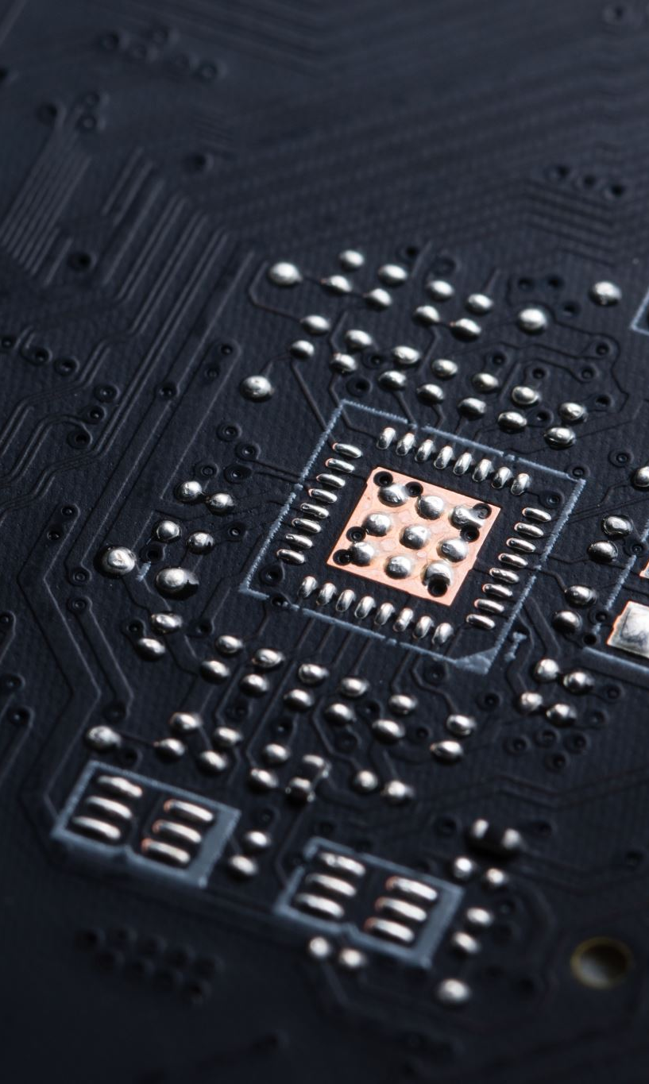
Multithreaded Processors
Notes:
1 Sharing a cache enables communication between cores without reverting to main memory, reducing latency and improving bandwidth by about an order of magnitude. An adverse effect of sharing could be possible cache bandwidth bottlenecks. Depends on application

Slide 16
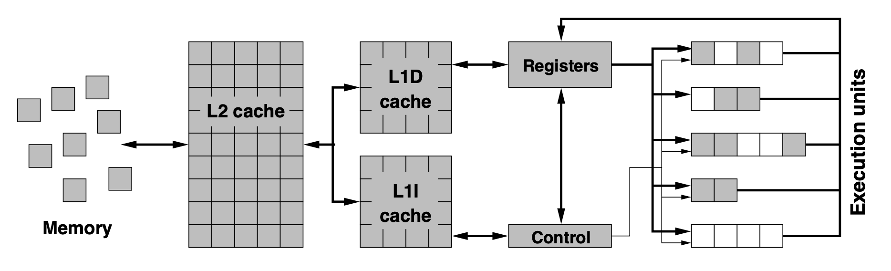
Multithreaded processors
Hyper-Threading or SMT (Simultaneous Multithreading)
Notes:
Threads can be implemented in software, where the operating system manages the scheduling and execution of different threads on the CPU cores, or in hardware, where the CPU has built-in threading capabilities (e.g., Hyper-Threading or Simultaneous Multithreading). allowing multiple threads to run simultaneously on a single CPU core, with each thread having its own architectural state and set omost notably the caches like caches.

Slide 17
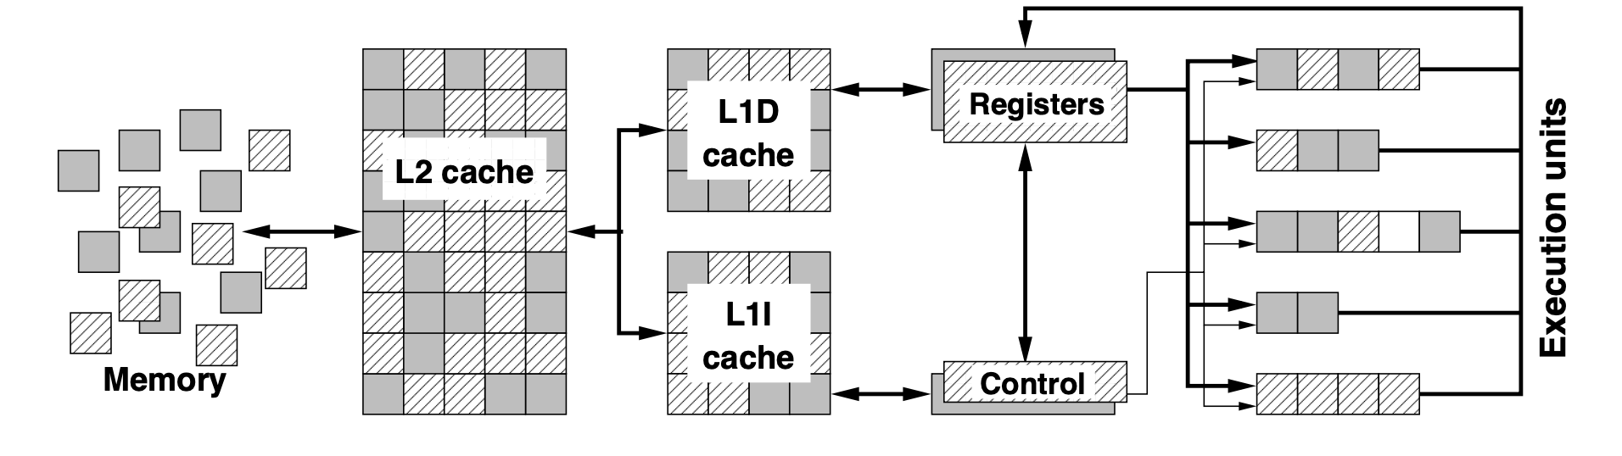
Two-way SMT

Slide 18

Vector Processors

Slide 19
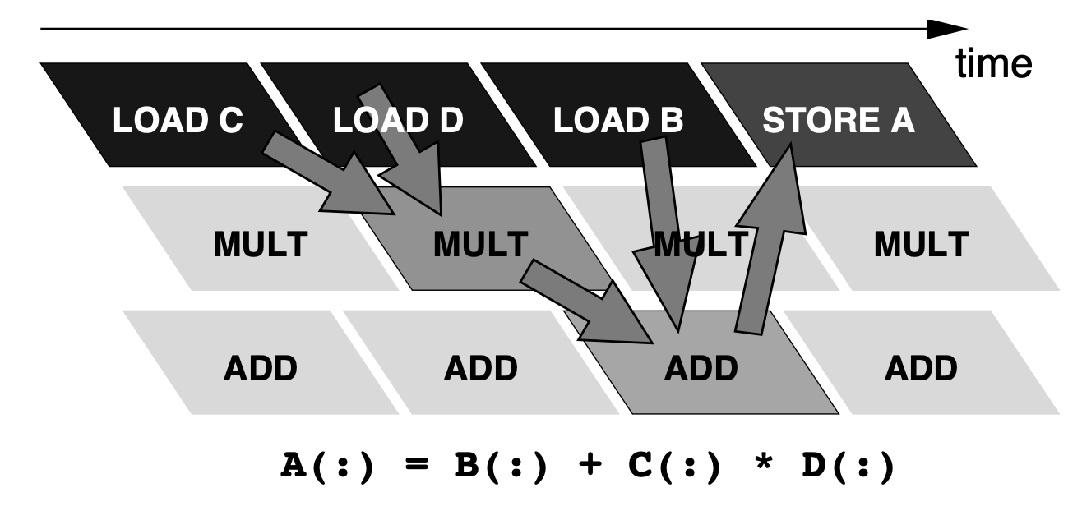
Vector processors
RISC-based massively parallel machines.
Vector registers usually between 64 and 256 bits.
Peak performance: 2 (ADD+MULT) × 4 (tracks) × 2 (GHz) = 16 GFlops/sec.
Bandwidth: 4 (tracks) × 2 (GHz) × 8 (bytes) = 64 GBytes/sec.
Notes:
Even on a vector process: if a code is nonvectorizable, neither peak perfor- mance nor peak memory bandwidth can be achieved
Tracks pipleline levels. processors that are designed to perform operations on vectors or arrays of data in a parallel manner.
vectorization requires that there are no true data dependencies across the iterations of a loop

Slide 20

Any Question?

