Slide 1

Introduction to High Performance Computing for Scientists and Engineers Chapter 3: Data access optimization
By Georg Hager, Gerhard Wellein

Slide 2
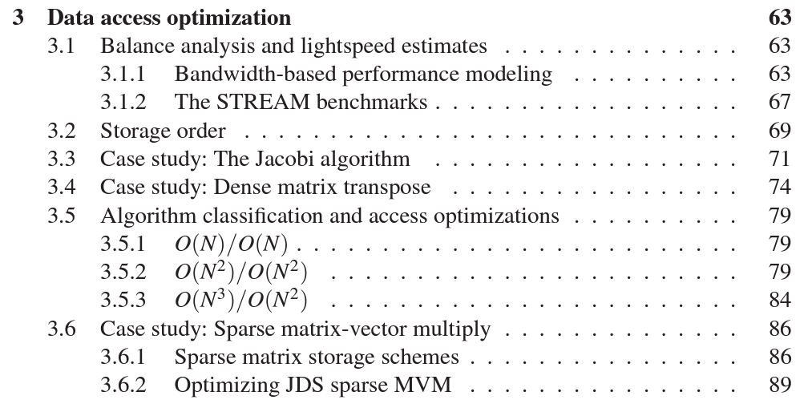
ToC
Notes:
Optimization techniques of data access in HPC applications Balance analysis

Slide 3
Data access
The most prominent performance limiter factor
Many applications have loop-based code
https://rammyram.medium.com/standard-convolution-to-deformable-convolution-part-1-1f11ac308dde
Notes:
Moves large amounts of data in and out of the CPU
Modern microprocessors have a very impressive theoretical peak performance (in number of FP operations executable per second), but the memory system is “too slow”.

Slide 4
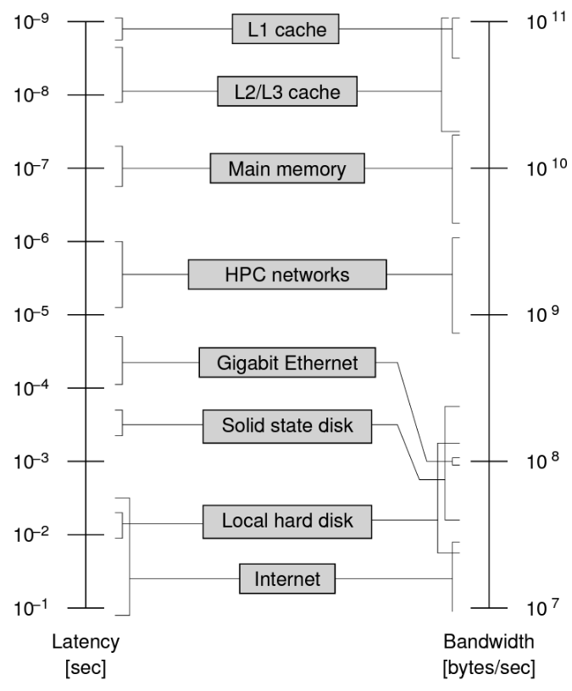
Typical latency and bandwidth numbers for data transfer to and from different devices in computer systems
Introduction to High Performance Computing for Scientists and Engineers, By Georg Hager, Gerhard Wellein, 2011, p.64
Notes:
The deeper data transfer they must reach less latency and higher bandwidth
Any optimization attempt, with respect to data access, should first aim at reducing traffic over slow data paths, or, making the data transfer as efficient as possible.
Registers have been omitted because their “bandwidth” usually matches the computational capabilities of the compute core, and their latency is part of the pipelined execution.

Slide 5
Bandwidth-based performance modeling
Machine balance
Introduction to High Performance Computing for Scientists and Engineers, By Georg Hager, Gerhard Wellein, 2011, p.65
Notes:
The increase of memory bandwidth typically falls behind the increase of FP performance
This bandwidth can be the bandwidth of each layer in memory hierarchy.
Machine balance, Bm, of a processor is the ratio between the maximum memory bandwidth and the peak FP performance. Access latency is assumed to be hidden completely.
The table shows typical balance values for operations limited by different transfer paths. The values are somewhat outdated.

Slide 6
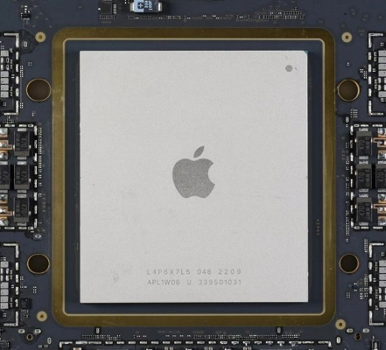
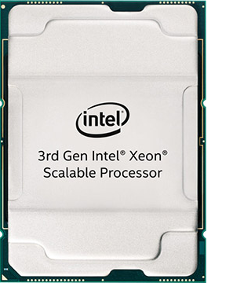
A new example of machine balance
Peak Memory Bandwidth = (Memory Interface Width x Number of Memory Channels) / 8 = (GB/s)
Peak Performance = Number of Cores x Clock Speed x Instructions per Cycle = GFlops/s
Apple M1 Ultra |  | Intel Xeon Platinum 8300
8 | Number of Memory Channels | 8
819.2 | Memory Bandwidth (GB/s) | 204.8
20 | Number of Cores | 40
3.2 | Clock Speed (GHz) | 2.8
21 | Peak Performance (TFlops/s) | 3
fp32 |  | AVX-512 instructions with FMA
https://www.techinsights.com/blog/apple-m1-ultra-advanced-packaging
https://gadgetversus.com/processor/intel-xeon-platinum-8380hl-specs/

Slide 7
Bandwidth-based performance modeling
Machine balance
Apple: 819.2 GB/s / 21 TFlops/s =
819.2 / 2 GW/s / 21 *1024 Gflops/s = 0.019
Intel: 204.8 GB/s / 3 TFlops/s =
204.8 / 2 GW/s / 3 *1024 Gflops/s = 0.033
Apple M1 Ultra |  | Intel Xeon Platinum 8300
0.019 | Machine balance | 0.033
Introduction to High Performance Computing for Scientists and Engineers, By Georg Hager, Gerhard Wellein, 2011, p.65
Notes:
the number of FP operations that can be performed during the time for an "average" memory access.
lower machine balance in a CPU is better. For each floating point operations we need this much transfer data.

Slide 8
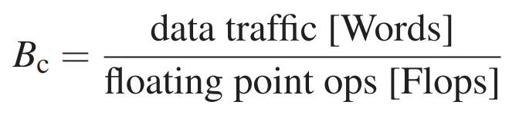

Code Balance
Data traffic: the amount of data transferred over the performance-limiting data path
$\frac{1}{B_{c}}$ is computational intensity.

Slide 9
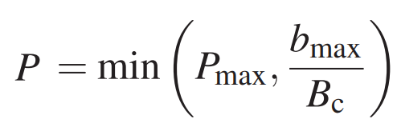
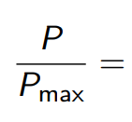
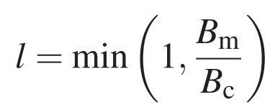
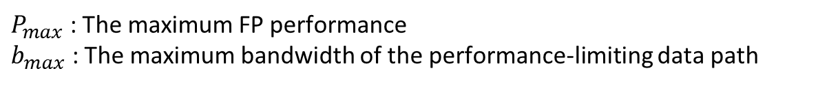
Lightspeed of a loop
We have:$B_{m}$and $B_{c}$
$P_{max}$ : The maximum FP performance
$b_{max}$ : The maximum bandwidth of the performance-limiting data path
Lightspeed is the maximum achievable peak performance
If l ≃ 1 or P ≈ Pmax : performance is not limited by bandwidth but other factors, either inside the CPU or elsewhere. so data access optimization is not needed)
Notes:
When you know the machine balance Bm of a CPU, and you want to run a loop that has Bc as its code balance. What will be the maximum achievable performance P (in Flops/sec)?
If l ≃ 1 or P ≈ Pmax : performance is not limited by bandwidth but other factors, either inside the CPU or elsewhere. so data access optimization is not needed)
This is based on crucial assumptions

Slide 10
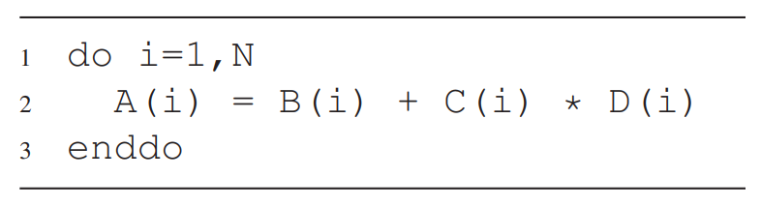



Example
Each iteration has three loads, one store and two floating-point operations.
Code balance:
Assume: CPU has machine balance
Lightspeed ratio: is 0.1/2 = 0.05 or 5% of peak FP performance

Slide 11
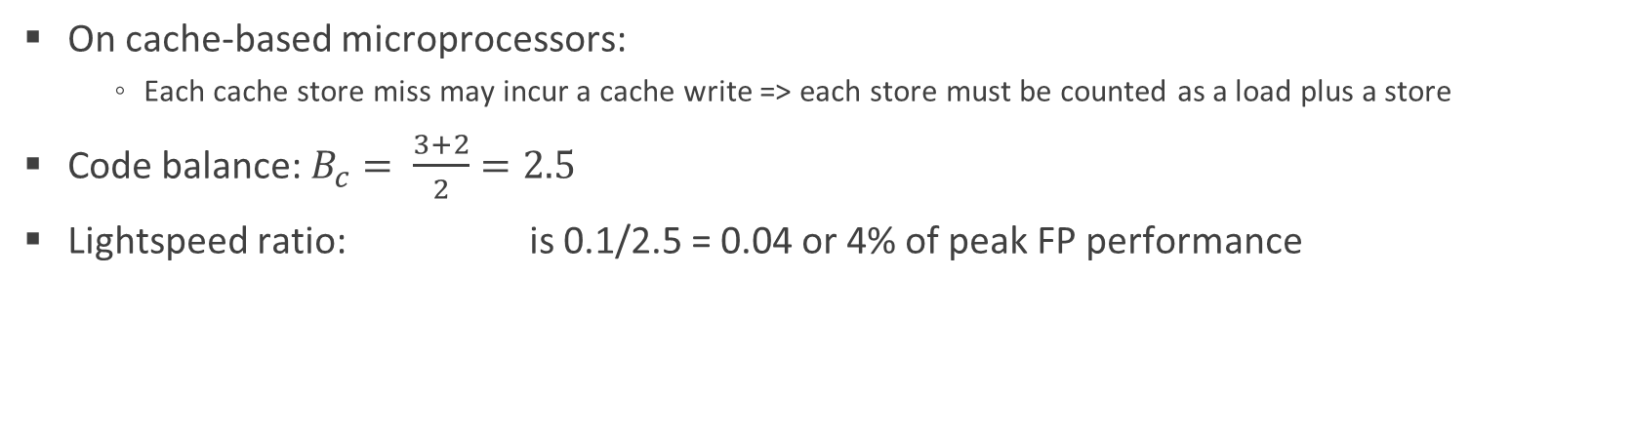
Example
On cache-based microprocessors:
Each cache store miss may incur a cache write => each store must be counted as a load plus a store
Code balance: $B_{c}= \frac{3+2}{2}=2.5$
Lightspeed ratio: is 0.1/2.5 = 0.04 or 4% of peak FP performance
Notes:
In reality, even the simplest memory-intensive loops are not able to achieve the theoretical hardware maximum memory bandwidth bmax.
There is a benchmark called stream micro-benchmarks can be used to measure the realistically achievable maximum memory bandwidth.

Slide 12
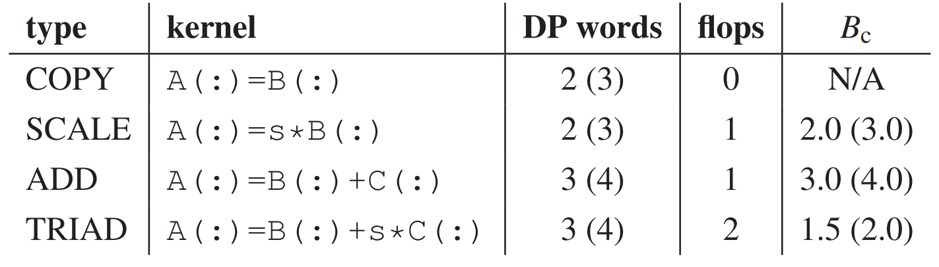
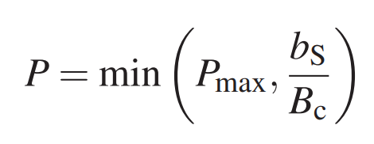
STREAM benchmark
Realistically achievable memory bandwidth, bS, which is measured by STREAM.
Notes:
The McCalpin STREAM benchmarks kernels with their respective data transfer volumes (third column) and floating-point operations (fourth column) per iteration. Numbers in brackets take write allocates for cache read miss into account.
in serial and OpenMP-parallel
Data paths inside the processor chip, Protocol overhead, Maximum bandwidth may be a reason that even STREAM in prediction balance fails

Slide 13
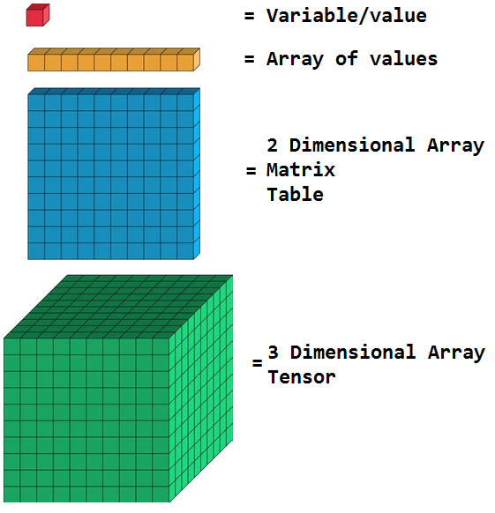
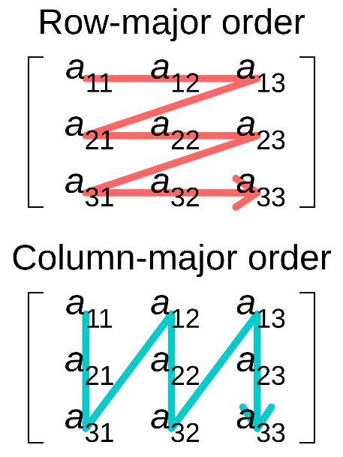
Storage order of Multidimensional arrays
Multi-dimensional arrays normally have an underlying contiguous 1D storage.
C and C++ use row-major layout. (Stride-1)
Fortran has a column-major layout. (Stride-N)
https://en.wikipedia.org/wiki/Row-_and_column-major_order
https://www.reddit.com/r/AutoHotkey/comments/tc7blu/0xguide_an_introduction_to_tablesmatrices_in/
Notes:
So how is data access?

Slide 14
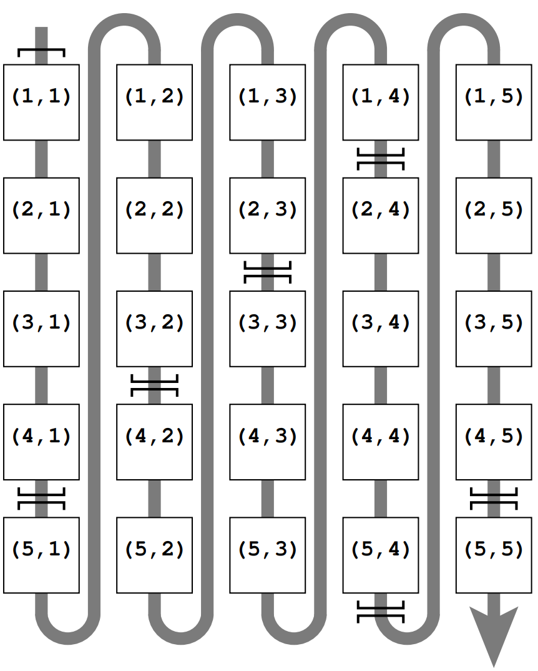
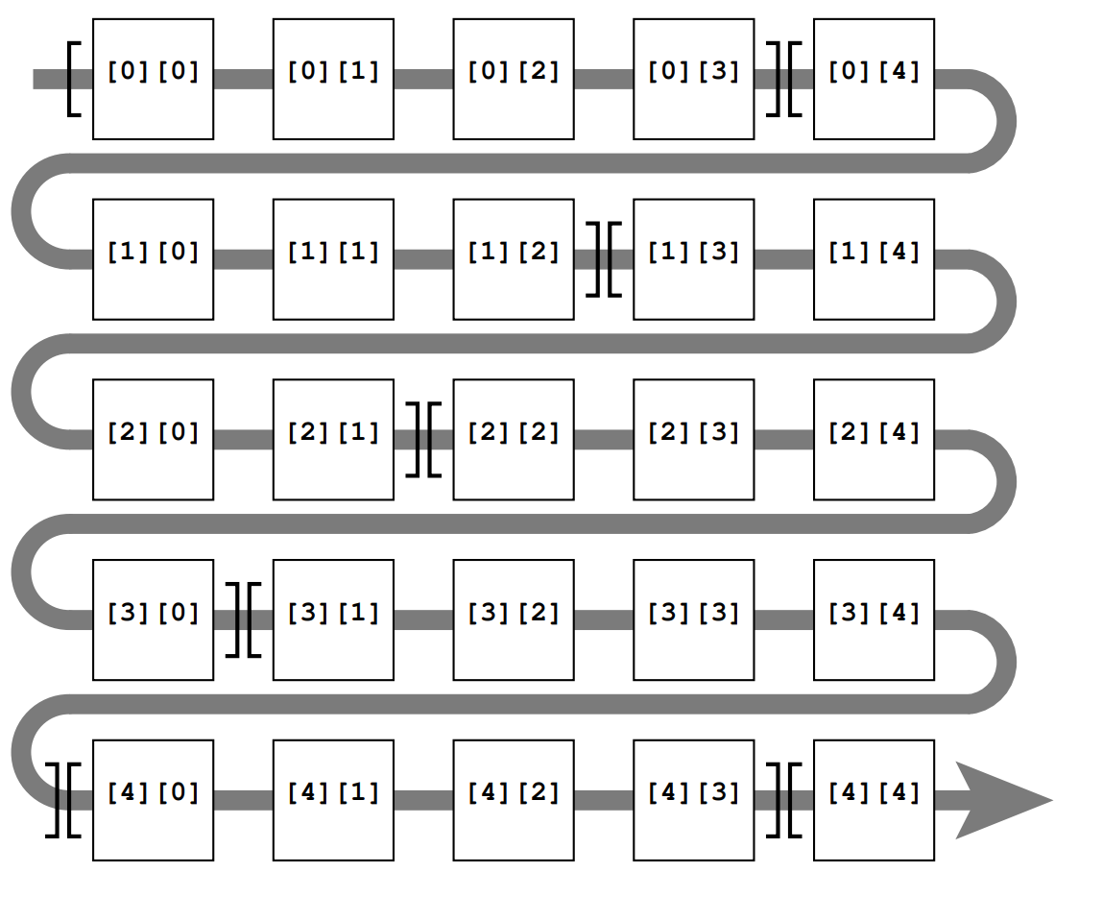
Row major vs Col major
Introduction to High Performance Computing for Scientists and Engineers, By Georg Hager, Gerhard Wellein, 2011, p.70
Row major order matrix storage schema
Introduction to High Performance Computing for Scientists and Engineers, By Georg Hager, Gerhard Wellein, 2011, p.70
Column major order matrix storage schema
Cache lines are assumed to hold four matrix elements

Slide 15
Test
for (i=0; i<N; i++)
for (j=0; j<N; j++)
A[i][j] = i*j; // stride-1 access
for (i=0; i<N; i++)
for (j=0; j<N; j++)
A[j][j] = i*j; // stride-N access
N = 1000
Row-major runtime: 6143 seconds
Col-major runtime: 9732 seconds
second array index is the “fast” (inner loop) index for both

Slide 16
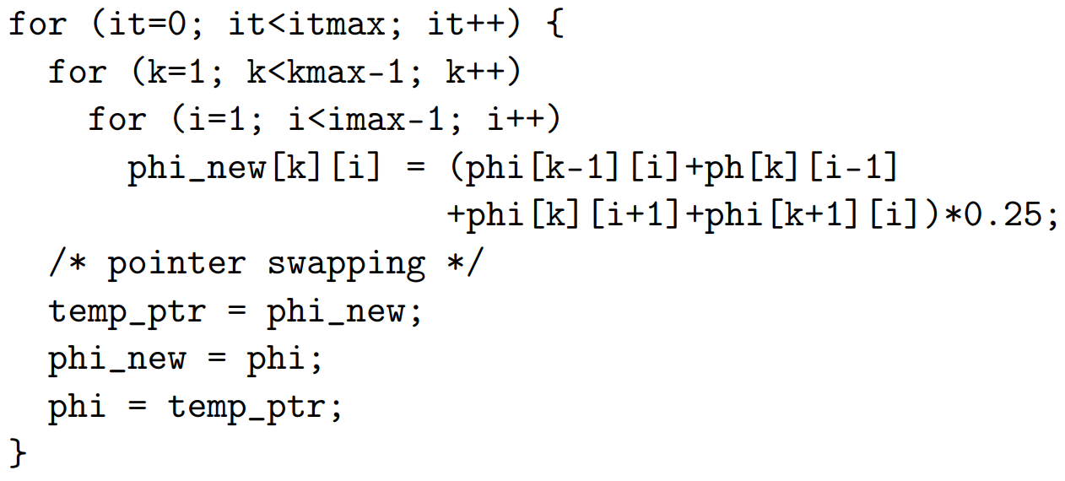
Case study: The 2D Jacobi algorithm
The Jacobi method is used on different methods in numerical analysis and simulation.
It can be used for solving the diffusion equation for a scalar function Φ(r,t).
4 floating-point operations per (k, i)
1 store to memory per (k, i)
How many loads from memory per (k, i)? (It depends on the cache size.)
phi_new and phi are 2D arrays (row-major storage)
Notes:
Skipping the mathematical and numerical details (given in the textbook), let us focus on the following computation:

Slide 17
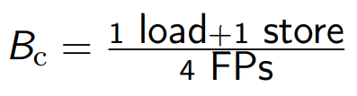
2D Jacobi: performance prediction
Suppose the cache can store at least two rows of phi, but not enough to store the entire array phi. Then, memory load traffic needed for computing phi_new[k][i] is as follows:
The phi[k-1][i] value is still in cache (it was first loaded from memory for computing phi_new[k-2][i]);
The phi[k][i-1] value is in cache;
The phi[k][i+1] value is also in cache;
The phi[k+1][i] value has to be loaded from memory (and it will be reused during computation on rows k+1 and k+2);
1 memory load per (k, i)
per (k, i)

Slide 18
Algorithm classification and access optimizations

Slide 19

Algorithm class O(N)/O(N)
1D loops (N: loop length)
1D arrays (N: array length)
Examples:
Scalar products
vector additions
sparse matrix vector multiplication
Optimization way: Loop fusion
Two loops after each other:
Number of floating-point operations: 2N
Number of memory loads & stores: 4N + 2N
Code balance:${ B}_{c}= \frac{6}{2}$
for (i=0; i<N; i++) {
A[i] = B[i] + C[i];
}
for (i=0; i<N; i++) {
Z[i] = B[i] + E[i];
}
Notes:
If both the number of arithmetic operations and the number of data transfers (loads/stores) are proportional to the problem size (or “loop length”) N, optimization potential is usually very limited.
Normally not much room for data access optimization, but loop fusion can sometimes help.
Optimization way: loop fusion

Slide 20

Loop Fusion
Two loops after each other:
Now each B[i] value is only loaded once instead of twice!
New code balance: ${ B}_{c}= \frac{5}{2}$
Loop fusion will also reduce looping overhead
for (i=0; i<N; i++) {
A[i] = B[i] + C[i];
}
for (i=0; i<N; i++) {
Z[i] = B[i] + E[i];
}
//optimized
for (i=0; i<N; i++) {
A[i] = B[i] + C[i];
//save a load for B(i)
Z[i] = B[i] + E[i];
}

Slide 21
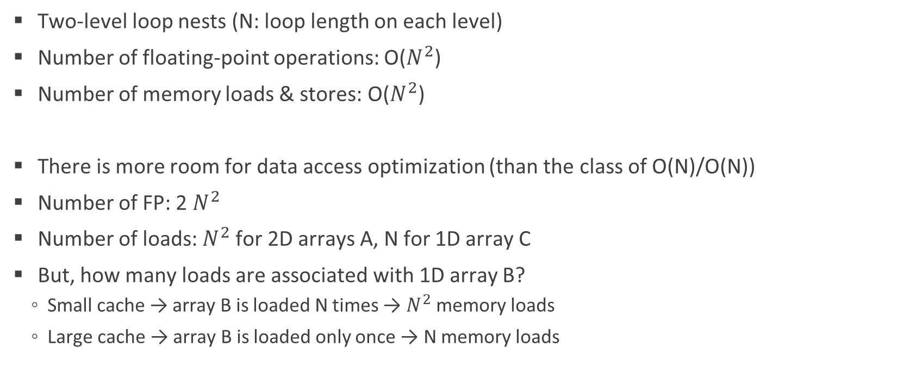
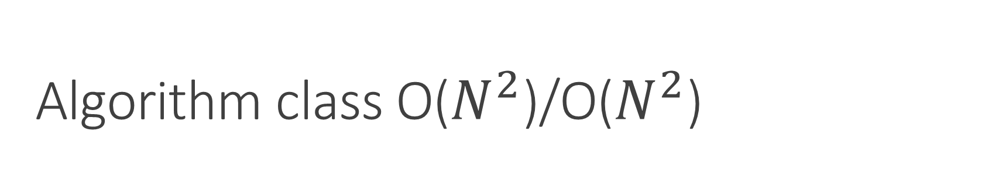
Algorithm class O($N^{2}$)/O($N^{2}$)
Two-level loop nests (N: loop length on each level)
Number of floating-point operations: O($N^{2}$)
Number of memory loads & stores: O($N^{2}$)
There is more room for data access optimization (than the class of O(N)/O(N))
Number of FP: 2 $N^{2}$
Number of loads: $N^{2}$for 2D arrays A, N for 1D array C
But, how many loads are associated with 1D array B?
Small cache → array B is loaded N times → $N^{2}$memory loads
Large cache → array B is loaded only once → N memory loads
// Dense matrix-vector multiply (MVM)
for (i=0; i<N; i++) {
for (j=0; j<N; j++)
C[i] += A[i][j]*B[j];
}

Slide 22
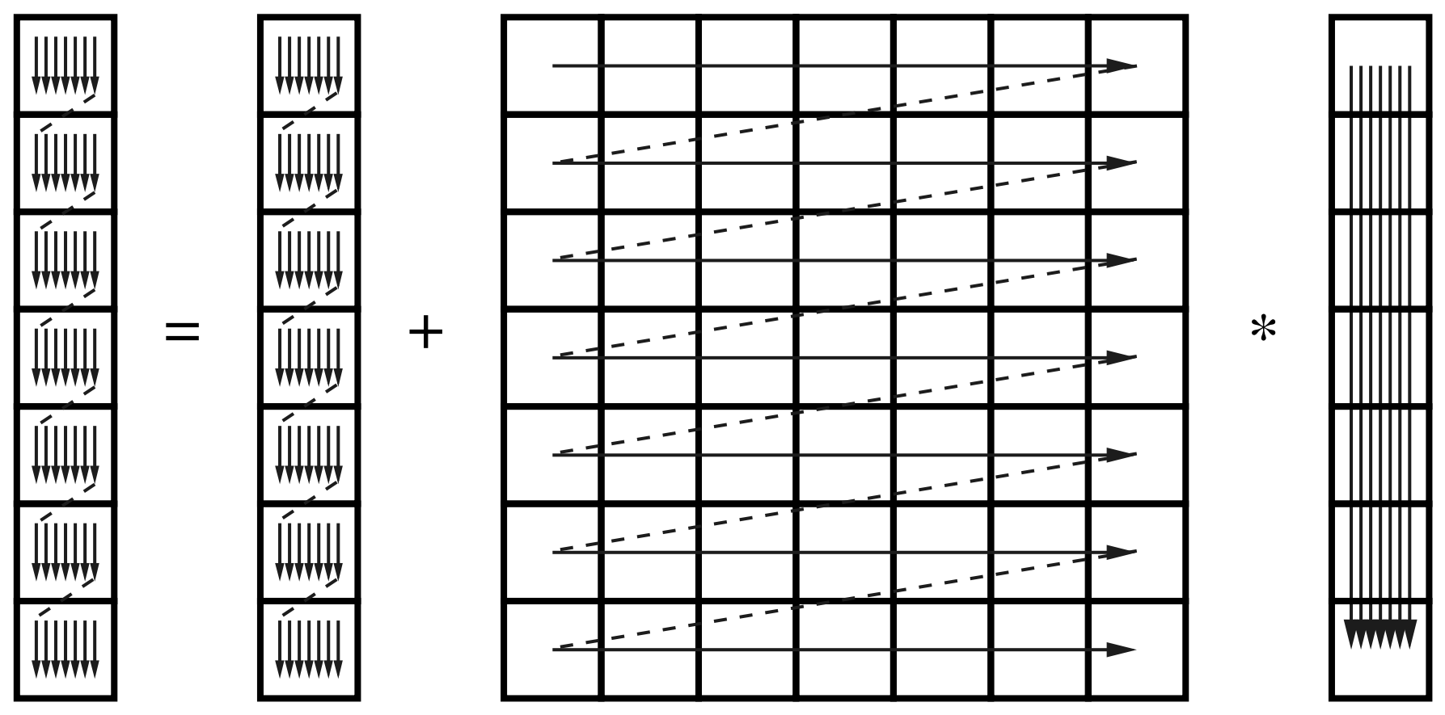
Unoptimized N ×N dense matrix vector multiply
Introduction to High Performance Computing for Scientists and Engineers, By Georg Hager, Gerhard Wellein, 2011, p.80
Optimization way: Loop unrolling

Slide 23
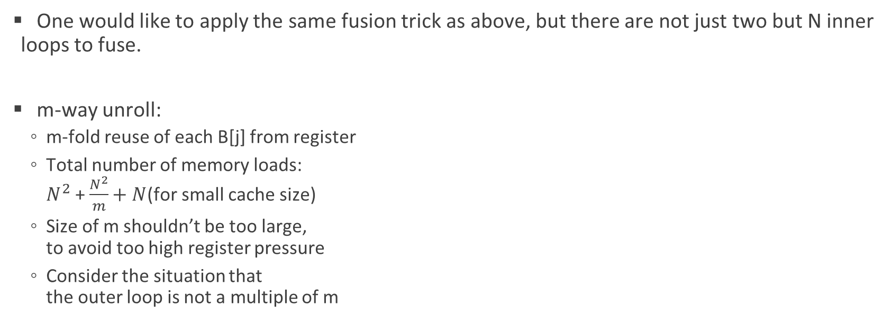
Loop unrolling
One would like to apply the same fusion trick as above, but there are not just two but N inner loops to fuse.
m-way unroll:
m-fold reuse of each B[j] from register
Total number of memory loads: $N^{2}$+ $\frac{N^{2}}{m}+N$(for small cache size)
Size of m shouldn’t be too large, to avoid too high register pressure
Consider the situation that the outer loop is not a multiple of m
for (i=0; i<N; i+=m) {
for (j=0; j<N; j++) {
C[i+0] += A[i+0][j]*B[j];
C[i+1] += A[i+1][j]*B[j];
// ...
C[i+m-1] += A[i+m-1][j]*B[j];
}
}
// remainder code in case (N%m)>0

Slide 24
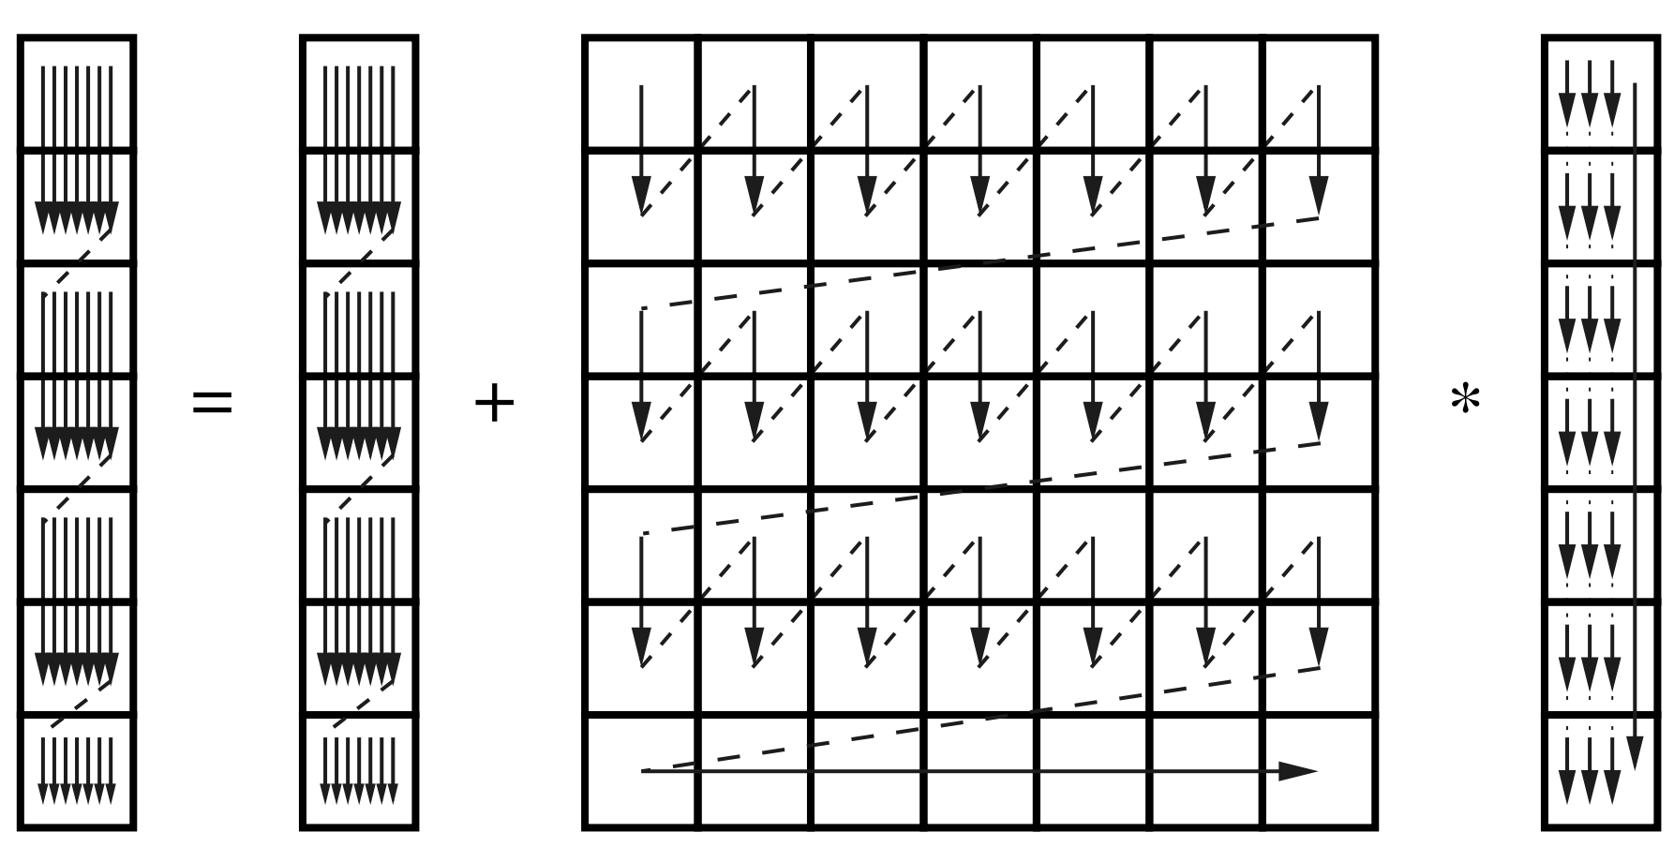
Introduction to High Performance Computing for Scientists and Engineers, By Georg Hager, Gerhard Wellein, 2011, p.82

Slide 25
Case study: Dense matrix transpose
for (j=0; j<N; j++) for (i=0; i<N; i++) A[j][i] = B[i][j];
Both A and B are assumed to be 2D arrays with row-major storage.
Very large jumps in memory associated with loading B[i][j] → very bad cache line utilization.

Slide 26
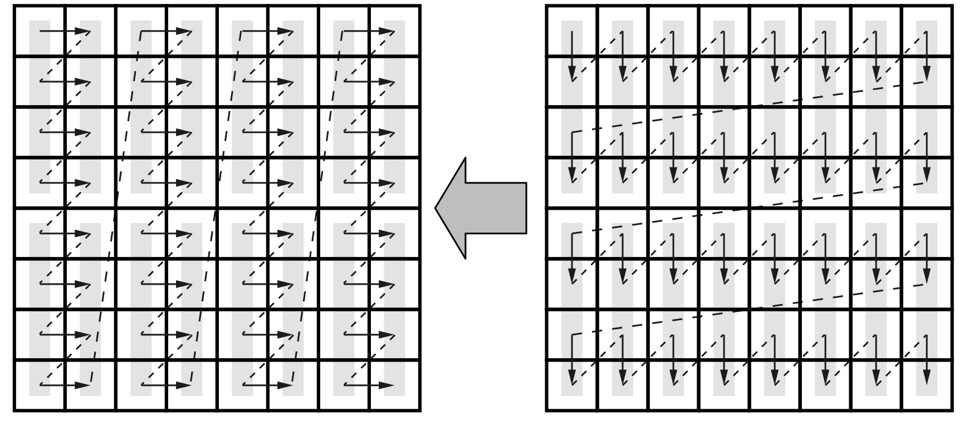
Loop unrolling applied to matrix transpose
for (j=0; j<N; j+=m) for (i=0; i<N; i++) { A[j+0][i] = B[i][j+0]; A[j+1][i] = B[i][j+1]; // .... A[j+m-1][i] = B[i][j+m-1]; }
Introduction to High Performance Computing for Scientists and Engineers, By Georg Hager, Gerhard Wellein, 2011, p.83

Slide 27
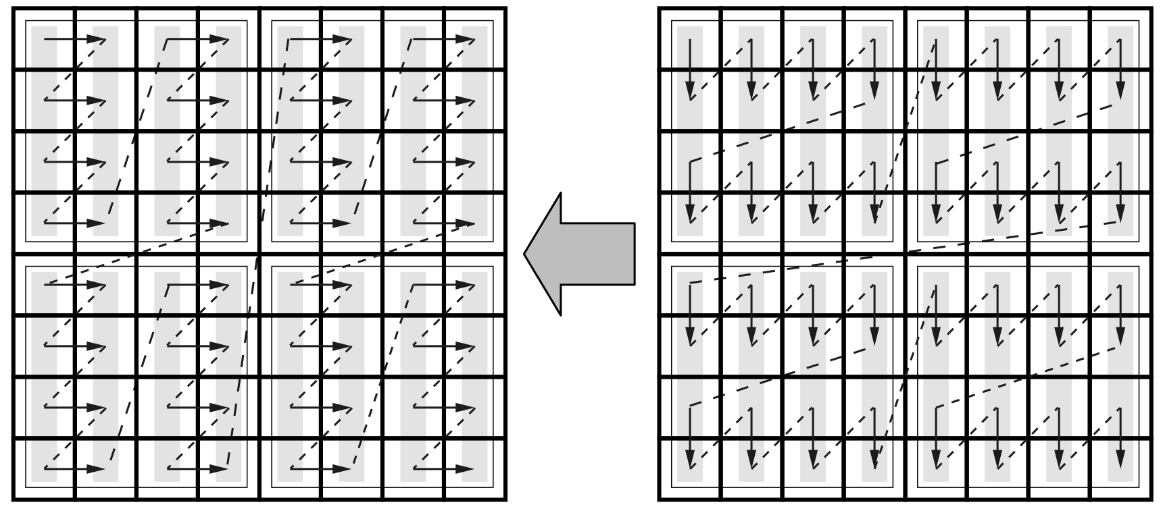
Loop blocking + unrolling
Up to d additional outer loop levels.
for (jj=0; jj<N; jj+=d) { jstart = jj; jstop = jj+d-1; for (ii=0; ii<N; ii+=d) { istart = ii; istop = ii+d-1; for (j=jstart; j<=jstop; j+=m) for (i=istart; i<=istop; i++) { A[j+0][i] = B[i][j+0]; A[j+1][i] = B[i][j+1]; // .... A[j+m-1][i] = B[i][j+m-1]; } } }
Introduction to High Performance Computing for Scientists and Engineers, By Georg Hager, Gerhard Wellein, 2011, p.84
4 × 4 blocked and two-way unrolled “flipped” matrix transpose.

Slide 28
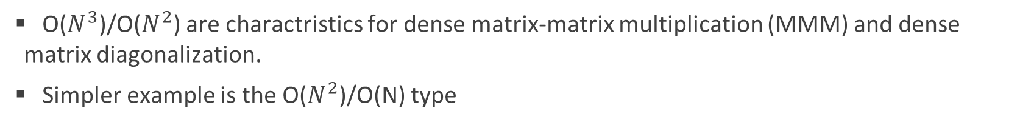
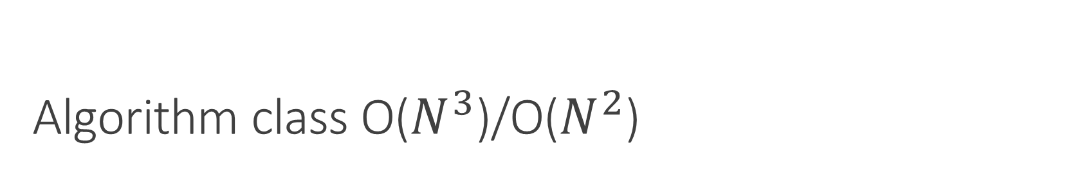
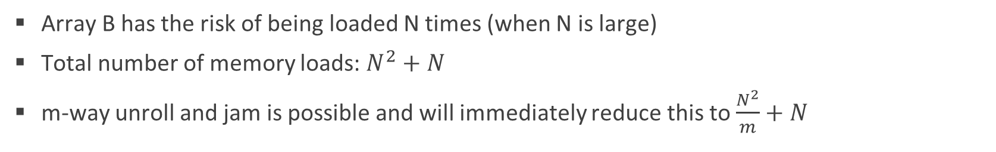
Algorithm class O($N^{3}$)/O($N^{2}$)
O($N^{3}$)/O($N^{2}$) are charactristics for dense matrix-matrix multiplication (MMM) and dense matrix diagonalization.
Simpler example is the O($N^{2}$)/O(N) type
for (int i = 1; i <= N; ++i) {
for (int j = 1; j <= N; ++j) {
sum = sum + foo(A[i], B[j]);
}
}
Array B has the risk of being loaded N times (when N is large)
Total number of memory loads: $N^{2}+N$
m-way unroll and jam is possible and will immediately reduce this to $\frac{N^{2}}{m}+N$

Slide 29
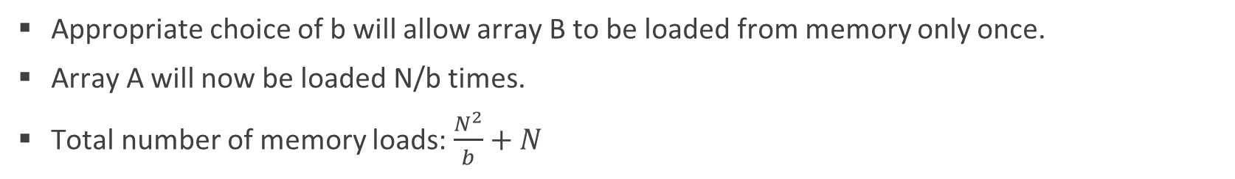
Blocking the inner loop with a blocksize of b
double sum = 0.; for (jj=0; jj<N; jj+=b) { jstart = jj; jstop = jj+b-1; for (i=0; i<N; i++) { for (j=jstart; j<=jstop; j++) sum = sum + foo(A[i],B[j]) } }
Appropriate choice of b will allow array B to be loaded from memory only once.
Array A will now be loaded N/b times.
Total number of memory loads: $\frac{N^{2}}{b}+N$
Notes:
k why unrolling should be applied at all when blocking already achieves the most important task of making the code cache-bound. The reason is that even if all the data resides in a cache, many processor architectures do not have the capability for sustaining enough loads and stores per cycle to feed the arithmetic units continuously.

Slide 30
Case study: Sparse matrix-vector multiply
“Real-world” application of the blocking and unrolling strategies.
Sparse matrix: the number of nonzero entries grows linearly with the number of matrix rows. Only the nonzero entries are stored because of efficiency.
Sparse matrix storage schemes:
CRS (Compressed Row Storage)
JDS (Jagged Diagonals Storage)
Notes:
CRS is well-suited for cache-based microprocessors while JDS supports dependency and loop structures that are favorable on vector systems

Slide 31
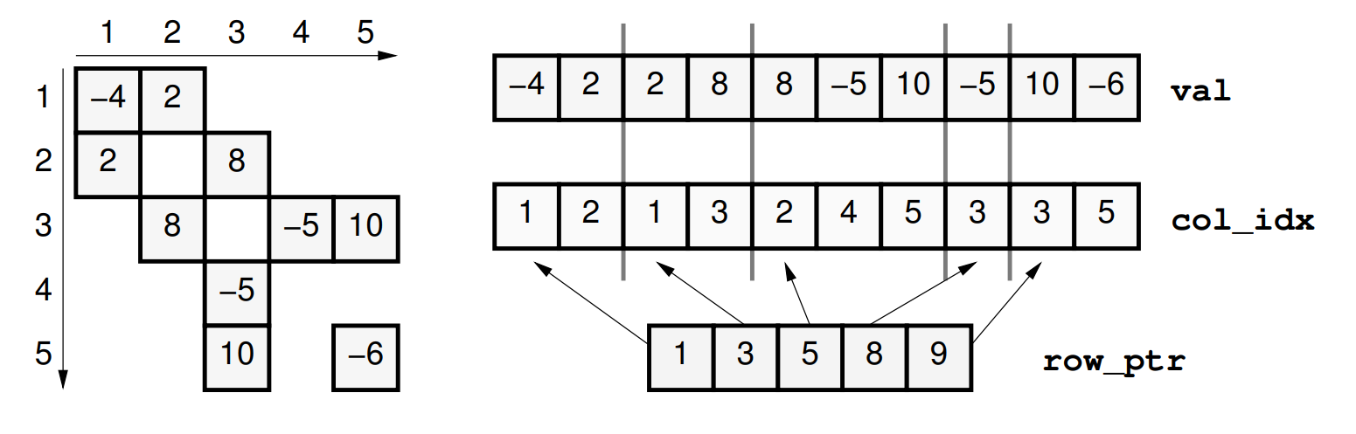
CRS (Compressed Row Storage)
Introduction to High Performance Computing for Scientists and Engineers, By Georg Hager, Gerhard Wellein, 2011, p.87
for (int i = 0; i < Nr; ++i) {
for (int j = row_ptr[i]; j < row_ptr[i+1]; ++j) {
C[i] += val[j] * B[col_idx[j]];
}
}
Bc = 5/4 W/F
Code to perform an MVM using CRS
Notes:
array val of length Nnz => row by row
col_idx of length Nnz and row_ptr of length Nr
There is a long outer loop (length Nr).
• The inner loop may be “short” compared to typical microprocessor pipeline lengths.
• Access to result vector C is well optimized: It is only loaded once from main memory.
• The nonzeros in val are accessed with stride one.

Slide 32
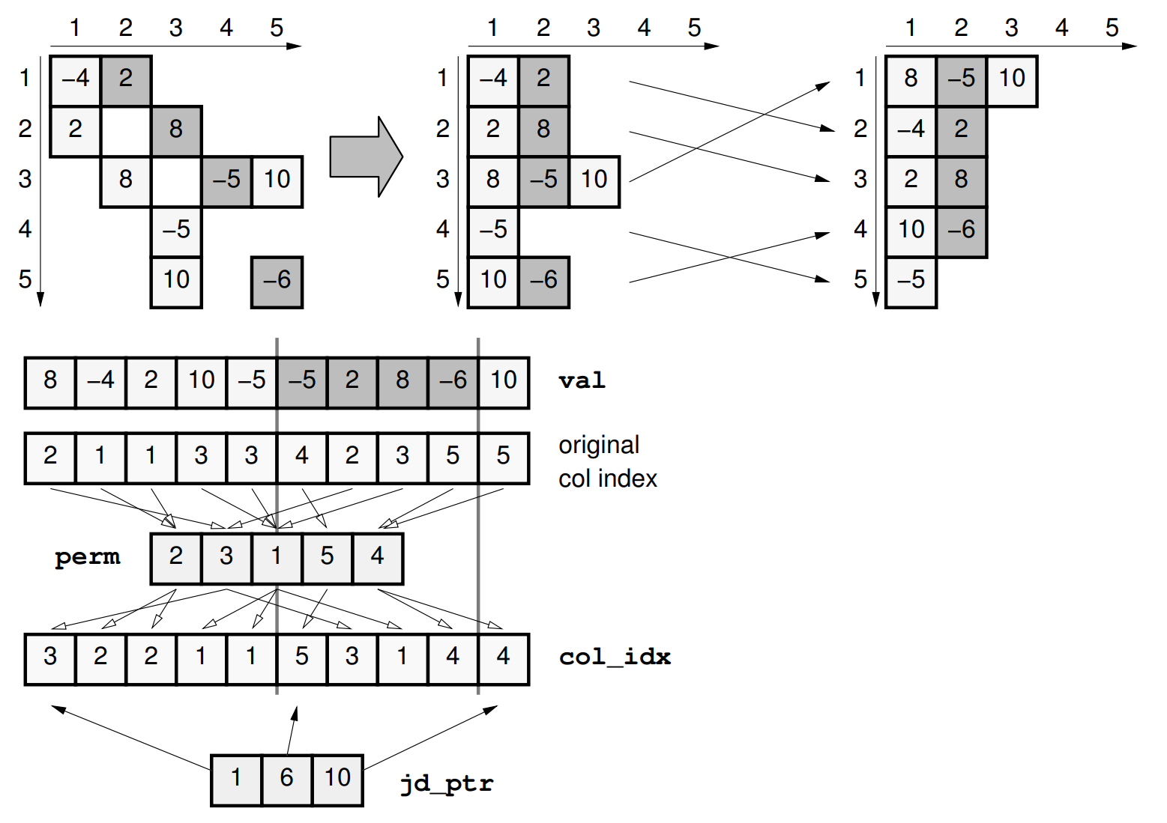
JDS (Jagged Diagonals Storage)
Bc = 9/4 W/F
for (int diag = 1; diag <= Nj; ++diag) {
diagLen = jd_ptr[diag+1] - jd_ptr[diag];
offset = jd_ptr[diag] - 1;
for (int i = 1; i <= diagLen; ++i) {
C[i] = C[i] + val[offset+i] * B[col_idx[offset+i]];
}
}
Notes:
"jagged" refers to the fact that the number of non-zero elements in each diagonal can be different
is similar to the Compressed Sparse Column (CSC) format but optimized for matrices with a block-diagonal structure.
First, all zeros are eliminated from the matrix rows and the nonzeros are shifted to the left
then the matrix rows are sorted by descending number of nonzeros so that the longest row is at the top and the shortest row is at the bottom. (The permutation map generated during the sorting stage)
Val is also: jagged diagonals
Advantages:
The outer loop is short
The nonzeros in val are accessed with stride one
Bc if : col_idx is counted with four bytes

Slide 33
Loop Peeling (Unwinding)
int p = 10;
for (int i=0; i<10; ++i){
y[i] = x[i] + x[p];
p = i;
}
y[0] = x[0] + x[10];
for (int i=1; i<10; ++i)
{
y[i] = x[i] + x[i-1];
}
p = 10 only for the first iteration, and for all other iterations, p = i - 1.
Notes:
Notice that p = 10 only for the first iteration, and for all other iterations, p = i - 1.

Slide 34
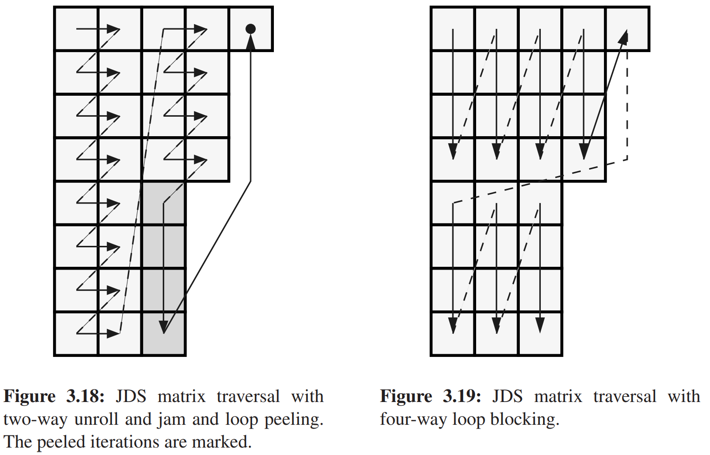
Optimizing JDS sparse MVM: Loop Peeling
for (int diag = 0; diag < Nj; diag += 2) {
int diagLen = std::min(jd_ptr[diag+1]-jd_ptr[diag], jd_ptr[diag+2]-jd_ptr[diag+1]);
int offset1 = jd_ptr[diag] - 1;
int offset2 = jd_ptr[diag+1] - 1;
for (int i = 0; i < diagLen; i++) {
C[i] += val[offset1+i] * B[col_idx[offset1+i]];
C[i] += val[offset2+i] * B[col_idx[offset2+i]];
}
offset1 = jd_ptr[diag];
for (int i = diagLen; i < jd_ptr[diag+1]-jd_ptr[diag]; i++) {
C[i] += val[offset1+i] * B[col_idx[offset1+i]];
}
}
Introduction to High Performance Computing for Scientists and Engineers, By Georg Hager, Gerhard Wellein, 2011, p.89
Notes:
Unroll and jam nee
for m-way unrolling, cuts rectangular m × x chunks and leaves m − 1 partial diagonals over for separate treatmentds length of the inner loop to be independent of the outer loop index that is not always in jagged diagonals.
If m is large enough, this can get close to the CRS balance
as explained before large m leads to strong register pressure and is not always desirable
diag += 2 right side image for b

Slide 35
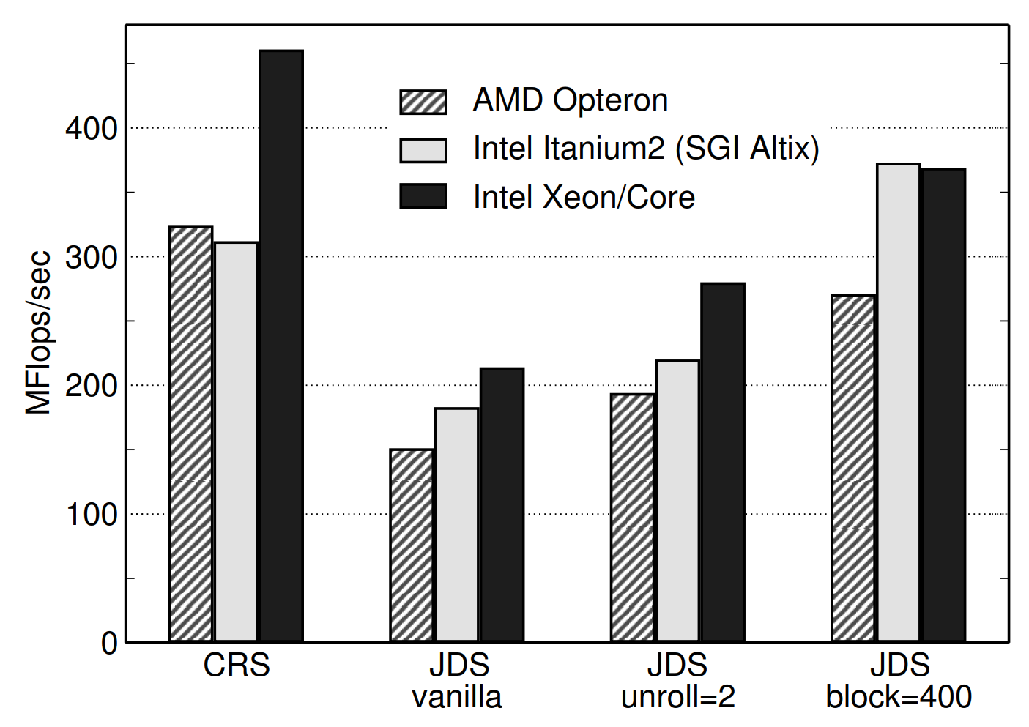
Performance comparison of sparse MVM codes
Introduction to High Performance Computing for Scientists and Engineers, By Georg Hager, Gerhard Wellein, 2011, p.91
Notes:
A matrix with 1.7 × 107 unknowns and 20 jagged diagonals

