Slide 1
RISC-V SoC with 4×4 Systolic Array Accelerator
Group Members:
Muhammad Romaan
Furqan Ahmad
Laraib Khan

Slide 2
Project Overview and Main Goal
Main Processor & Architecture: The main processor is a 32-bit RISC-V CPU that handles instructions one at a time.
Memory & Interconnect: It has an instruction memory to store commands (imem.v) and a data memory to store working information (dmem.v), with a special bridge connecting everything together using a standard communication pathway called AXI4-Lite.
Math Accelerator: The math accelerator is a 4x4 grid of processing units that handle heavy data tasks.
FPGA Implementation: The whole system is built and tested on a physical circuit board called the Digilent Arty A7-100T FPGA board.
ASIC Physical Design: The design is also implemented as a custom ASIC layout using the LibreLane toolchain.
Verification: The hardware is rigorously verified using a Universal Verification Methodology (UVM) testbench suite.

Slide 3
Inside the RISC-V Main Processor
The processor uses the standard RV32I instruction set and is built from a few key parts:
Control Unit (control.v): Reads the instructions and tells the rest of the processor what to do.
ALU (alu.v): Does the basic math and logic operations.
Register File (regfile.v): Provides 32 registers to hold temporary data while programs run.
Branch Unit (branch_unit.v): Decides when the program should jump to a different instruction (like when making choices or loops).
Immediate Generator (immgen.v): Extracts and prepares number values hidden inside instructions.

Slide 4
The 4x4 Systolic Array
How it is Organized: It is a 4x4 grid of small, connected processing blocks (pe.sv) that all march to the same beat.
What it Does: It multiplies two 4x4 matrices together to get a result matrix using numbers that are 8-bit or 16-bit wide.
How it Works: It passes data smoothly across rows and columns (called wave-front propagation) so numbers can be reused efficiently.
Speed: It can perform 64 multiply-and-add operations all at the same time, finishing the job in just 11 to 15 clock cycles.
Control Wrapper (accelerator_top.sv): Manages the input data, stores the weights and activation values, and lets the main processor talk to it through memory addresses.

Slide 5
Memory Map (How the Processor Talks to Hardware)
The processor communicates with different parts of the system by reading and writing to specific memory addresses:
0x0000_0000: Instruction Memory (where program commands live).
0x1000_0000: Status Register and LEDs (for checking if things are working).
0x4000_0000: Accelerator Control Registers (to check if it is done or currently computing).
0x4000_0040: Matrix A Input Buffer.
0x4000_0080: Matrix B Input Buffer.
0x4000_00C0: Result Read-back (where you can read the final calculated answer, such as $C[0][0] = 538$).

Slide 6
Testing and Verification Results
1. Software Simulation (UVM Testbench Waveform Analysis)
The simulation waveform displays the clock (clk), reset (rst), and the communication wires (awaddr, wdata, araddr, rdata) sending data back and forth.
Control and Data Flow: You can see the start signal go high, which changes the internal states, turns on the computing flag, and eventually triggers the done signal when the math is finished.
Scoreboard Results: Every single piece of data flowing through the matrix arrays matched the expected math results perfectly, ending with zero errors (UVM_ERROR : 0).+

Slide 7
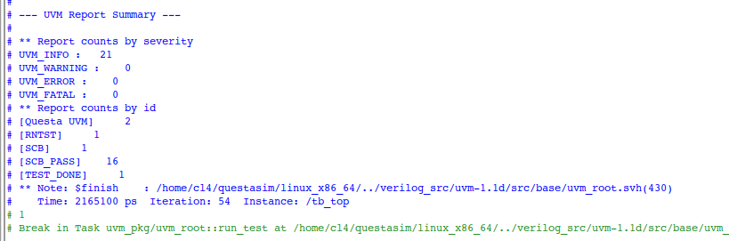
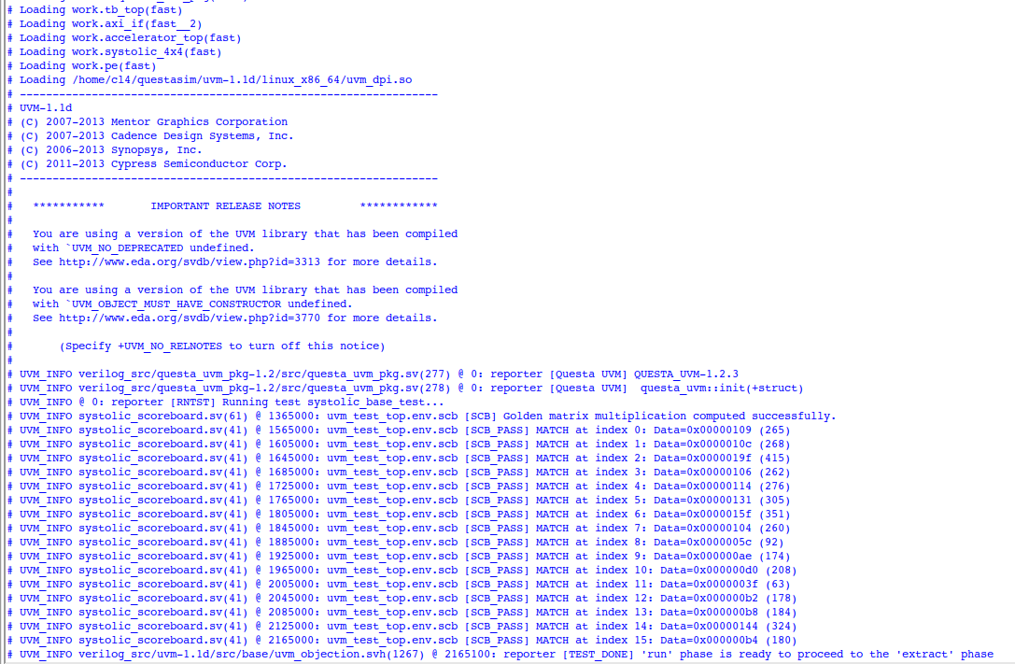

Slide 8
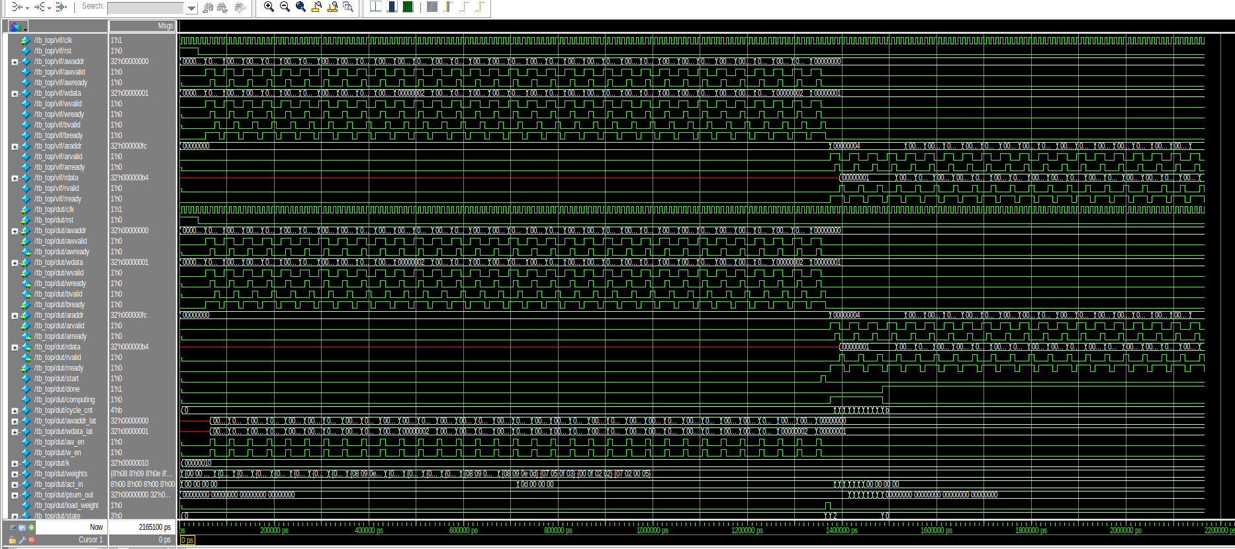

Slide 9
Physical FPGA Testing on Board
When loaded onto the actual Arty A7-100T board, the system was tested using a serial terminal connection.
The output logs showed the TPU successfully computing matrix values and returning PASS statuses:
[TPU] C00=0x0000021A X7=0x0000021A X8=0x0000021A LED=1111 (PASS)
Board Controls: Switch 0 lets you toggle between different live telemetry data (like clock heartbeats and pass/fail status), and Switch 3 acts as a clean master reset.

Slide 10
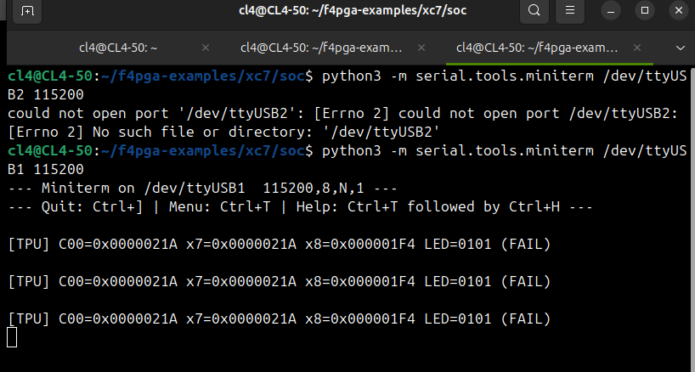
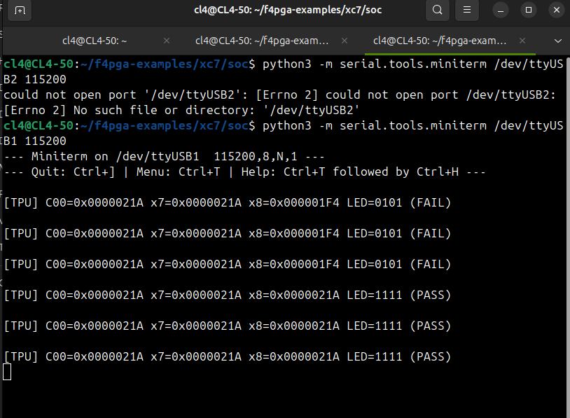

Slide 11
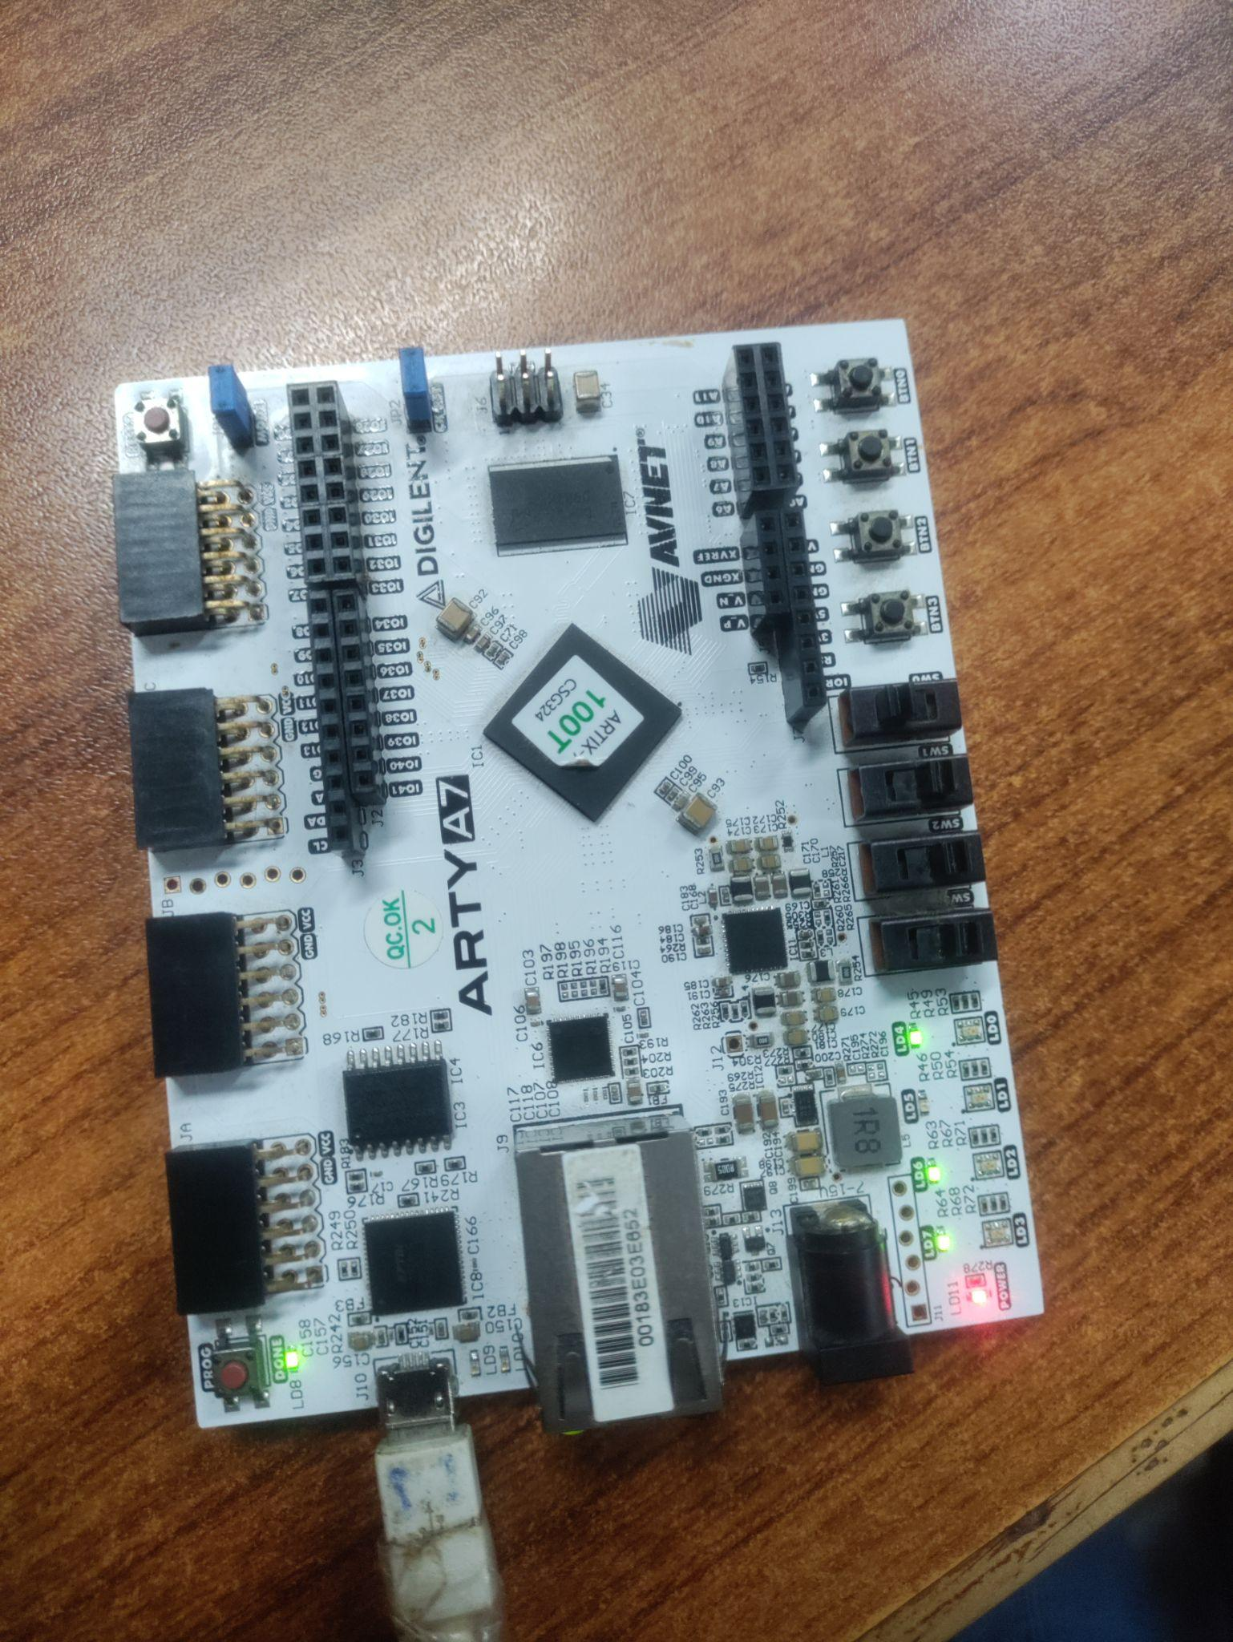
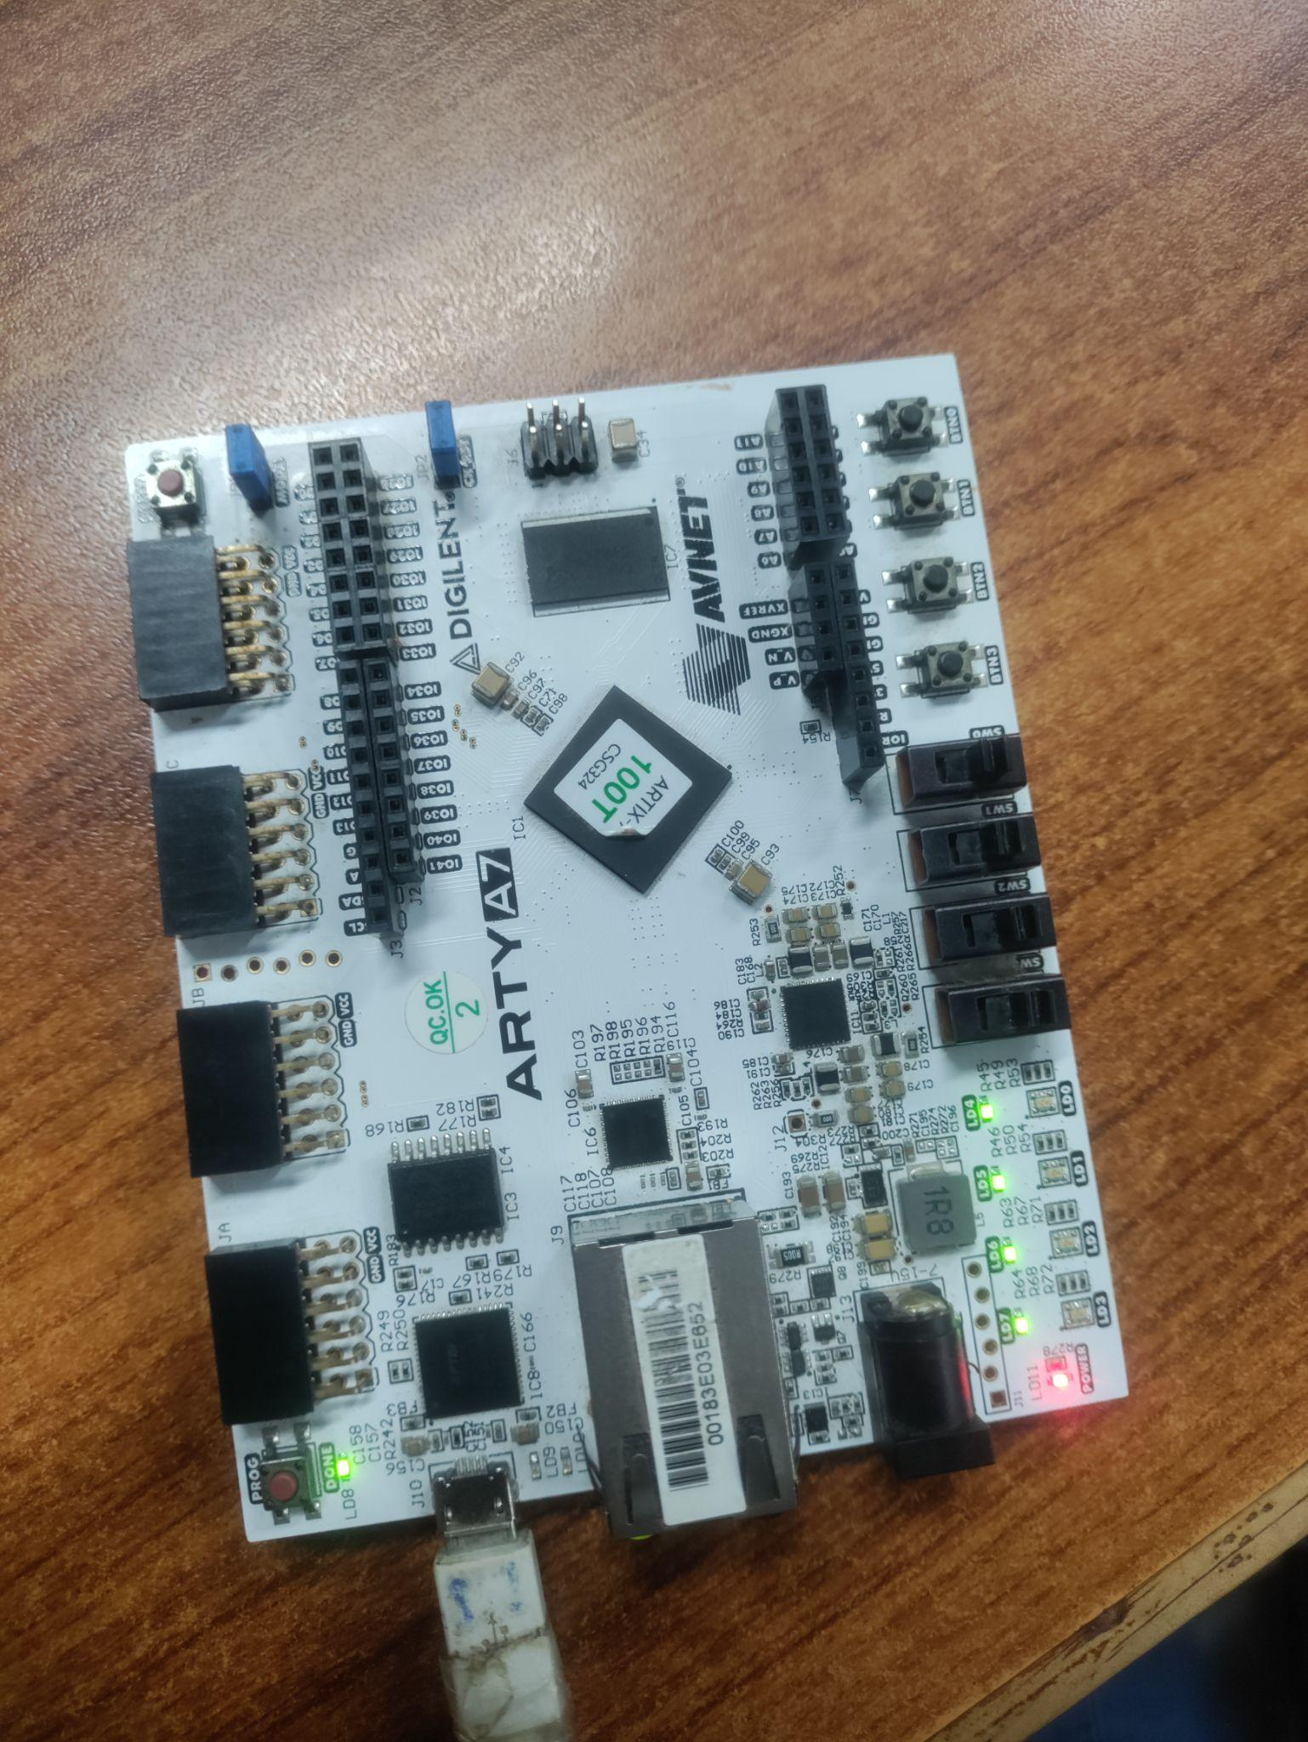

Slide 12
ASIC Physical Design
Design Layout: Targeted under the name asic_top, set with a physical square die size of 480 um x 480 um and a core working area of 465 um x 465 um.
Utilization and Clock: The core utilization target is set to 35%, running on a 25 ns clock period (aiming for a 40 MHz design layout target).
Power and Routing: Uses metal layer 5 (horizontal) and metal layer 4 (vertical) for power distribution rails and rings (PDN), while enabling congestion allowances and diode insertion rules to keep open-source layout tools from crashing.

Slide 13
