Slide 1

Exploratory Data Analysis of Uber Bookings
Mohammed Daif – Allah
Reem SAEED
Salwa MOHAMMAD

Slide 2
CONTENTS
Introduction
Data Understanding
Data Cleaning
Data Analysis

Slide 3
INTRODUCTION
In this task, Our goal is to find relationships and trends between different features about huge uber bookings which are 499995 ubers taken for a hotel from 2009 to 2015

Slide 4
INTRODUCTION
Key Questions.
When taking an uber, what is the distance predicted to be traveled ?
Does always more distance mean more fare amount ?
Does weather affect the distance traveled ?
Is there a pattern to spot of passenger count and the distance they travel in uber ?
And many more that we will answer…..

Slide 5
Data understanding
Dataset size : 498169 rows X 22 column
Key information:
Distance
Fare amount
Car condition
Weather condition
Passenger count
Distance from airports and starting point (jfk , , )

Slide 6
Data understanding
Mean of fare amount is 8.7$ with max 22.25$ and min 0.01$
Most distance traveled is 7 miles
Passenger count ranges from 1 to 6
More will be shown through plots and deeper conclusions

Slide 7
DATA CLEANING
No duplicates existed in the dataset
null values existed, 5 rows with null values
Errors existed in some features, fare amount being negative or 0 and passenger count being 0 were handled

Slide 8
OUTLIER DETECTION

Slide 9
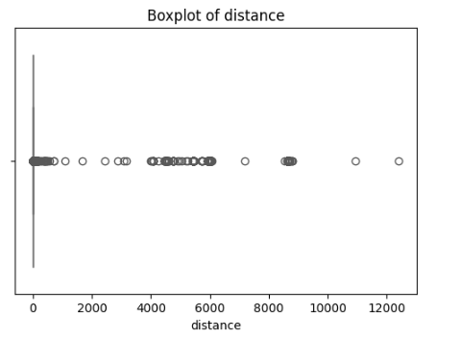
OUTLIER DETECTION
Many outliers existed through the dataset especially in the distance column. Outliers were outrageous.

Slide 10
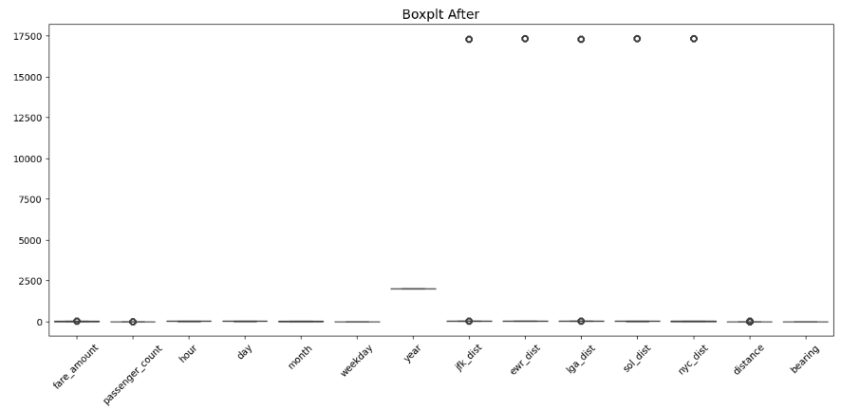
OUTLIER DETECTION
Outlier were handled and replaced. Which improved the skewness of features especially the distance traveled. Skewness dropped from 23 to 1.2

Slide 11
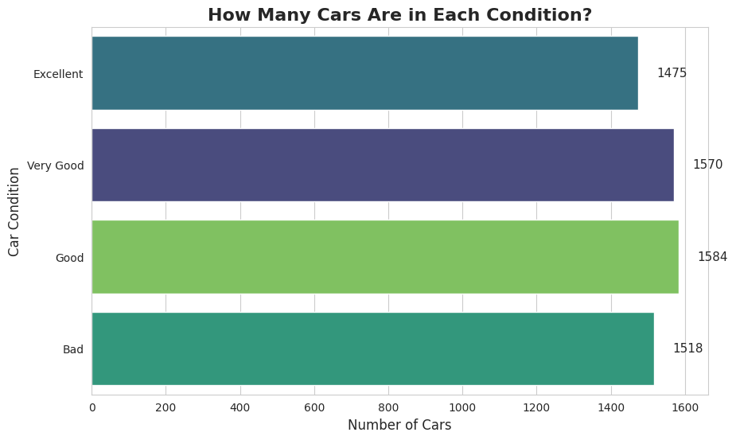
How Many Cars Are in Each Condition?
Balanced Distribution: The number of cars in each category is very close, suggesting a balanced dataset. There is no extreme dominance of any condition.
Most Common Condition: ✅ "Very Good" condition has the highest count (5,428 cars).
Least Common Condition: ✅ "Excellent" condition is the lowest (5,320 cars), but the difference is small.

Slide 12
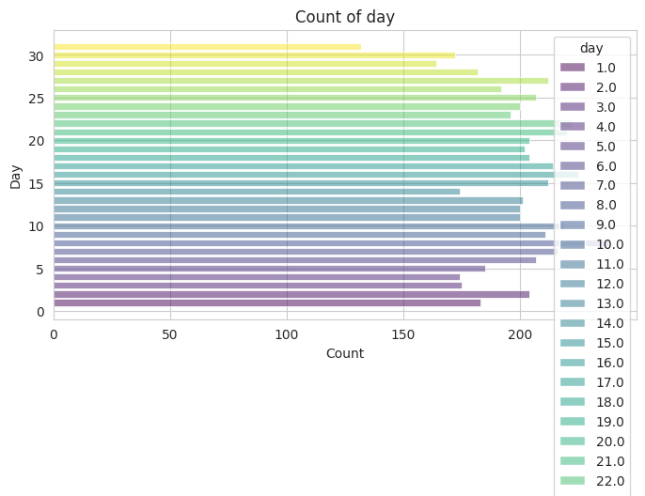
How Many Cars Are in Each Day?
Day Distribution:
The counts for most days appear fairly consistent, suggesting uniform distribution of data across the month.
However, days 11 and 12 show a noticeable drop in frequency.

Slide 13
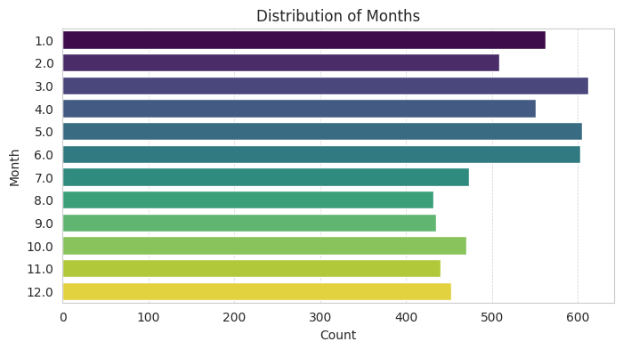
How Many Cars Are in Each Month?
Most Frequent Months:
The highest counts appear around month 6 (June) and month 4 (April).
Least Frequent Months:
Month 8 (August) shows a noticeably lower frequency compared to others.
The distribution appears to have some periodicity, with a gradual increase from month 1 (January) to month 6 (June), and a slight decrease afterward.

Slide 14
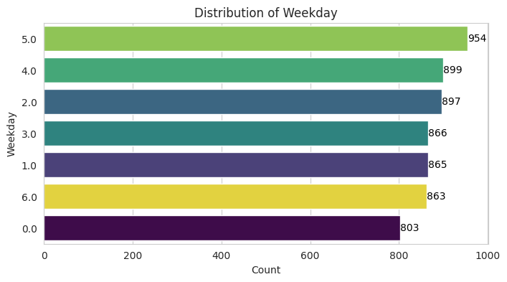
How Many Cars Are in Each Weekday?
Analysis of the Weekday Distribution Chart
Most Frequent Day:
Weekday 5 (Friday if 0 = Sunday) has the highest count (954), suggesting more activity on this day.
Least Frequent Day:
Weekday 0 (Sunday) has the lowest count (803), indicating reduced activity on this day.
General Distribution:
Counts for weekdays are relatively evenly distributed, with a slight increase toward the end of the workweek.
There is a difference of 151 between the most and least frequent days, suggesting some variability in weekday activity.

Slide 15
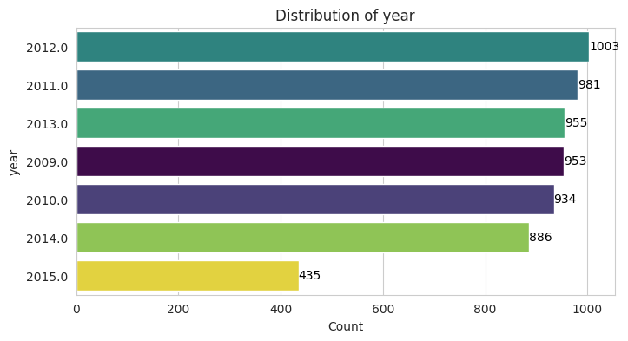
How Many Cars Are in Each Year?
Highest Count: 2012 (3499 times) is the most frequent year.
Lowest Count: 2015 (1541 times) is the least frequent year.
There is a gradual increase in frequency until the peak in 2012.
After 2012, there is a gradual decline leading to a significant drop in 2015.
This trend may suggest a reduction in data availability after 2014 or a change in activity patterns during this period.

Slide 16
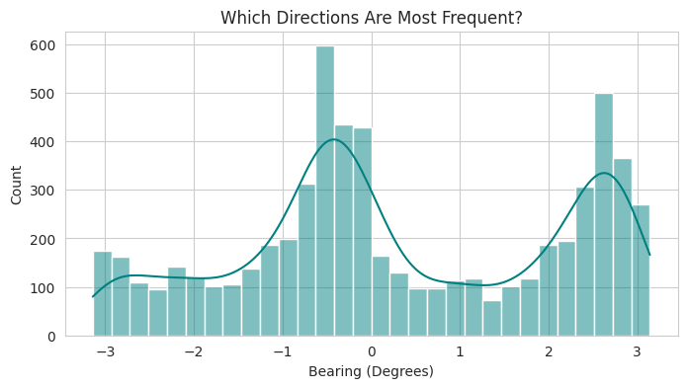
Primary Peak (~0 Degrees):
The most frequent direction is centered around 0 degrees (likely representing North or forward movement).
This peak reaches a count exceeding 600, suggesting a high volume of traffic in this direction.
Secondary Peak (~3 Degrees):
Another noticeable peak around 3 degrees also shows increased frequency, implying a secondary preferred direction.
This could reflect a common route orientation (e.g., North-East or East).
Low Frequencies:
Directions between -2 and 1 degrees show a dip, suggesting these bearings are less traveled.
The distribution appears symmetric, indicating a balanced movement between the two primary directions.

Slide 17
Traffic Condition Impact

Slide 18

Think like a capitalist
if we only thought about profits, what hour should we make the company increase the number of ubers to satisfy the demand and make more profit ?

Slide 19
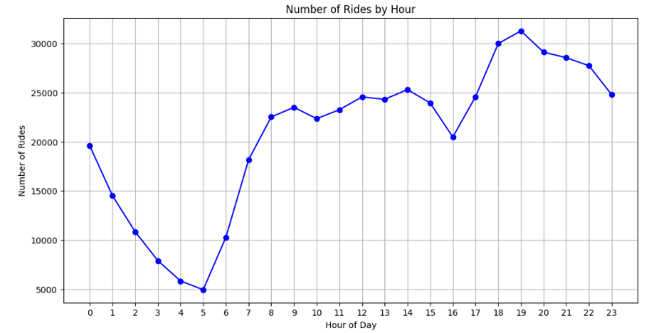
Think like a capitalist
More ubers should be supplied in hours after 5 pm especially at 7 pm hitting the mark of 31262 rides
While 5 am has least ubers booked 5000 rides.
But shouldn’t this be related to traffic ? If there is way demand that should lead to more traffic.

Slide 20
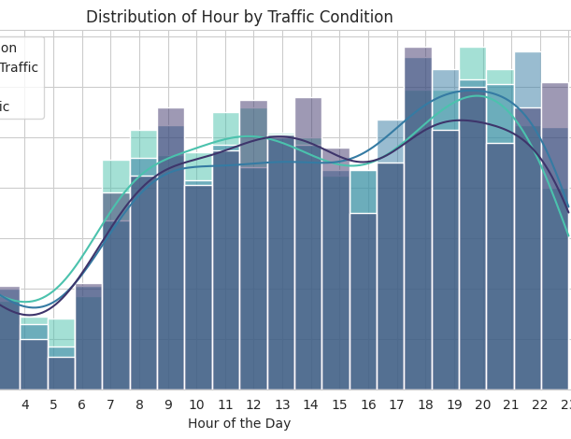
Distribution of Rides by Hour and Traffic Condition
There are two distinct peak periods for rides:
7-9 AM (heavy traffic due to work/school start).
5-8 PM (heavy traffic due to work/school end).
Between these peaks, rides are less congested, with smoother traffic flow.
During late-night hours (after 9 PM), rides gradually decrease, reaching the lowest levels between 2-5 AM.

Slide 21
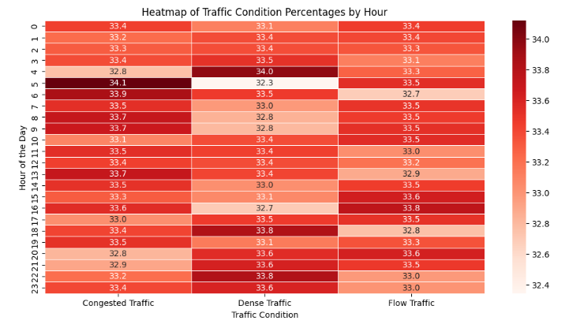
Think like a capitalist
Almost there is equal count of all ubers in different 3 types of traffic, this suggests that ubers are equally uniformly distributed though all reigons

Slide 22
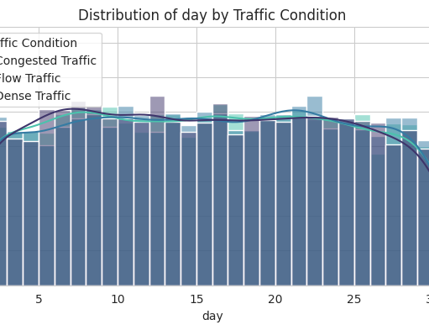
Distribution of day by Traffic Condition
Almost Uniform Distribution:
Most days show a similar distribution of trips, indicating relative stability in daily trips.
There is no significant variation between days, except for the last day, which has a higher number of trips.
Day 31 Shows a Noticeable Increase:
This may be due to the end of the month, where there could be increased activity such as payments, additional commutes, or special events.
If some months have only 30 days in the dataset, this could be an effect of incorrect recording or an incomplete month.

Slide 23
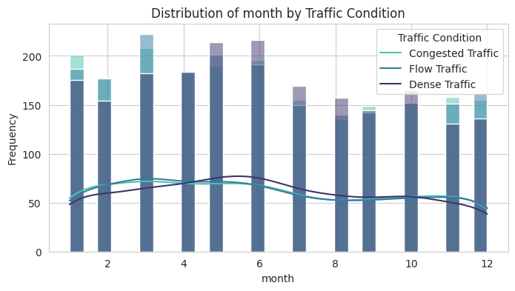
Distribution of month by Traffic Condition
Balanced Distribution: Trip numbers remain consistent throughout the year with minor variations.
Drop in July, August, September: Likely due to summer vacations and school holidays, reducing travel demand.
Increase in Months 1, 3, 5, 6, 11: Possibly driven by back-to-school periods, work routines, or seasonal events.
Stable Traffic Conditions: Traffic types (congested, flow, dense) remain steady across all months without significant fluctuations.

Slide 24
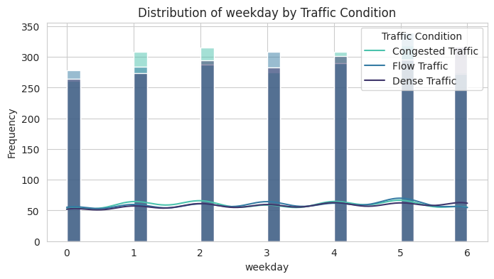
Distribution of weekday by Traffic Condition
Consistent Traffic Volume: Traffic instances are evenly distributed across all days, with no major fluctuations.
Slight Increase on Workdays (Sunday – Thursday): Higher traffic due to work and school commutes, making these days more congested.
Slight Decrease on Weekends (Friday & Saturday): Lower traffic volume on weekends, likely due to fewer work-related commutes.
Stable Traffic Conditions: Traffic types (Congested, Flow, Dense) remain consistent throughout the week.

Slide 25
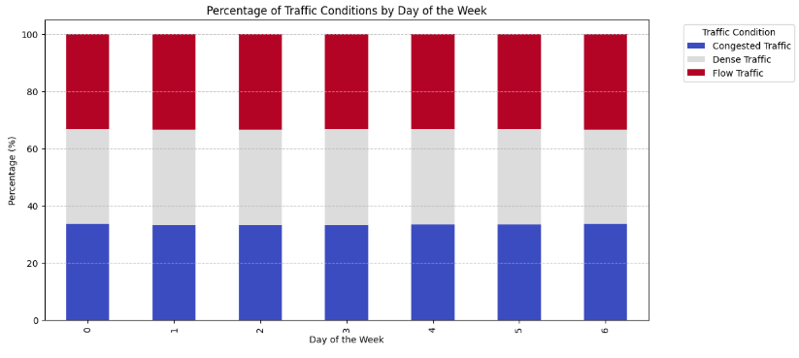
Think like a capitalist
This supports our claim and make it more general that ubers are well distributed, almost all ubers are in all types of traffics during the day.

Slide 26
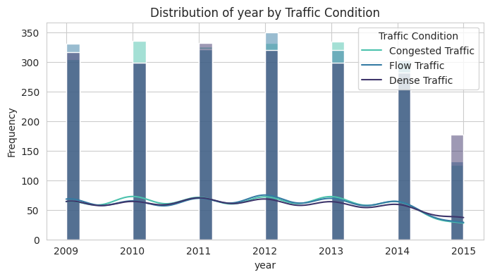
Distribution of year by Traffic Condition
Consistent Traffic Volume (2009–2014): Traffic conditions remained stable, indicating a steady pattern during these years.
Significant Drop in 2015: A notable decrease occurred, possibly due to missing data or changes in data collection.
Slight Increase in 2013: A peak in 2013 suggests an increase in vehicles or traffic congestion.
Dominance of Dense Traffic: Dense traffic is the most frequent condition, while congested traffic occurs less often, implying heavy but manageable traffic flow.

Slide 27
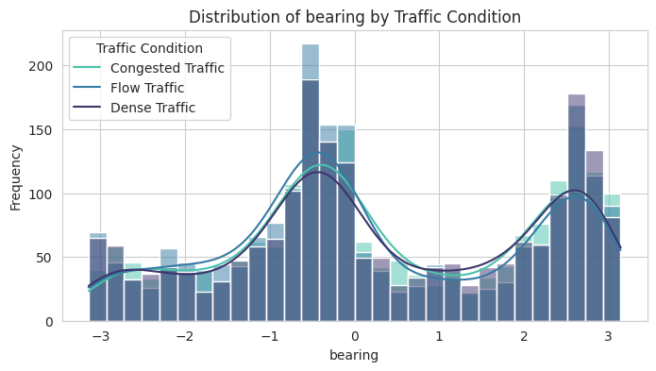
Distribution of bearing by Traffic Condition
Two Clear Peaks: Traffic activity is concentrated around -1 and 2, indicating two primary traffic directions.
Highest Frequency Near 0 and 2: The value 0 shows the highest traffic occurrences, while another peak near 2 suggests a secondary common route.
Traffic Condition Distribution:Flow Traffic is the most widespread across the distribution.
Congested Traffic is less frequent but more concentrated at the main peaks.

Slide 28
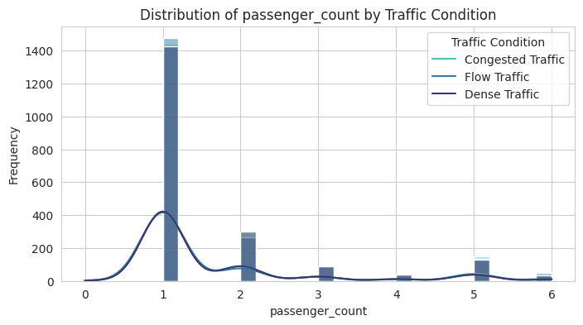
Distribution of Passenger Count by Traffic Condition
Majority of Trips Have One Passenger:
Passenger count = 1 shows the highest frequency (over 5000 trips), indicating that most vehicles carry only one passenger.
Lower Frequency for Higher Passenger Counts:
The frequency declines after 1 passenger, with smaller peaks at 2, 3, and 5 passengers, suggesting occasional group rides (e.g., shared transport or family trips).
Traffic Conditions and Passenger Count:
Congested traffic is more common with higher passenger counts, likely reflecting taxis or small buses being more involved in dense traffic.

Slide 29
Weather Impact

Slide 30

IS TAKING A TAXI AFFECTED BY THE WEATHER ?
A title that is relevant enough to stand on its own

Slide 31
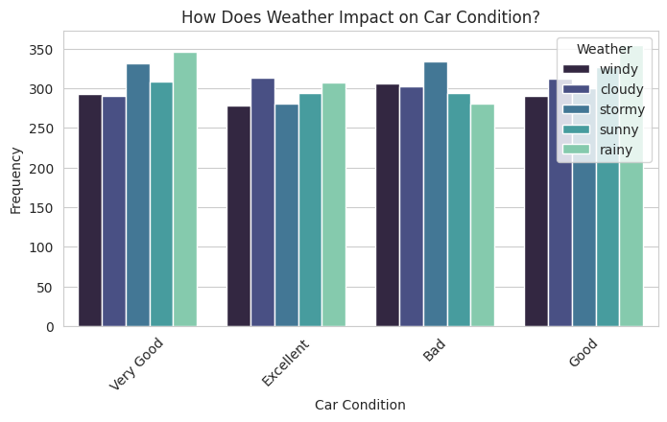
Distribution of Car Condition by Weather
"Very Good" and "Excellent" car conditions are more frequent under "Sunny" and "Windy" weather.
- "Bad" car condition has a relatively high frequency under "Rainy" and "Cloudy" weather.
"Good" car condition remains consistent across all weather types.

Slide 32
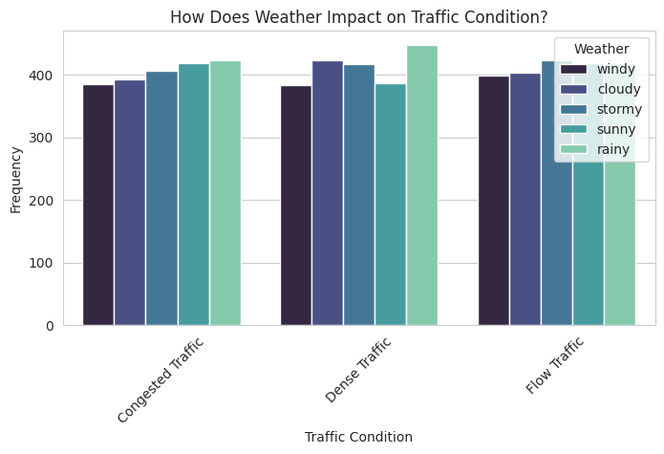
Distribution of Traffic Condition by Weather
"Heavy Traffic" shows increased frequency during "Windy" weather.
"Light Traffic" and "Moderate Traffic" remain relatively balanced across all weather conditions.
"Stormy" and "Rainy" weather do not significantly differ from "Cloudy" and "Sunny" in traffic conditions.
General Insights:
Weather conditions do not cause dramatic shifts but do show slight variations in both car and traffic conditions.
Sunny and Windy weather slightly increase the likelihood of better car conditions but correlate with more "Heavy Traffic."

Slide 33
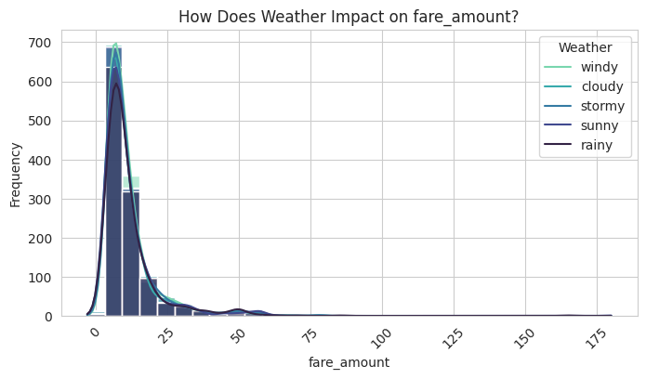
Distribution of Fare Amount by Weather
Consistent patterns across all weather conditions, with slight variations.
Different weather types (windy, cloudy, stormy, sunny, rainy) do not cause significant shifts in fare amount.
Minor increases in fare variability during rainy and stormy weather.

Slide 34
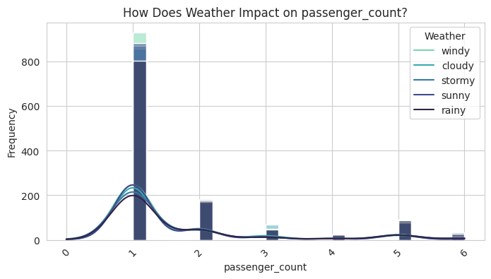
Distribution of Passenger Count by Weather
No major deviation based on weather; the passenger count remains stable across conditions.
Slight increase in multi-passenger trips in cloudy and stormy weather.

Slide 35
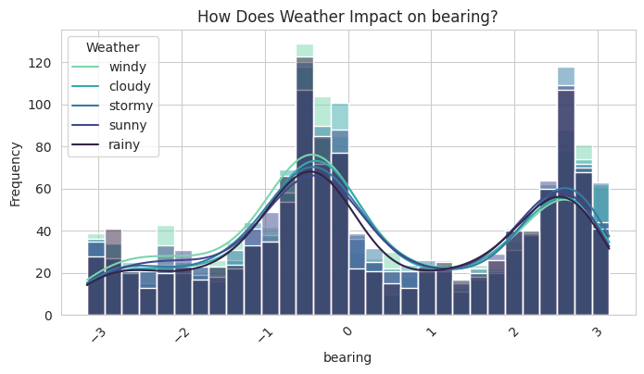
Distribution of Bearing by Weather
Weather events are concentrated around 0 and ±3 bearing values, forming two distinct peaks.
There is a symmetrical distribution around the center, with lower frequencies at the extremes.
Sunny and rainy conditions are the most frequent across all bearing values.
Windy and stormy conditions exhibit higher frequencies around 0 and 3 bearings.
Cloudy weather remains evenly spread but peaks near the central bearing

Slide 36
Distance attributes

Slide 37
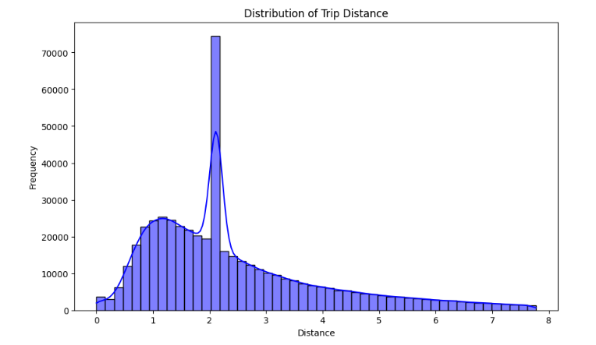
Trip Distance DISTRIBUTION
Most traveled distance is 2.12 miles, so the expected distance to be traveled is 2.12, exceeding 70k trips
Second most traveled distance is 1.2 miles.

Slide 38
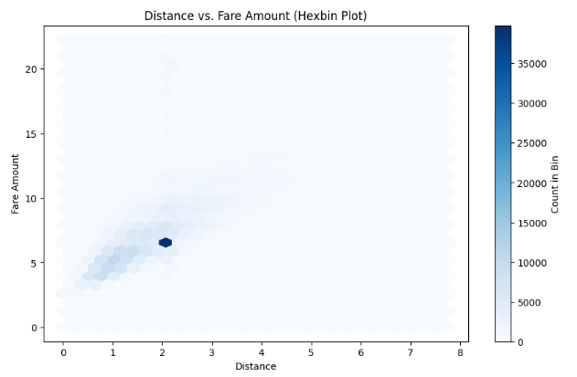
Trip Distance vs Fare amount
Since most traveled distance is 2.12 miles, most paid price for this distance is 6.5$, so also this means that the expected value of what the uber orderer would pay is 6.5$
The more likely other prices to be paid is above 6.5$ a little bit and less for distances between 0.5 miles and 2 miles

Slide 39
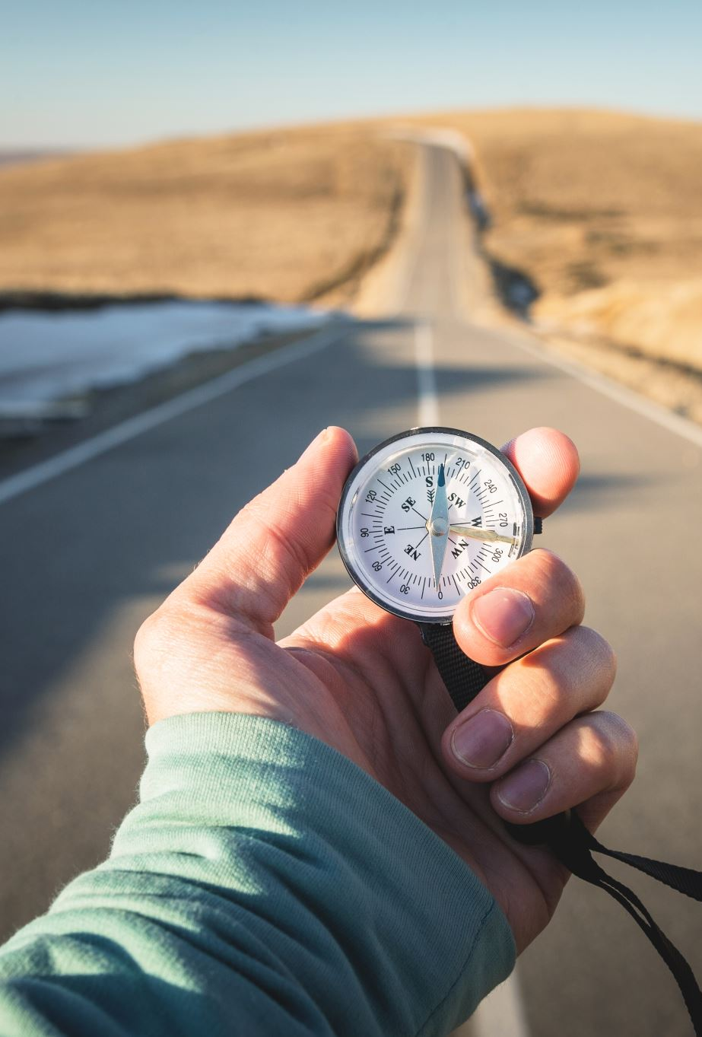
Survival of the fittest?
Shouldn’t the better condition car affect our distance of the trip ?
Shouldn’t we order the best condition car for longer trips ?

Slide 40
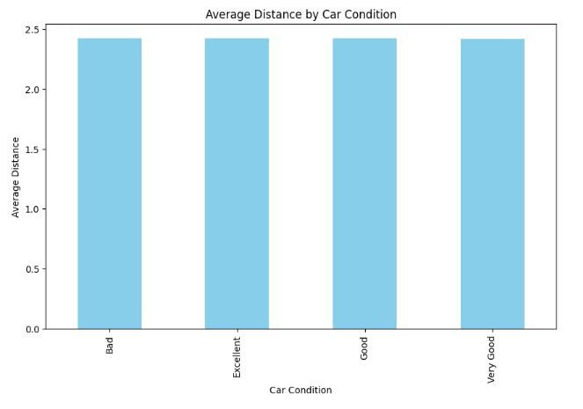
Survival of the fittest
As shown, not really a big difference between the average distance of every car condition unlike what our intuition thought.
This also could mean that people don’t take uber’s for longer trips, small distance to be traveled wont really matter on what car condition it is to be booked

Slide 41
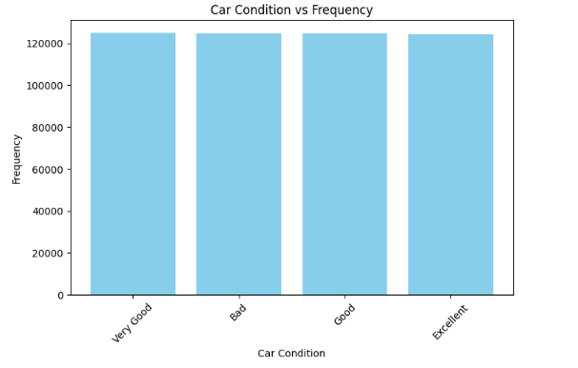
Survival of the fittest
All car conditions were ordered the same number of times.
Which also mean, people really wont care about the condition. Which suggests the trip is quick and short.

Slide 42

Cold slows you down
will weather effect even the smallest of distances traveled ?

Slide 43
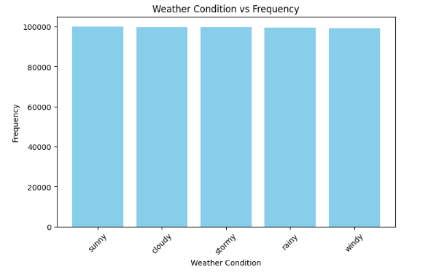
Cold slows you down, doesn’t it?
We observe that people order rides in every weather circumstance the same as in a normal day. Which shows that weather is no factor in booking rides, but will it effect the distances ?

Slide 44
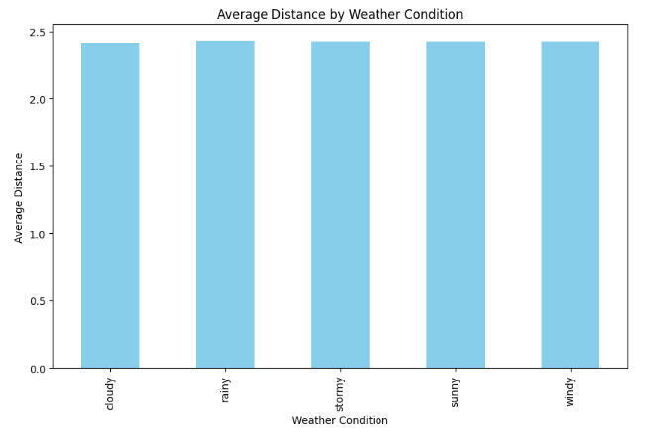
Cold slows you down, doesn’t it?
No effects shown on the average distance traveled for booking for every weather condition.

Slide 45
HOW PASSENGER COUNT IS RELATED TO DISTANCE
People book a ride in big counts in order to make fare amounts less, is that the case in here ?
do higher passenger count lessen the distance ?

Slide 46
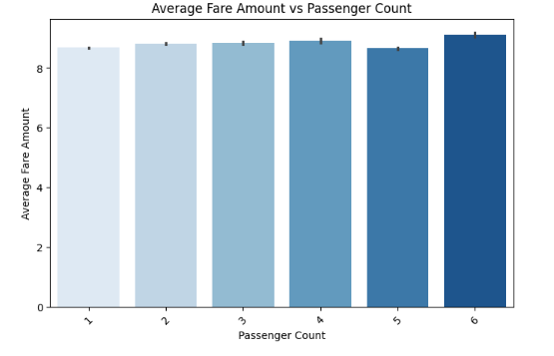
Passenger count and fare amount
Since almost all passenger count pay the same average plus – minus small amount, this suggest that there is a lot of people going from the same source to the same destination.

Slide 47
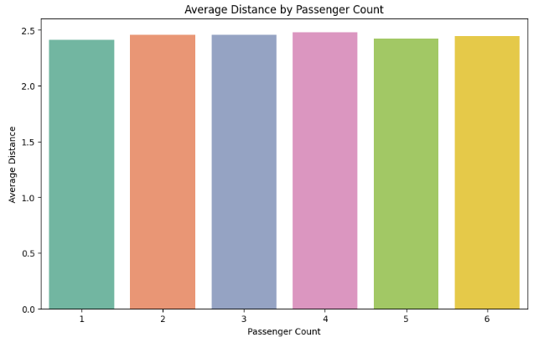
Passenger count and average distance
This strengthen our first hypothesis since all passenger counts travel the same average distance.

Slide 48
Total distance traveled as a function of time
how do months change the total distance traveled through that time ?

Slide 49
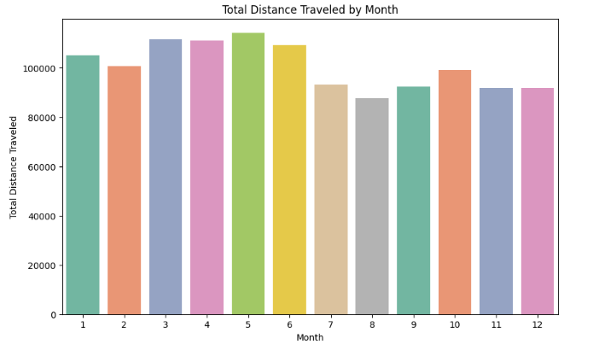
Distance as a function of time.
August showed the least total distances traveled through all months.
May showed the highest total distance traveled through all months
But does this mean more rides ordered through may ? Or is it less rides but the distance traveled is more in most rides?

Slide 50
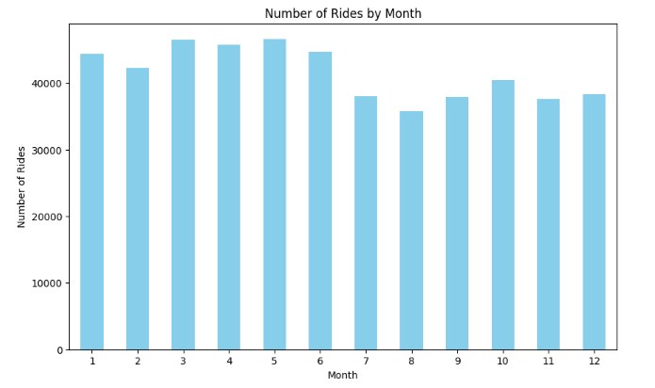
Distance as a function of time.
August showed the least rides 35762 while may showed the highest rides 46616 rides
So what’s the relation between number of rides and total distance ?

Slide 51
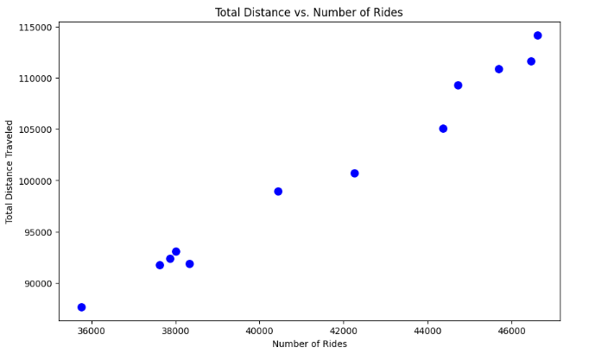
Distance as a function of time.
Very obvious to see that the more rides ordered the more distance traveled through a month, another obvious reason is that the average distance for rides is the same.
Correlation coefficient between total distance and number of rides is 0.99

Slide 52
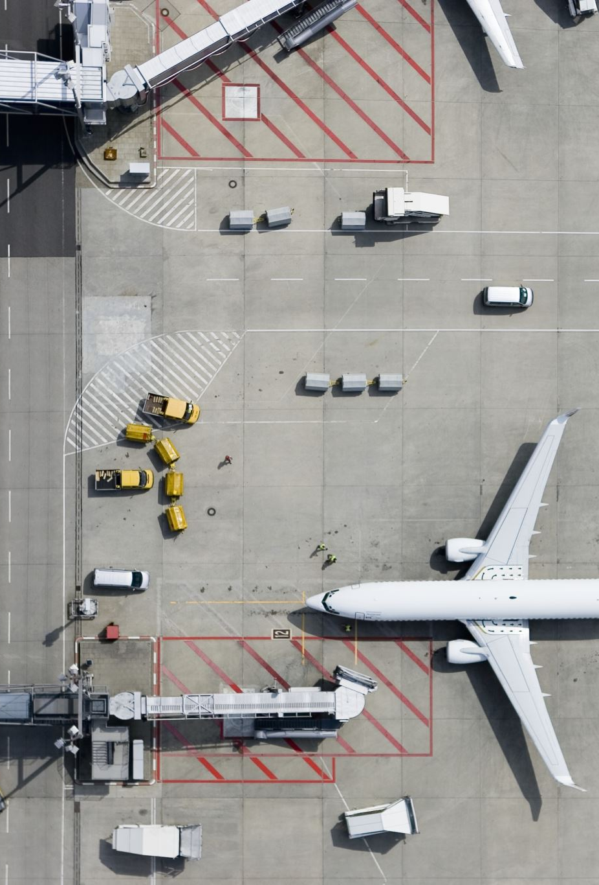
AIRPORTS MEAN UBERS
Always when we are in an airport that we landed in or we have gone to, we take taxi’s, but what fare amount we pay ?

Slide 53
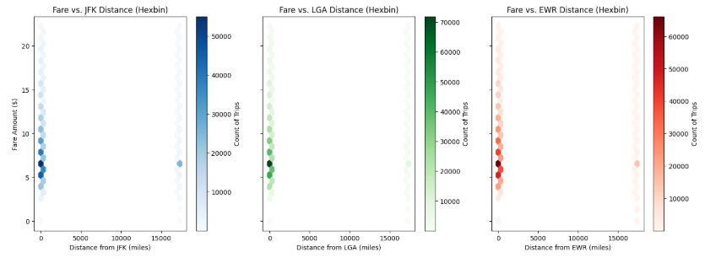
Airports mean ubers
All 3 airport pay the same amount which the average fair amount paid 6.5$.

