Slide 1



Taxi Ride EDA
Presented By Habiba Mowafy

Slide 2

Intro
Project Overview
This presentation aims to analyze Uber ride data as part of Cellula Internship - Task 4.
It includes Exploratory Data Analysis (EDA) to uncover insights and patterns in the dataset.
The key focus areas include data preprocessing, visualization, and statistical analysis.

Slide 3
Contents
Table Of Contents
01
Introduction
02
Data Exploration
Overview of the task and dataset.
Understanding and preprocessing the data
03
Analysis & Visualization idea
04
Conclusion
Key insights through EDA and visualizations
Summary of results and key takeaways.

Slide 4
Chapter 1
Introduction
Dataset Description : The dataset used in this analysis contains [500000] records with [26] features related to [ride details, timestamps, locations, fares, etc.].
Objective : The goal of this analysis is to [identify trends, peak usage times, geographic patterns, etc.] using data visualization and statistical methods..

Slide 5
Chapter 2
Data Exploration
Column Information:
1. User ID: Unique identifier for each user
2. User Name: Name of the user
3. Driver Name: Name of the driver
4. Car Condition: Condition of the car
5. Weather: Weather conditions during the ride
6. Traffic Condition: Traffic conditions during the ride
7. Ride ID: Unique identifier for each ride
8. Fare Amount: Fare amount for the ride
9. Pickup Datetime: Datetime when the ride was requested
10. Pickup Longitude: Longitude of the pickup location

Slide 6
Chapter 2
Data Exploration
Column Information:
11. Pickup Latitude: Latitude of the pickup location
12. Dropoff Longitude: Longitude of the dropoff location
13. Dropoff Latitude: Latitude of the dropoff location
14. Passenger Count: Number of passengers in the ride
15. Request Hour: Hour when the ride was requested
16. Request Day: Day when the ride was requested
17. Request Month: Month when the ride was requested
18. Request Day of the Week: Day of the week when the ride was requested
19. Request Year: Year when the ride was requested
20. Distance from JFK Airport: Distance from JFK airport to the pickup location

Slide 7
Chapter 2
Data Exploration
Column Information:
21. Distance from EWR Airport: Distance from EWR airport to the pickup location
22. Distance from LGA Airport: Distance from LGA airport to the pickup location
23. Distance from SOL: Distance from the Statue of Liberty to the pickup location
24. Distance from NYC: Distance from NYC to the pickup location
25. Distance from Pickup to Destination: Total distance of the ride
26. Bearing: Direction of the ride from start to end measured in angles

Slide 8
Chapter 2
Data Exploration
Observations:
- Most columns have complete data with 500,000 non-null entries.
- Columns ‘Dropoff Longitude’, ‘Dropoff Latitude’, and All distance information columns
have 5 missing values each.
- The dataset includes a mix of categorical and numerical data types.
No duplicate rows are present as each ride has a unique identifier, ensuring all rides are
different.
There are 500,000 unique User IDs but only 221,675 unique User Names, indicating
that some users might have multiple accounts or there are some users with the same
name.

Slide 9
Chapter 2
Data Exploration
Insights:
1️⃣ Taxi Fare
- Average fare: $11.36
- Lowest fare: -$44.90 (Invalid, must be removed)
- Highest fare: $500.00 (Very high, might be an outlier)
- Most common fare range: $6 - $12
- Takeaway: Some fares are too high or negative, requiring correction.
2️⃣ Passenger Counts
- Most trips: 1 or 2 passengers
- Few trips: 6 passengers (Likely shared rides)
- Some trips show 0 passengers: Error in data
- Takeaway: Most taxis carry one or two people.

Slide 10
Chapter 2
Data Exploration
Insights:
3️⃣ Time-Based Patterns
- Most taxi rides happen at: 1-2 PM
- Average ride day: 15th of the month
- Years covered: 2009 - 2015
- Takeaway: Taxis are busiest around midday.
4️⃣ Distance and Location
- Average trip distance: ~10 miles
- Airport trips are common, but some show 30,000 miles, which is impossible!
- Takeaway: Most trips are short rides, but some extreme distances are unrealistic.

Slide 11
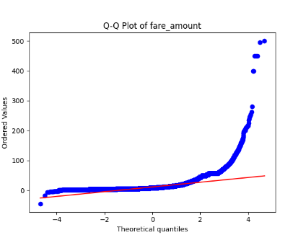
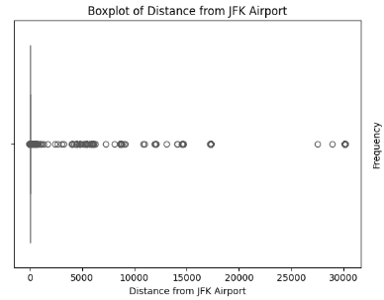
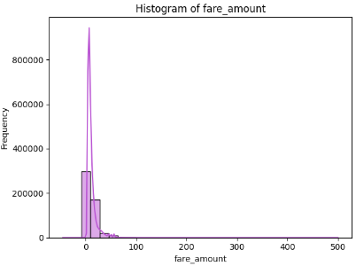
Chapter 2
Data Exploration
Insights:

Slide 12
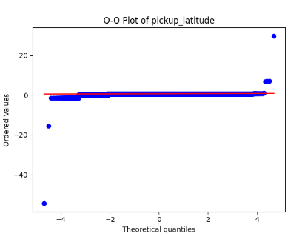
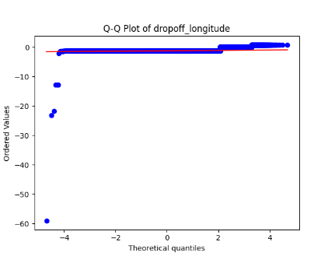
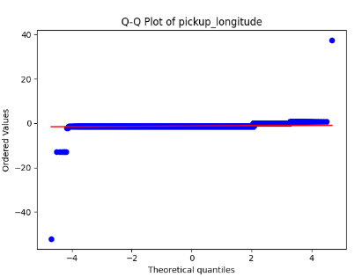
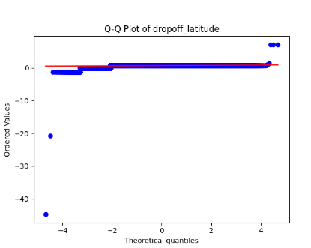
Chapter 2
Data Exploration
Insights:

Slide 13
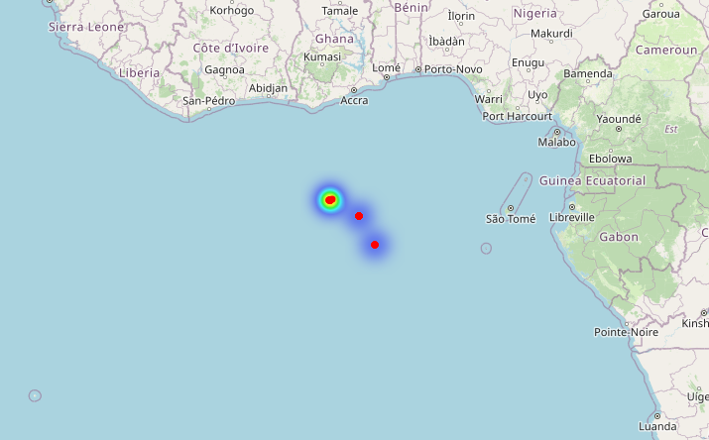
Chapter 2
Data Exploration
Insights:
In analyzing the previous plots, we noticed that the majority of the longitude and latitude values are clustered around zero—an obvious issue, as this places the data in the middle of the ocean! 🌊 It seems our ride data might just be catering to some very exclusive clientele—maybe those fish are taking rides to the coral reef! 🐟 Who knew Uber had a marine division?
Since correcting this information isn’t feasible
and removing only some entries would result in
losing entire columns’ entries, we made the
decision to drop all four affected features
to maintain data integrity.
So, now number of features in our data is 22 Feature.

Slide 14
Chapter 2
Data Exploration

Slide 15
Chapter 2
Data Exploration
Insights:
In analyzing the previous plots, we noticed that the majority of the longitude and latitude values are clustered around zero—an obvious issue, as this places the data in the middle of the ocean! 🌊 It seems our ride data might just be catering to some very exclusive clientele—maybe those fish are taking rides to the coral reef! 🐟 Who knew Uber had a marine division?
Since correcting this information isn’t feasible
and removing only some entries would result in
losing entire columns’ entries, we made the
decision to drop all four affected features
to maintain data integrity.
So, now number of features in our data is 22 Feature.

Slide 16
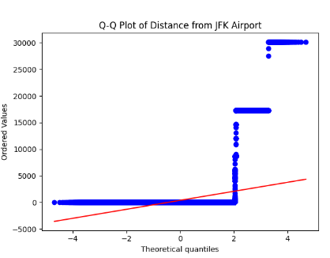
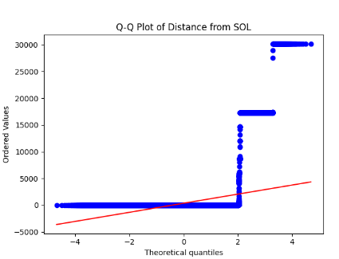
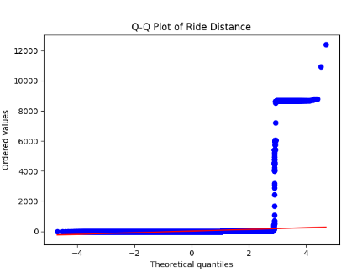
Chapter 2
Data Exploration
Insights:
Upon analyzing the Distance Columns’ plots, I encountered some perplexing values. For instance, seeing ride distances recorded at 5,000 miles or discrepancies like a 30,000-mile distance between the pickup location and the Service Operating Location is truly astounding. Even a penguin living at the North Pole wouldn’t manage those numbers! Moreover, some ride distances are showing as 0 miles, which, while theoretically possible in a parallel universe, certainly raises a few eyebrows here.

Slide 17
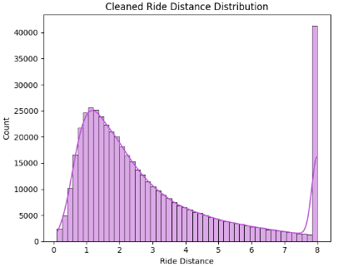
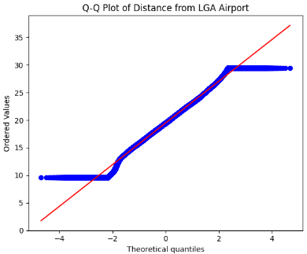
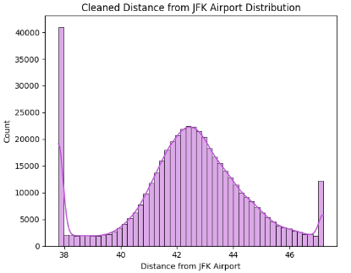
Chapter 2
Data Exploration
Insights:
After addressing the discrepancies by removing the extreme values and clipping the remaining outliers based on the interquartile range (IQR), we now have a dataset that presents much more reasonable and reliable numbers.

Slide 18
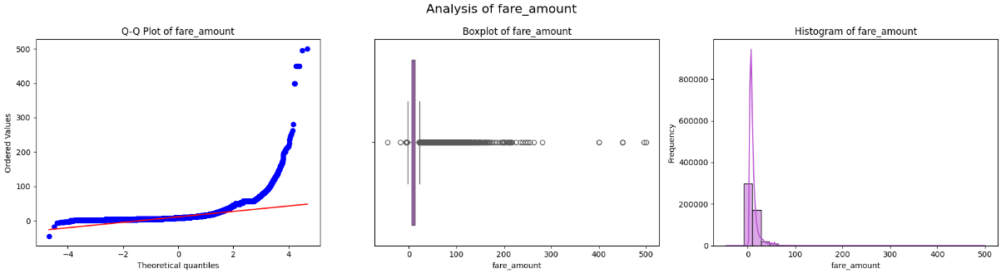
Chapter 2
Data Exploration
Insights:
While examining the Fare Amount data, I came across some rather curious entries, including negative values and fare amounts of zero. It looks like some riders are feeling especially generous and paying the passengers instead! On the other end of the spectrum, we also have some extraordinarily high fares that seem more fitting for a round-the-world ticket than a local ride. It's safe to say we need to address these outliers to ensure our fare analysis reflects reality!

Slide 19
Chapter 2
Data Exploration
Insights:
To enhance the accuracy of our fare amounts, I implemented a context-aware cleaning process using various grouping factors, including Car Condition, Weather, Traffic Condition, Request Day of the Week, and Request Hour.
For each combination of these factors, I calculated group-specific IQR bounds. I adjusted fares based on multipliers derived from the 4 factors. For instance, fares for 'Bad' car conditions allowed the most variance, while 'Excellent' cars required the least.
The same logic applies to weather and traffic conditions. By applying the highest multiplier among these factors, I established reasonable upper and lower bounds for fare cleaning—capping fares to ensure they align with expected ranges, while also maintaining a minimum fare of $2.50.

Slide 20
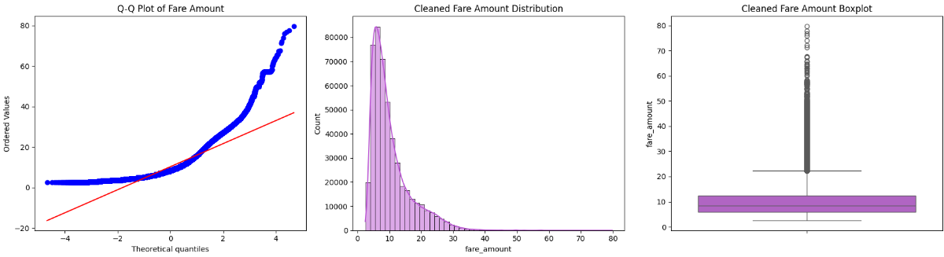
Chapter 2
Data Exploration
Insights:
After this thorough vetting, I filtered our dataset to ensure that the fare-to-distance ratio adhered to defined thresholds. Our final dataset not only represents significantly cleaner fare amounts but also offers insights into a more sensible fare-distance relationship.
We notice
that we still
have outliers
in the plots,
but it’s okay
because the
range became
lower, so these are acceptable outliers.

Slide 21
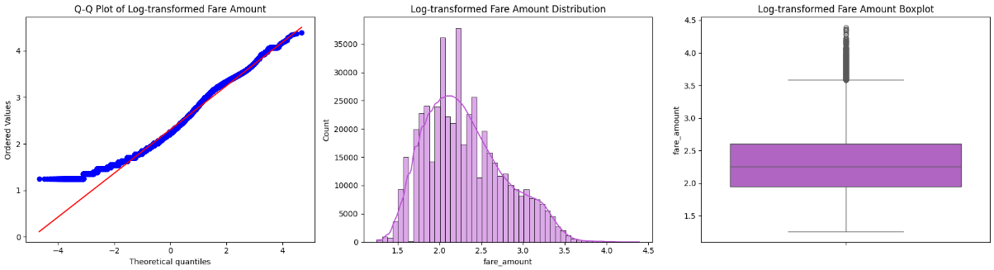
Chapter 2
Data Exploration
Insights:
Despite our efforts, the data still exhibits significant skewness. To address this, I applied a log transformation to the fare values, bringing us closer to a more balanced and normal distribution.

Slide 22
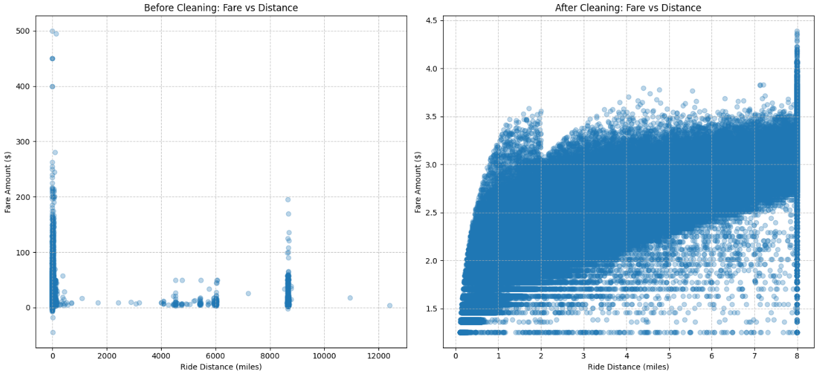
Chapter 2
Data Exploration
Insights:
On the left, we see the fare versus distance data before cleaning. The presence of extreme values and outliers is evident, with fares reaching as high as $500 for short distances and unsettling clusters at zero and negative values. In contrast, the right side of the plot showcases the cleaned data, which has eliminated these anomalies. The cleaned dataset presents a much clearer relationship, with fares now conforming to a more rational distribution based on distance.

Slide 23
Chapter 2
Data Exploration
Insights:
After tackling outliers, null values, and engaging in some feature engineering magic, our dataset has transformed into a more insightful collection of columns. Think of it as giving our data a much-needed makeover—now it’s ready for the runway!
Here’s a quick rundown of the new columns we’ve added, along with the remaining dataset size of 478,897 entries:
Fare per Mile: The fare charged per mile. It’s the fine print that helps you calculate if you’re getting a deal or a raw deal!
Is Rush Hour: A binary indicator of whether the ride occurred during rush hour. Because if you’ve been in traffic, you know it’s a real thing!

Slide 24
Chapter 2
Data Exploration
Insights:
Is Weekend: Indicates if the ride took place on a weekend. Perfect for those spontaneous getaways—or late-night pizza runs!
Is Night: A flag for whether the ride was at night.
Day Period: Categorizes the time of day. Morning, afternoon, or evening—this column knows when you’re most likely to need a ride!
Is Holiday: A binary indicator for holidays.
Nearest Airport Distance: Measures the distance to the nearest airport. Ideal for those who always seem to be racing to catch a flight!

Slide 25
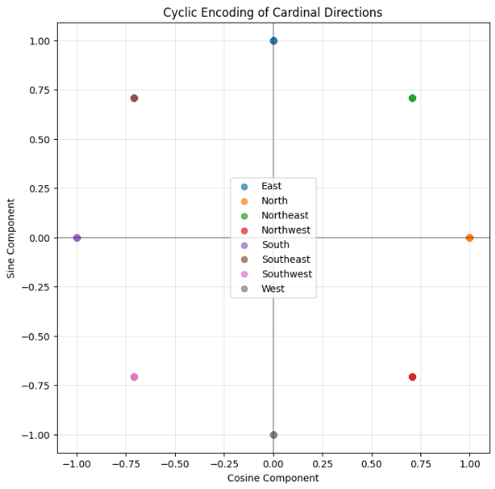
Chapter 2
Data Exploration
Insights:
Cardinal Direction: Provides the direction of the ride. A little geographical flair to spice things up!
With all these enhancements, our dataset
is not just larger but also richer in context,
ready to deliver insights that are both
meaningful and actionable!

Slide 26
Chapter 2
Data Exploration
Insights:
Let’s take our dataset a step further by highlighting the unique values for some key columns. This not only adds richness to our analysis but also gives us a clearer picture of the diversity within our data.
Here’s what we found:
Car Condition: ['Bad', 'Excellent', 'Good', 'Very Good’]
Weather: ['cloudy', 'rainy', 'stormy', 'sunny', 'windy’]
Traffic Condition: ['Congested Traffic', 'Dense Traffic', 'Flow Traffic’]
Day Period: ['Night', 'Morning', 'Afternoon', 'Evening’]
Cardinal Direction: ['Northwest', 'North', 'Southwest', 'South', 'Southeast', 'West', 'East’, 'Northeast’]
These unique values enrich our understanding of the dataset, proving that every ride has its own story—whether it’s a bad car on a rainy day or a smooth trip through flow traffic!

Slide 27
Analysis & Visualization idea
Chapter 3
In this chapter, aim to provide clear insights backed by compelling visualizations. This will facilitate understanding effectively. Ensure to accompany each visual with insightful interpretations to guide anyone reads it.

Slide 28
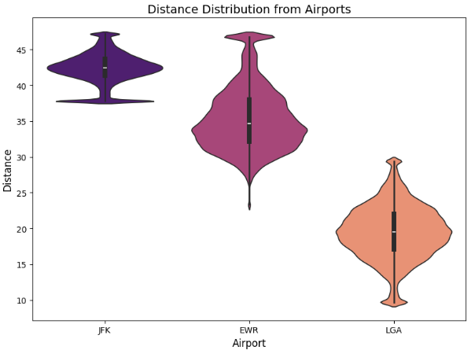
Analysis & Visualization idea
Chapter 3
This violin plot showcases the distribution of distances from three major airports: JFK, EWR, and LGA. The wider sections illustrate the density of rides at various distance levels. Notably, EWR has a higher spread, indicating more variability in ride distances compared to the others. Meanwhile, JFK shows a narrower distribution, suggesting more consistency in rides near this airport.

Slide 29
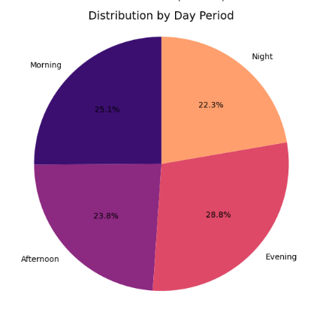
Analysis & Visualization idea
Chapter 3
The pie chart displays the proportion of rides during different day periods: Morning, Afternoon, Evening, and Night. Evening rides dominate at 28.8%, closely followed by Morning and Afternoon. The smaller Night segment suggests fewer requests during late hours.

Slide 30
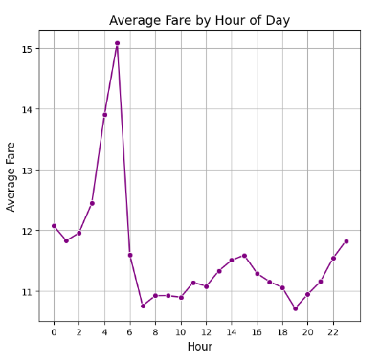
Analysis & Visualization idea
Chapter 3
This line chart illustrates the average fare across different hours of the day. A sharp increase in fare is observed around 5 AM, likely correlating with early morning rush-hour demand. Following this peak, we see a dip, which stabilizes later in the day.

Slide 31
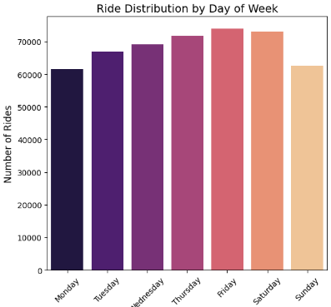
Analysis & Visualization idea
Chapter 3
The bar graph highlights the number of rides distributed throughout the week. Friday leads with the highest ride counts, reflecting typical end-of-week activity, while Saturday and Sunday also show considerable demand, likely due to leisure travel.

Slide 32
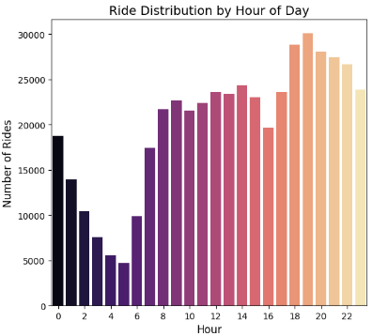
Analysis & Visualization idea
Chapter 3
This bar chart depicts the volume of rides by hour, revealing a clear trend where ride requests steadily increase throughout the day, peaking in the late afternoon and evening.

Slide 33
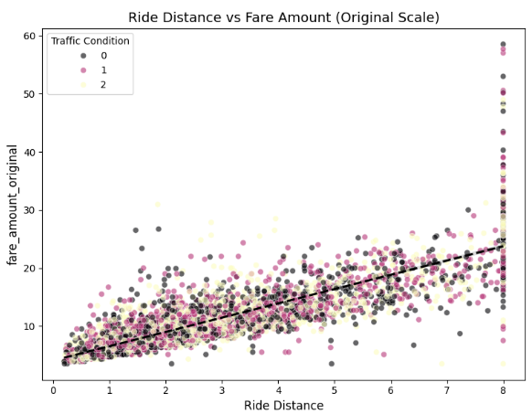
Analysis & Visualization idea
Chapter 3
This scatter plot compares ride distance against fare amounts, with points colored by traffic conditions. A positive correlation is visible, indicating that as ride distance increases, so does the fare. This analysis can help refine pricing strategies and enhance customer satisfaction.

Slide 34
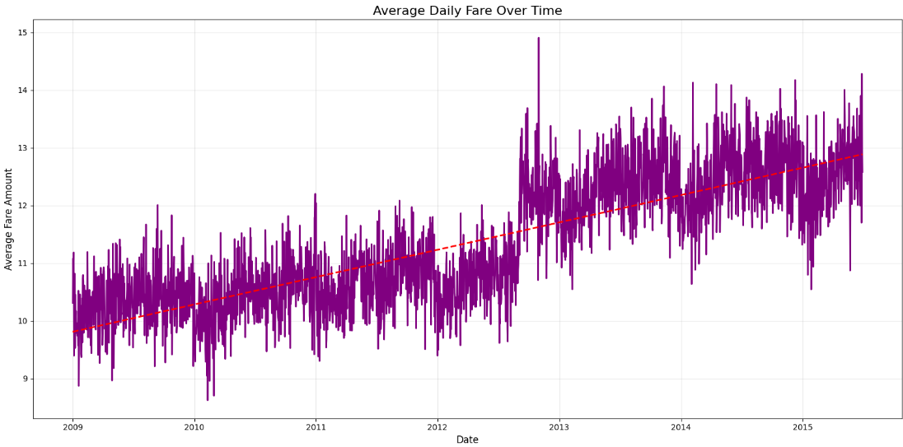
Analysis & Visualization idea
Chapter 3
This time series plot illustrates the average daily fare from 2009 to 2015, showing a clear upward trend. The red dashed
line indicates the overall
trendline, suggesting that,
on average, fares have gradually
increased over time.
The fluctuations signify
seasonal variations and
potential economic influences.

Slide 35
Analysis & Visualization idea
Chapter 3

Slide 36
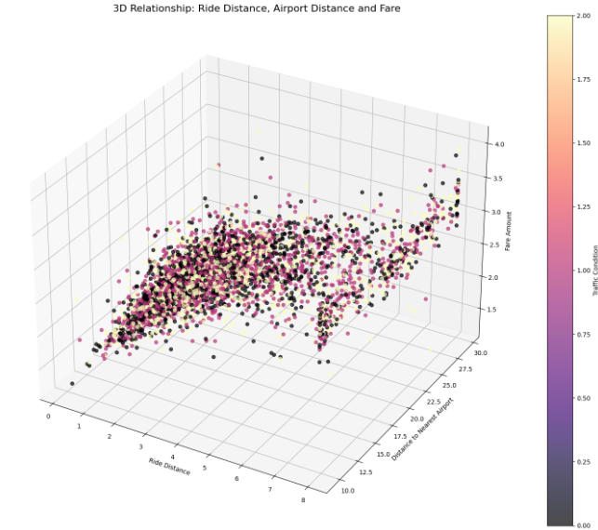
Analysis & Visualization idea
Chapter 3
This 3D scatter plot explores the relationship between ride distance, distance to the nearest airport, and fare amount. The gradient coloring represents fare amounts, indicating that as both ride distance and airport distance increase, fares tend to rise.

Slide 37
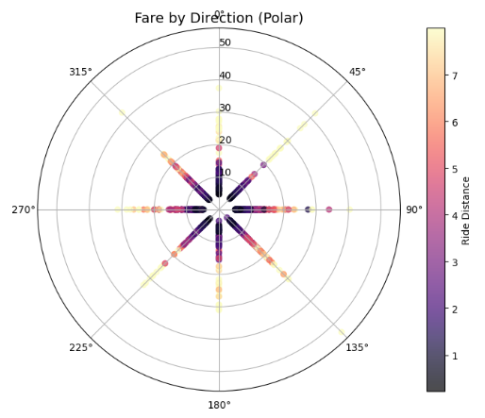
Analysis & Visualization idea
Chapter 3
The polar plot displays fare amounts based on cardinal directions. The radial distances correspond to ride distances, while the color gradient illustrates the fare amounts. Notably, certain directions may show higher average fares, providing insight into geographic pricing variations.

Slide 38
Conclusion
Chapter 4
In this presentation, we explored a comprehensive dataset that highlighted the complexities of ridesharing dynamics, particularly focusing on fare structures, ride distances, and external factors such as traffic and weather conditions.
Key Takeaways:
Correlation of Fare and Distance: We observed a strong relationship between ride distances and fare amounts, suggesting that longer trips generally result in higher charges. Traffic conditions further influenced these patterns.
Peak Demand Insights: Analysis of hourly and weekly trends revealed that evenings and weekends are prime times for increased ride requests, providing valuable data for operational strategy.

Slide 39
Conclusion
Chapter 4
Key Takeaways:
Directionality and Distance Impact: The exploration of fares by direction and airport distances offered insights into geographic pricing variations, which can inform targeted marketing efforts.
Temporal Changes in Fares: The analysis over time indicated a steady increase in average fares, prompting further evaluation of pricing policies moving forward.

Slide 40
Conclusion
Chapter 4
Implications:
These insights can be instrumental in refining fare structures, improving resource allocation, and enhancing customer experience. Understanding these dynamics aids in strategic decision-making and operational efficiency.
Overall, this analysis not only illustrates current patterns but also sets the stage for future research and modeling.

Slide 41
THANK YOU

