Slide 1
Exploratory Data Analysis (EDA) of Taxi Trips
Our Team: -Ahmed Mohamed Sobhy
-Mohamed ABABSA
-Hassan Abd Elfattah Ibrahim Obaia

Slide 2
Goal
To explore how taxi trip characteristics (fares, distances, passengers…) impact traffic conditions using EDA, while resolving data discrepancies
Dataset
500,000 taxi trips, 26 columns including times, fares, distances, and categorical features, an assumed NYC focus
2. Handling Missing Values
dropoff_longitude, dropoff_latitude, jfk_dist, ewr_dist, lga_dist, sol_dist, nyc_dist, distance, bearing: 5 missing values each
Removing these rows with missing values ensures a clean dataset for subsequent analysis by preserving only complete records.
3. Checking for Duplicates
There are no duplicate entries, meaning each row represents a unique trip or observation

Slide 3
4. Detecting & Removing the Outliers
Number of outliers in fare_amount : 43329
Number of outliers in distance : 20365
Number of outliers in jfk_dist : 34959
Number of outliers in ewr_dist : 1075
Number of outliers in lga_dist : 582
Number of outliers in sol_dist : 0
Number of outliers in nyc_dist : 2
5. Exploring the Dataset
The features are categorized as follows:
Categorical Features: Car Condition, Weather, Traffic Condition
Numerical Features: fare_amount, passenger_count
Time-Related Features: year, month, day, hour
Distance-Related Features: jfk_dist, ewr_dist, lga_dist, sol_dist, nyc_dist, distance
Geographical Features: pickup_longitude, pickup_latitude, dropoff_longitude, dropoff_latitude

Slide 4
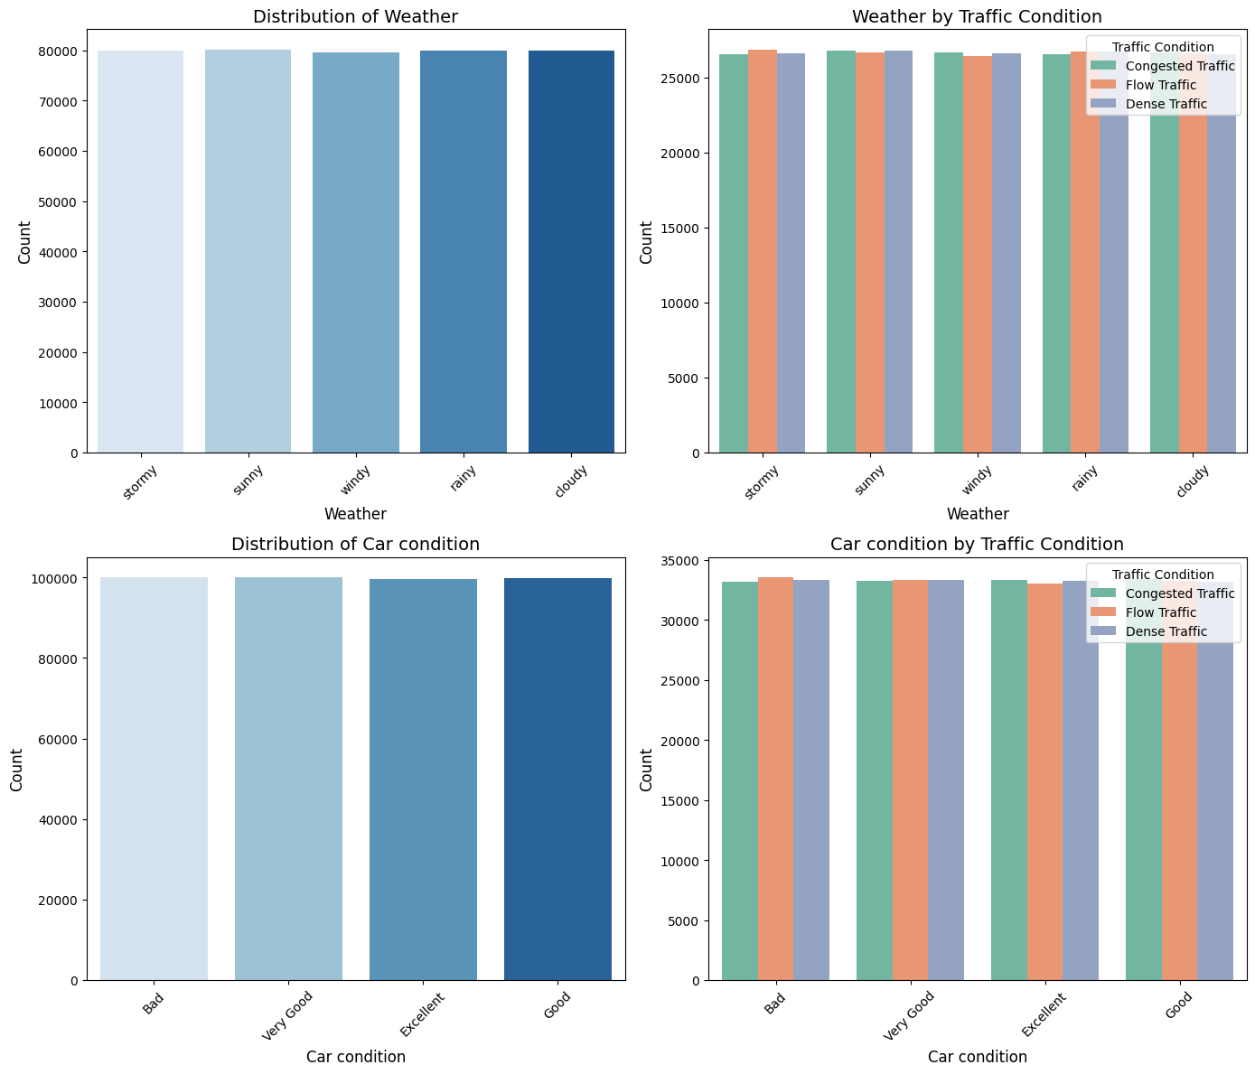
4.1. Categorical Features

Slide 5
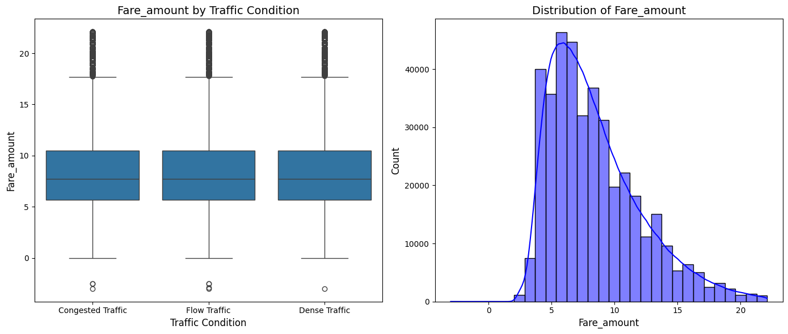
4.2. Numerical Features

Slide 6
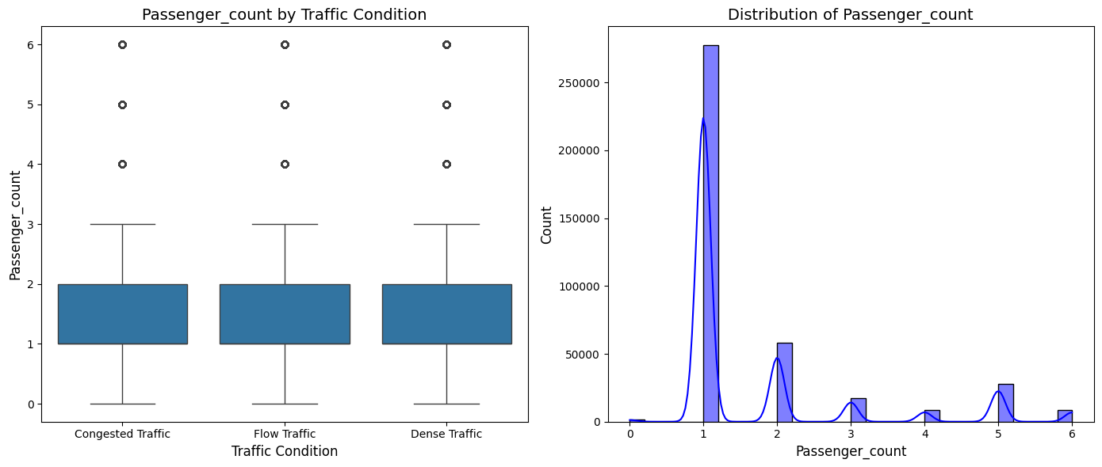
4.2. Numerical Features

Slide 7
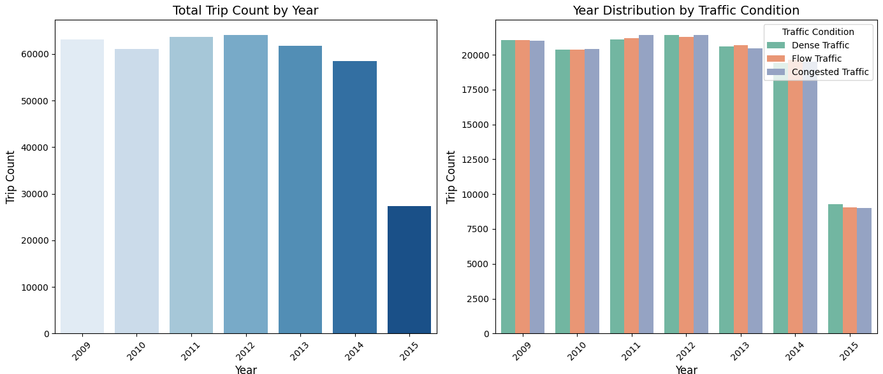
4.3. Time-Related Features

Slide 8
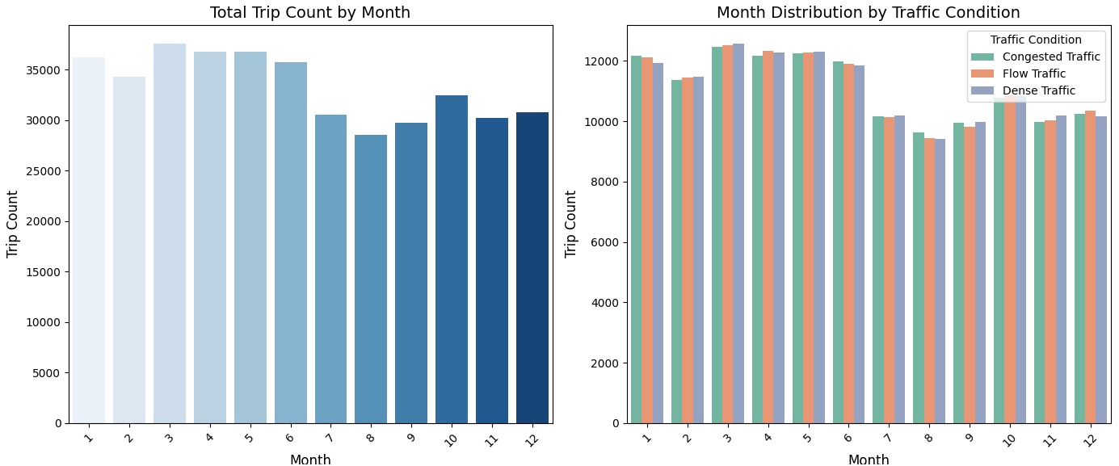
4.3. Time-Related Features

Slide 9
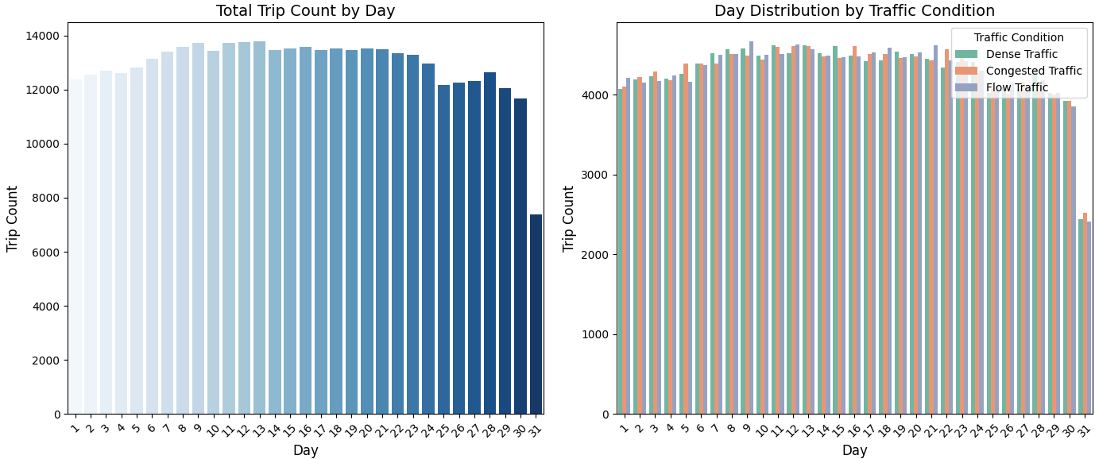
4.3. Time-Related Features

Slide 10
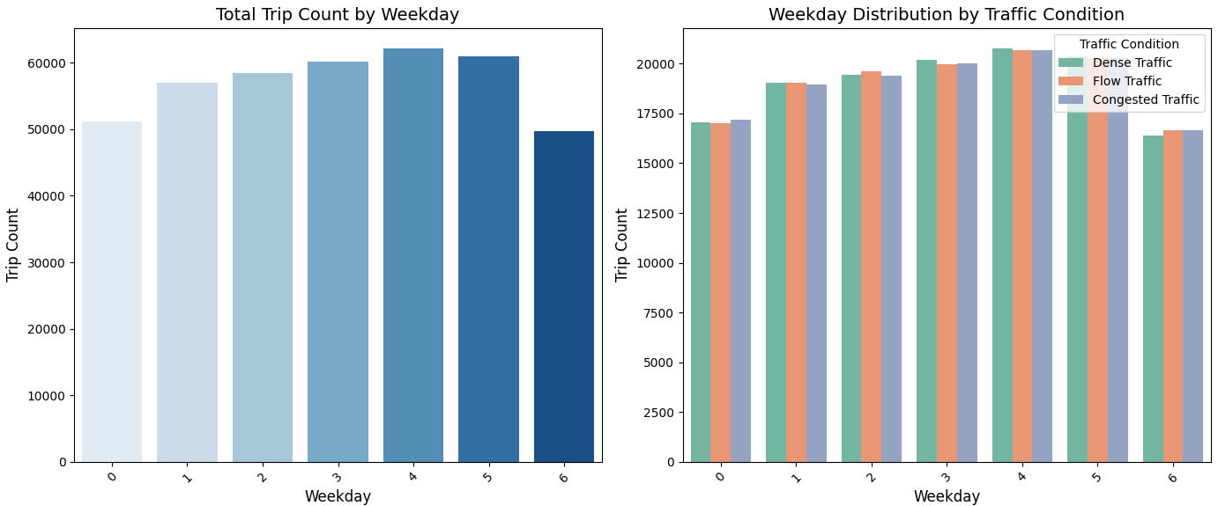
4.3. Time-Related Features

Slide 11
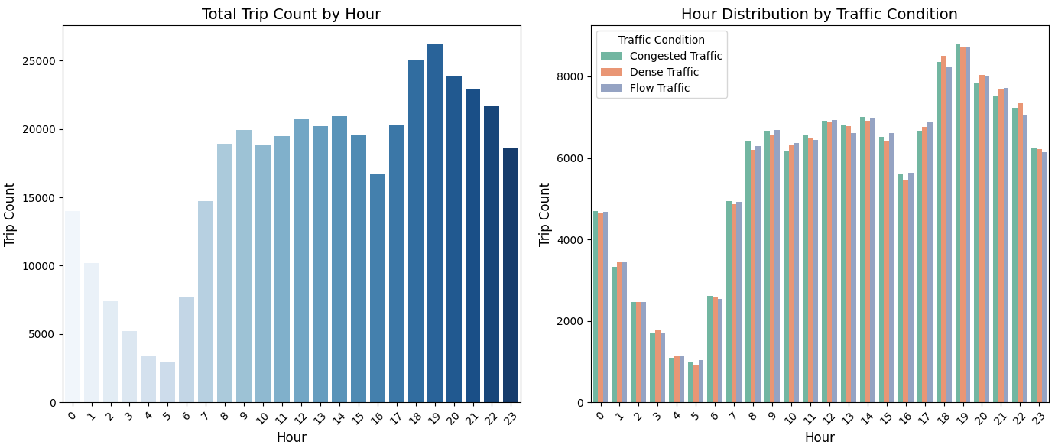
4.3. Time-Related Features

Slide 12
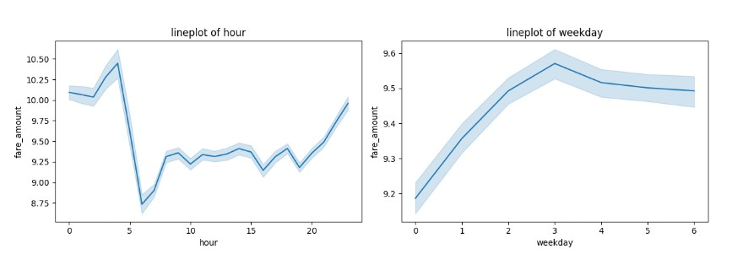
Now let's analyze Fare Amount Trends:
Hourly and Weekly Patterns.
Fare Amount by Hour: Fares peak early in the morning and late at night, with a significant drop in the early morning hours.
Fare Amount by Weekday: Fares increase towards midweek and slightly decline towards the weekend.

Slide 13
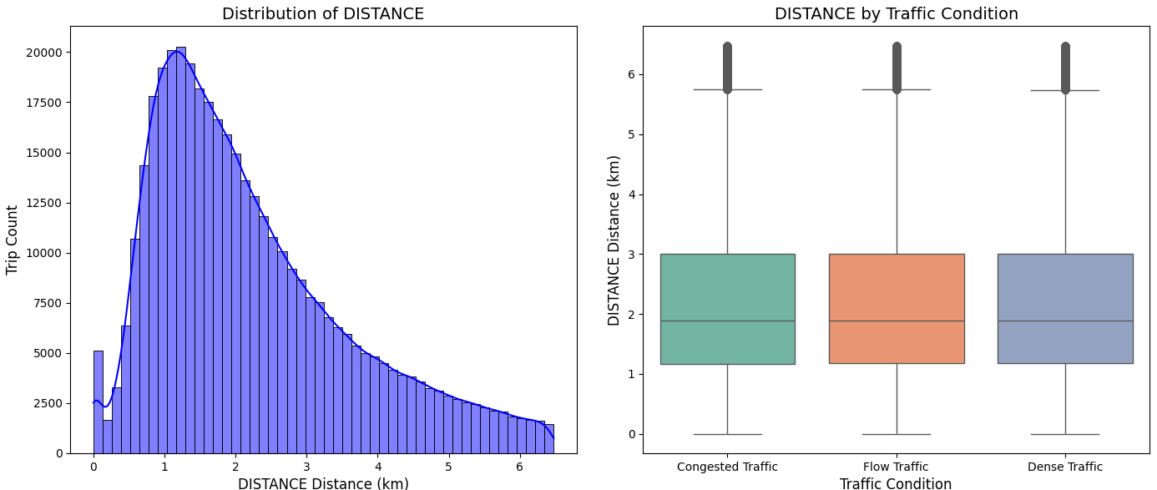
4.4. Distance-Related Features

Slide 14
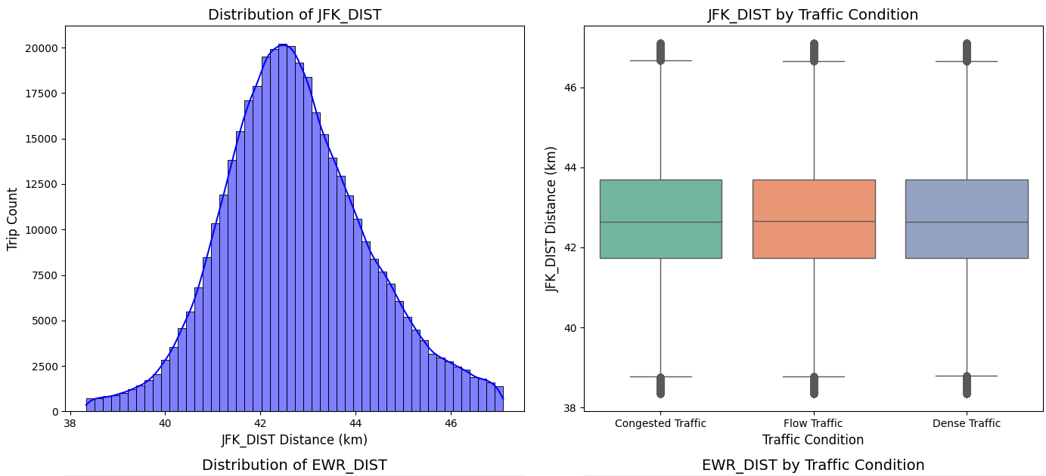
4.4. Distance-Related Features

Slide 15
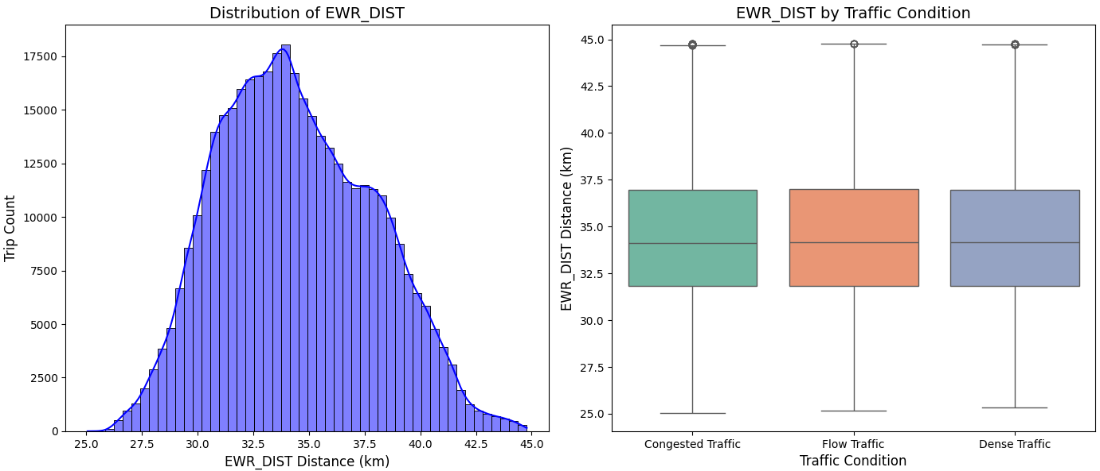
4.4. Distance-Related Features

Slide 16
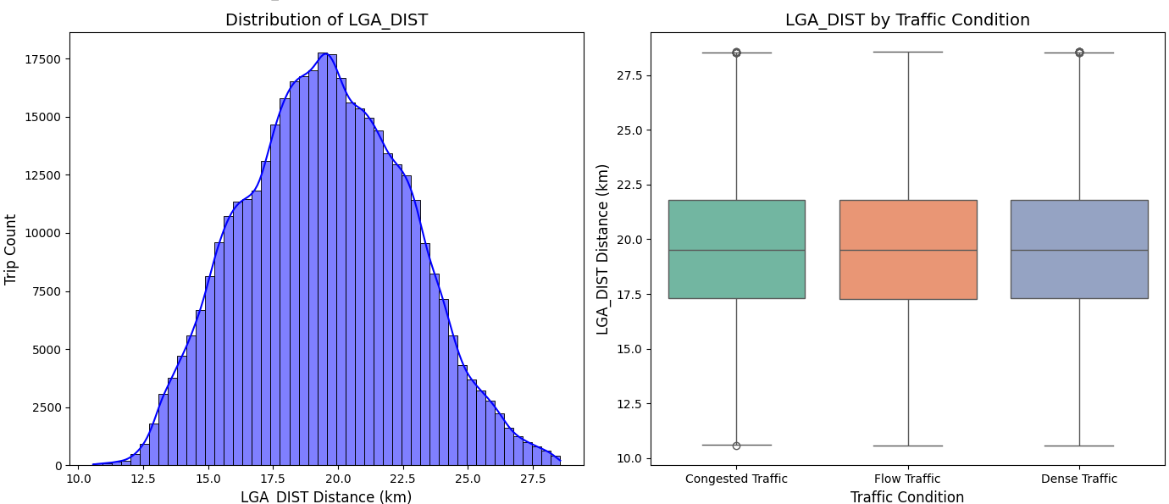
4.4. Distance-Related Features

Slide 17
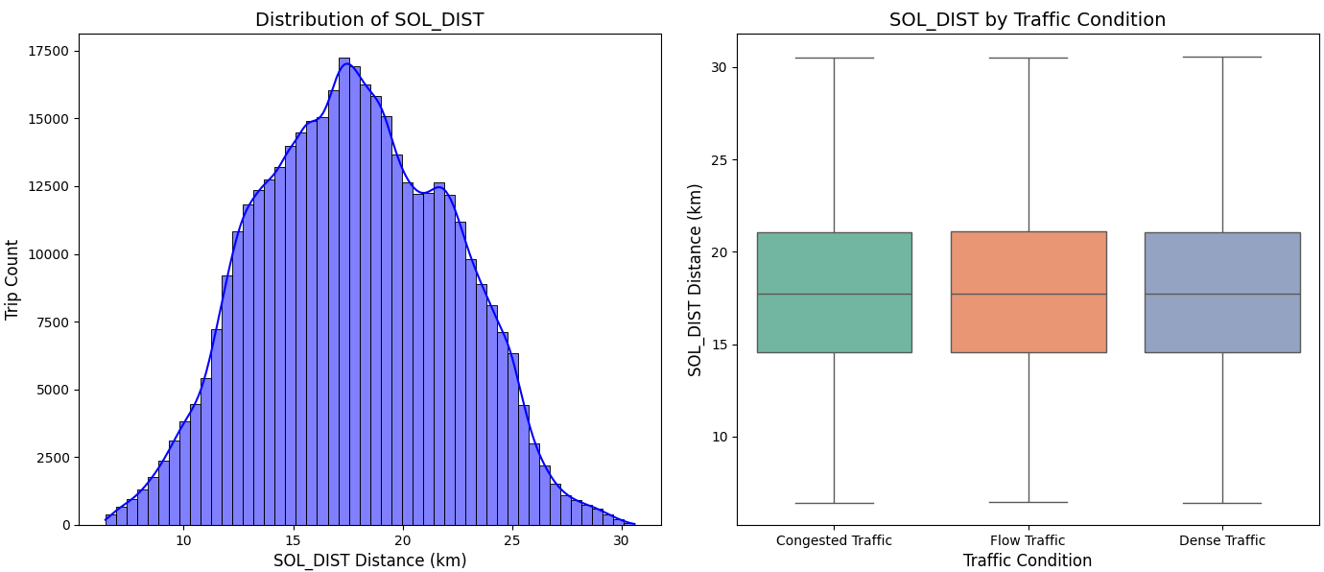
4.4. Distance-Related Features

Slide 18
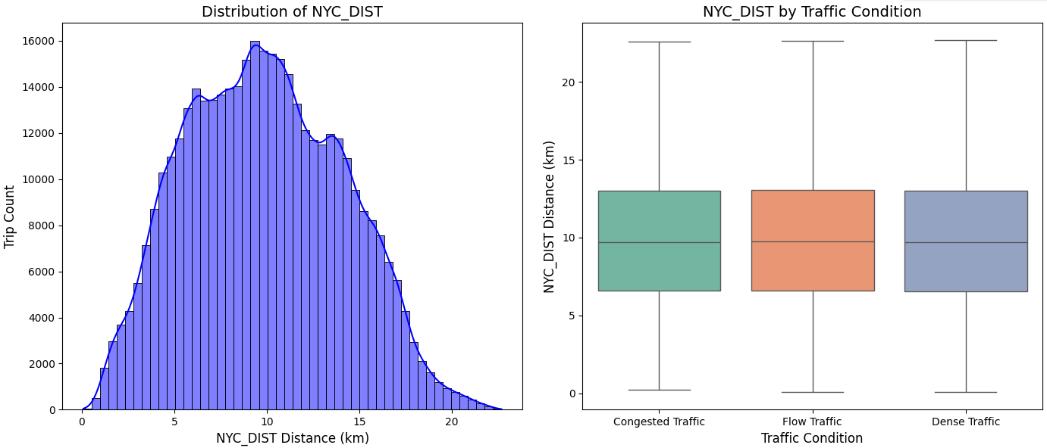
4.4. Distance-Related Features

Slide 19
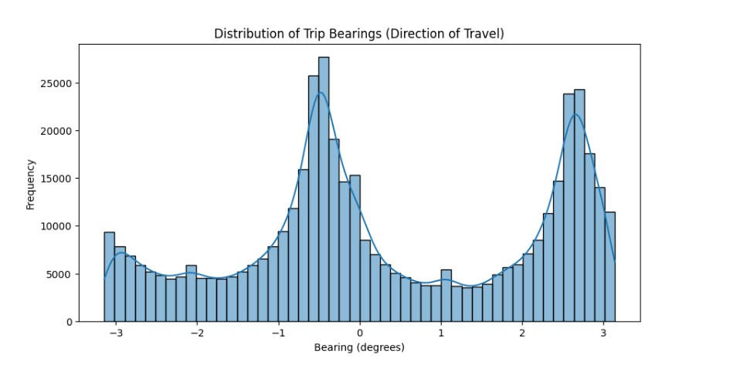
So what is the distribution of trip bearings
(direction of travel) ?
The distribution of trip bearings shows distinct peaks at specific directions, indicating that most trips follow a few dominant travel routes rather than being randomly distributed in all directions.

Slide 20
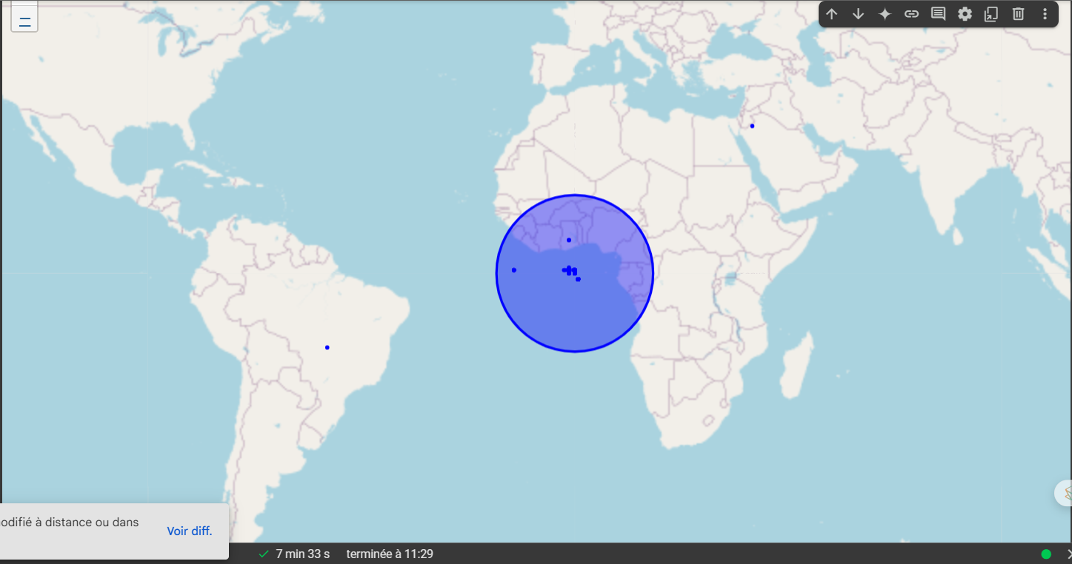
4.5. Geographical Features

Slide 21
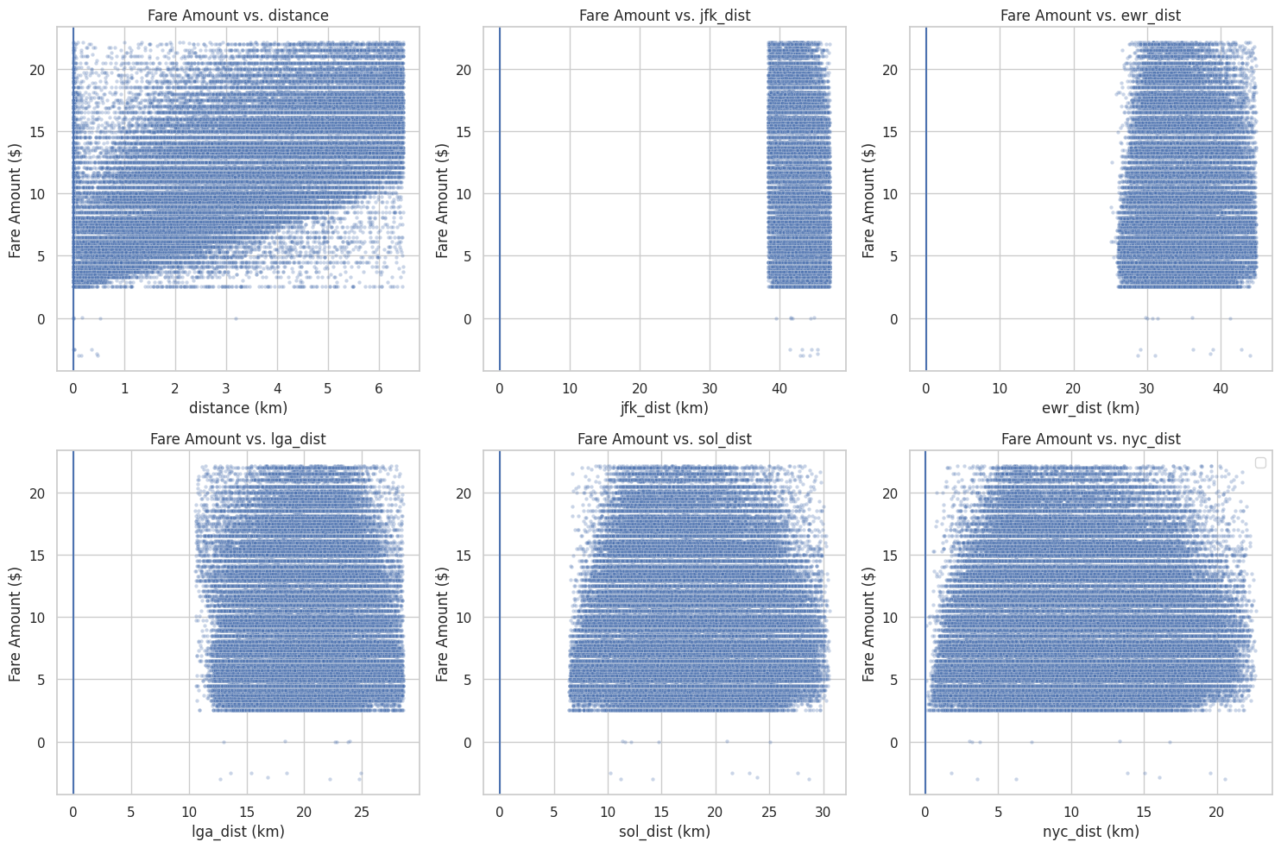
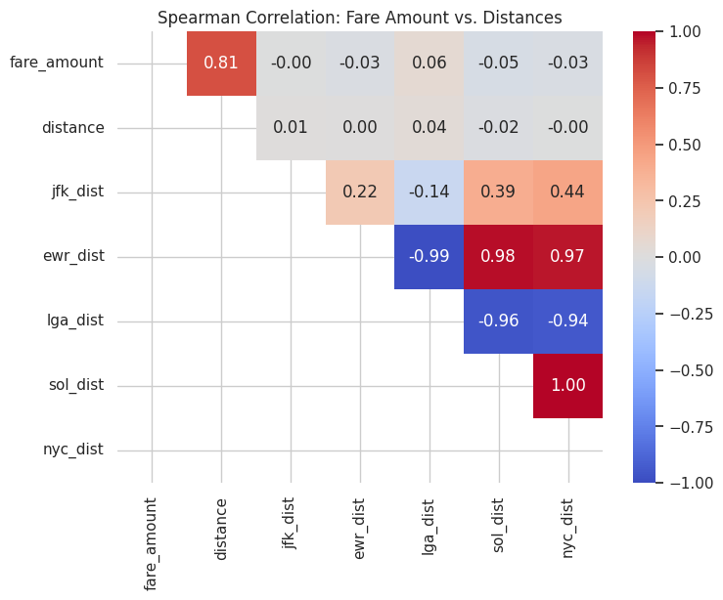
How do different distances relate to fare amounts?
Number of trips with zero fare: 4
Number of trips with zero distance: 3149

Slide 22
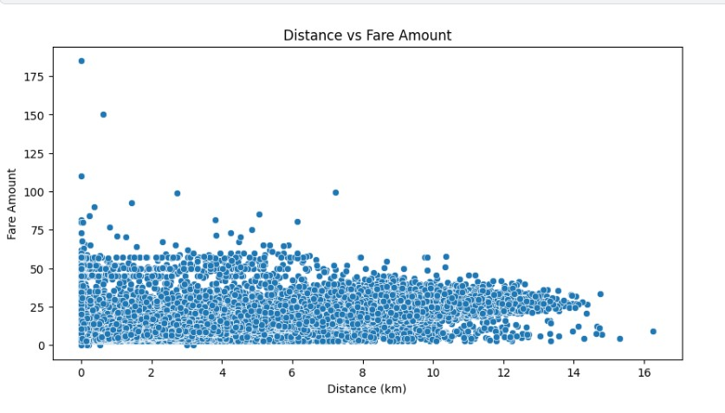
let's find out the relation between distance and fare amount
in scatter plot.
The scatter plot shows that fare amount does not always increase proportionally with distance, indicating possible variations due to factors like base fares, surge pricing, or additional charges.

Slide 23
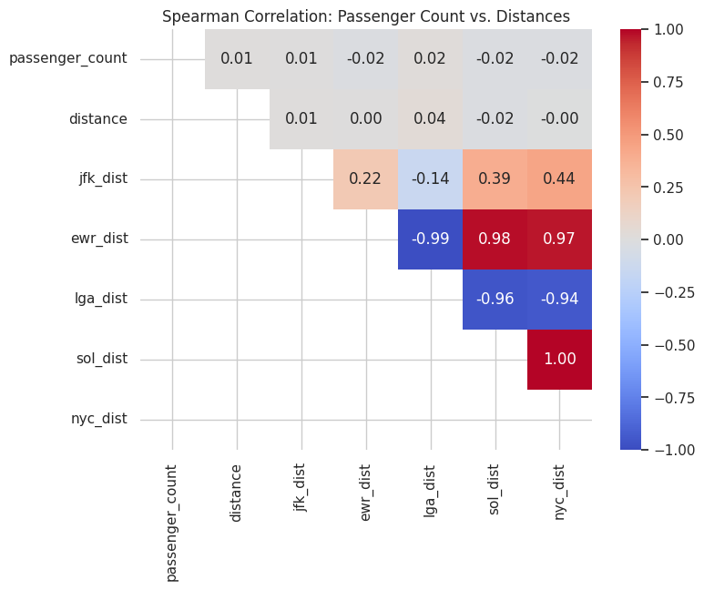
How do different distances relate to passenger counts?
Number of trips with zero passengers: 1511
Number of trips with zero distance: 3149

Slide 24
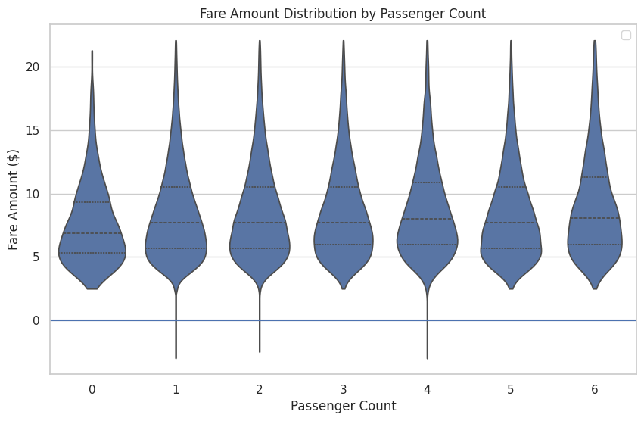
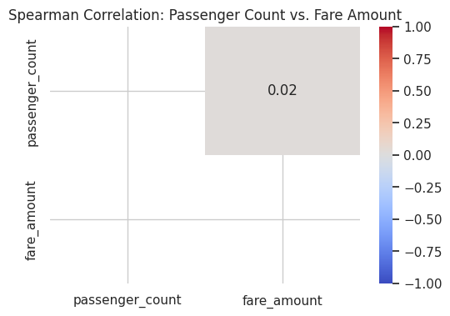
How does passenger count relate to fare amount?

Slide 25
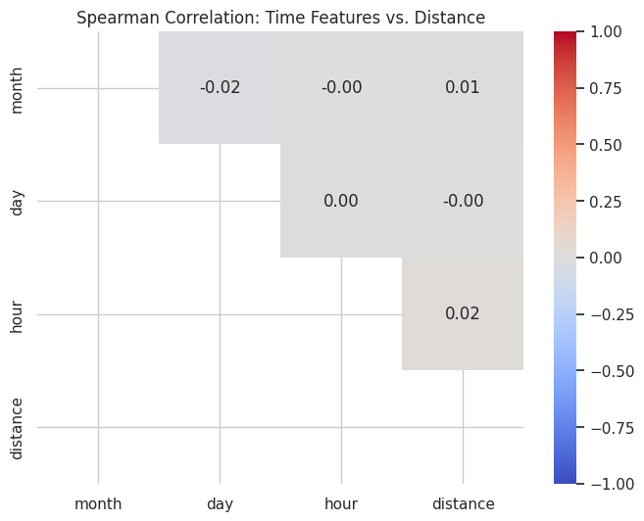
How do time features relate to total trip distance?

Slide 26
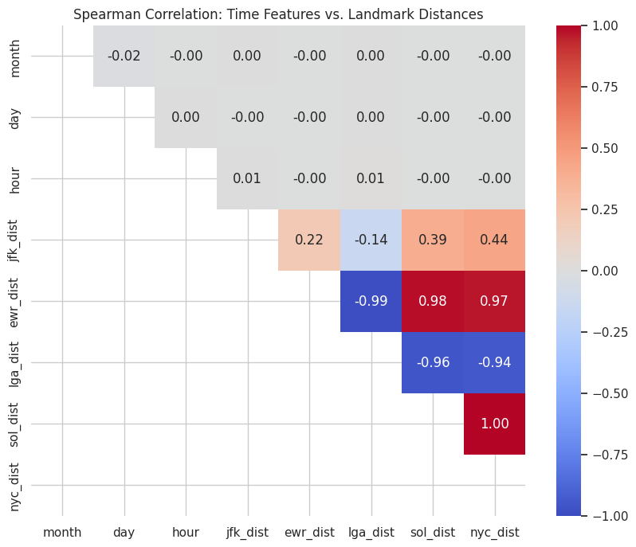
How do time features relate to landmark distances?

Slide 27
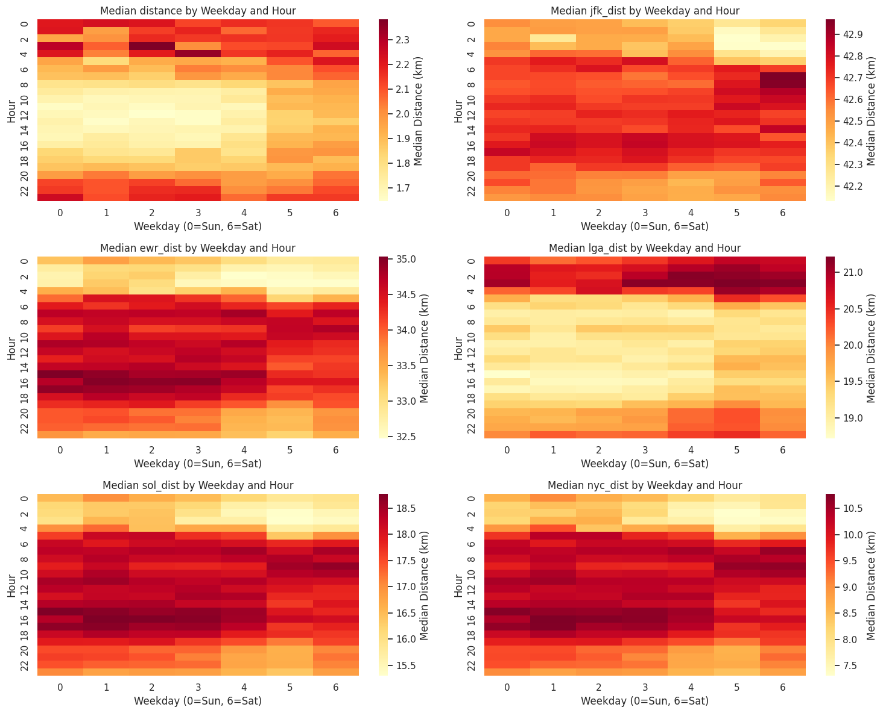
How do weekday and hour combinations affect distance patterns?

Slide 28
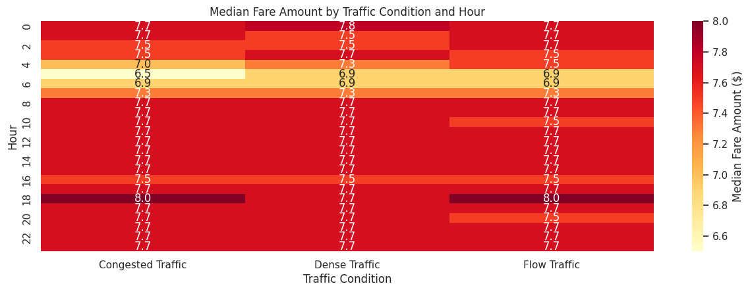
How do traffic conditions, time, and trip characteristics interplay to affect fare amounts and distances?

Slide 29
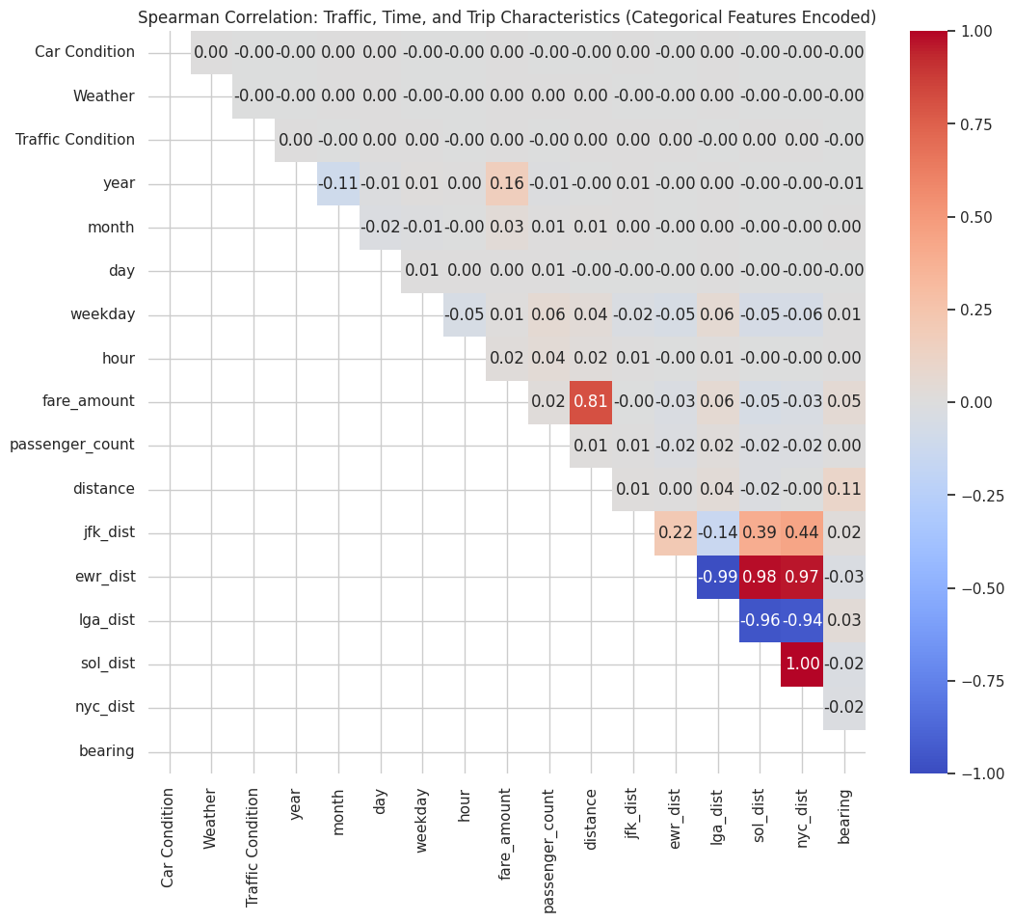
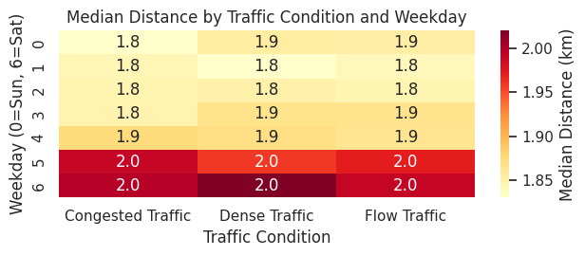
How do traffic conditions, time, and trip characteristics interplay to affect fare amounts and distances?

Slide 30
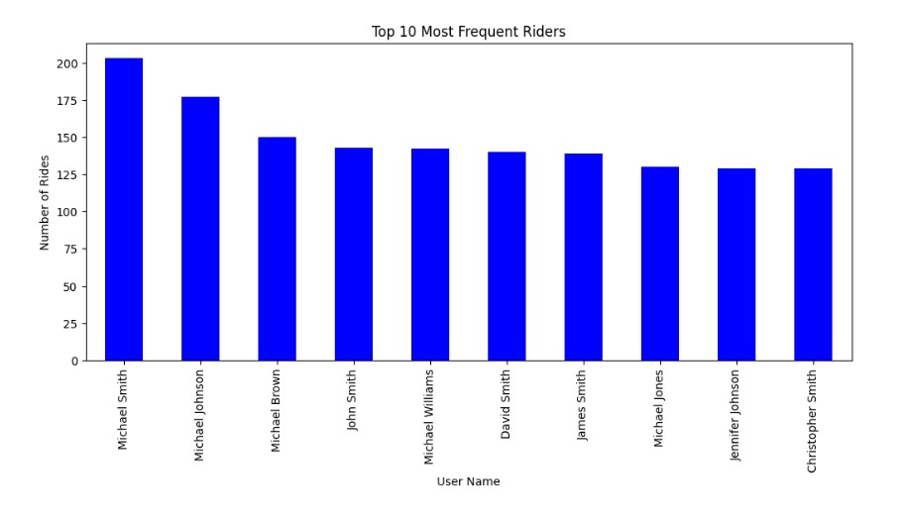
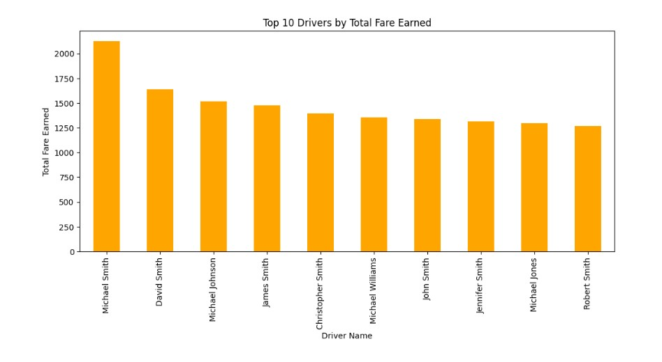
What is the most Top 10 drivers by total fare earned and total rides ?
Michael Smith is the top driver by total fare earned and also the most frequent rider, indicating a strong presence in both driver and rider activity

