Slide 1

Silver Lining Child Care Adoption System
Team Exceptional Trio
AED 5100

Slide 2

Overview Of the Project
The project aims at simplifying the Child Adoption Management. This is an Ecosystem implementation of a Functioning Child Care system with the following Functionalities:
Administration
Employee
User – Foster Parents
This project enables any user to signup, donate and apply for adoption of kids.

Slide 3

Approach
The Ecosystem approach used is Combination Model of Push and Pull Model.
The Work Request interaction is between all entities of the program.

Slide 4
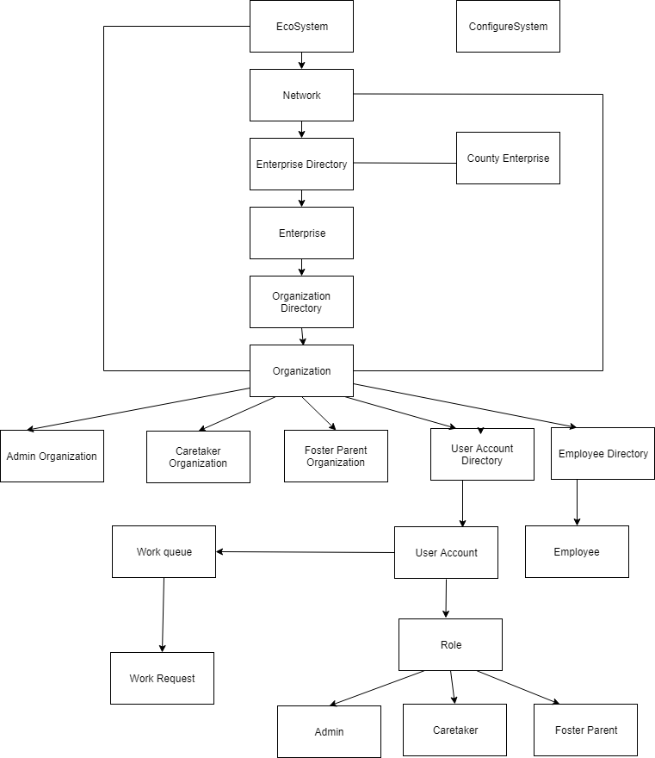
Object Model

Slide 5
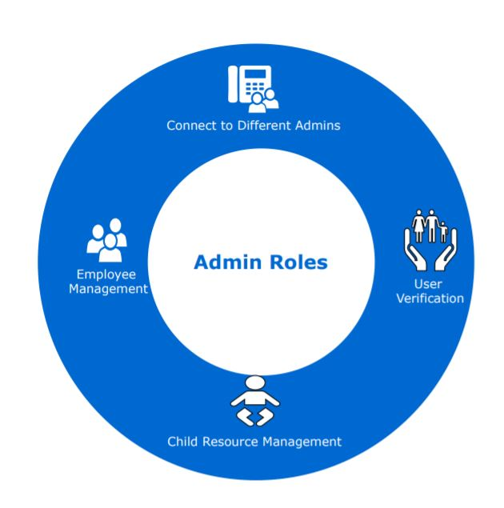

Role - Admin
The Administrator Role represents as an organization and has the following roles:
User Verification
Employee Management
Report Management
Ward Management

Slide 6
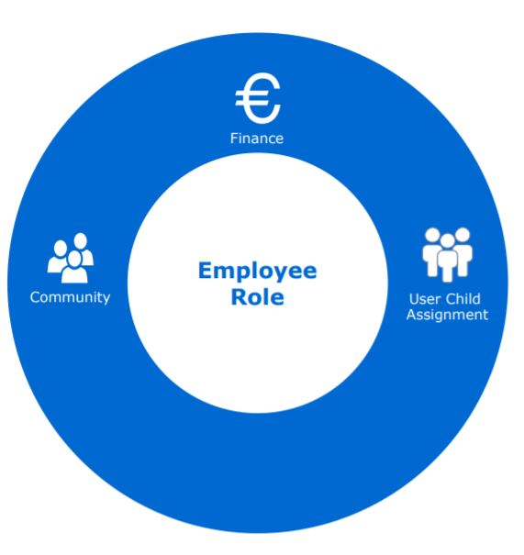

Role - Employee
The Employee Role represents as an organization and has the following roles:
Resource Management
Child Management
Ward Management

Slide 7
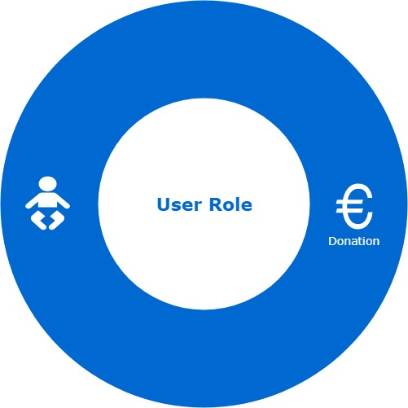

Role - User
The User Role represents as an organization and has the following roles:
Sign Up
Donation
Adoption

Slide 8

Key Functionalities
SMS Verification
Email Verification
PDF generation of resources
Statistics display in form of Pie Chart
User will not be able to log in until verified by admin

Slide 9
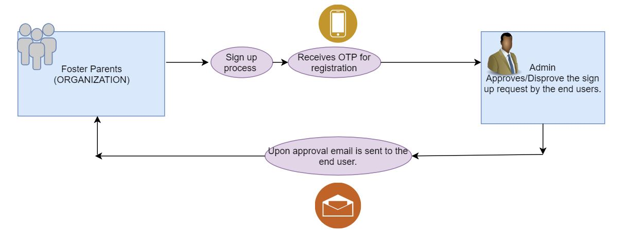
Flow:
User Verification Flow
Organization to Organization interaction

Slide 10
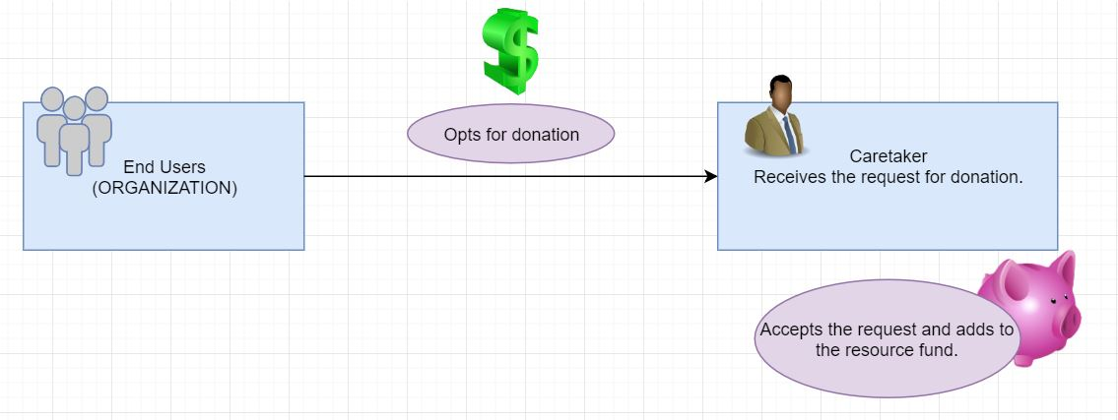
Donation Request

Slide 11
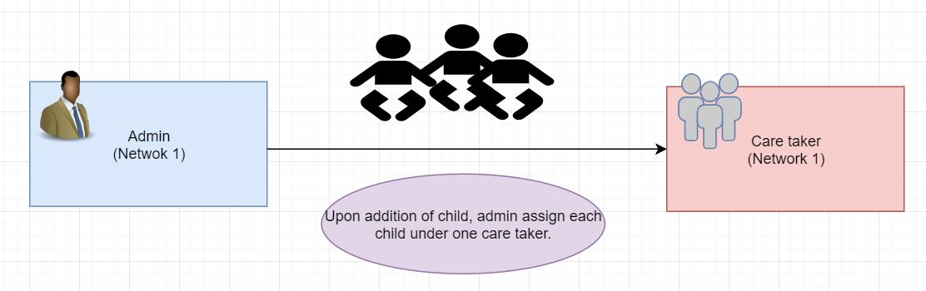
Assigning Child to Employee
Push request initiated by the Admin by assigning child to employee.

Slide 12
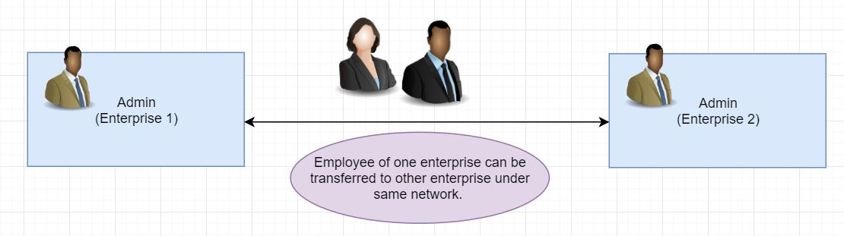
Employee Transfer

Slide 13

Login Screen

Slide 14
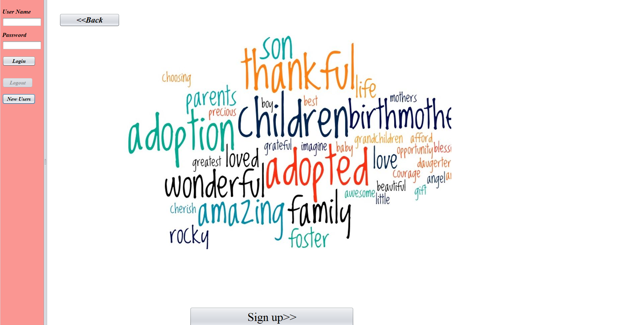
New user welcome page

Slide 15
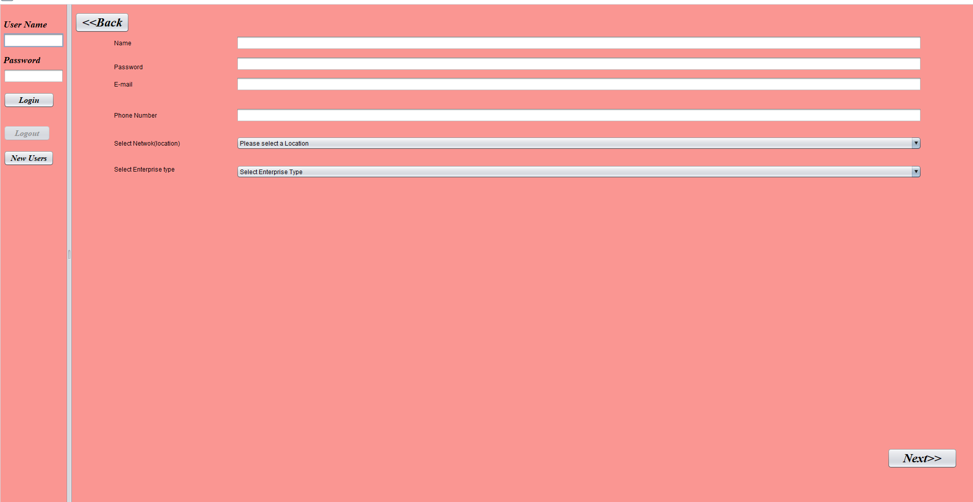
New User Signup form

Slide 16

User Verification

Slide 17
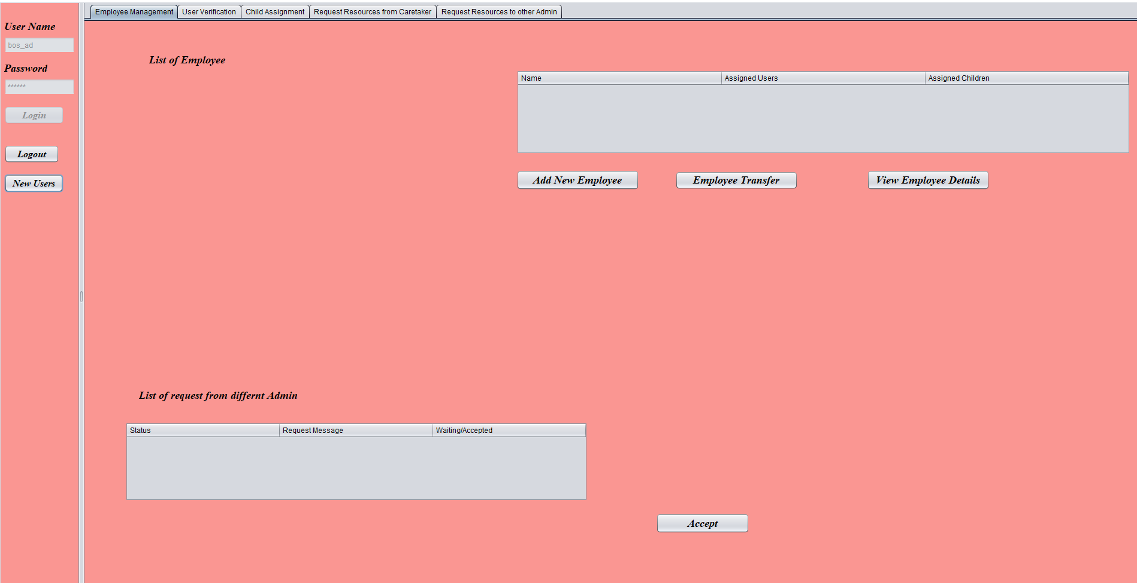
Admin Work Area

Slide 18
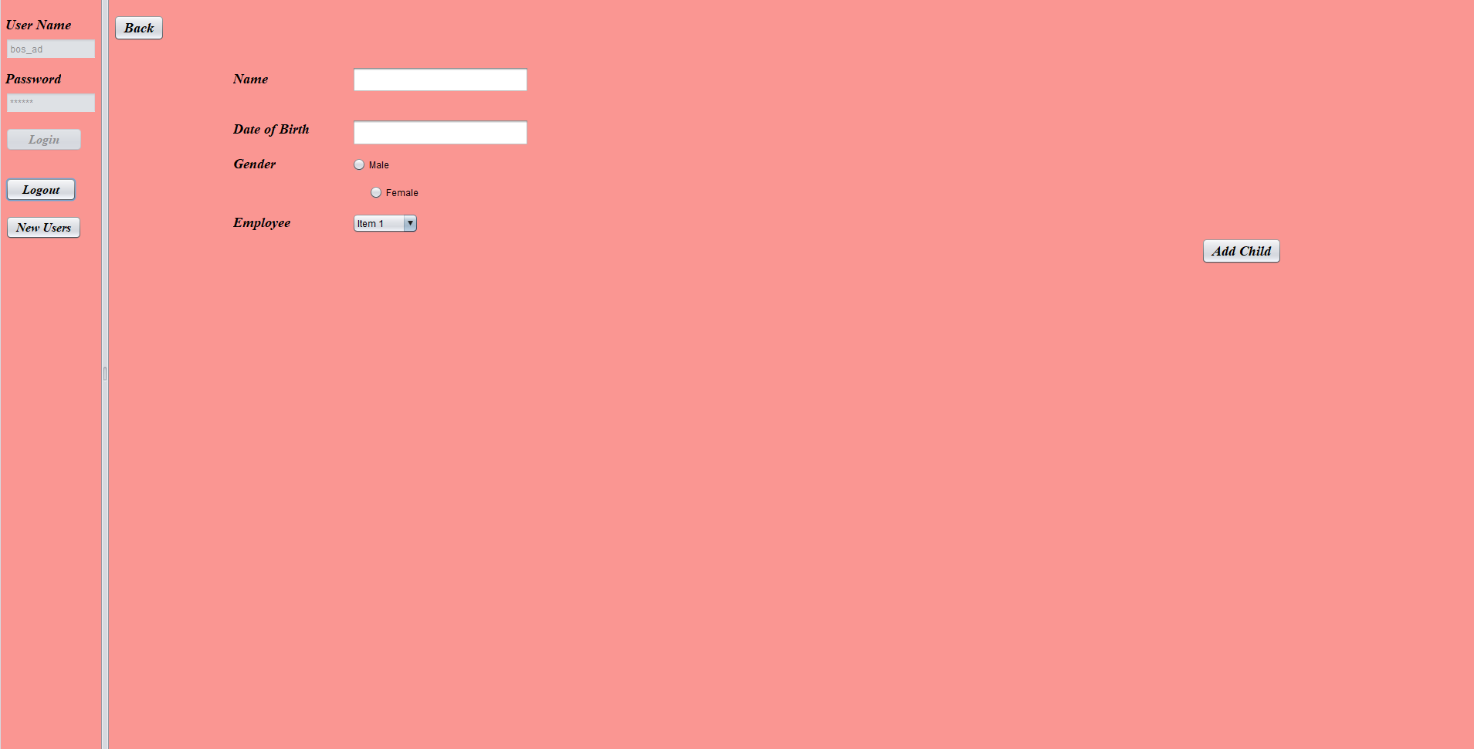
Add child to employee

Slide 19

Transfer Employee

Slide 20
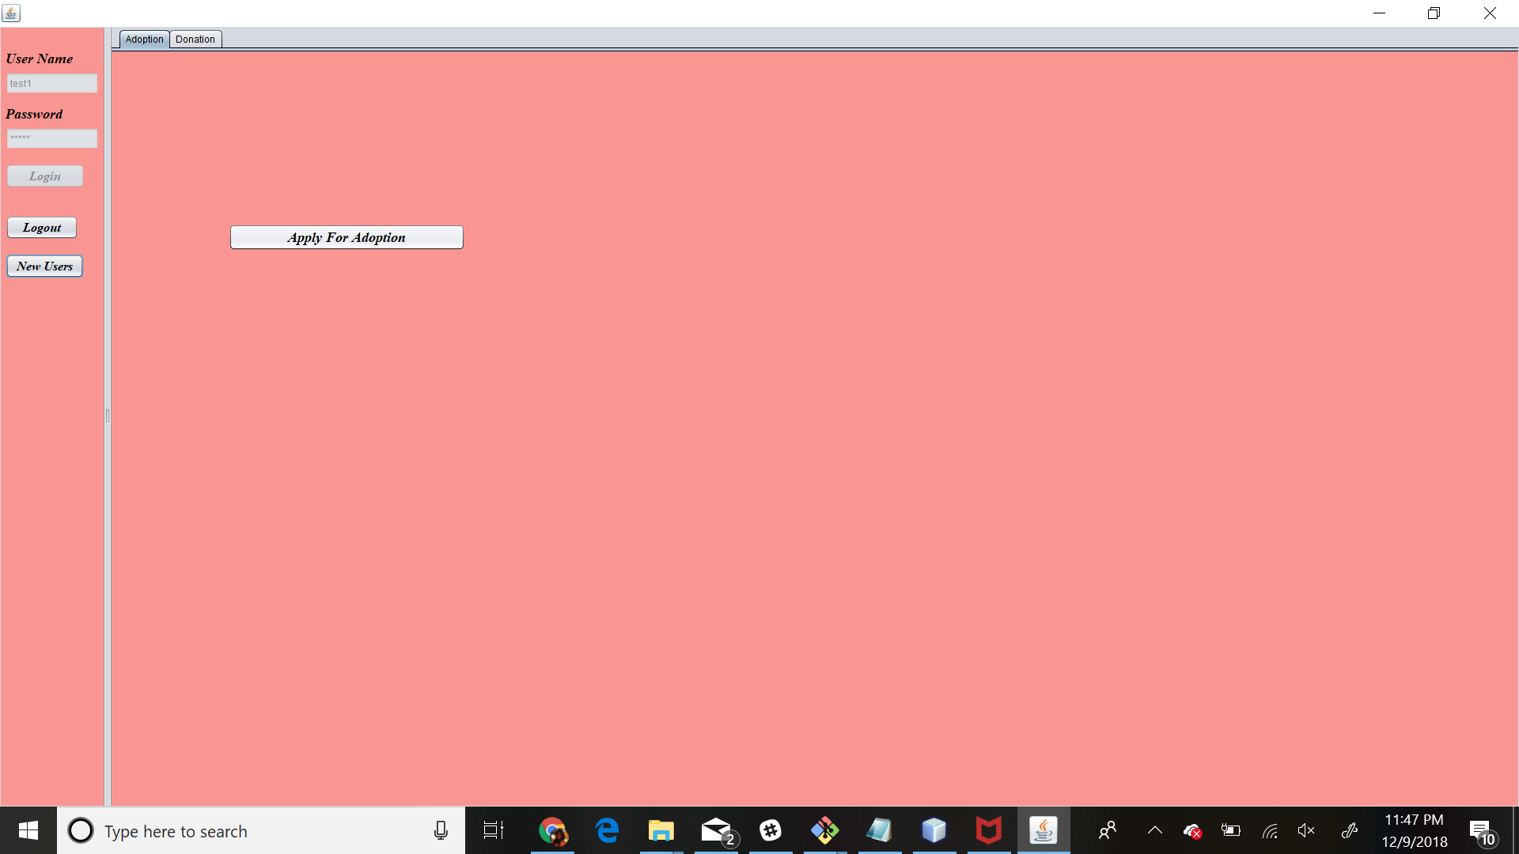
User Work Area

Slide 21
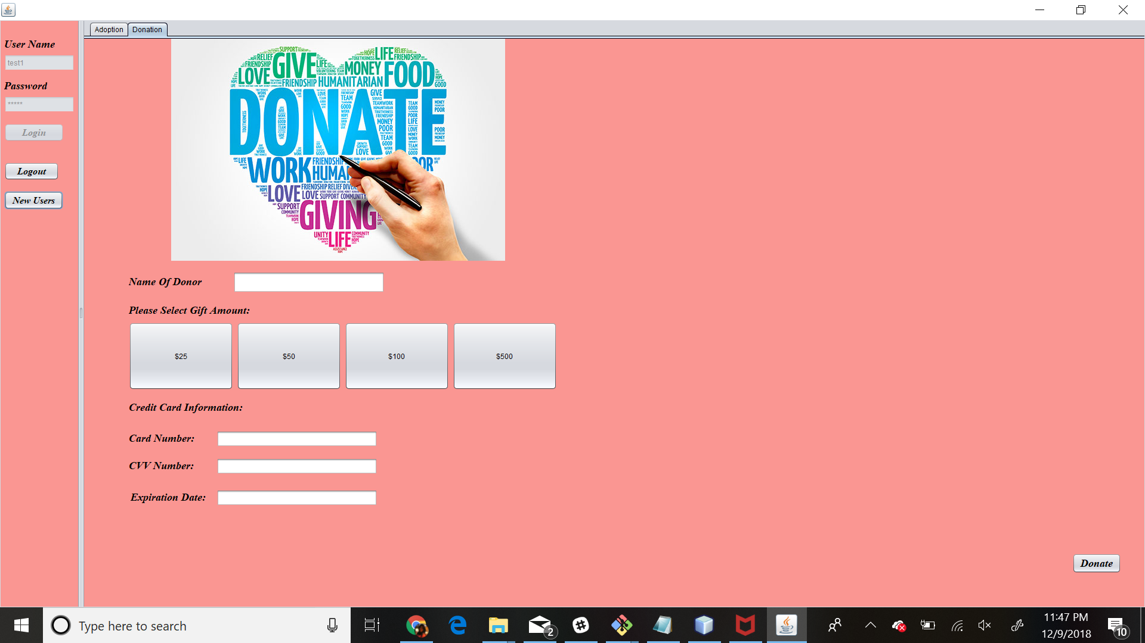
Donation Page for User

Slide 22
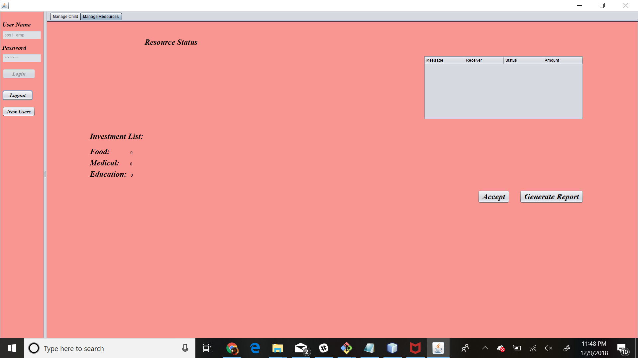
CareTaker Work Area

Slide 23
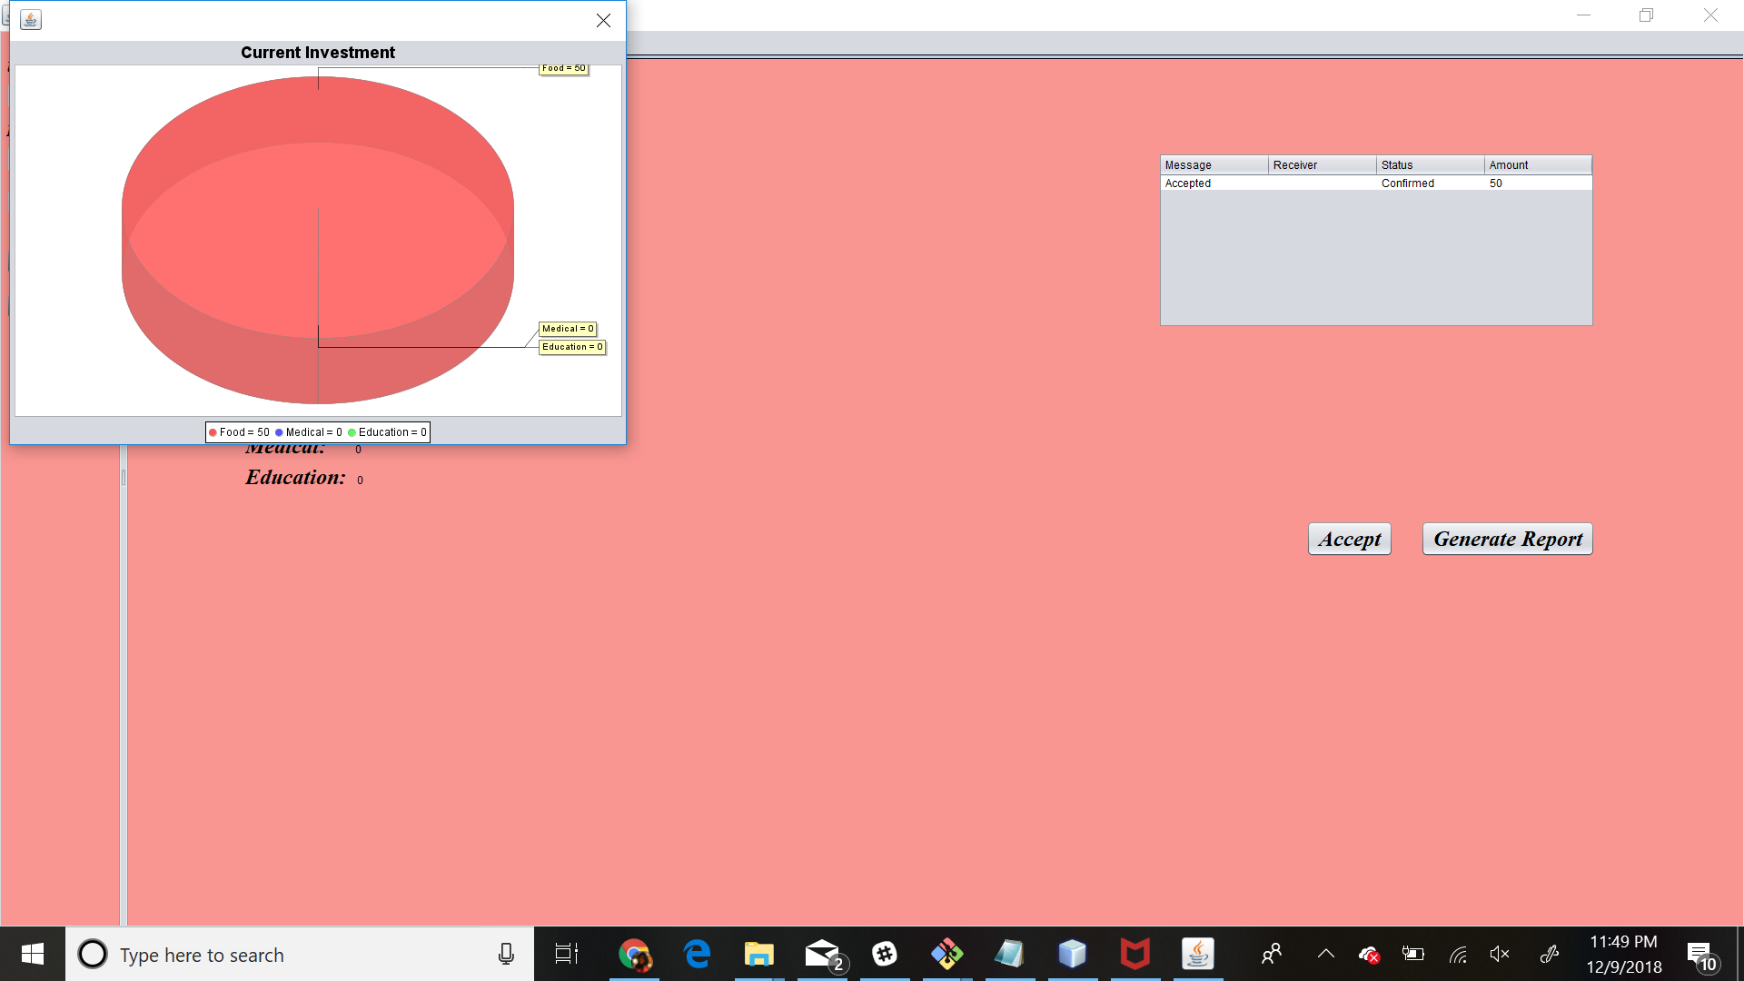
Donation Request Accepted

Slide 24

Future Scope
Silver lining aims to help people in need, this help can be extended to following as well:
Homeless people
Stray Animals
The application could also be extended to larger scale like including other states and country towards a future with a Silver lining

Slide 25



