Slide 1
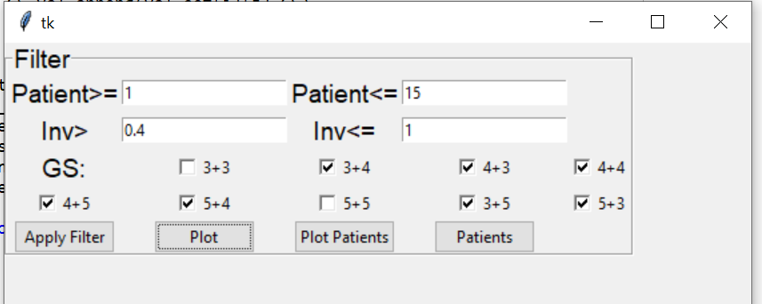
High Involvement data

Slide 2
A- Steps to generate test data
1- run filteringData_2_High_inv python
2- run save info _fromtest_data Matlab
A: Saves data gain
B: Save data info
C: Save “Label_IDs_test_P111-1140.mat”
4- Save_Label
5_ Select_CIDS_label_highinv_P111_140

Slide 3
B- Steps on Python to prepare test data
Run:
Model/teus_datagen_No_ae_Highinv_Test_P111_140.py
Run test

Slide 5
Steps to generate data 256x256
1- run save RF_resize
Saves
masked_DS_res
Masked_RF_res
2- FFT:
Run Data_FFT_res.m
saves
FFT_res
Masked_FFT_res
3- run filtering data2_balanced_resized_data.py
Saves high inv data
4- run .m
Saves balanced data
5- Label – generate and save all labels
Save_Label_res.m
6-After data is saved
Select_CIDS_label_highinv_P111_140
Notes:
Aug18-20 2020

Slide 6
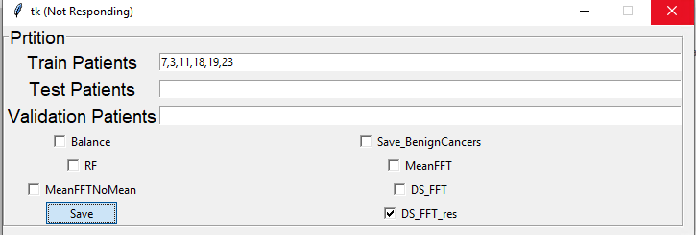
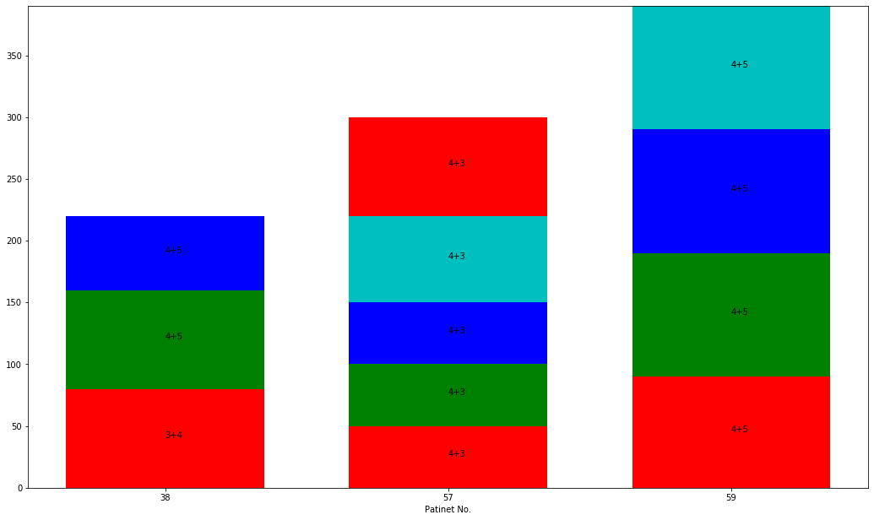
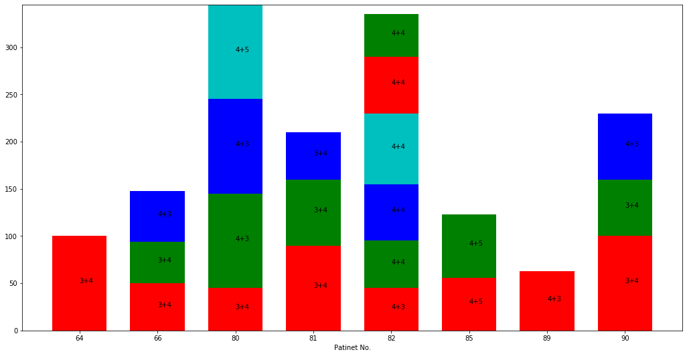
Saving data High inv directly (Aug 19)
Part 1 train: p2-30
Part 2 train: p31-60
Train_Cancer=[38]
Train_benign= [50,39,40]
Part 3 train: p61-90
Train_Cancer=[80,81,82,85,89,90]
Train_benign= [68,69,72,74,76,77,70]
Train_Cancer=[7,3,11,18,19,23]
Train_benign=[4,2,10,25,29,21,27];

Slide 7
Saving data High inv directly (Aug 19)
Part 1: 2-45
Val_BPids=[14,24,30,37]
Val_Cancer=[5,6,26,28,45]
Val_BPids=[46,61] # part 2 : 46-90
Val_cancer=[45, 64,66,57,59]
Val_Benign=[46,61]

Slide 8
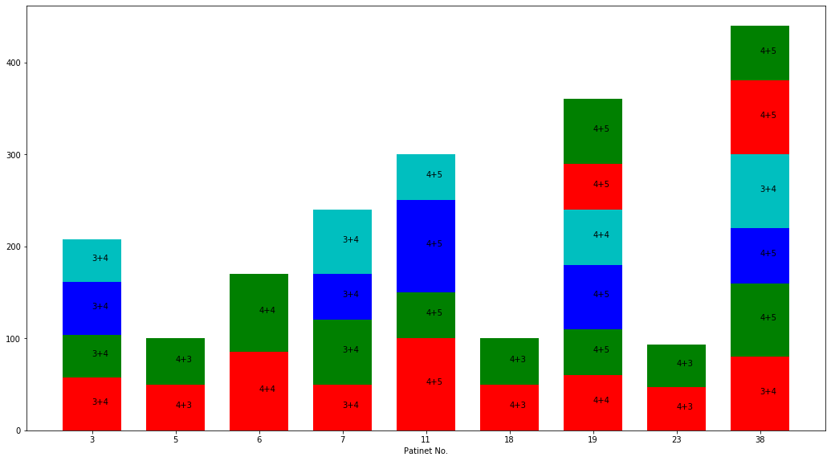
Saving data p1-90 for resized _v2 equal to the size of previous data (Aug24)
Part 1: 2-45
Val_BPids=[14,24,30,37]
Val_Cancer=[5,6,26,28,45]
Total: 34 cores
Notes:
New data saved to match the size of original data

Slide 9
Saving data1-90 again to match previous one

Slide 10
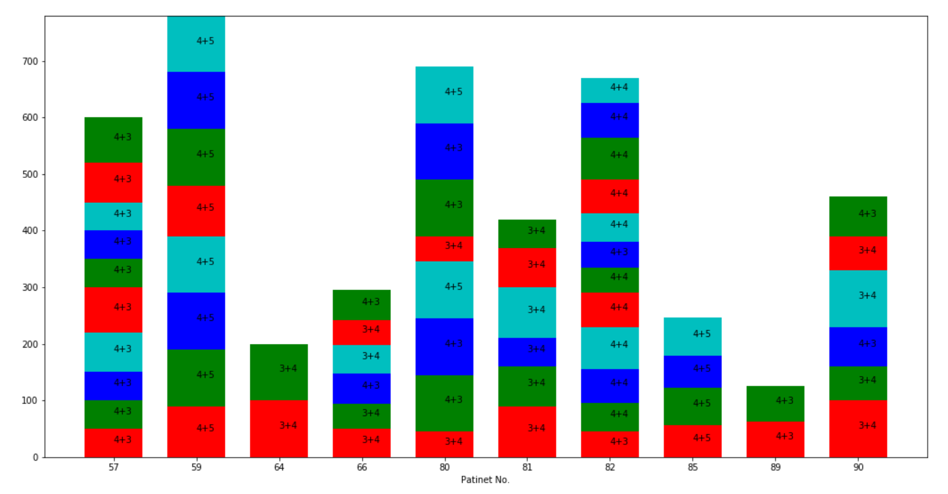
Saving data p1-90 for resized _v2 equal to the size of previous data (Aug24)
Part 2: 46-90
Val_BPids=[46,61]
Val_cancer=[64,66]
Total: 21 cores
Notes:
New data saved to match the size of original data

Slide 11
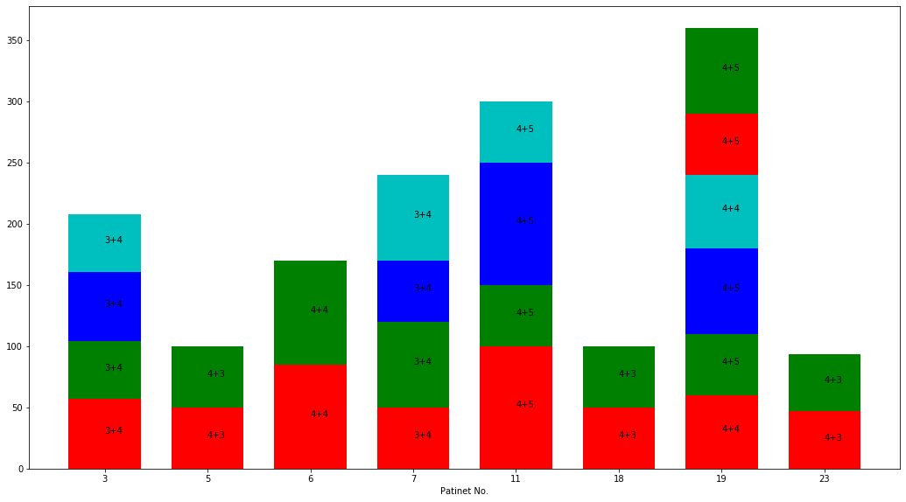
Saving data p1-90 for resized _v2 equal to the size of previous data (Aug24)
Part 1: train 2-30
Train_Cancer=[7,3,11,18,19,23]
Train_benign=[4,2,10,25,29,21,27];
Saves 88 cores
Notes:
New data saved to match the size of original data

Slide 12
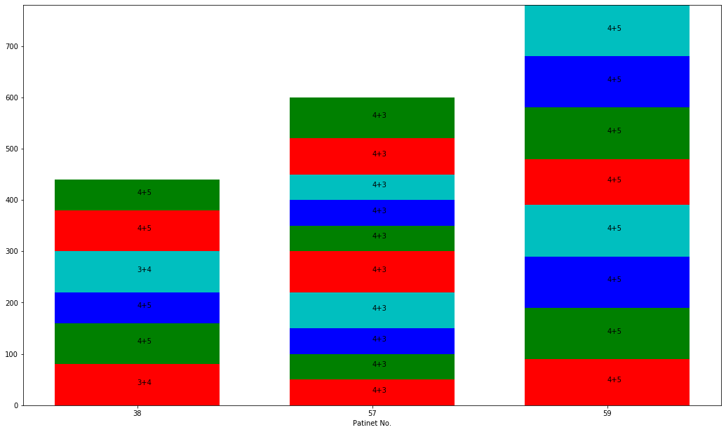
Saving data p1-90 for resized _v2 equal to the size of previous data (Aug24)
Part 2: train 31-60
Train_Cancer=[38]
Train_benign= [50,39,40]
Notes:
New data saved to match the size of original data

Slide 13
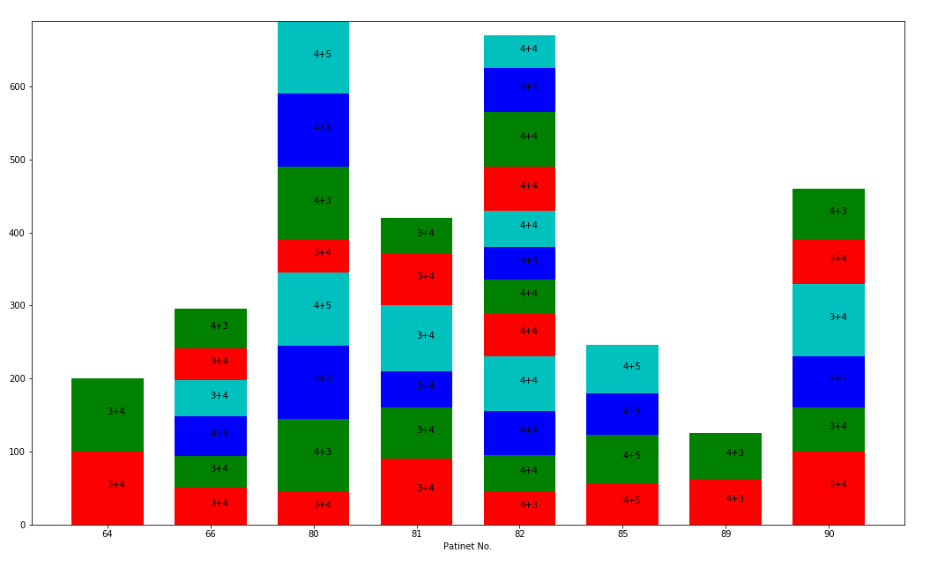
Saving data p1-90 for resized _v2 equal to the size of previous data (Aug24)
Part 3: train 61-90
Train_Cancer=[80,81,82,85,89,90]
Train_benign= [68,69,72,74,76,77,70]
Notes:
New data saved to match the size of original data

Slide 14
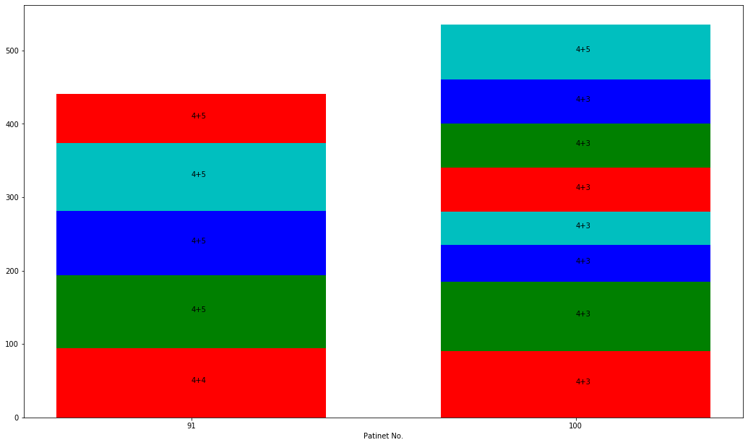
Saving data p1-90 for resized _v2 equal to the size of previous data (Aug24)
Test- part 1: 91-100
test_cancer=[91, 100]
Benign_cancer=[92,93,95,96,98,99]
101<part7<110
test_cancer=[101,103,104,105,108,109,110] used:[101,106,107,109,110]
Benign_cancer=[101,103,104,105,108,109,110]
101 103 104 105 106 108 109 110
Notes:
New data saved to match the size of original data
High inv directly

Slide 15
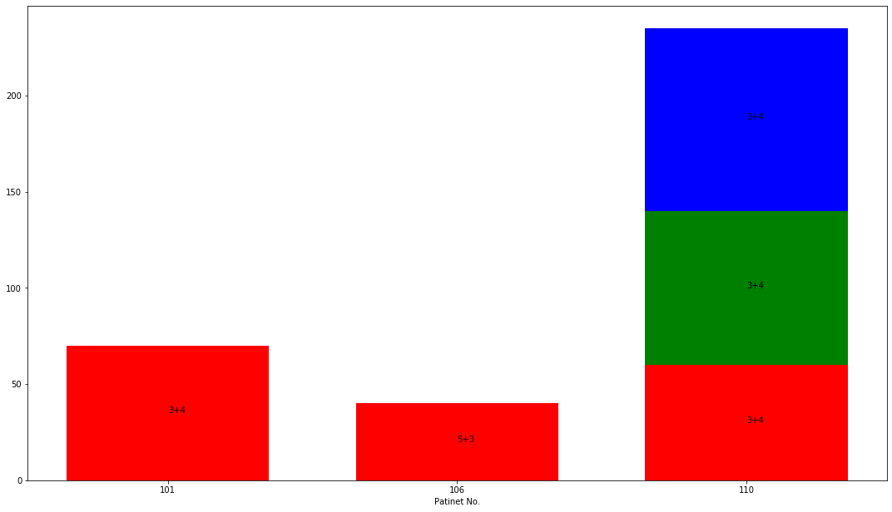
Saving data p1-90 for resized _v2 equal to the size of previous data (Aug24)
Test- part 2: 101-110
test_cancer=[101,106,110] Benign_cancer=[101,103,104,105,108,109,110]
Notes:
New data saved to match the size of original data
High inv directly

Slide 16
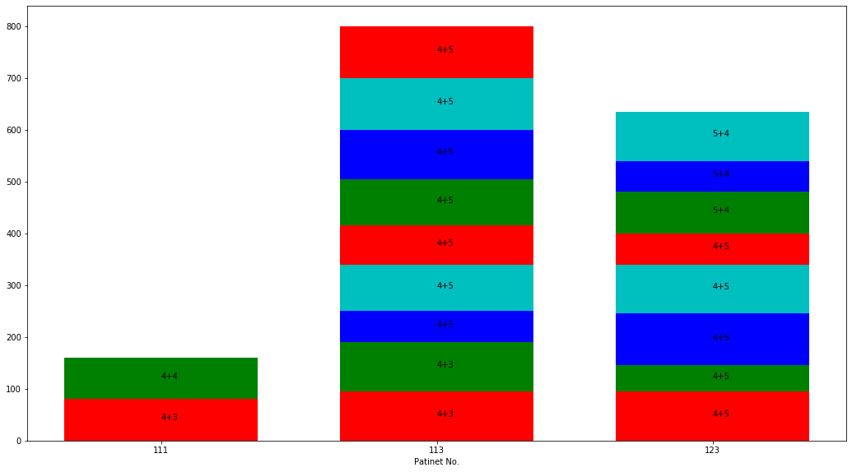
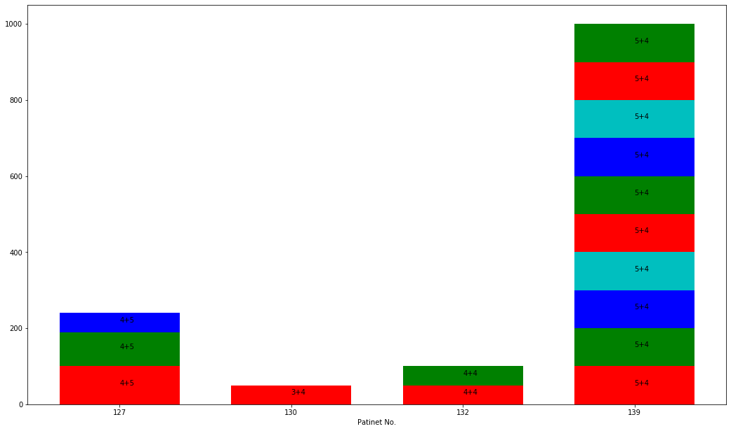
Resized P111-125 use as test new
P111-125
Cancer: 111,113,123
Test_BPids=[112,114,117,119,120,121,122,124,125]
Total= 84 cores
P126-140
Cancer: 127,130,132,139
Benign:128,130,131,132,134,135,136
Total= 69 cores
Total: 153 cores

Slide 18
Adding P111-140 to test
1- use save data for test
2- run
Gen_balanced_highinv_data
To generate balanced data to use for train and val
part 1 (p111-125): has 19 cancer+19 benigin = adding 38 cores
Part 2 (p126-140): has cancer+ benign = adding cores
3- Generate label : Labels_masks_train_Highinv_bal.m
4- run: save label_res
5- run: saveinfo_fromtest_data_Highinv_res_p1_90.m

Slide 19
Aug 18
Adding p111-140 to trian

Slide 20
New train size
 | Patient | # of Cores | Total Cores
Train validation | 2-90 | 132+38=170 24+32=56 | 156+70=226
Test | 91-110 | 105 | 105
BK_DS_FFT_train_P111_125___20200805-130102_bal.mat
Added to train
BK_DS_FFT_train_P126_140___20200805-123805_bal.mat
Added to val

Slide 21
Zero-padding

Slide 22
New approach of saving data on Oct 1-2020
Steps:
1- Images are first cropped 1:1536
2- Every six points is averaged in axial direction → 256
3- zero padded all images in vertical-→ 530
4- masked are also cropped, averaged and zero padded
5- masked_FFT are saved as the input to the Unet
Codes to run
1- save RF_cut_axial → 1536 x n
2- Data-FFT-cut-axial → saves FFT 256xnx32
3- Data-FFT-zero-pad → saves
1- FFT-whole-zpad: 256x530x32
2- FFT-masked-zp→ all masked 256x530

Slide 23
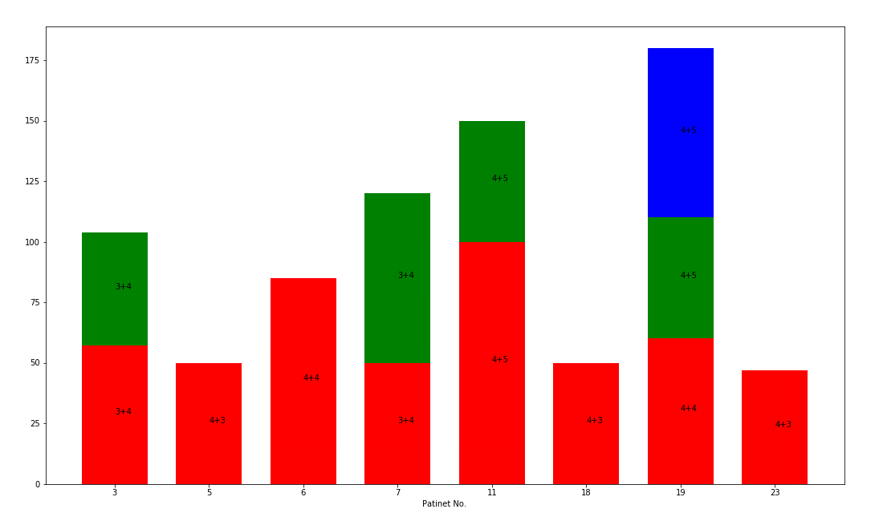
Saving data p1-90 for zp
Part 1: train 2-30
Train_Cancer=[7,3,11,18,19,23]
Train_benign=[4,2,10,25,29,21,27];
Saves 77 cores
11 cancer cores

Slide 24
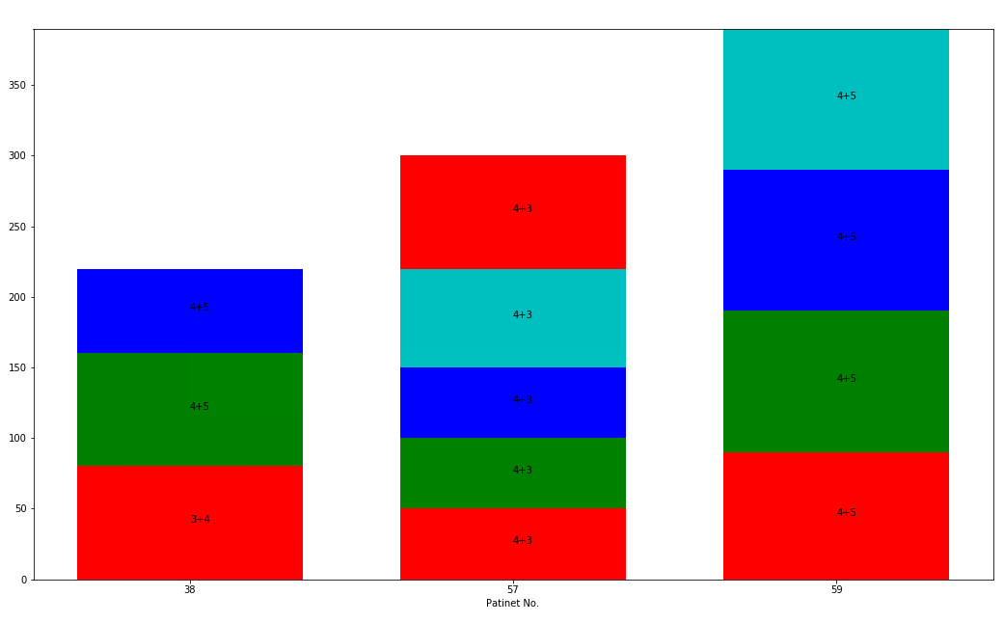
Saving data p1-90 for zp
Part 2: train 31-60
Train_Cancer=[38]
Train_benign= [50,39,40]
Saves 30 cores
3 cancer cores
Notes:
New data saved to match the size of original data

Slide 25
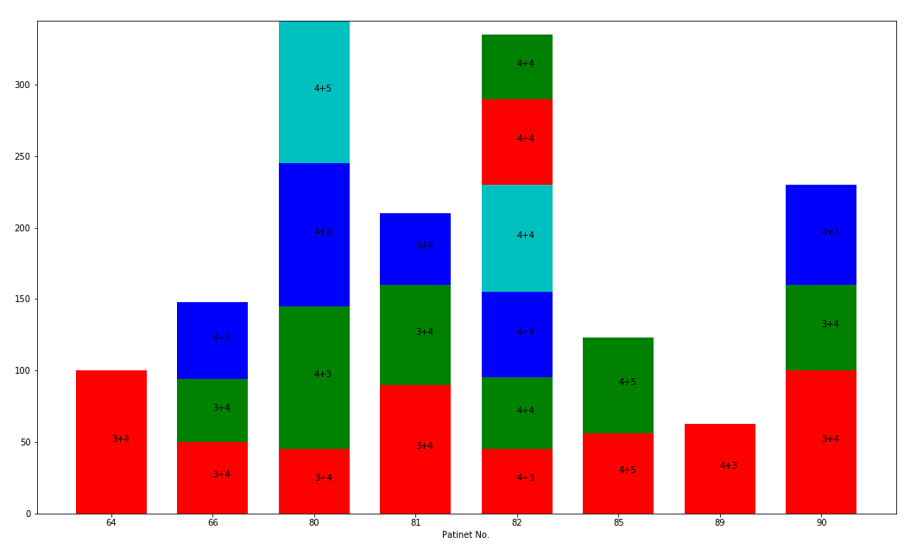
Saving data p1-90 for zp
Part 3: train 61-90
Train_Cancer=[80,81,82,85,89,90]
Train_benign= [68,69,72,74,76,77,70]
Saves 69 cores
19 cancer cores
Notes:
New data saved to match the size of original data

Slide 26
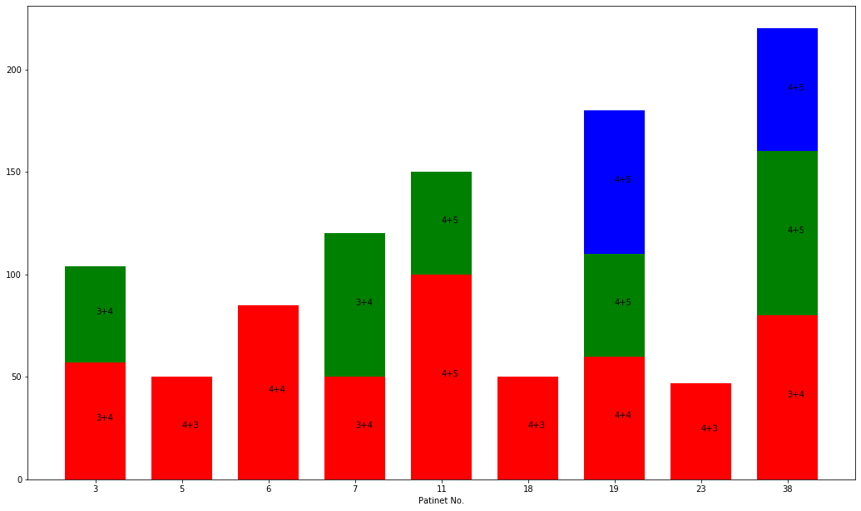
Saving data p1-90 for zp - validation
Part 1: 2-45
Val_BPids=[14,24,30,37]
Val_Cancer=[5,6,26,28,45]
Total: 32 cores
Only 2 cancer
Notes:
New data saved to match the size of original data

Slide 27
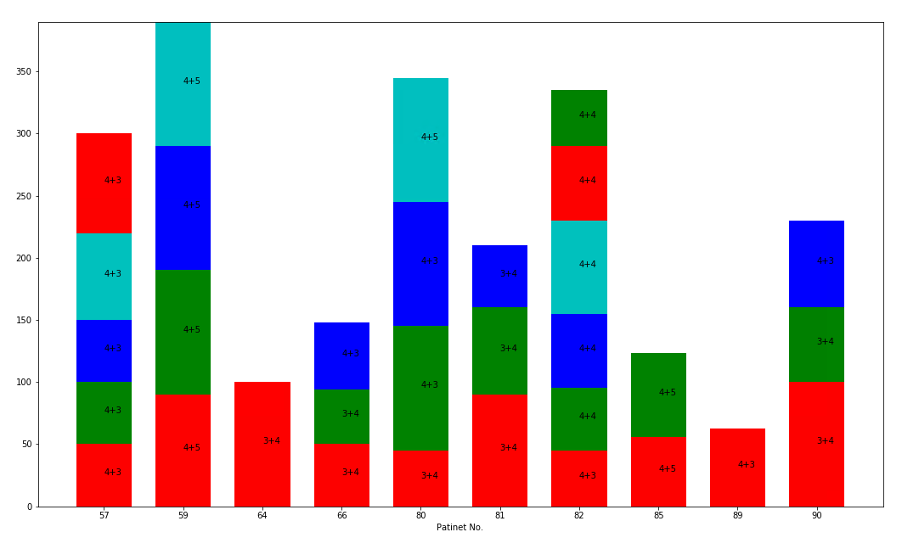
Saving data p1-90 for zp - validation
Part 2: 46-90
Val_BPids=[46,61]
Val_cancer=[64,66]
Total: 17 cores
4 cancer
Notes:
New data saved to match the size of original data

Slide 28
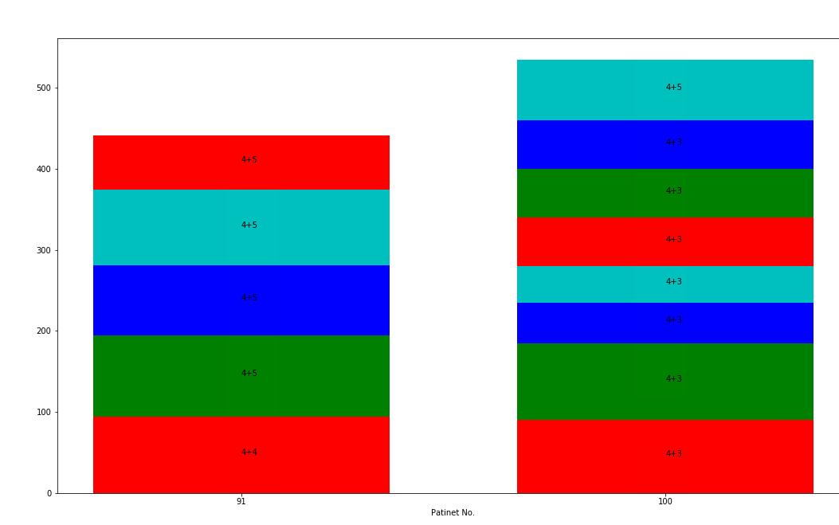

Saving test data 91-110
Test- part 1: 91-100
test_cancer=[91, 100]
Benign_cancer=[92,93,95,96,98,99]
Cores: 61
Test-part2 : 101-110
test_cancer=[101,106,110] Benign_cancer=[101,103,104,105,108,109,110]
106 was saved when inv>0.39
Cores: 44
Notes:
New data saved to match the size of original data
High inv directly

Slide 29
Saving test data 91-110
Test- part 2: 101-110
test_cancer=[101,106,110] Benign_cancer=[101,103,104,105,108,109,110]
Notes:
New data saved to match the size of original data
High inv directly

Slide 30
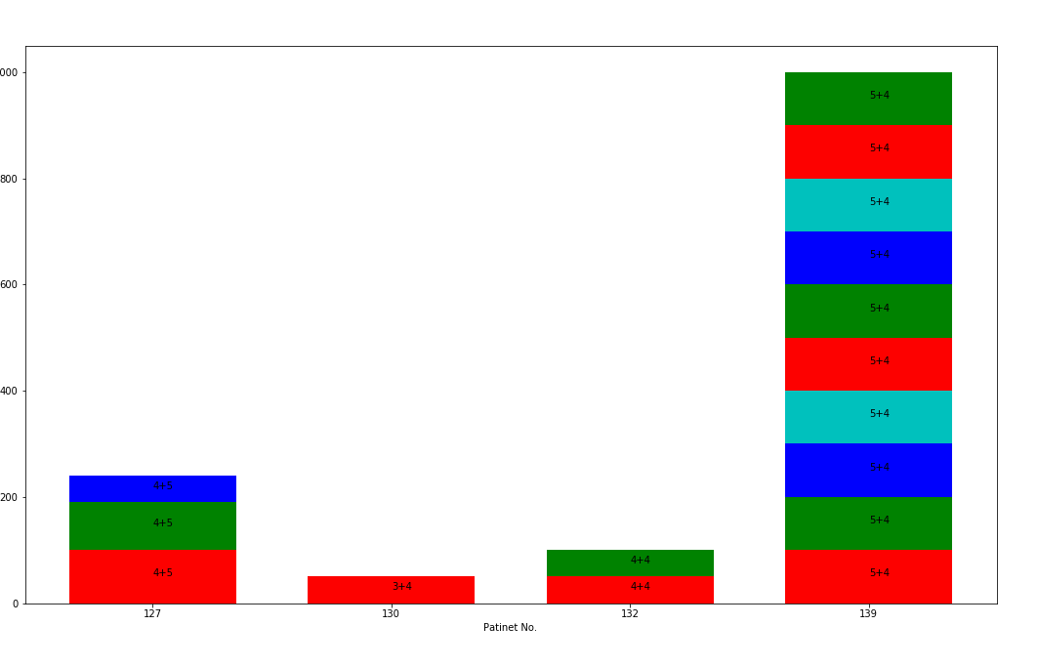
P111-125
P111-125
Cancer: 111,113,123
Test_BPids=[112,114,117,119,120,121,122,124,125]
Total: 84 cores
P126-140
Cancer: 127,130,132,139
Benign:128,130,131,132,134,135,136
Total: 69
All: 153 cores

Slide 31
New saving for zp data
Adding all involvements and all benign to test p91-110

Slide 32
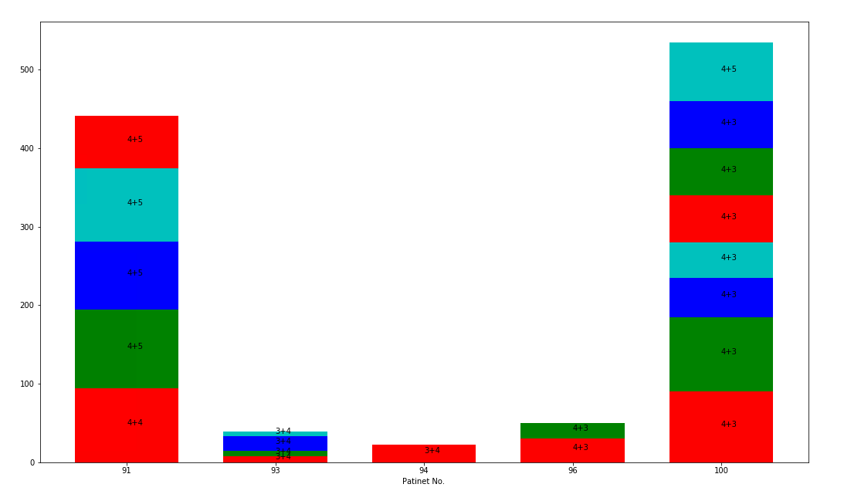
New saving for zp data
Test – part 1
Cancer: [91,93,94,96,100]
Benign:
Test_BPids=[92,93,94,95,96,98,99] #part 1 test

Slide 33
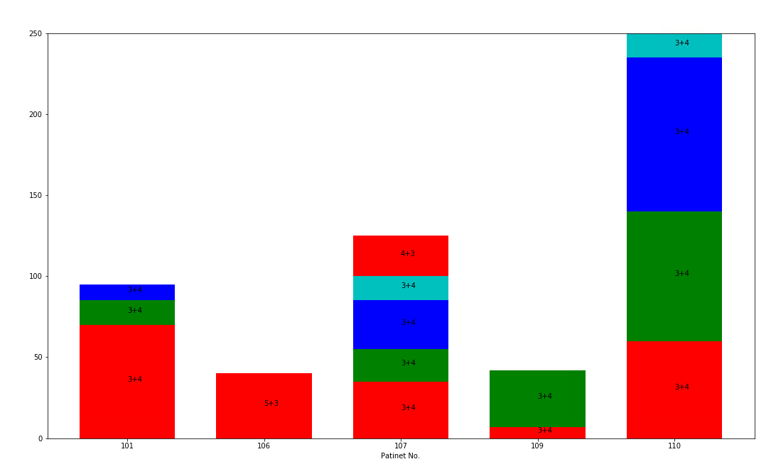
New saving for zp data
Test – part 2
Cancer: [101,106,107,109,110]
Benign:
Test_BPids=[101,102,103,104,105,106,107,108,109,110] #part 1 test

Slide 34
Total patients, p91-110
Test1: p91-100
70 cores, 9 patients
Test2: 101-110
69 cores, 10 patients
Total: 19 patients, 139 cores

Slide 35
Steps to prepare test data
1- filteringData_2_balanced_zp.py
2- Select_CIDs_Label_highinv_balanced_P1_90_zp_all_invs.m
3- teus_datagen_No_ae_bal_zp_Test_NonOrm_allinv.py (form model)

