Slide 1
Luminance Pitch Presentation
Kyle Fisher, Stephen Damm, Greg Logan

Slide 2
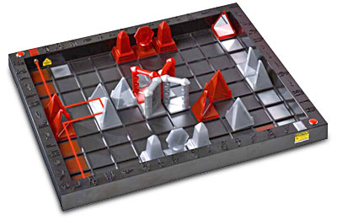
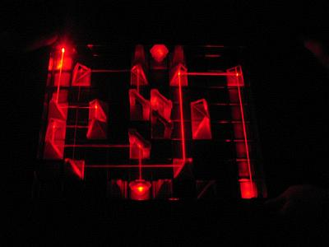
Introduction
Luminance is partially based on the concept behind Pharaoh
Pharaoh is a turn based strategy game
  Goal being to hit the opposing Pharaoh with your laser beam first
  Luminance is a single player variation of this idea
Hybrid action and puzzle game

Slide 3
Luminance
Guide energy beam from source to one or more destinations through obstacles using various tools
Real time light reactions
Different tools
  Much more than just mirrors!
Different colours
Light intensity plays a part
  Too weak a beam won't illuminate the target

Slide 4
Required Resources
Visual Studio 2008
XNA Game Studio 3.0
Code repository
Bug tracking
Xbox 360 (maybe)‏
Money
Time
Music and sound effects (time permitting)

Slide 5
Game Description

Slide 6
Target Market/Demographics
Flash gamers
Arcade gamers
Puzzle aficionados
People with short bursts of free time
  e.g. Students between classes (or during)‏
All ages (likely 12+)

Slide 7
Summary
Inexpensive to develop
Large potential userbase
Random level generation
  Endless entertainment

