Slide 1
Cyclist Bikers
Presented By : Shubham Kushwaha
Updated On : August 21,2021

Slide 2
Table of Contents
Purpose Statement(what are we talking about?)
Graph Representation
Conclusion

Slide 3
Objective
Identifying how casual members and annual member use cyclist bikes differently

Slide 4
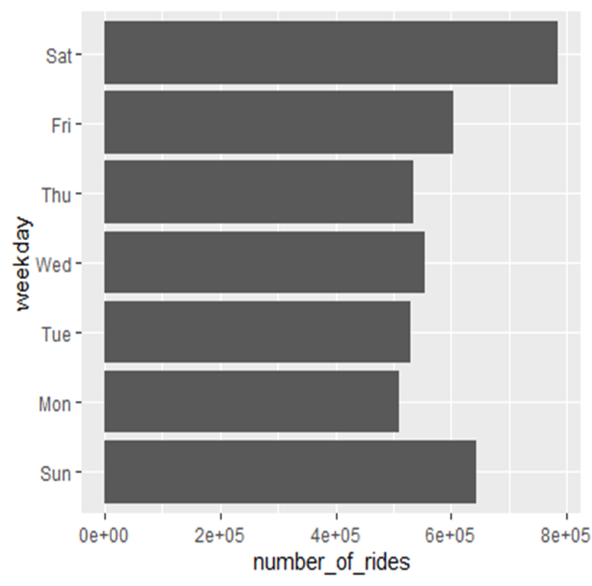
Numbers of rides per day
Numbers of rides varies every day
Note:- 2e+05(200000)
means 2 followed by 5 zeros

Slide 5
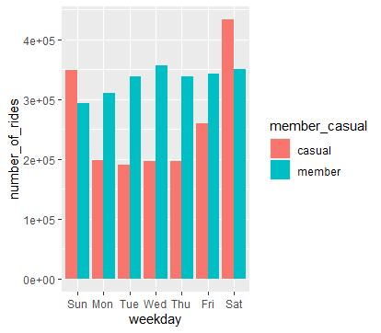
Number of Rides based on Member casual
Member usually rides more
than casual members
on weekdays

Slide 6
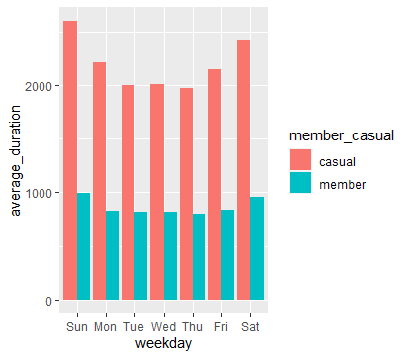
Duration
Casual members tends to use
cycle for longer duration
Average duration is
represented in Seconds

Slide 7
Conclusions
There are more casual cyclist on weekends
Casual member uses cycle more longer duration as compared to the members
People uses more cycles on weekends as compared to the weekdays

Slide 8
Thank you

