Slide 1

Scratch GPIO Introduction
Wilmslow CoderDojo
March 2014
Stephen Blythe (@shblythe)
This work is licensed under a Creative Commons Attribution-ShareAlike 4.0 International License

Slide 2
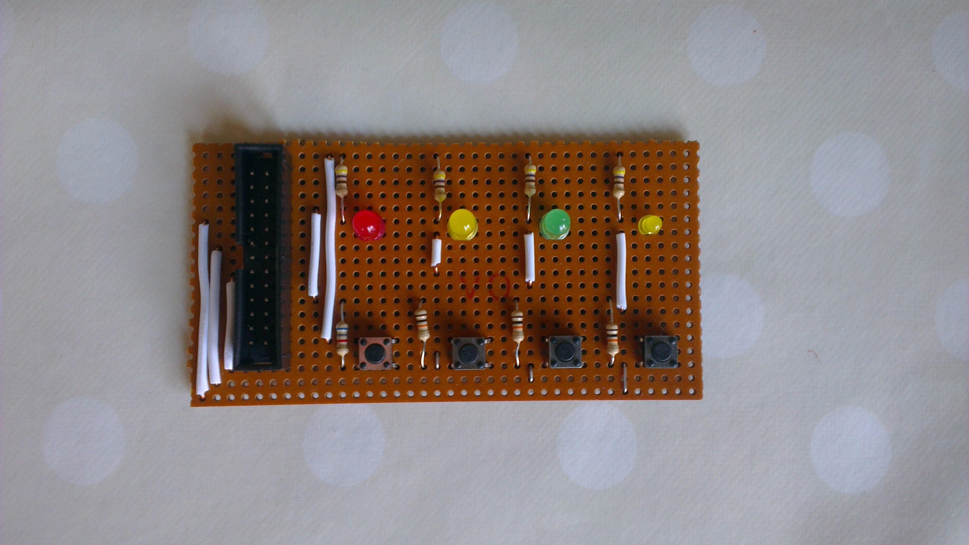
The Hardware
GPIO connector – connect to the Pi with the Ribbon cable (power off)
4 coloured LEDs
4 push buttons

Slide 3
Installing
Before you use it for the first time on your Pi, you need to install Scratch GPIO5 from cymplecy's website
  http://simplesi.net/scratchgpio/
Run Scratch using the special "Scratch GPIO5" icon on the desktop
Load the special Scratch Project file "ScratchGPIOStarter.sb"
Save it with a new name before you start work, in the "Documents/Scratch Projects" folder

Slide 4
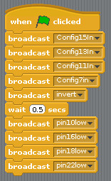
Set Me Up!
You need this bit in all your programs
It tells Scratch GPIO which pins are inputs and which way up the outputs are
Don't worry about this, but keep it in!
Click the green flag now to get everything ready

Slide 5


Let there be light!
Scratch uses "broadcast" to talk to the hardware
"allon" means switch everything on!
Guess what "alloff" does!
There are no spaces in these messages
Try these scripts!
Press 'g' and 'b' – what happens?

Slide 6
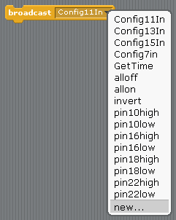
I Don't Understand!
If you want to send a message which isn't in the list, you need to click "new..." and type it in – carefully!
Once you've got this message in your program, it will appear in the list so you don't have to type it again

Slide 7

Individual Control
Scratch uses "pin10high" and "pin10low" messages to switch pin 10 (the red LED) on and off

Slide 8
LED pin numbers
10 | 16 | 18 | 22
Try making some other keyboard buttons control the other LEDs!

Slide 9
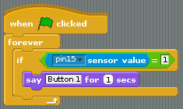
Push My Buttons!
A Sensor will tell you if a button is pressed
"1" means it is pressed

Slide 10
Button pin numbers
15 | 13 | 11 | 7

Slide 11
Over To You!
Could you use the buttons and LEDs in a Scratch program you've already created?
Could you make a game which just uses the buttons and LEDs?
Is there anything in the real world which you could simulate using the LEDs and/or buttons?
You could just make pretty moving patterns with the lights
  Can you use the buttons to choose the pattern?
  Or change the speed?

